Slide 1
Data Standardization Work Group (DSWG)
April 28, 2023

Slide 2
CSTE Data Standardization Workgroup Meeting​
Please mute phone/ headset/ computer audio!​
Agenda
Welcome & overview
What is "core surveillance"?
Travel History data elements kick-off
  Introduction to travel history data class
  Existing questions, data sources and background – Danielle Tack, CDC
  Travel history core open forum
Hospitalization data elements - continued
Request for information
Wrap-Up & Adjourn

Slide 3
Welcome, new members!

Slide 4

Data Standardization is the Key
For systems to talk to each other
and share automated services,
they must speak the same language.

Slide 5
Process overview
Pre-meeting:
  Gather background on what exists
  Advertise topic among CDC programs & CSTE to recruit participation
Meeting:
  Introduce topic, What is in/out of scope
  Background: Existing standards?
  What is part of core surveillance?
  Polling as needed throughout
  Identify what we still need to define/discussion/work out
Post-meeting:
  Open survey to group to:
    Solicit additional feedback for follow-up items
    Opportunity for participants to provide more info on any areas of concern from meeting
  Compile and document agreed-upon items
  Iterate in subsequent meetings

Slide 6
Meeting ground rules
Discussion Guidelines
  "Raise" your hand
  Use the chat to provide feedback and ask questions
  When called, state your name and affiliation
  Stay on point, be brief, and within the context of the discussion in progress
  80/20 consensus
  Co-Chairs/moderators' prerogative to move the discussion forward as needed
    Post-meeting survey provided for additional input
  Be courteous and be open to new ideas
Active participation encouraged for all!
Chats, voting, comments, etc.
Includes STLT jurisdictions + CDC Programs + CSTE, etc.

Slide 7
Core Surveillance

Slide 8
What is "core surveillance"?
Data elements/data classes that we identify as part of "core surveillance" are those that we want to collect and to define similarly across many conditions and across jurisdictions.
  Identify structure, value sets, common definitions for core elements.
  Facilitate data exchange, interjurisdictional transmission, addition of new conditions
=> Standardization of these elements should provide value for data exchange or interoperability
  Do you want to receive it as part of interjurisdictional exchange?
  Do you want an efficient way to ingest?
  Is there utility across multiple conditions -- would you want the elements available for many conditions or to add as a block?

Slide 9
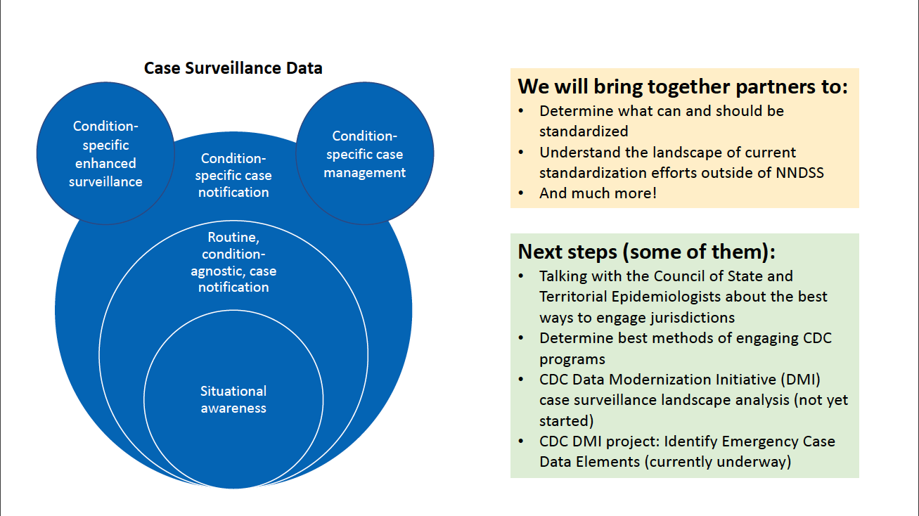
Core surveillance
  Core surveillance is inside the red circle.
  Focus on what is needed across public health agencies, NOT what we send to CDC.

Slide 10
Core Surveillance: In Scope
Identifying elements and structure for core surveillance
  Data elements/data classes that are valuable for data exchange or interoperability
  For situational awareness or routine, condition-agnostic case surveillance
For case-based surveillance (not syndromic, not aggregate reporting)
Identify common definitions and value sets/code sets for elements in core surveillance, interpretation notes
Focus first on the CONCEPT of the data element/class – we can work on the exact questions or value sets as a second step

Slide 11
Core Surveillance: Out of Scope
Standardizing of data elements that are mainly for research purposes or non-core elements that need significant discussion
Condition-specific guidelines (including for elements/classes defined as core)
Data exchange mechanism for sending/sharing

Slide 12
Data sources
Background research for each data class will include compilation of existing formats, standards and potential data sources
  USCDI; eCR (CDA, HL7 & FHIR); ELR; MMGs
How well do the public health surveillance needs align with the standard vocab and fields defined with healthcare?
As part of standardization, can we map incoming data elements to our selected core elements?
Can we make recommendations for how data from the electronic sources are integrated?
Can we automate the population of these core elements?

Slide 13
FAQs
Core ≠ Required
Even if a data element or class is part of core surveillance, this does not mean we need to fill in an answer for every case!
  It is okay to leave the data field as blank or Unknown if the information is not available, not a priority, or not useful for particular conditions.
Core ≠ Gen v2 MMG (or Gen v3, etc.)
We will define core for what we want in a jurisdiction's surveillance system.
This does NOT mean that all core elements gets transmitted to CDC.

Slide 14
Travel

Slide 15
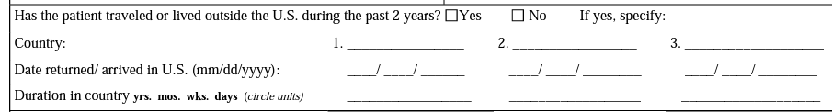
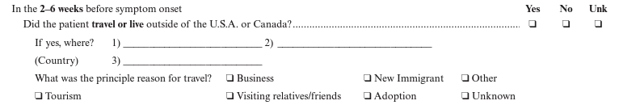
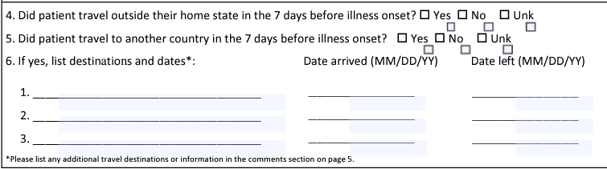
Travel history data class
Shown: Malaria, viral hepatitis, cholera

Slide 16
Travel history: the problem
Travel history is collected during case investigations for many conditions
  15 MMGs collect data related to travel, likely >15 case report forms
LOTS of variation across conditions in how travel is asked/stored
  International vs. Domestic?
  Locations? Dates? Mode of transport? Reason for travel? Etc.
  Interpretive vs. objective listing of itinerary
  Do we even agree on what is "travel"?
Relevant time frame varies by condition
Level of detail needed and/or collected varies by condition

Slide 17
Travel history: the challenge
How do we standardize the structure and framework for travel elements (while retaining the important differences in need)?
Lots of previous standardization/harmonization work
Opportunities to harmonize the elements across conditions
Possible opportunities to align with vocabulary and data elements from eCR v1, USCDI Level 2 or others

Slide 18
Travel: In Scope
In scope:
What should be part of core surveillance for jurisdictions? Can we identify a common structure for those core elements across conditions?
Necessary level of specificity for surveillance purposes (for example - geography, itinerary, mode of transport)

Slide 19
Travel: Out of Scope
Out of Scope:
Identification of the appropriate time frames for each condition
  For example, if the following question is asked, we will not be defining x: In the (x) weeks before symptom onset or diagnosis (use earlier date), did the subject travel out of their county, state, or country of residence?
Inclusion of sufficient travel detail to serve needs of DGMQ or airline exposure notification

Slide 20
Travel

Slide 21
Potential data elements related to travel
International Destination(s) of Recent Travel (82764-2)
Travel State (82754-3)
Reason(s) for Travel (66415-1)
Date Of Arrival to Travel Destination (TRAVEL06)
Date of Departure from Travel Destination (TRAVEL07)
Travel (SCT 420008001)
Date of Return to the US from Travel (55209-1)
Date of Return from Travel (TRAVEL08)
Travel Outside USA Prior To Illness Onset Within Program Specific Timeframe (TRAVEL38)
Did The Case Travel Domestically Prior To Illness Onset? (INV664)
Specify Different Travel Exposure Window (INV663)
Import Status (INV293)
Length of Time in the US (DEM225)
Length of Time in the US Units
Notes:
Data Element & Definitions
International Destination(s) of Recent Travel (82764-2)
International destination or countries the patient traveled to
Travel State (82754-3)
Domestic destination, state(s) traveled to
Reason(s) for Travel (66415-1)
Reason for travel related to current illness
Date Of Arrival to Travel Destination (TRAVEL06)
Date of arrival to travel destination
Date of Departure from Travel Destination (TRAVEL07)
Date of departure from travel destination
Travel (SCT 420008001)
In the (x) weeks before symptom onset or diagnosis (use earlier date), did the subject travel out of their county, state, or country of residence?
Date of Return to the US from Travel (55209-1)
Date returned to/arrived in US
Date of Return from Travel (TRAVEL08)
Date of return from most recent travel
Travel Outside USA Prior To Illness Onset Within Program Specific Timeframe (TRAVEL38)
Did the subject travel internationally in the (x) days prior to illness onset?
Did The Case Travel Domestically Prior To Illness Onset? (INV664)
Did the subject travel domestically in the (x) days prior to illness onset?
Specify Different Travel Exposure Window (INV663)
If the travel exposure window used by the jurisdiction is different from that stated in the travel exposure questions, specify the time interval in days here. Otherwise, leave blank.
Import Status (INV293)
Did symptom onset occur within 7-21 days of entering the US, following any travel or living outside the US?
Length of Time in the US (DEM225)
Length of time in the US since the last travel
Length of Time in the US Units
Length of time in the US, Units

Slide 22
Background Information: Travel (CDC)

Slide 23
U.S. Core Data for Interoperability (USCDI)
Travel History Location (level 1)
A location in a person’s travel history either as an address or as a coded location
  Geographic Location History from CDC ISO-3166 Country Codes
  DEs: International Destination(s) of Recent Travel (82764-2)/Travel State (82754-3)
Travel History Dates (level 1)
The dates spent in a location traveled to
  LOINC v2.72 Date travel started:Date:Pt:^Patient:Qn (Code 82752-7)
  DEs: Date Of Arrival to Travel Destination (TRAVEL06)/Date of Departure from Travel Destination (TRAVEL07)/Date of Return to the US from Travel (55209-)/
  Date of Return from Travel (TRAVEL08)
Purpose of Travel (comment)
Purpose of travel (business, tourism, etc.)
  Travel Purpose (CDC) value set
  DEs: Reason(s) for Travel (66415-1)
Notes:
No value set within USCDI for encounter location, this may be address or location type such as hospital, ICU; similarly for encounter type which is linked to a HL7 FHIR encounter type, value set is mapped to CPT codes
NOTE: Explanation of Benefit is a data class at the comment level of USCDI. Not included in slide. However, Member Admission Date and Member Discharge Date are listed

Slide 24
Health Level 7 (HL7)
HL7 v2
  Case Notification OBR (Observation Request) / OBX (Observation/Result)
  Syndromic Surveillance Admit, Discharge and Transfer (ADTs) / OBX
FHIR (Fast Healthcare Interoperability Resources)
  Observation Resource
    Observation.code [Type of observation (code /type)]
    Observation.effective[x], element for (dateTime or period)
    Observation.value[x] [Actual result (code and/or free text)]
  US Public Health Travel History Profile
    Observation.effective[x] (Travel History Dates)
    Observation.component:travelLocation (could be state, country, other or exact address)
    Observation.component:travelPurpose (code value and/or free text)
    Observation.hasMember references US Public Health Transporation Details
    Observation.hasMember references US Public Exposure Contact Information
Notes:
The FHIR Observation resource can be utilized to capture structured data related to Travel. Where the Observation.code equals a value indicating travel, Observation.effective[x] the dateTime or Period when the travel event took place, and the Observation.value in which travel information can be provided. Travel History address is also offered as an extension further in the profile, but it not a a big part of the profile
In the US Public Health Travel History the the Observation.value is replaced with components for travel location which must be provided and an optional travel purpose.
The has member sections refers to profiles for transportation details and exposure contact information that are captured in separate Observation instances, but can be linked as a group to US PH Travel History profile.
--------------other info----------------------
FHIR Observation resource can be utilized to capture structured data related to Travel.
Where the Observation.code equals a value indicating travel, Observation.code = "420008001"
Observation.effective[x] = dateTime or Period (when the travel event tool place)
Observation.valueCodeableConcept.coding = "Travel Information"
Likewise (US Public Health Travel History) extends the Observation resource to allow specification of both Travel Location and Travel Purpose (via slicing) to record travel history.
Observation.component:travelLocation (code and value, travelLocation must be provided)
Observation.component:travelPurpose (code and value, travelPurpose is optional)
Note: This creates a grouped list, location of travel and reason for travel.
Usage:
Refer to Resource Profile: http://hl7.org/fhir/us/ecr/STU2.1/StructureDefinition-us-ph-travel-history.html
Examples for this Resource Profile: http://hl7.org/fhir/us/ecr/STU2.1/StructureDefinition-us-ph-travel-history-examples.html
-----NOTES----
The third bullet in the top three is equivalent to the component that is sliced / extended in the PH profile... the PH profile creates two instances of the "Results Component" allowing both Location and Purpose to be grouped together in one resources... as well as repeat...
More compact and useful from a data structuring purpose.

Slide 25
Electronic Case Reporting (eCR)
The Travel History template captures travel information, location, time, purpose and transportation information.
CDA Mappings
  Travel History/effectiveTime (Travel History Dates)
  Travel History/text (Location - Free Text)
  Travel History/participant/participantRole/code (Location – Coded)
  Travel History/participant/participantRole/addr (Location – Address)
  Travel History/Purpose of Travel Observation/value (Purpose of Travel)
  Travel History/Transportation Details Organizer/Transportation Details Observation (Transportation Details)
FHIR eiCR profile in the eCR IG
    Uses the US Public Health Travel History: HL7.FHIR.US.PH-LIBRARY\US Public Health Travel History - FHIR v4.0.1
Notes:
The Travel History template captures travel information, location, time, purpose and transportation information.
The layout is similar to how the implementation guide outlines.
The effectiveTime contains the date(s) spent at a location that can be captured as free text or with coded values. When an address is known the (e.g., city, street), it is appropriate to use address rather than the coded location that is usually at the country or state level.
Free text describing the travel history details and location can be entered using the text element.
FHIR eiCR profile in the eCR IG Utilizes the US Public Health Travel Profile and the link is provided here
Backpocket info
Travel purpose and transportation details added in iICR R3.1
There is an Exposure/Contact Information Observation... which represents potential patient exposure and contact information. It also contains a Location code and address of exposure and maybe included with Social or Travel History
Full CDA -
ClinicalDocument/component/Social History Section V3/:
Travel History/effectiveTime - Travel History Dates
Travel History/text - Travel History Location - Free Text
Travel History/ participant/participantRole/code - Travel History Location – Coded
Travel History/participant/participantRole/addr - Travel History Location – Address
Travel History (V2)/Purpose of Travel Observation/value - Purpose of Travel
Travel History (V2)/Transportation Details Organizer/Tranportation Details Observation - Transportation Details
eCR / eICR Specification:
http://www.hl7.org/implement/standards/product_brief.cfm?product_id=436
Usage:
Refer to Resource Profile: http://hl7.org/fhir/us/ecr/STU2.1/StructureDefinition-us-ph-travel-history.html
Examples for this Resource Profile: http://hl7.org/fhir/us/ecr/STU2.1/StructureDefinition-us-ph-travel-history-examples.html
For access to all FHIR artifacts for the eCR profile: https://hl7.org/fhir/us/ecr/toc.html
For access to all FHIR artifacts for FHIR's current release (5.0.0): http://hl7.org/fhir/
FHIR version 5 was released in March.

Slide 26
Case Notifications to CDC
Message Mapping Guides (MMGs)
COVID, FDD, HAI MDRO, TBRD, Malaria, Measles, Mumps, Trich, Babesiosis, Rubella, CRS, Leptospirosis and Hepatitis MMGs
Travel (SCT 420008001) | In the (x) weeks before symptom onset or diagnosis (use earlier date), did the subject travel out of their county, state, or country of residence?
Specify Different Travel Exposure Window (INV663) | If the travel exposure window used by the jurisdiction is different from that stated in the travel exposure questions, specify the time interval in days here. Otherwise, leave blank.
Travel Outside USA Prior To Illness Onset Within Program Specific Timeframe (TRAVEL38) | Did the subject travel internationally in the (x) days prior to illness onset?
International Destination(s) of Recent Travel (82764-2) | International destination or countries the patient traveled to
Did The Case Travel Domestically Prior To Illness Onset? (INV664) | Did the subject travel domestically in the (x) days prior to illness onset?
Travel State (82754-3) | Domestic destination, state(s) traveled to
Notes:
Talking point... some dont' have a repeating block, but a 2nd hospitalization admit and discharge date to capture readmissions
Other wording for ICU: During any part of the hospitalization, did the subject stay in an Intensive Care Unit (ICU) or a Critical Care Unit (CCU)?

Slide 27
Case Notifications to CDC
Message Mapping Guides (MMGs)
Travel dates and reason for travel
Date Of Arrival to Travel Destination (TRAVEL06)​ | Date of arrival to travel destination​
Date of Departure from Travel Destination (TRAVEL07)​ | Date of departure from travel destination​
Date of Return from Travel (TRAVEL08)​ | Date of return from most recent travel​
Date of Return to the US from Travel (55209-1)​ | Date returned to/arrived in US​
Import Status (INV293)​ | Did symptom onset occur within 7-21 days of entering the US, following any travel or living outside the US?​
Length of Time in the US (DEM225)​ | Length of time in the US since the last travel​
Length of Time in the US Units​ | Length of time in the US, Units​
Reason(s) for Travel (66415-1)​ | Reason for travel related to current illness ​
Notes:
Talking point... some dont' have a repeating block, but a 2nd hospitalization admit and discharge date to capture readmissions
Other wording for ICU: During any part of the hospitalization, did the subject stay in an Intensive Care Unit (ICU) or a Critical Care Unit (CCU)?

Slide 28
Travel History core open forum

Slide 29
Sample Core – Travel History
Stand-alone Data Elements
  In the (x) weeks before symptom onset or diagnosis (use earlier date), did the subject travel out of their county, state, or country of residence? (SCT 420008001)
  Did the subject travel internationally in the (x) days prior to illness onset? (TRAVEL38)
  Did the subject travel domestically in the (x) days prior to illness onset? (INV664)
  Specify different travel exposure window If the travel exposure window used by the jurisdiction is different from that stated in the travel exposure questions, specify the time interval in days here. Otherwise, leave blank. (INV663)
Repeating Group Data Elements
  International destination or countries the patient traveled to (82764-2)
  Domestic destination, state(s) traveled to (82754-3)
  Reason for travel related to current illness (66415-1)
  Date arrival at destination (TRAVEL06)
  Date of departure from
  destination (TRAVEL07)

Slide 30
Additional questions
    Initial travel question
    One broad question vs. separation of domestic and international?
    Use of "travel or lived" vs. just "travel"?
    Repeating Group
    Focus on exposure timeframe (destination arrival/departure) vs. time in U.S. (leave/return to residence)
    Programmatic needs not captured by the core elements
    Can these be met by a condition-specific data elements to augment proposed?

Slide 31
Hospitalization

Slide 32
Hospitalization: Scope
In scope:
Hospitalization as an indicator of severity of disease.
  Similar to what is used in GenV2
Identifying elements and structure for core surveillance
  Data elements/data classes that are valuable for data exchange or interoperability
  For situational awareness or routine, condition-agnostic case surveillance
For case-based surveillance (not syndromic, not aggregate reporting)
Out of Scope:
Hospital/healthcare information as an exposure or risk factor.

Slide 33
Hospitalization Polling

Slide 34
Polling process
Poll questions will be shown first on a slide before poll opens
  Opportunity for clarifications & questions
Questions will be mostly Yes/No
  "unsure" / "unknown" option removed
  Feel free to abstain if you don't have a preference or don't feel strongly
  We will try to gauge lack of clarity via N and reactions
Opportunity for limited discussion on questions with a big split

Slide 35
Question 1
Should the specific hospital admission location (e.g., labor/delivery, ICU, internal med) be captured as part of core surveillance?
  Yes
  No

Slide 36
Question 2
Do you think the identifying information for the hospital facility is best documented as a core element in the jurisdiction surveillance system using the facility name or facility identifier?
Facility name should be a core element
Facility ID should be a core element
Both should be core elements
No preference or Unsure

Slide 37
Question 3
Is admission at an acute care hospital for at least 24 hours enough to be counted as a hospitalization (so admission could be for observation only, for example, assuming it is for the condition in question)?
Yes
No

Slide 38
What’s next?
May workgroup meeting: TRAVEL HISTORY continued
We have started drafting the hospitalization elements write-up – for further review, questions & feedback.
Look for items to review before the next meeting
Join our WG: last Friday of each month at 1pm EDT
  Next meeting May 26, 2023

