Slide 1
Data Standardization Work Group
Surveillance Practice and Implementation Subcommittee (SPIS)
March 23 2018

Slide 2
Agenda
Welcome and roll call
Workgroup collaboration tools
Discussion from 3/9 and project update
Health event timeline graphic
Discussion: Illness Onset Date
Wrap up

Slide 3
Welcome
Call-In/Webinar Information:
  https://cste.webex.com/cste/k2/j.php?MTID=t4dea93549404d3f14c39229a245d297d
  Password: dswg123
  Call in: 1-877-668-4490
Access code: 795 572 806
Roll call for members who have joined via the phone only
Notes:
1:02-1:10 Welcome and roll call; collaboration tools

Slide 4
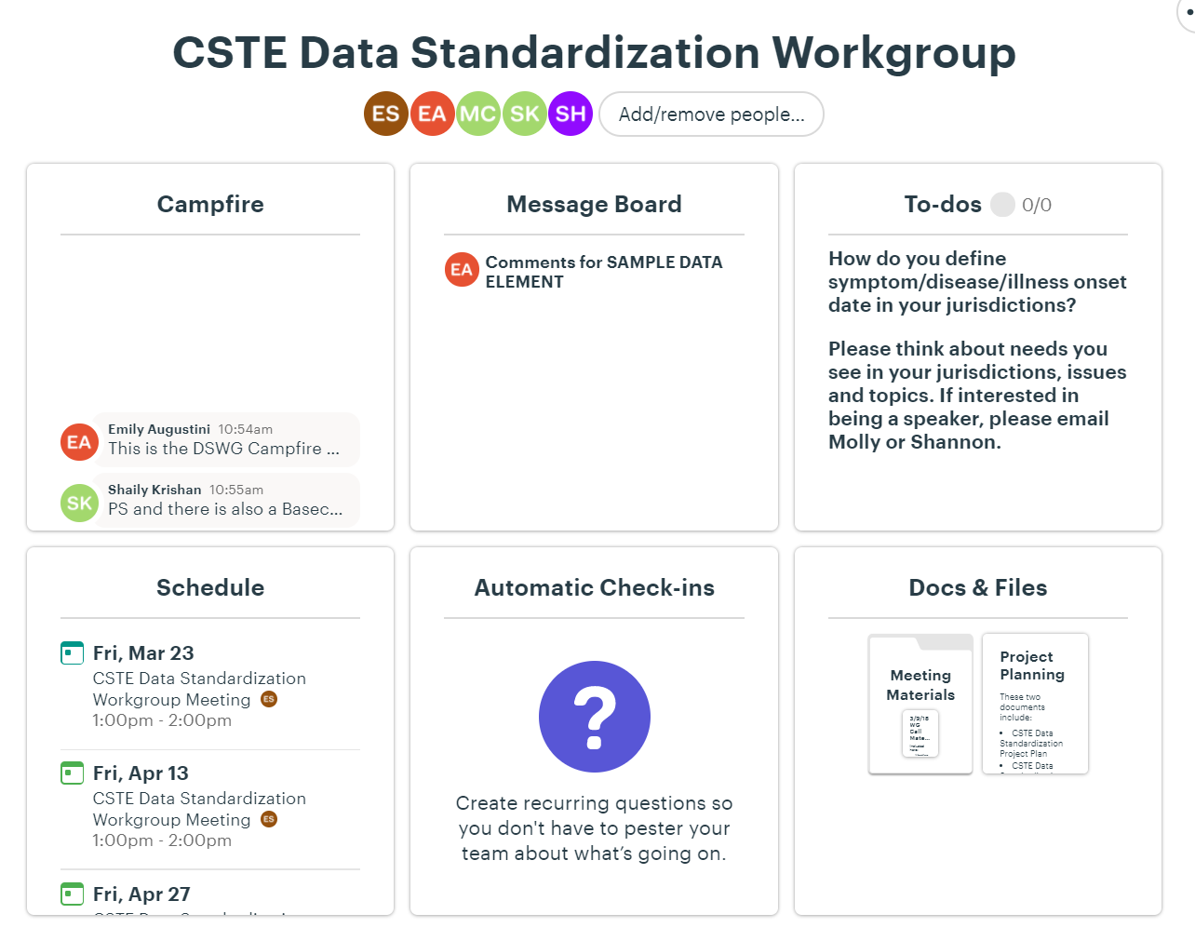
Collaboration Tools
Basecamp: https://3.basecamp.com/3164497/join/1guTDJpympSc

Slide 5
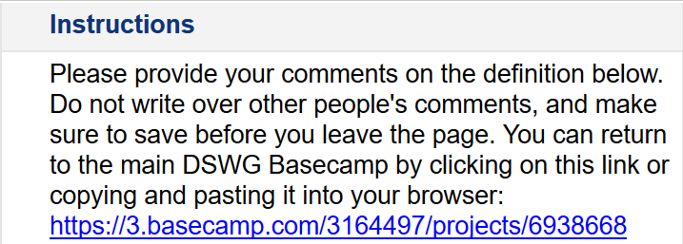
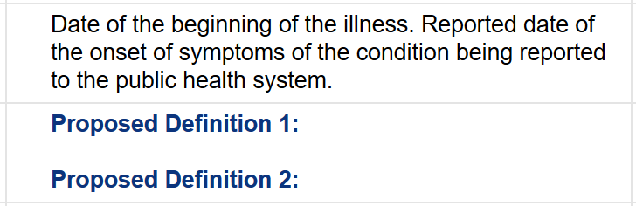
Collaboration Tools
Smartsheet Feedback Tool: https://app.smartsheet.com/b/publish?EQBCT=dd684ebb0ff0430ba11f5b4fb360a3aa

Slide 6
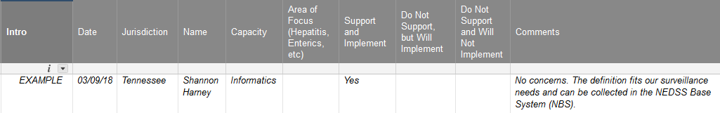
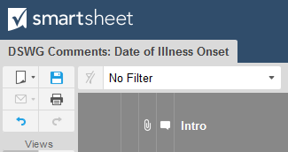
Collaboration Tools
Providing Feedback in the Smartsheet Feedback Tool
Save the page before leaving (Ctrl +S or click the icon)

Slide 7
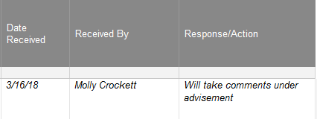
Collaboration Tools
Return to Basecamp via the link in the instructions
https://3.basecamp.com/3164497/projects/6938668
DSWG Planning Committee will review and comment back
The feedback will be included in the next call for discussion
Notes:
The Smartsheet Feedback Tool link will also be available in Basecamp.

Slide 8
Themes From 3/9
So many reasons why this is a great project … Starting to do great work in cluster definitions and trends. … would be great to visualize across jurisdictions.
There is a need to have a group contribute feedback during MMG review to make implementation easier.
A big challenge will be navigating the differences in data element definitions and understanding the reason for differences in practice. Will be a balance and will need to consider how to reconcile this.
Travel, gender, sex, sites of exposure, time period of exposure for different pathogens, when we report to CDC.
Have seen units present differently when it comes to case counts. … Looking forward to taking Workgroup activities back to jurisdiction for confidence in numbers.
Notes:
1:10-1:15: Themes, scope, goals, charter and project plan

Slide 9
Scope and Goals
Objective: Improve data quality through the development and application of consensus definitions for the core data elements for general communicable disease surveillance
Initial project phase through 6/30/2018:
  Develop and plot a standardized repeatable WG consensus process
  Pilot the process on three data elements – Illness Onset Date, Diagnosis Date and Report to Public Health Date
Survey to S/I members and analysis of results to assist in informing a long-term data standardization roadmap for WG and CSTE
Notes:
1:10-1:15: Themes, scope, goals, charter and project plan
Outside of the scope of this group (at this time) (from 3/9 slide):
Inclusion of existing data elements
Wording of existing data elements
Changes to value sets

Slide 10
Long-Term Roadmap
Continue consensus work for simple and more complex data elements
  Race, travel history
Consider expanding to include application and use of common data elements
  Timing of report to CDC, applying case definitions
Explore role of DSWG in CDC’s internal harmonization activities
  Begin conversations with groups at CDC to determine potential for collaboration
Determine appropriate involvement in MMG development/feedback
Notes:
1:10-1:15: Themes, scope, goals, charter and project plan

Slide 11
MMG Involvement
Short term
  Use definitions of data elements from GenV2 to help frame early discussions
  Consider existing and upcoming MMGs when developing long-term workgroup plan
Long term
  Potential to tackle specific, more challenging data elements from MMGs in development as proposed by workgroup members
  Full MMG review and aggregated group feedback may be beyond scope for this group
Notes:
1:10-1:15: Themes, scope, goals, charter and project plan

Slide 12
Project Documents
Charter and governance document
Project plan
Notes:
1:10-1:15: Themes, scope, goals, charter and project plan

Slide 13
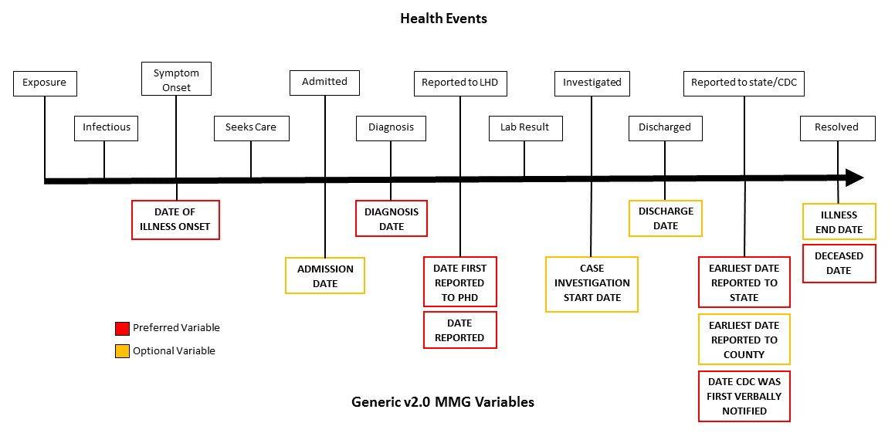
Health Event Timeline
Notes:
1:15-1:30: Health even timeline graphic

Slide 14
Illness Onset Date
Significance
  Identify exposures and incubation period
  Contact tracing and containment
  Prophylaxis
Gen v2.0 definition: Date of the beginning of the illness. Reported date of the onset of symptoms of the condition being reported to the public health system
Notes:
1:30-1:32: Illness Onset Date
In the Public Health Event Timeline, the first date we generally collect in all investigation is illness onset date. In the MMWR date algorithm, this is the first date in the investigations dates for assigning MMWR week and year. For the investigation, we use this date to help work backwards toward the date of exposure and to determine the incubation period. For some conditions, this can help with identifying exposures for contact tracing and containment, and implementing prophylaxis.
For the Generic Version 2.0 MMG, the definition is, “Date of beginning of the illness. Reported date of the onset of symptoms of the condition being reported to the public health system.”

Slide 15
Discussion: Illness Onset Date
What source of information do you use for determining the date of symptom/illness/disease onset?
  Patient (proxy) interview
  Provider interview
  Chart review
Notes:
1:32-1:38
Arizona Feedback:
Patient (proxy) interview is preferred. Otherwise, the medical record/chart review, with provider interview (less common).
Tennessee Feedback:
The TB program does not use Illness Onset Date. They focus on the Date of Report and then the Date the patient was counted as an official TB case. Some cases are asymptomatic and only have a lab result.
The hepatitis program uses all of the information above.
The foodborne program (also a FoodNet site) must have the illness onset date come from a patient (or proxy) interview, the provider, or a chart review.
- Recommendations: Capture a range of dates for onset instead of an exact date. Patients often do not recall exactly. Allow for a checkbox of Onset
Date Unknown, or Case unable to recall exact onset date.
The waterborne/zoonotic program (Crypto, Legionellosis, and Zoonoses) uses patient’s self-reported date of illness onset, or the date of specimen
collection if that information isn’t available or the patient cannot pinpoint a date.

Slide 16
Discussion: Illness Onset Date
What signs or symptoms do you count as the start of illness?
  Do you only include signs (objective) or symptoms (subjective), or both?
  Do you only include what is in the case definition, or also any related signs/symptoms?
  Do you only include signs/symptoms specific to that condition, or also those that are more vague (e.g., malaise)?
Notes:
1:38-1:44
Arizona Feedback:
Include signs and symptoms, although symptoms can be generalized or common across illnesses.
May be relevant to the disease and in addition to the case definition.
Tennessee Feedback:
Vaccine-preventable diseases program: Many conditions have a prodrome with non-specific symptoms. Some patients may not remember those symptoms. If those symptoms can be reported, they will be included and contribute to the illness onset date. For pertussis, the onset is with cough.
TB: As mentioned earlier, the dates used are Date of Report and Date Counted.
Hepatitis: Only the signs/symptoms in the case definition are considered. Symptoms: fever, headache, malaise, anorexia, nausea/vomiting, diarrhea, abdominal pain. Sign: jaundice.
Foodborne: Date of onset would be for the first of these signs/symptoms: vomiting, nausea, diarrhea, bloody diarrhea, constipation, weight loss, fatigue, chills, fever, headache, abdominal cramps, muscle aches; other.

Slide 17
Discussion: Illness Onset Date
How do you reconcile different dates of onset from different sources?
  Patient (proxy interview)
  Chart review
  Provider interview
  Laboratory specimen collection date/result date
Notes:
1:44-1:50
Arizona Feedback:
VPD: May have different onset dates from the provider or patient. Generally, take the patient’s information, but this is per investigator judgment.

Slide 18
Discussion: Illness Onset Date
What do you do if you have none of this information?
  Should we use a different date for illness onset date?
Notes:
1:50-1:55
Arizona Feedback:
HAI: Will use the specimen collection date if no other date is available.
STD: Most patients are asymptomatic and identified via screening. Will use the specimen collection date for those patients. For congenital syphilis cases, the date of birth is used.
VBD/Z: Date of report or the date of report may be used for illness onset date. If the patient is lost to follow-up or not investigated, the specimen collection date may be used. Will make the assumption the symptoms began on the date of collection.

Slide 19
Wrap Up: Action Items
Provide input on Illness Onset Date definition via Smartsheet Feedback Tool: Link will be sent out and posted on Basecamp message board
Provide survey question input for survey out to WG members regarding priorities for long-term data standardization roadmap: Message will be started on Basecamp this afternoon
How do you define Diagnosis Date in your jurisdictions?
  Is the data element being implemented the same way across diseases?
  If not, what are those differences?
  What are the challenges with the differences? Or are these necessary for those different diseases?
Notes:
1:55-1:58 Wrap Up and Thanks!

Slide 20
Wrap Up
Meeting slides and notes from this meeting will be uploaded to Basecamp on Tuesday. An email will also go out to members on that day with the link to Basecamp.
Next Call: Friday, April 13, at 1-2:00pmET/12-1:00pmCT
  Review the discussion from March 23
  Introduce the second data element: Diagnosis Date
Agendas will be sent out the Wednesday before the call.
THANK YOU for volunteering your time!

Slide 21
Future Meetings
Call-In/Webinar Information:
  https://cste.webex.com/cste/k2/j.php?MTID=t4dea93549404d3f14c39229a245d297d
  Password: dswg123
  Call in: 1-877-668-4490
  Access code: 795 572 806
Meeting Schedule:
  Friday, April 13th, 1-2pm ET
  Friday, April 27th, 1-2pm ET
  Friday, May 11th, 1-2pm ET
  Friday, May 25th, 1-2pm ET
Notes:
1:58 Future Meetings and Close

Slide 22



CSTE National Office
2872 Woodcock Boulevard, Suite 250
Atlanta, Georgia 30341
770.458.3811
770.458.8516
cmccoull@cste.org

