Slide 1
Data Standardization Work Group (DSWG)
May 26, 2023

Slide 2
CSTE Data Standardization Workgroup Meeting​
Please mute phone/ headset/ computer audio!​
Agenda
Welcome & announcements
Status update of DSWG outputs
What is core data for case surveillance? (quick overview)
Travel History continued...
  Brief intro/reminders
  Travel history examples across systems, jurisdictions, diseases
  Travel history priorities polling and open forum
Wrap-Up & Adjourn

Slide 3
Announcements

Slide 4

2023 CSTE Annual Conference
June 25-29, 2023 – Salt Lake City, Utah
Day-to-Day Agenda Now Available – Conference App coming soon
Selected Roundtables from S/I Committee
  June 27 – 12:45-1:30 pm: Surveillance & Informatics Steering Committee Meeting
  June 27 – 5:15-6:00 pm: Federal Datasets for Public Health and Healthcare Interoperability – USCDI and USCDI+
  June 28 – 12:45-1:30 pm: Moving Towards Standardized Data Elements for Case Surveillance
Selected Breakouts from S/I Committee
  June 27 – 3:45-5:00 pm: Jazz Up Your Case Notifications: Staying Ahead of the Curve
Position Statements, Networking/Evening Receptions, Plenary Sessions, Posters, Exhibitor/Sponsors!

Slide 5

Position Statement Track at Annual Conference
6 Roundtable Sessions | 6 Roundtable Sessions (5 ID + 1 CD/MCH)
ID | Monday, 6/26 | 7:30am to 8:15am
ID | Monday, 6/26 | 12:45pm to 1:30pm
CD/MCH | Monday, 6/26 | 5:15pm to 6:00pm
ID | Tuesday, 6/27 | 7:30am to 8:15am
ID | Tuesday, 6/27 | 12:45pm to 1:30pm
ID | Wednesday, 6/28 | 7:30am to 8:15am
11 Position Statements | 11 Position Statements (10 ID + 1 CD/MCH)
ID | Anaplasmosis​
ID | Congenital Cytomegalovirus (cCMV) ​
ID | Cronobacter​ infection in infants
ID | Ehrlichiosis​
ID | Hepatitis B – Acute and Chronic​
ID | Mumps​
CD/MCH | Neonatal Abstinence Syndrome
ID | Polio​
ID | Toxoplasmosis​ and Congenital Toxoplasmosis
ID | Varicella​
ID | Zika Virus Disease​
4 Voting Sessions | 4 Voting Sessions (3 ID + 1 CD/MCH)
ID | *NEW* Monday, 6/26 | 3:15pm to 5:00pm
ID | Tuesday, 6/27 | 3:15pm to 5:00pm
CD/MCH | Wednesday, 6/28 | 2:00pm to 3:15pm
ID | Wednesday, 6/28 | 4:00pm to 6:30pm
Notes:
Suggested script: [assuming these slides placed after slide or discussion about annual conference]
“The 2023 position statement process is now live! At this year's annual conference and in the conference agenda, position statement-related sessions can be found in the new position statement track. There are 11 position statements under consideration (10 infectious disease and 1 maternal/child health) – all are now available on CSTE’s website for review. At the conference, there will be 6 roundtable discussions to provide authors the opportunity to present and receive feedback on proposed surveillance changes. There will then be 4 voting sessions to move position statements out of committee and up to a full Council vote. Please note the new Monday infectious disease voting session. More information on topic-specific position statement schedules will be provided in the conference app and agenda prior to your arrival in Salt Lake City. ”

Slide 6
Upcoming Position Statement Webinars
Tuesday, May 30 at 4:00-5:30pm EDT
  Mumps, Varicella, Polio
Wednesday, May 31 at 3:00-4:00pm EDT
  NAS, Cronobacter infection in infants
Friday, June 2 at 3:00-4:00pm EDT
  cCMV, Zika virus disease
Tuesday, June 6 at 4:00-5:00pm EDT
  Anaplasmosis, Ehrlichiosis
Thursday, June 8 at 4:00-5:00pm EDT
  Hep B – Acute and Chronic, Toxoplasmosis and Congenital Toxoplasmosis
More information here: https://www.cste.org/page/PSWebinar
Notes:
Suggested script:
“Prior to the conference, we will also hold at least 5 discussion webinars, that we encourage all members to participate in to share feedback and ask questions of the authors. These webinars will be structured as they have been in years past. More information (including Zoom information) can be found on the position statement website.”
[Note for program staff: if you share these on a subcommittee call that takes place after certain webinar(s) on the slide, you may add the following verbal comment: “The webinars that have taken place were recorded and have been posted to the same position statement website for member viewing.”]

Slide 7
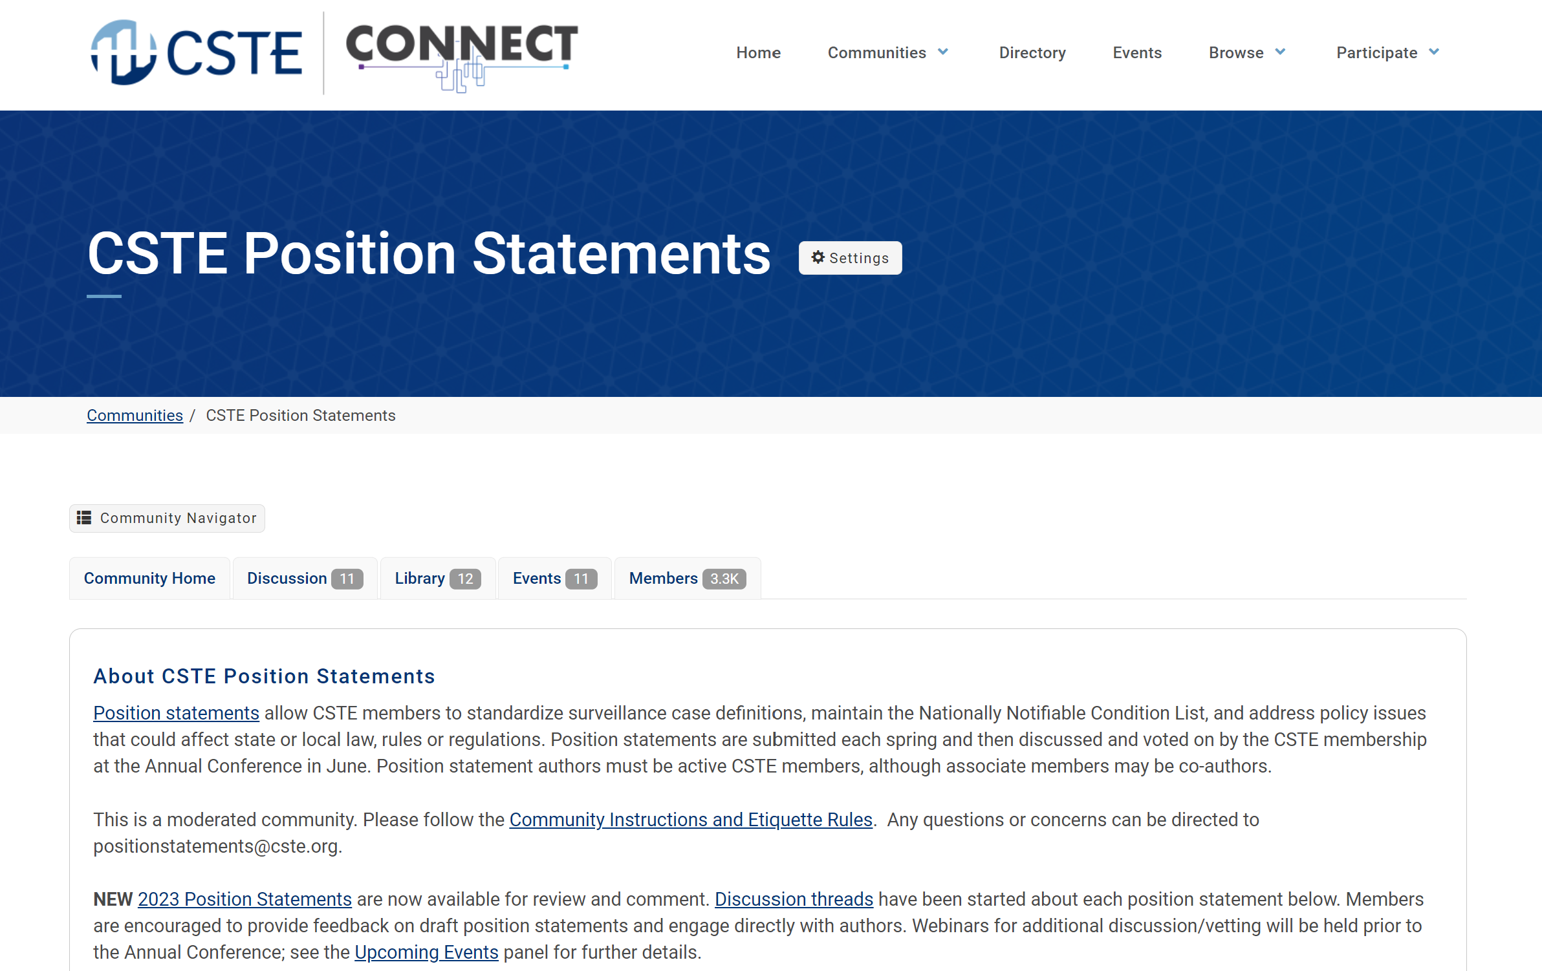
*NEW* CSTE Connect Discussion Threads
Link: https://connect.cste.org/
Notes:
[Suggested script]:
“And new this year, we will be hosting discussion threads on CSTE Connect, CSTE’s new online engagement portal. If you are already a CSTE member with up-to-date dues, you already have access to CSTE Connect. Threads have been started for each position statement under consideration and we encourage all members to discuss position statement content directly with the authors on this site.”

Slide 8
Position Statement Disclaimer
Position statements are considered to be in DRAFT form until finalized and approved by the Council at the CSTE Annual Business Meeting. Draft position statements are under active review/vetting and discussion. They shall not be widely distributed and are intended only for official CSTE members, invited disease/condition subject matter experts, and position statement authors and writing groups prior to approval.
Direct all media inquiries related to any draft CSTE position statement to the CSTE National Office at positionstatements@cste.org.
Notes:
[Suggested script]:
“And lastly, we ask that members do not widely distribute these position statements while they are still in draft form. If there are inquiries from members of the press about the position statement process or any draft position statement, please forward those along to the national office so that they can be appropriately triaged and responded to.”

Slide 9
Request for Information
To improve transparency and reduce duplication of efforts we would like to spearhead an effort to collect documentation from jurisdictions that have undergone data harmonization efforts and share some of the following:
Decision documents
Outcomes
Best practices
Data dictionaries for surveillance systems
This is not specific to any data element, and information will be placed in a repository accessible to DSWG members on the Basecamp site. If your jurisdiction can share this information, please send this to Becky Lampkins (blampkins@cste.org) and Laura Lane (llane@jmichael-consulting.com) with a descriptive subject line with permission to post on the Basecamp site.

Slide 10
Status update: DSWG outputs
Issues Brief: Data Standardization: Dates of Importance to Public Health Surveillance
  Comments returned to co-chairs this month (May) by CSTE staff
  Reviewing and responding to comments
Data Standardization: Workgroup Proposal for Standardized Case Counting Date
  Completed review by S/I Committee, moving to next phase of CSTE process
Standardizing data elements for Hospitalization
  Drafting documentation for review and input by DSWG
  Includes background for current overall effort, to use as a framework for subsequent data classes

Slide 11
Meeting ground rules
Discussion Guidelines
  "Raise" your hand
  Use the chat to provide feedback and ask questions
  When called, state your name and affiliation
  Stay on point, be brief, and within the context of the discussion in progress
  80/20 consensus
  Co-Chairs/moderators' prerogative to move the discussion forward as needed
    Post-meeting survey provided for additional input
  Be courteous and be open to new ideas
Active participation encouraged for all!
Chats, voting, comments, etc.
Includes STLT jurisdictions + CDC Programs + CSTE, etc.

Slide 12
Core Data for Case Surveillance

Slide 13
What are "core" data elements?
Data elements/data classes that we identify as "core" to case surveillance are those that we want to collect and to define similarly across many conditions and across jurisdictions.
  Identify structure, value sets, common definitions for core elements.
  Facilitate data exchange, interjurisdictional transmission, addition of new conditions
=> Standardization of these elements should provide value for data exchange or interoperability
  Do you want to receive it as part of interjurisdictional exchange?
  Do you want an efficient way to ingest?
  Is there utility across multiple conditions -- would you want the elements available for many conditions or to add as a block?

Slide 14
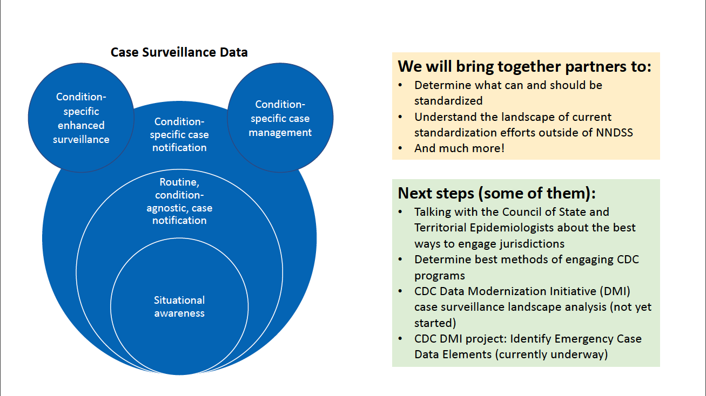
Core surveillance data
  Core surveillance data is inside the red circle.
  Focus on selected data classes or data elements that may be needed across public health agencies (e.g., for interjurisdictional exchange between PH agencies or from PH agency to CDC)

Slide 15
Core Data: In Scope
Identifying core data elements for surveillance (within selected data classes)
  Data elements/data classes that are valuable for data exchange or interoperability
  For situational awareness or routine, condition-agnostic case surveillance
For case-based surveillance (not syndromic, not aggregate reporting)
Identify common definitions, value sets/code sets, structure, and interpretation notes for core data elements
Focus first on the CONCEPT of the data element/class – we can work on the exact questions or value sets as a second step

Slide 16
Core Data: Out of Scope
Condition-specific details and value sets (even for data elements identified as core)
  For example:
    Condition-specific timeframes for core risk/exposure elements
    Condition-specific value set for a common risk/exposure element, if relevant values vary by condition
Standardizing of data elements that are mainly for research purposes or special studies
Comprehensive list of data elements to include in interjurisdictional data exchange
Data exchange mechanism for sending/sharing
Related (but separate) efforts are out of scope for DSWG:
  When to send case notifications
  List of data elements to be sent to CDC in Emergencies

Slide 17
FAQs
Core ≠ Required
Even if a data element or class is defined as core, this does not mean we need to fill in an answer for every case!
  It is okay to leave the data field as blank or Unknown if the information is not available, not a priority, or not useful for particular conditions.
Core ≠ Gen v2 MMG (or Gen v3, etc.)
We will not make recommendations for specific MMGs or exchanges.
We will focus on elements to submit to CDC, but may need to discuss a broader number of elements to get to the recommendation of what to transmit.

Slide 18
Travel

Slide 19
Travel history: the challenge
How do we standardize the structure and framework for travel elements (while retaining the important differences in need)?
Lots of previous standardization/harmonization work
Opportunities to harmonize the elements across conditions
Possible opportunities to align with vocabulary and data elements from eCR v1, USCDI Level 2 or others

Slide 20
Travel: In Scope
In scope:
What should be part of core surveillance for jurisdictions? Can we identify a common structure for those core elements across conditions?
Necessary level of specificity for surveillance purposes (for example - geography, itinerary, mode of transport)

Slide 21
Travel: Out of Scope
Out of Scope:
Identification of the appropriate time frames for each condition
  For example, if the following question is asked, we will not be defining x: In the (x) weeks before symptom onset or diagnosis (use earlier date), did the subject travel out of their county, state, or country of residence?
Inclusion of sufficient travel detail to serve needs of DGMQ or airline exposure notification

Slide 22
Travel history – examples from different systems

Slide 23
Arizona (non-vendor/home-grown)
3 components to travel history collection with the system:
  "Travel information" table
    Standardized table/structure across morbidities
    Multiple entries permitted for a case (repeating block)
  Time frames for the travel table are condition-specific, controlled by a back-end table
  Condition-specific questions are also included within investigation forms

Slide 24
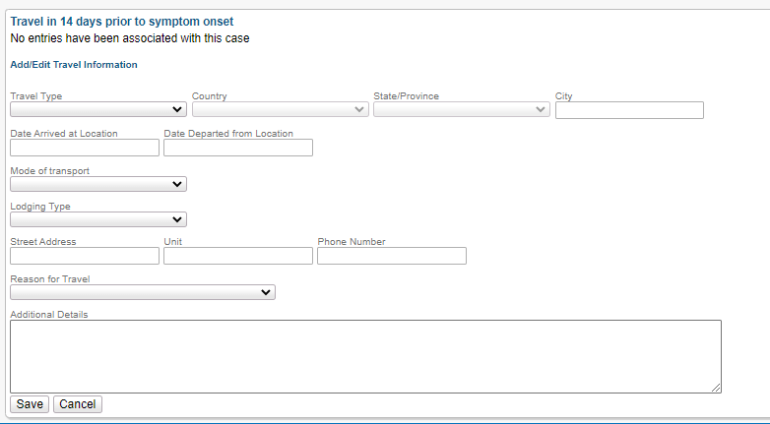
AZ "travel table"

Slide 25
AZ "travel table" configuration
Time interval (14 days) and reference (symptom onset) are display-only, controlled by a back-end table
  Configurable
  Can vary by condition

Slide 26
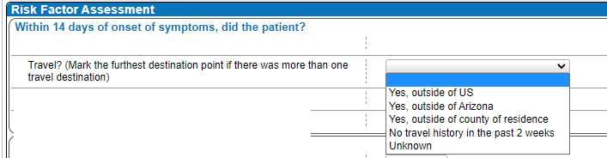
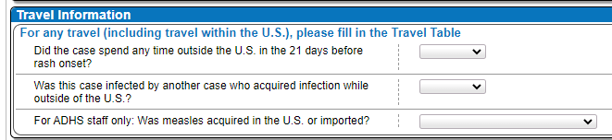

AZ condition-specific questions
WNV, MSL, HAV

Slide 27
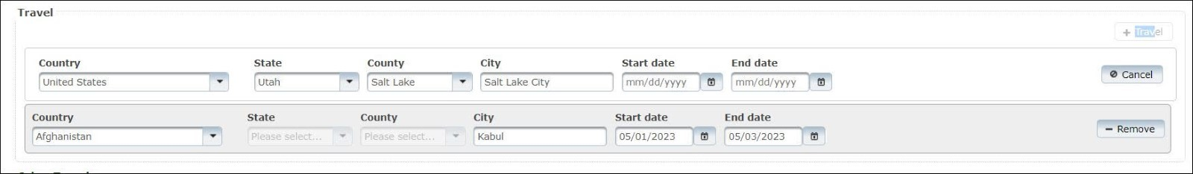
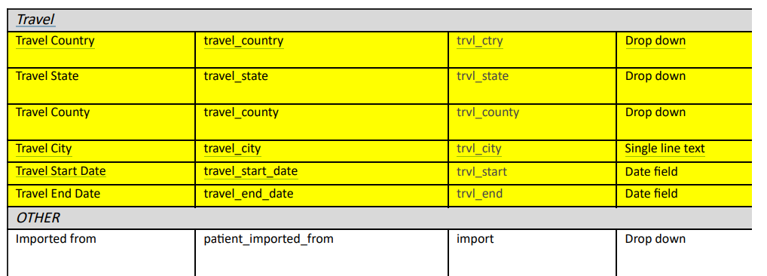
Utah (Epi Trax) - Slide 1
We have 3 main ways we capture travel related information. We have our standardized travel history block. You can add as many travel locations as you’d like.

Slide 28
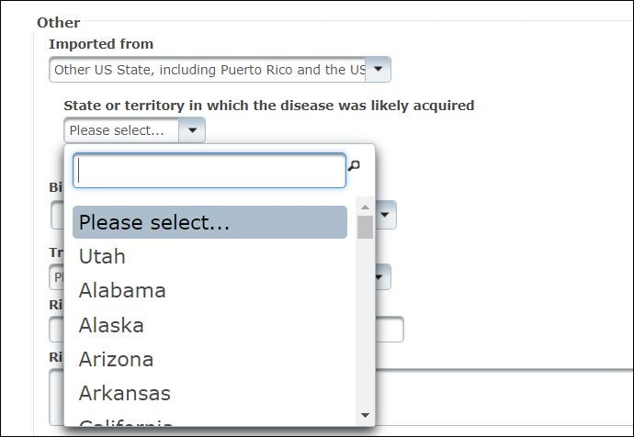
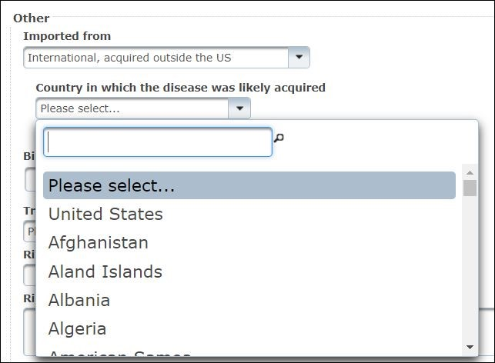
Utah (Epi Trax) - Slide 2
We have the imported question where the location value set is dependent on the first selection. This is standardized as well.

Slide 29
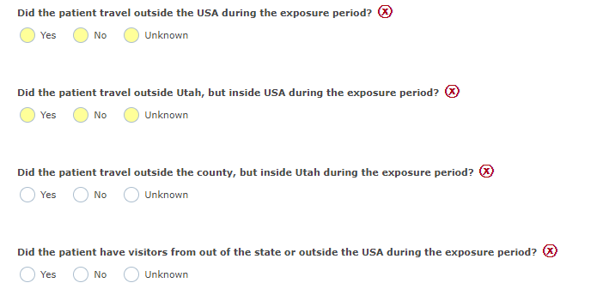
Utah (Epi Trax) - Slide 3
Other than that, travel questions are asked as “form fields” – so they are specific to the condition. Many conditions have a general format of these four questions:

Slide 30
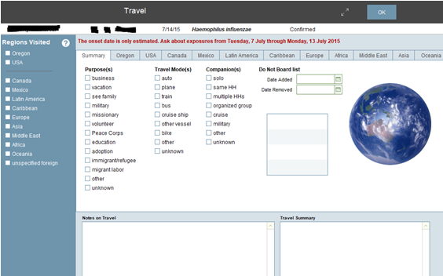
Oregon (Custom) - Slide 1
Our travel module captures Oregon destinations, major cities and all states in the US, certain hot spots in foreign countries, and all countries. One downfall is that we don’t collect departure/arrival dates of multi-stop trips, just when the person left and returned to Oregon and USA (if international). We use the data in this table to populate the HL7 messages for GenV2 reporting.

Slide 31
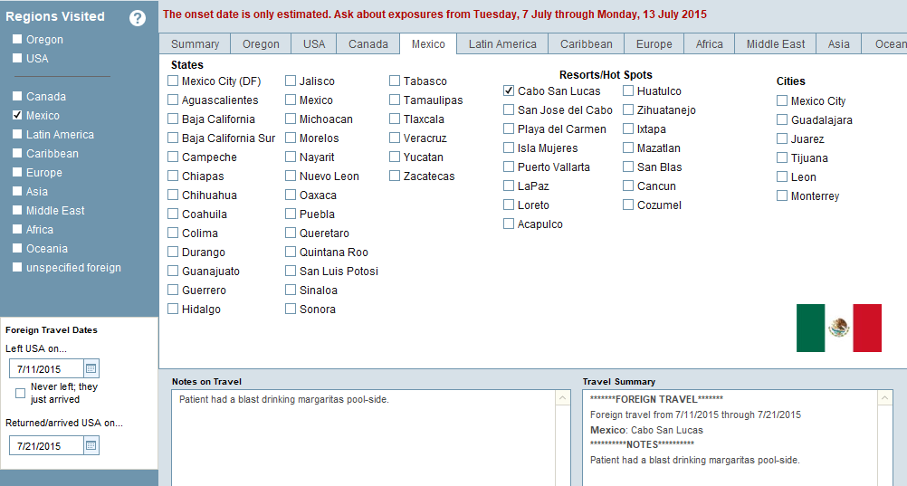
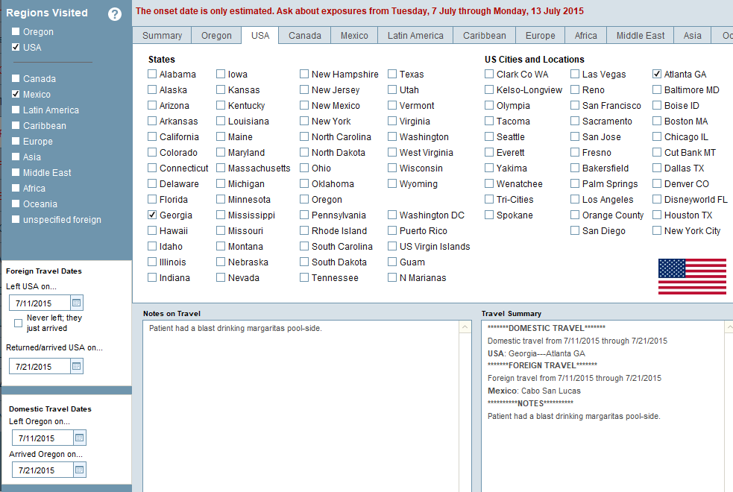
Oregon (Custom) - Slide 2
Our travel module captures Oregon destinations, major cities and all states in the US, certain hot spots in foreign countries, and all countries. One downfall is that we don’t collect departure/arrival dates of multi-stop trips, just when the person left and returned to Oregon and USA (if international). We use the data in this table to populate the HL7 messages for GenV2 reporting.

Slide 32
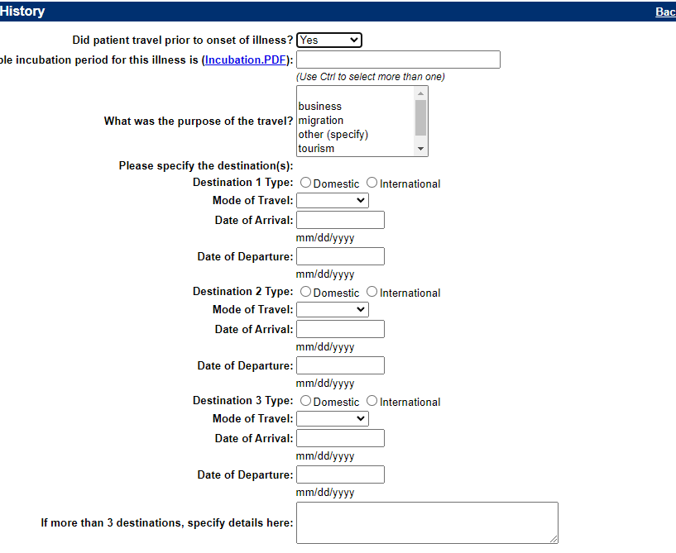
Alabama (NBS) - Slide 1
We use NBS to capture the basic travel information (dates of travel, destination, purpose, mode, etc.). REDCap is used to monitor contacts for Serious Infectious Diseases (e.g., HPAI, Mpox, Ebola) and initially COVID travelers.
This is how travel data is collected in legacy pages:
  Campylobacter:

Slide 33
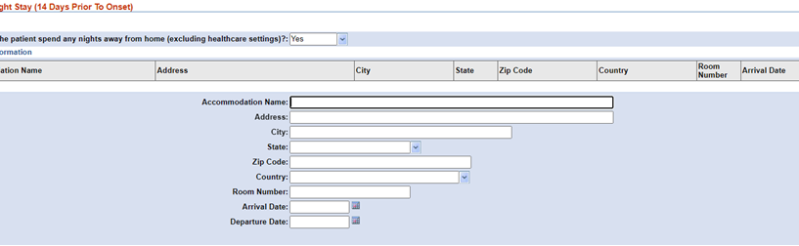
Alabama (NBS) - Slide 2
Page Builder pages (repeating blocks) allow for more customization dependent upon the condition's needs and you are not limited to the number of destinations as you are in legacy:
  Legionellosis:

Slide 34
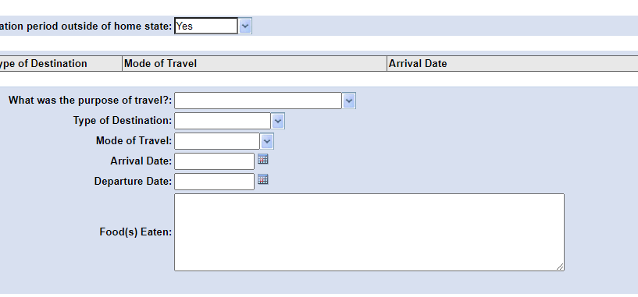
Alabama (NBS) - Slide 3
Page Builder pages (repeating blocks) allow for more customization dependent upon the condition's needs and you are not limited to the number of destinations as you are in legacy:
  Cyclosporiasis:

Slide 35
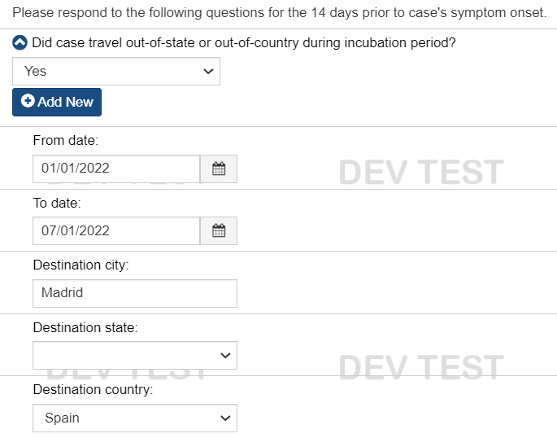
MA (MAVEN) - Slide 1
MA has a standard basic set of travel questions for travel during the incubation period. The incubation period used is noted in messages/text, but the underlying questions are the same in the database across conditions.

Slide 36
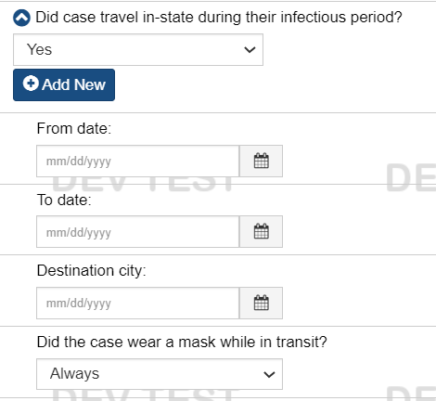
MA (MAVEN) - Slide 2
We have a separate set of very similar questions capturing travel while infectious.

Slide 37
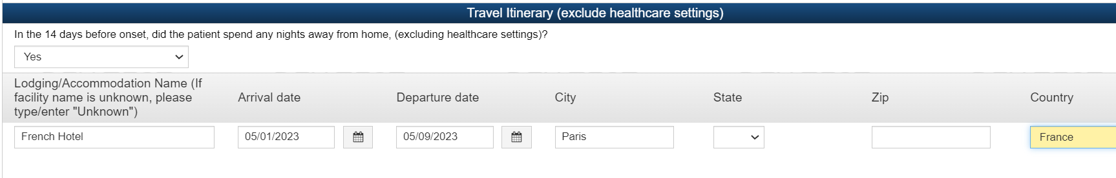
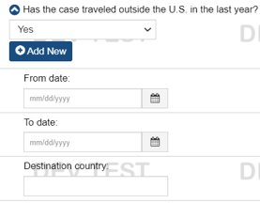
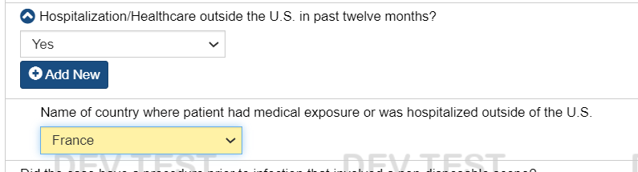
MA (MAVEN) - Slide 3
Beyond those, condition-specific information is captured in additional questions based on the type of exposure and condition specific risk factors (examples below are Legionellosis and MDRO)

Slide 38
Travel History polling questions

Slide 39
Polling process
Poll questions will be shown first on a slide before poll opens
  Opportunity for clarifications & questions
Questions will be mostly Yes/No
  Feel free to abstain if you don't have a preference or don't feel strongly
Opportunity for limited discussion on questions with a big split

Slide 40
Travel Polling Question 1
Is a repeating set of questions the best way to appropriately collect, store, and share travel data for surveillance purposes (versus summary-level questions that don't address multiple trips or destinations)?
  Yes
  No

Slide 41
Travel Polling Question 2
Should destination-specific travel dates be considered part of standard travel surveillance data for all conditions for which travel history is collected, so that they are available for public health surveillance notification and data exchange?
  Yes
  No

Slide 42
Travel Polling Question 3
Should information about travel during the incubation period be collected, stored, and shared separately from travel during the infectious period?
  Yes, use separate data elements/repeating block
  No, should rely on travel dates to differentiate
  No, not important to keep them separate

Slide 43
Travel Polling Question 4
Should information about domestic travel be collected, stored, and shared separately from international travel?
  Yes
  No

Slide 44
What’s next?
July workgroup meeting: TRAVEL HISTORY continued
We have started drafting the hospitalization elements write-up – for further review, questions & feedback.
Look for items to review before the next meeting
Join our WG: last Friday of each month at 1pm EDT
  The June meeting will be canceled
  Next meeting July 30, 2023

