Slide 1
Data Standardization Work Group (DSWG)
July 28, 2023

Slide 2
CSTE Data Standardization Workgroup Meeting​
Please mute phone/ headset/ computer audio!​
Agenda
Welcome & announcements
Hospitalization Update
Travel Discussion Continued
Recap of DSWG Roundtable/Strategies for Data Collection and Engagement
Next Topics
Wrap-Up & Adjourn

Slide 3
Meeting ground rules
Discussion Guidelines
  "Raise" your hand
  Use the chat to provide feedback and ask questions
  When called, state your name and affiliation
  Stay on point, be brief, and within the context of the discussion in progress
  80/20 consensus
  Co-Chairs/moderators' prerogative to move the discussion forward as needed
    Post-meeting survey provided for additional input
  Be courteous and be open to new ideas
Active participation encouraged for all!
Chats, voting, comments, etc.
Includes STLT jurisdictions + CDC Programs + CSTE, etc.

Slide 4
Core Data: In Scope for DSWG
Identify core data elements for surveillance for transmission to CDC
  For situational awareness or routine, cross-condition case surveillance
  For case-based surveillance (not syndromic, not aggregate reporting)
  Within selected data classes (e.g., hospitalization, travel history) that are used for multiple conditions
Identify common definitions, value sets/code sets, structure, and interpretation notes for those core data elements
Recommend best practices for how selected data elements are collected, structured or populated within PHA surveillance systems, if/when that will affect the interpretation of the data transmitted to CDC

Slide 5
Status update: Hospitalization
Finalizing a draft of Hospitalization data class recommendations
  Includes background for current overall effort, to use as a framework for subsequent data classes
Please look for email notification during August that the draft is ready for DSWG review
  We will solicit feedback from WG members to shape revisions and any further WG discussion

Slide 6
Travel History (continued...)

Slide 7
Travel history: the challenge
How do we standardize the structure and framework for travel elements (while retaining the important differences in need)?
Lots of previous standardization/harmonization work
Opportunities to harmonize the elements across conditions
Possible opportunities to align with vocabulary and data elements from eCR v1, USCDI Level 2 or others

Slide 8
Travel: Scope
In scope:
What should be part of core surveillance for jurisdictions for use in case notifications? Can we identify a common structure for those core elements across conditions?
Necessary level of specificity for national surveillance purposes (for example - geography, itinerary/dates of travel, mode of transport)
Out of Scope:
Identification of the appropriate time frames for each condition
  For example, if the following question is asked, we will not be defining x: In the (x) weeks before symptom onset or diagnosis (use earlier date), did the subject travel out of their county, state, or country of residence?
Inclusion of sufficient travel detail to serve needs of DGMQ or airline exposure notification

Slide 9
Travel – Outstanding ?s
Differentiating between travel that occurred when an individual was away from the jurisdiction versus time spent at a particular location)
Inclusion of reason for travel (e.g., Daily commute, work trip, vacation, multiple residences) in routine case notifications?
Inclusion of detailed travel information (e.g., flights, hotels, and specific places/events visited) in routine case notifications?
Addressing additional condition-specific needs by starting with a standard set of travel questions and then adding separate condition-specific data elements to augment the standard data?

Slide 10
Travel History – For Discussion

Slide 11
Travel History –
Summary (with repeating block)
  In the (x) weeks before symptom onset or diagnosis (use earlier date), did the subject travel out of their county, state, or country of residence? (SCT 420008001)
  Did the subject travel internationally in the (x) days prior to illness onset? (TRAVEL38)
  Did the subject travel domestically in the (x) days prior to illness onset? (INV664)
  Specify different travel exposure window If the travel exposure window used by the jurisdiction is different from that stated in the travel exposure questions, specify the time interval in days here. Otherwise, leave blank. (INV663)

Slide 12
Travel History –
Repeating Block
  International destination or countries the patient traveled to (82764-2) (Countries value set)
  Domestic destination, state(s) traveled to (82754-3) (States value set)
  Reason for travel related to current illness (66415-1)
  Date arrival at destination (TRAVEL06)
  Date of departure from
  destination (TRAVEL07)

Slide 13
Travel History –
Summary Only (No repeating block)
  In the (x) weeks before symptom onset or diagnosis (use earlier date), did the subject travel out of their county, state, or country of residence? (SCT 420008001)
  Did the subject travel internationally in the (x) days prior to illness onset? (TRAVEL38)
    If yes, please list international destinations (India~France~China) (Countries value set)
    First arrival date in any international destination
    Final departure date from any international destination
  Did the subject travel domestically in the (x) days prior to illness onset? (INV664)
    If yes, please list domestic travel destinations (Rhode Island~Florida) (States value set)
  Specify alternate travel exposure window If the travel exposure window used by the jurisdiction is different from that stated in the travel exposure questions, specify the time interval in days here. Otherwise, leave blank. (INV663)

Slide 14
Recap of DSWG Roundtable – 2023 CSTE Annual Conference
Moving Towards Standardized Data Elements for Case Surveillance
  Moderated by: Danielle Tack (CDC)
Takeaways
  Lots of interest in this topic!
  New voices represented at the roundtable session
  Discussed how to increase engagement
    with appropriate pre-call materials
    within jurisdiction
    across program areas
    outside monthly calls (e.g., online platform)
Notes:
Involve State Epis. LHJS Provide more background info. Specific asks. Timeline (public). Provide multiple ways for feedback – surveys and other methods. Have questions one person can take back to their epis and get input then send back to DSWG (so epis don't have to join every mtg)
Better inclusion of informatics folks and epis (liaisons? From agency participate)
Online platforms (Vote asynchronously), recordings available, transcripts, key takeaways or contention points available, polls (in meeting or online), pre-read materials, answer specific questions,

Slide 15
Feedback on Engagement Strategies
Basecamp Site
  Meeting Minutes & Slides
  Draft Documents (Briefs, Best Practices, One Pager)
  Resource Repository
CSTE Connect – coming soon
  Call calendar with data elements shown in advance
Monthly meetings
  Show examples of data elements in various systems
  Background research
  Key questions
    Poll questions, discussion, send emailed feedback
  Draft documents circulated for input
As we continue activities in 2023-2024... other ideas for engagement?

Slide 16
Strategies for Data Collection
To improve transparency and reduce duplication of efforts we would like to spearhead an effort to collect documentation from jurisdictions that have undergone data harmonization efforts and share some of the following:
Decision documents
Outcomes
Best practices
Data dictionaries for surveillance systems
This is not specific to any data element, and information will be placed in a repository accessible to DSWG members on the Basecamp site. If your jurisdiction can share this information, please send this to Becky Lampkins (blampkins@cste.org) and Laura Lane (llane@jmichael-consulting.com) with a descriptive subject line with permission to post on the Basecamp site.

Slide 17
Strategies for Data Collection
For upcoming data classes/elements...
  Looking for best practices and what works well
  Want to understand impact of changes
Please consider sharing:
  Screenshots showing collection in your systems
  Data dictionary (if multiple data elements are involved)
  Value sets used
  Challenges and successes in standardizing and harmonizing
Needed for background research on data concept before calls begin
If your jurisdiction can share this information, please send this to Becky Lampkins (blampkins@cste.org) and Myrna del Mar González-Montalvo (tvy2@cdc.gov) with a descriptive subject line with permission to post on the Basecamp site.

Slide 18
Next Topics
Pregnancy Status – August 25, 2023 DSWG Call
September – October 2023 (new calendar invites coming soon)
  Sexual Orientation and Gender Identity
    Submit any jurisdictional documentation by 8/11
  Industry and Occupation
    Submit any jurisdictional documentation by 8/25

Slide 19
Core Data for Case Surveillance

Slide 20
What are "core" data elements?
Data elements/data classes that are "core" to case surveillance are those that public health wants to collect and define similarly across many conditions and across jurisdictions.
Standardization of the structure, value set or definition of these elements should provide value
  Facilitate receiving elements as part of interjurisdictional exchange
  Improve efficiency of ingesting elements, regardless of sender
  Utility across multiple conditions -- elements available for many conditions
  Facilitate national case notification

Slide 21
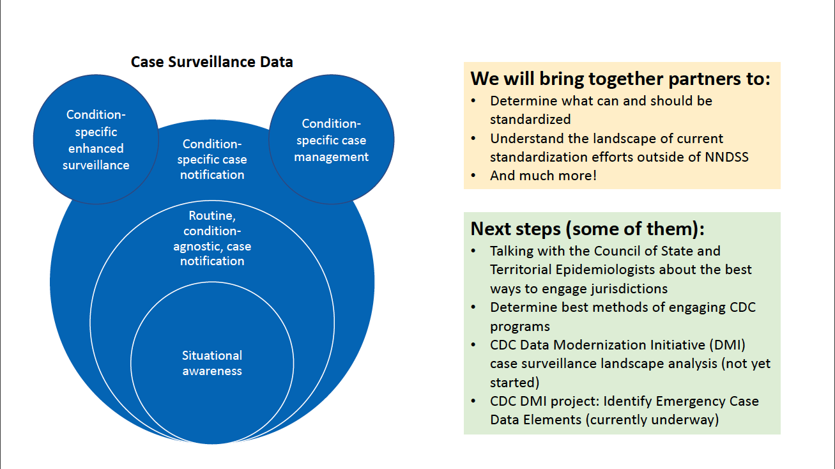
Core surveillance data
  Core surveillance data is inside the red circle:
Data classes or elements used for situational awareness or routine, cross-condition case surveillance
DSWG work will focus on identifying and standardizing the core surveillance data elements appropriate for transmission to CDC

Slide 22
Core Data: In Scope for DSWG
Identify core data elements for surveillance for transmission to CDC
  For situational awareness or routine, cross-condition case surveillance
  For case-based surveillance (not syndromic, not aggregate reporting)
  Within selected data classes (e.g., hospitalization, travel history) that are used for multiple conditions
Identify common definitions, value sets/code sets, structure, and interpretation notes for those core data elements
Recommend best practices for how selected data elements are collected, structured or populated within PHA surveillance systems, if/when that will affect the interpretation of the data transmitted to CDC

Slide 23
Core Data: Out of Scope for DSWG
Standardization of data elements that the DSWG does not identify as part of routine, case-based data transmission to CDC.
These may include:
  Data elements that are critical to case-based surveillance across conditions and/or interjurisdictional data exchange, but that are not appropriate for transmission to CDC (e.g., personally identifying info)
  Data elements relevant for only a small number of conditions
  Data elements mainly for research purposes or special studies

Slide 24
Core Data: Out of Scope for DSWG
Condition-specific details and value sets (even for data elements identified as core data for transmission to CDC)
  For example:
    Condition-specific timeframes for core risk/exposure elements
    Condition-specific value set for a common risk/exposure element, if relevant values vary by condition
Data exchange mechanism or format for sending data to CDC
Specific implementation plans/guidelines
Related (but separate) efforts are out of scope for DSWG:
  When to send case notifications
  List of data elements to be sent to CDC in emergencies

Slide 25
Resources for standardization
Background research presented to the DSWG for each data class will include existing formats, standards and potential data sources
  USCDI
  eCR (CDA & FHIR)
  ELR
  MMGs
Experience and expertise of DSWG participants, including surveillance and informatics staff from STLTs and CDC, and representatives from STLT and CDC programs!

Slide 26
FAQs
Core for CDC Transmission ≠ Required
Even if a data element or class is identified as appropriate for transmission to CDC, this does not mean we need to fill in or send an answer for every core element for every case!
  It is okay to leave the data field as blank or Unknown if the information is not available, not a priority, or not useful for particular conditions.

Slide 27
Considerations
What information is needed at the national level?
How can we best take advantage of electronic records and automation?
How can we best take advantage of and feed into other standardization efforts (e.g., HL7, USCDI, USCDI+)?
How can we reduce the manual surveillance burden on public health and health care entities?
Can we position ourselves for a more efficient process for adding emergent conditions to our systems? Exchanging information? Case notification onboarding?

