Slide 1
Data Standardization Work Group (DSWG)
June 28, 2019

Slide 2
Agenda
Update on the CSTE Brief
Pregnancy question harmonization (CDC/MITRE group)
DSWG topic prioritization survey results
MMWR Week/Year Survey preview
Action items

Slide 3
CSTE Brief Status
Notes:
1:30-1:55pm: 20-25 minutes

Slide 4
CSTE Brief Review Process
Passed level 1 review!
Assigned the proposed number of IB-SI-19-01

Slide 5
CSTE Brief Review Process
Process of review & approvals by:
  DSWG
  SPIS (May 3 call, comment period complete)
  Subcommittee chair, CSTE PM (Level 1)
  Co-chairs to make minor edits based on comments
  Steering Committee chair, CSTE President, and Executive Director in consultation with full EB
    Kate Goodin, Sharon Watkins (or her designee), Jeff Engel (and/or designee)
    Senior Directors of Epi Programs and Science/Policy will be invited to review
  Membership comment period on website for 3 weeks
  Final review if changes made by Steering Committee Chair in consultation with Executive Director and President

Slide 6
Harmonization of Pregnancy Status Questions
CDC/MITRE team
Notes:
1:30-1:55pm: 20-25 minutes

Slide 7
Topic Prioritization Survey Results
Notes:
1:30-1:55pm: 20-25 minutes

Slide 8
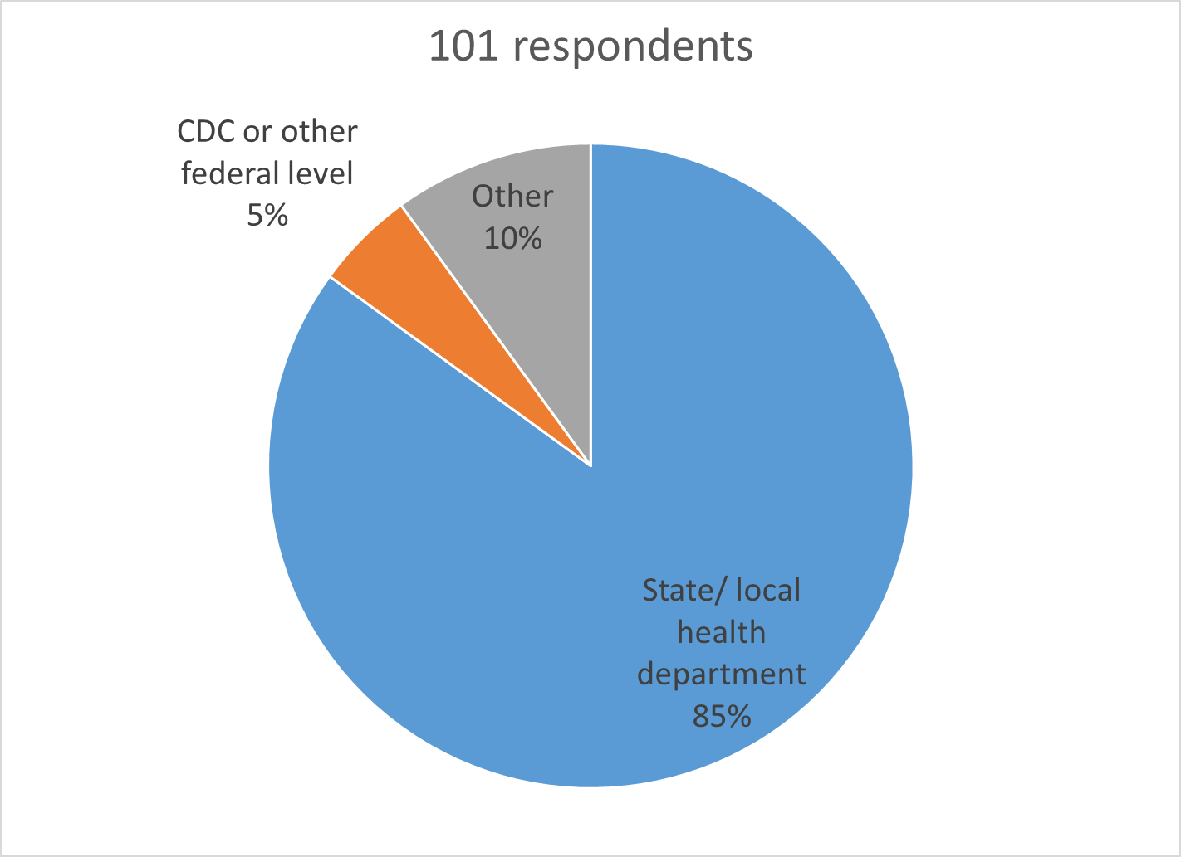
Topic Prioritization Survey

Slide 9
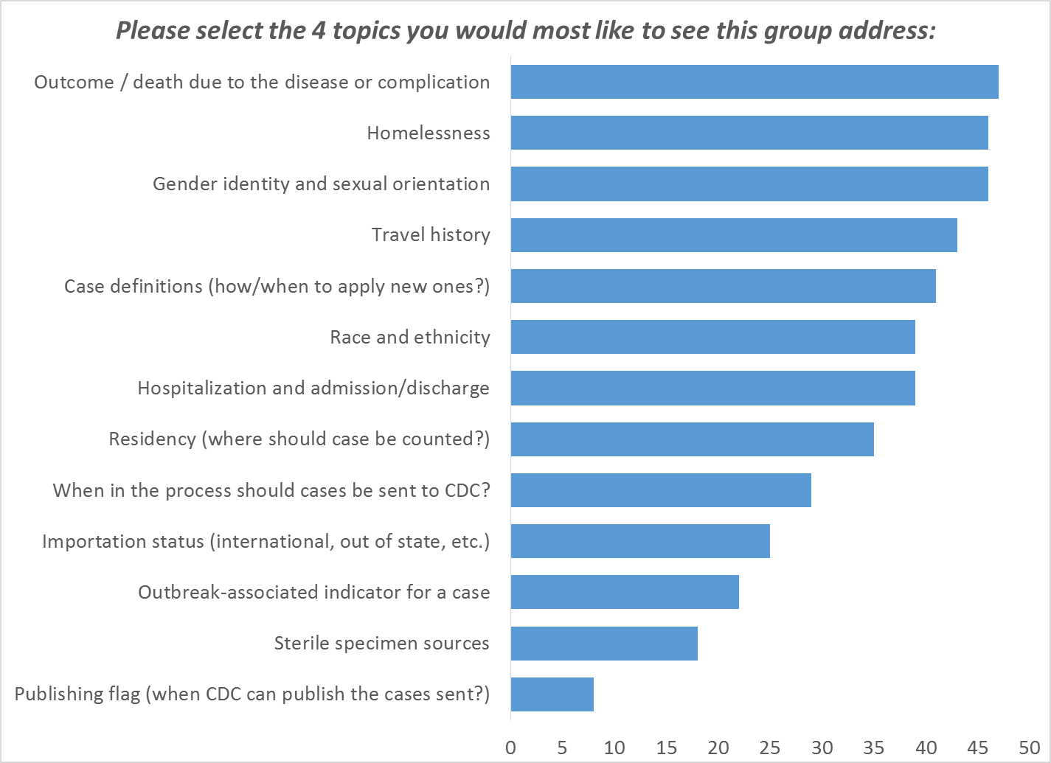
Topic Prioritization Survey

Slide 10
Other suggested topics
Treatment start and end dates
Occupation
IDU

Slide 11
MMWR Week/Year Survey Preview
Notes:
1:30-1:55pm: 20-25 minutes

Slide 12
Which statement best describes how you feel MMWR week (date used for case counting) should be determined from your surveillance data, if this were the single date that CDC uses for counting cases?
    Beginning of the illness
    Diagnosis/healthcare contact
    Public health awareness date
    CDC notification date
When answering the questions, please try to consider them independently from
  The trigger of when cases are submitted to CDC, and
  b) Whether CDC updates the weekly numbers retrospectively.

Slide 13
Options defined
Beginning of the illness - using a hierarchy of several data elements such as symptom onset, specimen collection, etc., that may have much variability between diseases and over the course of an investigation.
Diagnosis/healthcare contact - using a hierarchy of several data elements such as clinical diagnosis date, specimen collection, laboratory result date, etc., that has less variability in meaning across diseases or cases
Public health awareness date - using a data element that should be fully populated and universally available, with less variability in meaning across the diseases and jurisdictions, though with less relevance to the disease process.
CDC notification date - using a single fully populated data element representing a date concept that is universally available and represents an endpoint, though with potential variability across jurisdictions, and with less relevance to the disease process or state/local actions.

Slide 14
Would you like to see CDC display the NNDSS data by multiple dates?
If CDC were able to represent cases by multiple dates, which best describes how you think the PRIMARY date should be determined?
Which best describes how you think a SECONDARY date should be determined?

Slide 15
Implementation questions
How important is it that your jurisdiction count cases by the same criteria that CDC uses to count cases (either as the primary or the only counting date)?
  In other words, do the numbers you publish need to match what CDC publishes as the case counts for your jurisdiction?
If it’s important for CDC and jurisdiction case counts to match, how difficult would it be for you to change how YOU count cases?

Slide 16
Action Items (DSWG)
Next meeting will be at 1pm on Friday, July 26
  Focus on MMWR Week/CDC Reporting date(s)
Watch for short survey to prepare for MWMR Week/CDC Reporting date(s) discussion

Slide 17
How to Engage
  Email:
    Molly Crockett: Molly.Crockett@MassMail.State.MA.US
    Laura Erhart: laura.erhart@azdhs.gov
Join us!
Helpful to have perspectives from
variety of jurisdictions and program areas and
from informatics/surveillance side and disease-specific areas.

