Slide 1
Data Harmonization as a Service (DHaaS) Overview
Introduction for CSTE
June 28, 2019
Surveillance Data Platform (SDP)
DHaaS Task Team

Slide 2
Agenda
Welcome and Introductions
Surveillance Data Platform
Data Harmonization as a Service (DHaaS)
  Overview
  Task Plan
  Where DHaaS is Today
  SME Participation
Pregnancy Status Harmonization Scope

Slide 3
Surveillance Data Platform

Slide 4
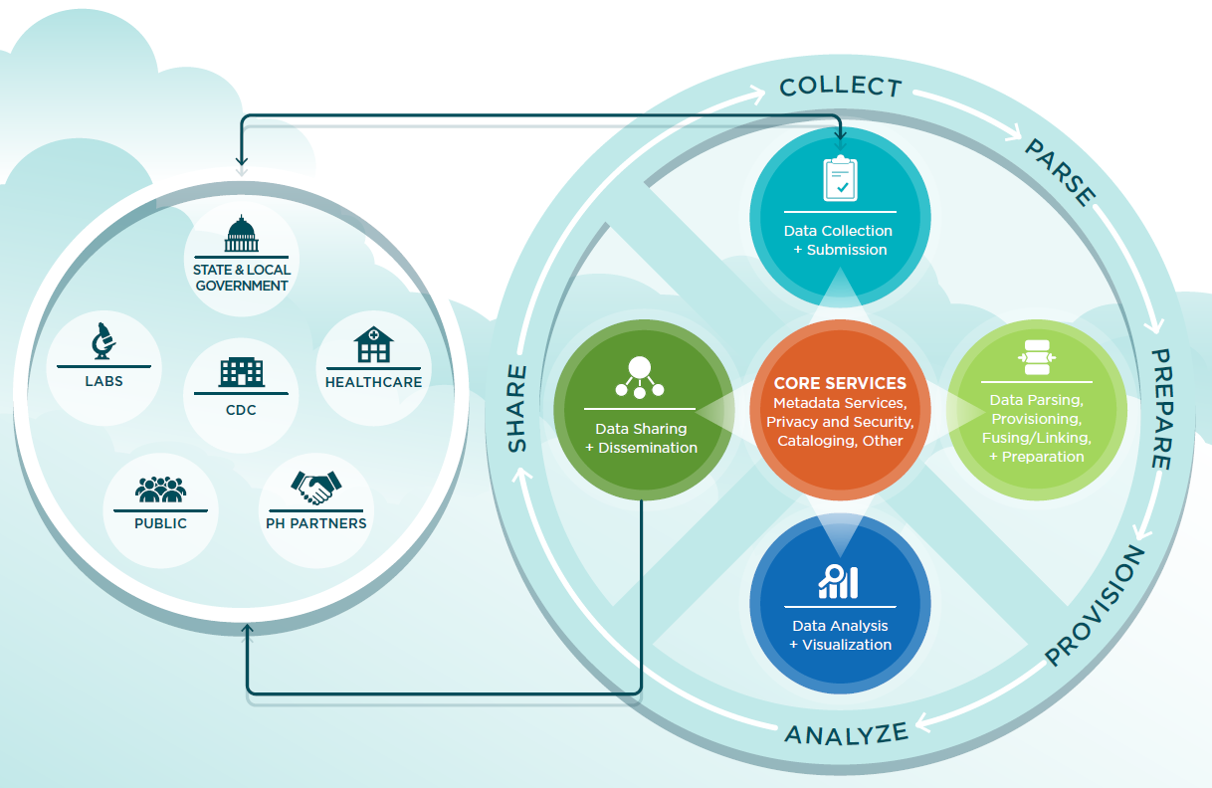
The Surveillance Data Platform (SDP) Program Represents an Opportunity to Achieve Essential Outcomes
The Surveillance Data Platform program will empower public health decision making by providing unified, systems-level informatics solutions and to improve reporting efficiencies throughout the U.S. public health system.
Outcomes
Enhance public health’s ability to manage, share, and analyze data
Reduce unnecessary burden on internal and external data partners
Improve efficiency in public health data usage and tracking across CDC
Notes:
In 2016, CDC initiated surveillance modernization by designing and developing a cloud-based platform of shared services called the Surveillance Data Platform.
The Surveillance Data Platform is an opportunity to achieve essential outcomes by delivering shared services that will have direct, tangible value to public health programs and partners.
SDP is a secure, cloud-based platform that centralizes and shares common information technology services needed for disease surveillance.
As one of several CDC surveillance strategy initiatives, SDP seeks to improve public health outcomes by
Enhancing public health’s ability to manage, share, and analyze data as well as share and reuse technological capabilities,
Reducing unnecessary burden on internal and external data partners, and
Improving efficiency in public health data usage and tracking across CDC.

Slide 5

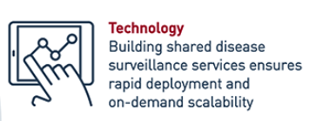
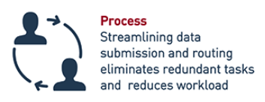
SDP Overview
SDP benefits the people, processes, and technology that inform and support our nation’s public health system
Notes:
People: SDP WG, Subgroups, and Tech Panels
Process: Development of Harmonization SOP (DHaaS and SMaHSC work discussed today), SDP-V Onboarding
The SDP program currently offers the following services–
Vocabulary Service (SDP-V),
Content-based Routing (CBR),
Enterprise Container Platform as a Service (ECPaaS) ,
Application Programming Interface (API) gateway, and
Collaboration Tools Services.
Additional shared services will be released as they become available.

Slide 6
DHaaS

Slide 7
Data Harmonization as a Service (DHaaS)
Harmonization: Addressing differences in data that are an impediment to comparing, reusing, and sharing otherwise similar information
  Identifies common concepts that are expressed using different terms, definitions and representations
  Improves data utility and reduces effort to collect and disseminate that data
  Enables CDC programs to drive public health action efficiently and consistently
DHaaS: A shared service designed to be executed on demand using a standard approach for a short duration to consolidate and align disparate data specifications to improve data harmony
Notes:
DHaaS uses people in provisional harmonization workgroups that apply processes and technologies to address strategically chosen topic areas for harmonization (e.g., opioid use). Data harmonization workgroups include epidemiologists and other subject matter experts (SMEs).

Slide 8
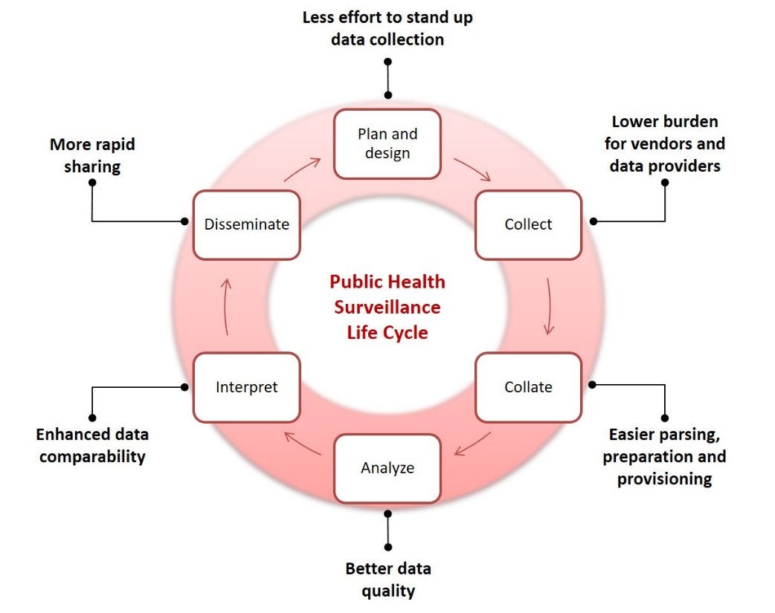
Harmonize to Improve the Public Health Surveillance Lifecycle
Value Proposition:
Reduce burdensome data wrangling and missed data analysis opportunities caused by unnecessarily incompatible data.
Approved questions or data elements to pick and choose from when designing surveys and data exchange(message) specifications.
Predesigned sections of surveys or message specifications
Data Dictionary or Standard Data Elements and Value Sets mapped to the instrument questions and answer sets. Needed for computer data storage and data exchange.
Data sets from multiple sources adhering to common data elements and value sets for the same kind of data.
Surveillance systems and databases able to process multi-sourced data sets that adhere to common data elements and value sets.
Multi-sourced data that can be easily combined and transformed to meet planned and subsequent analysis needs.
Diagram based on “CDC’s Vision for Public Health Surveillance in the 21st Century”. MMWR 2012; 61 (Suppl; July 27, 2012).
Notes:
Effective standards management and harmonization will contribute to the overall improvement of surveillance activities:
Increasing data reuse across CDC
Lowering burden for external surveillance partners, by:
Providing more well-defined and consistent reporting requirements
Decreasing implementation effort and complexity for vendors of electronic disease surveillance systems and electronic health records
Reducing redundant data reporting efforts of data providers, including individual hospitals, healthcare provider offices, laboratories, state and local health agencies, and other surveillance partners
Faster and easier development and deployment of new data collection efforts
Expedited parsing, preparation, and provisioning activities prior to data analysis
And Expanded analytical capability due to the increase in quality, comprehension, and consistency of collected data.
These goals continue to be the drivers for this work.

Slide 9
Levels of Harmony
Concept Agreement
Instrument Specification Agreement
Specification Deployment
Data Description Agreement
Data Harmony
Provide common foundation to discuss mission information objectives
Provide qualifier and quantifiers for mission relevant phenomena
Provide mission useful instrument and system specifications for data
Produce predictable data from data collection, data repository, and data exchange instruments
Draft as of May 13, 2019
Notes:
Concept Agreement – communities agree on the terminology and definitions for important concepts in a mission area.
Data Description Agreement – communities agree on important observation, calculation, and assessment data needed to measure aspects of population health. These are expressed using terminology agreed to in the concept agreement. They become the data elements, form fields, questions and value domains used in systems and collection instruments.
Instrument Specification Agreement – communities choose which data elements, form fields, questions and value domains from the data description agreement to use for a specific data collection, exchange, or repository effort
Specification Deployment - Communities deploy data collection, repository, and exchange instruments (and systems) that map to specification agreements

Slide 10
DHaaS Pregnancy for Emergency Response
Goal: Improve the consistency, integration and exchange of pregnancy related data during a public health emergency response
Task:
  Harmonize public health surveillance data elements for pregnancy
  Identify and propose a set of pregnancy data elements for possible inclusion in the Emergency Operations Center (EOC) minimal data set
  Publish harmonized pregnancy data elements in the Surveillance Data Platform Vocabulary Service (SDP-V)
Scope: Assessing pregnancy in terms of “being pregnant” during an emergency response

Slide 11
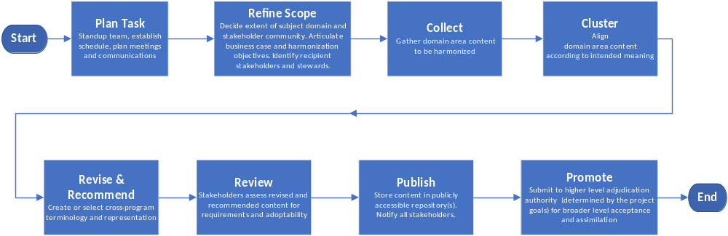

Specification Harmonization Workflow
Version: April 11, 2019

Slide 12
DHaaS Process Steps
1.Identify content that needs to be harmonized
SMEs help identify and down select input sources and scope
5. Link concepts to standard vocabulary
2. Refine scope based on themes
Continuous collaboration with SMEs
SMEs review the mapping template and provide feedback
4. Propose a unified conceptual model
3. Map themes to data elements and response sets

Slide 13
Where DHaaS is Today

Slide 14
DHaaS Schedule

Slide 15

DHaaS Progress
Landscape analysis
Extract data elements and refine scope
Map themes to data elements
Cluster and analyze
Identify set of data elements for EOC
Write final report
Identify subject matter experts (SMEs)
Publish in SDP-V
Starting
July 29 – Aug 30
Ending
Aug 12-26
Jul 29 – Aug 2
Discuss harmonization results with SMEs
Select data elements to propose for EOC
Jul 15 – Jul 26
Cluster data elements based on themes
Determine harmonization opportunities
Jun 17 – Jul 12
Map data elements to themes
Share initial mapping with SMEs
Prioritize themes and data elements
Jun 7 – Jun 28
Extract pregnancy related data elements
Select themes and define inclusion and exclusion criteria
Validate with SMEs
Jun 11 – Jun 21
Recruit SMEs
Schedule first meeting
May 20 – Jun 7
Identify surveillance systems
Identify input sources and references

Slide 16
DHaaS Roles and Relationships
CDC Centers and Subject Matter Experts
SDP Program Manager
CSELS
  Teresa Kinley
CPR
  Nikolay Lipskiy
  Shauna Mettee Zarecki
  Sara Vagi
CSELS
  Laura Conn
  Lorretta Foster
  Manjula Gama Ralalage
  Eric Morrisey
  Lesliann Helmus
  Nina Mitchell
  Sanjeev Tandon
NCBDDD
  Cheryl Broussard
  Margaret (Peggy) Honein
  Rebecca Leeb
NCCDPHP
  Shauna Cox
  Sascha Ellington
  Romeo Regi Galang
  Aniket Kulkarni
NCEH
  Tesfaye Bayleyegn
NCEZID
  Virginia Bowen
  Alaya Koneru
  Margaret Lampe
  Stephen Soroka
  Abigail Viall
NCIRD
  Lynn Gibbs-Scharf
  LaTreace Harris
DHaaS Core Team
Subject Matter Experts
CDC Centers
DHaaS Core Team
DPWG/CSELS
  Nedra Garrett
SDP/CSELS
  William Duck
SDP/MITRE
  Michelle Casagni
  Beth Linas
  Sridevi Polavaram
Harmonization activities
Establish
Review and feedback
CSTE member engagement in-progress
Identify topic and sources
Notes:
These are the roles and their relationships for executing the harmonization of pregnancy status. Our solicitation for subject matter experts has given us many points of contact. We desire CSTE member engagement in this harmonization activity

Slide 17
SME Participation

Slide 18
Subject Matter Expert Support for DHaaS
Commitment: Max 2 hours bi-weekly
Identify relevant sources for harmonization
Assist with defining pregnancy status scope
Provide insight to CDC use cases related to emergency response
Provide feedback and guidance on harmonization outputs and results
SME introduction to harmonization activity, virtual meeting (1 hour)
Two working sessions to discuss harmonization outputs and gain agreement (3-4 hours)
Additional virtual meetings as needed (1/2- 1 hour)
Email for on-going communication
Notes:
Commitment from SMEs to actively engage with DHaaS team will be no more than 2 hours bi-weekly through August 30, 2019. The harmonization effort will be an iterative process and DHaaS would like to ask SMEs to review and discuss results as they are being generated.

Slide 19
Why Participate in DHaaS
Develop and improve public health emergency response for pregnancy related surveillance using SDP-V
Guide pregnancy status data specifications for the Agency that will have direct and immediate impact
Ensure consistent data is collected across all emergency response efforts and there is a shared understanding of that data
Assist in establishing a repeatable process that improves efficiency for future DHaaS activities
Improve public health outcomes for a vulnerable population

Slide 20
Key Harmonization Meetings
Week of July 8, working session (virtual or in-person?), 3-4 hours
  Present initial mapping of data elements and themes; gain agreement and prioritize
  Discuss key factors to consider for identifying data elements for EOC
Week of July 29, working session (in-person with virtual option), 3-4 hours
  Review clustering and analysis output
  Gain agreement on proposed set of data elements for EOC
Week of Aug 19, virtual meeting, 1 hour
  Present harmonization findings and recommendations
  Solicit feedback for final report

Slide 21
Pregnancy Status Harmonization Scope
Pregnancy Status: Are you pregnant, how far along are you and how many babies expected (i.e., twins); (e.g., trimester, estimated delivery date, number of fetuses)
Obstetric history: For example, date last menstrual period, gravidity, parity, recent pregnancy (tailor to women who just delivered opposed to currently pregnant (e.g., within last 30 days, last 60 days, etc.))
Follow-up Themes
  Pregnancy Outcome (e.g., live, stillborn)
  Gestation (e.g., gestational age at birth, birthweight)
Notes:
Based on our discussion with CDC SMEs the following pregnancy themes (concepts) have been identified as in-scope. These are the critical data points to collect up-front during an activation and for follow-up to assess the impact of the emergency. We welcome your feedback on this scope.

