Slide 1
Data Standardization Work Group
Surveillance Practice and
Implementation Subcommittee (SPIS)
June 22 2018

Slide 2
Agenda
Welcome and Roll Call
CSTE Conference Recap
Workgroup Survey Highlights
Date of Illness Onset
  Signs and symptoms
  Implementation actions
Diagnosis Date
New meeting schedule
Wrap up

Slide 3
CSTE Conference Recap
Notes:
We’ve including the slides from the meeting at the end of the slide deck to be sent out after the call. For the call today, we wanted to talk through the discussion questions and share the feedback we received.

Slide 4
Conference Recap
Gender identity
Residency
Event Date
MMG Development/ Feedback
When to report to CDC
New versus existing events
What is the scope of this workgroup?
Importation status
Travel
Pregnancy Status
How/when to apply new case definitions
Homelessness
Race

Slide 5
Conference Recap
Scope of the workgroup
  Travel harmonization: incubation and infectious periods
  When to report to CDC and how to count
  Residency and who counts
  Data elements
    Homelessness
    Gender identity
    Importation status
    Pregnancy (preexisting workgroup)
  YNU questions in the MMG; only collect if Yes
Notes:
The following resources were recommended during the discussion:
Review standards in other industries
RCKMS work reviewed position statements and can provide an overview

Slide 6
Consensus Framework
Guided discussion
Workgroup feedback
Compile and summarize
Update discussion questions
Introduce data element
Introduce data element
Email
Smartsheet
Basecamp
Draft CSTE Brief
SPIS

Slide 7

Consensus Framework
DSWG
SPIS
S/I Steering
Committee
Executive
Board
BRIEF
CSTE Community
Implementation

Slide 8
Conference Recap
Consensus Framework
  What defines consensus?
  Who needs to be at the table?
  What level of representation is sufficient?
  What other forums should we be considering?
Notes:
Is this path to consensus complete and effective?
What level of representation is sufficient?
Half of the jurisdictions?
All disease programs in the jurisdictions?
What about the CDC disease programs?
And different surveillance systems?
Epi, surveillance, informatics
Where else can we share this for feedback?

Slide 9
Conference Recap
Consensus Framework
  Infectious diseases vs. non-infectious diseases; focus is on ID and MMG now
  Need to invite more of the epidemiologists and diseases subject matter experts to the table
    Ideas? Goal= every jurisdiction and every disease program
  Need to incorporate this guidance into the MMG for surveillance changes
  Consensus= everyone can live with it

Slide 10
Survey Results

Slide 11
THANK YOU!
June Bancroft (OR) | Alicia Lepp (ND)
Rachel Corrado (NYC) | Marijoyce Naguit (CA)
Sherri Davidson (AL) | Grace Oguntebi (NC)
Laura Erhart (AZ) | Jyotsna Ramachandran (NYC)
Annie Fine (NYC) | Corinne Thompson (NYC)
Judie Hyun (MD) | Kathy Turner (ID)
Caitlin Law (TN) | Lei Zhang (SNHD)

Slide 12
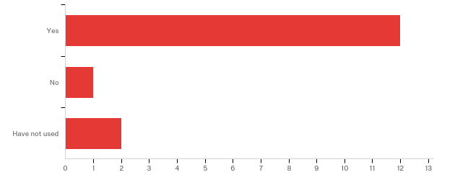
Collaboration Tools
Basecamp: document repository and forum
Notes:
Strengths
Collaborative and centralized
Repository and Document sharing
Everything is in one place
Can replace/reduce emails
Considerations
Links in email rather than attachments
Need to link to Basecamp from Smartsheet
Already receive the information via email
Basecamp sends a lot of email notifications
Seems cluttered and unclear

Slide 13
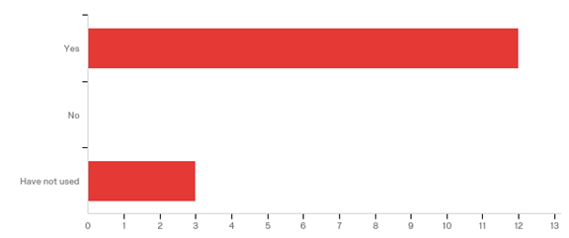
Smartsheet: Offline and structured feedback
Notes:
Strengths
Helpful to collect feedback in one place
Considerations
One method for providing and viewing feedback
One place for documents
Considerations
Prefer the spreadsheet window to the form, but see benefits of both
How can we provide feedback all can view?

Slide 14
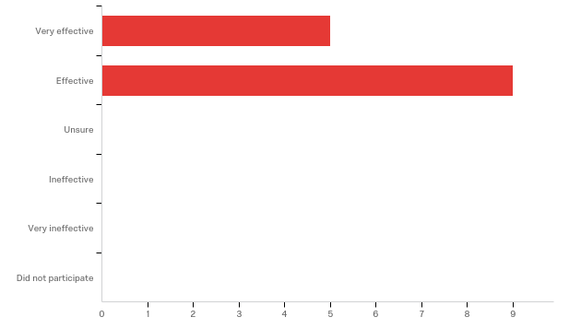
Consensus Process
Notes:
What worked well?
Active conversations on the calls
Learning about differences
Feedback tools allow comments to be accessible to everyone
Collected information on processes and barriers
Multiple opportunities for feedback
Discussion summarizes salient points
Working toward a common denominator
Slides summarize the offline content and previous conversation
Smartsheet for feedback- in case you forgot something/didn’t cover
Allowing the discussion to evolve; no agenda
Collect information ahead of time from each jurisdiction in the surveillance systems, find similarities and differences, move toward consensus
What could be improved?
Streamline online feedback and discussions on the calls
Kick-off with questions on call
Online information gathering
Summarize on the next call
Have an alternate attend the call if you are absent
One data element at a time
Need more jurisdictions
Need more disease areas
Encourage new participants
Encourage new voices
Need to set timeline for summaries are returned to participants
Sometimes discussion out of scope- set parameters

Slide 15
Collaboration Tools
Discussion
  Basecamp and Smartsheet offer transparency
    Additional ideas?
  Links in emails to these sites or documents vs. attachments?

Slide 16
MMG Participation
Online collaboration tool
Core team committed to development with 3-5 for each MMG
Model how to reach consensus
Need to improve harmonization across the MMGs
Facilitate the inter-jurisdiction discussion with CDC
  Reason for certain questions, clarify meaning, address feasibility of collection
Data definitions for the data elements
  Document across programs and jurisdictions how the data elements are used
  Already ongoing discussions for the MMG pilot sites
Notes:
Shared later in the survey, but in reference to “Need to improve harmonization across the MMGs”:
Is there anyone involved in the review of all of the MMGs to first look for similar questions already asked in a different MMG?
During the NMI sessions, a new tool was discussed. The tool will provide CDC programs developing new MMGs with a prepopulated template with previous MMG questions.

Slide 17
Major Goals
Consensus definitions for the apples-to-apples comparison
  Standardize to maintain data integrity and encompass biology of disease
  Common language to represent all findings in the investigation
  Identify current interpretations and practices
  Opinions on what they data elements should mean
  Develop and disseminate recommendations
  Collaborate with CDC
Collaborative environment to move beyond dates
Member engagement and enthusiasm/momentum

Slide 18
Additional Topics
Address all of the dates in the surveillance system
  Date reported to public health, specimen collection date, lab result date
  Event date counting and supporting dates
Additional fields
  Race and ethnicity
  Sexual orientation and gender identification
  Exposure period

Slide 19
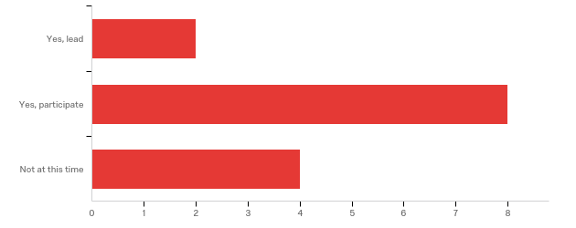
Subgroup Participation
Notes:
Now that we have a process established for the group, we want to be able to move more quickly through the data elements and needs. We are planning to leverage interest in specific data elements and topics for the subgroups during the off-weeks. We’ll also be looking to use that time for increased outreach offline to the missed jurisdictions and program areas, and CDC programs.

Slide 20
Date of Illness Onset

Slide 21
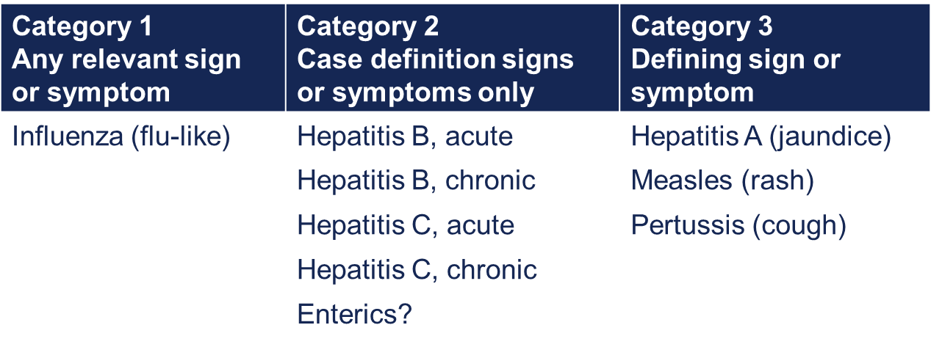
Conference Recap
What level of granularity is valuable?
    Date of Illness Onset: which signs/symptoms?
Notes:
Review from 04/13/2018:
In order to identify the Date of Illness Onset, you need to select the earliest date of the appropriate signs and symptoms. The signs and symptoms vary by condition, but also vary in specificity. There seem to be some conditions where any relevant sign or symptom would be appropriate, and influenza may be an example. Right now, that could be our Category 1.
Category 2 could be those conditions where the case definition signs and symptoms are the only signs and symptoms to be considered. There was some feedback the hepatitides could fit into this category, and perhaps enterics.
Category 3 could be those conditions where there really is a defining sign or symptom, and that’s the only one we really want to account for in the earliest onset.
Questions:
Would this specificity be sufficient to guide your investigators to selecting the most accurate date?
Is this too granular?
Could you help us fill out this table if we post it in a Smartsheet form?

Slide 22
Conference Recap
Beyond the scope of the workgroup to specify certain signs/symptoms
  Wording is challenging and need input into case definitions
  For example: malaise vs. fatigue (differences in the case definition, MMG, and then our surveillance systems)

Slide 23
Case Definitions
Consensus was to reference the case definitions/position statements
  Inconsistent format with different headers and sections
  Clinical background vs. inclusionary criteria

Slide 24
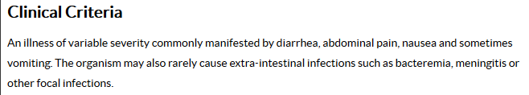
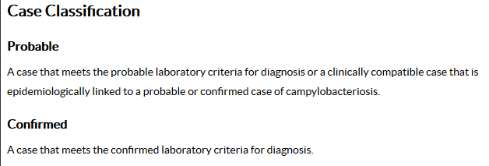
Campylobacteriosis (2015)
Notes:
New format offers a Background section, but then it’s clear on this slide for the clinical criteria and case classification.
H.Flu (2015) fits the same headers

Slide 25
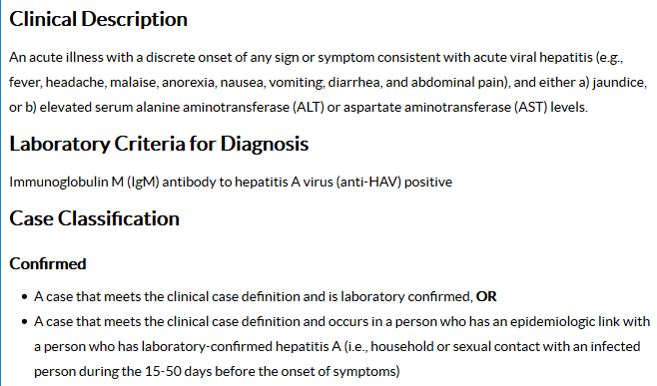
Hepatitis A (2012)
Notes:
Older format uses the Clinical Description section for criteria. Would need to verify this is consistent, but maybe for a certain set of years we reference the Clinical Description and after 2015, we reference the Clinical Criteria.
Measles (2013) fits the same headers

Slide 26
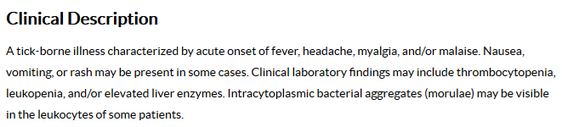
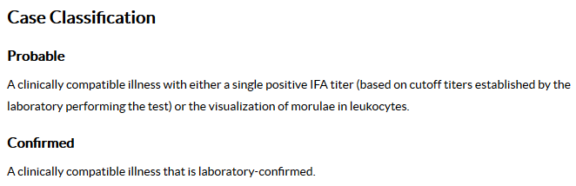
No explicit signs/symptoms
Ehrlichiosis (2010)
Notes:
Follows the same format as Hepatitis A.

Slide 27
No signs/symptoms
Dengue (2015)
  Background
  Laboratory Criteria for Diagnosis
  Epidemiologic Linkage
Notes:
This highlights a gap in our group, but the Dengue position statement has no clinical criteria. We’ll need to note some conditions do not have clinical criteria.

Slide 28
Implementation Actions
CSTE
  Brief process→ Publish→ Distribute
DSWG/SPIS
  Promote brief
  Review and update?

Slide 29
Implementation Actions
STLT Health Departments
  Gap analysis for the surveillance system and procedures
  Surveillance system revisions
    Do not require
    Do not use substitution/calculation
    Create a discrete data elements for:
      Onset of signs/symptoms
      Onset of illness (if needed)
      Event date

Slide 30
Implementation Actions
CDC
  Revise the Data Element Name to Symptom Onset Date with the description:
    Reported date of the onset of symptoms of the condition being reported to the public health system.
  Create a new data element with the name Date of Illness Onset with the description:
    Date of the beginning of the illness.

Slide 31
Implementation Actions
CDC
  Revise the HL7 Implementation Notes:
    “For unknown date, OBX-5 MAY be populated with ‘99999999’”.
    Replace with directions to leave NULL
    Would need updated in the Arboviral MMG also
  Reference this document in the MMG Data Element Description

Slide 32
Diagnosis Date

Slide 33
Diagnosis Date
What are we trying to achieve?
  Standardized, comparable meaning (true apples to apples)
  Standardized definition or algorithm?

Slide 34
Diagnosis Date
Standardized approach:
  Earliest of clinical diagnosis or specimen collection date for all cases.
Discrete data elements:
  Use diagnosis date for clinical diagnosis only. Leave blank if not clinically diagnosed (or use specimen collection date?).
  Add date of laboratory confirmation data element to GenV2 fields to capture result date of the first positive

Slide 35
Diagnosis Date
Standardized algorithm:
  Earliest of clinical diagnosis or specimen collection date or result date for all cases, or
  Clinical diagnosis, specimen collection date, result date as determined by jurisdiction
    Consider addition of ‘date type’ data element to GenV2
  Clinical diagnosis, specimen collection date, result date as determined by broad guidance
    E.g. certain disease type or certain type of presentation
    Consider addition of ‘date type’ data element to GenV2

Slide 36
Wrap Up

Slide 37

THANK YOU!
Elizabeth Sprouse
&
Emily Augustini

Slide 38
Schedule
  Meet monthly on the 4th Friday from 1-2pm ET/ 12-1pm CT
    July 27
    August 24
    September 28
    October 26
    November 23 (will try to move to the 30th)
    December 28 (may cancel)
New appointment with the call-in and webinar information is forthcoming!!!

Slide 39



How to Engage
  Email:
    Molly Crockett: Molly.Crockett@MassMail.State.MA.US
    Shannon Harney: Shannon.Harney@tn.gov
Basecamp: https://3.basecamp.com/3164497/join/1guTDJpympSc
Notes:
Include Emily and Elizabeth for future?

Slide 40
REFERENCE

Slide 41
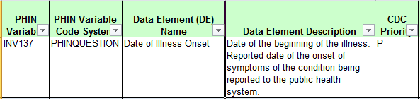
Date of Illness Onset
Generic v2.0 Message Mapping Guide Description:
  Date of the beginning of the illness.
  Reported date of the onset of symptoms of the condition being reported to the public health system.
Notes:
1:05-1:40 (tentative; can continue if there is discussion)
According to the Generic Version 2.0 Message Mapping Guide Data Element Description, the purpose of the Date of Illness Onset is to identify the beginning of the illness. This date is approximated by the date when signs or symptoms pertinent to the condition begin. Therefore, this data element could be considered synonymous with Symptom Onset Date, which is not a data element in the MMG.

Slide 42
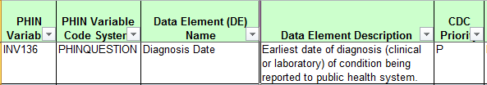
Diagnosis Date
Generic v2.0 Message Mapping Guide Description:
  Earliest date of diagnosis (clinical or laboratory) of condition being reported to public health system.

Slide 43
CSTE Conference

Slide 44
Charge and History
Workgroup charge
  To convene epidemiologists and informaticians to develop consensus on common definitions for core surveillance data elements to address jurisdictional variation.
History
CSTE 2017
Fall 2017
March 2018
CSTE 2018
Need identified: standardize data elements across diseases and jurisdictions
Planning committee convened
Kickoff: twice- monthly calls
Presentation: process, progress, and discussion

Slide 45
Mission
Mission: Improve data quality through the development and application of consensus definitions for the core data elements for general communicable disease surveillance
Process
  Develop a standardized, repeatable consensus process
  Represent all needs: epidemiology, surveillance, systems, informatics
Outcomes
  Standardize application of the data elements across diseases and jurisdictions
  Improve accuracy and consistency of data collected

Slide 46
Consensus Framework
Guided discussion
Workgroup feedback
Compile and summarize
Update discussion questions
Introduce data element
Introduce data element
Email
Smartsheet
Basecamp
Draft CSTE Brief
SPIS

Slide 47
Consensus Framework
DSWG
SPIS
S/I Steering
Committee
Executive
Board
BRIEF
CSTE Community
Implementation

Slide 48
Lessons Learned
How does the consensus process look for this workgroup?
  Requires multiple cycles of feedback, discussion, and compilation
  Multiple feedback tools to maximize response (different preferences)
    Online tools make responses visible to all members
    More sources to monitor can also be a challenge
  Need for representation across many jurisdictions and program areas
    Still need better representation/diversity

Slide 49
Lessons Learned
How are the data elements being applied?
  Surveillance system
  Jurisdiction practices
  Disease areas and specific diseases
  MMG and data element description
    Different NNDSS reporting formats
    Interpretation
What level of granularity is valuable to investigators?

Slide 50
Date of Illness Onset
Challenges
  Date of Illness Onset vs. Symptom Onset Date
  Surveillance system variation
  Usage varies across diseases
  Data source hierarchy
  Identifying the signs and symptoms (granularity)

Slide 51
Date of Illness Onset
Recommendations
  Interpret as “earliest date of onset of signs/symptoms”
  Do not require in the surveillance system
  Leave NULL when data are unavailable
  Do not substitute or calculate the date
  Create a discrete data element for Event Date
  Prioritize the patient/proxy as the first data source
  Refer to the CSTE position statements for symptoms
Handout

Slide 52
Diagnosis Date
Generic v2.0 Message Mapping Guide Description:
  Earliest date of diagnosis (clinical or laboratory) of condition being reported to public health system.
Use of Diagnosis Date within jurisdictions:
  Not all jurisdictions/programs have a discrete data element
  Importance and completeness of data element varies widely by jurisdiction and program area

Slide 53
Diagnosis Date
When does ‘diagnosis’ occur?
Provider visit
Clinical or suspected diagnosis
Specimen collection
Diagnosis pending laboratory confirmation
Lab Result
Laboratory confirmed

Slide 54
Case-counting dates
Need within jurisdictions for fully populated data element for case counting
Need across jurisdictions for data element with standardized hierarchy for case counting
Diagnosis date
Report date
Result date
???????
Specimen date
Illness onset date
Case-counting date

