Slide 1
This session will feature Poll Everywhere – a fun and exciting tool that enables the presenter to survey the audience and display the results in real time
To participate, please text
PREPSUMMIT1 to 22333
or visit PollEv.com/prepsummit1
THANK YOU!!!
Notes:
Session Outline
Introduction the topic and motivation for the discussion—setup the issue (10 min Rachel Santamaria Schwartz)
How do we demonstrate the value of programs? –Introduce impacts document, circulate copies among participants (15 min Carina Elsenboss)
Telling the story, communications and advocacy—Distill information to make it the most impactful to communicate with different audiences (15 min Meghan McGinty/NACCHO GA)
“Workshop time” –circulating copies of the document among audience members have individuals or small groups work together to personalize the template/tool with their own stories and information that clearly illustrate the public health impacts of disasters (Audience/ALL 15-20 min)
Debrief and reaction—what’s missing? What stories are people adding to illustrate impacts? How can we best use this information to advocate for public health i.e. funding, a seat at the table in planning and response, PAPHRA etc. (30 min)

Slide 2
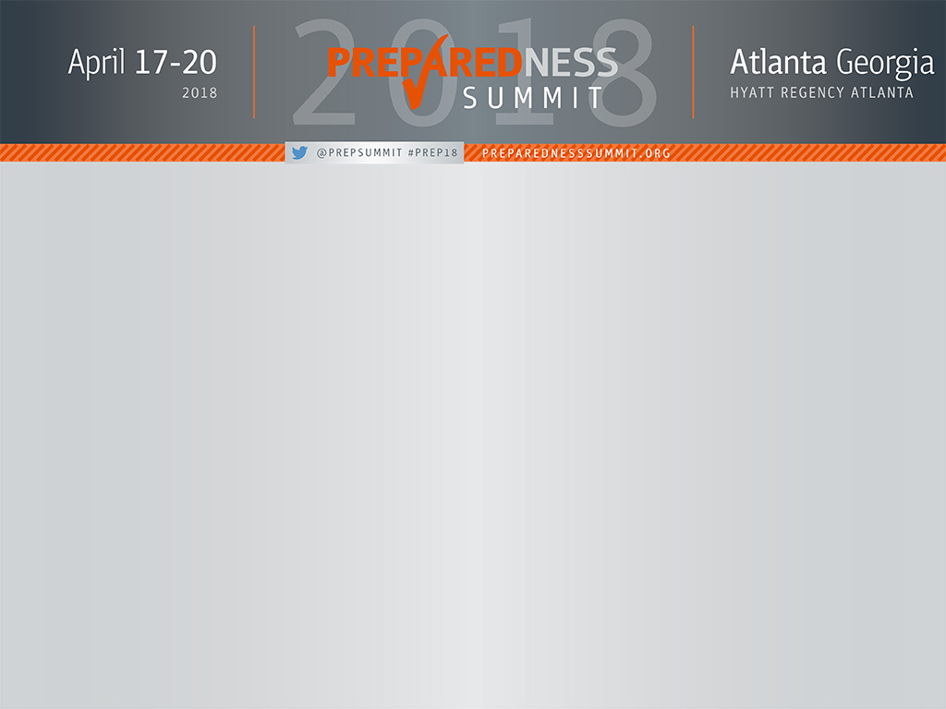
Applying Disaster Epidemiology Tools and Methods During Local Responses
Svetlana Smorodinksy, MPH
Jessica White, DrPH MS

Slide 3
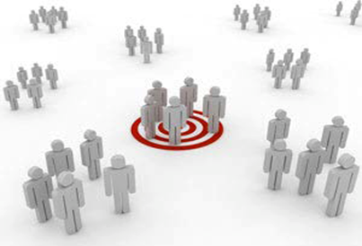
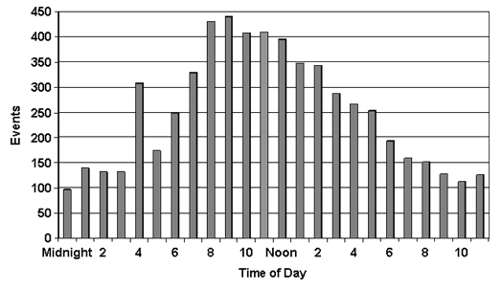
Background
Epidemiology is the study of distribution and determinants of illness, injury, disability and death in specified populations, and the application of this study to minimize these outcomes.
Applied across all of public health, including infectious diseases, chronic conditions, injuries, environmental and occupational hazards
Notes:
Tess

Slide 4
Background
Epidemiology applied in disaster settings is called disaster epidemiology (DE)
DE provides reliable and actionable information to incident commanders, planners, and decision-makers
Emergency managers across the country are partnering with epidemiologists
Foundational capability under ESF-8 public health planning and response
Notes:
Tess

Slide 5
Background
Origins of DE
  1980s: Description of epidemiologist roles in disaster response
  1990s: Public health and epidemiologic methods in disaster response published
  2010: Systematic use of “disaster epidemiology” helped establish the discipline as a formal subset of epidemiology with broad application
Notes:
Michael
Eric Nogi was an Epidemiologist at CDC in the 1980s when he

Slide 6
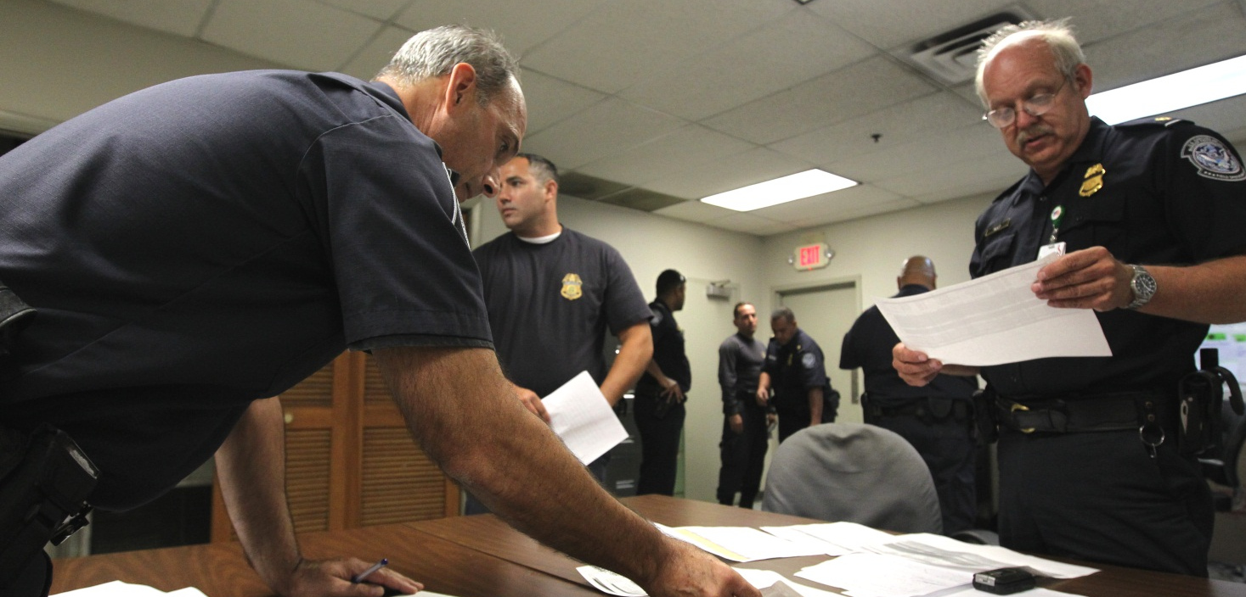
Background
Integrating DE across disciplines and agencies
  Public Health and PHEP
  Hospitals
  Academic partners
  Industrial hygiene and safety professionals
  Emergency managers
  Responders
  Regulators
  Business community
Notes:
Tess PH + PHEP = CDC, States, Locals, Tribal

Slide 7
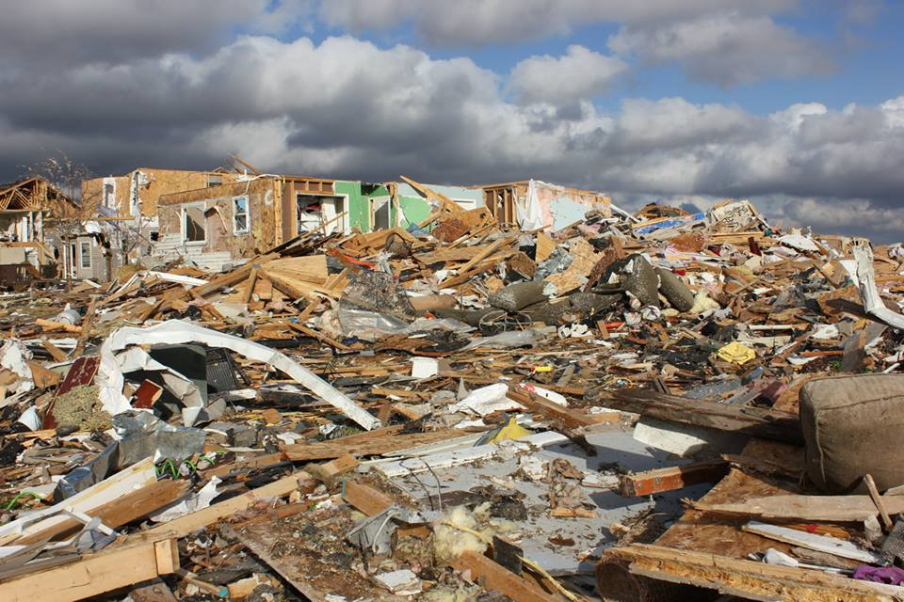
Background
DE was originally applied in response to large scale emergencies, and encompasses:
  Rapid needs assessment, Surveillance, Tracking, Research and Evaluation and Registries
Goal is prevention
Incident Command System: Link DE to Medical Unit
Notes:
Tess

Slide 8
Disaster Epidemiology Activities
The Disaster-Management Cycle
Humanitarian Action ◄▬▬▬► Sustainable development
Post-disaster
Rehabilitation
Recovery
Response
Prevention/
Mitigation
Preparedness
Pre-disaster
Disaster
Impact
Disaster
Notes:
Tess

Slide 9
Disaster Epidemiology Activities
The Disaster-Management Cycle
Humanitarian Action ◄▬▬▬► Sustainable development
Tracking
Registries
Epidemiologic studies
Rehabilitation
Recovery
Response
Prevention/
Mitigation
Preparedness
Evaluation studies
- Relief programs
- Other interventions
Studies to compare efficacy of control strategies and interventions
Disaster
Impact
Surveillance
- Affected communities
- Responders
Rapid needs assessments
Notes:
Tess
Framework created the applications of epidemiology in disaster settings
Developed by:
Centers for Disease Control & Prevention (CDC)/National Center for Environmental Health (NCEH) and
Council for State and Territorial Epidemiologists (CSTE)

