Slide 1


Slide 2

Disaster Epidemiology 101:
Tools for Public Health Preparedness, Response, and Recovery
Tess Konen, MPH
Senior Epidemiologist
Minnesota Department of Health
Hayleigh McCall, MPH
Program Analyst
Council of State and Territorial Epidemiologists (CSTE)
Notes:
Tess introduce then Hayleigh

Slide 3
THANK YOU!!!
This session will feature Poll Everywhere – a fun and exciting tool that enables the presenter to survey the audience and display the results in real time
To participate, please text
PREPSUMMIT4 to 22333
or visit PollEv.com/prepsummit4
Notes:
Tess introduce poll everywhere

Slide 4
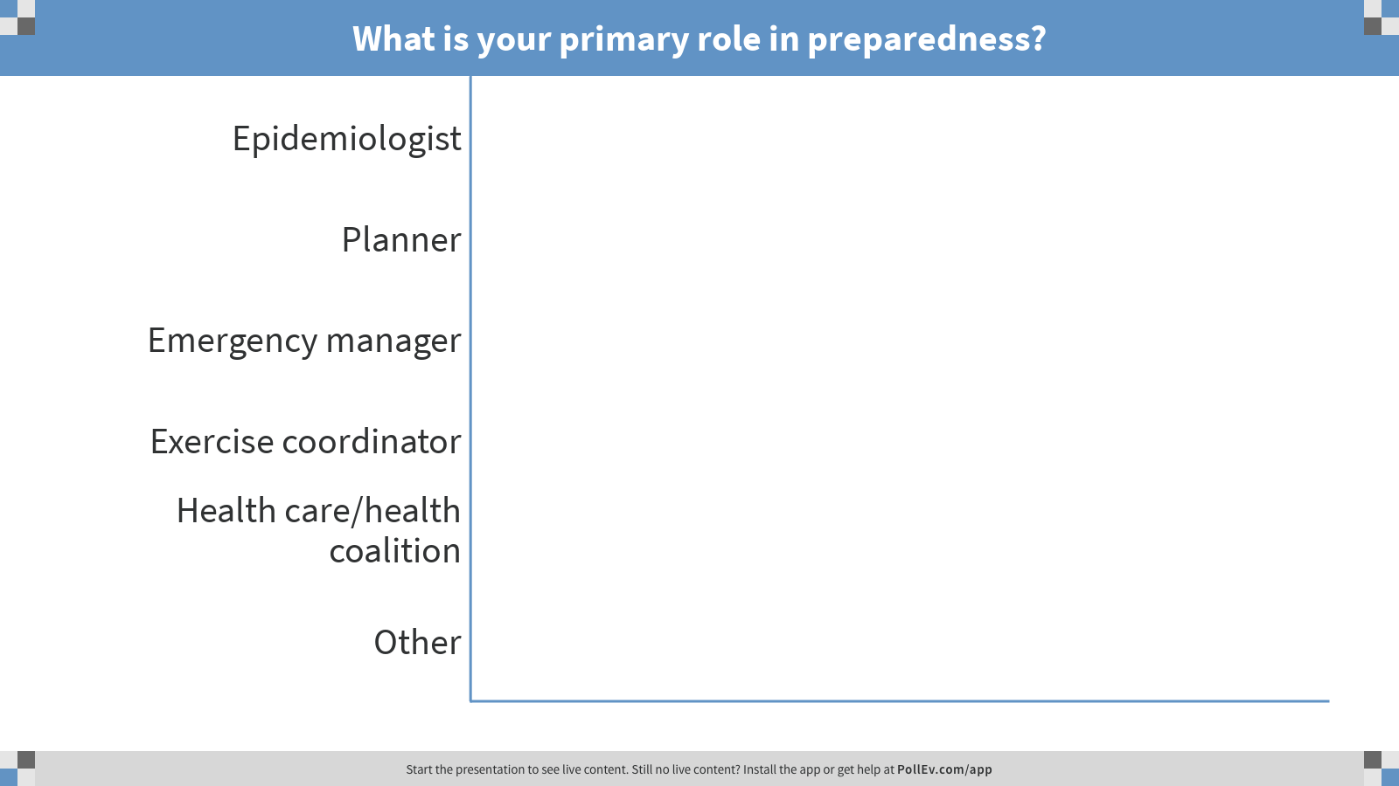
Notes:
Poll Title: What is your primary role in preparedness?
https://www.polleverywhere.com/multiple_choice_polls/zgic6JZ0fibFmBWcHGVcI

Slide 5
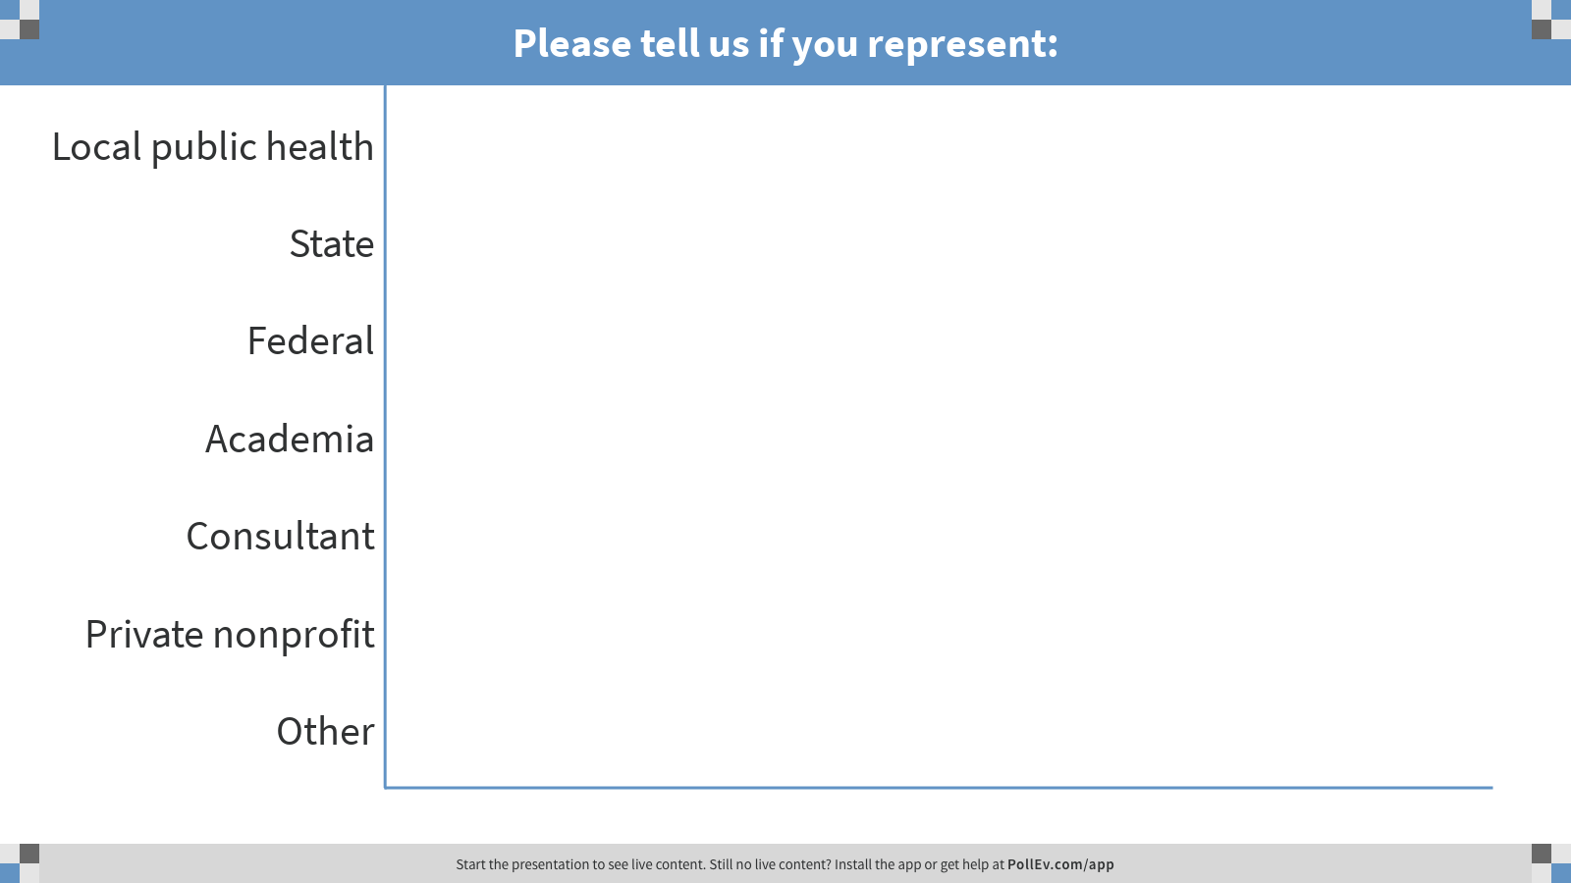
Notes:
Poll Title: Please tell us if you represent:
https://www.polleverywhere.com/multiple_choice_polls/Nnq0InhHnevkJw0dmSFuL

Slide 6
Objectives
Define disaster epidemiology (DE) and its role in planning, response, and recovery efforts
Describe how DE methods can be integrated into existing efforts to help public health (PH) programs achieve their PHEP Capabilities
Discuss the role of an epidemiologist during a disaster and how epidemiologists can partner with emergency management (EM)
Demonstrate how DE methods are being applied at local, state, tribal & national levels
Notes:
Hayleigh

Slide 7

Council of State and Territorial Epidemiologists’ (CSTE)
Disaster Epidemiology (DE) Subcommittee
Strengthen capacity to respond by integrating DE into the emergency management cycle
Help public health and emergency management leadership understand essential role of DE
Identify common set of capabilities to support collection of epidemiologic data during emergency response situations
Notes:
Hayleigh
Mention that Tess is subcommittee chair

Slide 8

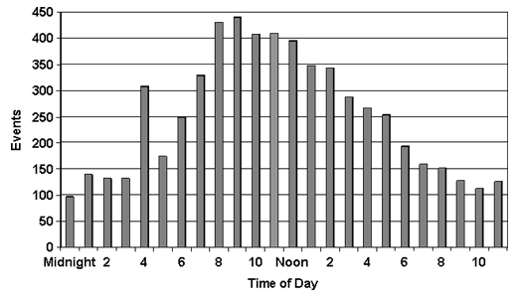
What is epidemiology?
Epidemiology is the study of distribution and determinants of illness, injury, disability and death in specified populations, and the application of this study to minimize these outcomes
Applied across all of public health, including infectious diseases, chronic conditions, injuries, environmental and occupational hazards
Notes:
Tess
To make sure we are all on the same page, I am going to go over some definitions quickly.
Epidemiology is the study of the patterns of disease in a population in order to reduce the health risk.
This approach is applied across all the whole spectrum of public health from the traditional infectious disease to chronic, maternal child health, environmental and occupational hazards.

Slide 9
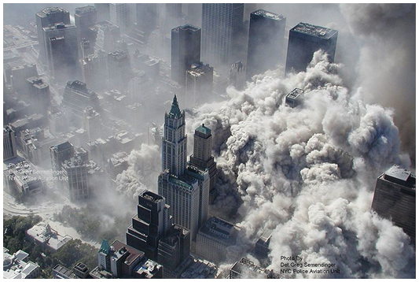
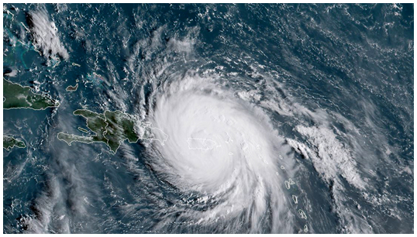
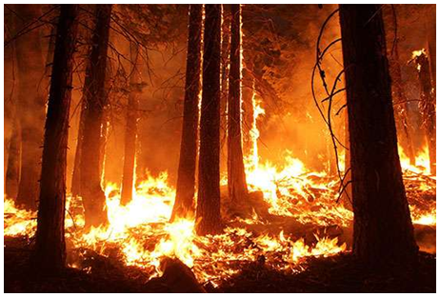
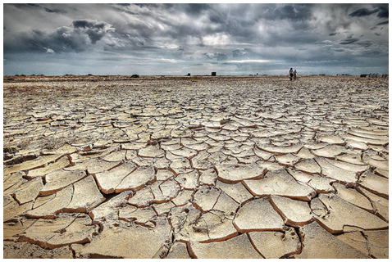
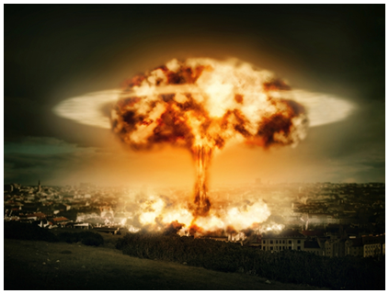
What is disaster epidemiology?
Epidemiology applied in disaster settings is called disaster epidemiology (DE)
Notes:
Tess
Quite simply, epidemiology methods applied to disasters is disaster epidemiology. Like any sub-field, it has it’s own tools and approaches.

Slide 10
What is disaster epidemiology?
DE provides reliable and actionable health and needs information to incident commanders, planners, and decision-makers
Goal is to prevent further morbidity and mortality by addressing immediate and long-term needs by using gathered information to:
  Adjust priorities
  Allocate resources
  Project/plan for future needs/disasters
Notes:
Tess
Disaster epidemiology is the application of epidemiologic methods to characterize the nature and dynamics of the health consequences in a disaster setting. It began with the study of health risks after environmental disasters and is now regarded as a subset of environmental epidemiology.
Increasingly, emergency managers are working with epidemiologists to have data for general situational awareness, to inform decisions and response plans, to allocate resources.
It is part of public health emergency response within the incident command system framework.

Slide 11
Origins of DE
1980s: Description of epidemiologist roles in disaster response
1990s: Public health and epidemiologic methods in disaster response published
2010: Systematic use of “disaster epidemiology” helped establish the discipline as a formal subset of epidemiology with broad application
Notes:
Tess
De is not new, but in 1980s it was mainly applied to international disasters and descriptive in nature. One of the first DE applications was in East Bengal, Bangladesh after a cyclone hit. Since then, the role of epidemiologists in disaster response has increased dramatically.
In 1990s, as more was being written about this discipline, DE began to be applied in some larger incidents in the US (mainly in response to large-scale disasters that affected Gulf States). DE became accepted term and this discipline was more developed.
The increasing widespread applications took hold in 2010. Now these methodologies are more embedded in disaster response and supported federally.
When DE first started, it was primarily used in large scale emergencies. Now, it has been applied in smaller events, always with the goal of preventing exposure and illness.
The same tools can be applied to both large scale and smaller scale events to collect relevant data on the affected population and prevent health issues and reduce risk.
The goal is to identify the risk/hazards during the disaster and prevent/mitigate to reduce further health issues.

Slide 12
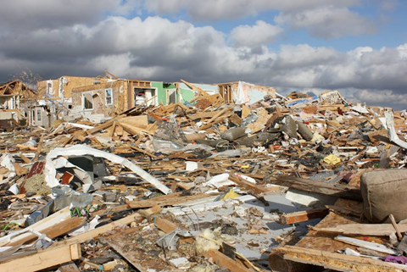
Origins of DE
DE originally applied in response to large-scale emergencies and encompasses:
  Rapid needs assessments
  Surveillance
  Tracking
  Research, registries, & evaluation
Goal is prevention
Notes:
Tess
When DE first started, it was primarily used in large scale emergencies. Now, it has been applied in smaller events, always with the goal of preventing exposure and illness.
The same tools, needs assessments, health surveillance, tracking, evaluations, research, rosters, and registries can be applied to both large scale and smaller scale events to collect relevant data on the affected population and prevent health issues and reduce risk.
We will go into these tools later.
The goal is to identify the risk/hazards during the disaster and prevent/mitigate to reduce further health issues.

Slide 13

Where does DE fit?
DE integrates across disciplines and agencies
  Public health and PHEP
  Hospitals and clinicians
  Academic partners
  Industrial hygiene and safety professionals
  Emergency managers
  Responders
  Regulators
  Business community
Notes:
Hayleigh
DE is cross-sectional and collaboratively and works across many different disciples and agencies. Integrating with these partners provides more comprehensive information about the disaster.
Public health=planning and training (at all levels: LPH, tribal, state, federal); CDC-training, grant support
Business community=vendors, medical devices

Slide 14
DE and Incident Command System (ICS)
ICS links DE to Medical Unit
Foundational part of ESF-8 as it relates to PH planning and response
Provides ICS leadership with credible health data for:
  Situational awareness
  Making decisions
  Allocating resources
Notes:
Hayleigh
DE is integrated into the ICS in the medical unit.
DE serves the needs of Incident command well—under ESF-8. (public health & medical services)
DE is a core part of PH planning and response.

Slide 15
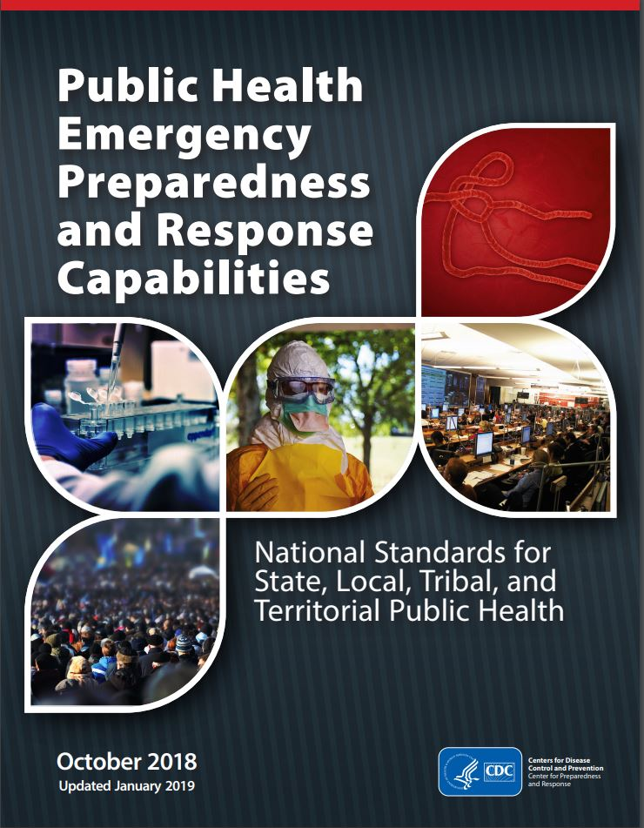
DE and PHEP Capabilities
Recent revisions added references to environmental health functions and partners, including:
  References to DE tools (CASPER & ACE)
  Focus on radiological planning before an imminent risk
  Resources for recovery operations after radiological incidents
Notes:
Hayleigh
Specifically, the capabilities further emphasize the importance of disaster epidemiology
DE methods and tools can help you meet your PHEP and HPP required capabilities. The following slides highlight the PHEP and HPP Capabilities and Functions that DE fit in.

Slide 16
DE and PHEP Capabilities
Capability 1: Community Preparedness
  Assess and determine risks to the population and identify and map at-risk populations
Capability 2: Community Recovery
  Assess impact and inform recovery efforts post-disaster (using rapid needs assessments, public health research)
Capability 3: Emergency Operations Coordination
  Provide situation awareness to detect need for activation or dissemination of resources
Capability 4: Emergency Public Information and Warning
  Inform health alerts and the development of educational materials
Notes:
Hayleigh

Slide 17
DE and PHEP Capabilities
Capability 5: Fatalities Management
  Analyze postmortem data to determine the extent of emergency, and use of electronic death registry system (EDRS) to improve the speed/completeness
Capability 6: Information Sharing
  Use of electronic case reporting (eCR), electronic death registration (EDR), electronic laboratory results (ELR), syndromic surveillance (SyS) reporting
  Develop of Health Alert Networks (HAN)
Capability 7: Mass Care
  Provide information on needs of population impacted and infection control in mass care settings
Capability 8: Medical Countermeasures
  Use surveillance to determine the need for MCM and to identify at-risk populations
Notes:
Hayleigh

Slide 18
DE and PHEP Capabilities
Capability 9: Medical Material Management and Distribution
  Analyze medical and social demographic data to inform medication and durable medical equipment needs
Capability 10: Medical Surge
  Collect data on healthcare delivery system and EMS calls
Capability 11: Non-Pharm Interventions
  Identify/interrupt spread of disease
  Focus on mass screening processes for contamination & decontamination in response to nuclear/radiological events
Capability 12: PH Laboratory & Testing
  Contextualize lab results for situational awareness
Notes:
Hayleigh

Slide 19
DE and PHEP Capabilities
Capability 13: PH Surveillance and Epidemiological Investigation
  Monitor trends of illness or injury and provide situation awareness
  References DE tools (ACE & CASPER) and registries
  Includes tracking systems, monitoring the exposed, and syndromic surveillance systems
Capability 14: Responder Safety and Health
  Use ERHMS as a resource for responders and volunteers
Notes:
Hayleigh
Emergency Responder Health Monitoring and Surveillance (ERHMS)

Slide 20
DE and HPP Capabilities
Capability 3: Emergency Operations Coordination
  Support healthcare response efforts through coordination of resources
Capability 6: Information Sharing
  Provide situation awareness and contribute to the incident common operating picture
Notes:
Hayleigh
Hospital Preparedness Program (HPP)

Slide 21


Conceptual framework
Framework identified the applications of epidemiology in disaster settings
Developed by:
  Centers for Disease Control & Prevention (CDC)/National Center for Environmental Health (NCEH)
  Council of State and Territorial Epidemiologists (CSTE)
Notes:
Tess

Slide 22
The Disaster Management Cycle
Post-disaster
Pre-disaster
Prevention, Mitigation, Preparedness
Disaster Impact
Rehabilitation, Response, Recovery
Disaster
Notes:
Tess
The disaster management cycle includes:
planning and preparedness pre-disaster,
the disaster event when the disaster is active,
and the response and recovery phases post-disaster.

Slide 23
The Disaster Management Cycle
Post-disaster:
Tracking
Registries
Pre-disaster:
Epidemiology investigations
Evaluation and risk studies
Prevention, Mitigation, Preparedness
Disaster Impact
Rehabilitation, Response, Recovery
Disaster:
Surveillance
  Affected communities
  Responders
Rapid needs assessments
Notes:
Tess
DE fits into all phases of the disaster management cycle.
During and following the disaster, health surveillance of the affected communities and responders might occur to know the severity and level of impact. As well as, rapid needs assessment to inform the response efforts.
In the response and recovery phase, you continue to track health outcomes and inform the health impact and need to mitigate health risk. (using rosters or registries, line lists…).
In the preparedness phase, we use our data to assess what changes could be made to reduce risk. Epidemiologic studies and evaluation studies inform interventions and controls to prepare for the next disaster.

Slide 24
Who is a disaster epidemiologist?
When an incident happens, a disaster epidemiologist should be pulled from areas of public health that are most affected
  Hurricane: epidemiologist with water quality training
  Radiation event: epidemiologist with radiologic exposure training
  Chemical spill: epidemiologist with exposure science training
  Mass evacuation: epidemiologist with shelter surveillance training
Notes:
Hayleigh

Slide 25
Who is a disaster epidemiologist?
Preparedness Epidemiology
Focus: large-scale infectious disease outbreaks and bioterrorism
Epidemiologists follow confirmed, probable, and suspect case counts
Disaster Epidemiology
Focus: environmental and man-made disasters
Epidemiologists perform surveillance for mortality and morbidity related to the disaster
Notes:
Hayleigh
This slide shows the differences in the response roles for ID vs. EH epi. It depends on your expertise.
The ID epi will likely be focusing on outbreaks and case definitions, case counts, while the EH epi may be focusing on environmental or manmade disasters and conducting surveillance of mortality and morbidity.

Slide 26
Who is a disaster epidemiologist?
Disaster Epidemiology
Environmental Health
Public Health Emergency Preparedness and Response
Epidemiology
Occupational Health
Infectious Disease
Maternal and Child Health
Chronic Disease
Substance Use and Mental Health
Injury
Notes:
Hayleigh
Example: Zika response involved MCH, EH, ID, Response, Epi, OccH (integrational epidemiology), making the case for teams made up of experts of various areas.

Slide 27
DE tools
To better prepare for the next disaster, disaster epidemiologists have come together to develop multiple tools to utilize during emergency responses
These tools can be adapted to fit the needs of the jurisdiction
Notes:
Hayleigh

Slide 28
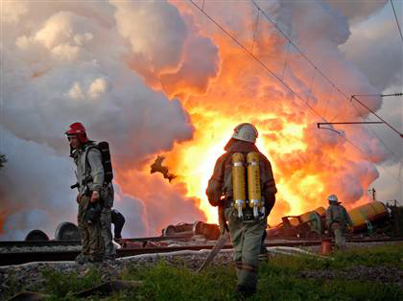
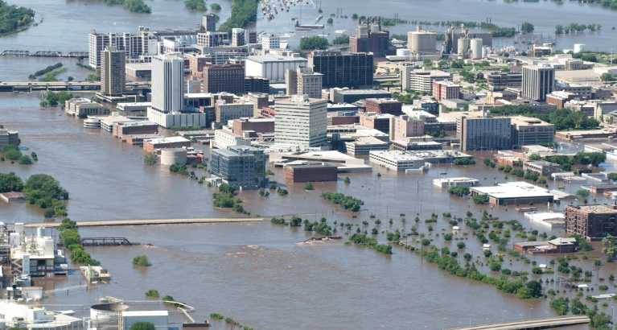
Surveillance
Many types of surveillance for health-related outcomes
Describes the health burden of an affected community
Notes:
Hayleigh
Quantifies mortality and morbidity in affected communities, responders, and sheltered residents

Slide 29
Types of surveillance
Syndromic surveillance
Retrospective surveillance
Mortality surveillance
Shelter surveillance
Responders health monitoring and surveillance
Notes:
Hayleigh
SyS
Mortality surveillance - Death reporting systems
Shelter surveillance – health surveillance in shelters
Responder health monitoring and surveillance

Slide 30
Syndromic vs. Traditional surveillance
Syndromic surveillance
Traditional surveillance
Data collected for other purposes
Pre-diagnostic information
Near real-time
Case reports from healthcare providers & laboratories
Confirmed diagnosis
Lag in reporting
Illness Onset
Symptom Progression
Healthcare Seeking
Testing/ Diagnosis
Treatment
Recovery or Death
Syndromic
Traditional
Near real-time, pre-diagnostic information (i.e. chief complaint, over-the-counter sales)
Delayed confirmed diagnosis (i.e. reportable disease, laboratory tests)
Created by: Jessica White, Maricopa County
Notes:
Hayleigh
“The collection and analysis of health-related data that precedes diagnosis and signal a sufficient probability of a case or an outbreak to warrant further public health response.”
Identifies intra-disaster outbreaks or clusters of conditions
Characterizes burden of incident on affected sub-populations
Provides descriptive analysis of conditions, injuries, and fatalities
Can use multiple types of data (attendance data, pharmacy info) but most commonly used is data from clinics and hospitals (chief complaint data)

Slide 31
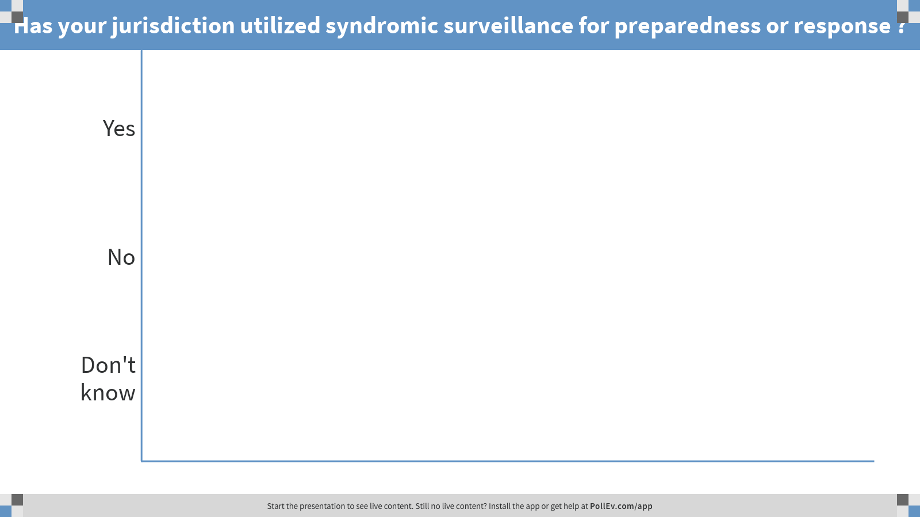
Notes:
Poll Title: Has your jurisdiction utilized syndromic surveillance for preparedness or response ?
https://www.polleverywhere.com/multiple_choice_polls/TAXKyyNDiypznLcYhY7cO

Slide 32
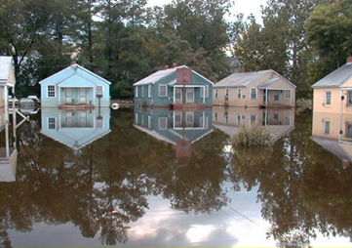
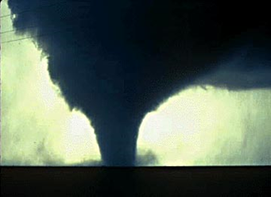

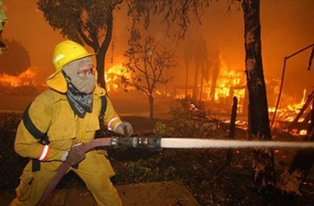
Syndromic surveillance for disaster response
Extreme heat
Extreme cold
Poor air quality – lung health
Disease vectors
Hurricanes
Snow/ice storms
CO poisoning
Mass gathering events
Flooding
Tornados
Drought
Wildfires
Notes:
Hayleigh
These are some common examples of sys for disasters. Also common to use for mass gathering events.
National groups come up with agreed upon definitions, using key phrases. The International Society of Disease Surveillance (ISDS) has a community group called Syndromic Surveillance and Public Health Emergency Preparedness, Response and Recovery (SPHERR)

Slide 33
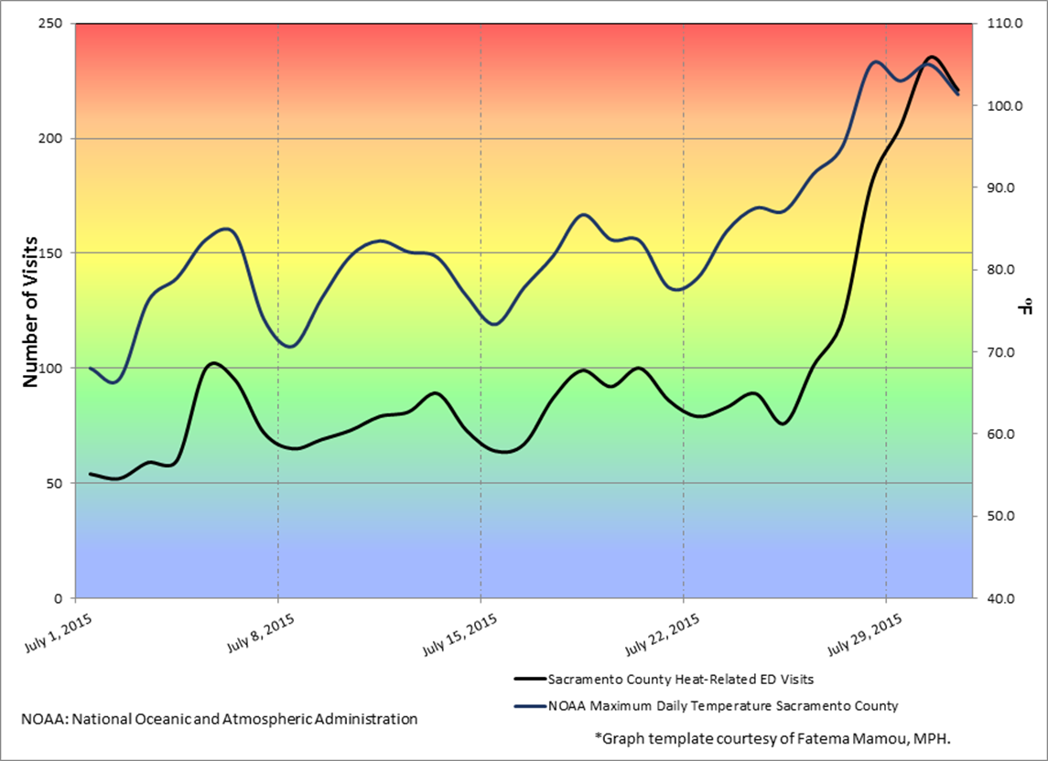
Heat-Related ER Visits
Sacramento, CA, July 1-31, 2015
Notes:
Hayleigh
Here is an example of applying sys to heat waves using environmental data and emergency department data to assess trends and peaks to better inform messaging and actions.
Actions:
Do we need to open another cooling center
Do better at warning people?

Slide 34
Retrospective surveillance
Review of medical records to:
  Assess disaster-related injuries and deaths
  Identify populations impacted
  Protective actions taken
Notes:
Hayleigh
More traditional surveillance, would involve a retrospective review of injuries and deaths related to an event to characterize the impact and identify trends in the population and to inform protective actions for next time (feedback loop).

Slide 35
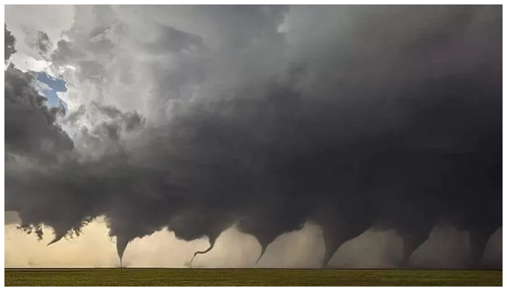
Retrospective surveillance following Oklahoma Tornado Outbreak
May 19-31, 2013
Of 49 deaths and 755 injuries associated with the disaster, 55% were indirectly related
  35% trying to get in or out of shelter
  6% fleeing the area
  5% rescuing an animal or person
35% of hospital visits were for injuries during cleanup
Notes:
Hayleigh
This informs our knowledge by characterizing the injuries and deaths so we can message and inform public on the safe approach.
In this example, l more than half of the injuries and deaths were indirectly related, of these a large portion were due to cleanup and evacuation/seeking shelter.

Slide 36
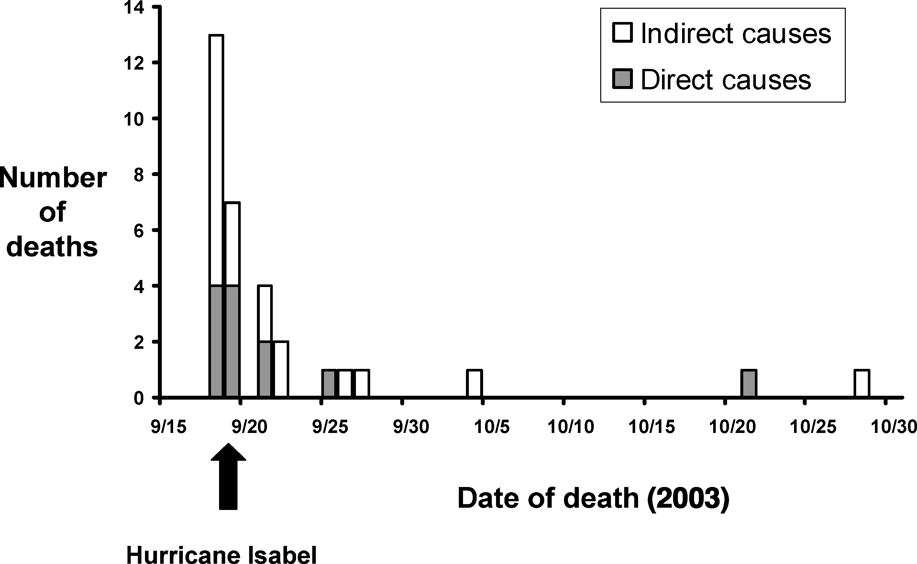
Mortality surveillance
Hurricane Isabel-Related Mortality—Virginia, 2003
From: J Public Health Management Practice, 2006, 12(1), 97–102
Notes:
Tess
Mortality surveillance can occur retrospectively, or if you have electronic death registration systems, you can have near real-time information on the deaths related to an event. Of course, depends on ME coding of deaths and attributing to the event.
Here you can see when the deaths are occurring and if they are related directly or indirectly to the event. Most immediately after, but still some occurring months later

Slide 37
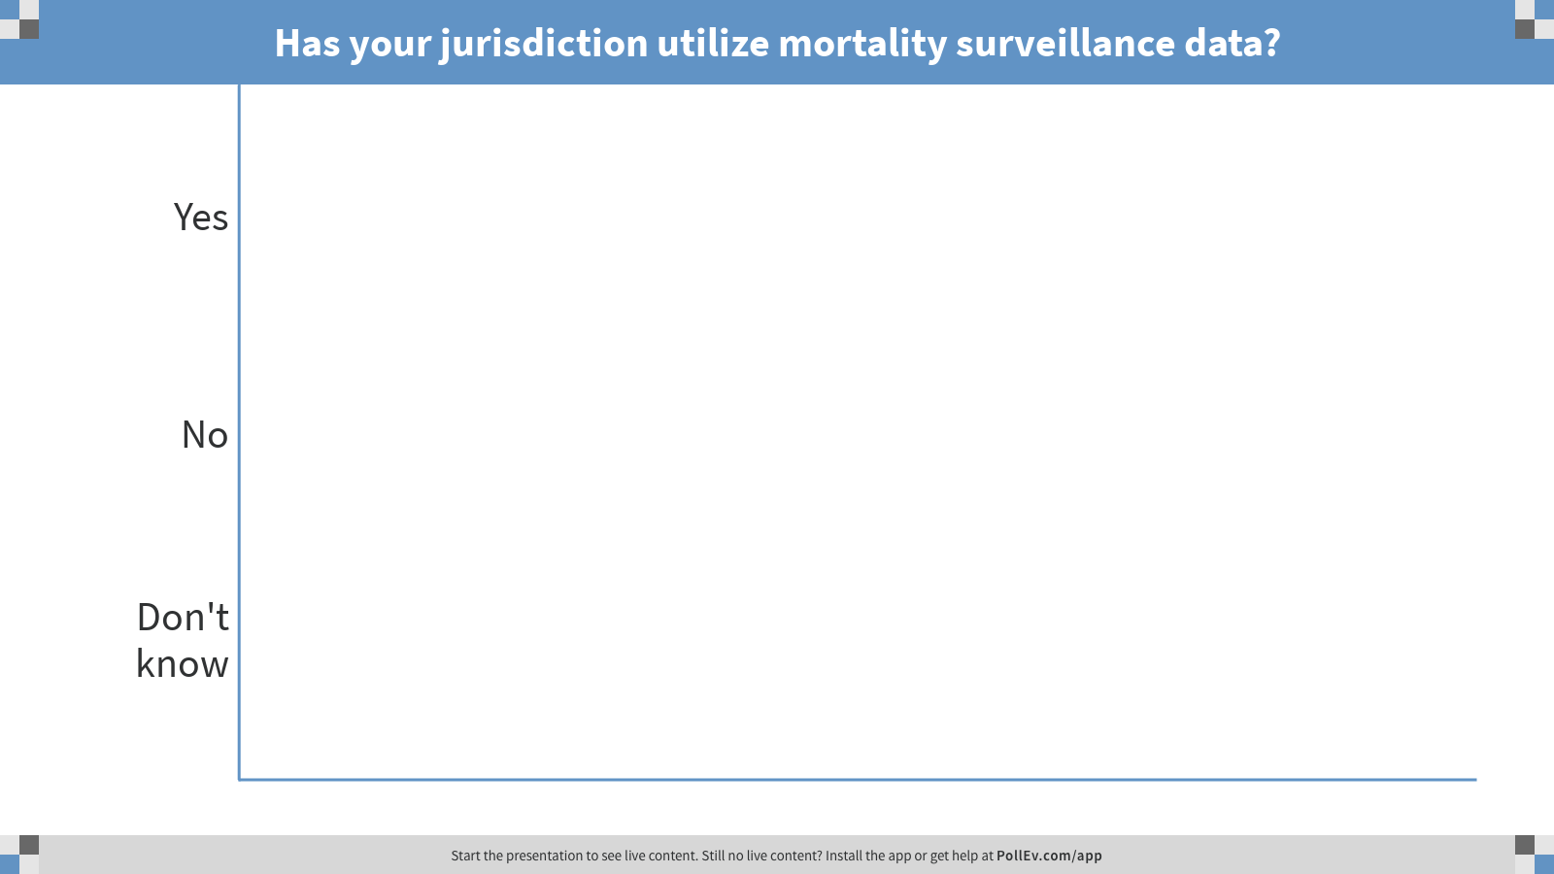
Notes:
Tess
Poll Title: Has your jurisdiction utilize mortality surveillance data?
https://www.polleverywhere.com/multiple_choice_polls/9nO1fqi425hiBsSguYSQ2

Slide 38
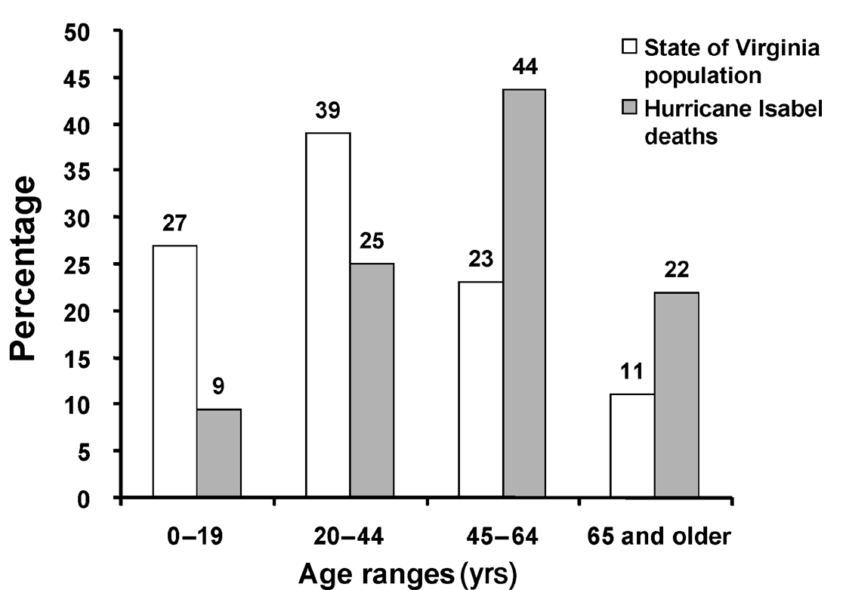
Mortality surveillance
Comparison of the percentages of age distribution for
Hurricane Isabel deaths in Virginia with the Virginia population
(2000 Census estimates)
From: J Public Health Management Practice, 2006, 12(1), 97–102
Notes:
Tess
This tells you about the affected populations, you see that there is more mortality in those aged 45-64 years and 65+

Slide 39
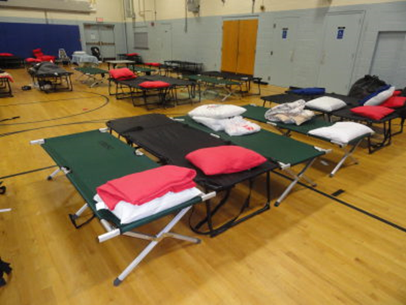
Shelter surveillance
Track populations in shelter settings
Characterize environmental and sanitation conditions
Identify outbreaks and clusters of conditions
Data to consider collecting:
  Demographic data
  Morbidity surveillance
  Shelter survey/environmental health assessment
Notes:
Tess
One type of surveillance, is shelter surveillance. This tracks populations within the shelter facilities to identify outbreaks or disease clusters.
Also to assess environmental and sanitation conditions.
Active-cot-to-cot assessments
Passive-track shelter residents coming for health issue/complaint
Necessary to work with organizations that organize shelters (Red Cross in US) on having forms useful to everyone.

Slide 40
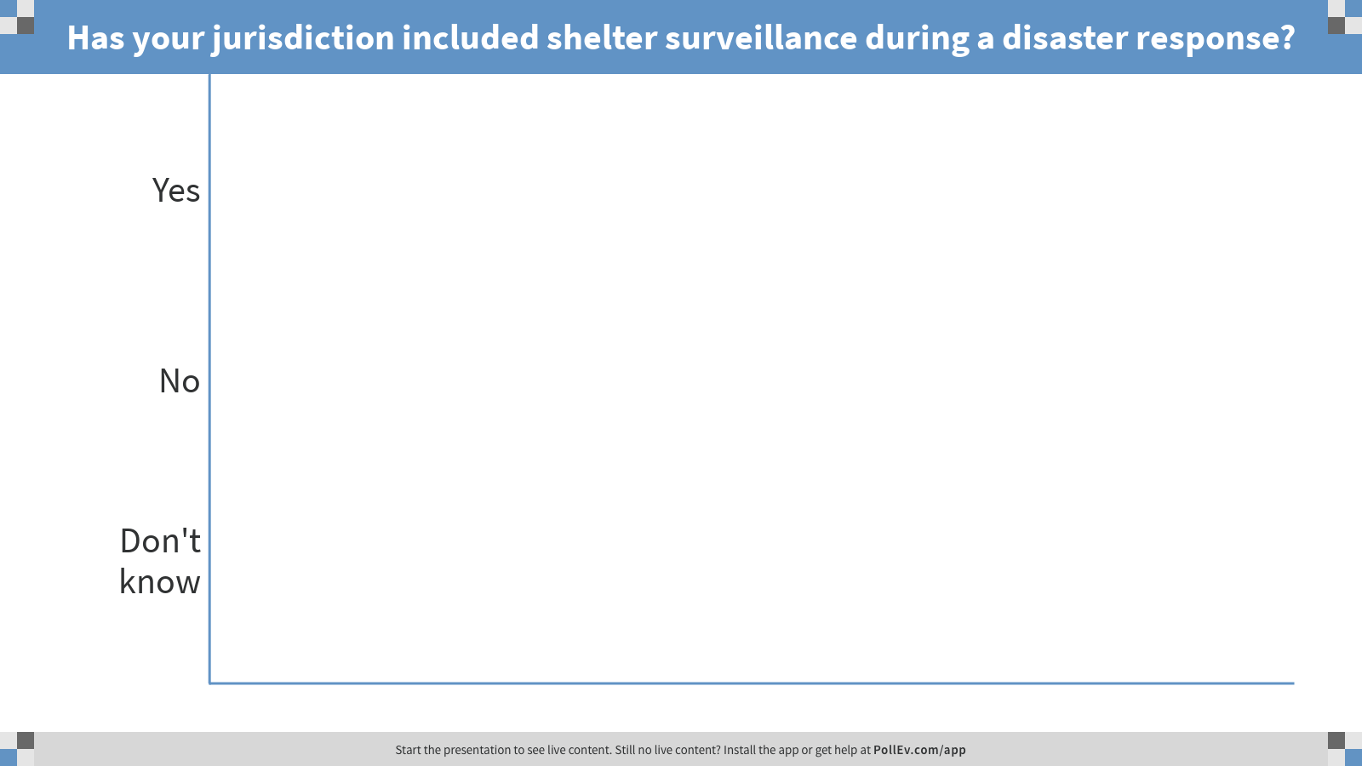
Notes:
Poll Title: Has your jurisdiction included shelter surveillance during a disaster response?
https://www.polleverywhere.com/multiple_choice_polls/fwNdQiBwRzuXahHQW3Pvp

Slide 41
Shelter surveillance
From: CSTE Shelter Surveillance Guidance Document
Notes:
Tess
One type of surveillance, is shelter surveillance. This tracks populations within the shelter facilities to identify outbreaks or disease clusters.
Also to assess environmental and sanitation conditions.
Active-cot-to-cot assessments
Passive-track shelter residents coming for health issue/complaint
Necessary to work with organizations that organize shelters (Red Cross in US) on having forms useful to everyone.

Slide 42
Data transfer options from shelter to health department
From: CSTE Shelter Surveillance Guidance Document
Notes:
Tess
How does this information exchange look? The shelter data could be communicated to multiple departments within the health departments, depending on topic.
Ideally shelter environmental data goes to EH
and demographic data is analyzed for all shelters,
and any morbidity data is analyzed and tracked by ID.
The information goes back to shelter for any actions to take.

Slide 43
Shelter surveillance during Hurricane Sandy
CDC and NJ Department of Health conducted shelter-based surveillance to track morbidity
ARC staff recorded demographic data, primary complaint(s), disposition, referral data for each client health visit
Collected aggregate morbidity data in the 21 shelters housing >30 residents overnight
Shelters reported: 5,189 health services visits which addressed 7,101 health needs
  52% acute illness, 32% follow-up care, 13% chronic illness exacerbations, 3% injury
Notes:
Tess
An example of shelter surveillance is during Hurricane Sandy CDC and New Jersey coordinated shelter surveillance for morbidity.
Red Cross staff recorded demographic information, primary complaints, dispositions and referral data for each client health visit.
The data was aggregated for all of the shelters.
They found there were 5,189 visits with 7,101 health needs.
Half of the needs were acute illness, followed by 32% with follow-up care needs,
13% with chronic illness exacerbations and smallest amount due to injury.

Slide 44
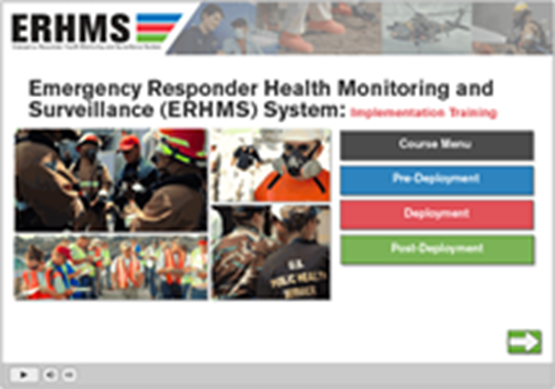
Responder surveillance
CDC Emergency Responder Health Monitoring Surveillance (ERHMS) is a health monitoring and surveillance framework for protecting responders through all phases of response
Collaboration between epidemiology, industrial hygiene, and emergency managers
Notes:
Hayleigh
CDC Emergency Responder Health Monitoring Surveillance (ERHMS) is a health monitoring and surveillance framework for protecting responders through all phases of a response
This requires collaboration between epidemiology, industrial hygiene, and emergency managers
Functions under Safety Officer in ICS
The National Institute for Occupational Safety and Health has an ERHMS Information Management System with user guide and Training videos at that link on the slide.

Slide 45
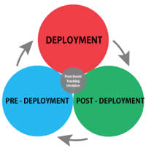
ERHMS key questions
Key questions to ask:
  Pre-deployment: which responders are “ready,” credentialed, and available to respond?
  Deployment: who are the responders on-site? To what are they exposed? How is their health?
  Post-deployment: what did the responders do while deployed? How is their health now? To what were they exposed during deployment?
  From: http://www.cdc.gov/niosh/topics/erhms/
Notes:
Hayleigh
framework provides recommendations for protecting emergency responders during small and large emergencies in any setting
Pre-ready: Existing health concerns inform assigned role or activities?
Deployment: what are the risks? Are they encountering exposures or health issues? Do they need health care or more guidance? Do they need to return or be re-assigned?
Post: what was their experience? Any on-going concerns to track or address?

Slide 46
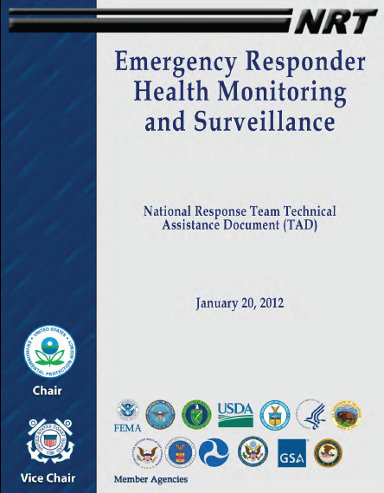
Emergency Responder Health Monitoring Surveillance (ERHMS)
National Response Team -- Technical Assistance Document
  https://www.nrt.org/sites/2/files/ERHMS_Final_060512.pdf
  Contains tools, examples & forms that have been used in other events
Notes:
Hayleigh
Incorporated into ICS, with safety officer applying
See the technical assistance document for examples

Slide 47
ERHMS findings following Hurricanes Katrina and Rita
Survey administered to 2834 US Coast Guard responders to determine disaster-related exposures and health effects
  Most frequent exposures: animal/insect vector (46%), floodwater (29%)
  Most frequent health effects: sunburn (39%), heat stress (30%)
  Significant positive associations:
    Mold exposure and sinus infection
    Carbon monoxide and confusion
    Lack of sleep and slips, trips, falls
    Lack of sleep and depression
    Being a Gulf-state responder and depression
From: http://dx.doi.org/10.1097/JOM.0000000000000188
Notes:
Hayleigh
ERHMS was applied to coast guard responders to Hurricanes Katrina and Rita to determine disaster-related exposures and health effects.
They found the most frequency exposure were animal/insect bites (46%) and floodwater exposures (29%) and most frequency health issues were sunburn 39% heat stress (30%)
There were also positive associations with mold and sinus infections, CO exposure and confusion, lack of sleep and depression/falls, and generally depression
Significant positive associations were for mold exposure and sinus infection (POR = 10.39); carbon monoxide and confusion (POR = 6.27); lack of sleep and slips, trips, falls (POR = 3.34) and depression (POR = 3.01); being a Gulf-state responder and depression (POR = 3.22).

Slide 48

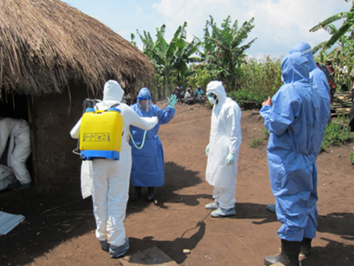
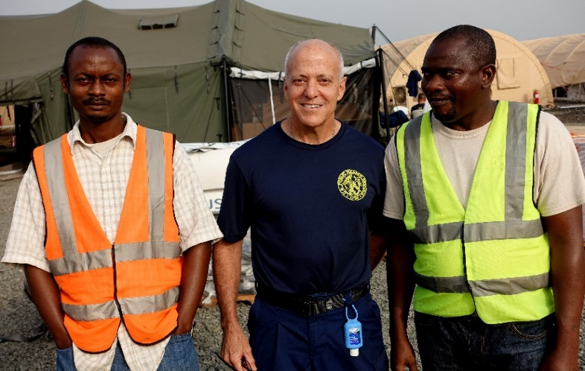
CDC Ebola response: a case study
In-Country Safety Officer
  Personal safety and security
    Interact with Regional Security Officer in-country
  Ebola risk assessments
  (Medevac)
  Injury/illness surveillance
  Food/water safety
  Vector/rodent control
  Lodging assessments
  Resiliency
  Accountability
From: http://www.cdc.gov/niosh/topics/ebola/default.html
Notes:
Hayleigh
CDC utilized this during the deployment for the Ebola response to monitor their workers and any risks that might come up, for not just Ebola itself, but also from the environment (vectors/rodents) and huge mental health impacts.
Active monitoring
CDC did active fever monitoring of all deployed staff and reported to all states and territories
Post-deployment debriefs:
Resiliency, Employee Assistance Program (EAP)
After action
Security
Team-specific

Slide 49

Tracking tools
Data collection tools to follow populations affected by a disaster
Can be used for short-term or long term follow up
Notes:
Tess

Slide 50

Rosters
Early assessment tool
Survey instrument to identify exposed persons for follow-up
Quickly collect information to identify people affected by disaster
Can be used to populate future registries
Notes:
Tess
Agency for Toxic Substances and Disease registries created a rapid response registry to register responders and other exposed people quickly- 5 minute survey
States have also created their own RRR to capture people on the scene for later follow-up
Survey instrument to register responders and other exposed persons
Two-page form that can be distributed on paper or electronically.
Implemented quickly to collect information to identify and people displaced or affected by a disaster.
Requires five minutes or less to collect basic information

Slide 51
Registries
Track affected people for medium to long-term health consequences
Inform needs for continuing medical/behavioral care or stablishing public health measures
Follow exposed population for conditions that may have delayed symptom onsets
Provide a basis for health education and disaster prevention
Notes:
Tess
While the roster is to collect basic information right away, a registry is a more formal assessment. This would occur when you have funding to establish a registry and have identified your study population (narrowed down the population of interest who are eligible).
Health problems like exposure to environmental contaminant necessitate evaluation for long-term health implications.
Assess long-term health impacts from exposures

Slide 52

9/11 WTC Registry
Voluntary enrollment of individuals that worked at the site or responded to the event
Results will help determine to what extend physical and mental health conditions have persisted
From: https://www1.nyc.gov/site/911health/about/wtc-health-registry.page
Notes:
Tess
Agency for Toxic Substances and Disease registries created a rapid response registry to register responders and other exposed people quickly- 5 minute survey
States have also created their own RRR to capture people on the scene for later follow-up
Survey instrument to register responders and other exposed persons
Two-page form that can be distributed on paper or electronically.
Implemented quickly to collect information to identify and people displaced or affected by a disaster.
Requires five minutes or less to collect basic information

Slide 53
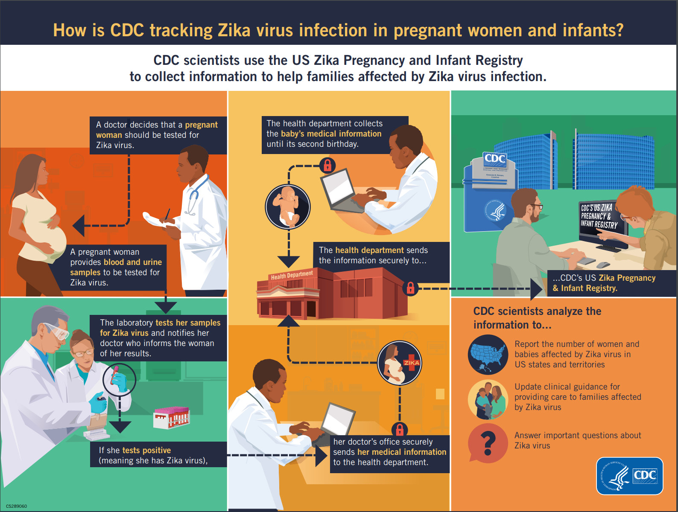
CDC Zika Pregnancy and Infant Registry
Collects information about pregnant women with possible Zika virus infection
Identified adverse pregnancy outcomes
Makes recommendations for clinicians to prevent Zika infection during pregnancy
From: https://www.cdc.gov/pregnancy/zika/research/registry.html
Notes:
Tess
A more recent registry, is CDC’s Zika pregnancy and infant registry. Pregnant women with lab confirmed Zika are included to identify adverse pregnancy outcomes to make recommendations to clinicians for care and Zika prevention.

Slide 54
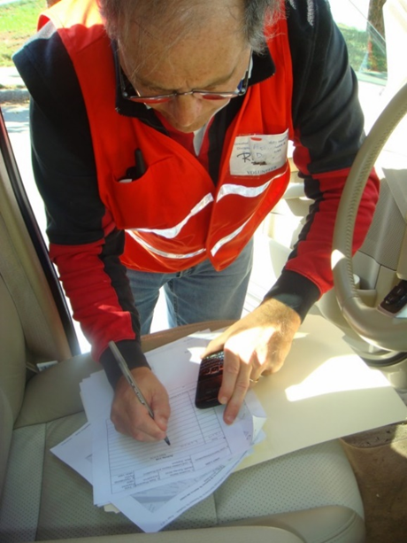
Rapid Needs Assessment
Launched early in response phase
Identifies needs of affected communities in a systematic, timely, and statistically valid manner
Provides basis for appropriate response
Notes:
Hayleigh

Slide 55
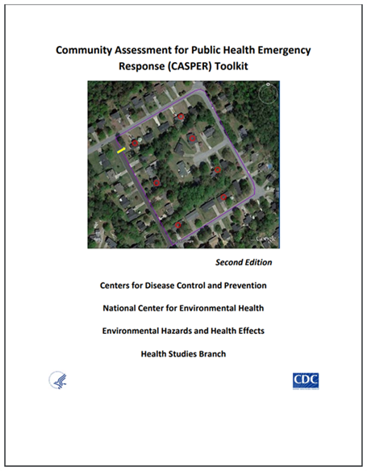
Community Assessment for Public Health Emergency Response (CASPER)
Type of rapid needs assessment
CDC epidemiologic technique to provide quick, low-cost household-based information about a community
Two-staged cluster sampling with door-to-door surveying
  7 interviews x 30 clusters = 210 surveys
Notes:
Hayleigh
One type of rapid needs assessment is the Community Assessment for Public Health Emergency Response (CASPER) developed by the CDC. It is now one of the main tools used for rapid need assessments.
Includes structured, systematic methodology of doing door-to-door survey interviews trough two-stage cluster sampling to get a representative sampling of a specific geographic area.

Slide 56
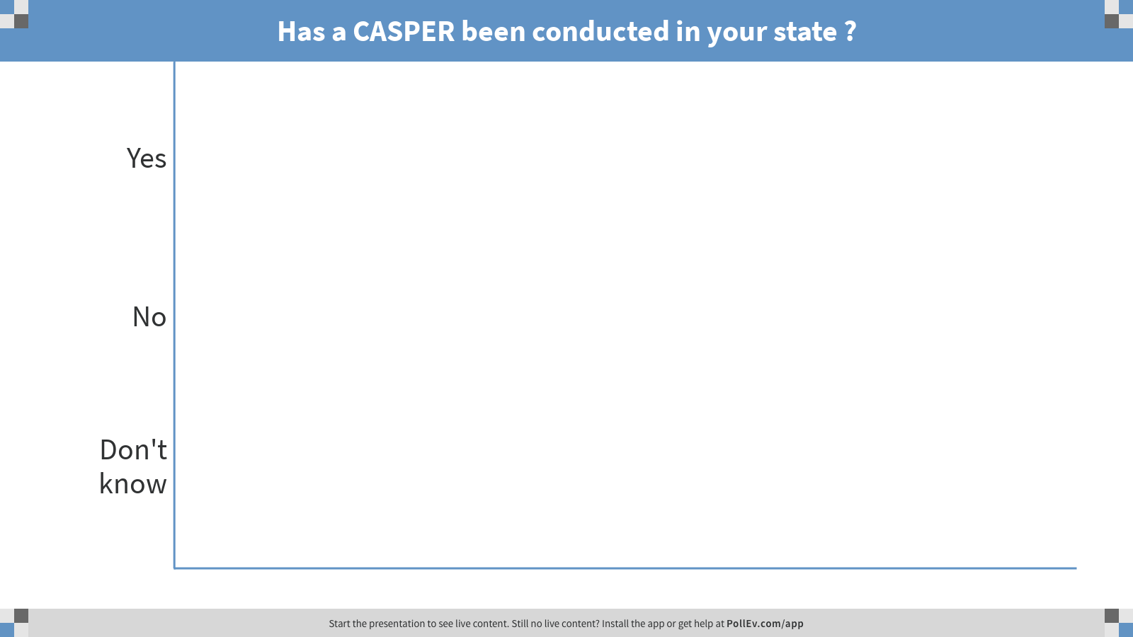
Notes:
Poll Title: Has a CASPER been conducted in your state ?
https://www.polleverywhere.com/multiple_choice_polls/attluVqHBLS2B0yOAwqsW

Slide 57
CASPER: Napa Valley Earthquake
August 2014: 6.0 magnitude earthquake hit Napa Valley, CA
CASPER conducted middle of September
  42% required home repair
  37% of households had an emergency kit before the earthquake
  23% were injured from earthquake or cleanup
  48% injured from clean-up within 2 weeks of earthquake
  Mental health treatment sought by 41% of households
From: http://www.safestates.org/?WebinarCASPER
Notes:
Hayleigh
During disaster:
Current needs
Communications
Health status
Disaster experience
One example of using a CASPER is following a large earthquake in Napa Valley, CA.
Using the CASPER methodology, they found:
that the impacted area had lots of home repair damage (42%),
23% injured with 48% of those occurring within 2 weeks from the incident (due to cleanup),
and that 41% of households were seeking mental health help.

Slide 58
CASPER: Preparedness for Radiological Emergencies
Oakland County, MI lies 50 miles from the Fermi Nuclear Power Plant
Findings:
  62.8% had a 7-day supply of prescription medication for each person who needed it
  64.2% had a working carbon monoxide detector
  67.1% had a first-aid kit
  93.3% of all respondents would report to a radiation screening center; 96% would evacuate; and 91.8% would shelter-in-place
  55.8% of respondents indicated their main information source would be television, 18.4% radio, 13.6% the Internet
From: http://www.ncbi.nlm.nih.gov/pubmed/24906059
Notes:
Hayleigh
Focus of this CASPER is prior to any event as training application of CASPER
Be ready make a plan-
Evacuation plans
Personal readiness plans
Communications
Recovery:
Assess long-term or ongoing needs
Evaluate response efforts or programs

Slide 59
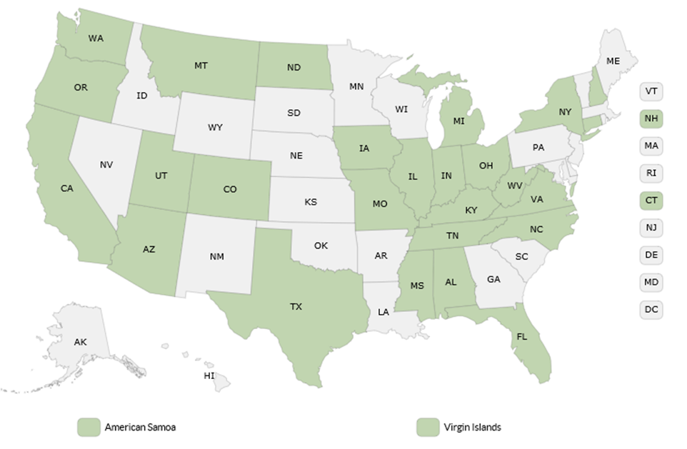
Current Scope of CASPERs
Over 125 CASPERs conducted in states across the US
Increase in number of preparedness and non-disaster CASPERs
Notes:
Hayleigh
In in the US, the number of CASPERs has increased to over 125, very common now. Likely even more not included on this map.

Slide 60
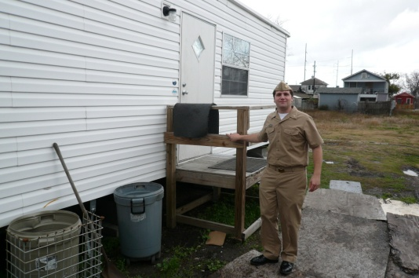
Epidemiologic investigations and research
Identify determinants of disaster-related death, illness, injury, disability
Identifies appropriate intervention and prevention strategies
Provides information to understand the short-, medium-, and long-term sequelae from a disaster event
Notes:
Tess

Slide 61

Epi Investigation: Assessment of Chemical Exposures (ACE) Program
Chemical release response ATSDR/CDC training & response
Epidemiologic assessment after a chemical release
Toolkit materials
  Surveys, consent forms, medical chart abstraction form, Interviewer training manual, databases
  All modifiable
From: http://www.atsdr.cdc.gov/ntsip/ace.html
Notes:
Tess
One type of epi. Investigation is an Assessment of chemical exposures (or ACE)
This was developed by ATSDR and CDC for responding to chemical releases.
The toolkit includes multiple resources that can be adapted to your response needs.
It includes surveys, consent forms, abstraction form, interviewer training manual, and database templates.
Describe Chlorine release in CA at metal recycling facility that led to new regulations.

Slide 62
ACE – Elk River, WV Chemical Spill
Jan. 9, 2014: 10,000 G. of a toxic industrial chemical (MCHM) was released into Elk River, just upstream of drinking water intake for Charleston, WV
Jan. 21, 2014: Officials learned 700 G. of another chemical (PPH) was part of same release event
Water for 30,000 people affected (Do Not Use Order)
WVBPH and CDC/ATSDR conducted ACE investigation
From: http://emergency.cdc.gov/chemical/MCHM/westvirginia2014/
Notes:
Tess
An example when ACE was used was when toxic industrial chemicals were accidentally released into a river in Charlestown, WV
The release occurred upstream from a drinking water source and impacted the drinking water for 300,000 people who were told to not drink the water.
Weren’t sure what kind of health impacts from these chemicals at the level in the water. Population not drinking, but still using for bathing.
ACE findings
Routes of exposure:
Bathing, showering, other skin contact – 52.6%
Eating, drinking, swallowing – 43.9%
Breathing mist or vapor – 14.6%
MCHM = 4 methyl cyclohexane methanol
PPH = poly glychol ethers

Slide 63
ACE – Elk River, WV Chemical Spill
Routes of exposure
  Bathing, showering, other skin contact – 52.6%
  Eating, drinking, swallowing – 43.9%
  Breathing mist or vapor – 14.6%
369 people when to ED
  13 (3.5%) admitted – Symptoms (Sx) + other chronic condition
  356 (96.5%) treated and released – Sx = Nausea, rash, vomiting, abdominal pain, diarrhea, headache, itching, sore throat, eye pain, cough
From: http://emergency.cdc.gov/chemical/MCHM/westvirginia2014/
Notes:
An example when ACE was used was when toxic industrial chemicals were accidentally released into a river in Charlestown, WV
The release occurred upstream from a drinking water source and impacted the drinking water for 300,000 people who were told to not drink the water.
Weren’t sure what kind of health impacts from these chemicals at the level in the water. Population not drinking, but still using for bathing.
ACE findings
Routes of exposure:
Bathing, showering, other skin contact – 52.6%
Eating, drinking, swallowing – 43.9%
Breathing mist or vapor – 14.6%
MCHM = 4 methyl cyclohexane methanol
PPH = poly glychol ethers

Slide 64
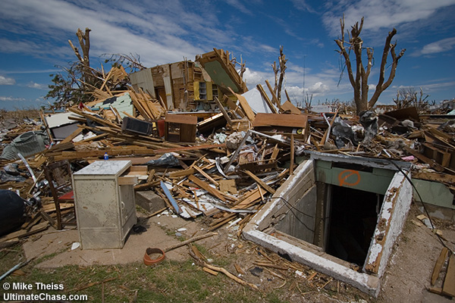
Epidemiologic studies
In 1990s, OK conducted a study of causes of fatal and non-fatal injuries associated with tornados
  Increase risk of death and injury among people seeking shelter under freeway overpasses & in shelters with wooden doors
  Recommended changes in education and construction standards
Notes:
Tess
Several case–control studies following tornadoes in Texas and Oklahoma (1979, 1999) identified risk factors for death and injury.76–78
One study examined risks among occupants fleeing their homes in motor vehicles versus those who remained within structures, raising concerns about the relative safety of occupying motor vehicles during tornados.79
Although typically conducted postdisaster, investigations and studies may be implemented long after life-saving emergency measures have been completed and issues requiring formal study have been identified
May be more common knowledge now first determined with epi analysis.

Slide 65
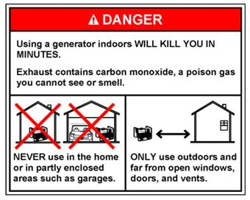
Evaluation studies
May be applied at different phases of disaster management cycle to assess response actions or interventions
Often provides information about efficient, efficacious, and cost-effective actions during response and recovery
Notes:
Tess
Evaluation studies, also called accountability studies and assess interventions and relief programs. These can be applied at different phases of the disaster management cycle to assess response actions or interventions.
Evaluate the impact of actions to inform improved response and support. How well did those interventions or programs work?
There are also risk investigations and studies, which characterize the risks from disasters. Example is there were carbon monoxide poisonings and this was related to the location people were putting their generator and now this is a built in part of communication after a disaster to make sure to have it far away from the house, well ventilated.

Slide 66

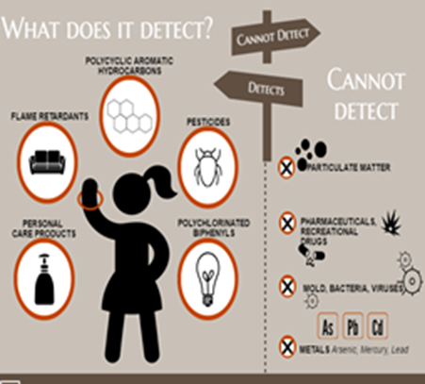
Risk investigation: Hurricane Harvey hazardous exposures
13 hazardous waste sites flooded
People in nearby Houston communities potentially exposed
Passive Wristband Samplers deployed to measure exposures
  Residents wear for 7 days
  Return by mail
  Bands can detects >1,500 chemicals
Research partnership with:
  Oregon State University SRP
  Texas A&M
  UTHealth School of PH
  Baylor College of Medicine
Notes:
Tess
13 hazardous waste sites were flooded during hurricane Harvey. So you can imagine there were all kind of contaminates in the water
In this risk investigation study, an academic partnership provided people in a community in Houston with passive wristbands to measure the exposures.
Risk characterization that informs what type of exposure, where, how much and possible actions/interventions to prevent future exposure.

Slide 67
Research During Emergencies: Disaster Research Response (DR2) Program
National Institute of Environmental Health Sciences (NIEHS) identified the need to rapidly perform critical health research during disaster response and recovery
Program includes:
  Ready-to-go data collection tools (database of surveys, forms, etc.)
  Research protocols (IRB pre-approval)
  Training and exercises
  Network of trained research responders
From: http://www.nationalacademies.org/hmd/Reports/2014/Enabling-Rapid-Sustainable-Public-Health-Research-During-Disasters.aspx
Notes:
Hayleigh

Slide 68
Resource and tool repositories
Houses forms and tools for data collection and analysis
  Facilitate dissemination and adoption
  Evaluate/improve tools based on experience
  Can be adjusted for jurisdiction/event
Primary repositories
  CDC’s Disaster Epidemiology Community of Practice (DECoP)
  CSTE’s Disaster Epidemiology Tool & Resource Repository
  National Library of Medicine (DR2)
Notes:
Hayleigh
To help with your planning and preparedness, there are several tool repositories that PH professionals use to share their work so you don’t have to recreate, but just adapt.
The disaster epi community of practice, CSTE de, and national library of medicine all have good repositories for you to explore. They are listed on the CSTE DE website, please check them out.

Slide 69
CSTE DE Subcommittee publications and guidance documents
The Role of Applied Epidemiology Methods in the Disaster Management Cycle
  Published 2014 in AJPH
CSTE’s Disaster Epidemiology Resource Guide
  Target publication date – Spring 2019
CSTE’s Shelter Surveillance Guidance Document
  Target publication date – Fall 2019
Notes:
Hayleigh
Our CSTE DE subcommittee have several publications either already published or in the works.
Previously published in AJPH on how epi methods fit into the disaster cycle-distilling what we presented to you
Now-we are developing case study examples for a resource guide to completed this fall and published by CSTE. Also, there is a shelter surveillance guidance doc, with more information and forms that is being finalized and should be out soon.

Slide 70
Benefits of Disaster Epidemiology
Provides situational awareness prior to and during a disaster
Monitors changes and needs of the community throughout the phases of emergency management
Opportunity for teams in the field to distribute health education materials
Use data to strengthen preparedness efforts
Notes:
Tess
Hopefully you have seen now that DE has many benefits to emergency preparedness.
It provides information for situational awareness
Monitors changes and needs of the affected community throughout disaster cycle
Useful in informing and promoting health education
The data is useful in strengthening preparedness efforts and overall prevent or reduce illness and death

Slide 71
Things to consider…
Integrating DE components into local, regional, county and state plans to help achieve PHEP capabilities.
Examples:
  Utilizing medical volunteers such as the Medical Reserve Corps to assist with conducting shelter surveillance
  Practicing conducting CASPERS by using the protocol for community health assessments
Notes:
Tess
Consider writing in DE into your preparedness planning as you update or write each section. Add one tool or methodology into what you already have and strengthen it as time goes on.
For example, you can include that you will use the medical reserve corp to help with shelter surveillance data collection
Or practice conducting CASPERs as one of your exercises.

Slide 72
Conclusions
Epidemiology has a role in all phases of disaster management as part of the public health emergency response – ESF8
Epidemiologic information, supplied in real-time, supports situational awareness and provides actionable information that may reduce mortality and morbidity
There are many disaster epidemiology tools that can be utilized before, during, and after an emergency
Notes:
Tess
Epidemiology has a role in all phases of disaster management as part of the public health emergency response— and is included in PHEP and the ICS
Epidemiologic information, supplied in real time supports situational awareness and provides actionable information that may save lives and reduce mortality and morbidity
There are many disaster epidemiology tools that can be utilized before, during and after an emergency

Slide 73
Join us!
CSTE’s 10th Annual Disaster Epidemiology Workshop
  May 14-15th
  Atlanta, GA
Join in-person or via webinar
To register or for more information, email Hayleigh McCall at hmccall@cste.org
Notes:
Hayleigh
Also, monthly calls with presentations and discussion.
The CSTE Disaster Epidemiology Subcommittee is intended to bring together various disciplines of epidemiology to enhance the public health response to emergencies.
Convenes various wide range of partners to develop unified and collaborative epidemiologic approaches towards improving emergency preparedness and disaster response capacities at local, state, regional, and national levels following natural disasters and other emergencies.
May 14-15th^{th} CSTE DE has a workshop on DE in Atlanta. You can also join via webinar using the links on the screen or contacting Hayleigh McCall.

Slide 74

Discussion
Notes:
Tess

Slide 75
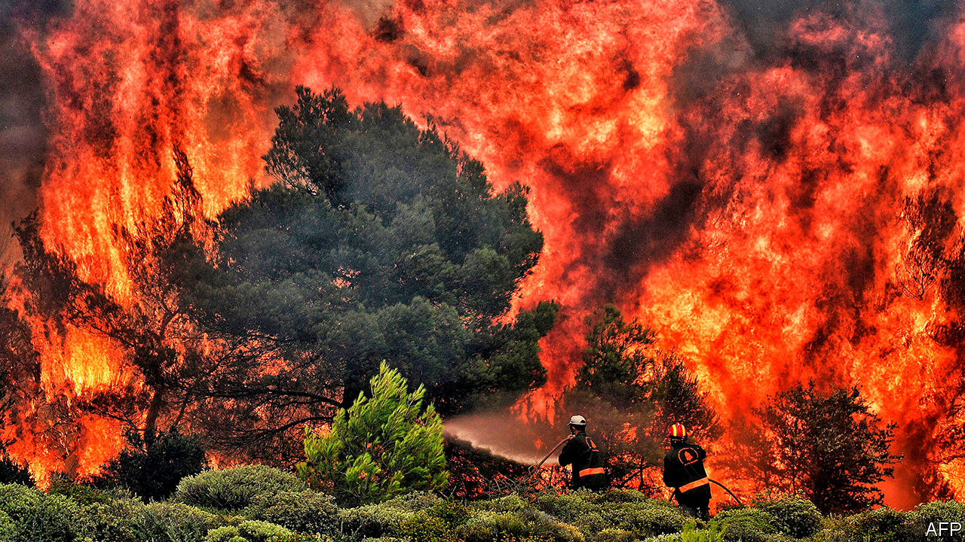
Putting it all together
Notes:
Let’s say you have a large fire in your area that requires evacuating people and concerns about air pollution. Which DE tools could you use?
You might use syndromic surveillance to identify key phrases about smoke inhalation and cardiovascular/respiratory events
You can use mortality surveillance to assess demographic and death situations
You could use shelter surveillance to not only assess incoming client needs but any outbreaks in shelters
You could use ERHMS to track those you deployed to see if they are developing health concerns (not only if at scene but if on-going and stress is issue)
You could do a rapid needs assessment immediately following to see what the community needs are (mental health, financial, symptoms, meds/health impacts)
You could do evaluation and research studies to collect data and understand the full impacts and how best to survive or mitigate injury

Slide 76
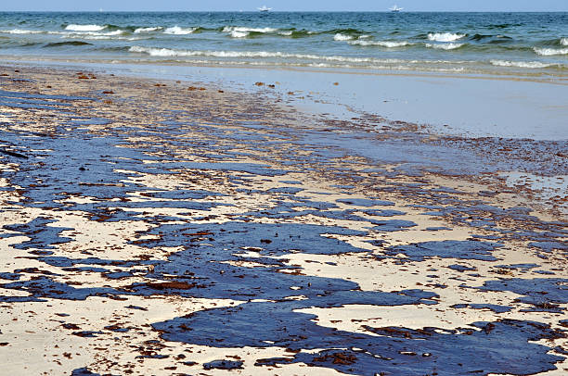
Putting it all together
Notes:
An oil spill occurs in your area.
What DE tools can you apply?
ERHMS to assess impact on workers/volunteers
ACE to assess exposure and health impact
CASPER- needs assessment to see impact area (BP had huge financial implications on fishing industry and financial stress), also impacts useage and community essence)

Slide 77
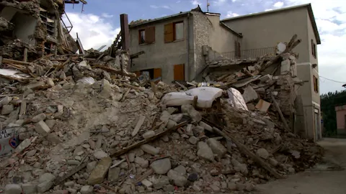
Putting it all together
Notes:
Earthquake in your community
Syndromic surveillance for injuries
Mortality review for related to earthquake
People in shelter
ERHMS impact on responders/volunteers (pre, during, post)
CASPER- assess readiness before or impact/needs after

Slide 78
Contact information
Tess Konen, MPH
  Minnesota Department of Health, MN Tracking Program
  Senior Epidemiologist
  Tess.Konen@state.mn.us
Hayleigh McCall, MPH
  Council of State and Territorial Epidemiologists
  Program Analyst
  hmccall@cste.org

Slide 79
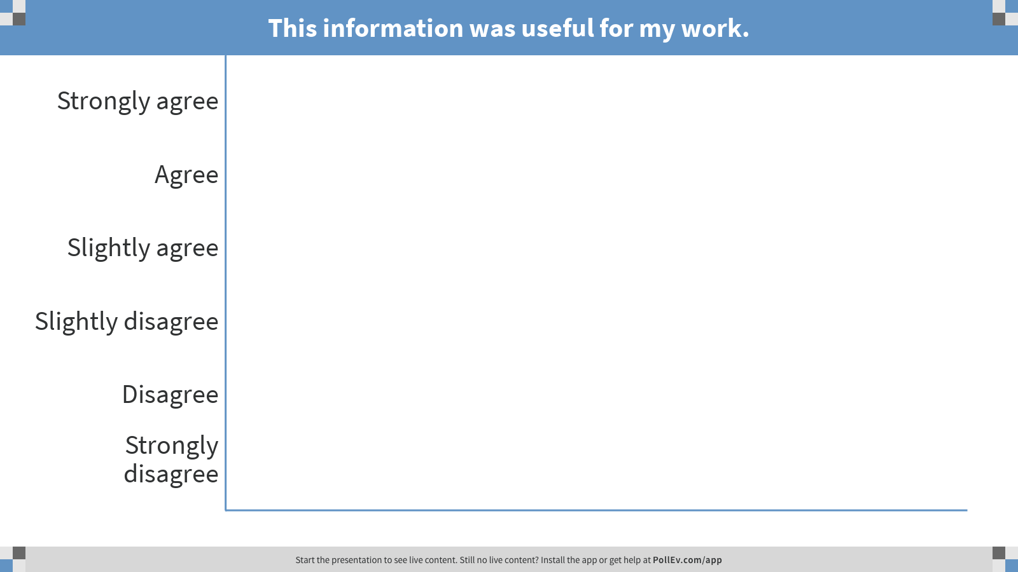
Notes:
Poll Title: This information was useful for my work.
https://www.polleverywhere.com/multiple_choice_polls/HD2O1sJwvCnfB6koCyRph

Slide 80
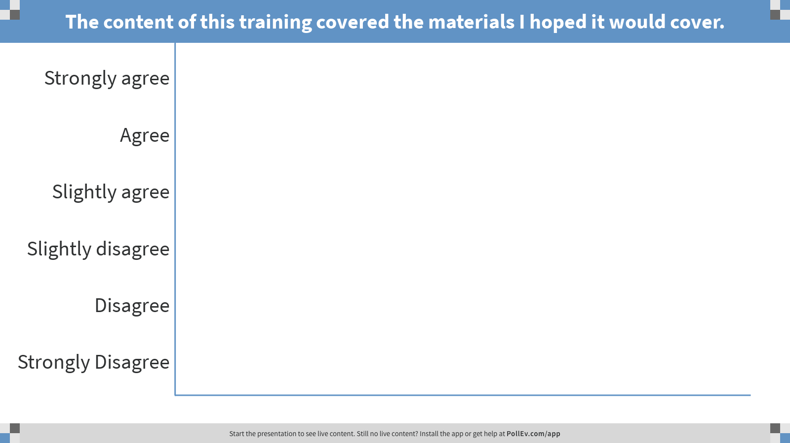
Notes:
Poll Title: The content of this training covered the materials I hoped it would cover.
https://www.polleverywhere.com/multiple_choice_polls/iyMEMwquUsudFpQH398X6

