Slide 1
How Disaster Epidemiology Tools and Methods Meet PHEP Capabilities
Name: Tess Konen, MPH & Andrew Adams, MPH
Title: How Disaster Epidemiology Tools and Methods Meet PHEP Capabilities
Event Title: PHEP Connects Webinar
Date: December 8th, 2021
For the audio portion of this presentation, dial (669) 254-5252 and enter meeting ID 161 241 1865, passcode 569595 . Slides from today’s presentation will be available in CDC’s Online Technical Resource and Assistance Center (On-TRAC).

Slide 2
Disclosure
CDC, our planners, and our content experts wish to disclose they have no
financial interests or other relationships with the manufacturers of
commercial products, suppliers of commercial services, or commercial
supporters.
Notes:
Anchor Script:
But before we get started, it's important that we let you know that our CDC planners and our content experts wish to disclose they have no financial interests or other relationships with manufacturers, commercial products, suppliers of commercial service, or commercial supporters.

Slide 3
Please Note
All audio lines are automatically muted
Post your questions anytime through chat box
This is being recorded and will be posted in On-TRAC
Call technical support for assistance (1- 866-692-4538 and the Participant Code is 70088050)
Participate in our evaluation questions
Notes:
Anchor Script:
Just a little housekeeping before we get started. All slides will be provided in the chat box. In addition, we’ll provide a link in the chat box to our evaluation questions. Your feedback will help us to evaluate and improve the quality of this training experience. The survey should take you less than 10 minutes to complete. All responses will be analyzed and reported in aggregate for internal use only and will be handled in a confidential and secure manner.
Additionally, we’ve included a phone number for technical support in our chat box. So please call 1- 866-692-4538 and the Participant Code is 70088050 if you need assistance. All your phones will start off on mute and will remain so during the webinar. We welcome your input and questions if time allots at the end, and I think it will. Please submit your questions in the q&a box during the question answer period. This is a recorded session, and so, we will be archiving these sessions into the On-TRAC website in the coming weeks

Slide 4
Purpose
Define Disaster Epidemiology (DE) and its role in all phases of the emergency management cycle and provide an overview of how DE tools and methods crosswalk to meet PHEP Capability requirements. .
Notes:
Anchor Script:
The purpose of todays’ webinar is to provide an overview of . . .

Slide 5



Presenters
Full Name: Tess Konen
Job Title: Senior Epidemiologist
Organization: Minnesota Department of Health
Email Address: Tess.Konen@state.mn.us
Full Name: Andrew Adams
Job Title: Senior Program Analyst
Organization: Council of State and Territorial Epidemiologists (CSTE)
Email Address: aadams@cste.org
Notes:
Anchor Script:
Here are the presenters that will be facilitating today’s topic.
Presenter Name #1: Tess Konen graduated from the University of Michigan, School of Public Health with a master’s degree in Occupational Environmental Epidemiology. She completed a CSTE/CDC Epidemiology Fellowship at the Minnesota Department of Health (MDH) in the Minnesota Tracking program. Currently, she is an environmental epidemiologist in the Minnesota Tracking program focusing on heat-illness, acute poisonings, radon, birth defects, climate change indicators, and disaster epidemiology. She is the co-chair of the CSTE Disaster Epidemiology Subcommittee and works on post-disaster, long-term surveillance planning at MDH.
Presenter Name #2 Andrew Adams is a Senior Program Analyst at the Council of State & Territorial Epidemiologists (CSTE), overseeing CSTE’s Disaster Epidemiology and Preparedness portfolios, which includes being the staff lead for the Disaster Epidemiology Subcommittee. He is also currently supporting CSTE’s COVID-19 response. Prior to joining CSTE, Andrew spent five years at a county-level health department serving as the PHEP Coordination and Epidemiologist. He graduated from Saint Louis University’s College for Public Health & Social Justice with a master’s degree in Epidemiology & Biosecurity/Disaster Preparedness.
Let’s go ahead and get started! At this time, I’d like to turn the virtual microphone over to ____________to start with our presentation.

Slide 6
Webinar Outline
Define Disaster Epidemiology (DE) and its role in the EM cycle
Describe how DE methods can be integrated to help achieve PHEP Capabilities
Showcase specific DE tools and demonstrate how application at local or state level
Disaster epidemiology resources and communities
Notes:
Presenter’s Script:

Slide 7
Disaster Epidemiology

Slide 8

What is epidemiology?
Notes:
To make sure we are all on the same page, I am going to go over some definitions quickly.
Epidemiology is the study of distribution and determinants of illness, injury, disability and death in specified populations, and the application of this study to minimize these outcomes.
This approach is applied across all the whole spectrum of public health from the traditional infectious disease to chronic, maternal child health, environmental and occupational hazards.

Slide 9
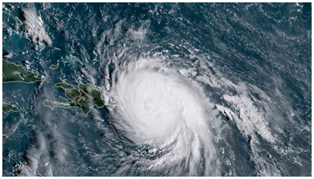
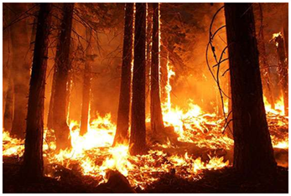
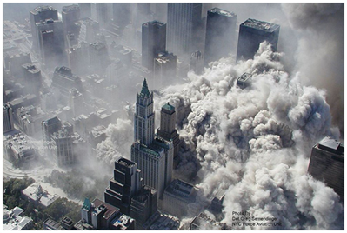
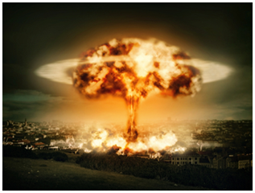
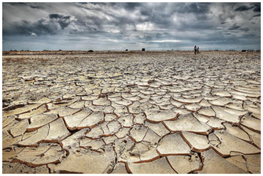
What is disaster epidemiology?
The use of epidemiology to assess the short- and long-term adverse health effects of disasters and to predict consequences of future disasters
Notes:
Tess
Quite simply, epidemiology methods applied to disasters is disaster epidemiology. Like any sub-field, it has it’s own tools and approaches.
Disaster Epidemiology is defined as the use of epidemiology to assess the short- and long-term adverse health effects of disasters and to predict consequences of future disasters.

Slide 10
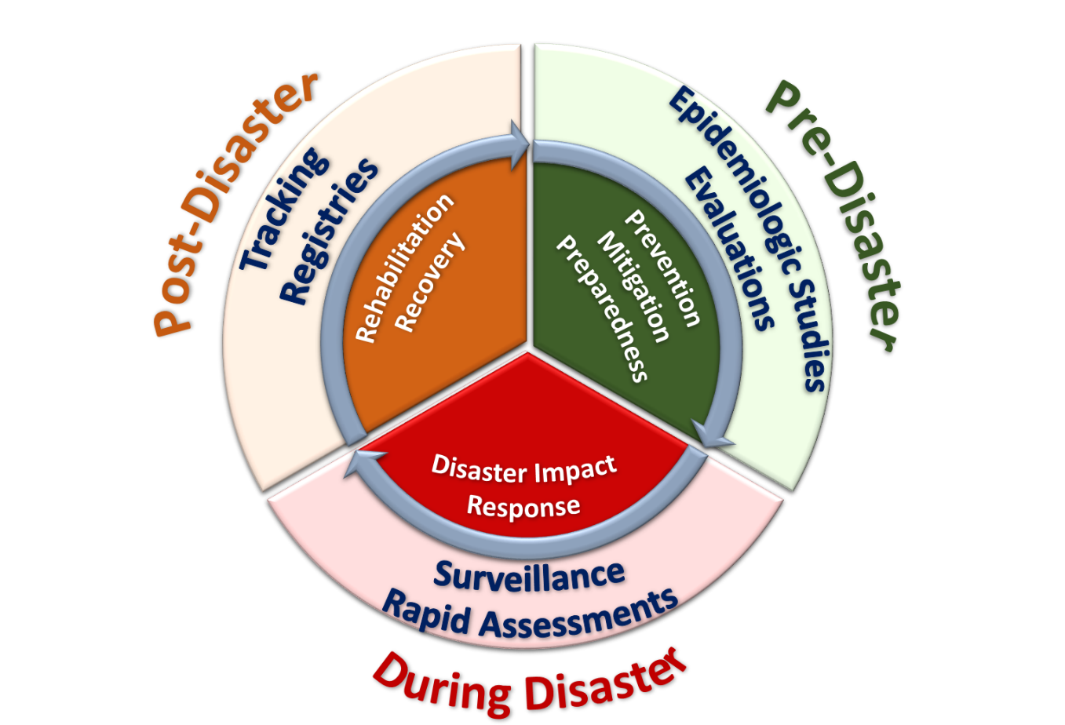
Disaster epidemiology in the EM cycle
Notes:
Conceptual framework developed by trusted partners Centers for Disease Control & Prevention (CDC)/National Center for Environmental Health (NCEH), Council of State and Territorial Epidemiologists (CSTE)
identifies the applications of epidemiology in disaster settings
For DE purposes, collapse traditional EM cycle into pre, during, post incident phases
DE was originally applied in response to large scale emergencies. It has evolved and expanded in the past decade. Now, we use DE across all EM phases
DE tends to define its approach in relationship to the timeliness of needed information pre, during, post

Slide 11
How can DE help you?
DE provides reliable and actionable information to incident commanders, planners, and decision-makers
Provides situational awareness
Assesses the short- and long-term adverse health effects of disasters
Informs planning and preparation for future disasters
Notes:
DE is multi-disciplinary: brings together various topic areas of epidemiology including acute and communicable disease, environmental health, occupational health, chronic disease, injury, mental and behavioral health.
Provides timely, evidence-based situational awareness
Provides information that helps us understand what the needs are, plan the response, gather and distribute the appropriate resources.
The main objectives of disaster epidemiology are to
prevent or reduce the number of deaths, illnesses, and injuries caused by disasters,
provide timely and accurate health information for decision-makers,
improve prevention and mitigation strategies for future disasters by collecting information for future response preparation.

Slide 12
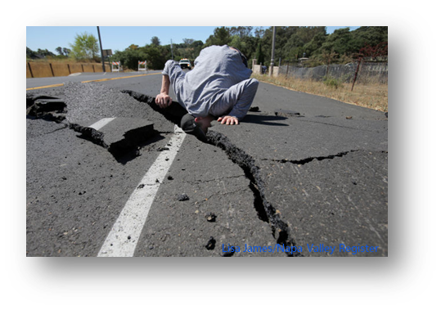

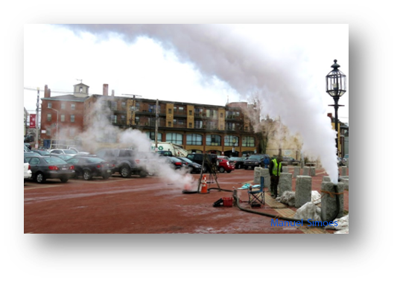
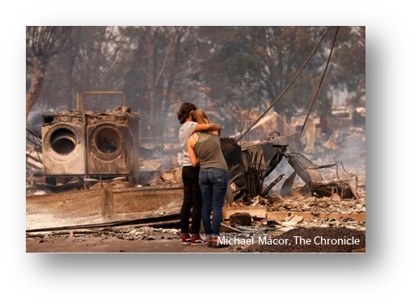
Disaster Epidemiology takes an All-Hazard approach
Notes:
DE is all-hazard
SMEs: Consider disease, injury, death, MH/BH, public health consequences of property damage, business disruption, and environmental impact
DE helps identify hazards, risks, and vulnerabilities
Applied across all of public health impacts
During an infectious disease (ID) outbreak, public health turns to the ID experts
During an environmental disaster, public health turns to EH experts
Knowledge of response to all-hazards
DE and Emergency Management: Smooth transition from daily roles to response roles
Cross training of epidemiologists – Epi needs to know Emergency Management and Disaster Epi
PHEP/EM need to pull the appropriate epi SME
If you are a PHEP, meet your epi!

Slide 13
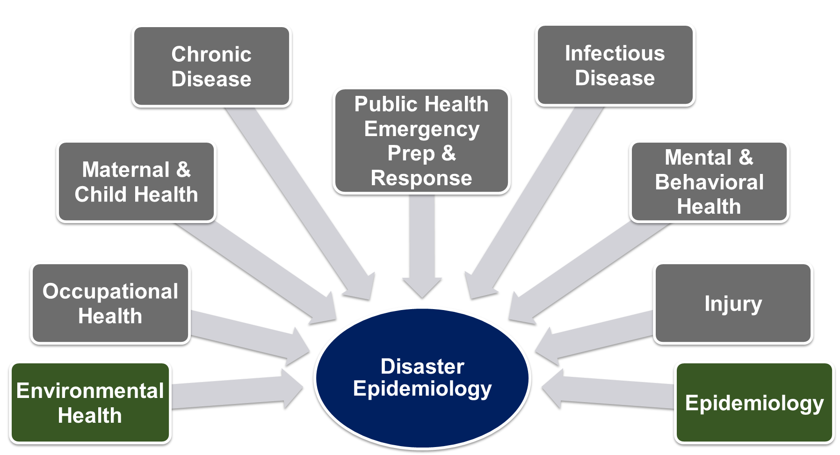
Disaster epidemiology is multi-disciplinary
Notes:
KSA, Experience, Training
When an incident happens, a disaster epidemiologist should be pulled from areas of public health that are most affected
Earthquake: call for an injury epidemiologist
Chemical release: call for an environmental epidemiologist
Mass evacuation: call for an infectious disease epidemiologist
Disaster Epis also get formal emergency management training
Understanding incident command system and how emergency operations work is critical
Any epidemiologist can be a disaster epidemiologist

Slide 14
PHEP capabilities and DE

Slide 15

PHEP Capabilities Guide 2018
2018 revisions added references to specific DE tools and emphasized the importance of DE
Notes:
Several DE tools and methods are now specifically listed in PHEP Capabilities Guide 2018
Specifically, the capabilities further emphasize the importance of disaster epidemiology
DE methods and tools can help you meet your PHEP and HPP required capabilities. The following slides highlight the PHEP and HPP Capabilities and Functions that DE fit in.

Slide 16
DE and PHEP capabilities
Capability 1: Community Preparedness
Capability 3: Emergency Operations Coordination
Capability 4: Emergency Public Information and Warning
Capability 13: Surveillance and Epi Investigations
Capability 14: Responder Safety and Health
Notes:
For this presentation, we will focus on 5 of the capabilities, however DE has a role in all of them. Please see the handout for examples of DE and PHEP crossover
Capability 1: Community Preparedness
Assess and determine risks to the population and identify and map at-risk populations
Method example: studies, assessments
Capability 3: Emergency Operations Coordination
Provide situation awareness to detect need for activation or dissemination of resources
Method example: syndromic surveillance
Capability 4: Emergency Public Information and Warning
Inform health alerts and the development of educational materials
Method example: ACE, CASPER
Capability 13: PH Surveillance and Epidemiological Investigation
Monitor trends of illness or injury and provide situation awareness
Method example: PHEP Capability Guide specifically references DE tools (ACE & CASPER) and registries
Includes tracking systems, monitoring the exposed, and syndromic surveillance systems
Capability 14: Responder Safety and Health
Method example: Emergency Responder Health Monitoring Surveillance (ERHMS) is a health monitoring and surveillance framework for protecting responders through all phases of response

Slide 17
DE tools and examples

Slide 18
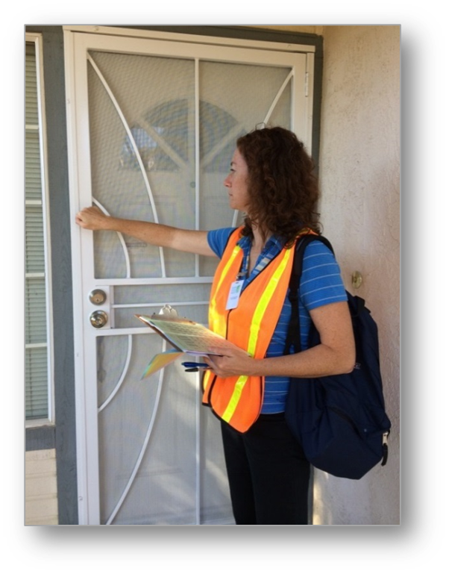
Rapid needs assessments
Launched early in response phase
Identifies needs of affected communities in a systematic, timely, and statistically valid manner
Provides basis for appropriate response
Community Assessment for Public Health Emergency Response (CASPER)
  Type of rapid needs assessment
  CDC epidemiologic technique to provide quick, low-cost household-based information about a community
Notes:
Rapid Needs Assessments
RNA = systematic process of information collection and analysis regarding the type, depth, and scope of a problem
Are launched early in response phase and can also be done for preparedness and recovery purposes
Identify needs of affected communities in a systematic, timely, and statistically valid manner
Provide basis for appropriate response
CASPER
One type of rapid needs assessment is the Community Assessment for Public Health Emergency Response (CASPER) developed by the CDC. It is now one of the main tools used for rapid need assessments.
Includes structured, systematic methodology of doing door-to-door survey interviews through two-stage cluster sampling to get a representative sampling of a specific geographic area. (analyzed at household level)
Guiding principle:
What do you want to know?
Why do you want to know it?
What are you going to do about it?
Actionable – emphasis on “do”

Slide 19
Preparedness CASPER: Radiological emergencies
Oakland County, MI lies 50 miles from the Fermi Nuclear Power Plant. Michigan Department of Health conducted a CASPER to assess community preparedness and best methods of communication.
Findings:
  62.8% had a 7-day supply of prescription medication for each person who needed it
  67.1% had a first-aid kit
  93.3% of all respondents would report to a radiation screening center; 96% would evacuate; and 91.8% would shelter-in-place
  55.8% of respondents indicated their main information source would be television, 18.4% radio, 13.6% online
Notes:
Focus of this CASPER is prior to any event as training application of CASPER
Be ready make a plan-
Evacuation plans
Personal readiness plans
Communications
PHEP capabilities: cap 1 community preparedness and cap 4 Emergency Public Information and Warning

Slide 20
Response CASPER: Mental Health Needs Assessment after the 2010 Gulf Oil Spill
A CASPER was conducted in Gulf Coast counties to determine general and mental health needs of the community after the oil spill.
  22% Mississippi respondents reported ≥14 days of poor physical health in the previous 30 days
  More respondents in Mississippi were worried about money for housing and meals and reported symptoms of anxiety than in the two Alabama assessment areas.
Supports evidence-based public health decision-making to guide response and allocate resources.
Notes:
PHEP Cap:
Capability 13: PH Surveillance and Epidemiological Investigation
Monitor trends of illness or injury and provide situation awareness

Slide 21
Recovery CASPER: Longitudinal wildfire assessment
Texas Department of State Health Services conducted a CASPER to assess public health impacts from a devastating wildfire.
CASPER was conducted 3 years later to measure progress in recovery and assess long-term health and mental health status.
Initial CASPER informed key public health issues and resource allocation. Follow-up CASPER informed new concerns or unmet needs to share with officials.
Notes:
PHEP capabilities: cap2 community recovery and cap 4 Emergency Public Information and Warning (informed communication methods as well)

Slide 22
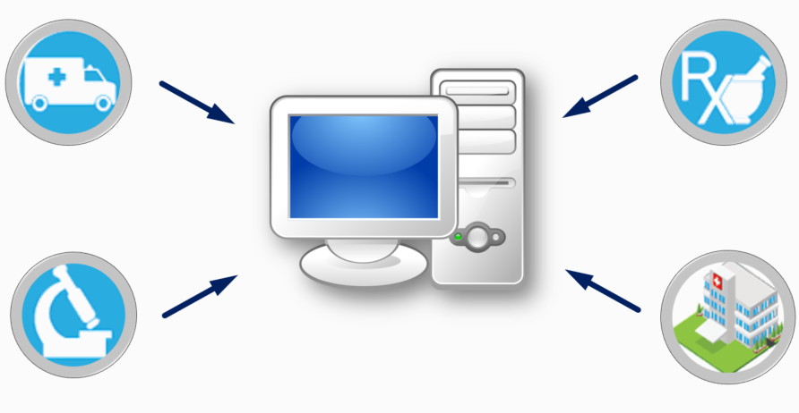
Syndromic surveillance
Early warning system for detecting, understanding, and monitoring health events
Syndromic is before diagnosis – e.g., mine keywords from chief complaint and triage notes
Notes:
Syndromic surveillance uses patient healthcare encounter data and statistical tools to detect, monitor, and characterize unusual activity for further public health investigation or response.
Allows us to detect potential aberrations in populations more quickly than a traditional outbreak could be detected by diagnostic means.
Data can come from emergency rooms, poison control centers, emergency medical services, pharmacies, and work or school absenteeism.
Data are monitored in near real-time as potential indicators of an event, a disease, or an outbreak of public health significance.
Identifies intra-disaster outbreaks or clusters of conditions
Characterizes burden of incident on affected sub-populations
Provides descriptive analysis of conditions, injuries, and fatalities
Can use multiple types of data (attendance data, pharmacy info) but most commonly used is data from clinics and hospitals (chief complaint data)

Slide 23
Syndromic surveillance of asthma following building collapse
NYC Department of Health conducted syndromic surveillance of asthma following building collapses and fires.
ED visits for asthma did not increase for the day of the events and for several days afterward.
Surveillance findings were shared with leadership, and they were able to respond to questions from the press regarding the health impacts of local air quality.
Capability 3: Emergency Operations Coordination: Provide situation awareness to detect need for activation or dissemination of resources
Notes:
PHEP capabilities this meets: cap 3

Slide 24
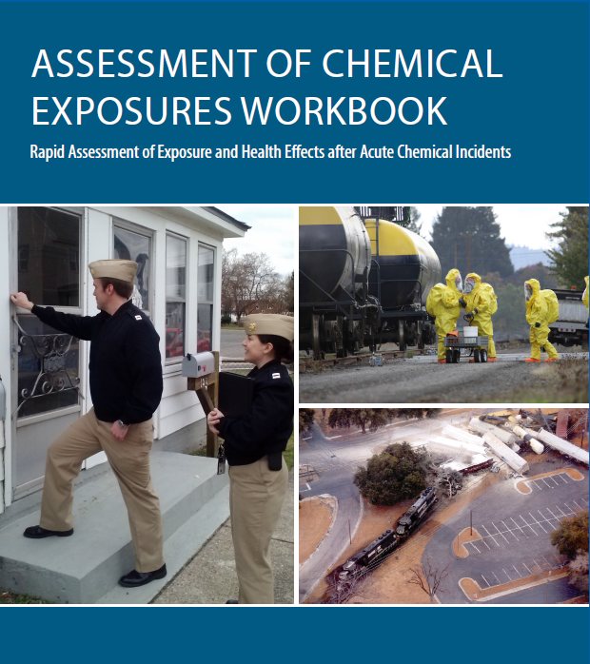
Assessment of chemical exposure (ACE) Toolkit
Toolkit
Health impacts and root causes of exposure
Focus on response from a health perspective
Collaborate with multiple disciplines
Notes:
Rapid assessment during the aftermath of large-scale chemical releases resulting in multiple casualties
Unlike a CASPER which is a method, ACE is a toolkit and can use any epi approach
Toolkit includes: standardized surveys, consent forms, medical chart abstraction form, data entry programs, geospatial analysis tools, and laboratory specimen testing
All materials are modifiable and adaptable to local incident needs
ATSDR built the ACE program based on lessons learned from the Graniteville, South Carolina, train derailment that released chlorine gas
ACE is public health lane
Look at health impacts and root causes of exposure
Focus on appropriate response from health perspective
Collaborative project with multiple disciplines
Benefits :
1. Identify actions to prevent future incidents
2. Roster exposed cohort of individuals for further follow-up
3. After action and improvement planning for public health and safety response
4. Identify health effects in the community, workers, and first responders
5. Determine appropriate medical treatment and efficacy of decontamination
6. Collaborate with many disciplines PH usually doesn’t cross paths with

Slide 25
ACE following freight train derailment of chemical
Freight train carrying vinyl chloride derailed and New Jersey Department of Health conducted ACE survey to gather information on community exposure, health impacts, and communication.
  58% experienced at least one new or worsening symptom
  9% sought medical care
  Residents evacuated rather than sheltering in place had fewer symptoms.
  Residents preferred to receive information directly from a person of authority. Need more info. on how to shelter-in place safely.
Provided situational awareness and monitoring of illness. Informed best method for communicating with public about emergency.
Notes:
Vinyl chloride is a colorless, sweet-smelling gas, the inhalation of which can cause respiratory and neurological symptoms, and, at
high concentrations, can cause cardiac dysrhythmia, loss of consciousness, and death.
Informed future planning for evacuation and shelter in place clarifying directions. Most got info. from tv or neighbors , although prefer to get from person of authority.
PHEP cap this meets:
Capability 4: Emergency Public Information and Warning
Inform health alerts and the development of educational materials
Capability 13: PH Surveillance and Epidemiological Investigation
Monitor trends of illness or injury and provide situation awareness

Slide 26
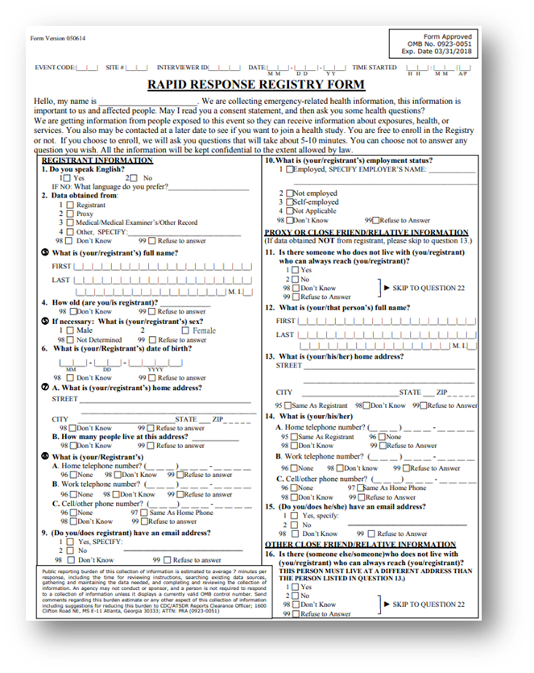
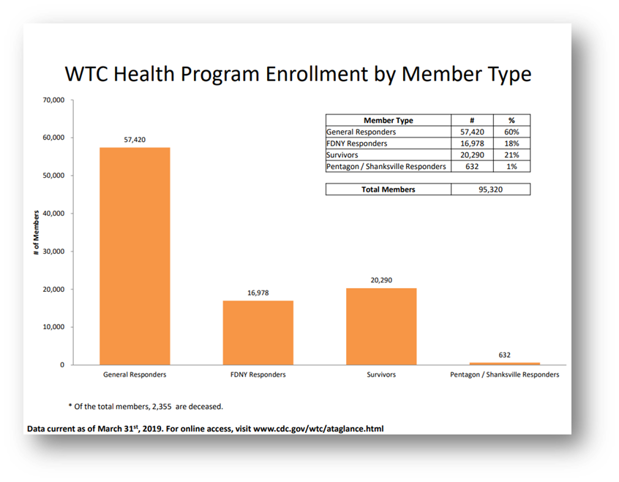
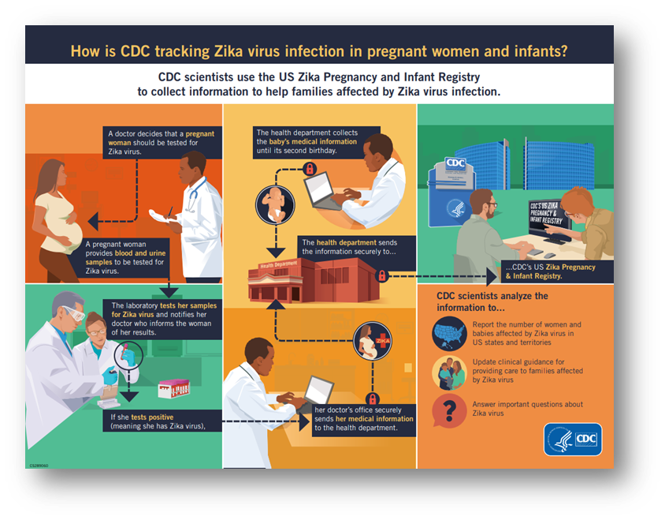
Tracking, Rostering, Registries
Notes:
Familiar with cancer registry
What do we do in cases when resulting illnesses, injuries, or disabilities—including emotional trauma—may not be recognized or resolved in the immediate post-disaster period?
Disaster epi-related registries: CDC Zika and WTC post 9/11
WTC post 9/11: Results will help determine to what extend physical and mental health conditions have persisted
A more recent registry, is CDC’s Zika pregnancy and infant registry. Pregnant women with lab confirmed Zika are included to identify adverse pregnancy outcomes to make recommendations to clinicians for care and Zika prevention.
Before we get to registries, there’s tracking and rosters
Tracking
Collection and integration of data from environmental monitoring, exposure, and health effects in people over time
Can be used for short-term or long-term follow up
Rosters
Early assessment tool to quickly find people affected by disaster
Collect information on the exposed persons for follow-up
Can be used to populate future registries
Registries
Track affected people for medium to long-term health consequences
Inform needs for continuing medical/behavioral care or establishing public health measures
Follow exposed population for conditions that may have delayed symptom onsets
In all three approaches, we typically gather initial information during response and recovery phases
Ultimately, these approaches inform ongoing care, future public health interventions, and public health emergency planning and preparedness
Meets cap. 13

Slide 27
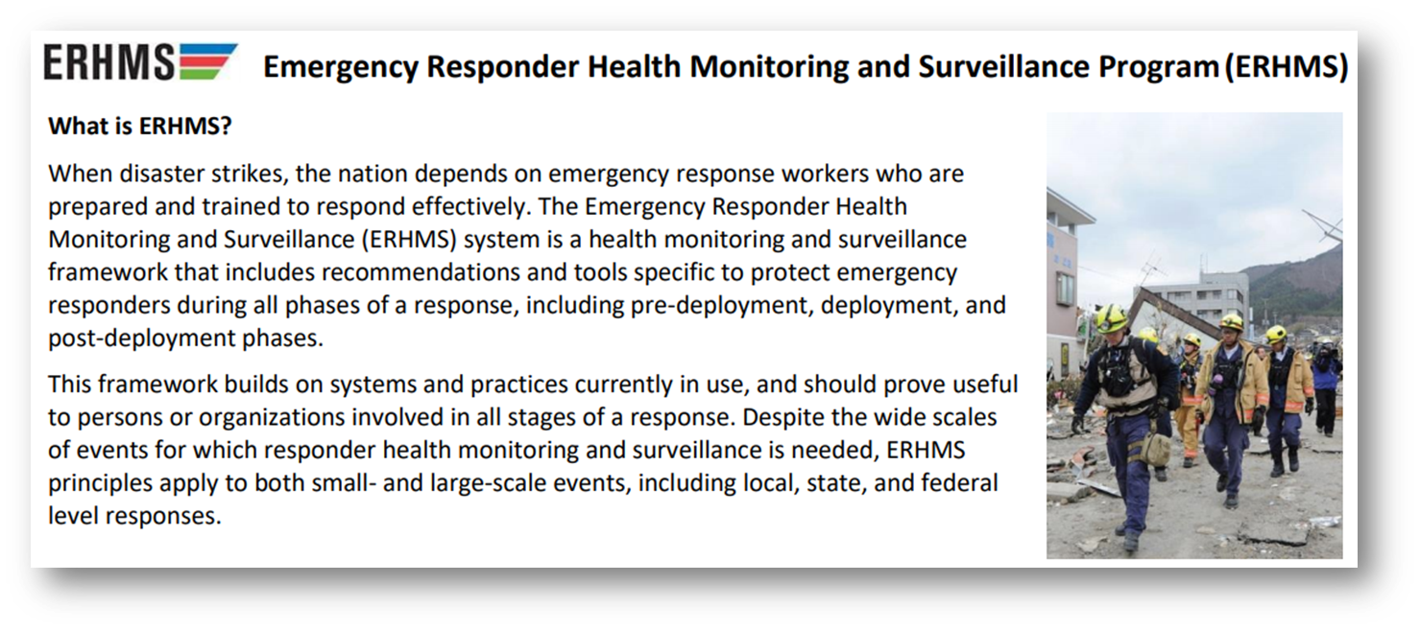
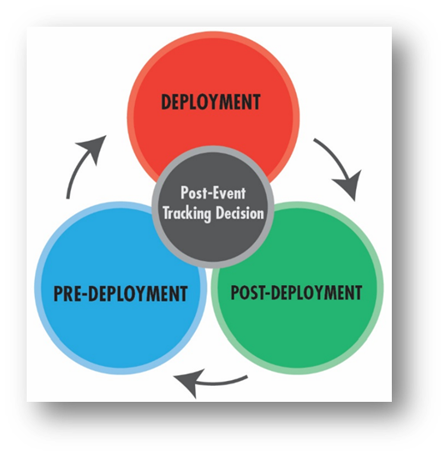
Emergency Responder Health Monitoring Surveillance (ERHMS)
Notes:
CDC Emergency Responder Health Monitoring Surveillance (ERHMS) is a health monitoring and surveillance framework for protecting responders through all phases of response
Collaboration with epidemiology, industrial hygiene, and emergency managers
Key questions to ask:
Pre-deployment: which responders are “ready,” credentialed, and available to respond?
Deployment: who are the responders on-site, and to what are they exposed? How is their health?
Post-deployment: what did the responders do while deployed, how is their health now, and what to what were they exposed during the entire deployment?

Slide 28
ERHMS during Hurricane Matthew
Georgia Department of Public Health sent out surveys to Hurricane Matthew responders to self-register their deployment activities and to complete a health and safety check
Responders valued someone checking in on them during their deployment and supervisors could verify their responders were accounted for and unharmed
Capability 14 (Responder Safety and Health) and capability 15 (Volunteer Management)
Notes:
Any state receiving this funding can implement ERHMS to meet Capability 14 or 15 (Volunteer Management).
Can also be conducted as a drill for planning purposes:
Monongalia County Health Department was able to implement ERHMS™ during a multi-agency,
statewide emergency drill, Operation Dawson Storm. The drill was conducted in July 2016 in
Morgantown, WV with military, emergency medical personnel, law enforcement, and public health
officials and focused on potential exposure to a radiological source. The health department focused on
conducting health monitoring of first responders before the drill and after the drill and developed preand
post-drill questionnaires.

Slide 29
Resources

Slide 30
Disaster epidemiology communities
CSTE Disaster Epidemiology Subcommittee: https://www.cste.org/group/DisasterEpi
CDC Disaster Epidemiology Community of Practice (DECoP: https://www.cdc.gov/nceh/casper/decop-invite.htm
Syndromic Surveillance and Public Health Emergency Preparedness, Response and Recovery (SPHERR) Subcommittee: https://knowledgerepository.syndromicsurveillance.org/spherr-workgroup

Slide 31
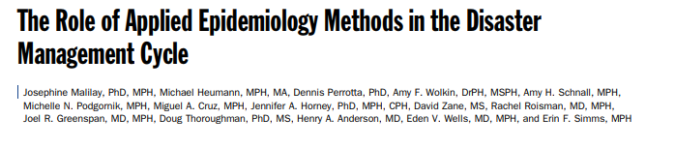
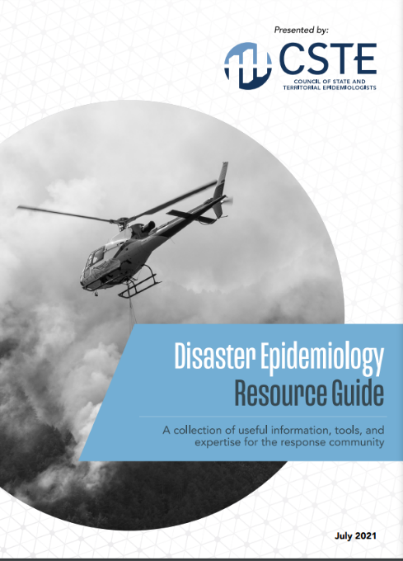
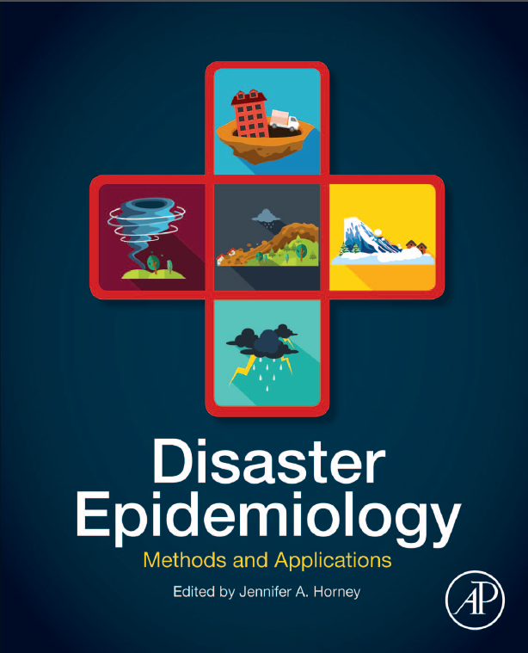

Disaster Epidemiology Resources
Notes:
CSTE DE tool repository: https://www.cste.org/page/epidisaster
NEW DE resource guide: https://cdn.ymaws.com/www.cste.org/resource/resmgr/disasterepi/DE_Resource_Guide_Final_v3.pdf

Slide 32
Potential Polling Questions
What is your primary role in preparedness?
Has a CASPER been conducted in your state?
Where you aware of these DE tools mentioned in PHEP capabilities?
Notes:
Polling questions consist of multiple choice, multiple answer or short answer questions.
Identify questions to poll the audience during the presentation.
In the note section of slides- Synchronize the questions with slides.
Identify slide # and corresponding polling question.

Slide 33
Canned Questions
Notes:
These pre-planned questions will be read during the questions and answer period.

Slide 34
Questions
Notes:
Anchor Script:
I want to thank our presenters _________________ for taking time from their busy schedule to present today. It was an informative session.
We have a few minutes left in this hour so let’s see if we have any questions. We’ll start with the questions in the chat box & submitted in the q&a . Our own __________ has been supporting as a chat box moderator_______, what questions have we received? Thanks folks. Great questions.
AFTER QUESTIONS ARE ALL RECEIVED:
We have a few minutes remaining. ______________ are there any last comments you’d like to conclude with.
Thank you, everyone. It was a pleasure being with you today. Please check the DSLR Friday updates for any upcoming webinars. As a reminder, the evaluation survey in the chat box will be used to gather your feedback to improve our webinars.
In addition, a copy of the slides have been made available to you in the chat box. We’re working harder to ensure these sessions are be posted in On-TRAC sooner. So, you can look forward to that within a week or two.
Thanks again for joining us today and we will see you next time.

