Slide 1

Disaster Epidemiology:
How Preparedness and Response Tools Support Recovery and Mitigation
Andrew Adams, Council of State and Territorial Epidemiologists
Svetlana Smorodinsky, California
Tess Konen, Minnesota

Slide 2
Disaster Epidemiology
How Preparedness and Response Tools Support Recovery and Mitigation
Andrew Adams, Council of State and Territorial Epidemiologists
Svetlana Smorodinsky, California
Tess Konen, Minnesota

Slide 3
Our Speakers
Andrew Adams, Senior Program Analyst, Council of State and Territorial Epidemiologists
Svetlana Smorodinsky, Disaster Epidemiologist, California Department of Public Health, CSTE Disaster Epidemiology Subcommittee Co-Chair
Tess Konen, Senior Epidemiologist, Minnesota Department of Health, CSTE Disaster Epidemiology Subcommittee Co-Chair

Slide 4
Presentation Objectives
Define disaster epidemiology and its role in all phases of the emergency management cycle
Explain how disaster epidemiology can assist state and local agencies in responding to emerging public health threats
Showcase how disaster epidemiology meets PHEP Capability requirements and integrates with Emergency Management
Identify methods to be used in recovery and the benefits and challenges of using and collecting data in the recovery phase
Engage with colleagues on experiences and challenges in utilizing data to inform community recovery efforts

Slide 5
Outline
Disaster Epidemiology and Public Health Emergency Preparedness
Case Studies of Disaster Epidemiology in the Field
Discussion, Questions and Answers

Slide 6
Disaster Epidemiology: The Basics

Slide 7
Slido Info & Question 1

Slide 8
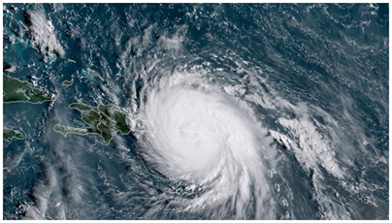

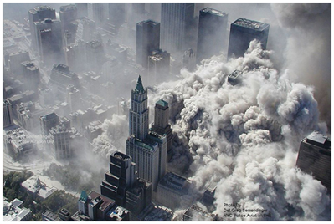
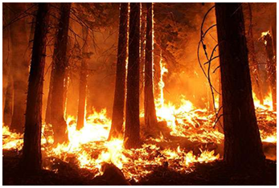
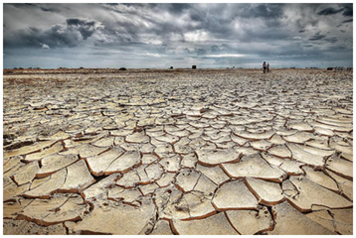
What is Disaster Epidemiology?
The use of epidemiology to assess the short- and long-term adverse effects of disasters and to predict consequences of future disasters

Slide 9
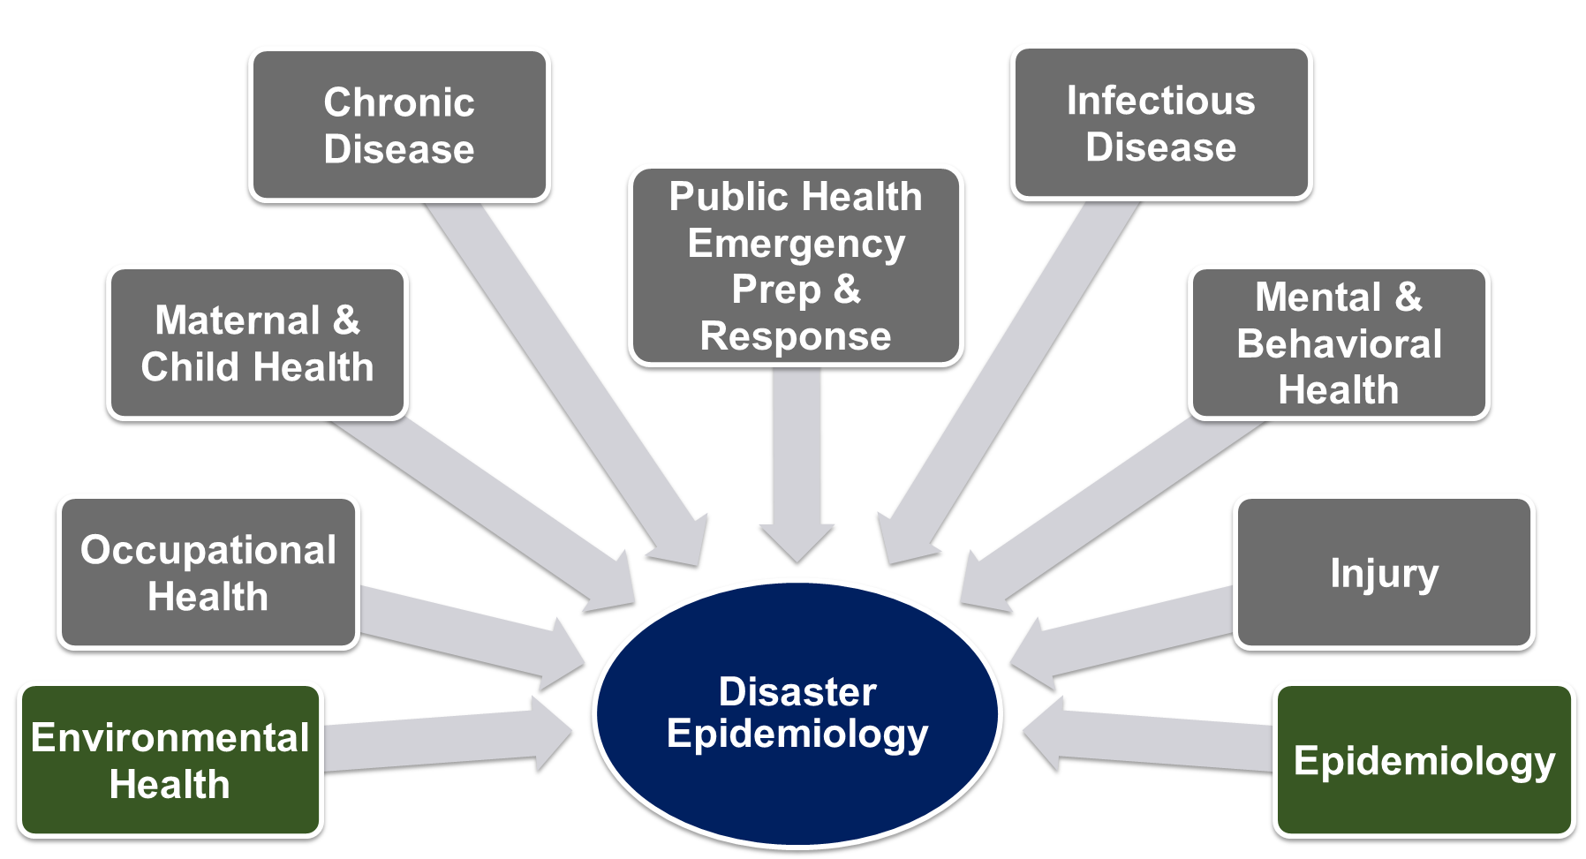
Disaster Epidemiology is Multi-disciplinary

Slide 10
Disaster Epi Basics
[text]
[text]
[text]
[text]

Slide 11
Disaster Epi Basics
[text]
[text]
[text]
[text]

Slide 12
Disaster Epi Basics
[text]
[text]
[text]
[text]

Slide 13
Disaster Epidemiology Tools, Resources and Methodologies

Slide 14
Emergency Responder Health Monitoring Surveillance (ERHMS)

Slide 15
Assessment of Chemical Exposure (ACE) Toolkit

Slide 16
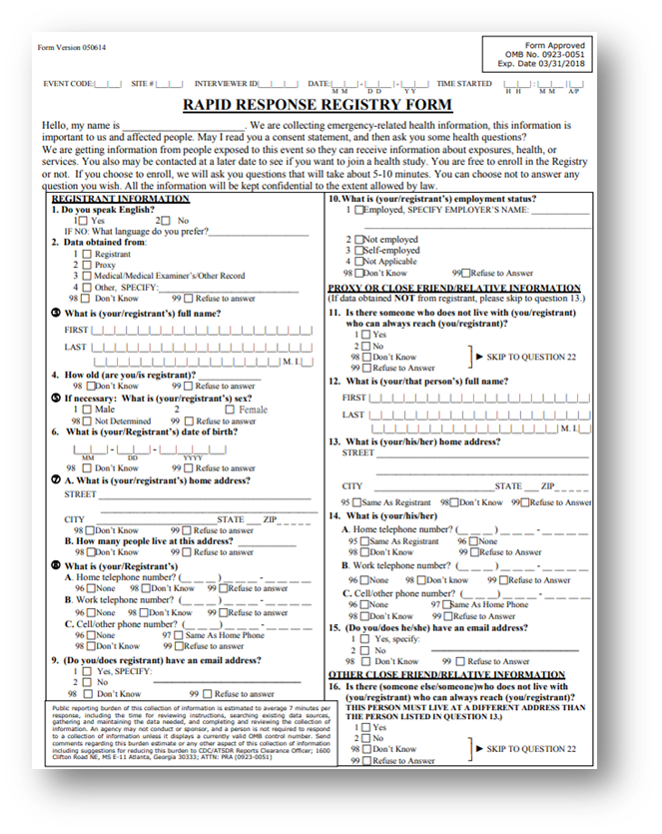
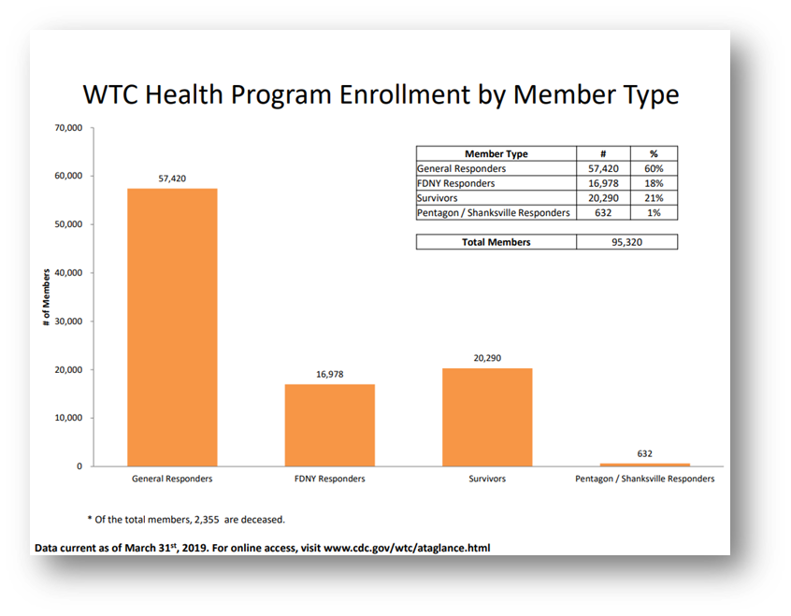
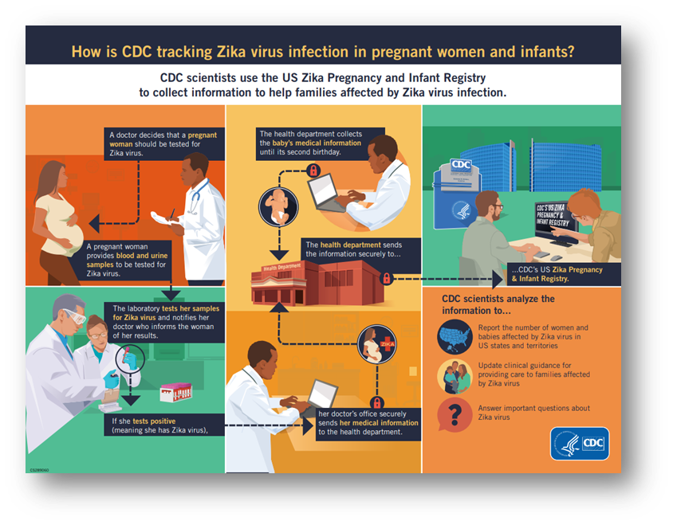
Tracking, Rosters, Registering
Notes:
Familiar with cancer registry
What do we do in cases when resulting illnesses, injuries, or disabilities—including emotional trauma—may not be recognized or resolved in the immediate post-disaster period?
Disaster epi-related registries: CDC Zika and WTC post 9/11
WTC post 9/11: Results will help determine to what extend physical and mental health conditions have persisted
A more recent registry, is CDC’s Zika pregnancy and infant registry. Pregnant women with lab confirmed Zika are included to identify adverse pregnancy outcomes to make recommendations to clinicians for care and Zika prevention.
Before we get to registries, there’s tracking and rosters
Tracking
Collection and integration of data from environmental monitoring, exposure, and health effects in people over time
Can be used for short-term or long-term follow up
Rosters
Early assessment tool to quickly find people affected by disaster
Collect information on the exposed persons for follow-up
Can be used to populate future registries
Registries
Track affected people for medium to long-term health consequences
Inform needs for continuing medical/behavioral care or establishing public health measures
Follow exposed population for conditions that may have delayed symptom onsets
In all three approaches, we typically gather initial information during response and recovery phases
Ultimately, these approaches inform ongoing care, future public health interventions, and public health emergency planning and preparedness
Meets cap. 13

Slide 17
Surveillance
Shelter Surveillance
..
…
…

Slide 18
Rapid Needs Assessments

Slide 19
Disaster Epidemiology and the Emergency Management Cycle

Slide 20
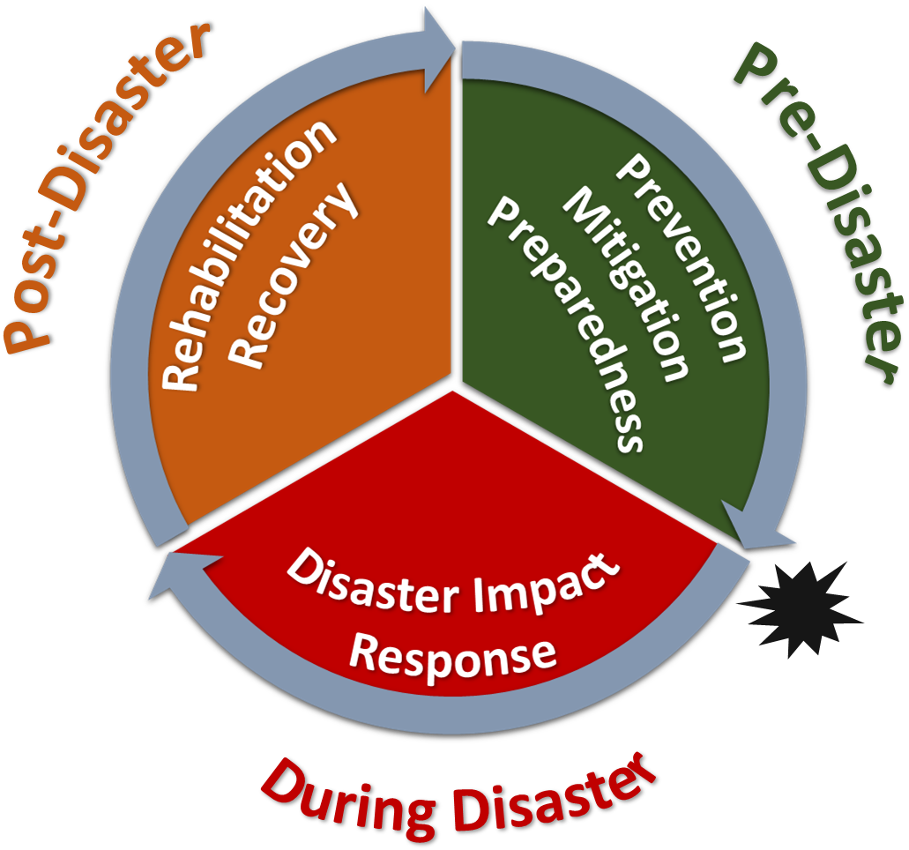

Slide 21
Slido question 2

Slide 22
Disaster Epidemiology and Preparedness
Uses available data to identify populations at risk
Maps the location of vulnerable populations
Assists in developing emergency plans
Participates in tabletop and functional exercises, and drills

Slide 23
Disaster Epidemiology and Preparedness
Activity
Purpose
Rapid Assessments
Hazard Vulnerability Assessment
Joint Risk Assessment
Epidemiologic Investigations & Studies
Determine level of community preparedness & identify populations at-risk
Systematically evaluate potential disaster damage & develop a prioritized list of vulnerabilities
Decision-makers and technical experts working together to implement science-based risk management measures
Identify determinants of disaster-related death and illness
Identify interventions & prevention measures
Provide information to understand disaster impacts for future planning

Slide 24
Disaster Epidemiology and Response
[text]
[text]
[text]
[text]

Slide 25
Disaster Epidemiology and Response
[text]
[text]
[text]
[text]

Slide 26
Disaster Epidemiology and Recovery
Identify and document ongoing community needs
Inform resource allocation
Evaluate interventions and provide recommendations
Determine physical and mental health impact from the incident

Slide 27
Disaster Epidemiology and Recovery
Activity
Purpose
Public Health Surveillance & Tracking Systems
Registries
Rapid Needs Assessments
Epidemiologic Investigations & Studies
Determine health impact from incident
Monitor for long-term health consequences
Identify on-going community needs
Study public health impacts and evaluate interventions

Slide 29
Disaster Epidemiology in the Field

Slide 30
Community Assessment for Public Health Emergency Response (CASPER)
Case study: Mitigation/Preparedness CASPER
Case study: Recovery CASPER

Slide 31
Syndromic Surveillance in Action
Case study: Situational Awareness for Mitigation/Early Response and monitoring trends

Slide 32
Post-Disaster Mental Health Assessments
Case study:
  ERHMS?
  CASPER?

Slide 33
Mortality Assessments and Recovery
[text]
[text]
[text]

Slide 34

Disaster Epidemiology at CSTE

Slide 35

CSTE Disaster Epidemiology Subcommittee
Strengthen capacity to respond to, prepare for and recover from disasters by integrating disaster epidemiology into the emergency management cycle
Help public health and emergency management leadership understand the essential role of disaster epidemiology
Identify a common set of capabilities to support the collection of epidemiologic data during emergency response situations
QR Code for SmartSheet Interest Form?
www.cste.org/group/DisasterEpi

Slide 36
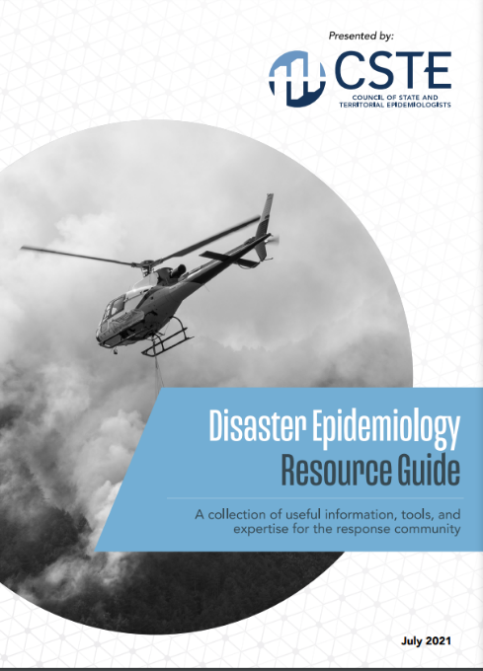
CSTE Disaster Epidemiology Resources
CSTE Disaster Epidemiology Resource Repository: https://www.cste.org/page/epidisaster
CSTE Disaster Epidemiology Resource Guide: https://cdn.ymaws.com/www.cste.org/resource/resmgr/disasterepi/DE_Resource_Guide_Final_v3.pdf
  Living document
  Published in 2021
  Overview of disaster epi methods and tools with real-world examples

Slide 37
14th Annual CSTE Disaster Epidemiology Workshop
May 16 – 18, 2023 via Zoom
  Continuing education credits available
Day 1: An Introduction to Disaster Epidemiology
Day 2: Disaster Epidemiology in the Field: Activities and Partnerships
Day 3: Incorporating and Modernizing Data in Disaster Epidemiology
QR Code for Registration/ CSTE LEARN ?

Slide 39
Discussion and Engagement
~35 minutes

Slide 40
Discussion Questions
What are your data sources during recovery operations?

Slide 41
Discussion Questions
How do you determine you’ve transitioned from acute response to long-term response and recovery operations?
  Data triggers?
  Policy decision?
  Other..

Slide 42
Discussion Questions
How will you use Disaster Epidemiology Tools and Methods to assist in recovery operations in your jurisdiction?

Slide 43
Discussion Questions
What are community needs and challenges following an incident or disasters
  Helpful data sources/types/sets?

Slide 44
Disaster Epidemiology:
Training Courses, Resources, and Toolkits

Slide 45
Training Courses, Resources and Toolkits
Disaster Epidemiology eLearning Modules (CDC): https://www.cdc.gov/nceh/hsb/disaster/training.htm#disaster_epiElearning
  Module 1: Public Health Impacts of Disasters
  Module 2: Public Health Emergency Management
  Module 3: CASPER
  Module 4: Disaster Surveillance
CASPER (CDC): https://www.cdc.gov/nceh/casper/training-resources.htm
Emergency Response Health Monitoring & Surveillance (ERHMS) Online Training Course (CDC): https://emergency.cdc.gov/training/erhmscourse/index.asp
  ERHMS Info Manager
CDART: Comprehensive Disaster Assessment & Readiness Tools (CDC ATSDR): https://www.atsdr.cdc.gov/CDART.html
Notes:
DE eLearning Modules –
Module 1: direct & indirect impact on public health in different types of communities
Module 2:
Module 3: CASPER -→ review of the CASPER methodology, when to conduct and data analysis
Module 4: Disaster Surveillance → includes information on why disaster surveillance is important, the purpose of morbidity and mortality surveillance during a response and tools to assist
CASPER – Community Assessment for Public Health Emergency Response – CDC offers a state-based, in-person training, and an online module as a part of the larger DE learning and training series
ERHMS Info Manager – developed by CDC NIOSH, and is a software product that can be used to implement the ERHMS framework
CDART – scenario driven, surveys and tools to help standardize the evaluation process for public health and healthcare preparedness; developed by ATSDR

Slide 46
Training Courses, Resources and Toolkits
Toxicological Outbreak Investigation Course & Toolkit (CDC): https://www.cdc.gov/nceh/hsb/elearning/toi/default.htm
Epi CASE (Contact Assessment Symptom Exposure) Toolkit (CDC ATSDR): https://www.atsdr.cdc.gov/epitoolkit/index.html
ACE (Assessment of Chemical Exposures) Toolkit and Training (CDC ATSDR): https://www.atsdr.cdc.gov/ntsip/ace_toolkit.html
Notes:
Toxicological outbreak investigation → basic information and customizable documents that can be used during an outbreak investigation, for outbreaks caused by non-infectious, toxic agents.
Epi CASE Toolkit ->

Slide 47
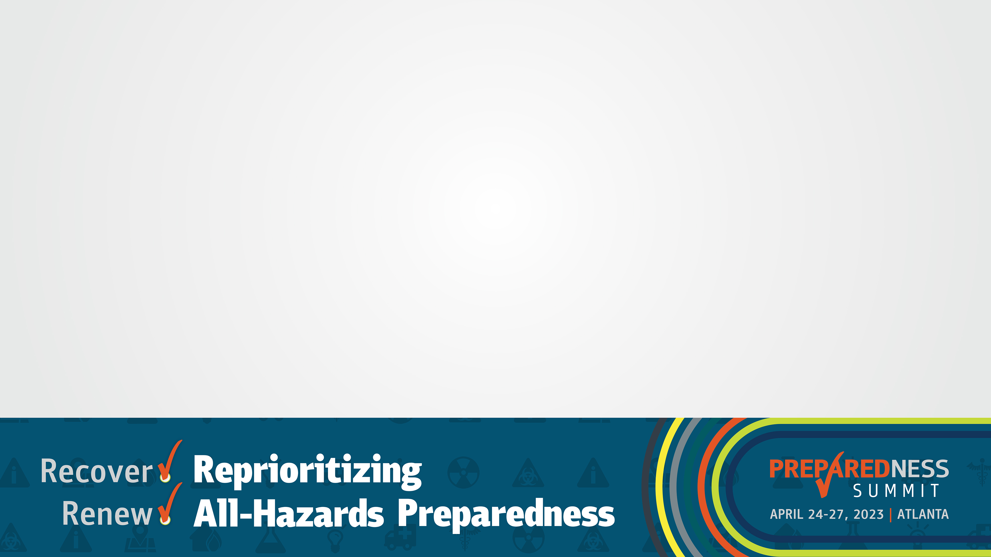
What Questions Do You Have?
~10 minutes

Slide 48
Thank You!
Andrew Adams: aadams@cste.org
Svetlana Smorodinsky: Svetlana.Smorodinsky@cdph.ca.gov
Tess Konen: tess.konen@state.mn.us

Slide 49
