Slide 1

Disaster Epidemiology:
How Preparedness and Response Tools Support Recovery and Mitigation
Andrew Adams, Council of State and Territorial Epidemiologists
Svetlana Smorodinsky, California
Tess Konen, Minnesota

Slide 2
Disaster Epidemiology
How Preparedness and Response Tools Support Recovery and Mitigation
Andrew Adams, Council of State and Territorial Epidemiologists
Svetlana Smorodinsky, California
Tess Konen, Minnesota

Slide 3
Our Speakers
Andrew Adams, Senior Program Analyst, Council of State and Territorial Epidemiologists
Svetlana Smorodinsky, Disaster Epidemiologist, California Department of Public Health, CSTE Disaster Epidemiology Subcommittee Co-Chair
Tess Konen, Senior Epidemiologist, Minnesota Department of Health, CSTE Disaster Epidemiology Subcommittee Co-Chair

Slide 4
Presentation Objectives
Define disaster epidemiology and its role in all phases of the emergency management cycle
Explain how disaster epidemiology can assist state and local agencies in responding to emerging public health threats
Showcase how disaster epidemiology meets PHEP Capability requirements and integrates with Emergency Management
Identify methods to be used in recovery and the benefits and challenges of using and collecting data in the recovery phase
Engage with colleagues on experiences and challenges in utilizing data to inform community recovery efforts

Slide 5
Outline
Define Disaster Epidemiology (DE)
Explain its role in the Emergency Management Cycle
Describe how DE methods can be integrated to help achieve Public Health Emergency Preparedness and Response Capabilities
Share case studies of DE methods used for recovery
Discussion, Questions and Answers
Share disaster epidemiology resources and training

Slide 6
Disaster Epidemiology: the basics

Slide 7
Slido Info & Question 1

Slide 8

What is epidemiology?
Notes:
To make sure we are all on the same page, I am going to go over some definitions quickly.
Epidemiology is the study of distribution and determinants of illness, injury, disability and death in specified populations, and the application of this study to minimize these outcomes.
This approach is applied across all the whole spectrum of public health from the traditional infectious disease to chronic, maternal child health, environmental and occupational hazards.

Slide 9
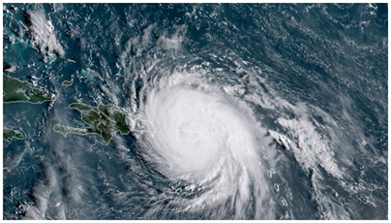
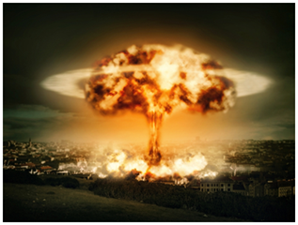
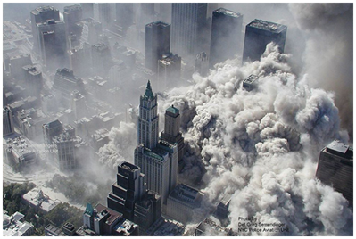
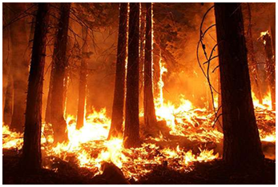
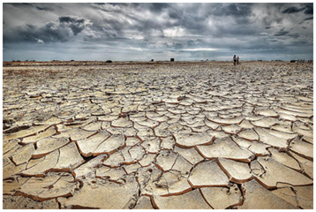
What is Disaster Epidemiology?
The use of epidemiology to assess the short- and long-term adverse effects of disasters and to predict consequences of future disasters
Notes:
Quite simply, epidemiology methods applied to disasters is disaster epidemiology. Like any sub-field, it has it’s own tools and approaches.
Disaster Epidemiology is defined as the use of epidemiology to assess the short- and long-term adverse health effects of disasters and to predict (and ultimately mitigate or prevent) consequences of future disasters.

Slide 10
How can Disaster Epidemiology help you?
DE provides reliable and actionable information to incident commanders, planners, and decision-makers
Provides situational awareness
Assesses the short- and long-term adverse health effects of disasters
Informs planning and preparation for future disasters
Notes:
The main objectives of disaster epidemiology are to:
provide timely and accurate information for decision-makers (information that helps you understand what the needs are, plan the response, gather and distribute the appropriate resources)
prevent or reduce the number of deaths, illnesses, and injuries caused by disasters,
improve prevention and mitigation strategies for future disasters by using collected information

Slide 11
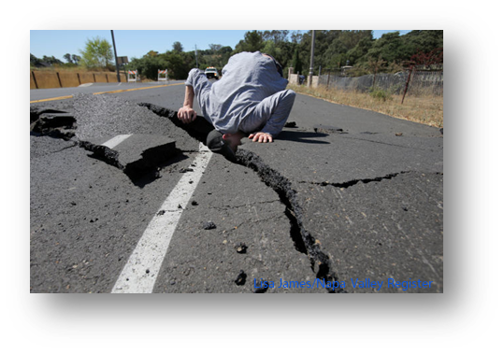

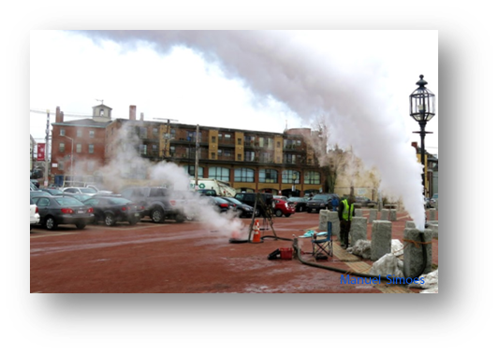
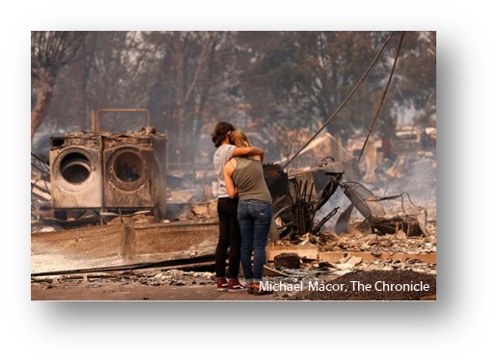
Disaster Epidemiology takes an All-Hazard approach
Notes:
DE began with studying health risks after environmental disasters and is considered part of environmental epidemiology, but the tools and methods are applied across all types of disasters now.
DE takes an all-hazards approach, applying a framework and tools no matter the disaster
To help identify hazards, risks, and vulnerabilities across all aspects of public health
Need to consider all aspects impacted
Consider disease, injury, death, MH/BH, public health consequences of property damage, business disruption, and environmental impact

Slide 12
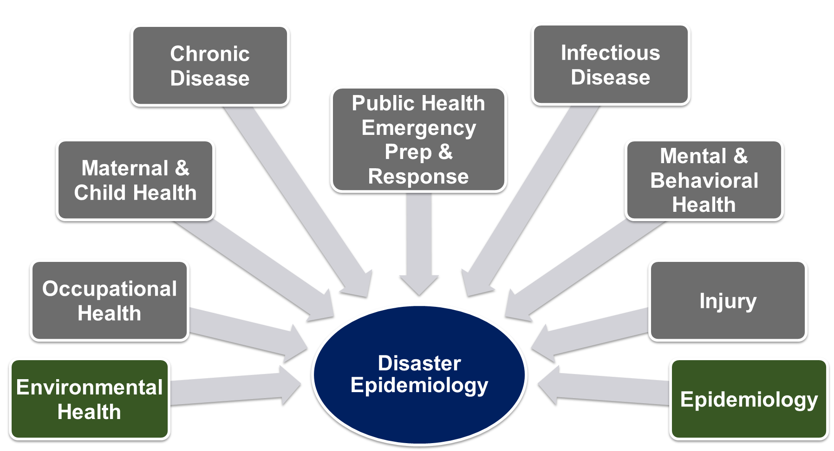
Disaster Epidemiology is Multi-disciplinary
Notes:
DE is multi-disciplinary: brings together various topic areas of epidemiology including acute and communicable disease, environmental health, occupational health, chronic disease, injury, mental and behavioral health.
When an incident happens, the SME epidemiologist should be selected
During an infectious disease (ID) outbreak, public health turns to the ID experts
During an environmental disaster, public health turns to EH experts
Knowledge of response to all-hazards
Cross training of epidemiologists is essential – Epi needs to know Emergency Management (ICS and emergency operations) and Disaster Epi
Any epidemiologist can be a disaster epidemiologist
PHEP/EM need to pull the appropriate epi SME for the response
Important for PHEP to meet your epi’s

Slide 13
Disaster Epidemiology and the Emergency Management Cycle

Slide 14
DE and Incident Command System (ICS)
ICS links DE to Medical Unit
Foundational part of ESF-8 as it relates to PH planning and response
Provides ICS leadership with credible health data for:
  Situational awareness
  Making decisions
  Allocating resources
Notes:
DE is integrated into the ICS in the medical unit.
DE serves the needs of Incident command well—under ESF-8. (public health & medical services)
DE is a core part of PH planning and response.

Slide 15
Conceptual Framework
Framework identified the applications of epidemiology in disaster settings
Developed by:
  Centers for Disease Control & Prevention (CDC)/National Center for Environmental Health (NCEH)
  Council of State and Territorial Epidemiologists (CSTE)
Notes:
The Centers for Disease Control & Prevention (CDC)/National Center for Environmental Health (NCEH)
Council of State and Territorial Epidemiologists (CSTE)
Developed a framework of how epidemiology is applied in the different disaster phrases

Slide 16
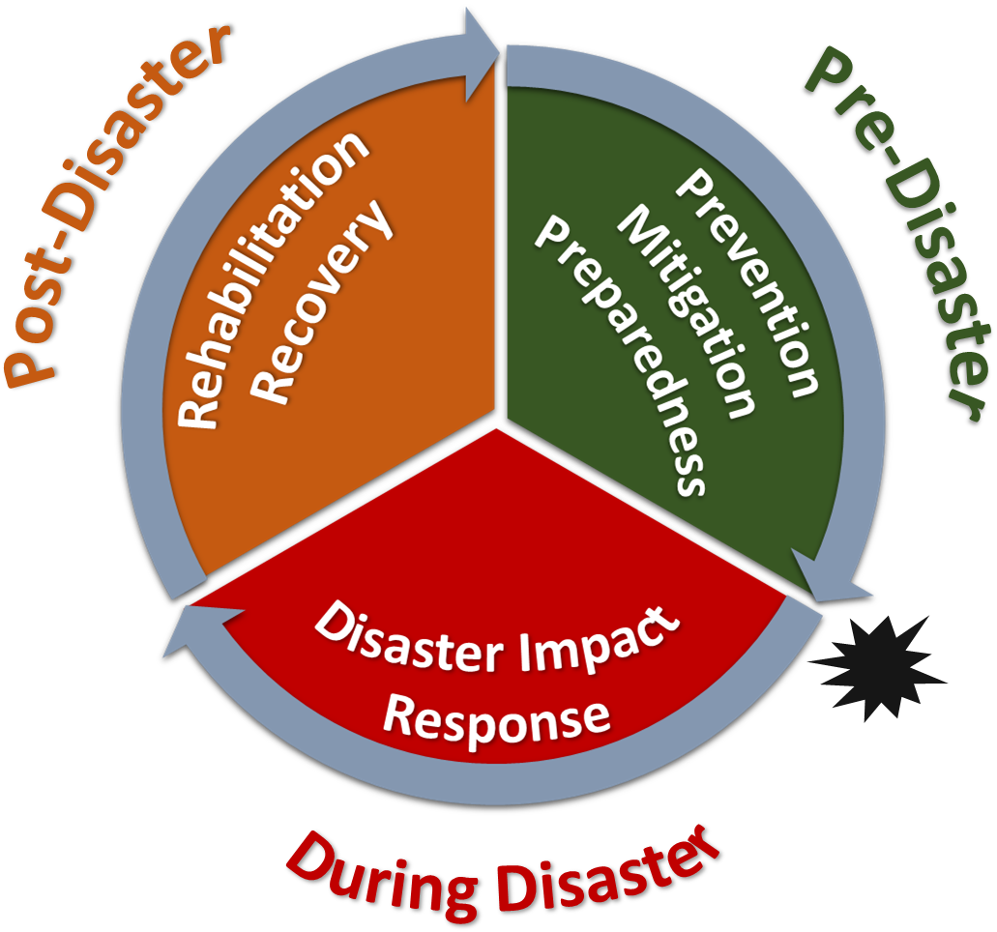

Slide 17
The Disaster Management Cycle
Prevention, Mitigation, Preparedness
Disaster Impact
Rehabilitation, Response, Recovery
Post-disaster
Pre-disaster
Disaster
Notes:
The disaster management cycle includes:
planning and preparedness pre-disaster,
the disaster event when the disaster is active,
and the response and recovery phases post-disaster.

Slide 18
Disaster epidemiology activities
Post-disaster:
Tracking
Registries
Pre-disaster:
Epidemiology investigations
Evaluation and risk studies
Prevention, Mitigation, Preparedness
Disaster Impact
Rehabilitation, Response, Recovery
Disaster:
Surveillance
  Affected communities
  Responders
Rapid needs assessments
Notes:
DE fits into all phases of the disaster management cycle.
During and following the disaster, health surveillance of the affected communities and responders might occur to know the severity and level of impact. As well as, rapid needs assessment to inform the response efforts.
In the response and recovery phase, you continue to track health outcomes and inform the health impact and need to mitigate health risk. (using rosters or registries, line lists…).
In the preparedness phase, we use our data to assess what changes could be made to reduce risk. Epidemiologic studies and evaluation studies inform interventions and controls to prepare for the next disaster.

Slide 19
Public Heath Emergency Preparedness and Response Capabilities and Disaster Epidemiology

Slide 20
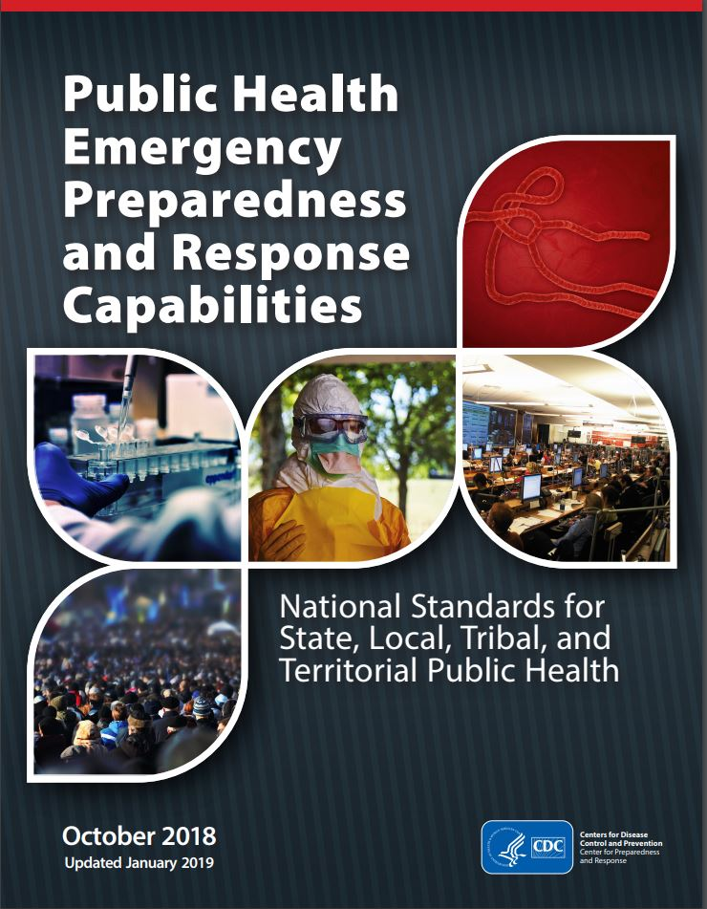
DE and PHEP capabilities
Recent revisions added references to environmental health functions and partners, including:
  References to DE tools (CASPER & ACE)
  Focus on radiological planning before an imminent risk
  Resources for recovery operations after radiological incidents
Notes:
Specifically, the capabilities further emphasize the importance of disaster epidemiology
DE methods and tools can help you meet your PHEP and HPP required capabilities. The following slides highlight the PHEP and HPP Capabilities and Functions that DE fit in.
For those of you under PHEP important to understand how work fits in and even if you aren’t under the rgant, but work with emergency folks who do, this may provide more context about their priorities.

Slide 21
DE and PHEP capabilities
Capability 1: Community Preparedness
  Assess and determine risks to the population and identify and map at-risk populations
Capability 2: Community Recovery
  Assess impact and inform recovery efforts post-disaster (using rapid needs assessments, public health research)
Capability 3: Emergency Operations Coordination
  Provide situation awareness to detect need for activation or dissemination of resources
Capability 4: Emergency Public Information and Warning
  Inform health alerts and the development of educational materials
Notes:
DE fits into many of the PHEP capabilities. For instance, in cap1, epi’s can assist in assessing and determining potential risks and identifying at-risk populations.
For community recovery, epi’s can collect information to inform recovery and assess impact through rapid needs assessments and research.
For cap 3, epi’s may be the ones identifying a need for activation from reviewing the surveillance data and can provide information for situational awareness.
For cap4, surveillance may inform the necessity of health alerts and coordinate with poison control centers can provide educational information.

Slide 22
DE and PHEP capabilities
Capability 5: Fatalities Management
  Analyze postmortem data to determine the extent of emergency, and use of electronic death registry system (EDRS) to improve the speed/completeness
Capability 6: Information Sharing
  Use of electronic case reporting (eCR), electronic death registration (EDR), electronic laboratory results (ELR), syndromic surveillance (SyS) reporting
  Develop of Health Alert Networks (HAN)
Capability 7: Mass Care
  Provide information on needs of population impacted and infection control in mass care settings
Capability 8: Medical Countermeasures
  Use surveillance to determine the need for MCM and to identify at-risk populations
Notes:
Cap5, analysis of ante mortem and postmortem data can determine the severity of the emergency and impact. The electronic death registration system can improve this process.
Cap6: this is cornerstone of epi, using and collecting information and sharing it with partners. There are various systems that can come into play with this and assist with it.
Cap7: epi’s can provide information on the needs of population areas impacted and conduct surveillance in mass care setting.
Cap8: they may identify the need for medical countermeasures from surveillance and help identify the at-risk population that needs MCM

Slide 23
DE and PHEP capabilities
Capability 9: Medical Material Management and Distribution
  Analyze medical and social demographic data to inform medication and durable medical equipment needs
Capability 10: Medical Surge
  Collect data on healthcare delivery system and EMS calls
Capability 11: Non-Pharm Interventions
  Identify/interrupt spread of disease
  Focus on mass screening processes for contamination & decontamination in response to nuclear/radiological events
Capability 12: PH Laboratory & Testing
  Contextualize lab results for situational awareness
Notes:
Cap9: Epi’s can analyze medical and social demographic information to inform the medications and durable medical needs. Using things like the empower map.
Cap10: use data on hospital beds and EMS calls to inform medical surge and response.
Cap11: identify and interrupt the spread of disease. Also focus on process for mass screening and decontamination
Cap12: connect lab and preparedness and assist in translation between lab results in context

Slide 24
DE and PHEP capabilities
Capability 13: PH Surveillance and Epidemiological Investigation
  Monitor trends of illness or injury and provide situation awareness
  References DE tools (ACE & CASPER) and registries
  Includes tracking systems, monitoring the exposed, and syndromic surveillance systems
Capability 14: Responder Safety and Health
  Use ERHMS as a resource for responders and volunteers
Notes:
cap13: Has the most explicit connection to epidemiology. PH surveillance and epi investigation. There are various tools for tracking and surveillance that we will get into later, but this includes tracking systems and syndromic surveillance.
Cap14: epi’s involved in the tracking of workers and volunteers

Slide 25
Disaster Epidemiology Tools, Resources and Methodologies

Slide 26
Emergency Responder Health Monitoring Surveillance (ERHMS)

Slide 27
Assessment of Chemical Exposure (ACE) Toolkit

Slide 28
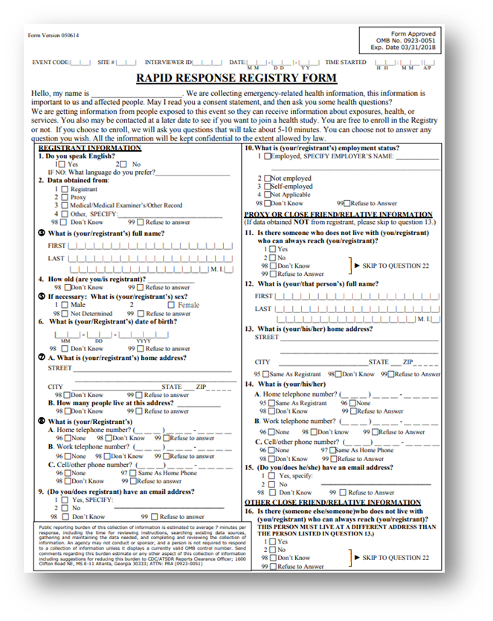
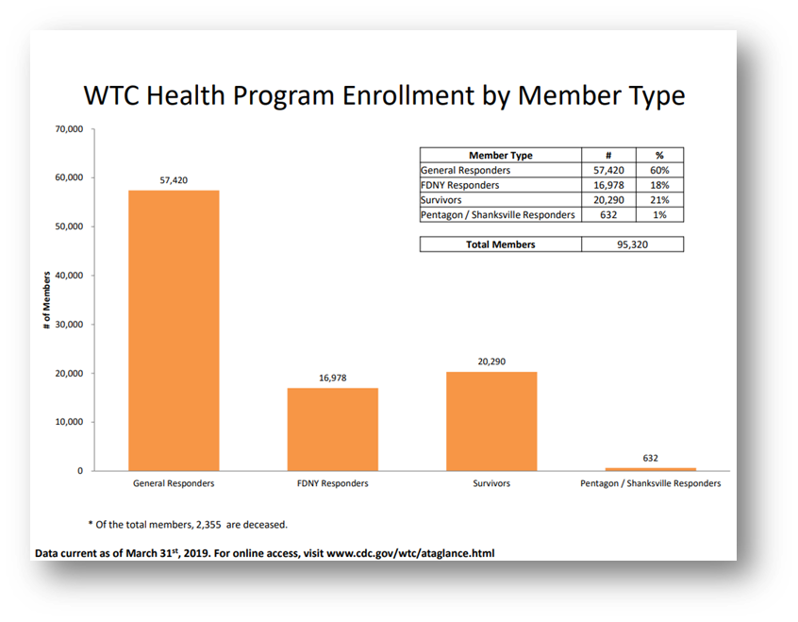
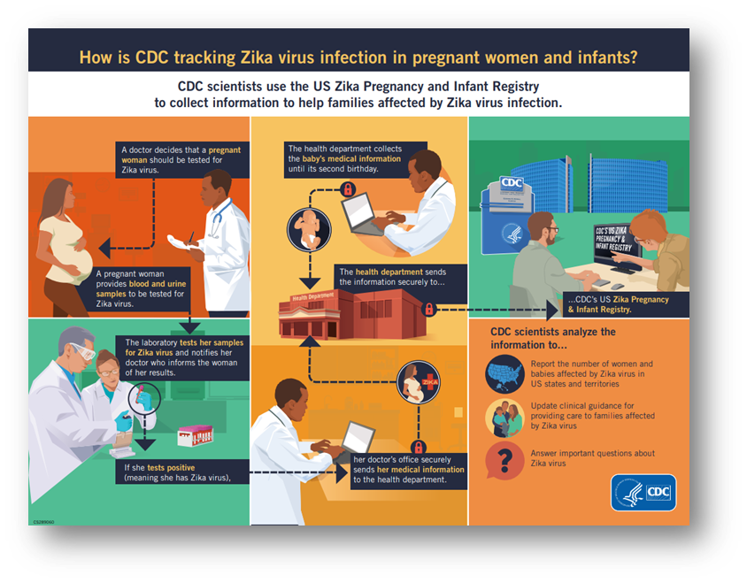
Tracking, Rosters, Registering
Notes:
Familiar with cancer registry
What do we do in cases when resulting illnesses, injuries, or disabilities—including emotional trauma—may not be recognized or resolved in the immediate post-disaster period?
Disaster epi-related registries: CDC Zika and WTC post 9/11
WTC post 9/11: Results will help determine to what extend physical and mental health conditions have persisted
A more recent registry, is CDC’s Zika pregnancy and infant registry. Pregnant women with lab confirmed Zika are included to identify adverse pregnancy outcomes to make recommendations to clinicians for care and Zika prevention.
Before we get to registries, there’s tracking and rosters
Tracking
Collection and integration of data from environmental monitoring, exposure, and health effects in people over time
Can be used for short-term or long-term follow up
Rosters
Early assessment tool to quickly find people affected by disaster
Collect information on the exposed persons for follow-up
Can be used to populate future registries
Registries
Track affected people for medium to long-term health consequences
Inform needs for continuing medical/behavioral care or establishing public health measures
Follow exposed population for conditions that may have delayed symptom onsets
In all three approaches, we typically gather initial information during response and recovery phases
Ultimately, these approaches inform ongoing care, future public health interventions, and public health emergency planning and preparedness
Meets cap. 13

Slide 29
Surveillance
Shelter Surveillance
..
…
…

Slide 30
Rapid Needs Assessments

Slide 31
Disaster Epidemiology and Preparedness
Uses available data to identify populations at risk
Maps the location of vulnerable populations
Assists in developing emergency plans
Participates in tabletop and functional exercises, and drills

Slide 32
Disaster Epidemiology and Preparedness
Activity
Purpose
Rapid Assessments
Hazard Vulnerability Assessment
Joint Risk Assessment
Epidemiologic Investigations & Studies
Determine level of community preparedness & identify populations at-risk
Systematically evaluate potential disaster damage & develop a prioritized list of vulnerabilities
Decision-makers and technical experts working together to implement science-based risk management measures
Identify determinants of disaster-related death and illness
Identify interventions & prevention measures
Provide information to understand disaster impacts for future planning

Slide 33
Disaster Epidemiology and Recovery

Slide 34
Slido question 2

Slide 35
Defining recovery period
Purpose: consists of those activities that continue beyond the emergency period to restore critical community functions and begin to manage stabilization efforts.
Timing: The recovery phase begins immediately after the threat to human life has subsided. The goal of the recovery phase is to bring the affected area back to some degree of normalcy.
Notes:
But what does that really mean? How do you know when it starts or ends?
Integrated with response mechanisms, and the EOP incident management process should be extended into recovery.
Recovery management transitions to regular agency management processes or some intermediate method defined by the responsible organizations.

Slide 36
Disaster Epidemiology and Recovery
Identify and document ongoing community needs
Inform resource allocation
Evaluate interventions and provide recommendations
Determine physical and mental health impact from the incident

Slide 37
Disaster Epidemiology and Recovery
Activity
Purpose
Public Health Surveillance & Tracking Systems
Registries
Rapid Needs Assessments
Epidemiologic Investigations & Studies
Determine health impact from incident
Monitor for long-term health consequences
Identify on-going community needs
Study public health impacts and evaluate interventions

Slide 38
Disaster Epidemiology: case studies in recovery

Slide 39
Community Assessment for Public Health Emergency Response (CASPER)
Case study: Mitigation CASPER
Case study: Recovery CASPER

Slide 40
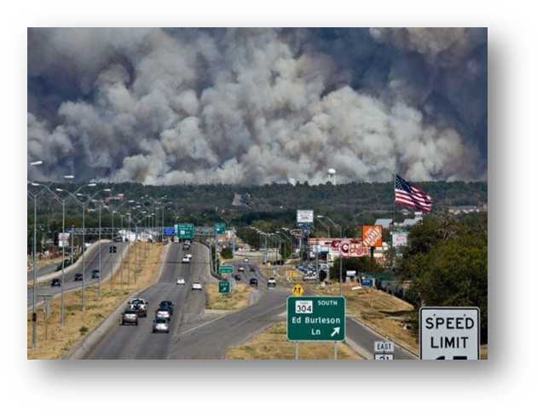
Recovery CASPER: Longitudinal wildfire assessment
Texas Department of State Health Services conducted a CASPER to assess public health impacts from a devastating wildfire.
Initial CASPER informed key public health issues and resource allocation. Follow-up CASPER informed new concerns or unmet needs to share with officials.
Notes:
Initial CASPER informed key public health issues and resource allocation.
CASPER was conducted 3 years later to measure progress in recovery and assess long-term health and mental health status.
Follow-up CASPER informed new concerns or unmet needs to share with officials.
Preparedness and response capabilities: cap2 community recovery and cap 4 Emergency Public Information and Warning (informed communication methods as well)

Slide 41
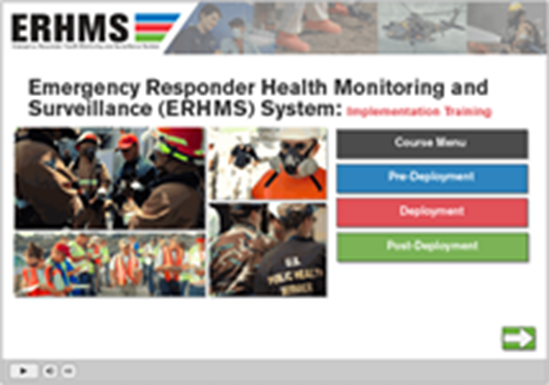
Responder surveillance
CDC Emergency Responder Health Monitoring Surveillance (ERHMS) is a health monitoring and surveillance framework for protecting responders through all phases of response
Collaboration with epidemiology, industrial hygiene, and emergency managers
  http://www.cdc.gov/niosh/topics/erhms/
Notes:
CDC Emergency Responder Health Monitoring Surveillance (ERHMS) is a health monitoring and surveillance framework for protecting responders through all phases of a response
This requires collaboration between epidemiology, industrial hygiene, and emergency managers. Functions under Safety Officer in ICS
The National Institute for Occupational Safety and Health has an ERHMS Information Management System with user guide and Training videos at that link on the slide.

Slide 42
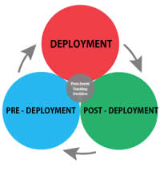
ERHMS key questions
Key questions to ask:
  Pre-deployment: which responders are “ready,” credentialed, and available to respond?
  Deployment: who are the responders on-site, and to what are they exposed? How is their health?
  Post-deployment: what did the responders do while deployed, how is their health now, and what to what were they exposed during the entire deployment?
  http://www.cdc.gov/niosh/topics/erhms/
Notes:
framework provides recommendations for protecting emergency responders during small and large emergencies in any setting
Pre-ready? Existing health concerns inform assigned role or activities?
Deployment-what are the risks? Are they encountering exposures or health issues? Do they need health care or more guidance? Do they need to return or be re-assigned ?
Post-what was their experience? Any on-going concerns to track or address?

Slide 43
ERHMS Oregon example

Slide 44

Rosters
Early assessment tool
Survey instrument to identify exposed persons for follow-up
Quickly collect information to identify people affected by disaster
Can be used to populate future registries
Notes:
Agency for Toxic Substances and Disease registries created a rapid response registry to register responders and other exposed people quickly- 5 minute survey
States have also created their own RRR to capture people on the scene for later follow-up
Survey instrument to register responders and other exposed persons
Two-page form that can be distributed on paper or electronically.
Implemented quickly to collect information to identify and people displaced or affected by a disaster.
Requires five minutes or less to collect basic information

Slide 45
Registries
Track affected people for medium to long-term health consequences
Inform needs for continuing medical/behavioral care or stablishing public health measures
Follow exposed population for conditions that may have delayed symptom onsets
Provides a basis for health education and disaster prevention
Notes:
While the roster is to collect basic information right away, a registry is a more formal assessment. This would occur when you have funding to establish a registry and have identified your study population (narrowed down the population of interest who are eligible).
Health problems like exposure to environmental contaminant necessitate evaluation for long-term health implications.
Assess long-term health impacts from exposures

Slide 46

9/11 WTC Registry
Individuals that worked at the site or responded to the event
Results will help determine to what extend physical and mental health conditions have persisted
Notes:
Agency for Toxic Substances and Disease registries created a rapid response registry to register responders and other exposed people quickly- 5 minute survey
States have also created their own RRR to capture people on the scene for later follow-up
Survey instrument to register responders and other exposed persons
Two-page form that can be distributed on paper or electronically.
Implemented quickly to collect information to identify and people displaced or affected by a disaster.
Requires five minutes or less to collect basic information

Slide 47
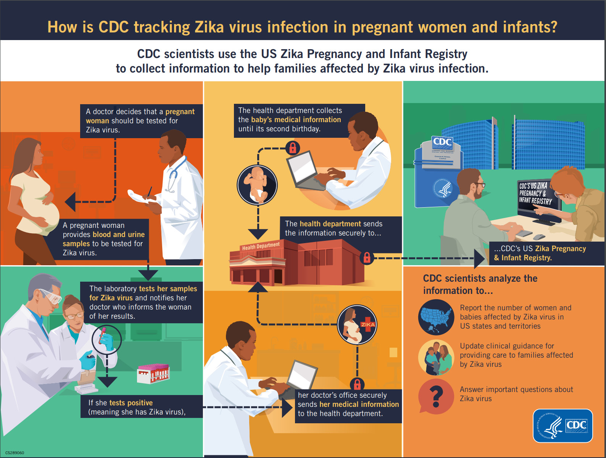
CDC Zika Pregnancy and Infant Registry
Collects information about pregnant women with possible Zika virus infection
Identifies adverse pregnancy outcomes
Makes recommendations for clinicians to prevent Zika virus infection during pregnancy
https://www.cdc.gov/pregnancy/zika/research/registry.html
Notes:
A more recent registry, is CDC’s Zika pregnancy and infant registry. Pregnant women with lab confirmed Zika are included to identify adverse pregnancy outcomes to make recommendations to clinicians for care and Zika prevention.

Slide 48
Syndromic Surveillance in recovery
Case study: Situational Awareness for Mitigation/Early Response and monitoring trends
Example?
Use to monitor trends and decreasing injuries, see if increase in id spread or injuries from cleanup?

Slide 49
Post-Disaster Mental Health Assessments
Case study:
  ERHMS?
  CASPER?

Slide 50
Mortality Assessments and Recovery
[text]
[text]
[text]

Slide 51
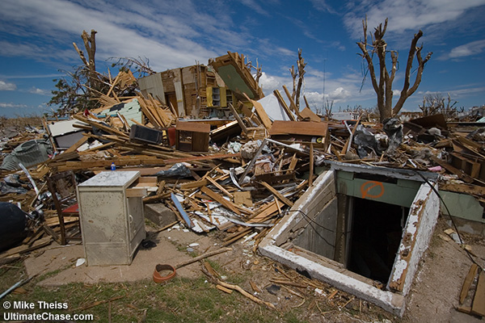
Epidemiologic studies
In 1990s, Oklahoma conducted a study of causes of fatal and non-fatal injuries associated with tornados
  Increase risk of death and injury among people seeking shelter under freeway overpasses & in shelters with wooden doors
  Recommended changes in education and construction standards
Notes:
Several case–control studies following tornadoes in Texas and Oklahoma (1979, 1999) identified risk factors for death and injury.76–78
One study examined risks among occupants fleeing their homes in cars versus those who remained within structures, raising concerns about the relative safety of occupying cars during tornados.79
Although typically conducted postdisaster, investigations and studies may be implemented long after life-saving emergency measures have been completed and issues requiring formal study have been identified.
May be more common knowledge now first determined with epi analysis.

Slide 52
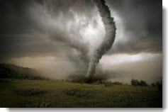
Retrospective Surveillance during Oklahoma Tornado Outbreak - May 19-31, 2013
Intense review of medical records at 32 hospitals to:
  assess tornado-related injuries and deaths,
  identify populations impacted
  protective actions taken
Notes:
Review of medical records to:
Assess disaster-related injuries and deaths
Identify populations impacted
Protective actions taken
More traditional surveillance, would involve a retrospective review of injuries and deaths related to an event to characterize the impact and identify trends in the population and to inform protective actions for next time (feedback loop).

Slide 53
Surveillance during Oklahoma Tornado Outbreak
Of 49 deaths and 755 injuries associated with the disaster:
  336 injuries (45%) were directly related
  419 injuries (55%) were indirect related
  35% trying to get in or out of shelter
  6% fleeing the area, 5% rescuing an animal or person
  35% of hospital visits were for injuries during cleanup
Notes:
This informs our knowledge by characterizing the injuries and deaths so we can message and inform public on the safe approach.
In this example, l more than half of the injuries and deaths were indirectly related, of these a large portion were due to cleanup and evacuation/seeking shelter.

Slide 54
Research During Emergencies: Disaster Research Response Program
National Institute of Environmental Health Sciences (NIEHS) identified the need to rapidly perform critical health research during disaster response and recovery
Program includes:
  Ready-to-go data collection tools (database of surveys, forms, etc.)
  Research protocols (IRB pre-approval)
  Training and exercises
  Network of trained research responders
http://www.nationalacademies.org/hmd/Reports/2014/Enabling-Rapid-Sustainable-Public-Health-Research-During-Disasters.aspx
Notes:
Research during disasters can occur with the disaster research response program.
National Institute of Environmental Health Sciences (NIEHS) identified the need to rapidly perform critical health research during disaster response and recovery
Program includes:
Ready-to-go data collection tools (database of surveys, forms, etc.)
Research protocols (IRB pre-approval)
Training and exercises
Network of trained research responders

Slide 55
Disaster Research Response DR2 Program

Slide 56

Disaster Epidemiology at CSTE

Slide 57

CSTE Disaster Epidemiology Subcommittee
Strengthen capacity to respond to, prepare for and recover from disasters by integrating disaster epidemiology into the emergency management cycle
Help public health and emergency management leadership understand the essential role of disaster epidemiology
Identify a common set of capabilities to support the collection of epidemiologic data during emergency response situations
QR Code for SmartSheet Interest Form?
www.cste.org/group/DisasterEpi

Slide 58
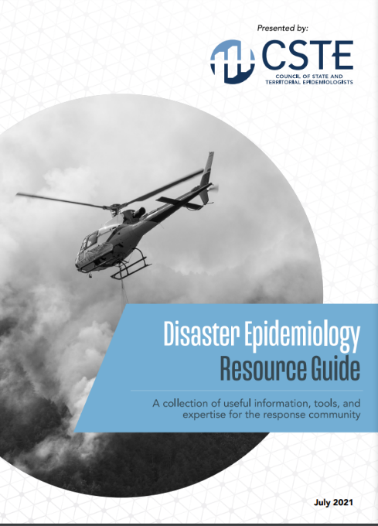
CSTE Disaster Epidemiology Resources
CSTE Disaster Epidemiology Resource Repository: https://www.cste.org/page/epidisaster
CSTE Disaster Epidemiology Resource Guide: https://cdn.ymaws.com/www.cste.org/resource/resmgr/disasterepi/DE_Resource_Guide_Final_v3.pdf
  Living document
  Published in 2021
  Overview of disaster epi methods and tools with real-world examples

Slide 59
14th Annual CSTE Disaster Epidemiology Workshop
May 16 – 18, 2023 via Zoom
  Continuing education credits available
Day 1: An Introduction to Disaster Epidemiology
Day 2: Disaster Epidemiology in the Field: Activities and Partnerships
Day 3: Incorporating and Modernizing Data in Disaster Epidemiology
QR Code for Registration/ CSTE LEARN ?

Slide 61
Discussion and Engagement
~35 minutes

Slide 62
Discussion Questions
What are your data sources during recovery operations?

Slide 63
Discussion Questions
How do you determine you’ve transitioned from acute response to long-term response and recovery operations?
  Data triggers?
  Policy decision?
  Other..

Slide 64
Discussion Questions
How will you use Disaster Epidemiology Tools and Methods to assist in recovery operations in your jurisdiction?

Slide 65
Discussion Questions
What are community needs and challenges following an incident or disasters
  Helpful data sources/types/sets?

Slide 66
Disaster Epidemiology:
Training Courses, Resources, and Toolkits

Slide 67
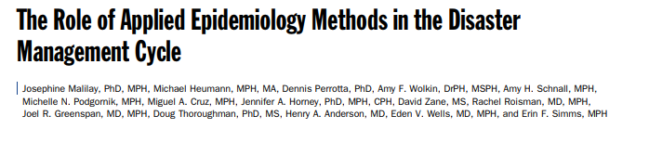
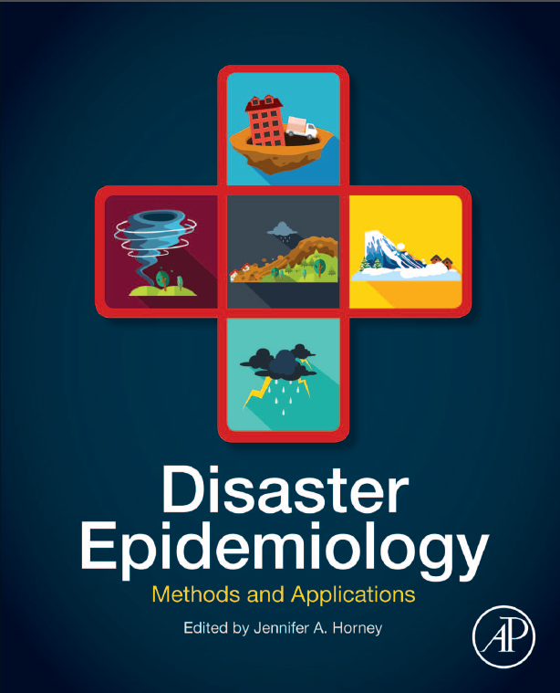
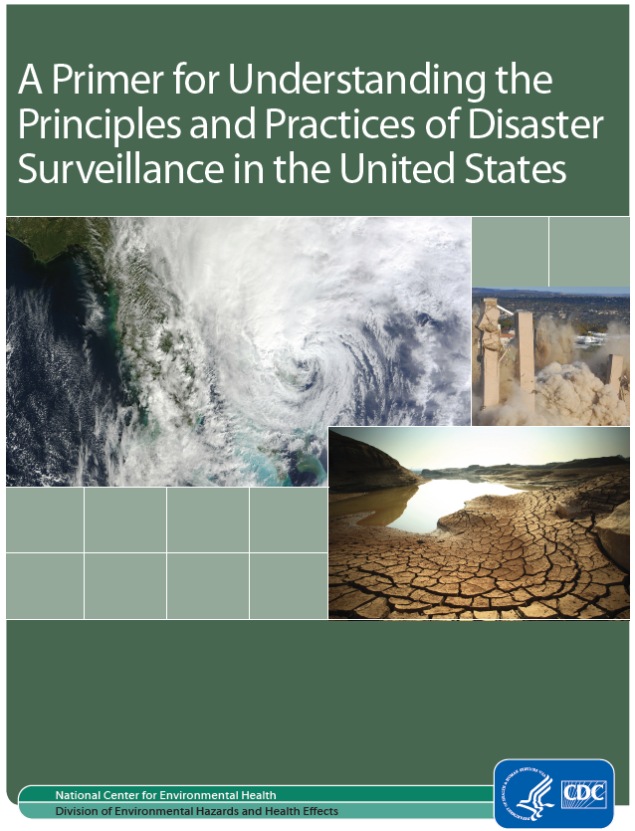
Disaster Epidemiology Resources
Notes:
CSTE DE tool repository: https://www.cste.org/page/epidisaster
NEW DE resource guide: https://cdn.ymaws.com/www.cste.org/resource/resmgr/disasterepi/DE_Resource_Guide_Final_v3.pdf
CDC DE primer: https://www.cdc.gov/nceh/hsb/disaster/Disaster_Surveillance_508.pdf
DE methods and applications by Dr. Jen Horney, teaching classes at U of Delaware

Slide 68
Training Courses, Resources and Toolkits
Disaster Epidemiology eLearning Modules (CDC): https://www.cdc.gov/nceh/hsb/disaster/training.htm#disaster_epiElearning
  Module 1: Public Health Impacts of Disasters
  Module 2: Public Health Emergency Management
  Module 3: CASPER
  Module 4: Disaster Surveillance
CASPER (CDC): https://www.cdc.gov/nceh/casper/training-resources.htm
Emergency Response Health Monitoring & Surveillance (ERHMS) Online Training Course (CDC): https://emergency.cdc.gov/training/erhmscourse/index.asp
  ERHMS Info Manager
CDART: Comprehensive Disaster Assessment & Readiness Tools (CDC ATSDR): https://www.atsdr.cdc.gov/CDART.html
Notes:
DE eLearning Modules –
Module 1: direct & indirect impact on public health in different types of communities
Module 2:
Module 3: CASPER -→ review of the CASPER methodology, when to conduct and data analysis
Module 4: Disaster Surveillance → includes information on why disaster surveillance is important, the purpose of morbidity and mortality surveillance during a response and tools to assist
CASPER – Community Assessment for Public Health Emergency Response – CDC offers a state-based, in-person training, and an online module as a part of the larger DE learning and training series
ERHMS Info Manager – developed by CDC NIOSH, and is a software product that can be used to implement the ERHMS framework
CDART – scenario driven, surveys and tools to help standardize the evaluation process for public health and healthcare preparedness; developed by ATSDR

Slide 69
Training Courses, Resources and Toolkits
Toxicological Outbreak Investigation Course & Toolkit (CDC): https://www.cdc.gov/nceh/hsb/elearning/toi/default.htm
Epi CASE (Contact Assessment Symptom Exposure) Toolkit (CDC ATSDR): https://www.atsdr.cdc.gov/epitoolkit/index.html
ACE (Assessment of Chemical Exposures) Toolkit and Training (CDC ATSDR): https://www.atsdr.cdc.gov/ntsip/ace_toolkit.html
Notes:
Toxicological outbreak investigation → basic information and customizable documents that can be used during an outbreak investigation, for outbreaks caused by non-infectious, toxic agents.
Epi CASE Toolkit ->

Slide 70
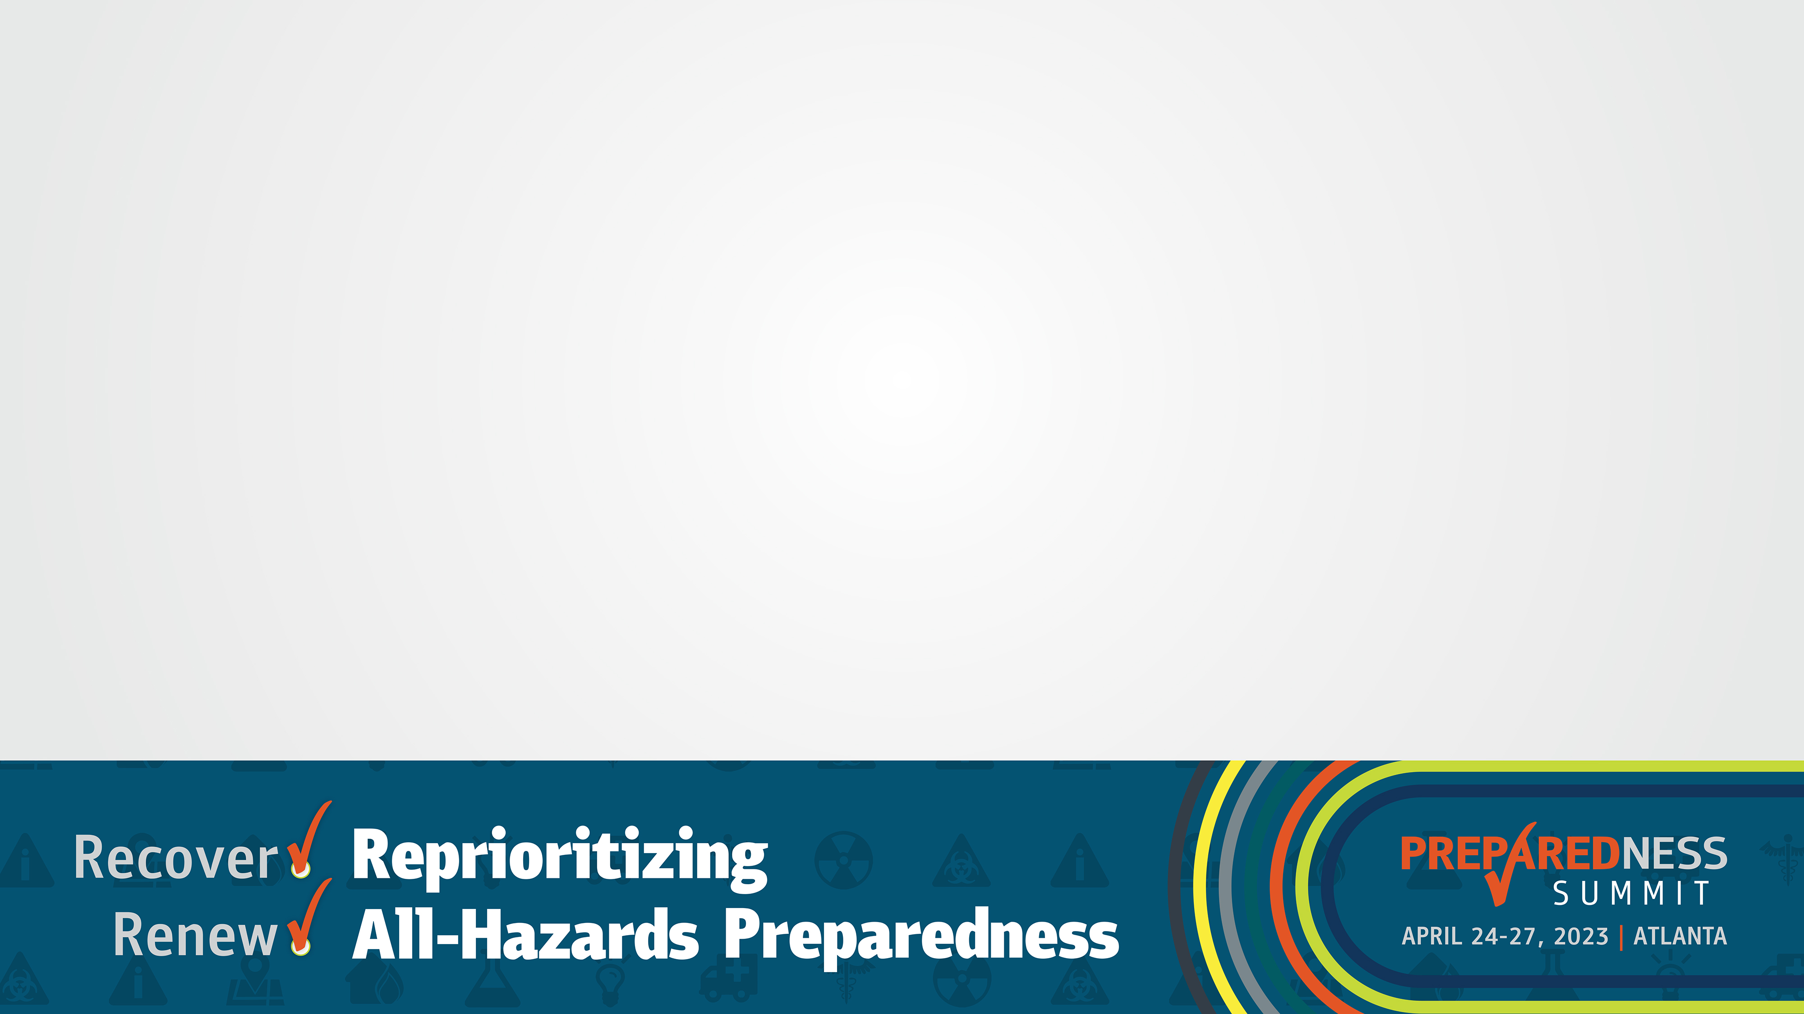
What Questions Do You Have?
~10 minutes

Slide 71
Thank You!
Andrew Adams: aadams@cste.org
Svetlana Smorodinsky: Svetlana.Smorodinsky@cdph.ca.gov
Tess Konen: tess.konen@state.mn.us

Slide 72
