Slide 1

Disaster Epidemiology:
How Preparedness and Response Tools Support Recovery and Mitigation
Andrew Adams, Council of State and Territorial Epidemiologists
Svetlana Smorodinsky, California
Tess Konen, Minnesota

Slide 2
Speakers
Andrew Adams, Senior Program Analyst, Council of State and Territorial Epidemiologists
Svetlana Smorodinsky, Disaster Epidemiologist, California Department of Public Health, CSTE Disaster Epidemiology Subcommittee Co-Chair
Tess Konen, Senior Epidemiologist, Minnesota Department of Health, CSTE Disaster Epidemiology Subcommittee Co-Chair

Slide 3
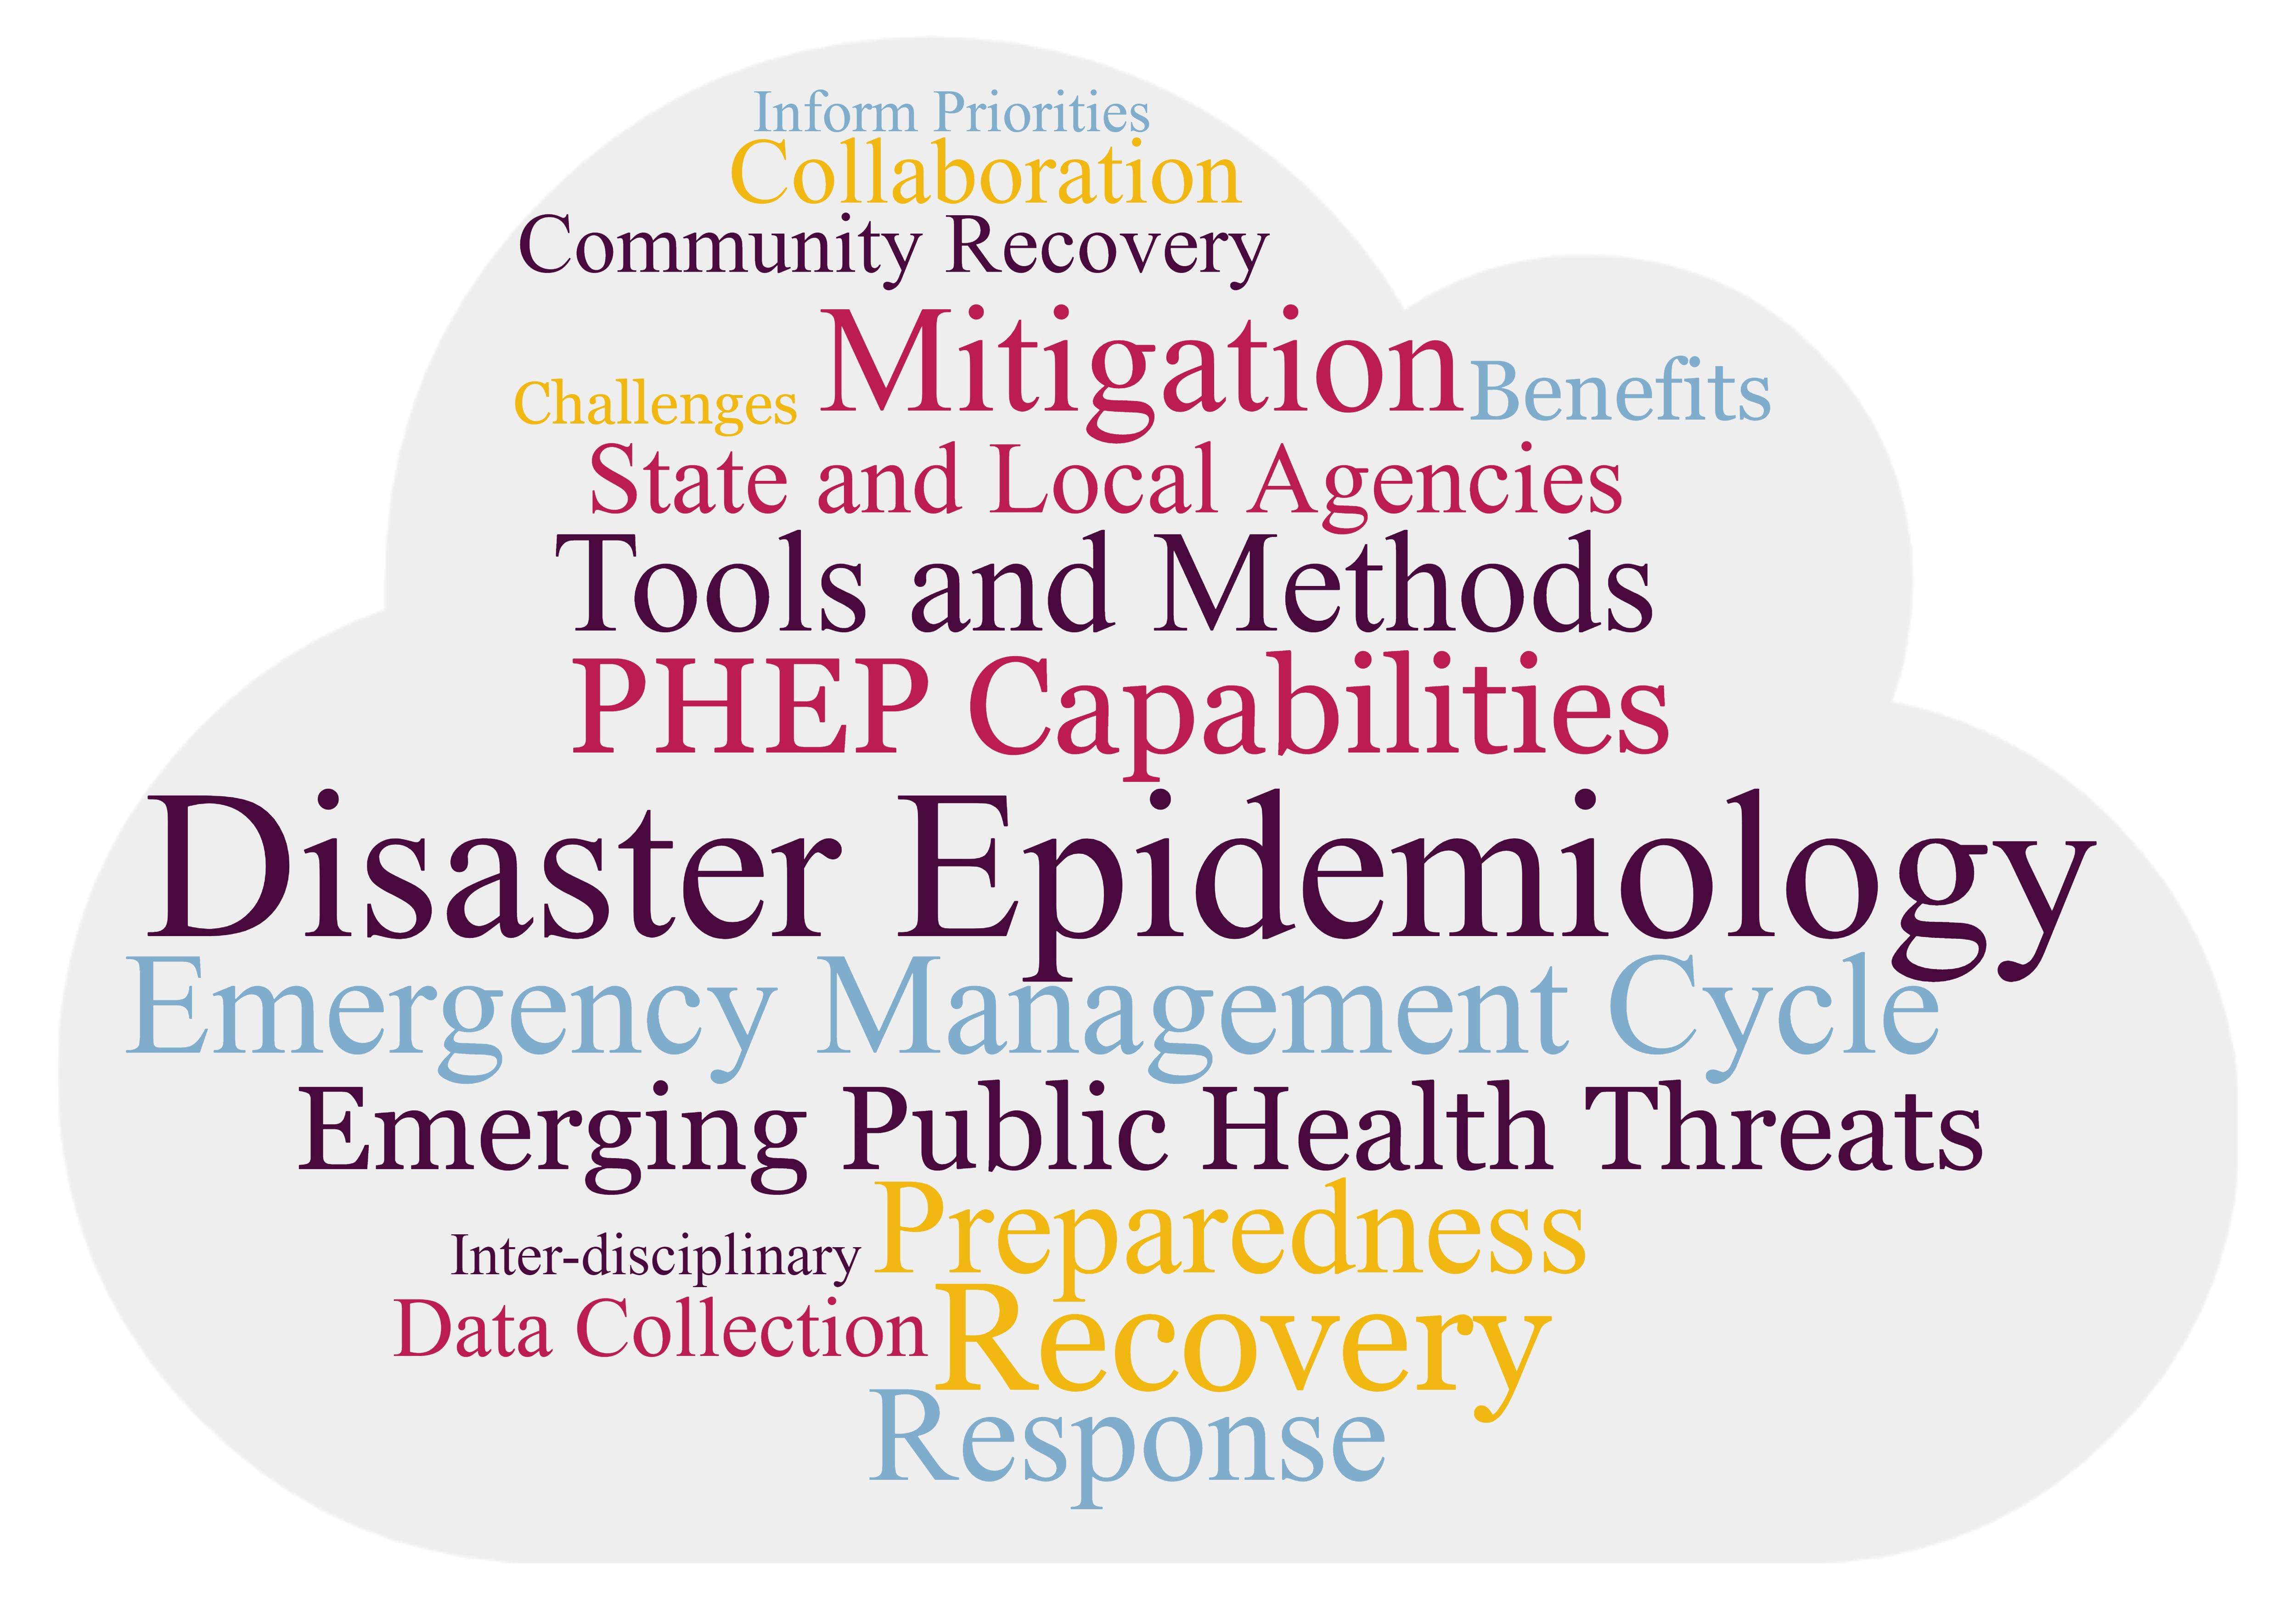
Presentation Objectives
Notes:
Define Disaster Epidemiology (DE) and its role in all phases of the emergency management cycle
Explain how DE can assist state and local agencies in responding to emerging public health threats
Showcase how DE meets PHEP Capability requirements and integrates with Emergency Management
Identify methods to be used in mitigation and recovery and the benefits and challenges of using and collecting data in the recovery phase
Engage with colleagues on experiences and challenges in utilizing data to inform mitigation priorities and community recovery efforts

Slide 4
Presentation Objectives
Define Disaster Epidemiology (DE) and its role in all phases of the emergency management cycle
Explain how DE can assist state and local agencies in responding to emerging public health threats
Showcase how DE meets PHEP Capability requirements and integrates with Emergency Management
Identify methods to be used in mitigation and recovery and the benefits and challenges of using and collecting data in the recovery phase
Engage with colleagues on experiences and challenges in utilizing data to inform mitigation priorities and community recovery efforts

Slide 5
Session Outline
Define Disaster Epidemiology (DE)
Explain its role in the Emergency Management Cycle
Describe how DE methods can used to achieve Public Health Emergency Preparedness and Response Capabilities
Share case studies of DE methods used for recovery and mitigation
Discussion, Questions and Answers
Share disaster epidemiology resources and training

Slide 6
Disaster Epidemiology: the Basics

Slide 7
Slido Info & Question 1

Slide 8

What is Epidemiology?
Notes:
To make sure we are all on the same page, I am going to go over some definitions quickly.
Epidemiology is the study of distribution and determinants of illness, injury, disability and death in specified populations, and the application of this study to minimize these outcomes.
This approach is applied across all the whole spectrum of public health from the traditional infectious disease to chronic, maternal child health, environmental and occupational hazards.

Slide 9
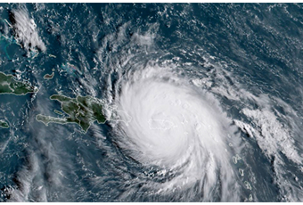
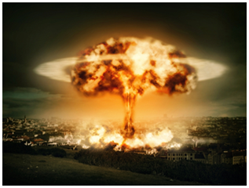
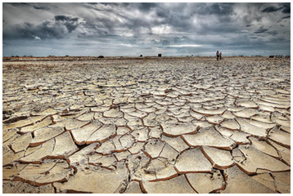
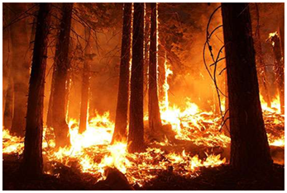
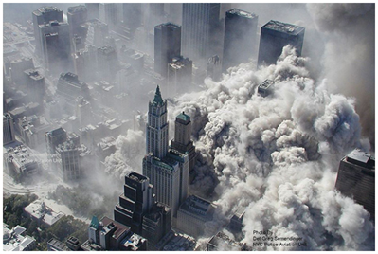
What is Disaster Epidemiology?
The use of epidemiology to assess the short- and long-term adverse effects of disasters and to predict consequences of future disasters
Notes:
Quite simply, epidemiology methods applied to disasters is disaster epidemiology. Like any sub-field, it has it’s own tools and approaches.
Disaster Epidemiology is defined as the use of epidemiology to assess the short- and long-term adverse health effects of disasters and to predict (and ultimately mitigate or prevent) consequences of future disasters.

Slide 10
How Can Disaster Epidemiology Help You?
DE provides reliable and actionable information to incident commanders, planners, and decision-makers
Provides situational awareness
Assesses the short- and long-term adverse health effects of disasters
Informs planning and preparation for future disasters
Notes:
The main objectives of disaster epidemiology are to:
provide timely and accurate information for decision-makers (information that helps you understand what the needs are, plan the response, gather and distribute the appropriate resources)
prevent or reduce the number of deaths, illnesses, and injuries caused by disasters,
improve prevention and mitigation strategies for future disasters by using collected information

Slide 11
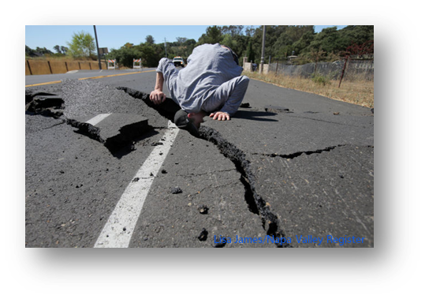

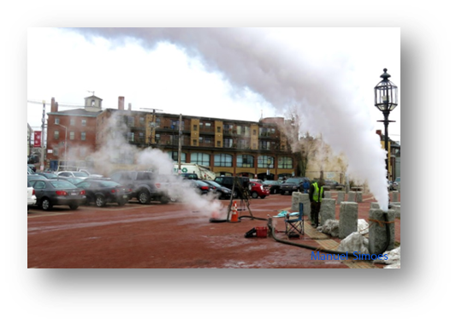
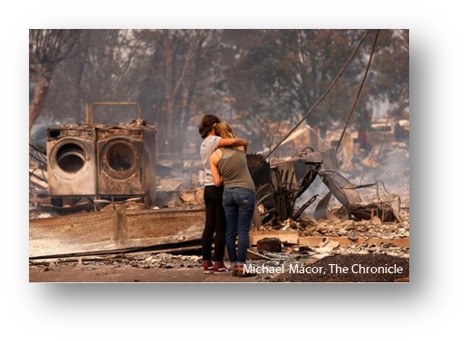
Disaster Epidemiology: an All-Hazard approach
Notes:
DE began with studying health risks after environmental disasters and is considered part of environmental epidemiology, but the tools and methods are applied across all types of disasters now.
DE takes an all-hazards approach, applying a framework and tools no matter the disaster
To help identify hazards, risks, and vulnerabilities across all aspects of public health
Need to consider all aspects impacted
Consider disease, injury, death, MH/BH, public health consequences of property damage, business disruption, and environmental impact

Slide 12
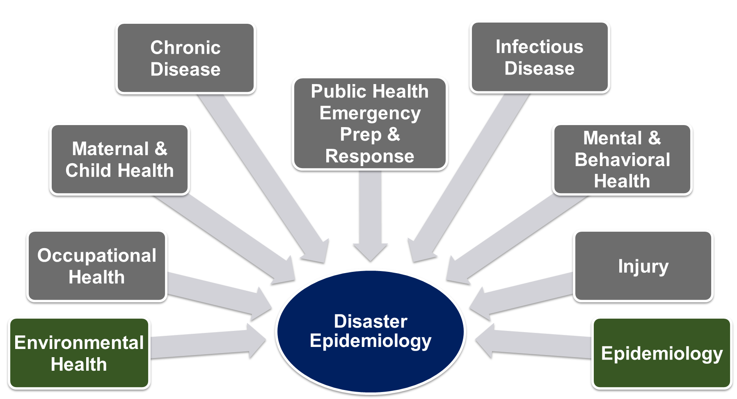
Disaster Epidemiology is Multi-disciplinary
Notes:
DE is multi-disciplinary: brings together various topic areas of epidemiology including acute and communicable disease, environmental health, occupational health, chronic disease, injury, mental and behavioral health.
When an incident happens, the SME epidemiologist should be selected
During an infectious disease (ID) outbreak, public health turns to the ID experts
During an environmental disaster, public health turns to EH experts
Knowledge of response to all-hazards
Cross training of epidemiologists is essential – Epi needs to know Emergency Management (ICS and emergency operations) and Disaster Epi
Any epidemiologist can be a disaster epidemiologist
PHEP/EM need to pull the appropriate epi SME for the response
Important for PHEP to meet your epi’s

Slide 13
Disaster Epidemiology and the Emergency Management Cycle

Slide 14
Slido question 2

Slide 15
DE and Incident Command System (ICS)
Incident Commander or
EOC Director
Safety Officer
Operations
Plans
Logs
ERHMS Unit
ESF-8 Liaison
Finance
Medical Unit or Science Branch
Situation Analysis or Tech Specialists
Notes:
DE can fit in multiple aspects of ICS.
This slide shows just some possibilities.
On the command level, a disaster epidemiologist can be embedded with the Safety Officer to implement the Emergency Responder Health Monitoring and Surveillance Framework, or ERHMS. We’ll talk about ERHMS later in this session.
DE falls under ESF-8. (public health & medical services) and thus could serve as an ESF 8 Liaison Officer at an EOC.
In the Operations Section, DE can be integrated into the Medical Unit, or Epidemiology and Surveillance Unit of a Science Branch.
In Planning and Intelligence, DE could be part of Situation Analysis cell, serve GIS or other technical specialist roles, or provide data to feed dashboards for SitReps.
Overall, DE is a core part of PH planning and response.
It is Foundational part of ESF-8
Provides ICS leadership with credible health data for:
Situational awareness
Making decisions
Allocating resources

Slide 16
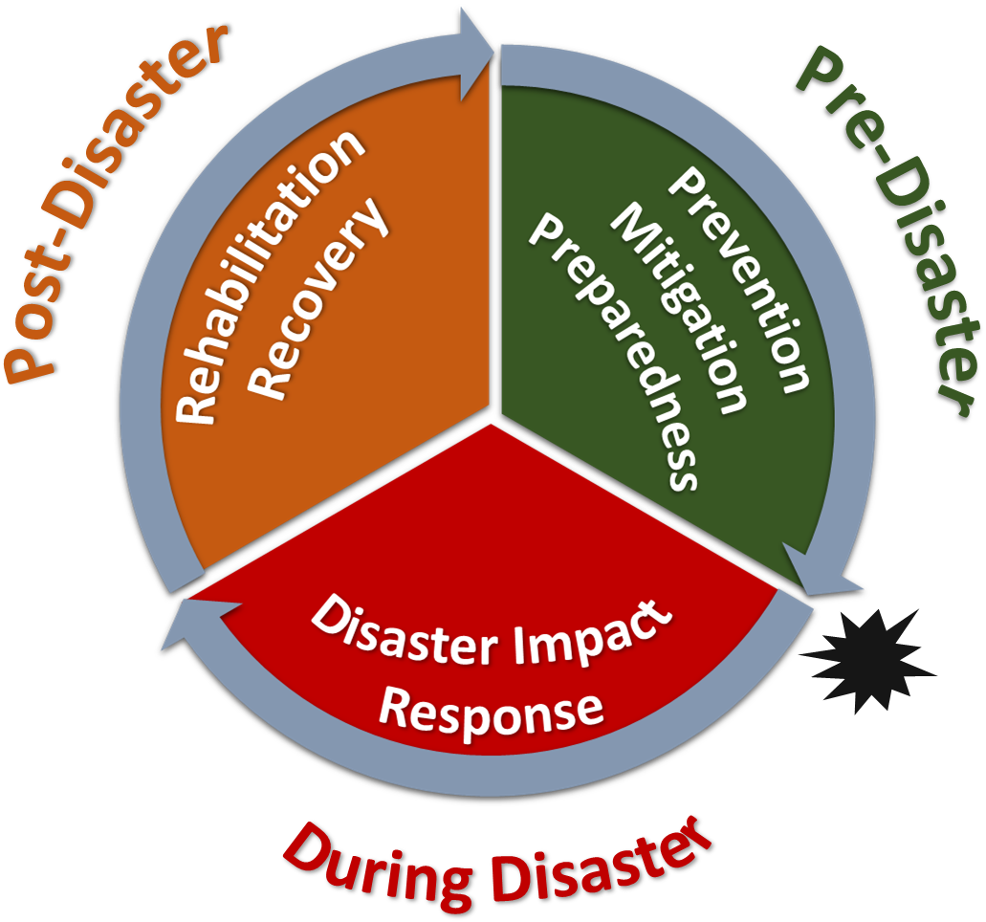
Conceptual Framework
Notes:
The Centers for Disease Control & Prevention (CDC)/National Center for Environmental Health (NCEH)
Council of State and Territorial Epidemiologists (CSTE)
Developed a framework of how epidemiology is applied in the different disaster phrases
Framework identified the applications of epidemiology in disaster settings
Developed by:
Centers for Disease Control & Prevention (CDC)/National Center for Environmental Health (NCEH)
Council of State and Territorial Epidemiologists (CSTE)

Slide 17
The Disaster Management Cycle
Post-disaster
Prevention, Mitigation, Preparedness
Disaster Impact
Rehabilitation, Response, Recovery
Pre-disaster
Disaster
Notes:
The disaster management cycle includes:
planning and preparedness pre-disaster,
the disaster event when the disaster is active,
and the response and recovery phases post-disaster.

Slide 18
Disaster Epidemiology Activities
Post-disaster
Tracking
Registries
Pre-disaster
Epidemiology investigations
Evaluation and risk studies
Prevention, Mitigation, Preparedness
Disaster Impact
Rehabilitation, Response, Recovery
Disaster
Surveillance
  Affected communities
  Responders
Rapid needs assessments
Notes:
DE fits into all phases of the disaster management cycle.
During and following the disaster, health surveillance of the affected communities and responders might occur to know the severity and level of impact. As well as, rapid needs assessment to inform the response efforts.
In the response and recovery phase, you continue to track health outcomes and inform the health impact and need to mitigate health risk. (using rosters or registries, line lists…).
In the preparedness phase, we use our data to assess what changes could be made to reduce risk. Epidemiologic studies and evaluation studies inform interventions and controls to prepare for the next disaster.

Slide 19
Disaster Epidemiology & PHEP Capabilities

Slide 20
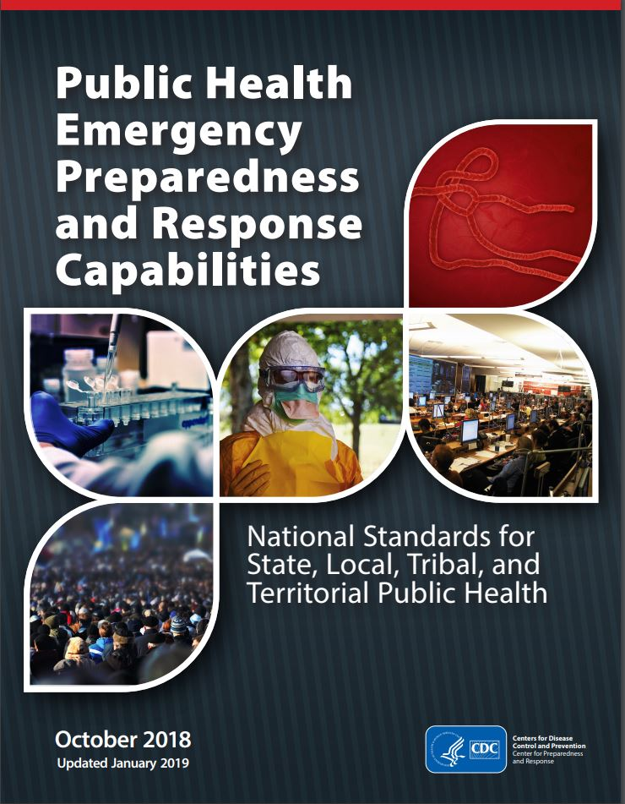
DE and PHEP capabilities
Recent revisions added references to environmental health functions and partners, including:
  References to DE tools (CASPER & ACE)
  Focus on radiological planning before an imminent risk
  Resources for recovery operations after radiological incidents
Notes:
Public Health Emergency Preparedness and Response Capabilities
CDC established 15 capabilities that serve as national standards for public health preparedness planning (many jurisdictions grant funded and need to meet these capabilities to continue funding)
Specifically, the capabilities further emphasize the importance of disaster epidemiology
DE methods and tools can help you meet your PHEP and HPP required capabilities. The following slides highlight the PHEP and HPP Capabilities and Functions that DE fit in.
For those of you under PHEP important to understand how work fits in and even if you aren’t under the rgant, but work with emergency folks who do, this may provide more context about their priorities.

Slide 21
DE and PHEP Capabilities
Capability 1: Community Preparedness
  Assess and determine risks to the population and identify and map at-risk populations
Capability 2: Community Recovery
  Assess impact and inform recovery efforts post-disaster (using rapid needs assessments, public health research)
Capability 3: Emergency Operations Coordination
  Provide situation awareness to detect need for activation or dissemination of resources
Capability 4: Emergency Public Information and Warning
  Inform health alerts and the development of educational materials
Notes:
DE fits into many of the PHEP capabilities. For instance, in cap1, epi’s can assist in assessing and determining potential risks and identifying at-risk populations.
For community recovery, epi’s can collect information to inform recovery and assess impact through rapid needs assessments and research.
For cap 3, epi’s may be the ones identifying a need for activation from reviewing the surveillance data and can provide information for situational awareness.
For cap4, surveillance may inform the necessity of health alerts and coordinate with poison control centers can provide educational information.

Slide 22
DE and PHEP Capabilities
Capability 5: Fatalities Management
  Analyze postmortem data to determine the extent of emergency, and use of electronic death registry system (EDRS) to improve the speed/completeness
Capability 6: Information Sharing
  Use of electronic case reporting (eCR), electronic death registration (EDR), electronic laboratory results (ELR), syndromic surveillance (SyS) reporting
  Develop of Health Alert Networks (HAN)
Capability 7: Mass Care
  Provide information on needs of population impacted and infection control in mass care settings
Capability 8: Medical Countermeasures
  Use surveillance to determine the need for MCM and to identify at-risk populations
Notes:
Cap5, analysis of ante mortem and postmortem data can determine the severity of the emergency and impact. The electronic death registration system can improve this process.
Cap6: this is cornerstone of epi, using and collecting information and sharing it with partners. There are various systems that can come into play with this and assist with it.
Cap7: epi’s can provide information on the needs of population areas impacted and conduct surveillance in mass care setting.
Cap8: they may identify the need for medical countermeasures from surveillance and help identify the at-risk population that needs MCM

Slide 23
DE and PHEP Capabilities
Capability 9: Medical Material Management and Distribution
  Analyze medical and social demographic data to inform medication and durable medical equipment needs
Capability 10: Medical Surge
  Collect data on healthcare delivery system and EMS calls
Capability 11: Non-Pharm Interventions
  Identify/interrupt spread of disease
  Focus on mass screening processes for contamination & decontamination in response to nuclear/radiological events
Capability 12: PH Laboratory & Testing
  Contextualize lab results for situational awareness
Notes:
Cap9: Epi’s can analyze medical and social demographic information to inform the medications and durable medical needs. Using things like the empower map.
Cap10: use data on hospital beds and EMS calls to inform medical surge and response.
Cap11: identify and interrupt the spread of disease. Also focus on process for mass screening and decontamination
Cap12: connect lab and preparedness and assist in translation between lab results in context

Slide 24
DE and PHEP Capabilities
Capability 13: PH Surveillance and Epidemiological Investigation
  Monitor trends of illness or injury and provide situation awareness
  References DE tools (ACE & CASPER) and registries
  Includes tracking systems, monitoring the exposed, and syndromic surveillance systems
Capability 14: Responder Safety and Health
  Use ERHMS as a resource for responders and volunteers
Capability 15: Volunteer Management
  Use ERHMS as a resource for responders and volunteers
Notes:
cap13: Has the most explicit connection to epidemiology. PH surveillance and epi investigation. There are various tools for tracking and surveillance that we will get into later, but this includes tracking systems and syndromic surveillance.
Cap14: epi’s involved in the tracking of workers and volunteers

Slide 25
Disaster Epidemiology and Recovery & Mitigation

Slide 26
Slido question 3

Slide 27
Defining Recovery Period
Restore critical community functions
Begin stabilization efforts
Bring the affected area back to some degree of normalcy
Recovery begins immediately after the threat to life subsided
Notes:
But what does that really mean? How do you know when it starts or ends?
Integrated with response mechanisms, and the EOP incident management process should be extended into recovery.
Recovery management transitions to regular agency management processes or some intermediate method defined by the responsible organizations.
Restore critical community functions and begin to manage stabilization efforts.
The goal of the recovery phase is to bring the affected area back to some degree of normalcy.
The recovery phase begins immediately after the threat to human life has subsided. Often in the late stages of the response and then transfers the efforts into routine work.

Slide 28
Defining Recovery Period
Restore critical community functions and begin to manage stabilization efforts.
The goal of the recovery phase is to bring the affected area back to some degree of normalcy.
The recovery phase begins immediately after the threat to human life has subsided. Often in the late stages of the response and then transfers the efforts into routine work.
Notes:
But what does that really mean? How do you know when it starts or ends?
Integrated with response mechanisms, and the EOP incident management process should be extended into recovery.
Recovery management transitions to regular agency management processes or some intermediate method defined by the responsible organizations.

Slide 29
Disaster Epidemiology and Recovery
Identify and document ongoing community needs
Inform resource allocation
Evaluate interventions and provide recommendations
Determine physical and mental health impact from the incident

Slide 30
Disaster Epidemiology and Recovery
Activity
Purpose
Public Health Surveillance & Tracking Systems
Registries
Rapid Needs Assessments
Epidemiologic Investigations & Studies
Determine health impact from incident
Monitor for long-term health consequences
Identify on-going community needs
Study public health impacts and evaluate interventions

Slide 31
Defining Mitigation
Reduce or eliminate risk
Break repeated damage cycle
Process and projects
Notes:
"Hazard mitigation" is any sustainable action that reduces or eliminates long-term risk to people and property from future disasters.
Mitigation planning breaks the cycle of disaster damage, reconstruction and repeated damage.
Hazard mitigation includes long-term solutions that reduce the impact of disasters in the future
Hazard mitigation planning reduces loss of life and property by minimizing the impact of disasters.
It begins with state, tribal and local governments identifying natural disaster risks and vulnerabilities that are common in their area.
After identifying these risks, they develop long-term strategies for protecting people, property and the environment from similar events.
Mitigation plans are key to breaking the cycle of disaster damage and reconstruction.
FEMA has a substantial number of requirements and policies on how to conduct hazard mitigation planning,
Some of those requirements include community assessments and collaborations among agencies, community groups, different levels of government, and the private sector.
State and Local hazard mitigation plans are required to be submitted for FEMA approval and revised every 5 years for the jurisdiction to receive funding.

Slide 32
Disaster Epidemiology and Mitigation
Support collaboration with Emergency Management
Promote community engagement
Fill data and knowledge gaps
Identify community status and priorities
Assess beliefs, knowledge, and practices

Slide 33
Disaster Epidemiology and Mitigation
Activity
Purpose
Rapid Assessments
Community engagement
Population vulnerabilities
Mitigation priorities
Attitudes, beliefs
Hazard Vulnerability Assessments
Evaluate potential damage and cascading impacts
Develop priorities
Notes:
Rapid Assessments
Promote community engagement, determine population vulnerabilities, inform mitigation priorities, identify beliefs, knowledge, and practices
Hazard Vulnerability Assessment
Systematically evaluate potential disaster damage and cascading impacts from public health perspective & develop a prioritized list of vulnerabilities for structural and non-structural projects

Slide 34

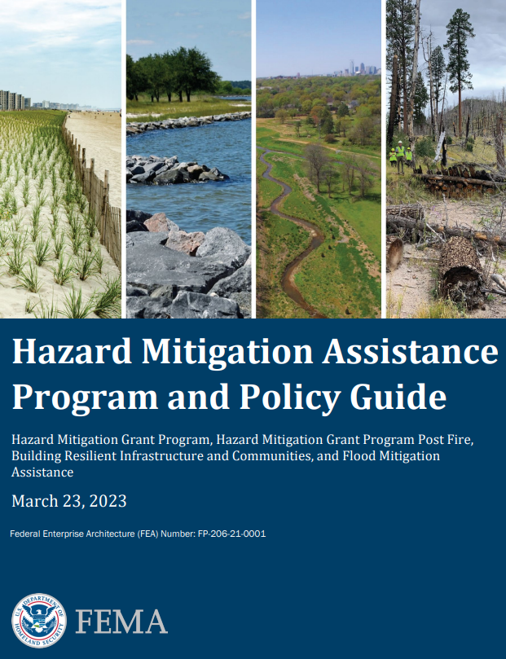
State and Local Hazard Mitigation Planning
Notes:
Disaster Epi tools and methods can help emergency management to identify critical knowledge gaps and fulfill FEMA planning requirements
Example: Can use CASPER to document vulnerabilities
FEMA local mitigation plan guidance released in April , page 23, element B2 in Risk Assessment
B2. Does the plan include a summary of the jurisdiction's vulnerability and the impacts on the community from the identified hazards? Does this summary also address NFIP insured structures that have been repetitively damaged by floods?

Slide 35
Disaster Epidemiology Methods Overview and Case Studies in Recovery & Mitigation

Slide 36
Slido question 4

Slide 37
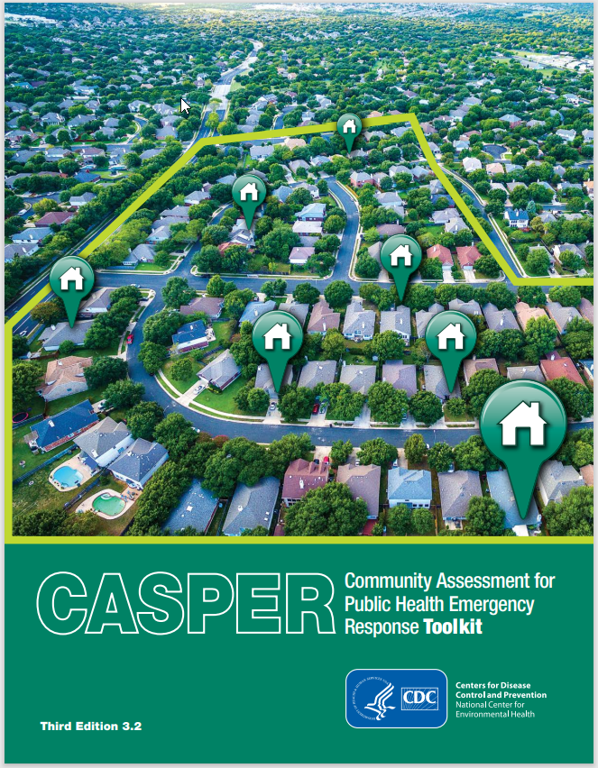
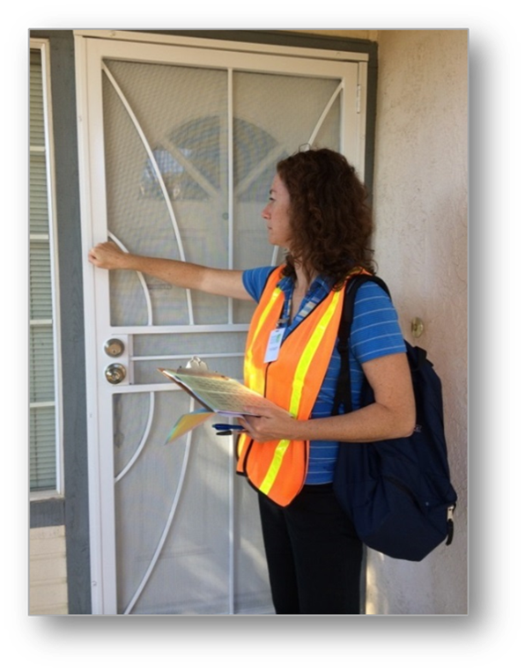
Rapid Needs Assessments
Used in all Emergency Management Cycle Phases
Identify community status
Systematic, timely, and statistically robust
Example: Community Assessment for Public Health Emergency Response (CASPER)
Notes:
Rapid Needs Assessments
RNA = systematic process of information collection and analysis regarding the type, depth, and scope of a problem
Typically are launched early in response phase and can also be done for preparedness, recovery, and mitigation purposes
Identify needs of affected communities in a systematic, timely, and statistically valid manner
Provide basis for appropriate response
CASPER
One type of rapid needs assessment is the Community Assessment for Public Health Emergency Response (CASPER) developed by the CDC. It is now one of the main tools used for rapid need assessments.
Includes structured, systematic methodology of doing door-to-door survey interviews through two-stage cluster sampling to get a representative sampling of a specific geographic area. (analyzed at household level)
Guiding principle:
What do you want to know?
Why do you want to know it?
What are you going to do about it?
Actionable – emphasis on “do”

Slide 38
Rapid Needs Assessments
Launched early in response phase
Identifies needs of affected communities in a systematic, timely, and statistically valid manner
Provides basis for appropriate response
Community Assessment for Public Health Emergency Response (CASPER)
  Type of rapid needs assessment
  CDC epidemiologic technique to provide quick, low-cost household-based information about a community
Notes:
Rapid Needs Assessments
RNA = systematic process of information collection and analysis regarding the type, depth, and scope of a problem
Are launched early in response phase and can also be done for preparedness and recovery purposes
Identify needs of affected communities in a systematic, timely, and statistically valid manner
Provide basis for appropriate response
CASPER
One type of rapid needs assessment is the Community Assessment for Public Health Emergency Response (CASPER) developed by the CDC. It is now one of the main tools used for rapid need assessments.
Includes structured, systematic methodology of doing door-to-door survey interviews through two-stage cluster sampling to get a representative sampling of a specific geographic area. (analyzed at household level)
Guiding principle:
What do you want to know?
Why do you want to know it?
What are you going to do about it?
Actionable – emphasis on “do”

Slide 39
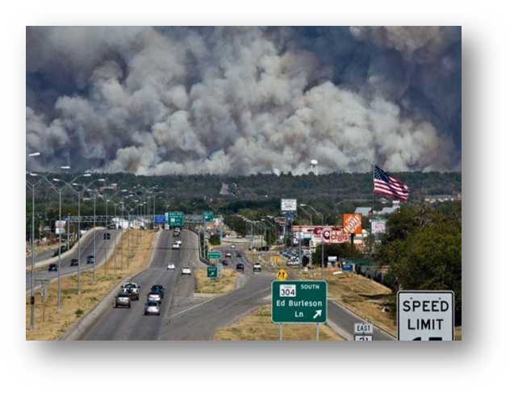
Recovery CASPER:
Longitudinal Wildfire Impact Assessment
Texas
Response CASPER informed:
  Key public health issues
  Resource allocation
  Rebuilding intent
Recovery CASPER informed:
  New concerns
  Unmet needs
  Rebuilding reality
Notes:
Texas Department of State Health Services conducted a CASPER to assess public health impacts from a devastating wildfire.
Initial CASPER informed key public health issues and resource allocation. Follow-up CASPER informed new concerns or unmet needs to share with officials.
Response phase CASPER informed key public health issues and resource allocation.
CASPER was conducted 3 years later to measure progress in recovery and assess long-term health and mental health status.
Follow-up CASPER informed new concerns or unmet needs to share with officials.
Preparedness and response capabilities: cap2 community recovery and cap 4 Emergency Public Information and Warning (informed communication methods as well)

Slide 40
Recovery CASPER: Longitudinal wildfire assessment
Texas Department of State Health Services conducted a CASPER to assess public health impacts from a devastating wildfire.
Initial CASPER informed key public health issues and resource allocation. Follow-up CASPER informed new concerns or unmet needs to share with officials.
Notes:
Initial CASPER informed key public health issues and resource allocation.
CASPER was conducted 3 years later to measure progress in recovery and assess long-term health and mental health status.
Follow-up CASPER informed new concerns or unmet needs to share with officials.
Preparedness and response capabilities: cap2 community recovery and cap 4 Emergency Public Information and Warning (informed communication methods as well)

Slide 41
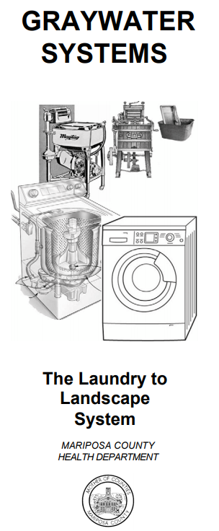
Mitigation CASPER: Drought
California
Domains of knowledge:
  Drought knowledge and beliefs
  Access to water, water use and reduction
  Health impacts, chronic diseases
  Disaster threats, communications
  Graywater systems beliefs and use
Data into Action
  Expanded program for residents with AFN
  Launched graywater informational campaign
  Conducted follow-up CASPER
Notes:
Area of Interest: Mariposa County
Domains of Knowledge:
Drought knowledge and beliefs
Access to water, water use and reduction
Health impacts, chronic diseases
Disaster threats, communications
Graywater systems beliefs and use
Data into Action
Expanded program for residents with AFN
Launched graywater informational campaign
Conducted follow-up CASPER

Slide 42

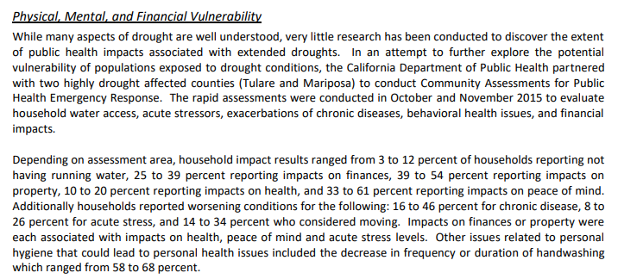
CASPER Informs State Hazard Mitigation Plan

Slide 43
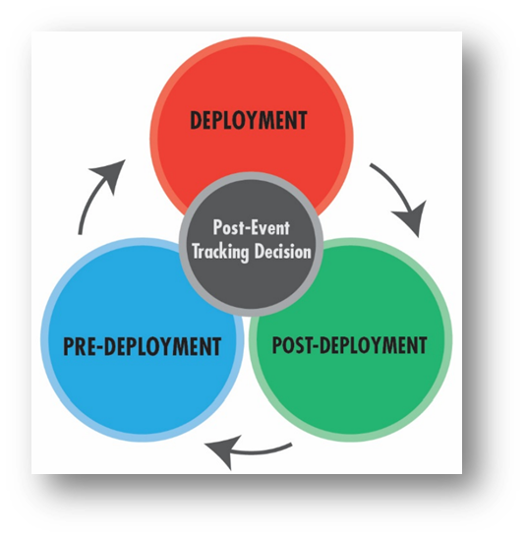
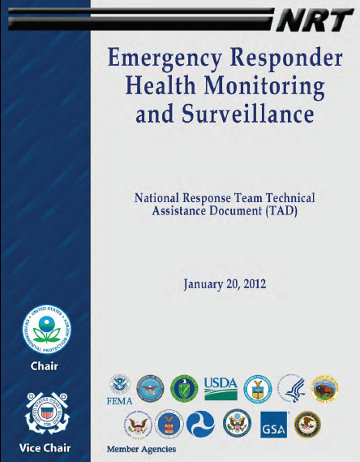
Responder Safety & Health
CDC/NIOSH Emergency Responder Health Monitoring and SurveillanceTM (ERHMS) Framework
Notes:
CDC Emergency Responder Health Monitoring Surveillance (ERHMS) is a health monitoring and surveillance framework for protecting responders through all phases of a response
This requires collaboration between epidemiology, industrial hygiene, and emergency managers. Functions under Safety Officer in ICS
Key questions to ask:
Pre-deployment: which responders are “ready,” credentialed, and available to respond?
Deployment: who are the responders on-site, and to what are they exposed? How is their health?
Post-deployment: what did the responders do while deployed, how is their health now, and what to what were they exposed during the entire deployment?

Slide 44
ERHMS for Responder Mental Health Assessment: Mass Shooting
Oregon
Response phase:
  Behavioral strike teams
  ERHMS framework used for fitness for duty
Recovery phase:
  After-action sessions
  Monitored case load
  Transitioned to local providers
  Developed improvement plan
Notes:
SERV-OR is Oregon’s roster of licensed physicians, nurses, pharmacists, Emergency Medical Technicians (EMTs), behavioral health providers, respiratory therapists and others who have registered to volunteer in response to local, state, and/or federal emergencies.
In 2015, 10 people died and 7 were injured at a community college campus in rural southern Oregon
Behavioral strike teams provided surge capacity
Collected data through evidence-based data collection tool PsySTART
Used ERHMS framework to ensure behavioral clinicians were fit to respond and assessed if needed any resources after
Held after-action session for all clinicians to ensure their experience did not cause any trauma
Monitored case load and then transitioned to local providers as need decreased
Developed improvement plan based on feedback and implemented at anniversary to provide counseling

Slide 45
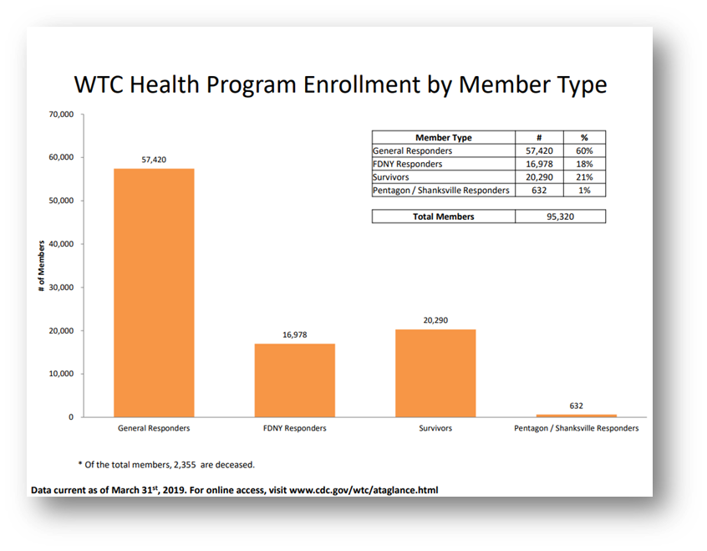
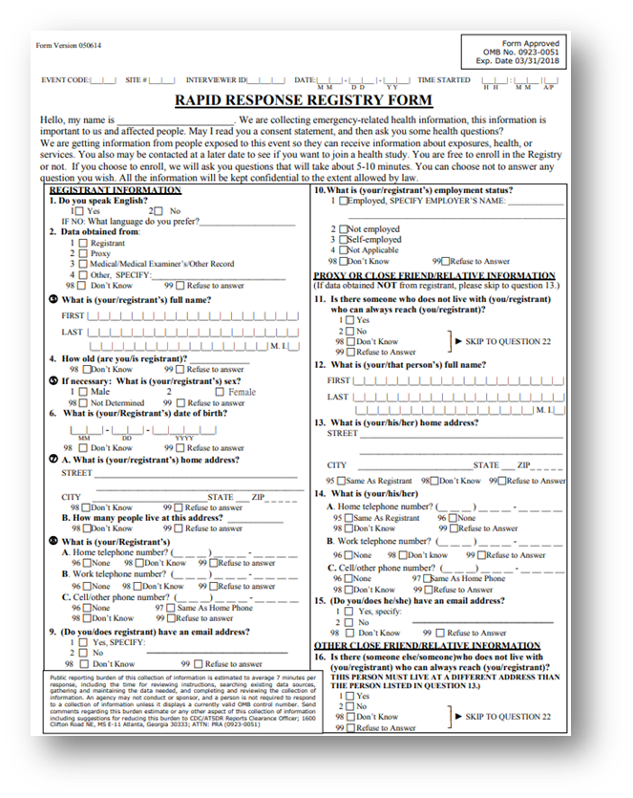
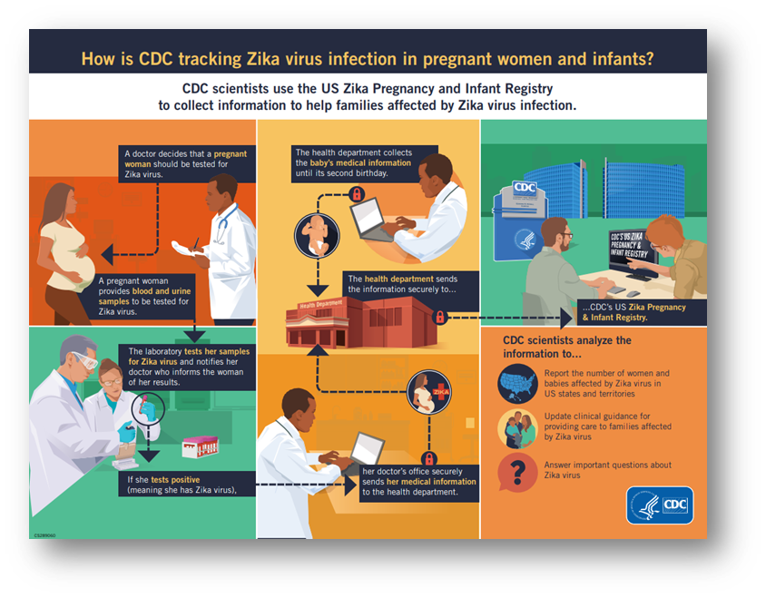
Tracking, Rosters, Registering
Notes:
Familiar with cancer registry
What do we do in cases when resulting illnesses, injuries, or disabilities—including emotional trauma—may not be recognized or resolved in the immediate post-disaster period?
Disaster epi-related registries: CDC Zika and WTC post 9/11
WTC post 9/11: Results will help determine to what extend physical and mental health conditions have persisted. mong persons enrolled in the World Trade Center Health Registry, there was an excess risk for prostate cancer, thyroid cancer, and myeloma in 2007-2008 compared with that for New York State residents; however, these findings were based on a small number of events and multiple comparisons.
A more recent registry, is CDC’s Zika pregnancy and infant registry. Pregnant women with lab confirmed Zika are included to identify adverse pregnancy outcomes to make recommendations to clinicians for care and Zika prevention.
Before we get to registries, there’s tracking and rosters
Tracking
Collection and integration of data from environmental monitoring, exposure, and health effects in people over time
Can be used for short-term or long-term follow up
Rosters
Early assessment tool to quickly find people affected by disaster
Collect information on the exposed persons for follow-up
Can be used to populate future registries
Registries
Track affected people for medium to long-term health consequences
Inform needs for continuing medical/behavioral care or establishing public health measures
Follow exposed population for conditions that may have delayed symptom onsets
In all three approaches, we typically gather initial information during response and recovery phases
Ultimately, these approaches inform ongoing care, future public health interventions, and public health emergency planning and preparedness
Meets cap. 13

Slide 46
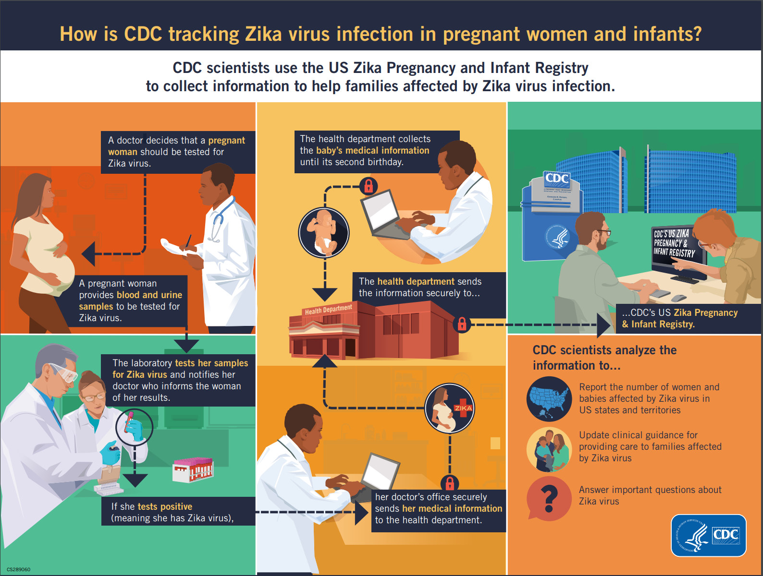
Registry for “Mitigation”: Zika Virus
CDC Zika Pregnancy and Infant Registry
  Pregnant women with possible Zika virus infection
  Adverse pregnancy outcomes
“Mitigation” actions:
  Recommendations to prevent infection during pregnancy
  Elimination of mosquito breeding grounds
https://www.cdc.gov/pregnancy/zika/research/registry.html
Notes:
A more recent registry, is CDC’s Zika pregnancy and infant registry. Pregnant women with lab confirmed Zika are included to identify adverse pregnancy outcomes to make recommendations to clinicians for care and Zika prevention.
Certain types of birth defects can happen from Zika virus infection during pregnancy. Several brain and eye defects were more commonly reported.
About 5% of babies born to people with Zika while pregnant had Zika-associated birth defects. Additionally, some babies affected by Zika during pregnancy might look healthy at birth but can develop long-term health problems as they grow.
Infection during early pregnancy may be more likely to cause birth defects, but we have seen babies with birth defects born to people infected with Zika anytime during pregnancy.
Recommendations for clinicians to prevent Zika virus infection during pregnancy
Elimination of mosquito breeding grounds is a physical project along the lines of levee reinforcement to prevent flooding or a building earthquake retrofit

Slide 47
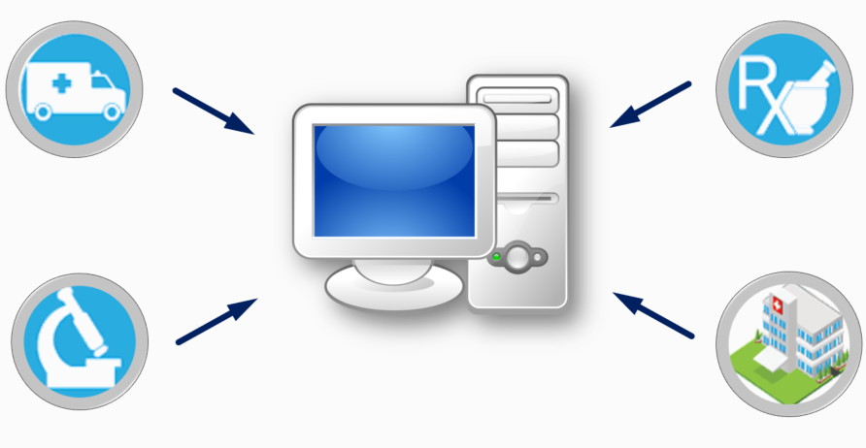
Syndromic Surveillance (SyS)
Early warning system for detecting, understanding, and monitoring health events
Notes:
Syndromic surveillance uses patient healthcare encounter data and statistical tools to detect, monitor, and characterize unusual activity for further public health investigation or response.
Syndromic is before diagnosis – e.g., mine keywords from chief complaint and triage notes
Allows us to detect potential aberrations in populations more quickly than a traditional outbreak could be detected by diagnostic means.
Data can come from emergency rooms, poison control centers, emergency medical services, pharmacies, and work or school absenteeism.
Data are monitored in near real-time as potential indicators of an event, a disease, or an outbreak of public health significance.
Identifies intra-disaster outbreaks or clusters of conditions
Characterizes burden of incident on affected sub-populations
Provides descriptive analysis of conditions, injuries, and fatalities
Can use multiple types of data (attendance data, pharmacy info) but most commonly used is data from clinics and hospitals (chief complaint data)
After a disaster, continued monitoring of syndromic surveillance data is important because some health outcomes may be delayed (e.g., with longer incubation periods of some communicable diseases) or are more likely during a clean-up phase (e.g., injury or exposure to a toxic substance) [8].
A return to expected visit counts, types of complaints, and demographics mark an important milestone during a recovery phase.
Because of post-disaster surveillance, we now know more about co exposure from generators and that cleanup injuries are common and need more caution/safety equipment

Slide 48
Syndromic Surveillance in recovery
After a disaster, continued monitoring of syndromic surveillance data is important because some health outcomes may be delayed or are more likely during a clean-up phase
A return to expected visit counts, types of complaints, and demographics mark an important milestone during a recovery phase
The Kansas Department of Health and Environment has retrospectively analyzed storm- and tornado-related injuries to inform prevention efforts.
Notes:
After a disaster, continued monitoring of syndromic surveillance data is important because some health outcomes may be delayed (e.g., with longer incubation periods of some communicable diseases) or are more likely during a clean-up phase (e.g., injury or exposure to a toxic substance) [8].
A return to expected visit counts, types of complaints, and demographics mark an important milestone during a recovery phase.
Because of post-disaster surveillance, we now know more about co exposure from generators and that cleanup injuries are common and need more caution/safety equipment

Slide 49
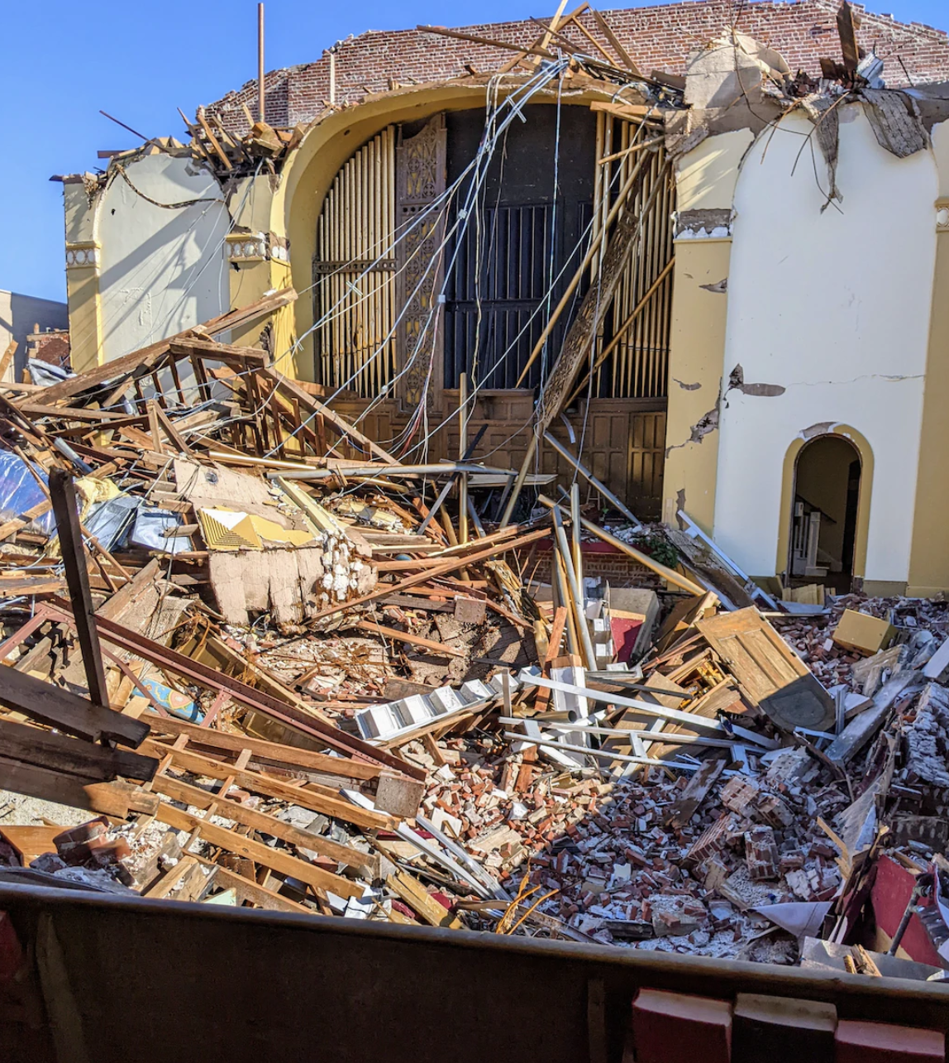

SyS for Recovery: Asthma Following Building Collapse
New York City
Emergency Department visits for asthma
SyS findings informed questions about the health impacts of local air quality
Notes:
NYC Department of Health conducted syndromic surveillance of asthma following building collapses and fires.
ED visits for asthma did not increase for the day of the events and for several days afterward.
Surveillance findings were shared with leadership, and they were able to respond to questions from the press regarding the health impacts of local air quality.
Surveillance findings were shared with leadership, and they were able to respond to questions from the press regarding the health impacts of local air quality.
Preparedness and Response Capability 3: Emergency Operations Coordination: Provide situation awareness to detect need for activation or dissemination of resources
3

Slide 50
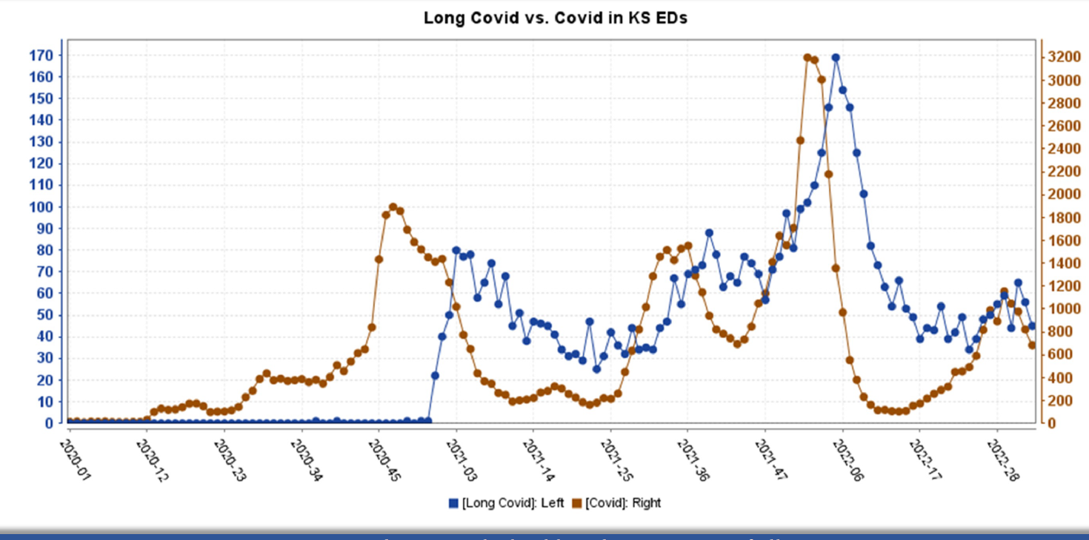
SyS for Recovery: “Long COVID”
Kansas, Nebraska
“Long COVID”, diagnosis code for Post-COVID condition, history of COVID infection
Sleep disorders, heartbeat abnormalities, fatigue
More reliable tracking of syndrome-based trends over time
Attributed to: Gabriel Haas from Kansas Department of Health and Sandra Gonzalez from University of Nebraska-Lincoln
Notes:
KS and NE used mention of “Long COVID” or diagnosis code for Post-COVID condition or History of COVID infection and explored associated symptoms.
Peaks in visits for Long COVID followed peaks in visits for COVID-19.
Sleep disorders were the most common symptoms for both sexes. Heartbeat abnormalities and fatigue were the most common for pediatric visits
This helps to better understand the codes used for Long COVID ED visits, the conditions associated with Long COVID, and the consistency in presentations across jurisdictions.
Understanding Long COVID related conditions may help provide ways to more reliably track syndrome-based trends over time.
KS and NE had a similar proportion of Long COVID to COVID-19 ED visits (KS 7.21%, NE 10.26%).
Peaks in visits for Long COVID followed peaks in visits for COVID-19.
For both KS and NE, sleep disorders were the most overrepresented symptoms among male and female Long COVID – related ED visits.
For both KS and NE, abnormalities of heartbeat and malaise and fatigue were the most overrepresented symptoms among pediatric Long COVID – related ED visits (0-17).
Syndromic surveillance can help to understand which Long-COVID symptoms are more overrepresented among people with history of COVID who have visited the ED.
This may help to better understand the codes used for Long COVID ED visits, the conditions associated to Long COVID, and the consistency in presentations across jurisdictions.
Finally, understanding Long COVID related conditions may help provide ways to more reliably track syndrome-based trends over time.

Slide 51
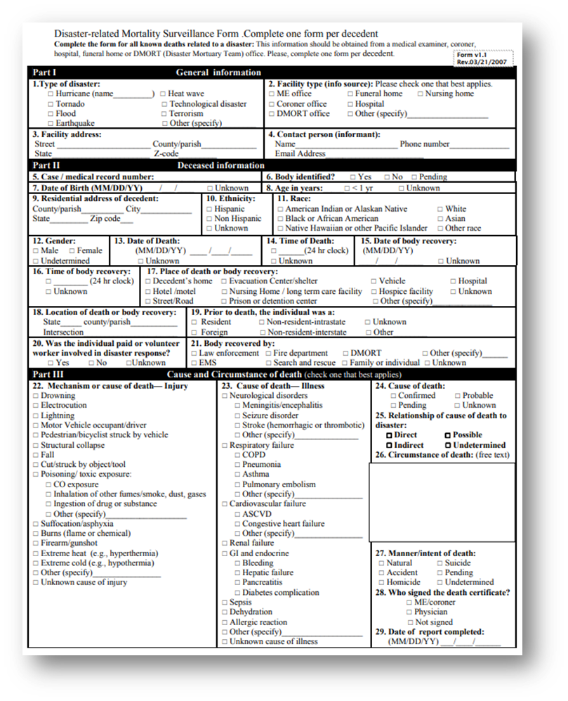
Mortality Surveillance and Assessment
Disaster impact severity
  Leading causes of death
  At-risk groups
  Common risk factors
Prevention strategies
CDC Toolkit
Electronic death registration systems
https://www.cdc.gov/nceh/hsb/disaster/surveillance.htm
Notes:
Define the severity and impact of the disaster
Identify the leading causes of death, at-risk groups, and common risk factors to help guide immediate and future prevention strategies
Challenge: defining disaster-related deaths and identifying them
CDC has a matrix for attributing deaths and a toolkit
Reporting of deaths after a disaster and through electronic death registration systems (EDRS)

Slide 52
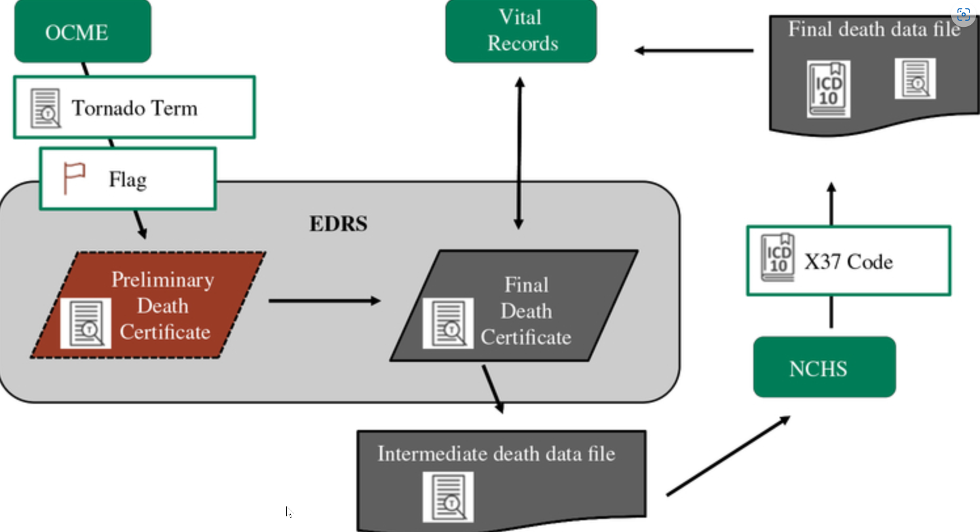
Mortality Surveillance during Recovery: Tornado
Oklahoma
Retrospective mortality surveillance
  EDRS flags
  Medical records review at 32 hospitals
Notes:
More traditional surveillance, would involve a retrospective review of injuries and deaths related to an event to characterize the impact and identify trends in the population and to inform protective actions for next time (feedback loop).
This informs our knowledge by characterizing the injuries and deaths so we can message and inform public on the safe approach.
Official counts of deaths attributed to disasters are often under-reported, thus adversely affecting public health messaging designed to prevent further mortality. Following a 2013 tornado, OK public health and the CDC retrospectively analyzed electronic death records to determine if the EDRS was capturing all tornado-attributed deaths. They evaluated three event fatality markers, which are used to collate information about deaths for immediate response and retrospective research efforts.
They found The tornado-specific flag was the most sensitive and timely.
They also did an intense review of medical records at 32 hospitals to:
assess tornado-related injuries and deaths,
identify populations impacted
protective actions taken
In this example, l more than half of the injuries and deaths were indirectly related, of these a large portion were due to cleanup and evacuation/seeking shelter.
Of 49 deaths and 755 injuries associated with the disaster:
336 injuries (45%) were directly related
419 injuries (55%) were indirect related
35% trying to get in or out of shelter
6% fleeing the area, 5% rescuing an animal or person
35% of hospital visits were for injuries during cleanup

Slide 53
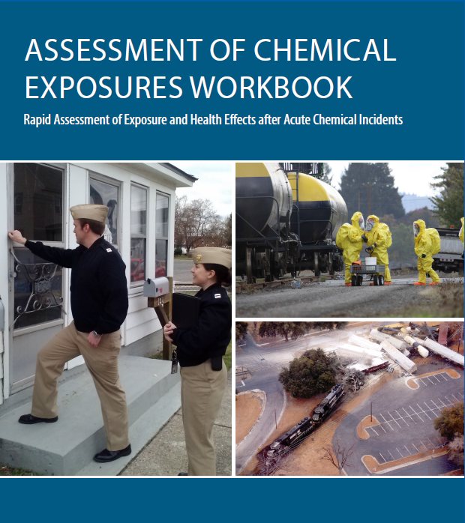
Assessment of Chemical Exposure (ACE)
Toolkit
Health impacts and root causes of exposure
Collaboration with multiple disciplines
Notes:
Rapid assessment during the aftermath of large-scale chemical releases resulting in multiple casualties
Unlike a CASPER which is a method, ACE is a toolkit and can use any epi approach
Toolkit includes: standardized surveys, consent forms, medical chart abstraction form, data entry programs, geospatial analysis tools, and laboratory specimen testing
All materials are modifiable and adaptable to local incident needs
ATSDR built the ACE program based on lessons learned from the Graniteville, South Carolina, train derailment that released chlorine gas
ACE is public health lane
Look at health impacts and root causes of exposure
Focus on appropriate response from health perspective
Collaborative project with multiple disciplines
Benefits :
1. Identify actions to prevent future incidents
2. Roster exposed cohort of individuals for further follow-up
3. After action and improvement planning for public health and safety response
4. Identify health effects in the community, workers, and first responders
5. Determine appropriate medical treatment and efficacy of decontamination
6. Collaborate with many disciplines PH usually doesn’t cross paths with

Slide 54
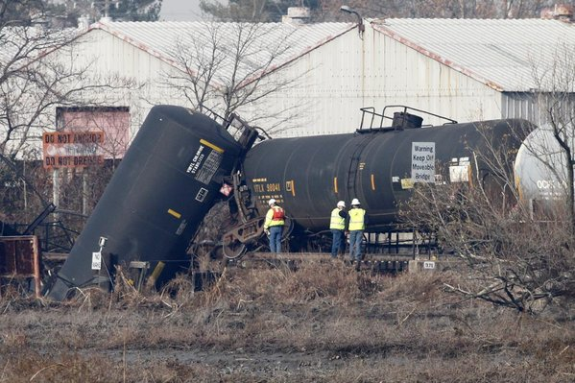
ACE for Recovery: Train Derailment
New Jersey
Freight train derailment
  Vinyl chloride release
ACE
  Community exposure
  Health impacts
  Communications
Notes:
Freight train carrying vinyl chloride derailed and NJ conducted ACE survey to gather information on community exposure, health impacts, and communication.
Provided situational awareness and monitoring of illness.
Informed best method for communicating with public about emergency.
Vinyl chloride is a colorless, sweet-smelling gas, the inhalation of which can cause respiratory and neurological symptoms, and, at
high concentrations, can cause cardiac dysrhythmia, loss of consciousness, and death.
58% experienced at least one new or worsening symptom
9% sought medical care
Residents evacuated rather than sheltering in place had fewer symptoms.
Residents preferred to receive information directly from a person of authority. Need more info. on how to shelter-in place safely.
Informed future planning for evacuation and shelter in place clarifying directions. Most got info. from tv or neighbors , although prefer to get from person of authority.
preparedness and response cap this meets:
Capability 4: Emergency Public Information and Warning
Inform health alerts and the development of educational materials
Capability 13: PH Surveillance and Epidemiological Investigation
Monitor trends of illness or injury and provide situation awareness

Slide 55
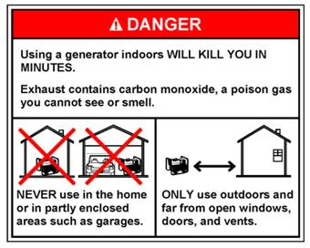

Disaster Research
NIEHS Disaster Research Response Program (DR2)
Epidemiological studies
Evaluation studies
Notes:
Evaluation studies, also called accountability studies and assess interventions and relief programs.
These can be applied at different phases of the disaster management cycle to assess response actions or interventions.
Evaluate the impact of actions to inform improved response and support. How well did those interventions or programs work?
There are also risk investigations and studies, which characterize the risks from disasters.
Example is there were carbon monoxide poisonings and this was related to the location people were putting their generator and now this is a built in part of communication after a disaster to make sure to have it far away from the house, well ventilated.
Research during disasters can occur with the disaster research response program.
National Institute of Environmental Health Sciences (NIEHS) identified the need to rapidly perform critical health research during disaster response and recovery
Program includes:
Ready-to-go data collection tools (database of surveys, forms, etc.)
Research protocols (IRB pre-approval)
Training and exercises
Network of trained research responders

Slide 56
Research During Emergencies: Disaster Research Response Program
National Institute of Environmental Health Sciences (NIEHS) identified the need to rapidly perform critical health research during disaster response and recovery
Program includes:
  Ready-to-go data collection tools (database of surveys, forms, etc.)
  Research protocols (IRB pre-approval)
  Training and exercises
  Network of trained research responders
http://www.nationalacademies.org/hmd/Reports/2014/Enabling-Rapid-Sustainable-Public-Health-Research-During-Disasters.aspx
Notes:
Research during disasters can occur with the disaster research response program.
National Institute of Environmental Health Sciences (NIEHS) identified the need to rapidly perform critical health research during disaster response and recovery
Program includes:
Ready-to-go data collection tools (database of surveys, forms, etc.)
Research protocols (IRB pre-approval)
Training and exercises
Network of trained research responders

Slide 57
Evaluation studies
May be applied at different phases of disaster management cycle to assess response actions or interventions
Often provides information about efficient, efficacious, and cost-effective actions during response and recovery
Notes:
Evaluation studies, also called accountability studies and assess interventions and relief programs. These can be applied at different phases of the disaster management cycle to assess response actions or interventions.
Evaluate the impact of actions to inform improved response and support. How well did those interventions or programs work?
There are also risk investigations and studies, which characterize the risks from disasters. Example is there were carbon monoxide poisonings and this was related to the location people were putting their generator and now this is a built in part of communication after a disaster to make sure to have it far away from the house, well ventilated.

Slide 58
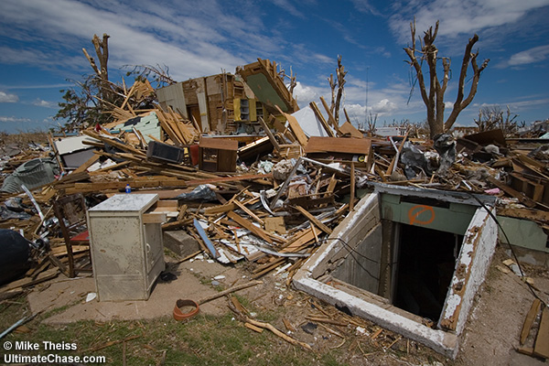
Epidemiologic Study for Recovery: Tornado
Oklahoma
Causes of fatal and non-fatal injuries associated with tornados
  People seeking shelter under freeway overpasses and in shelters with wooden doors
  Changes in education and construction standards
Notes:
Several case–control studies following tornadoes in Texas and Oklahoma (1979, 1999) identified risk factors for death and injury.76–78
One study examined risks among occupants fleeing their homes in cars versus those who remained within structures, raising concerns about the relative safety of occupying cars during tornados.79
Although typically conducted postdisaster, investigations and studies may be implemented long after life-saving emergency measures have been completed and issues requiring formal study have been identified.
May be more common knowledge now first determined with epi analysis.
In 1990s, Oklahoma conducted a study of causes of fatal and non-fatal injuries associated with tornados
Increase risk of death and injury among people seeking shelter under freeway overpasses & in shelters with wooden doors
Recommended changes in education and construction standards

Slide 59

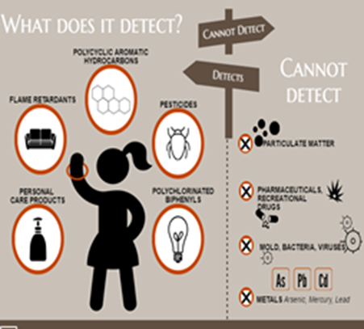
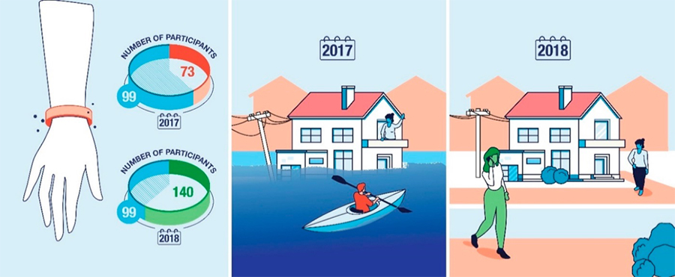
Exposure Study during Recovery: Post-Hurricane Hazardous Exposures
Texas
Silicone wristband samplers
  Immediately after the hurricane
  One year later
Notes:
13 hazardous waste sites were flooded during hurricane Harvey. So you can imagine there were all kind of contaminates in the water
In this risk investigation study, an academic partnership provided people in a community in Houston with passive wristbands to measure the exposures.
Risk characterization that informs what type of exposure, where, how much and possible actions/interventions to prevent future exposure.
13 hazardous waste sites flooded
People in nearby Houston communities potentially exposed
Passive Wristband Samplers deployed to measure exposures
Residents wear for 7 days
Return by mail
Bands can detect > 1,500 chemicals
Research partnership with
Oregon State University Superfund Research Program
Texas A&M
UTHealth School of Public Health
Baylor College of Medicine

Slide 60
Disaster Research Response DR2 Program
Examined households’ earthquake risk perceptions and their immediate response following the 2011 Christchurch Earthquake and the 2011 Tohoku Japan earthquake.
https://tools.niehs.nih.gov/dr2/index.cfm/resource/24301
Notes:
The measures included:
environmental and social context
building structure
Risk perception
behavioral response (during and after)
emotional response
risk information channel
previous earthquake experience
earthquake damage

Slide 61

Disaster Behavioral Health (DBH)
Assesses availability of behavioral health facilities and programs
Responds to psychological surge needs
Engages behavioral health partners and stakeholders
Develops behavioral health messaging and guidance
Notes:
Communities and individuals must have the behavioral health support to be able to return an optimal level of function.
To assess how well recovery is occurring and how resilient an entity is, epidemiology can assist with measures of this process. Traditionally, mental health personnel review behavioral health data.
However, public health has become more involved in assessing behavioral health needs. In addition, there is an increase in trained professionals of both public health and disaster behavioral health, which
allows for the opportunity to increase response activities.
An after-action meeting and summary should occur to assess the effectiveness of behavioral health interventions. (2) Frequent behavioral health training of responders and volunteers will only benefit disaster planning, response, and recovery initiatives.

Slide 62

California DBH Plan
CASPER for a DBH assessment
Partnership with epidemiologists
DBH actions for mitigation and recovery
Notes:
4.5.1 Sources of Disaster Behavioral Health Personnel CALIFORNIA DISASTER BEHAVIORAL HEALTH PLAN (2020) Potential sources of personnel that may assist in mitigating the impact of a disaster on behavioral health include:
U.S. Centers for Disease Control and Prevention: • Community Assessment for Public Health Emergency Response (CASPER) Program: DBH risk and epidemiology
Office of Public Health Preparedness and Response (OPHPR) Branch: specialized, focused population assessments in addition to CASPER
Mitigation
1. Identify Higher Risk Populations
Prior to a disaster, consider outreach to higher risk groups to provide pre-disaster education and resilience strengthening that may mitigate the acute and long-term psychological consequences of disaster
2. Develop Disaster-Related Information
Recovery
1. Assess Intermediate and Long-Term Needs
This is where disaster epidemiology comes in
Assess and evaluate the intermediate and long-term needs of the affected community with an understanding that secondary stresses may contribute to an increased need for behavioral health services.
2. Engage Community Resources to Provide DBH Services
3. Provide Supportive Interventions for DBH Response Teams and Other Disaster Personnel
Providing support to disaster survivors can be stressful and behavioral health professionals are not immune to stress reactions in the context of their work.
On-going support services should be offered to all DBH Response Team members and other disaster responders, especially in the long-term recovery phase of disaster.

Slide 63

Disaster Epidemiology at CSTE

Slide 64

CSTE Disaster Epidemiology Subcommittee
Strengthen capacity to respond to, prepare for and recover from disasters by integrating disaster epidemiology into the emergency management cycle
Help public health and emergency management leadership understand the essential role of disaster epidemiology
Identify a common set of capabilities to support the collection of epidemiologic data during emergency response situations
QR Code for SmartSheet Interest Form?
www.cste.org/group/DisasterEpi

Slide 65
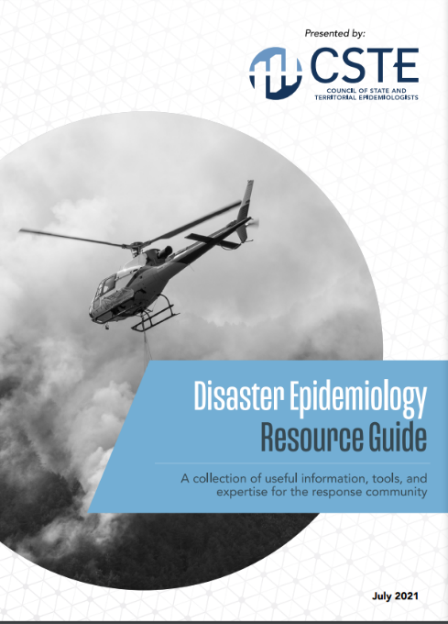
CSTE Disaster Epidemiology Resources
CSTE Disaster Epidemiology Resource Repository: https://www.cste.org/page/epidisaster
CSTE Disaster Epidemiology Resource Guide: https://cdn.ymaws.com/www.cste.org/resource/resmgr/disasterepi/DE_Resource_Guide_Final_v3.pdf
  Living document
  Published in 2021
  Overview of disaster epi methods and tools with real-world examples

Slide 66
14th Annual CSTE Disaster Epidemiology Workshop
QR Code for Registration/ CSTE LEARN ?
May 16 – 18, 2023 via Zoom
  Continuing education credits available
Day 1: An Introduction to Disaster Epidemiology
Day 2: Disaster Epidemiology in the Field: Activities and Partnerships
Day 3: Incorporating and Modernizing Data in Disaster Epidemiology

Slide 67
Discussion and Engagement
~35 minutes

Slide 68
Discussion Questions
How will you use Disaster Epidemiology Tools and Methods to assist in recovery operations in your jurisdiction?

Slide 69
Discussion Questions
How do you determine you’ve transitioned from acute response to long-term response and recovery operations?
  Data triggers?
  Policy decision?
  Other..

Slide 70
Discussion Questions
What are your data sources during recovery operations?

Slide 71
Discussion Questions
What are some data challenges in the recovery period?

Slide 72
Discussion Questions
What are community needs and challenges following an incident or disasters
  Helpful data sources/types/sets?

Slide 73
Disaster Epidemiology:
Training Courses, Resources, and Toolkits

Slide 74

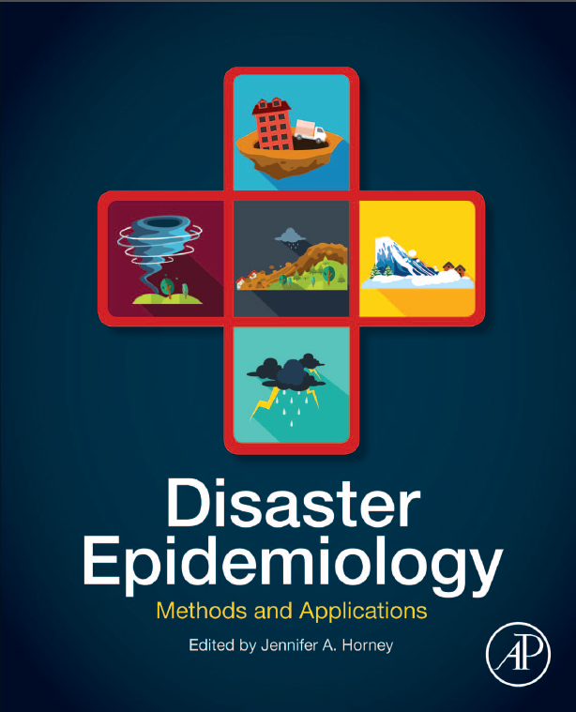
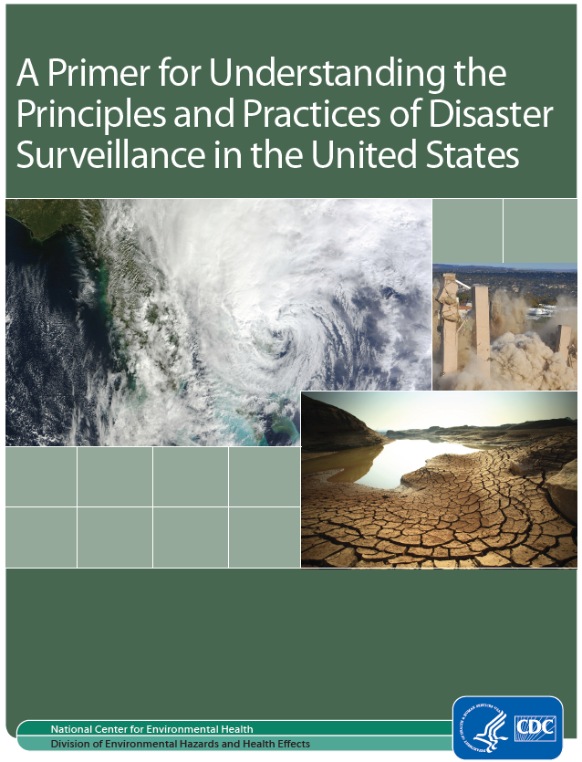
Disaster Epidemiology Resources
Notes:
CSTE DE tool repository: https://www.cste.org/page/epidisaster
NEW DE resource guide: https://cdn.ymaws.com/www.cste.org/resource/resmgr/disasterepi/DE_Resource_Guide_Final_v3.pdf
CDC DE primer: https://www.cdc.gov/nceh/hsb/disaster/Disaster_Surveillance_508.pdf
DE methods and applications by Dr. Jen Horney, teaching classes at U of Delaware

Slide 75
Training Courses, Resources and Toolkits
Disaster Epidemiology eLearning Modules (CDC): https://www.cdc.gov/nceh/hsb/disaster/training.htm#disaster_epiElearning
  Module 1: Public Health Impacts of Disasters
  Module 2: Public Health Emergency Management
  Module 3: CASPER
  Module 4: Disaster Surveillance
CASPER (CDC): https://www.cdc.gov/nceh/casper/training-resources.htm
Emergency Response Health Monitoring & Surveillance (ERHMS) Online Training Course (CDC): https://emergency.cdc.gov/training/erhmscourse/index.asp
  ERHMS Info Manager
CDART: Comprehensive Disaster Assessment & Readiness Tools (CDC ATSDR): https://www.atsdr.cdc.gov/CDART.html
Notes:
DE eLearning Modules –
Module 1: direct & indirect impact on public health in different types of communities
Module 2:
Module 3: CASPER -→ review of the CASPER methodology, when to conduct and data analysis
Module 4: Disaster Surveillance → includes information on why disaster surveillance is important, the purpose of morbidity and mortality surveillance during a response and tools to assist
CASPER – Community Assessment for Public Health Emergency Response – CDC offers a state-based, in-person training, and an online module as a part of the larger DE learning and training series
ERHMS Info Manager – developed by CDC NIOSH, and is a software product that can be used to implement the ERHMS framework
CDART – scenario driven, surveys and tools to help standardize the evaluation process for public health and healthcare preparedness; developed by ATSDR

Slide 76
Training Courses, Resources and Toolkits
Toxicological Outbreak Investigation Course & Toolkit (CDC): https://www.cdc.gov/nceh/hsb/elearning/toi/default.htm
Epi CASE (Contact Assessment Symptom Exposure) Toolkit (CDC ATSDR): https://www.atsdr.cdc.gov/epitoolkit/index.html
ACE (Assessment of Chemical Exposures) Toolkit and Training (CDC ATSDR): https://www.atsdr.cdc.gov/ntsip/ace_toolkit.html
Notes:
Toxicological outbreak investigation → basic information and customizable documents that can be used during an outbreak investigation, for outbreaks caused by non-infectious, toxic agents.
Epi CASE Toolkit ->

Slide 77
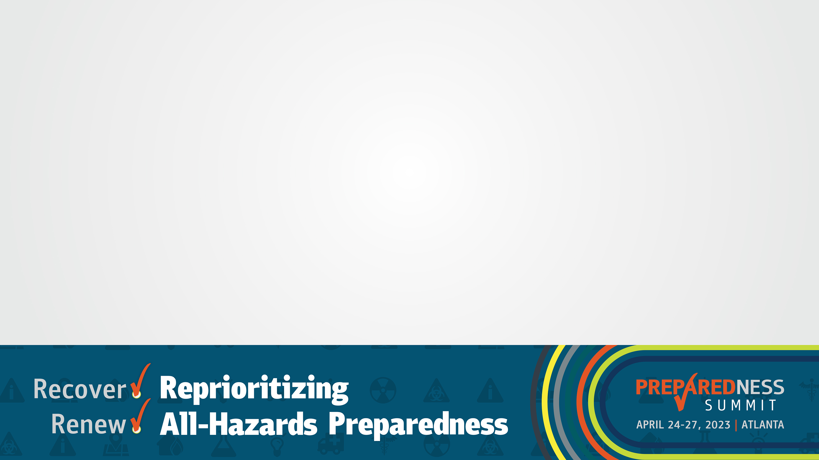
What Questions Do You Have?
~10 minutes

Slide 78
Thank You!
Andrew Adams: aadams@cste.org
Svetlana Smorodinsky: Svetlana.Smorodinsky@cdph.ca.gov
Tess Konen: tess.konen@state.mn.us

Slide 79
