Slide 1
Disaster Epidemiology: Applied perspective
Svetlana Smorodinsky and Tess Konen

Slide 2

Disaster Epidemiology Subcommittee Overview

Slide 3
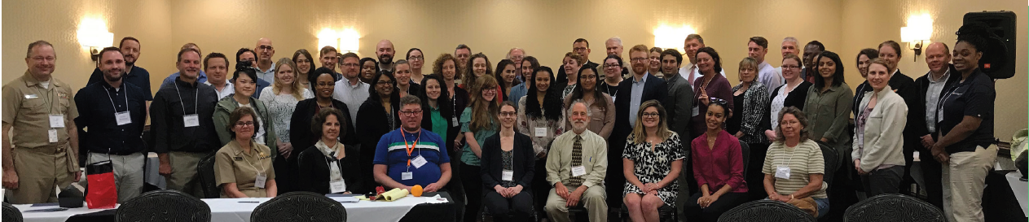
Disaster Epidemiology (DE) Subcommittee
Strengthen capacity
Help public health and emergency management leadership understand essential role of DE
Identify common set of capabilities
Notes:
Strengthen capacity to respond by integrating DE into the emergency management cycle
Help public health and emergency management leadership understand essential role of DE
Identify common set of capabilities to support collection of epidemiologic data during emergency response situations

Slide 4

DE Subcommittee by the Numbers
2007: started
14th workshop
382 members
  50 active
3rd Wed monthly calls
DE call
Notes:
Started in 2007
Subcommittee around for 13 years and on the 14th workshop!
382 subcommittee members
About 50 active members
Monthly Conference Calls with content speakers

Slide 5
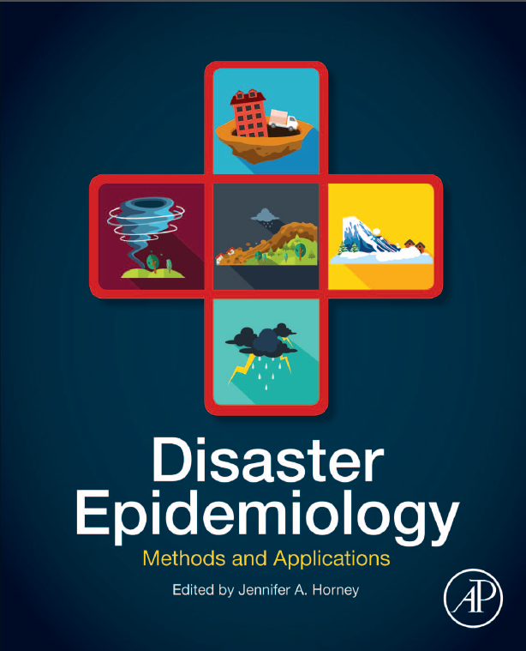
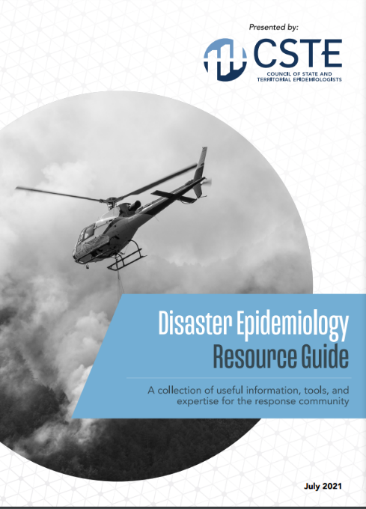
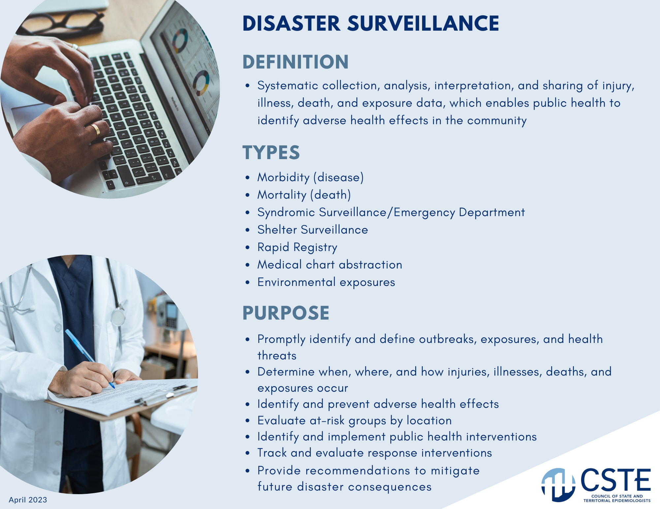
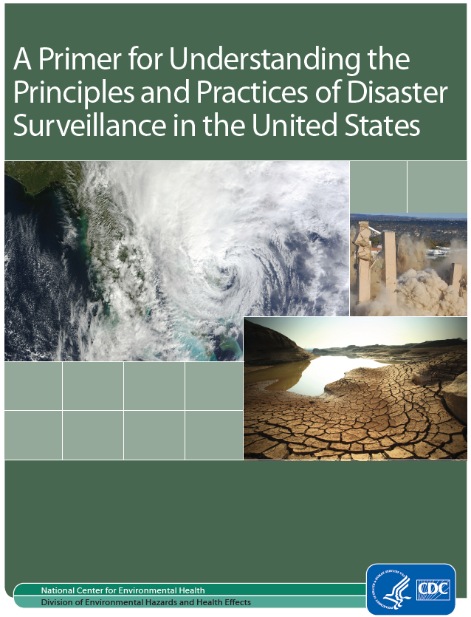
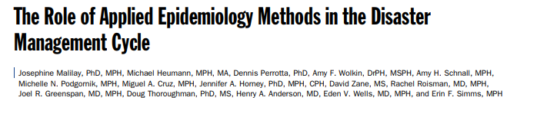
DE Subcommittee Resources
Notes:
Also syndromic surveillance guidance doc and EM cards
CSTE Disaster Epidemiology Resource Repository: https://www.cste.org/page/epidisaster
CSTE Disaster Epidemiology Resource Guide: https://cdn.ymaws.com/www.cste.org/resource/resmgr/disasterepi/DE_Resource_Guide_Final_v3.pdf
Living document
Published in 2021
Overview of disaster epi methods and tools with real-world examples
Outreach cards to be published soon
Resource Repository
https://www.cste.org/page/epidisaster
Resource Guide:
https://cdn.ymaws.com/www.cste.org/resource/resmgr/disasterepi/DE_Resource_Guide_Final_v3.pdf
Outreach Cards

Slide 6
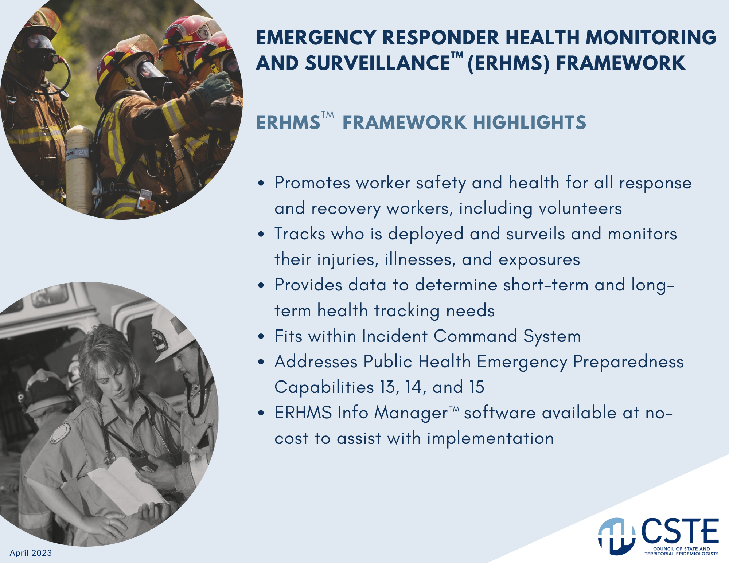
Disaster Epidemiology Outreach Cards
Notes:
Resource typing work

Slide 7

What Is This Session About?

Slide 8
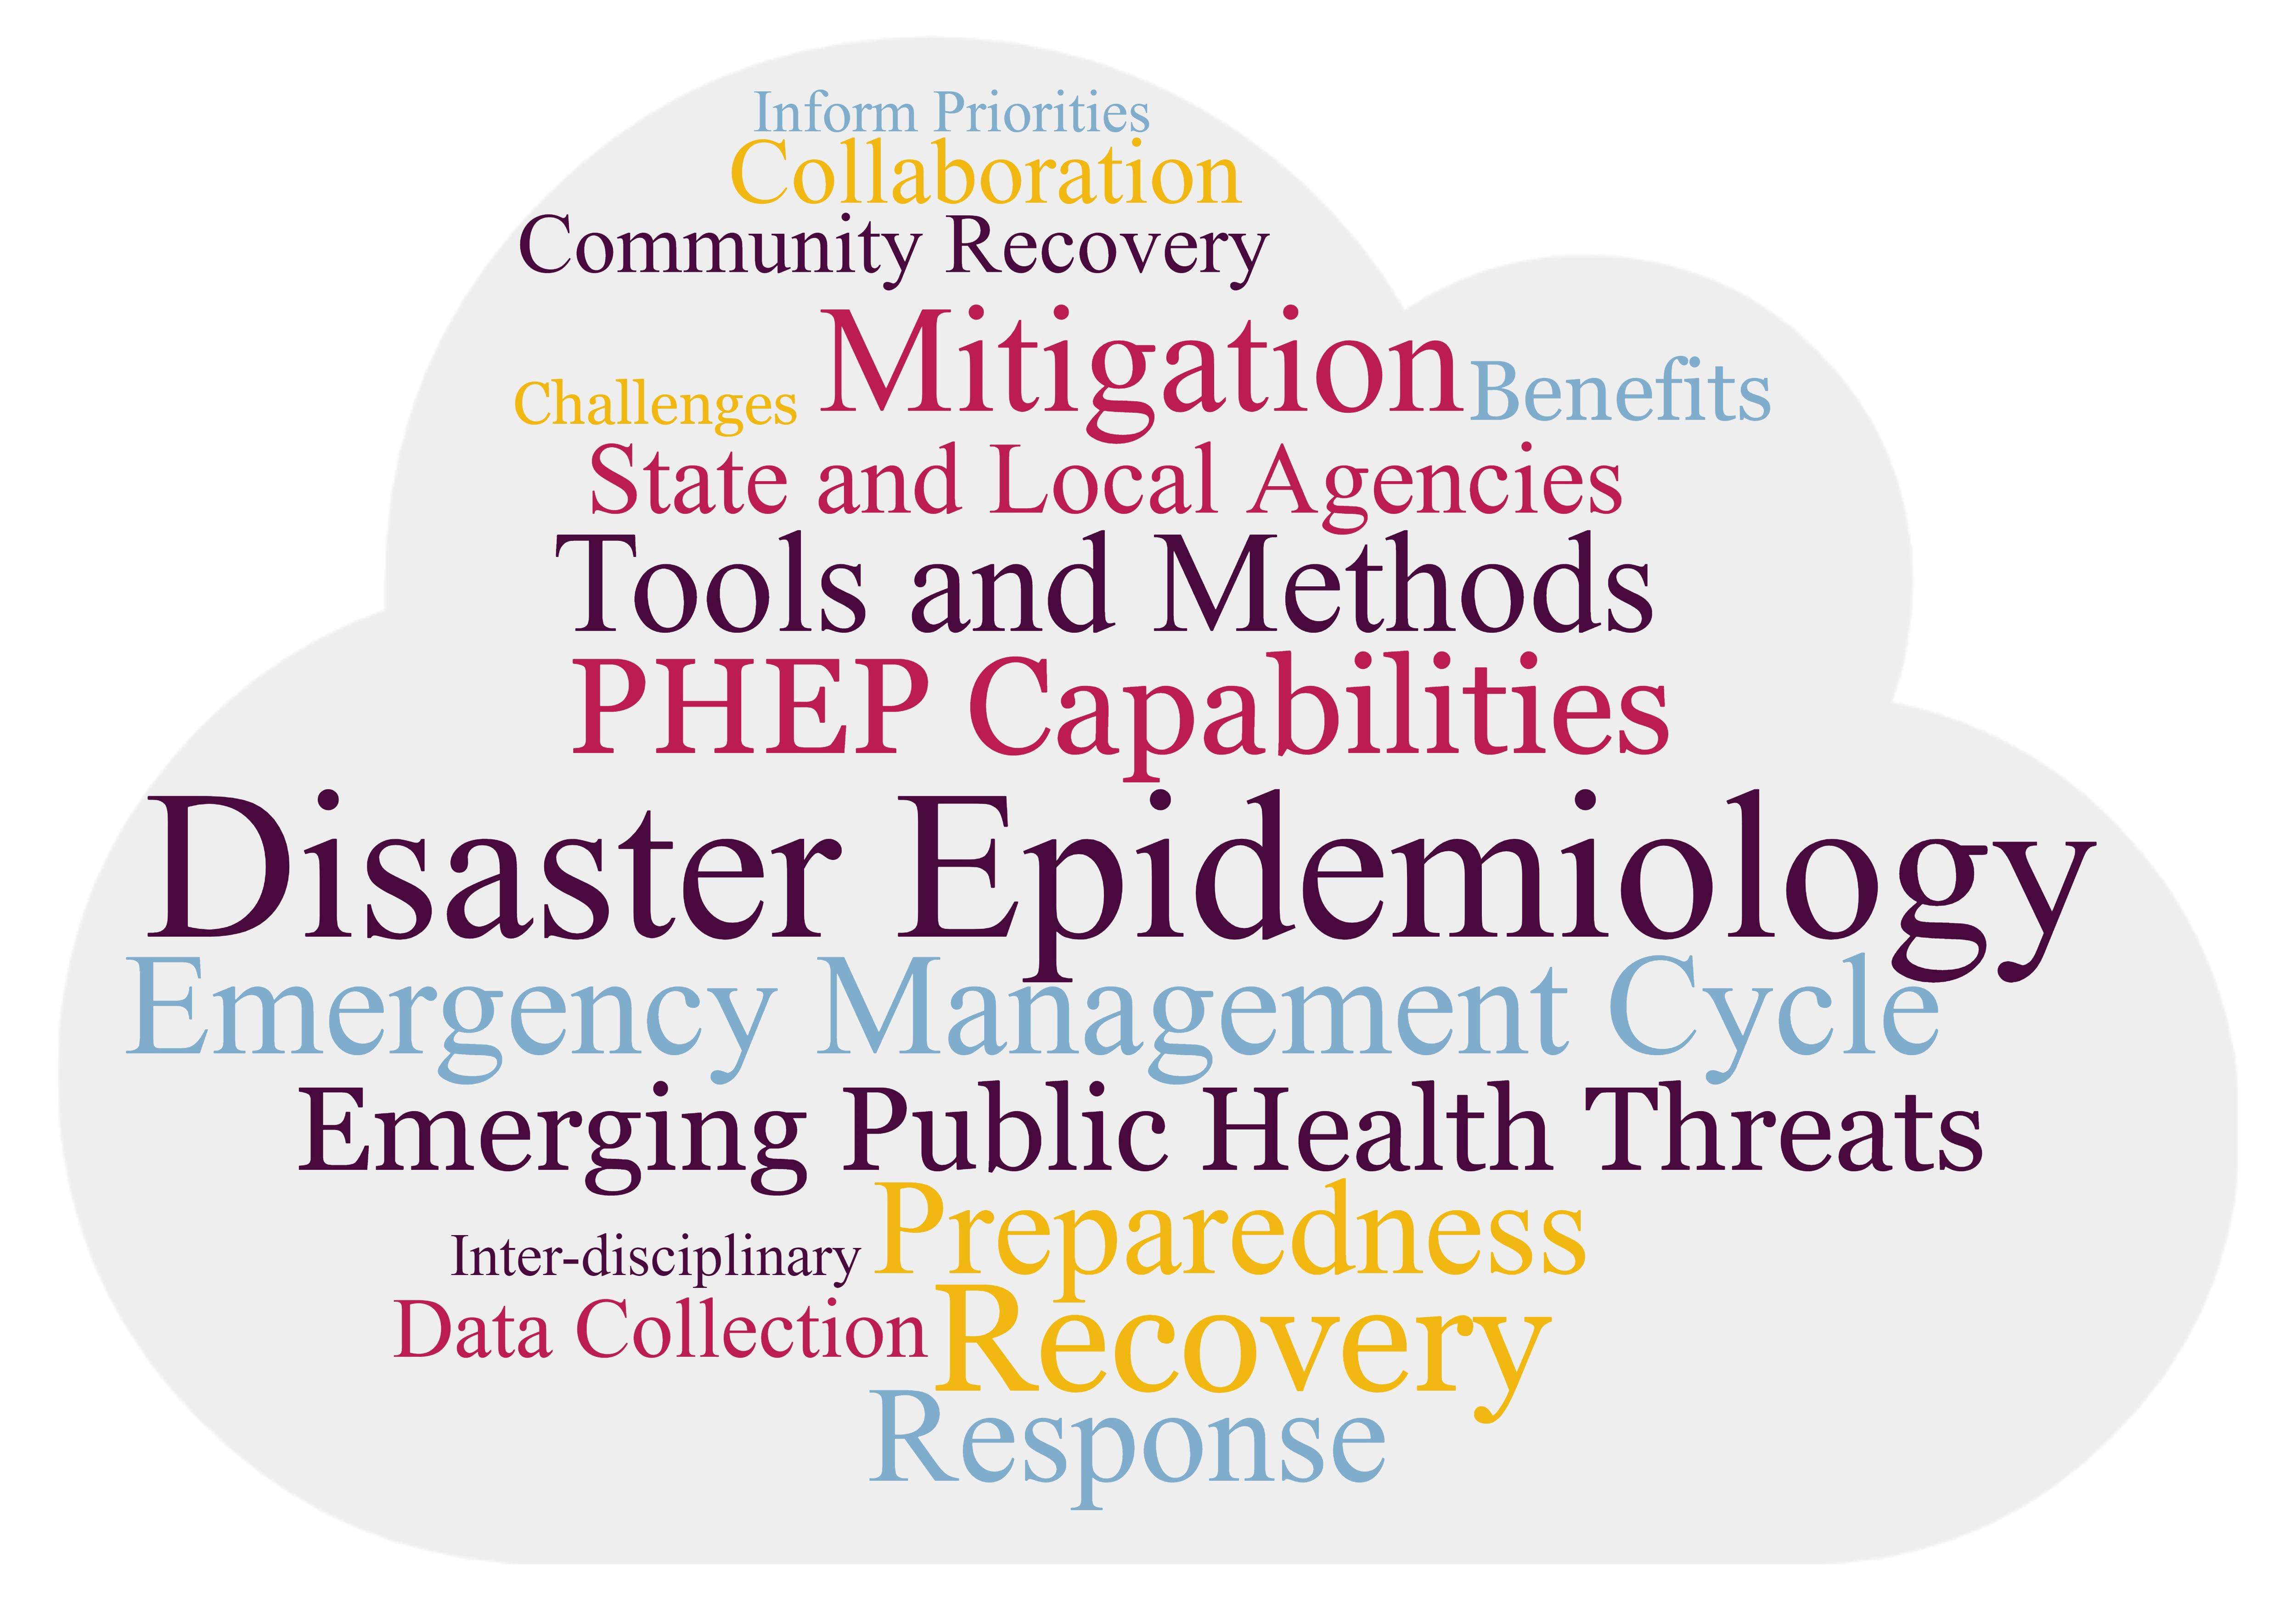
Presentation Objectives
Notes:
Define Disaster Epidemiology (DE) and its role in all phases of the emergency management cycle
Explain how DE can assist state and local agencies in responding to emerging public health threats
Showcase how DE meets PHEP Capability requirements and integrates with Emergency Management
Identify methods to be used in mitigation and recovery and the benefits and challenges of using and collecting data in the recovery phase
Engage with colleagues on experiences and challenges in utilizing data to inform mitigation priorities and community recovery efforts

Slide 9
Poll 1
What data or information have you been asked for?

Slide 10
Session Outline
Define Disaster Epidemiology (DE)
Discuss who is a disaster epidemiologist
Explain DE role in the Emergency Management Cycle
Share case studies of DE methods
Pull it all together
Discussion
  How to get more involved in the DE subcommittee!
  Share disaster epidemiology resources and training

Slide 11

Disaster Epidemiology: the Basics

Slide 12

What is Epidemiology?
Notes:
To make sure we are all on the same page, I am going to go over some definitions quickly.
Epidemiology is the study of distribution and determinants of illness, injury, disability and death in specified populations, and the application of this study to minimize these outcomes.
This approach is applied across all the whole spectrum of public health from the traditional infectious disease to chronic, maternal child health, environmental and occupational hazards.

Slide 13
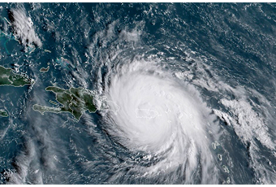
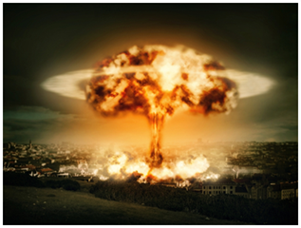
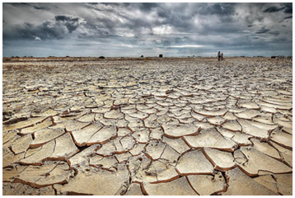
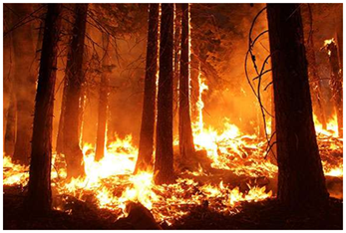
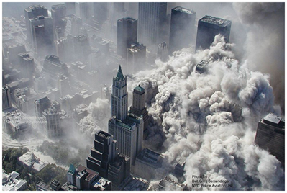
What is Disaster Epidemiology?
Notes:
Quite simply, epidemiology methods applied to disasters is disaster epidemiology. Like any sub-field, it has it’s own tools and approaches.
Disaster Epidemiology is defined as the use of epidemiology to assess the short- and long-term adverse health effects of disasters and to predict (and ultimately mitigate or prevent) consequences of future disasters.

Slide 14
Poll 2
What do you see as your role in emergencies?
Notes:
Do you have a role in emergencies?
What is your role in emergencies?

Slide 15
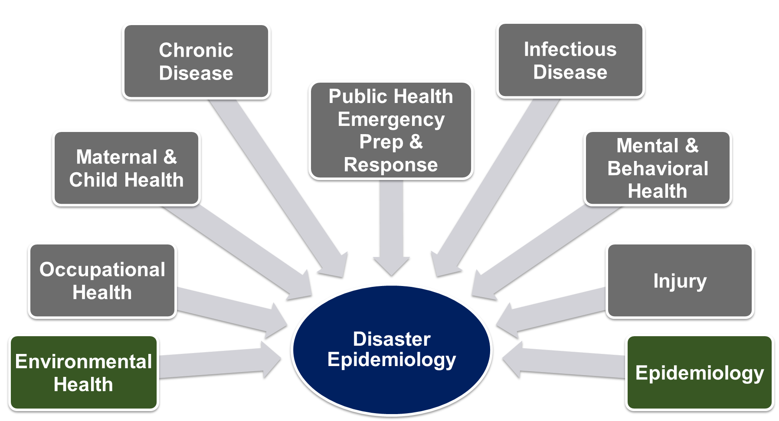
Disaster Epidemiology is Multi-disciplinary
Notes:
DE is multi-disciplinary: brings together various topic areas of epidemiology including acute and communicable disease, environmental health, occupational health, chronic disease, injury, mental and behavioral health.
When an incident happens, the SME epidemiologist should be selected
During an infectious disease (ID) outbreak, public health turns to the ID experts
During an environmental disaster, public health turns to EH experts
Knowledge of response to all-hazards
Cross training of epidemiologists is essential – Epi needs to know Emergency Management (ICS and emergency operations) and Disaster Epi
Any epidemiologist can be a disaster epidemiologist
PHEP/EM need to pull the appropriate epi SME for the response
Important for PHEP to meet your epi’s

Slide 16

What Does Disaster Epidemiology Do?
Provides reliable & actionable data
Provides situational awareness
Assesses disaster impacts
Informs future preparedness and response
Notes:
How Can Disaster Epidemiology Help You?
The main objectives of disaster epidemiology are to:
provide timely and accurate information for decision-makers (information that helps you understand what the needs are, plan the response, gather and distribute the appropriate resources)
prevent or reduce the number of deaths, illnesses, and injuries caused by disasters,
improve prevention and mitigation strategies for future disasters by using collected information
DE provides reliable and actionable information to incident commanders, planners, and decision-makers
Provides situational awareness
Assesses the short- and long-term adverse health effects of disasters
Informs planning and preparation for future disasters

Slide 17
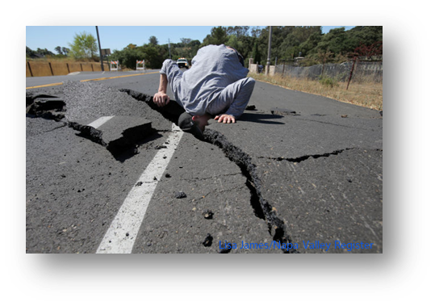

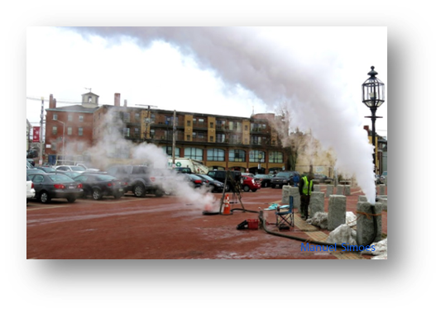
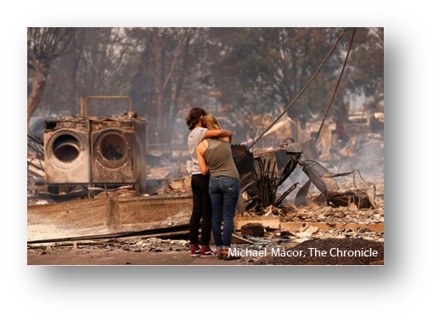
Disaster Epidemiology: an All-Hazard Approach
Notes:
DE began with studying health risks after environmental disasters and is considered part of environmental epidemiology, but the tools and methods are applied across all types of disasters now.
DE takes an all-hazards approach, applying a framework and tools no matter the disaster
To help identify hazards, risks, and vulnerabilities across all aspects of public health
Need to consider all aspects impacted
Consider disease, injury, death, MH/BH, public health consequences of property damage, business disruption, and environmental impact

Slide 18
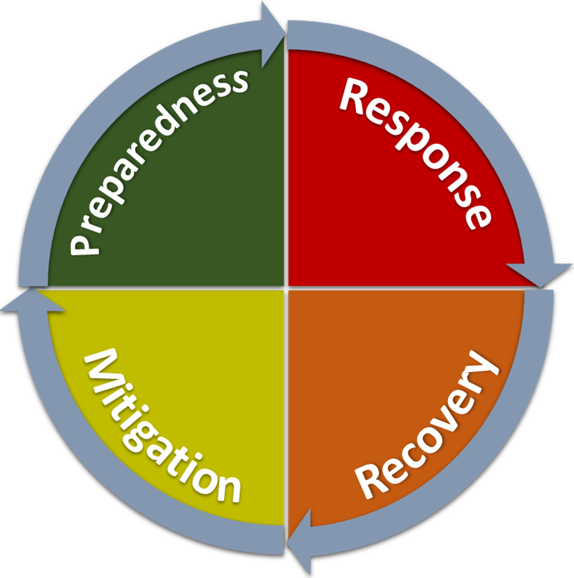
Disaster Epidemiology and the Emergency Management Cycle

Slide 19
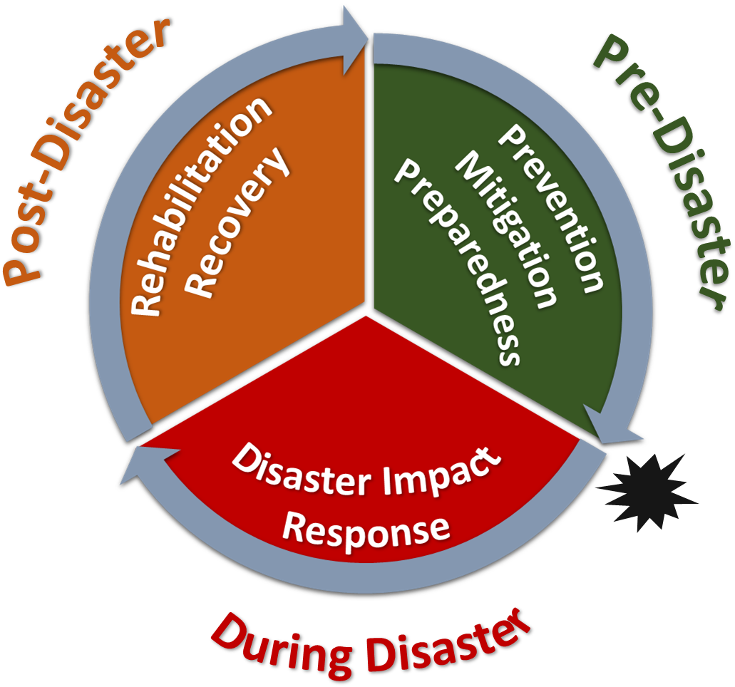
DE Conceptual Framework
Notes:
The Centers for Disease Control & Prevention (CDC)/National Center for Environmental Health (NCEH)
Council of State and Territorial Epidemiologists (CSTE)
Developed a framework of how epidemiology is applied in the different disaster phrases
Framework identified the applications of epidemiology in disaster settings
Developed by:
Centers for Disease Control & Prevention (CDC)/National Center for Environmental Health (NCEH)
Council of State and Territorial Epidemiologists (CSTE)

Slide 20
Disaster Epidemiology Activities
Post-disaster
Tracking
Registries
Pre-disaster
Epidemiology investigations
Evaluation and risk studies
Prevention, Mitigation, Preparedness
Disaster Impact
Rehabilitation, Response, Recovery
Disaster
Surveillance
  Affected communities
  Responders
Rapid needs assessments
Notes:
DE fits into all phases of the disaster management cycle.
During and following the disaster, health surveillance of the affected communities and responders might occur to know the severity and level of impact. As well as, rapid needs assessment to inform the response efforts.
In the response and recovery phase, you continue to track health outcomes and inform the health impact and need to mitigate health risk. (using rosters or registries, line lists…).
In the preparedness phase, we use our data to assess what changes could be made to reduce risk. Epidemiologic studies and evaluation studies inform interventions and controls to prepare for the next disaster.

Slide 21
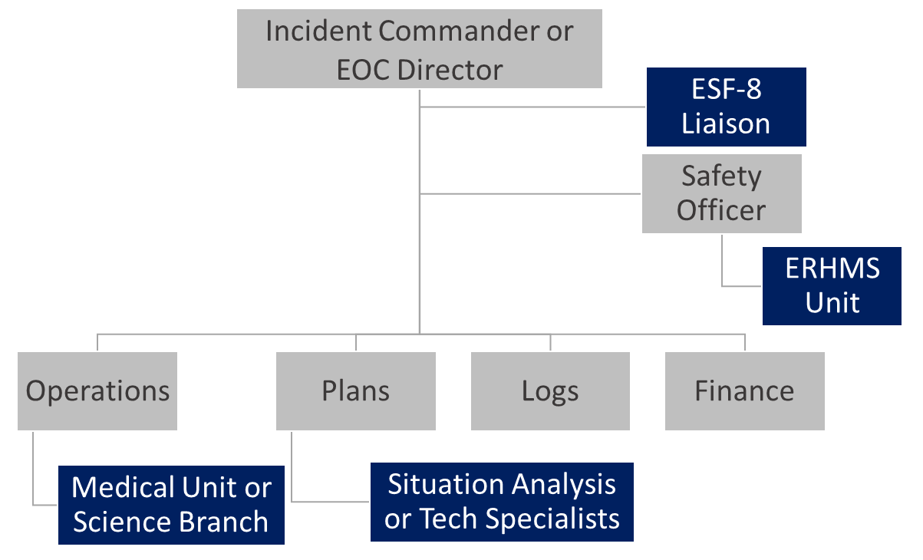
DE and Incident Command System (ICS)
Notes:
DE can fit in multiple aspects of ICS.
This slide shows just some possibilities.
On the command level, a disaster epidemiologist can be embedded with the Safety Officer to implement the Emergency Responder Health Monitoring and Surveillance Framework, or ERHMS. We’ll talk about ERHMS later in this session.
DE falls under ESF-8. (public health & medical services) and thus could serve as an ESF 8 Liaison Officer at an EOC.
In the Operations Section, DE can be integrated into the Medical Unit, or Epidemiology and Surveillance Unit of a Science Branch.
In Planning and Intelligence, DE could be part of Situation Analysis cell, serve GIS or other technical specialist roles, or provide data to feed dashboards for SitReps.
Overall, DE is a core part of PH planning and response.
It is Foundational part of ESF-8
Provides ICS leadership with credible health data for:
Situational awareness
Making decisions
Allocating resources

Slide 22
Poll 3
What can epidemiologists contribute to emergencies?

Slide 23

DE Methods Overview and Case Studies

Slide 24
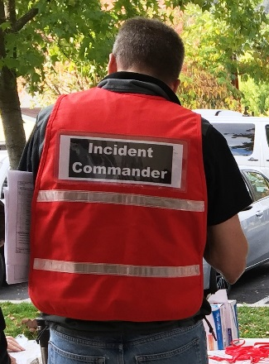
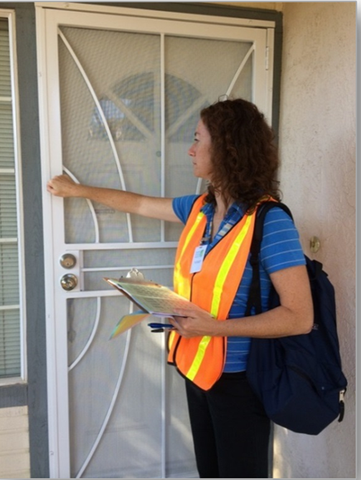
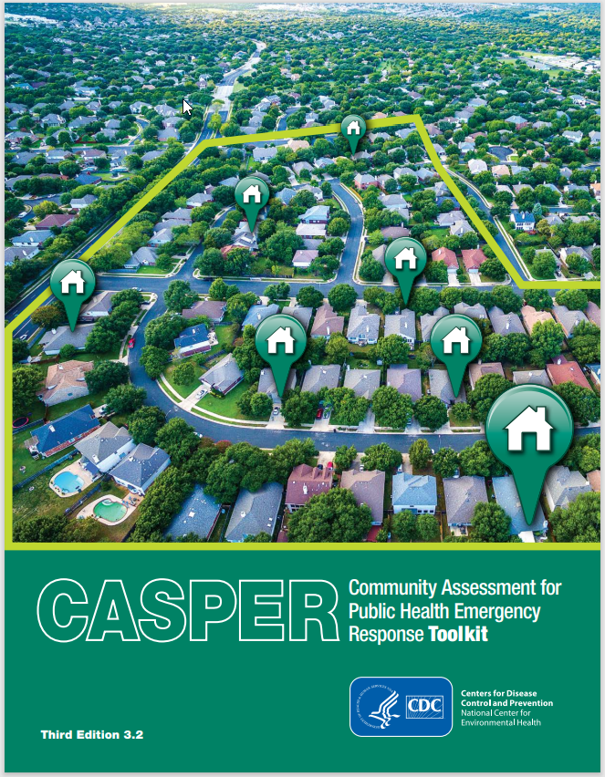
Rapid Needs Assessments
Notes:
Used in all Emergency Management Cycle Phases
Identify community status
Systematic, timely, and statistically robust
Rapid Needs Assessments
RNA = systematic process of information collection and analysis regarding the type, depth, and scope of a problem
Typically are launched early in response phase and can also be done for preparedness, recovery, and mitigation purposes
Identify needs of affected communities in a systematic, timely, and statistically valid manner
Provide basis for appropriate response
CASPER
One type of rapid needs assessment is the Community Assessment for Public Health Emergency Response (CASPER) developed by the CDC. It is now one of the main tools used for rapid need assessments.
Includes structured, systematic methodology of doing door-to-door survey interviews through two-stage cluster sampling to get a representative sampling of a specific geographic area. (analyzed at household level)
Guiding principle:
What do you want to know?
Why do you want to know it?
What are you going to do about it?
Actionable – emphasis on “do”

Slide 25
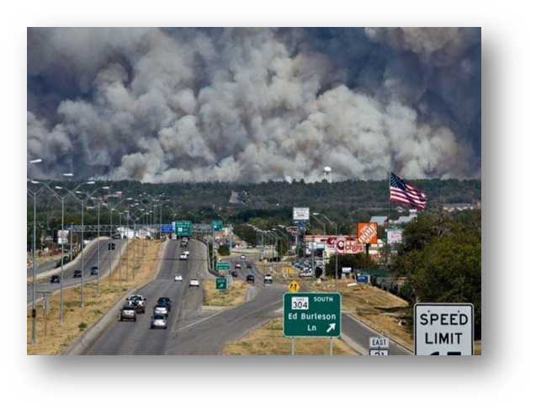
CASPER:
Longitudinal Wildfire Impact Assessment
Texas
Response CASPER informed:
  Key public health issues
  Resource allocation
  Rebuilding intent
Recovery CASPER informed:
  New concerns
  Unmet needs
  Rebuilding reality
Notes:
Texas Department of State Health Services conducted a CASPER to assess public health impacts from a devastating wildfire.
Initial CASPER informed key public health issues and resource allocation. Follow-up CASPER informed new concerns or unmet needs to share with officials.
Response phase CASPER informed key public health issues and resource allocation.
CASPER was conducted 3 years later to measure progress in recovery and assess long-term health and mental health status.
Follow-up CASPER informed new concerns or unmet needs to share with officials.
Preparedness and response capabilities: cap2 community recovery and cap 4 Emergency Public Information and Warning (informed communication methods as well)

Slide 26
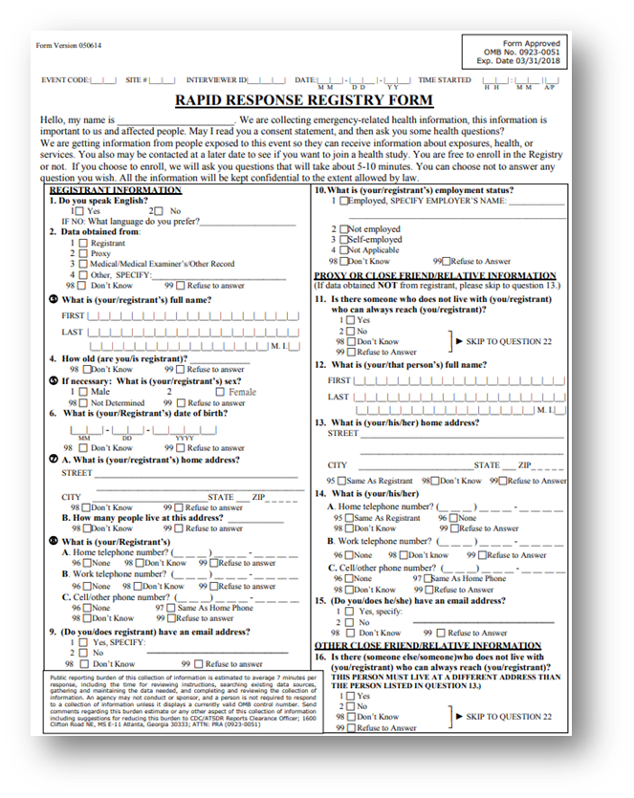
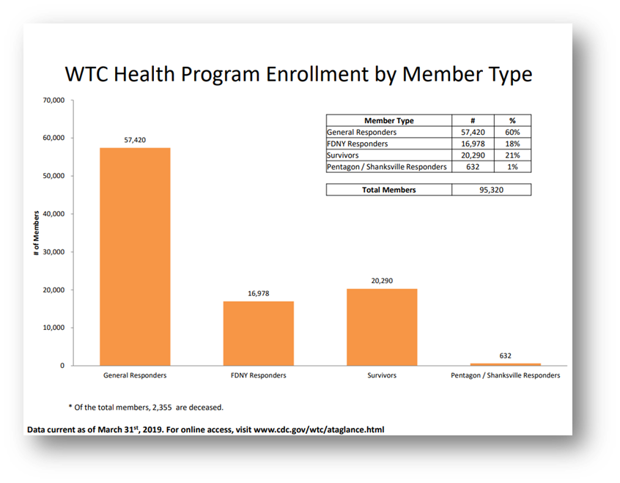
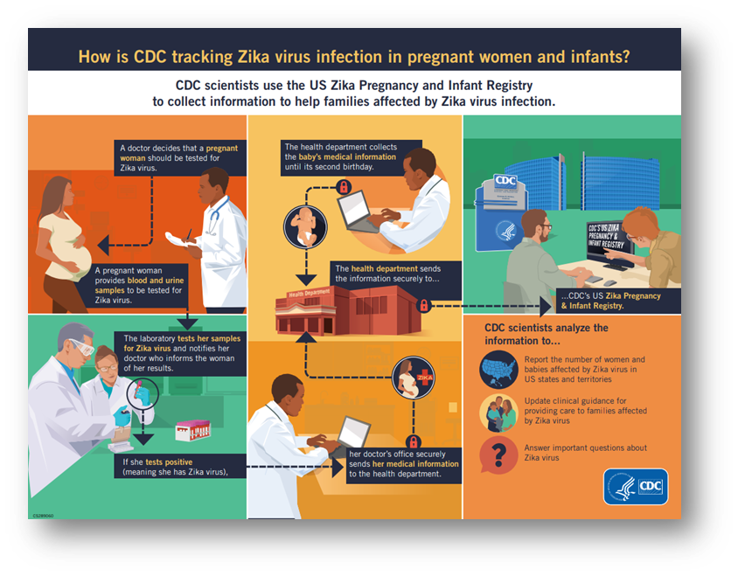
Tracking, Rosters, Registering
Notes:
What do we do in cases when resulting illnesses, injuries, or disabilities—including emotional trauma—may not be recognized or resolved in the immediate post-disaster period?
Disaster epi-related registries: CDC Zika and WTC post 9/11
Before we get to registries, need to address tracking:
Tracking
Collection and integration of data from environmental monitoring, exposure, and health effects in people over time
Can be used for short-term or long-term follow up
Rosters
Early assessment tool to quickly find people affected by disaster
Collect information on the exposed persons for follow-up
Can be used to populate future registries
Registries
Track affected people for medium to long-term health consequences
Inform needs for continuing medical/behavioral care or establishing public health measures
Follow exposed population for conditions that may have delayed symptom onsets
Familiar with cancer registry
WTC post 9/11: Results will help determine to what extent physical and mental health conditions have persisted. Among persons enrolled in the World Trade Center Health Registry, there was an excess risk for prostate cancer, thyroid cancer, and myeloma in 2007-2008 compared with that for New York State residents; however, these findings were based on a small number of events and multiple comparisons.
In all three approaches, we typically gather initial information during response and recovery phases
Ultimately, these approaches inform ongoing care, future public health interventions, and public health emergency planning and preparedness
Meets cap. 13

Slide 27
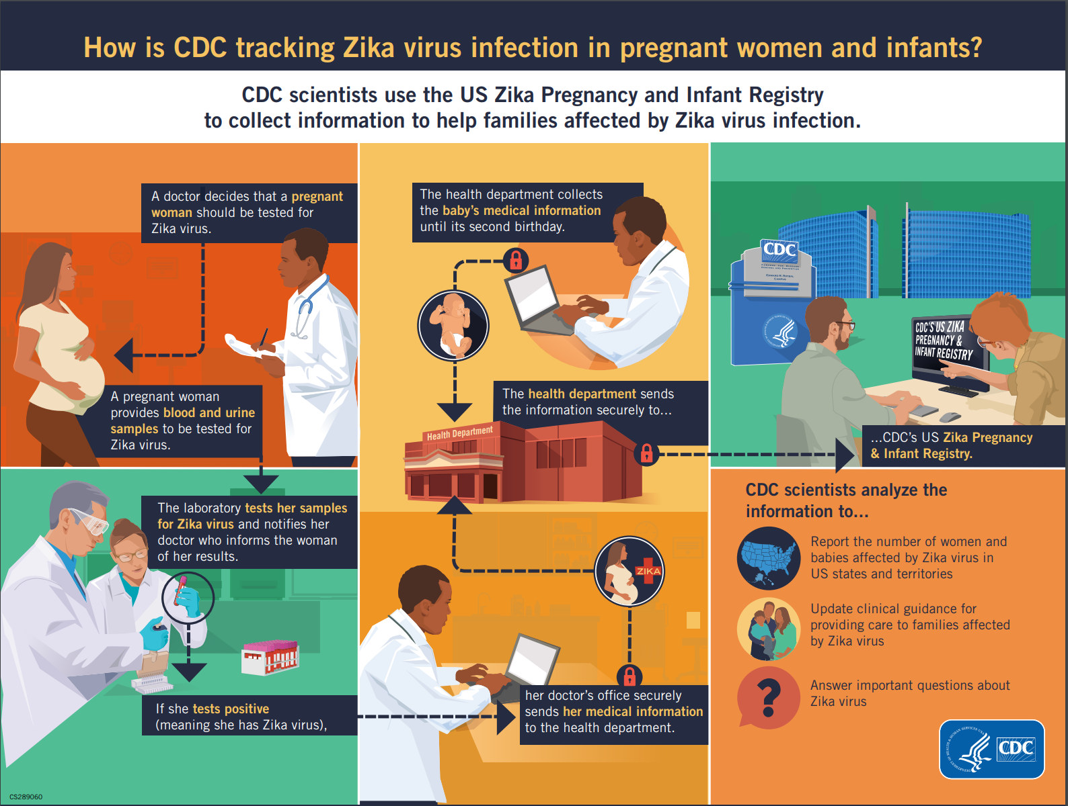
Registry: Zika Virus
CDC Zika Pregnancy and Infant Registry
  Pregnant women with possible Zika virus infection
  Adverse pregnancy outcomes
Potential “Mitigation” actions:
  Recommendations to prevent infection during pregnancy
  Elimination of mosquito breeding grounds
  Collaborations with vector control
https://www.cdc.gov/pregnancy/zika/research/registry.html
Notes:
A more recent registry, is CDC’s Zika pregnancy and infant registry. Pregnant women with lab confirmed Zika are included to identify adverse pregnancy outcomes to make recommendations to clinicians for care and Zika prevention.
Certain types of birth defects can happen from Zika virus infection during pregnancy. Several brain and eye defects were more commonly reported.
About 5% of babies born to people with Zika while pregnant had Zika-associated birth defects. Additionally, some babies affected by Zika during pregnancy might look healthy at birth but can develop long-term health problems as they grow.
Infection during early pregnancy may be more likely to cause birth defects, but we have seen babies with birth defects born to people infected with Zika anytime during pregnancy.
There is potential for using this registry for mitigation actions:
Recommendations for clinicians to prevent Zika virus infection during pregnancy
Elimination of mosquito breeding grounds is a physical project along the lines of levee reinforcement to prevent flooding or a building earthquake retrofit

Slide 28
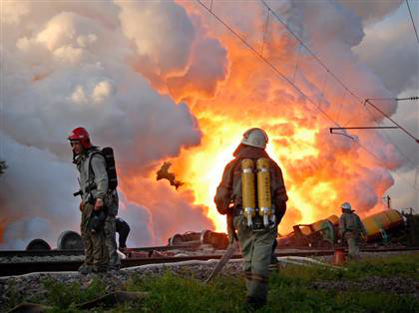
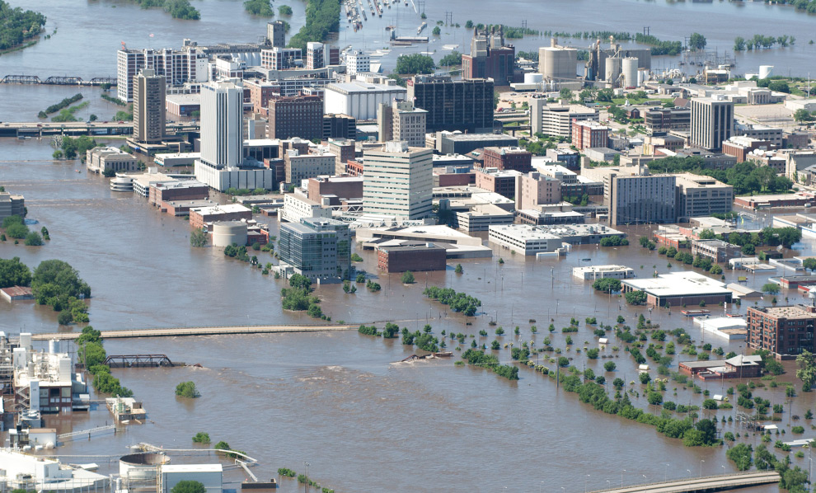

Surveillance
Notes:
There are many types of surveillance to describe the health impact of an affected community.
Surveillance methods depend on the population and outcome (mortality vs. morbidity vs. sys)
Describe the health burden of an affected community
Quantify mortality and morbidity in affected communities, responders, and sheltered residents

Slide 29
Syndromic vs. Traditional Surveillance
Syndromic Surveillance
Traditional Surveillance
Data collected for other purposes
Pre-diagnostic information
Near real-time
Case reports from healthcare providers & laboratories
Confirmed diagnosis
Lag in reporting
Illness Onset
Symptom Progression
Healthcare Seeking
Testing/ Diagnosis
Treatment
Recovery or Death
Syndromic
Traditional
Near real-time, pre-diagnostic information (i.e. chief complaint, over the counter sales)
Delayed confirmed diagnosis (i.e. reportable disease, laboratory tests)
Created by Jessica White, Maricopa County
Notes:
“The collection and analysis of health-related data that precede diagnosis and signal a sufficient probability of a case or an outbreak to warrant further public health response.”
Identifies intra-disaster outbreaks or clusters of conditions
Characterizes burden of incident on affected sub-populations
Provides descriptive analysis of conditions, injuries, and fatalities
Can use multiple types of data (attendance data, pharmacy info) but most commonly used is data from clinics and hospitals (chief complaint data)

Slide 30
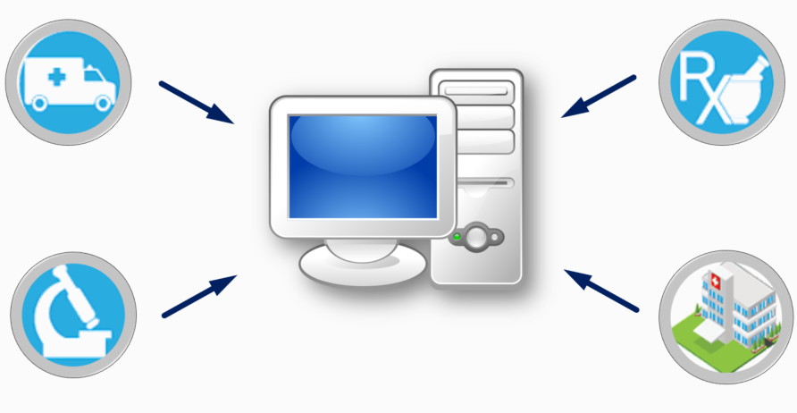
Syndromic Surveillance (SyS)
Early Warning
Notes:
Early warning system for detecting, understanding, and monitoring health events
Syndromic surveillance uses patient healthcare encounter data and statistical tools to detect, monitor, and characterize unusual activity for further public health investigation or response.
Syndromic is before diagnosis – e.g., mine keywords from chief complaint and triage notes
Allows us to detect potential aberrations in populations more quickly than a traditional outbreak could be detected by diagnostic means.
Data can come from emergency rooms, poison control centers, emergency medical services, pharmacies, and work or school absenteeism.
Data are monitored in near real-time as potential indicators of an event, a disease, or an outbreak of public health significance.
Identifies intra-disaster outbreaks or clusters of conditions
Characterizes burden of incident on affected sub-populations
Provides descriptive analysis of conditions, injuries, and fatalities
Can use multiple types of data (attendance data, pharmacy info) but most commonly used is data from clinics and hospitals (chief complaint data)
Recovery phase
After a disaster, continued monitoring of syndromic surveillance data is important because some health outcomes may be delayed (e.g., with longer incubation periods of some communicable diseases) or are more likely during a clean-up phase (e.g., injury or exposure to a toxic substance) [8].
A return to expected visit counts, types of complaints, and demographics mark an important milestone during a recovery phase.
Because of post-disaster surveillance, we now know more about co exposure from generators and that cleanup injuries are common and need more caution and safety equipment

Slide 31
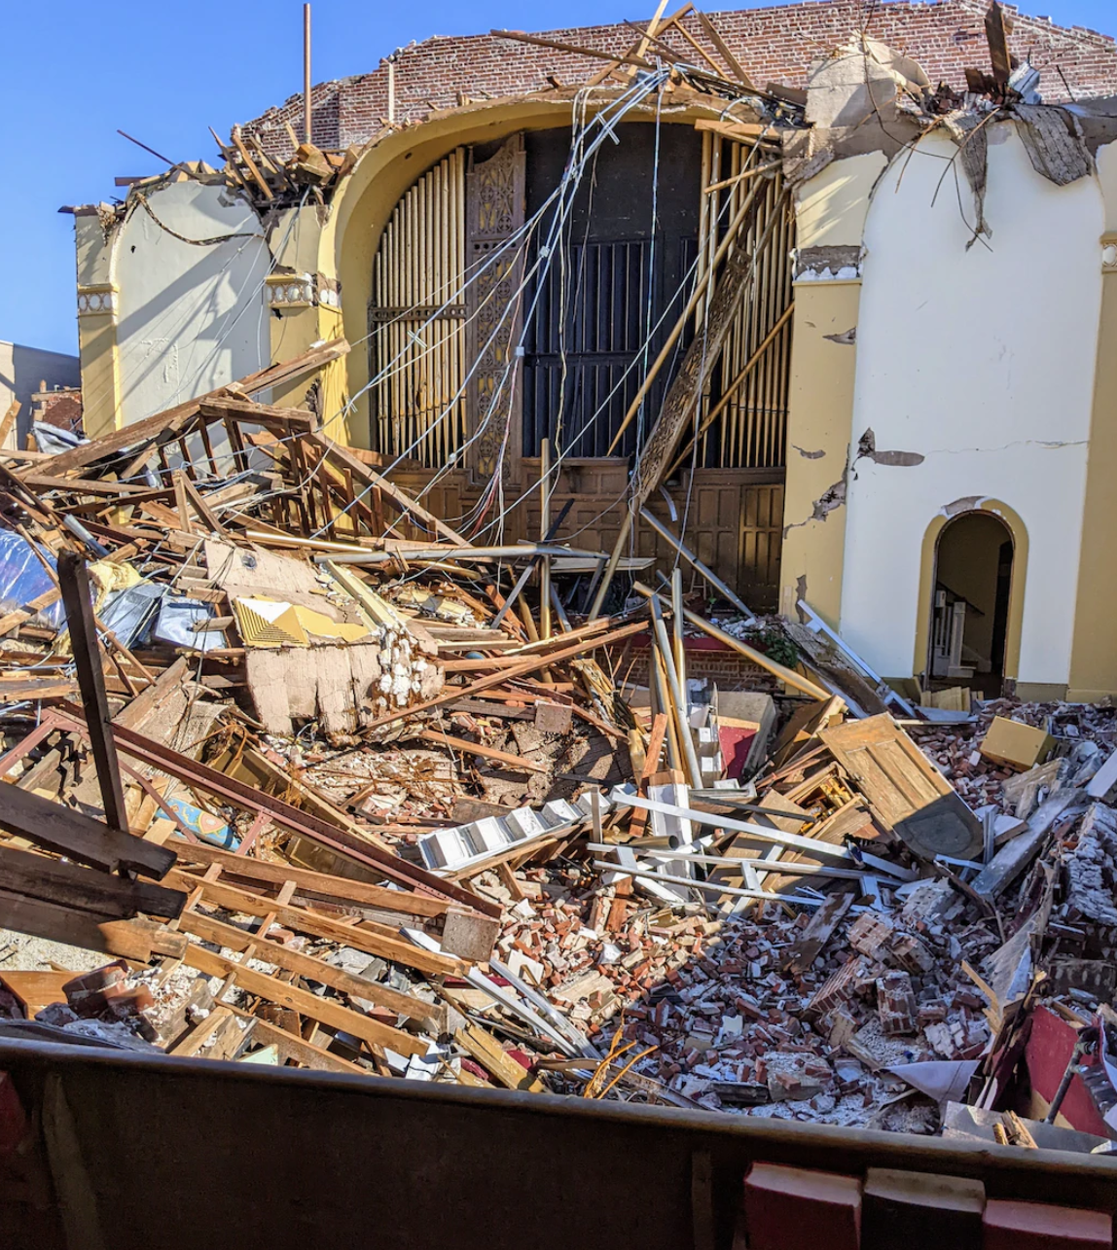

SyS: Asthma Following Building Collapse
New York City
Emergency Department visits for asthma
SyS findings informed questions about the health impacts of local air quality
Notes:
NYC Department of Health conducted syndromic surveillance of asthma following building collapses and fires.
ED visits for asthma did not increase for the day of the events and for several days afterward.
Surveillance findings were shared with leadership, and they were able to respond to questions from the press regarding the health impacts of local air quality.
Preparedness and Response Capability 3: Emergency Operations Coordination: Provide situation awareness to detect need for activation or dissemination of resources
3

Slide 32
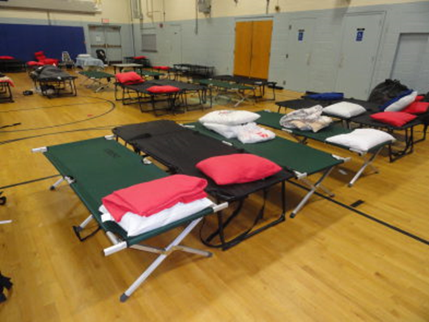
Shelter Surveillance
Track populations in shelter settings
Characterize environmental and sanitation conditions
Identify outbreaks and clusters of conditions
Notes:
Another type of surveillance, is shelter surveillance. This tracks populations within the shelter facilities to identify outbreaks or disease clusters.
Also to assess environmental and sanitation conditions.
Track populations in shelter settings
Characterize environmental and sanitation conditions
Identify outbreaks and clusters of conditions
Data to consider collecting:
Demographic data
Morbidity surveillance
Shelter survey/environmental health assessment
Active-cot-to-cot assessments
Passive-track shelter residents coming for health issue/complaint
Necessary to work with organizations that organize shelters (Red Cross in US) on having forms useful to everyone.

Slide 33
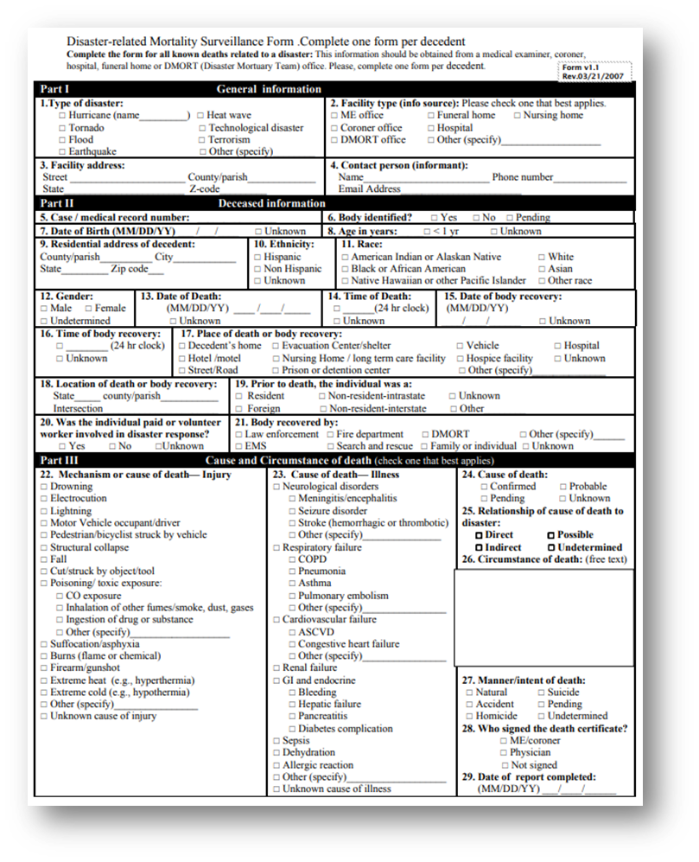
Mortality Surveillance and Assessment
Disaster impact severity
  Leading causes of death
  At-risk groups
  Common risk factors
Prevention strategies
CDC Toolkit
Electronic death registration systems
https://www.cdc.gov/nceh/hsb/disaster/surveillance.htm
Notes:
Define the severity and impact of the disaster
Identify the leading causes of death, at-risk groups, and common risk factors to help guide immediate and future prevention strategies
Challenge: defining disaster-related deaths and identifying them
CDC has a matrix for attributing deaths and a toolkit
Reporting of deaths after a disaster and through electronic death registration systems (EDRS)

Slide 34
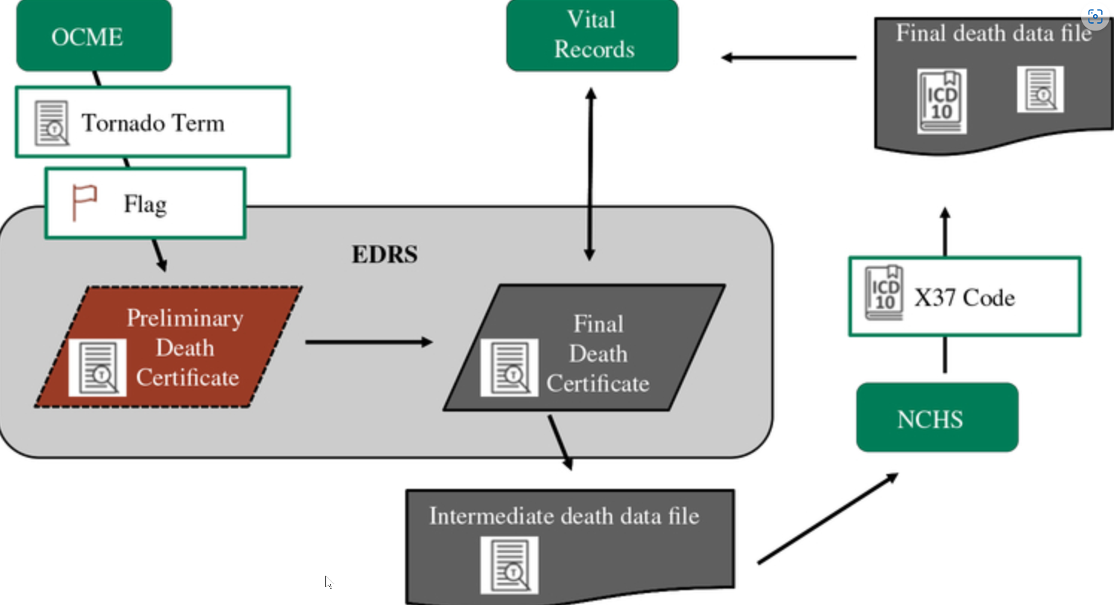
Mortality Surveillance: Tornado
Oklahoma
Retrospective mortality surveillance
  EDRS flags
  Medical records review at 32 hospitals
Notes:
More traditional surveillance, would involve a retrospective review of injuries and deaths related to an event to characterize the impact and identify trends in the population and to inform protective actions for next time (feedback loop).
Official counts of deaths attributed to disasters are often under-reported, thus adversely affecting public health messaging designed to prevent further mortality. Following a 2013 tornado, OK public health and the CDC retrospectively analyzed electronic death records to determine if the EDRS was capturing all tornado-attributed deaths. They evaluated three event fatality markers, which are used to collate information about deaths for immediate response and retrospective research efforts. This informs our knowledge by characterizing the injuries and deaths so we can message and inform public on the safe approach.
They found The tornado-specific flag was the most sensitive and timely.
They also did an intense review of medical records at 32 hospitals to:
assess tornado-related injuries and deaths,
identify populations impacted
protective actions taken
In this example, l more than half of the injuries and deaths were indirectly related, of these a large portion were due to cleanup and evacuation/seeking shelter.
Of 49 deaths and 755 injuries associated with the disaster:
336 injuries (45%) were directly related
419 injuries (55%) were indirect related
35% trying to get in or out of shelter
6% fleeing the area, 5% rescuing an animal or person
35% of hospital visits were for injuries during cleanup

Slide 35
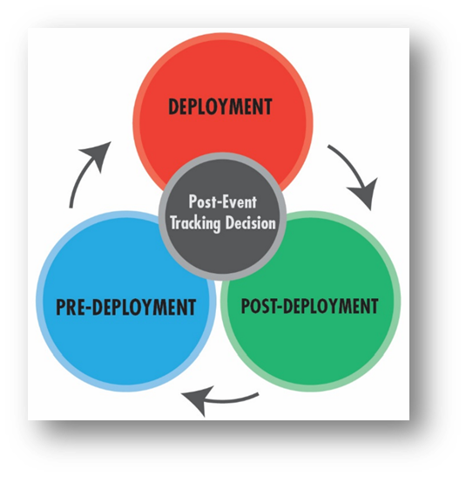
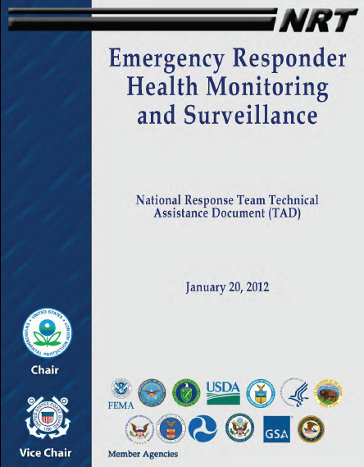
Responder Safety & Health
CDC/NIOSH
Emergency Responder Health Monitoring and SurveillanceTM (ERHMS) Framework
Notes:
CDC Emergency Responder Health Monitoring Surveillance (ERHMS) is a health monitoring and surveillance framework for protecting responders through all phases of a response
This requires collaboration between epidemiology, industrial hygiene, and emergency managers. Functions under Safety Officer in ICS
Key questions to ask:
Pre-deployment: which responders are “ready,” credentialed, and available to respond?
Deployment: who are the responders on-site, and to what are they exposed? How is their health?
Post-deployment: what did the responders do while deployed, how is their health now, and what to what were they exposed during the entire deployment?

Slide 36
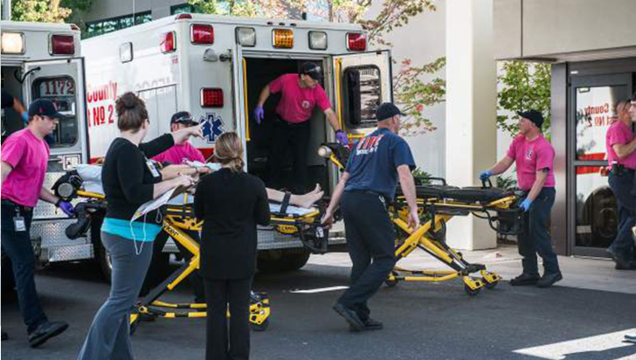
ERHMS: Mass Shooting
Oregon
Response phase:
  Behavioral strike teams
  ERHMS framework used for fitness for duty
Recovery phase:
  After-action sessions
  Monitored case load
  Transitioned to local providers
  Developed improvement plan
https://www.cnn.com/2015/10/01/us/oregon-college-shooting/index.html
Notes:
SERV-OR is Oregon’s roster of licensed physicians, nurses, pharmacists, Emergency Medical Technicians (EMTs), behavioral health providers, respiratory therapists and others who have registered to volunteer in response to local, state, and/or federal emergencies.
In 2015, 10 people died and 7 were injured at a community college campus in rural southern Oregon
Behavioral strike teams provided surge capacity
Collected data through evidence-based data collection tool PsySTART
Used ERHMS framework to ensure behavioral clinicians were fit to respond and assessed if needed any resources after
Held after-action session for all clinicians to ensure their experience did not cause any trauma
Monitored case load and then transitioned to local providers as need decreased
Developed improvement plan based on feedback and implemented at anniversary to provide counseling

Slide 37
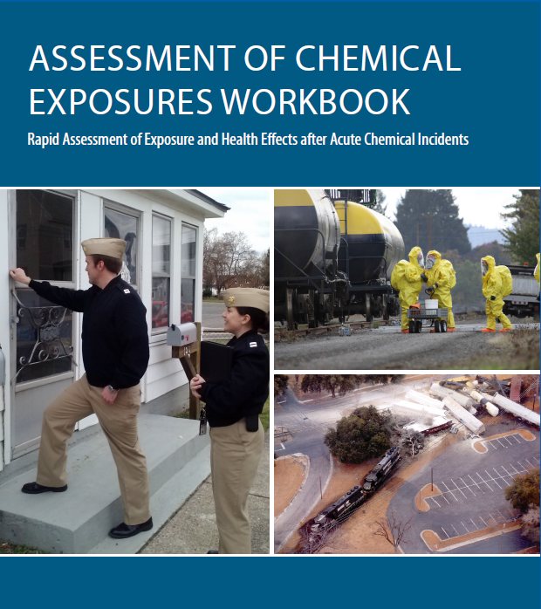
Assessment of Chemical Exposure (ACE)
Toolkit
Health impacts and root causes of exposure
Collaboration with multiple disciplines
Notes:
Rapid assessment during the aftermath of large-scale chemical releases resulting in multiple casualties
Unlike a CASPER which is a method, ACE is a toolkit and can use any epi approach
Toolkit includes: standardized surveys, consent forms, medical chart abstraction form, data entry programs, geospatial analysis tools, and laboratory specimen testing
All materials are modifiable and adaptable to local incident needs
ATSDR built the ACE program based on lessons learned from the Graniteville, South Carolina, train derailment that released chlorine gas
ACE is public health lane
Look at health impacts and root causes of exposure
Focus on appropriate response from health perspective
Collaborative project with multiple disciplines
Benefits :
1. Identify actions to prevent future incidents
2. Roster exposed cohort of individuals for further follow-up
3. After action and improvement planning for public health and safety response
4. Identify health effects in the community, workers, and first responders
5. Determine appropriate medical treatment and efficacy of decontamination
6. Collaborate with many disciplines PH usually doesn’t cross paths with

Slide 38
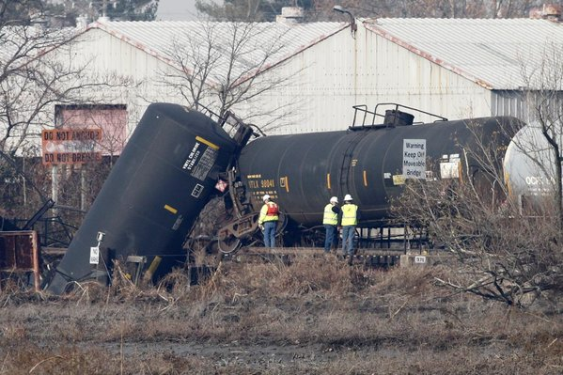
ACE: Train Derailment
New Jersey
Freight train derailment
  Vinyl chloride release
ACE
  Community exposure
  Health impacts
  Communications
Notes:
Freight train carrying vinyl chloride derailed and NJ conducted ACE survey to gather information on community exposure, health impacts, and communication.
Provided situational awareness and monitoring of illness.
Informed best method for communicating with public about emergency.
Vinyl chloride is a colorless, sweet-smelling gas, the inhalation of which can cause respiratory and neurological symptoms, and, at
high concentrations, can cause cardiac dysrhythmia, loss of consciousness, and death.
58% experienced at least one new or worsening symptom
9% sought medical care
Residents evacuated rather than sheltering in place had fewer symptoms.
Residents preferred to receive information directly from a person of authority. Need more info. on how to shelter-in place safely.
Informed future planning for evacuation and shelter in place clarifying directions. Most got info. from tv or neighbors , although prefer to get from person of authority.
preparedness and response cap this meets:
Capability 4: Emergency Public Information and Warning
Inform health alerts and the development of educational materials
Capability 13: PH Surveillance and Epidemiological Investigation
Monitor trends of illness or injury and provide situation awareness

Slide 39

Pulling It All Together

Slide 40
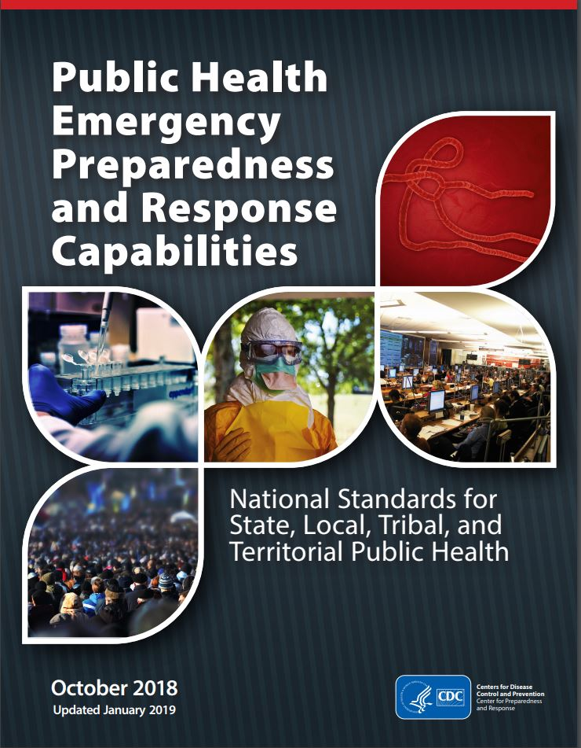
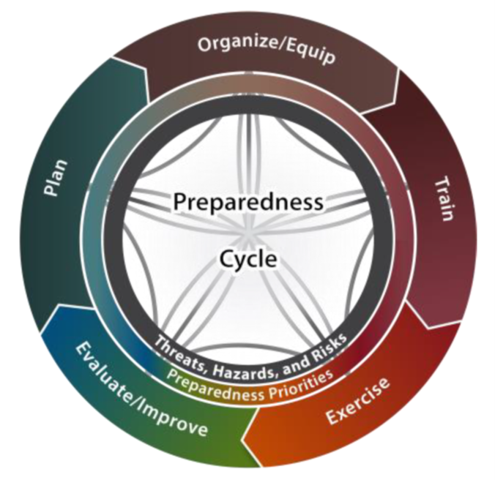
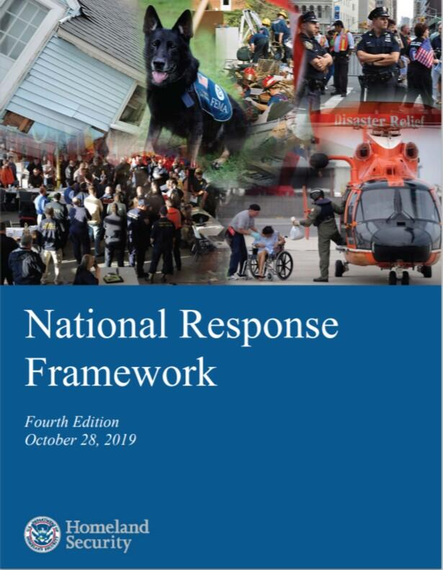
How To Integrate?
https://timothyriecker.com/2020/02/07/new-2020-hseep-revision/
Notes:
Often we get questions about how to operationalize and integrate these DE methods. This really depends on how your jurisdiction is organized-how integrated epi and emergency management is.
This is the focus of the workshop. Some groups have Epi teams that activate following a disaster. There will be a panel on developing DE programs
Must establish a good relationship and flow of information. EM’s request information from epi’s that are trained and they can then identifying methods/tools to gather information to inform decisions.
Epidemiologist connect with emergency preparedness and apply skills in doing surveillance
Integrating DE components into local, regional, county and state plans to help achieve PHEP capabilities.
Examples:
Utilize the ICS to conduct CASPERs
Utilizing medical volunteers such as the Medical Reserve Corps to assist with conducting shelter surveillance
Create syndromic surveillance definition for a large, upcoming event

Slide 41
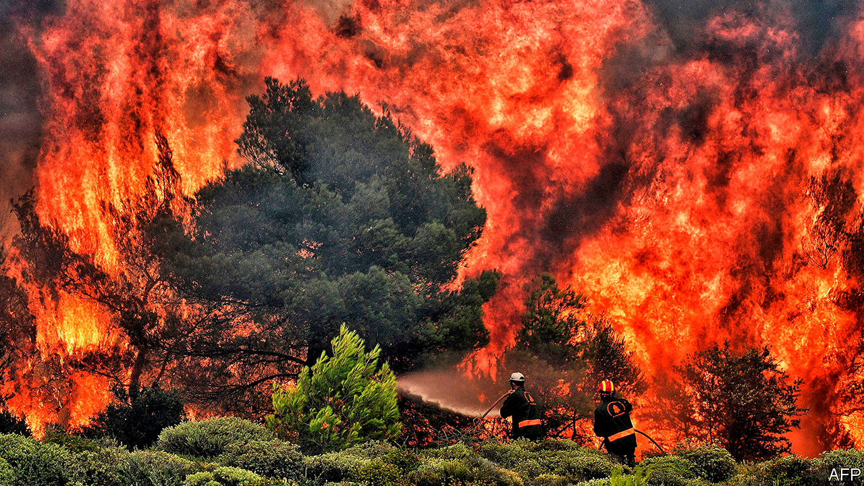
Putting It All Together
Notes:
Let’s say you have a large fire in your area that requires evacuating people and concerns about air pollution. Which DE tools could you use?
You might use syndromic surveillance to identify key phrases about smoke inhalation and cardiovascular/respiratory events
You can use mortality surveillance to assess demographic and death situations
You could use shelter surveillance to not only assess incoming client needs but any outbreaks in shelters
You could use ERHMS to track those you deployed to see if they are developing health concerns (not only if at scene but if on-going and stress is issue)
You could do a rapid needs assessment immediately following to see what the community needs are (mental health, financial, symptoms, meds/health impacts)
You could do evaluation and research studies to collect data and understand the full impacts and how best to survive or mitigate injury

Slide 42

Putting It All Together
Notes:
An oil spill occurs in your area.
What DE tools can you apply?
ERHMS to assess impact on workers/volunteers
ACE to assess exposure and health impact
CASPER- needs assessment to see impact area (Deepwater horizon had huge financial implications on fishing industry and financial stress), also impacts useage and community essence)

Slide 43
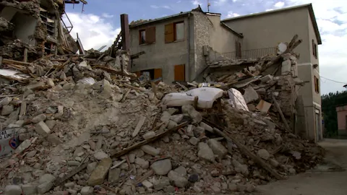
Putting It All Together
Notes:
Earthquake in your community
Syndromic surveillance for injuries
Mortality review for related to earthquake
People in shelter
ERHMS impact on responders/volunteers (pre, during, post)
CASPER- assess readiness before or impact/needs after

Slide 44


What questions do you have about DE?
What information do you need?

Slide 45
Further DE Training

Slide 46
Training Courses, Resources and Toolkits
Disaster Epidemiology eLearning Modules (CDC): https://www.cdc.gov/nceh/hsb/disaster/training.htm#disaster_epiElearning
  Module 1: Public Health Impacts of Disasters
  Module 2: Public Health Emergency Management
  Module 3: CASPER
  Module 4: Disaster Surveillance
CASPER (CDC): https://www.cdc.gov/nceh/casper/training-resources.htm
Emergency Response Health Monitoring & Surveillance (ERHMS) Online Training Course (CDC): https://emergency.cdc.gov/training/erhmscourse/index.asp
  ERHMS Info Manager
CDART: Comprehensive Disaster Assessment & Readiness Tools (CDC ATSDR): https://www.atsdr.cdc.gov/CDART.html
FEMA Center for Domestic Preparedness, Disaster Related Exposure Assessment and Monitoring https://cdp.dhs.gov/training/course/MGT%20908
Notes:
DE eLearning Modules –
Module 1: direct & indirect impact on public health in different types of communities
Module 2:
Module 3: CASPER -→ review of the CASPER methodology, when to conduct and data analysis
Module 4: Disaster Surveillance → includes information on why disaster surveillance is important, the purpose of morbidity and mortality surveillance during a response and tools to assist
CASPER – Community Assessment for Public Health Emergency Response – CDC offers a state-based, in-person training, and an online module as a part of the larger DE learning and training series
ERHMS Info Manager – developed by CDC NIOSH, and is a software product that can be used to implement the ERHMS framework
CDART – scenario driven, surveys and tools to help standardize the evaluation process for public health and healthcare preparedness; developed by ATSDR

Slide 47
Training Courses, Resources and Toolkits
Toxicological Outbreak Investigation Course & Toolkit (CDC): https://www.cdc.gov/nceh/hsb/elearning/toi/default.htm
Epi CASE (Contact Assessment Symptom Exposure) Toolkit (CDC ATSDR): https://www.atsdr.cdc.gov/epitoolkit/index.html
ACE (Assessment of Chemical Exposures) Toolkit and Training (CDC ATSDR): https://www.atsdr.cdc.gov/ntsip/ace_toolkit.html
Notes:
Toxicological outbreak investigation → basic information and customizable documents that can be used during an outbreak investigation, for outbreaks caused by non-infectious, toxic agents.
Epi CASE Toolkit ->

Slide 48
Andrew Adams: aadams@cste.org
Svetlana Smorodinsky: Svetlana.Smorodinsky@cdph.ca.gov
Tess Konen: tess.konen@state.mn.us

