Slide 1
Race/Ethnicity Data Considerations
CSTE Disaster Epidemiology Subcommittee Meeting

Slide 2
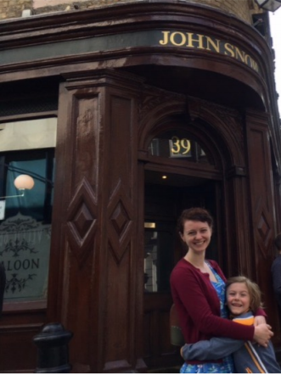

Who are we & where do we work?
Rapid Health Information NetwOrk (RHINO)
RHINO serves as the Washington State Syndromic Surveillance Program
  Team of 7 epidemiologists, as well as a program manager
Reporting is mandated under RCW 43.70.057 for emergency departments
  More than 1,000 outpatient clinics also report (~2,500 are registered)
Currently funded under OD2A, ED-SNSRO, and FASTER cooperative agreements with CDC
Amanda Dylina Morse, MPH
Epidemiologist
amanda.morse@doh.wa.gov
Notes:
I’ve been using syndromic data and the ESSENCE platform for several years. I facilitate our data user trainings in Washington State and was invited in 2019 to conduct one for the state of Idaho and their health district epidemiologists
Was deputy chair of the NSSP Community of Practice for two years and often present on calls

Slide 3

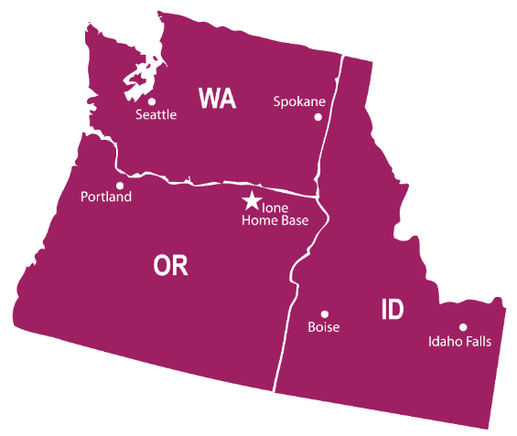

Who are we & where do we work?
Northwest Tribal Epidemiology Center (NWTEC)
Housed within the Northwest Portland Area Indian Health Board (NPAIHB)
Located in Portland, Oregon
NPAIHB serves the 43 federally recognized tribes in a three state region:
Idaho, Oregon, and Washington
Sujata Joshi, MSPH
Project Director/Epidemiologist
sjoshi@npaihb.org
“Our mission is to eliminate health disparities and improve the quality of life of American Indians and Alaska Natives by supporting Northwest Tribes in their delivery of culturally appropriate, high quality healthcare.”

Slide 4
Why collect and analyze data by race/ethnicity?
Notes:
Question for group
-Identify groups who experience disparities
-Understand the effects of racism, discrimination, and unequal access
-Prioritize groups for interventions and resource allocation

Slide 5
Race/ethnicity data collection and standardization
Federal standards for collection of race/ethnicity data – OMB 1997 standards
  Separate questions and minimum categories for race/ethnicity
    Race: American Indian or Alaska Native, Asian, Black or African American, Native Hawaiian or Other Pacific Islander, White
    Ethnicity: Hispanic or Latino, Not Hispanic or Latino
  Standards encourage:
    Additional granularity when supported by sample size and when data can be aggregated back to the above “standard” categories
    Self-identification by respondent
    Ability for respondents to select multiple races
Reference/Resource: https://minorityhealth.hhs.gov/assets/pdf/checked/1/Explanation_of_Draft_Standards.pdf
Notes:
Sujata

Slide 6
Race/ethnicity data collection and standardization
Limitations to federal standard
  Race/ethnicity data are not required to be collected by federal agencies
  OMB standards have been critiqued as being:
    Too broad
    Not reflective of how people identify themselves
    Confusing – especially because of the split between ethnicity and race questions
States set their own standards for race/ethnicity data collection for many health datasets
  Patchwork between states and within states
  Promising Practice: Oregon Race, Ethnicity, Language and Disability Data Collection
Notes:
Sujata

Slide 7
Race/ethnicity data collection and standardization
Issues to consider
  Completeness
  Accuracy
  Comparability across time, datasets, and geography
  Handling of race/ethnicity in combination
  Handling of multiple race responses
  Finding appropriate denominators
Notes:
Sujata

Slide 8
Considerations for AI/AN populations
For many American Indian/Alaska Native people, race/ethnicity background is (first and foremost) a political status that:
  Indicates citizenship in sovereign dependent nations
  Confers rights (such as access to health care and education services) under treaty obligations of the U.S. government
Tribal affiliation data are often not collected in health and administrative datasets, so we rely on accurate and complete race/ethnicity data to measure the health status of and disparities experienced by AI/AN communities
Notes:
Sujata

Slide 9
Considerations for AI/AN populations
Accurate race/ethnicity data collection for AI/AN people is especially important because:
  AI/AN populations are small, and insufficient numbers often result in data on AI/AN communities being suppressed due to concerns about confidentiality and statistical instability
  American Indian/Alaska Native people are more likely to be racially misclassified (i.e., incorrectly documented as another race) in health and administrative datasets
    Misclassification further compounds the small numbers issues, and underestimates disease burden in AI/AN communities
Further, a large proportion of AI/AN people identify as more than one race
Notes:
Sujata
These two reasons are perhaps the main reasons why state and federal agencies have historically not reported data on AI/AN people in published reports. Tribal Epidemiology Centers were founded in part to help tribal and urban Indian communities to collect and report on representative data for their communities.

Slide 10
Misclassification in Washington’s in-patient hospital discharge data
A linkage between the Northwest Tribal Registry and 2016 Washington Hospital Discharge data found:
4,717 misclassified AI/AN records
  63.8% of misclassified records were originally coded as White, and 19.0% had unknown race
“Correcting” these misclassified records increased the number of AI/AN hospitalizations by 42.3%
The age-adjusted hospital discharge rate for AI/AN increased by 46% after correcting misclassified records

Slide 11
Misclassification in Washington ESSENCE Hospitalizations
A linkage between the Northwest Tribal Registry and hospitalizations in Washington’s ESSENCE system (5/15-9/15/20) found 9,443 misclassified AI/AN visits
CC and DD Category | Prelink | Misclass | Postlink | % Postlink AI/AN Misclassified
CDC Pregnancy and Pregnancy Loss and Delivery v1 | 1066 | 357 | 1423 | 25.1%
CDC Asthma CCDD v1 | 1015 | 382 | 1397 | 27.3%
CDC Alcohol v1 | 1101 | 221 | 1322 | 16.7%
All Traffic Related v2 | 444 | 190 | 634 | 30.0%
SDC Disaster Related Mental Health v1 | 493 | 229 | 722 | 31.7%
Homelessness v1 | 582 | 98 | 680 | 14.4%
CDC Suicidal Ideation v1 | 474 | 184 | 658 | 28.0%
SDC Suicide Related V1 | 523 | 198 | 721 | 27.5%
CDC Coronavirus-DD v1 | 454 | 80 | 534 | 15.0%
CLI CC with CLI DD and Coronavirus DD v2 | 653 | 131 | 784 | 16.7%
CDC All Drug v2 | 356 | 111 | 467 | 23.8%
CDC Opioid Overdose v2 | 185 | 64 | 249 | 25.7%
Total AI/AN Hospitalization Visits | 25774 | 9443 | 35217 | 26.8%

Slide 12
Handling of Multiple Race Data for AI/AN Populations
Reporting data on single vs. multiple race AI/AN (and Non-Hispanic vs. any ethnicity AI/AN) can significantly change estimates of burden for AI/AN communities. The data below show these effects using data from 2 years (2015 & 2016) of Washington death certificate data. Note that these differences do not account for the effect of misclassification.
Numerator Description | Number of Deaths | Δ compared to previous row | % difference compared to previous Row
Non-Hispanic Single Race AI/AN | 1,502 | -- | --
Non-Hispanic Multiple Race AI/AN | 2,139 | 637 | 42.4%
Multiple Race AI/AN, Any Ethnicity | 2,229 | 90 | 4.2%

Slide 13
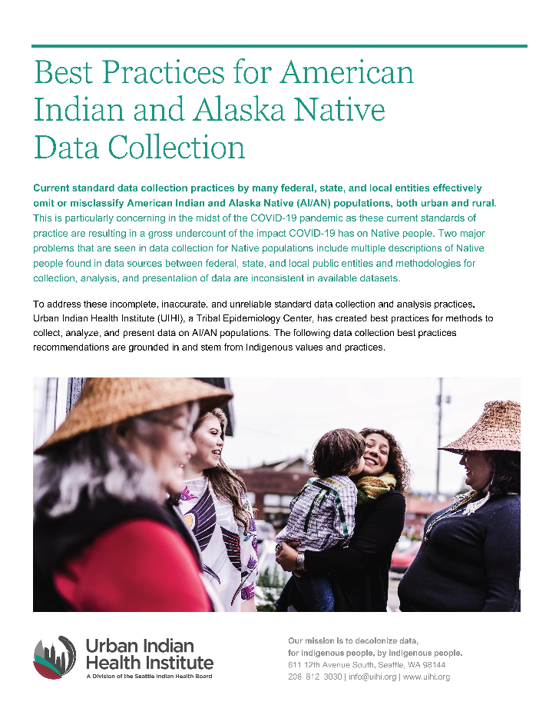
Resource on Collection of Data for AI/AN Communities
https://www.uihi.org/resources/best-practices-for-american-indian-and-alaska-native-data-collection/

Slide 14
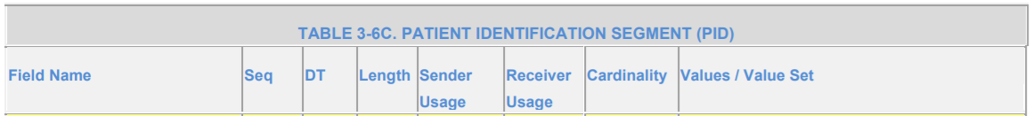
Race/ethnicity data collection in syndromic data
Although all syndromic sites sending to NSSP conform to the PHIN Messaging Guide basic standards for “required” (R) and “required but may be empty” (RE) elements, there is considerable variance beyond these base standards
  Receiving more than one flat code for patient race
  Receiving updates to the patient race field
Data limitations arise from both the lack of standardization in data reporting but also from front-end workflow practices at the facilities impacting data correctness
  Even if the field is nearly always complete, how do we assess the accuracy of that information?
Notes:
Amanda
-

Slide 15
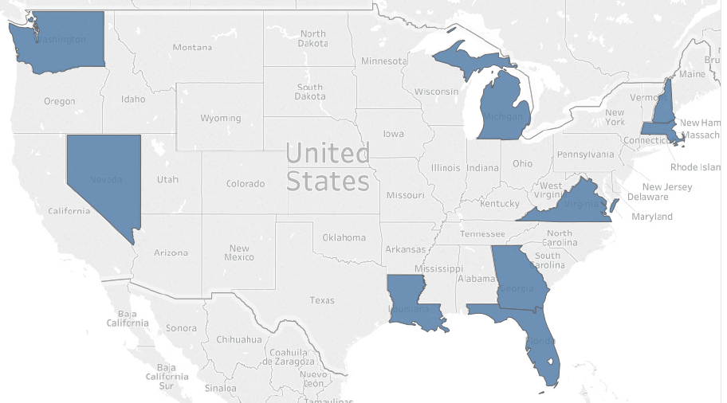
Preliminary Exploration of Reporting Practices – NSSP Site
Last month, we decided to start gathering information about jurisdiction-level race and ethnicity data collection practices
So far, we have received 9 responses
  All were from NSSP sites

Slide 16
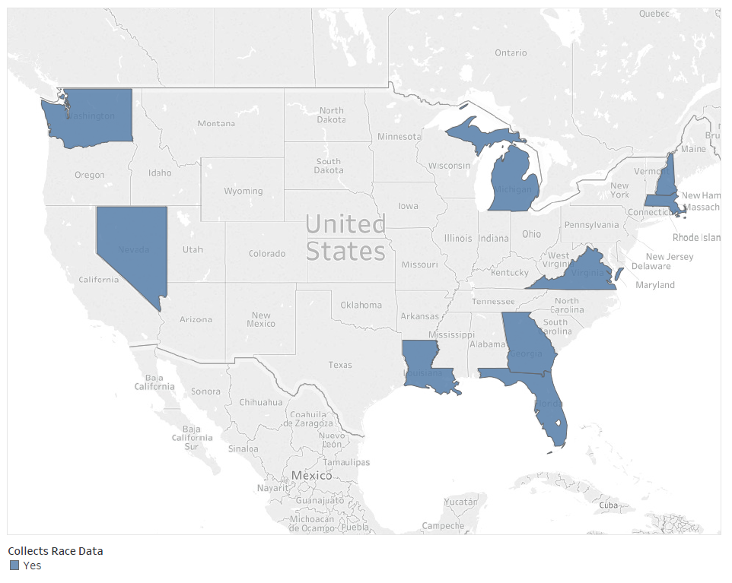
Preliminary Exploration of Reporting Practices – Collects Race
All 9 jurisdictions reported that they receive information on patient race in their syndromic feeds

Slide 17
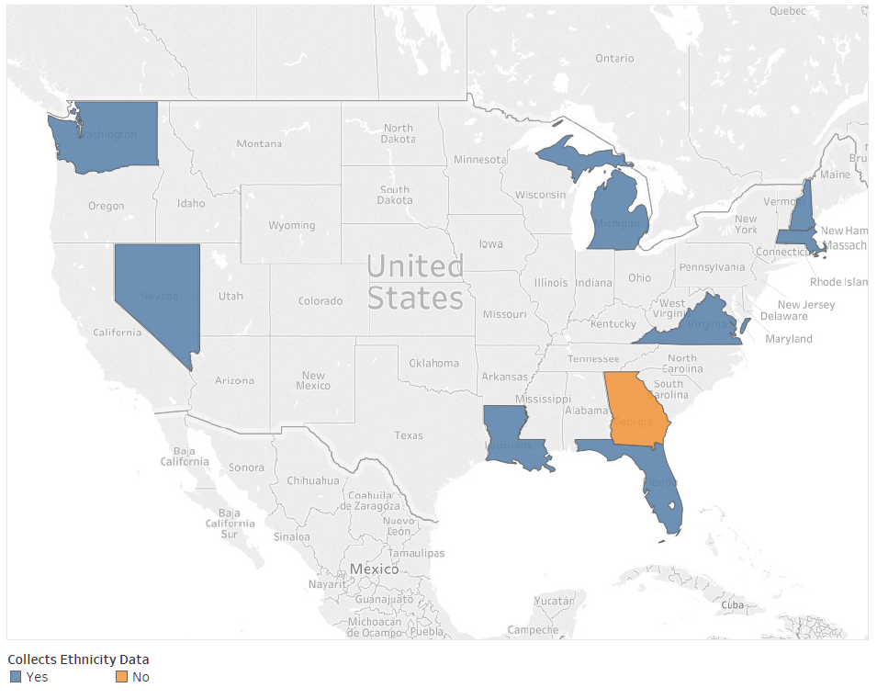
Preliminary Exploration of Reporting Practices – Collects Ethnicity
Almost all jurisdictions (8/9) reported receiving information on patient ethnicity in their syndromic feeds

Slide 18
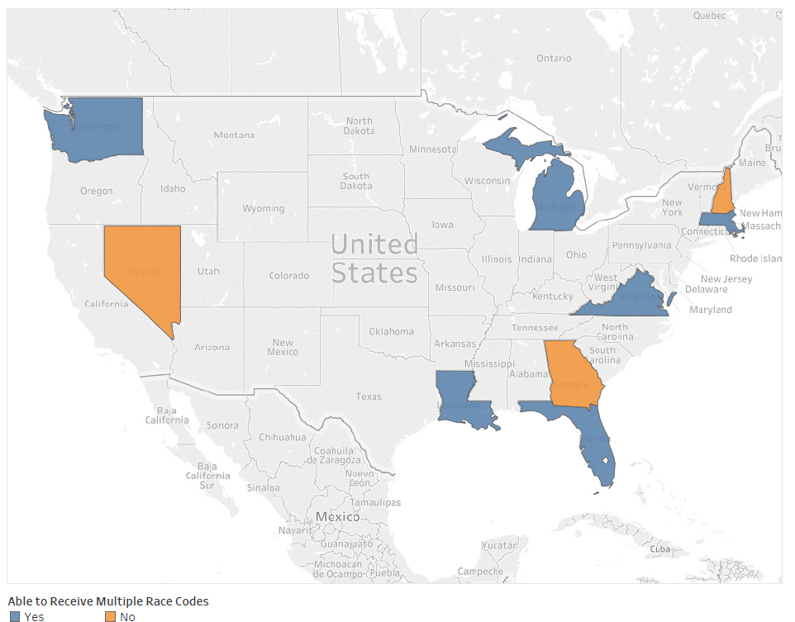
Preliminary Exploration of Reporting Practices – Multiple Race Values
Most jurisdictions (6/9) reported receiving multiple values for patient race
Key questions to explore:
  What allows sites to receive multiple codes (can be system, vendor, policy, or other facilitators)?
  How do you treat records that do have multiple race codes listed?
  What prevents sites from collecting multiple values (preference, technological barriers)?

Slide 19
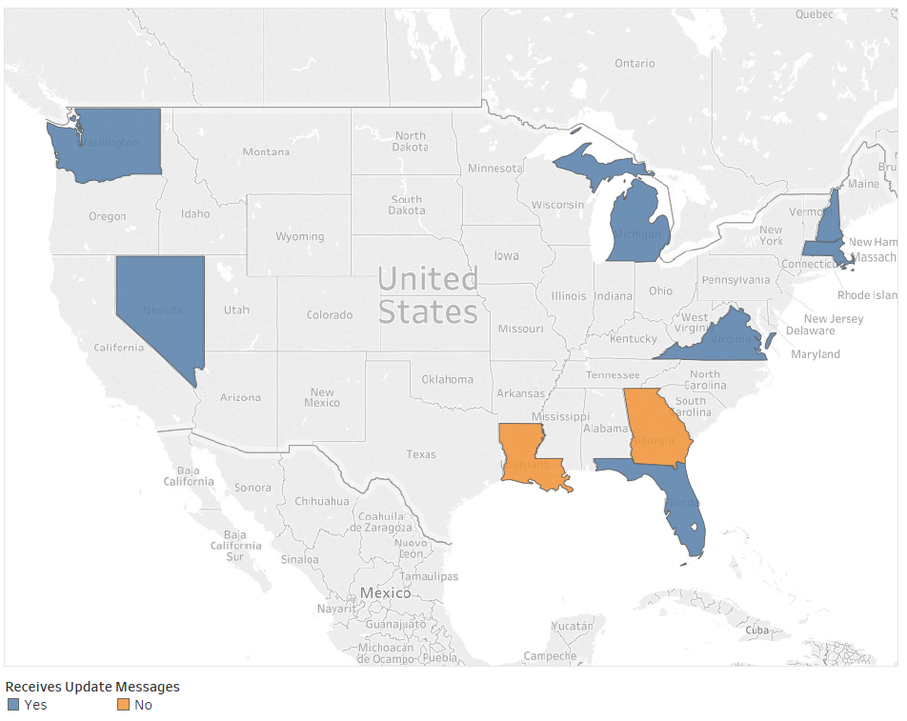
Preliminary Exploration of Reporting Practices – Receives Field Updates
Most jurisdictions (7/9) reported receiving update messages for their race and ethnicity fields
Updates to the race and ethnicity fields may overwrite existing data
  More exploration needs to be done around this issue

Slide 20
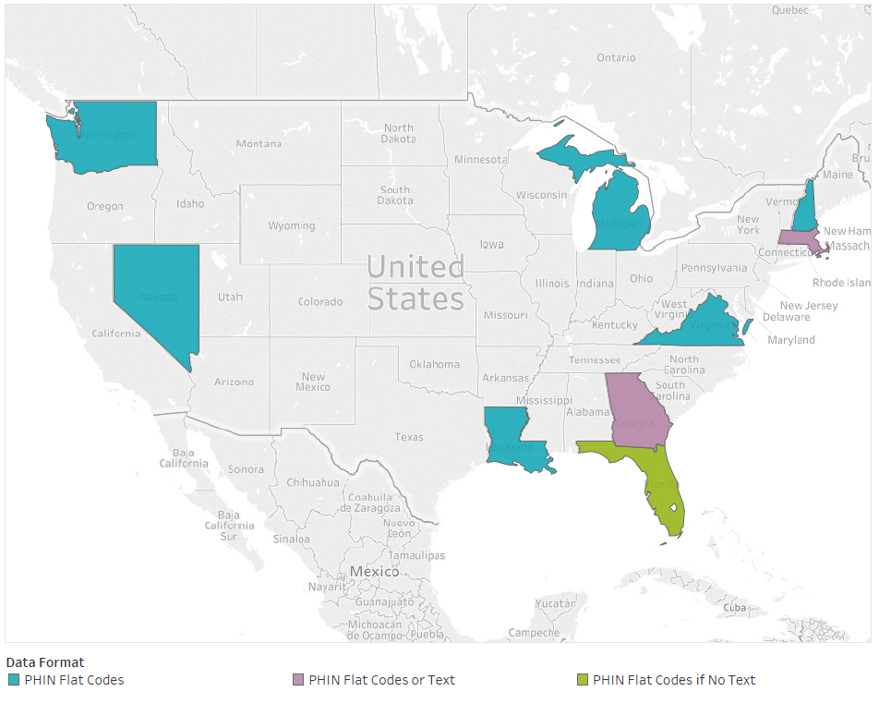
Preliminary Exploration of Reporting Practices – Data Formatting
Most jurisdictions (6/9) reported that they receive PHIN flat codes for race and ethnicity data
  2 jurisdictions reported that they receive both PHIN flat codes and free-text
  1 receives codes only when there is no text
Work is being done with NSSP to categorize visits with less structured race and ethnicity data
  There are some choices with aggregation which could exacerbate misclassification issues

Slide 21
NSSP race/ethnicity data quality group
Group activities:
  Assessing the landscape of race/ethnicity data collection across syndromic sites
    What are current practices?
    What are current levels of completeness?
    What are barriers and facilitators to collecting and transmitting race/ethnicity data?
  Using assessment findings to support efforts to improve race/ethnicity data collection at the system/hospital levels
  Understanding workflows for collection and reporting of race/ethnicity data in EHR systems
  Highlighting examples of how sites are using race/ethnicity fields for surveillance efforts
Meetings: 2nd Wednesday of the month, 3-4 pm ET

