Slide 1
Use of Earth Observation Data within Syndromic Surveillance Systems
CSTE DISASTER EPIDEMIOLOGY SUBCOMMITTEE
AUGUST 19, 2020
JULIA GOHLKE, VIRGINIA TECH
BEN ZAITCHIK, JOHNS HOPKINS UNIVERSITY
MEREDITH JAGGER, CONSULTANT

Slide 2
OVERVIEW
Project Overview (Julia)
Discussion: Experience Using Environmental and SyS Data Together (Meredith, Group)
Earth Observation Data: Options, Resolution, Limitations (Ben)
Discussion: Adding Data Sources to ESSENCE (Meredith, Group)

Slide 3



Contact Info
Julia M. Gohlke, PhD
jgohlke@vt.edu
Benjamin Zaitchik, PhD
zaitchik@jhu.edu
Meredith Jagger
mph. jagger@use.startmail.com

Slide 4
Project Goal and Objectives:
Enhance the CDC Social Vulnerability Index (CDC SVI) by adding exposure estimates, using Hurricane Harvey as case study:
  1. Incorporating Earth Observations (EO) datasets on flooding, heat, power outages, and chemical emissions from industrial facilities.
  2. Incorporating a synthetic population model of movement of people pre, during and post disaster.
  3. Evaluating the utility of these enhancements through analysis of healthcare visit data collected pre, during, and post Hurricane Harvey.

Slide 5
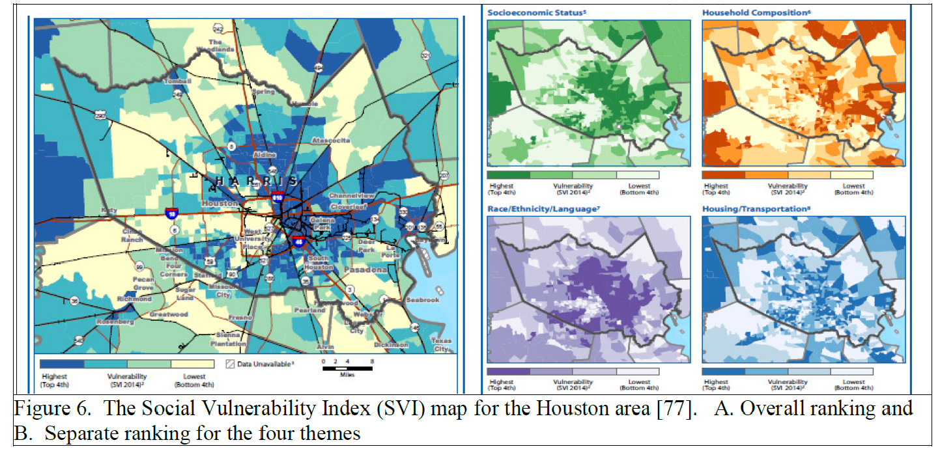
The CDC SVI is used to estimate the amount of needed supplies, locations of emergency shelters, assisted evacuations, support response
https://svi.cdc.gov/

Slide 6

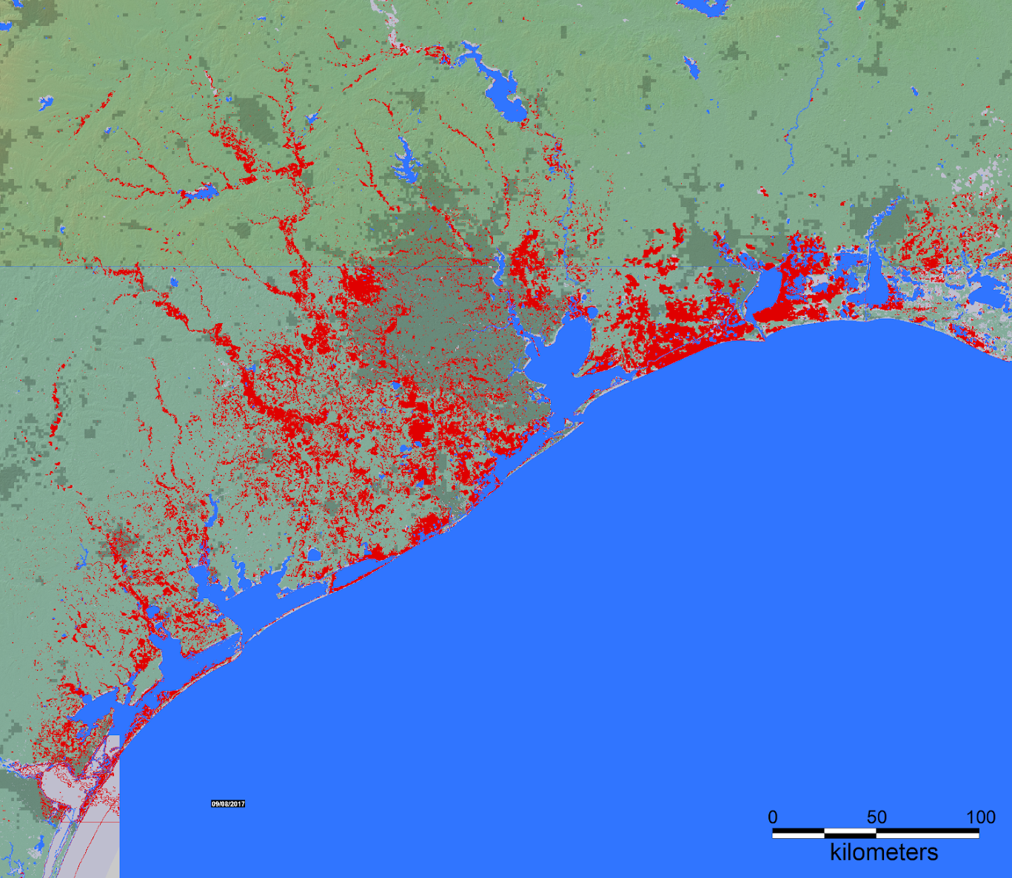
Hurricane Harvey
Maximum Observed Flooding
Flooded
Spatial resolution : 200 m
Inundation Data
Brakenridge, G.R. and Kettner, A. J., 02-02-2020, "DFO Flood Event 4510", Dartmouth Flood Observatory, University of Colorado, Boulder, Colorado, USA, http://floodobservatory.colorado.edu/Events/2017USA4510/2017USA4510.html.

Slide 7
Health Outcome Datasets
Texas Flood Registry, collaboration between Rice University and several organizations
Inpatient and Outpatient visits from the Texas Department of State Health Services (2016, 2017, 2018)
Syndromic surveillance data from Houston Health Department (2017, 2019)

Slide 8
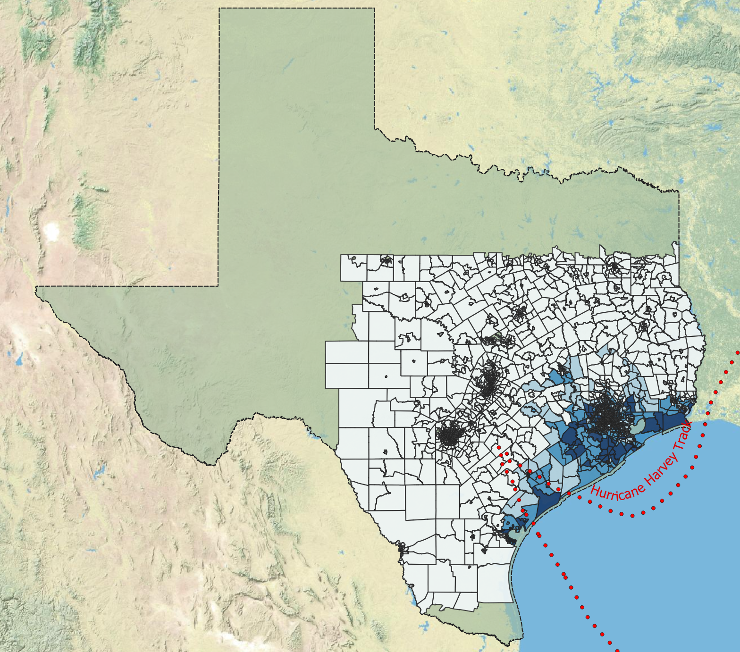

Emergency Department (ED) Visit Data
Flood Ratio
1.2 Million Inpatient Records
7.9 Million Outpatient Records
Geocoded to 2883 Census Tracts
117 Counties in Study Area
Variables
Patient Zip and Census Block
Sex, Age, Race, Ethnicity
Diagnostic Codes
Condition Codes
Patient Status
Statement Start Date
Admission Date (IP)
Study Area and Data Description

Slide 9
Heath Outcome Categories and Number of Visits During Flood and Post Flood Periods
Scale is Logarithmic

Slide 10
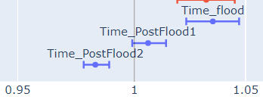
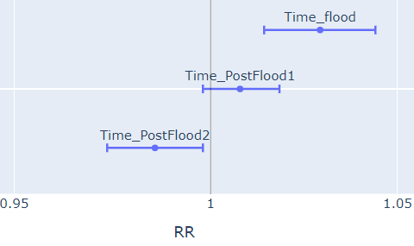
Total visits increased by 4% during the flood impact period, with increases in several categories
Total Visits
Flood Period | RR | 95% Conf. Int
Flood Storms (OP) | 11.25 | 7.30 | 17.34
Drowning (IP) | 9.23 | 1.07 | 79.44
Hypothermia (IP) | 3.24 | 1.58 | 6.62
CO Exposure (OP) | 2.75 | 1.09 | 6.92
Medication Refill (OP) | 2.00 | 1.73 | 2.31
Intestinal Infectious (OP) | 1.41 | 1.23 | 1.63
Dialysis (OP) | 1.41 | 1.28 | 1.55
Bite-Insect (OP) | 1.23 | 1.12 | 1.35
Pregnancy Comp (OP) | 1.13 | 1.06 | 1.20
Outpatient
Inpatient
* Decreases in ED visits for chest pain and acute respiratory illnesses during impact period
Notes:
Reformat Results?

Slide 11
CDC Social Vulnerability Index of patient census tract and visits during the flood and post flood periods
A 10% increase in the CDC SVI was associated with increased relative risks for intestinal infectious diseases and acute respiratory illness during the flood impact periods.
A 10% increase in the CDC SVI was associated with increased relative risks for outpatient visits for acute respiratory illness and dialysis in post flood periods.
Flood Period | RR | 95% Conf. Int
Intestinal infectious diseases (IP) | 14.27 | 1.13 | 181.27
ARI (OP) | 2.94 | 1.66 | 5.19
Post Flood Period 1 | RR | 95% Conf. Int
ARI (OP) | 2.02 | 1.36 | 3.00
Post Flood Period 2 | RR | 95% Conf. Int
Dialysis (OP) | 7.07 | 1.91 | 26.35
Notes:
Reformat Results?

Slide 12
Health Outcome Next Step –
Syndromic Surveillance Data
Similar Poisson Modeling
Definitions from chief complaint/discharge diagnosis queries and approximations of syndromes and subsyndromes
4 Million Records
  June 2017 – December 2017
  June 2019 – December 2019
Variables
Date
Time
Zip code
Age
Sex
Chief Complaint Orig
Discharge Diagnosis
Provider Diagnosis
Race
Ethnicity
Hospital Name
Hospital Zip Code

Slide 13
The Team
Ben Zaitchik and Lauren Deanes, Johns Hopkins University
Samarth Swarup, Anna Brower, and Sanchit Sinha, University of Virginia
Julia Gohlke, Suwei Wang, and Balaji Ramesh, Virginia Tech
Biru Yang and John Fleming, Houston Health Department
Elaine Hallisey, Barry Flanagan, and Caitlin Mertzlufft at CDC GRASP
Meredith Jagger, Independent Consultant

Slide 14
Discussion Questions
What is your experience or familiarity with using environmental data in combination with syndromic surveillance?
  What type(s) of environmental data, events, and health outcomes?
  What resolutions (temporal, geographic)?
  Was the analysis conducted during or after a disaster response? How fast do you need it?
  Was the work done within or outside of SyS platform?

Slide 15
Earth Observations

Slide 16
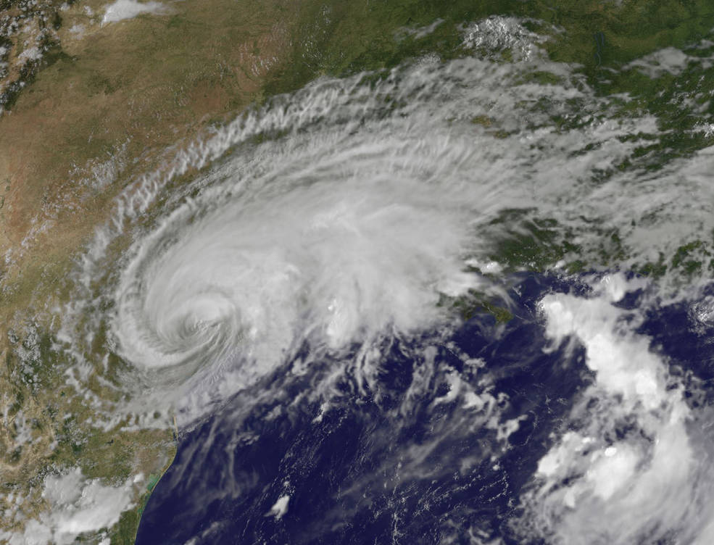
What are Earth Observations?
Earth Observations (“EO”) refer to remote observations, in situ observations, data-informed computer models, and data assimilation systems.
This is a powerful set of tools for observations across space and time, but each EO has its own limitations in resolution, temporal coverage, latency, precision, and accuracy

Slide 17
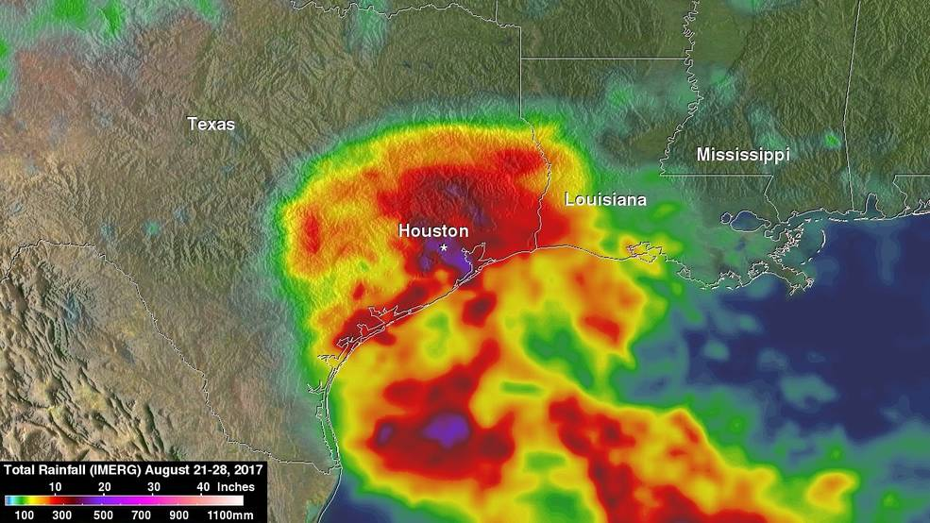
Why use remotely acquired EO?
Coverage
Consistency
Completeness
Capabilities

Slide 18
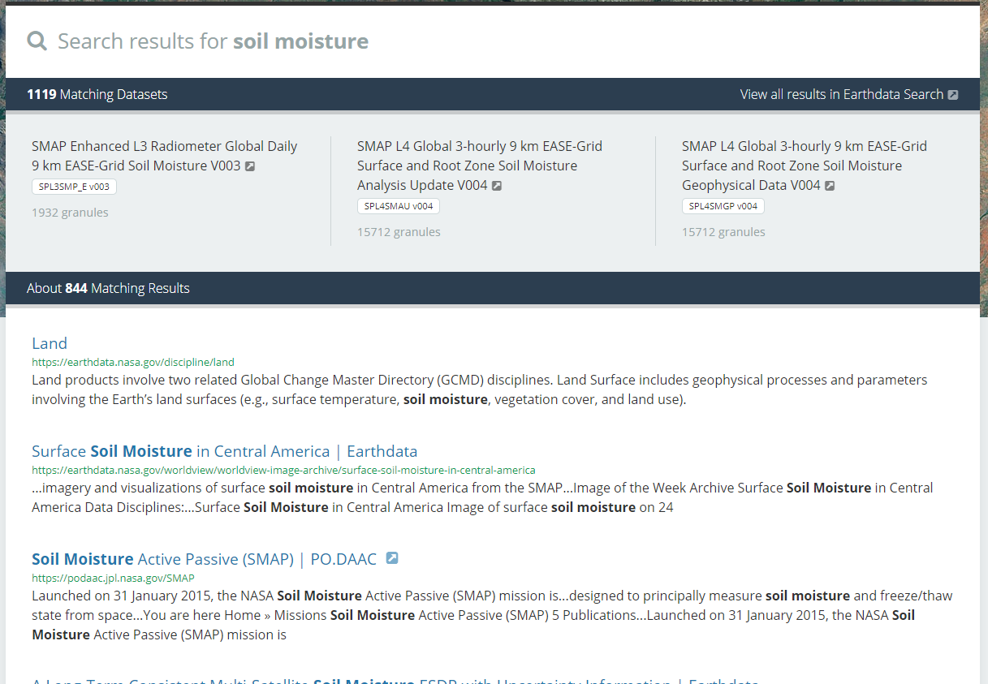
Why not use remotely acquired EO?
Uncertainties
Unfamiliarity
Unavailability
Unwieldiness

Slide 19
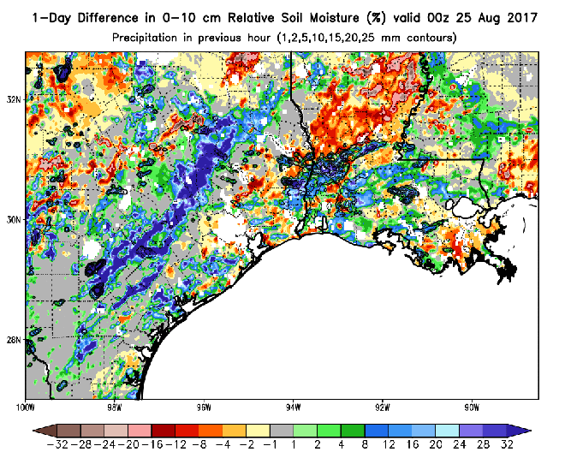
EO in our project
NLDAS:
surface meteorology
hydrological states
Image: NASA SPoRT

Slide 20
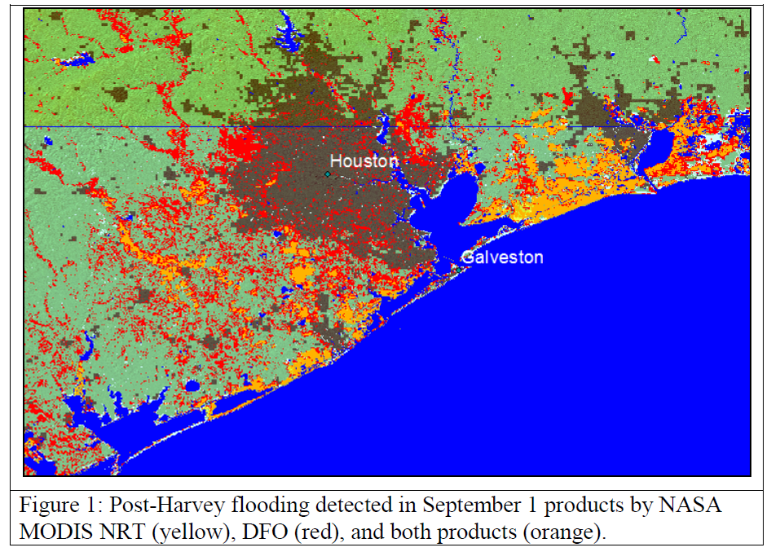
EO in our project
The Dartmouth Flood Observatory:
Inundated area

Slide 21
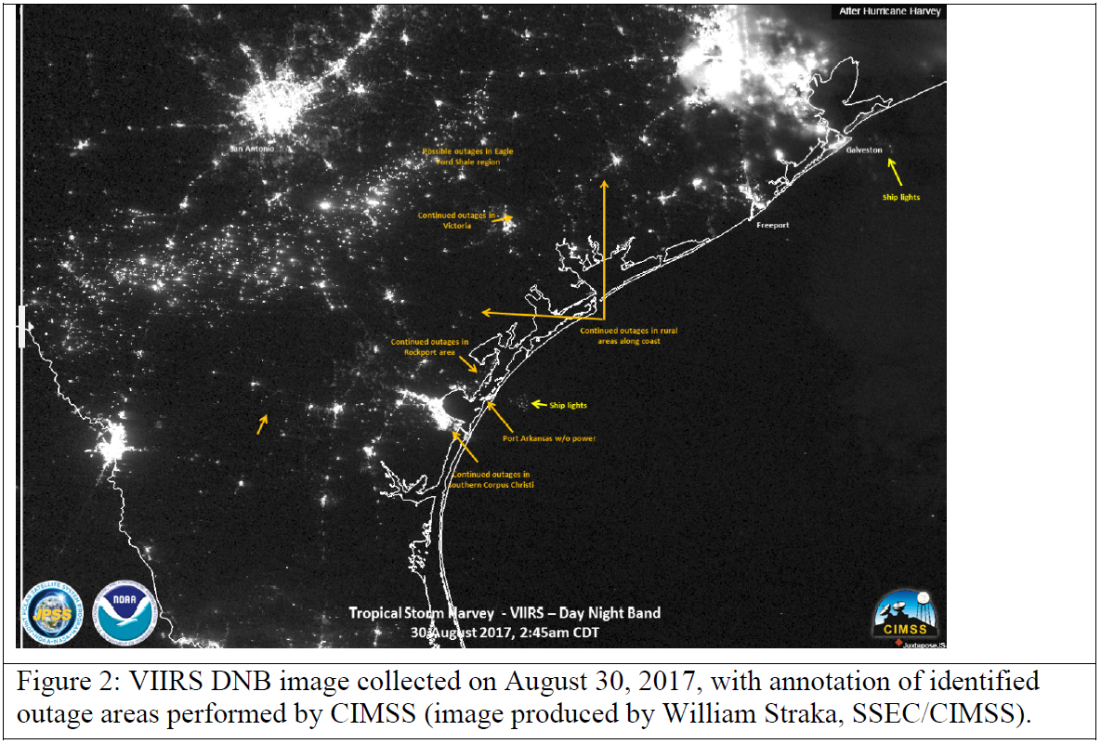
EO in our project
NASA VIIRS:
Nighttime lights

Slide 22
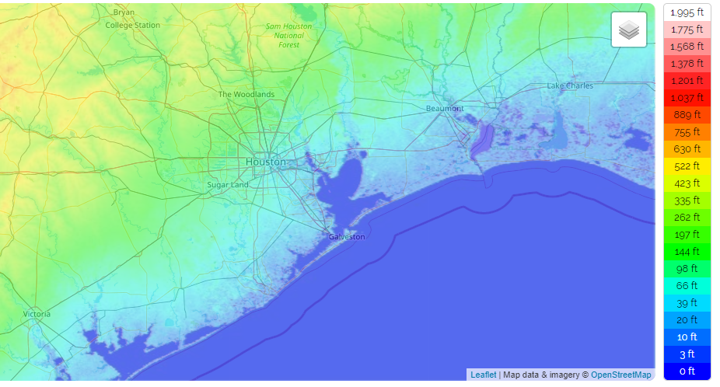
EO in our project
Multiple static products:
Elevation
Distance from coast
Surface water bodies
Etc. etc.

Slide 23
EO for ESSENCE?
Some meteorological variables are already present in weather station data in ESSENCE.
In those cases, would greater spatial coverage or forecast potential be useful?
Other variables are not yet available in ESSENCE.
Are there environmental variables that would be worth adding?
What are the applications and the requirements (resolution, latency, etc.) for those observations?

Slide 24
Discussion Questions
What types of additional environmental or EO data might be useful in your disaster epi work?
Would an ESSENCE data source be the best way to get you/your ESSENCE users these data?
Research → Real-time → Operational
Notes:
Keep in mind we cannot promise anything! If a data source is already processed and available at the right resolution, the NSSP change committee can review the utility and decide if they would like JHU to proceed with adding it to ESSENCE. If a data source is not fully developed or requires additional processing, that would be a bigger project.

