Slide 1

Climate Data Profiles for Minnesota’s Emergency Management & Preparedness Professionals
Brenda Hoppe, PhD, Senior Research Scientist
CSTE Disaster Epidemiology Committee meeting
January 15, 2020

Slide 2
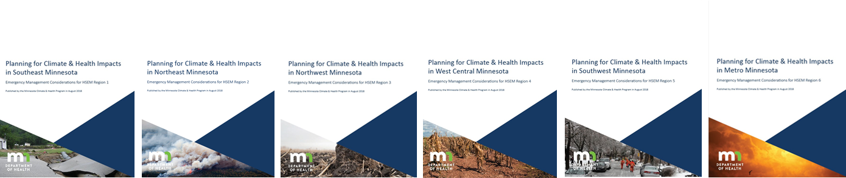
State & Local Emergency Management
Jennifer Nelson
Eric Waage
Lucy Angelis
Roy Holmes
Heather Winkleback
Mark Marcy
Mike Peterson
Jeanna Hayes
Gary Peterson
Hundrieser Consulting
Bonnie Hundrieser
State Climatology Office
Kenny Blumenfeld
Peter Boulay
Silver Jackets
Terry Zien
University of Minnesota
Stacey Stark
MDH
Micaela Resh
Nissa Tupper
Kristin Raab
Emmy Waldhart
Cheryl Petersen-Kroeber
Deb Radi
Chris Kimber
THANK YOU!!!

Slide 3
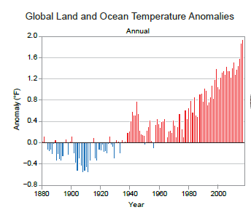
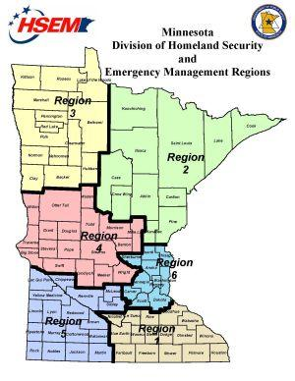
MN HSEM Climate Data Profiles
Image from NCA4, Vol 1.

Slide 4
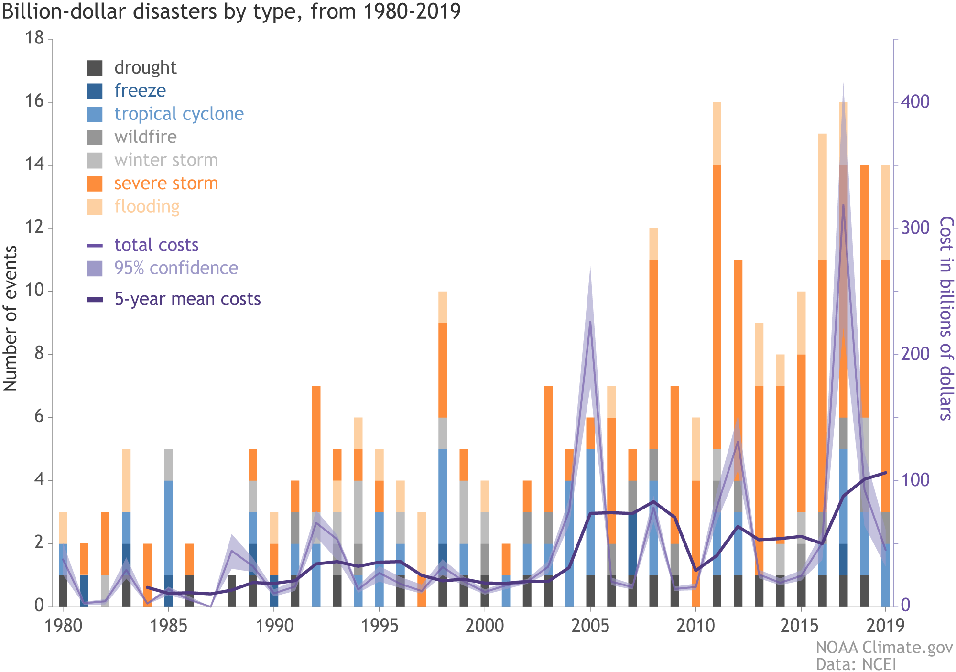
Disasters & Costs Trending Up
From NOAA. Billion-Dollar Weather and Climate Disasters, 2019.

Slide 5
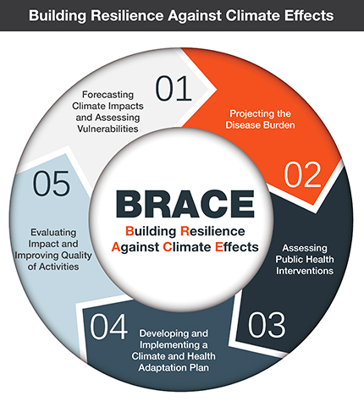
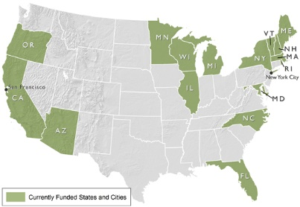
Minnesota Climate & Health Program
CDC’s Climate-Ready States & Cities Initiative Grantees

Slide 6


Minnesota Climate & Health Program
Fon Restorff

Slide 7

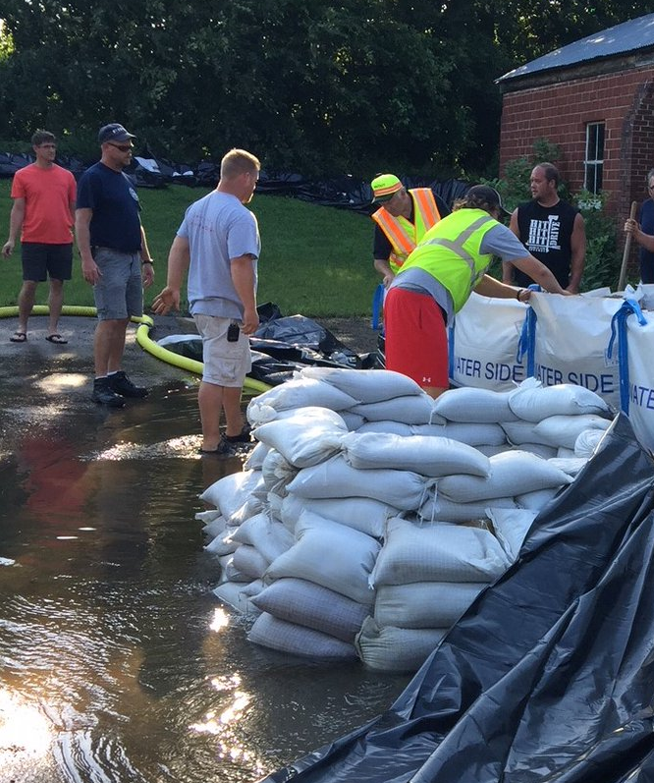
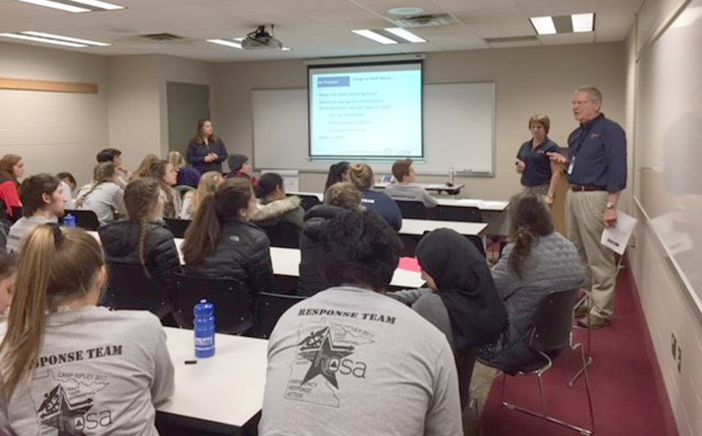
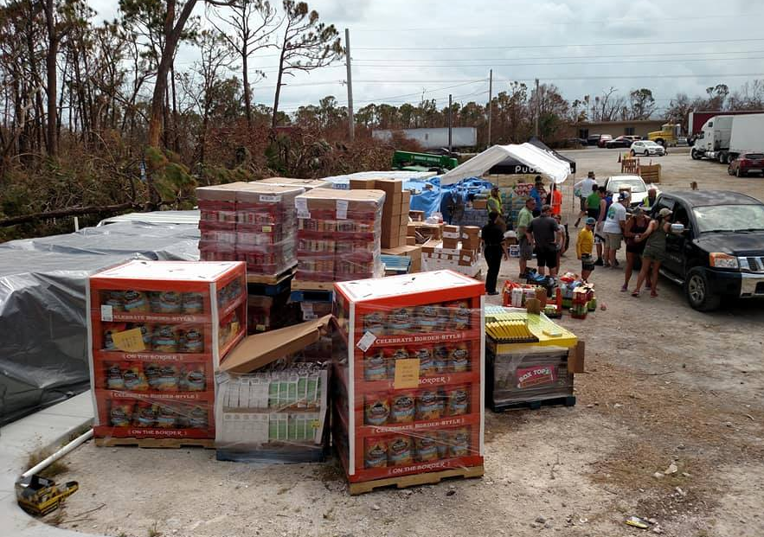
Emergency Management: Frontline Experts
Source: Homeland Security and Emergency Management

Slide 8
Need Climate Data? You got it!
Data
Knowledge
Action

Slide 9

The Past No Longer Predicts the Future

Slide 10

“I skate to where the puck is going to be, not where it has been.”
-Wayne Gretzky

Slide 11
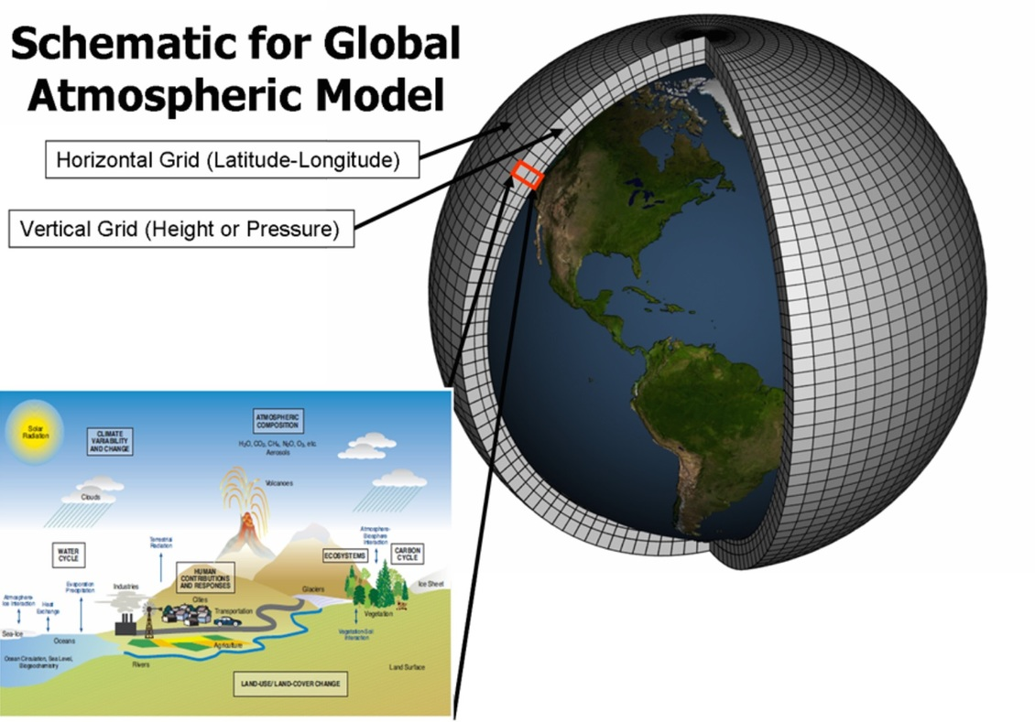
What’s the Big Deal with Climate Data?
Image courtesy of Geophysical Fluid Dynamics Laboratory, National Oceanic and Atmospheric Administration, USA

Slide 12
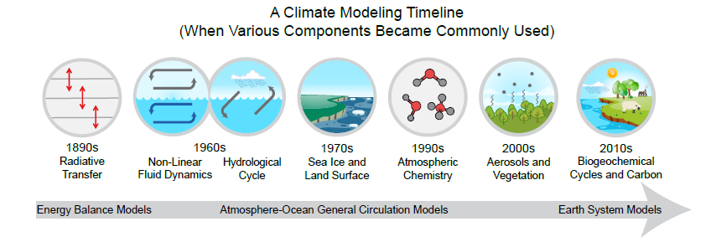
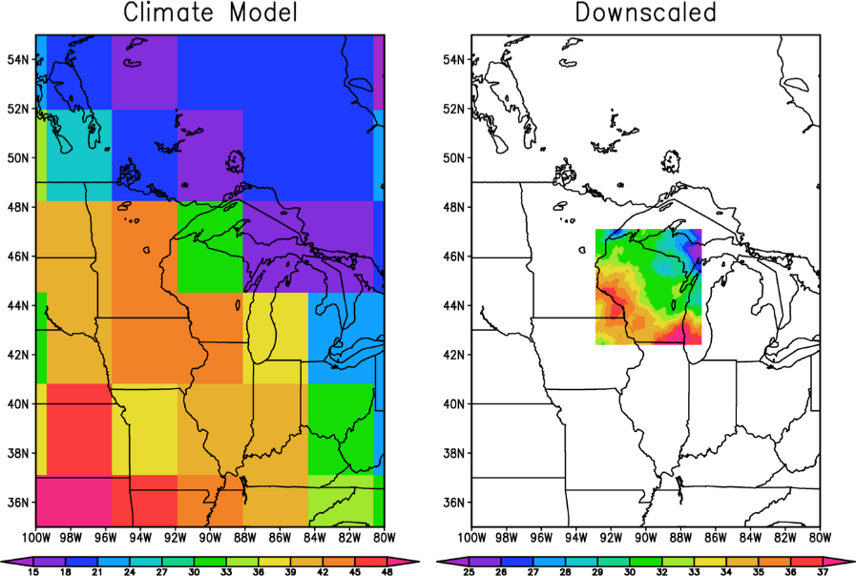
What’s the Big Deal with Climate Data?
Image from Fourth NCA, Vol 1.
Source:globalchange.gov

Slide 13

“What gets measured gets managed.”
- Peter Drucker, management guru

Slide 14

MN HSEM Climate Data Profiles
6 profiles for each HSEM region
For use in:
  State All Hazard Mitigation Plan
  Other emergency-related plans
  Engaging partners in local planning
  Factoring into exercises
Source: Homeland Security and Emergency Management

Slide 15
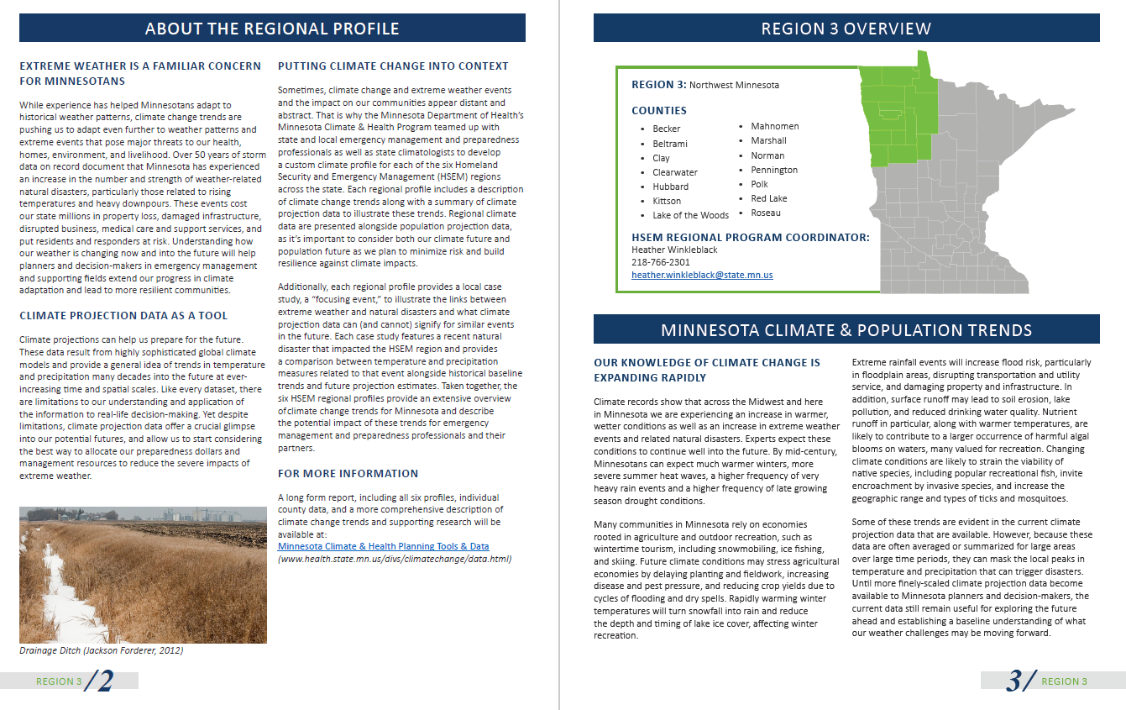
MN HSEM Climate Data Profiles

Slide 16
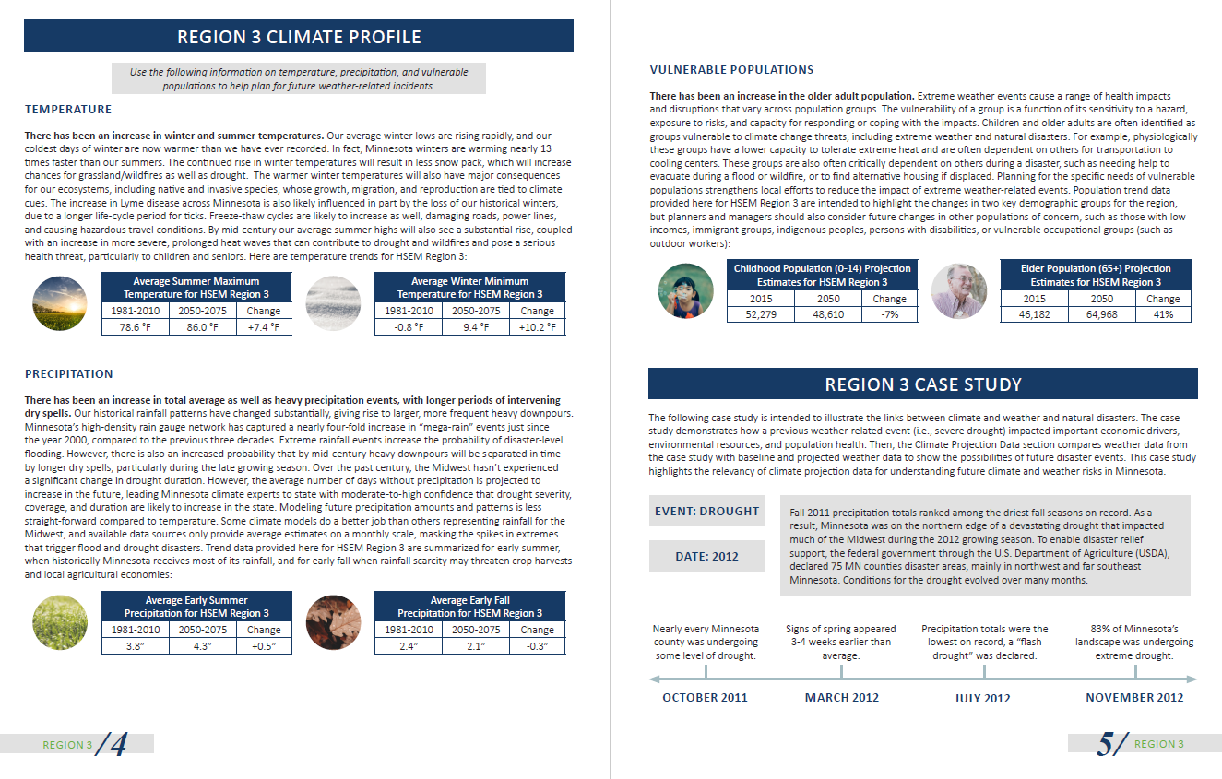
MN HSEM Climate Data Profiles

Slide 17
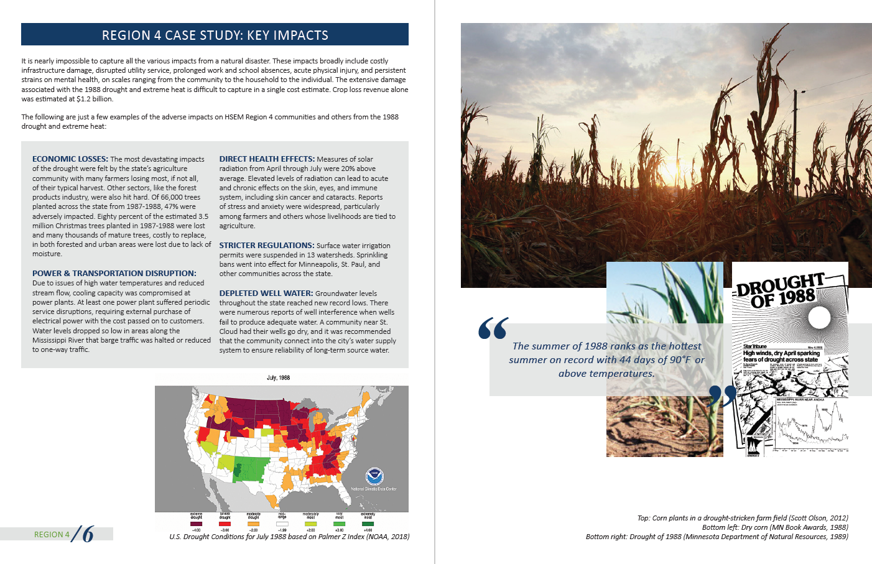
MN HSEM Climate Data Profiles
Focusing Event!

Slide 18

MN HSEM Climate Data Profiles
Region 1: 2007 Flood
Region 2: 2011 Wildfire
Region 3: 2012 Drought
Region 4: 1988 Drought
Region 5: 2013 Ice Storm
Region 6: 2011 Extreme Heat
Source: Homeland Security and Emergency Management

Slide 19
MN HSEM Climate Data Profiles
Focusing Event!

Slide 20
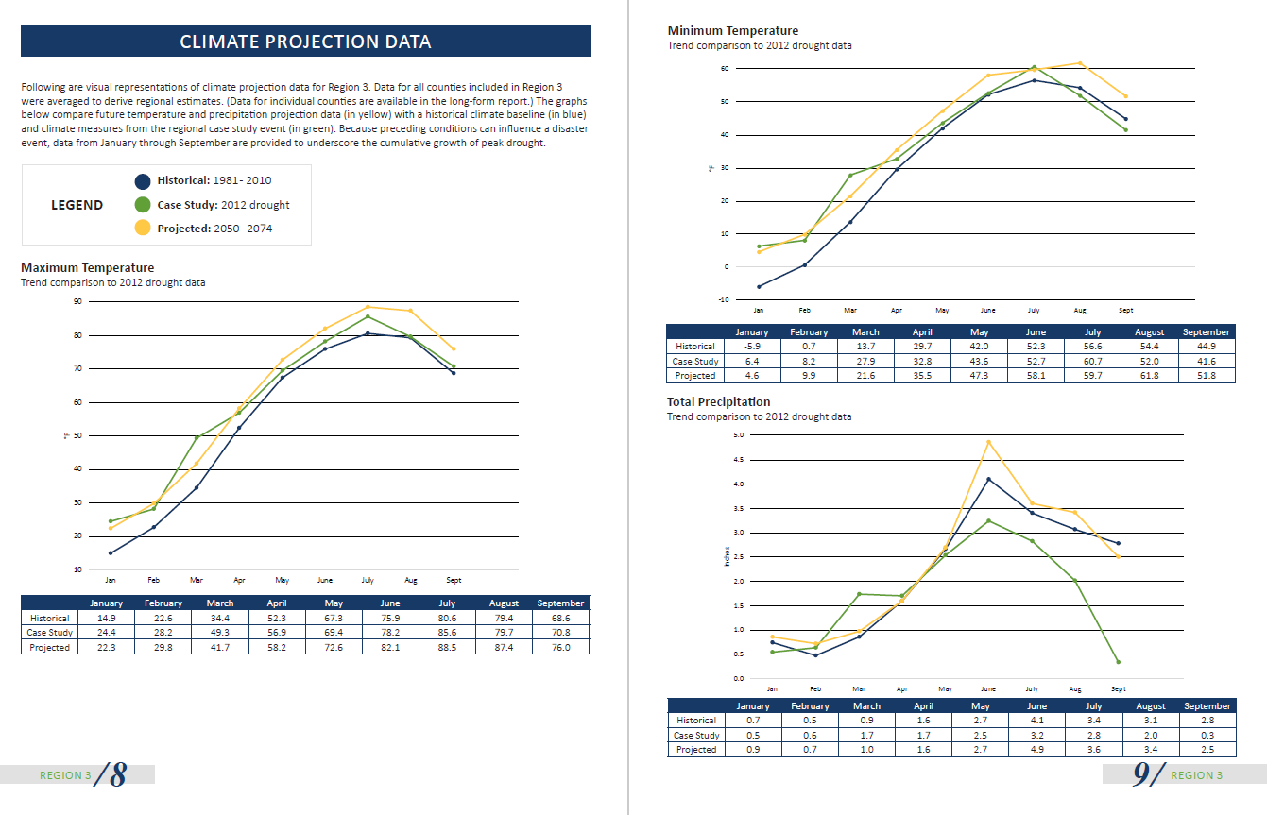
MN HSEM Climate Data Profiles

Slide 21
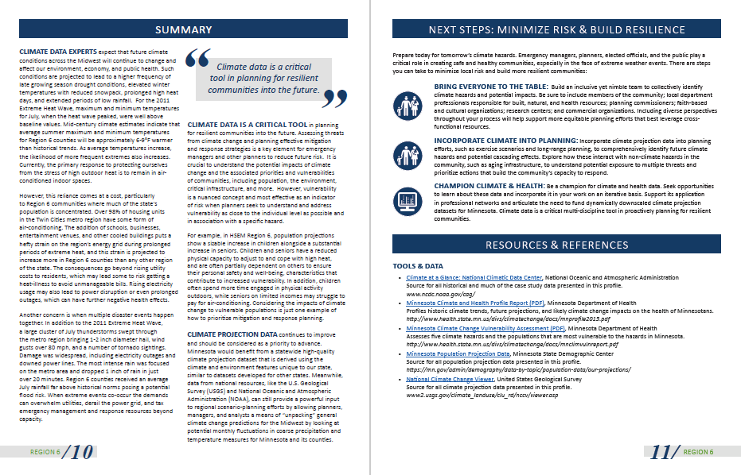
MN HSEM Climate Data Profiles

Slide 22
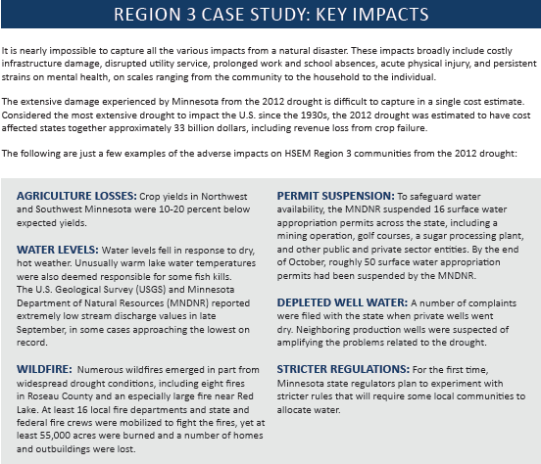
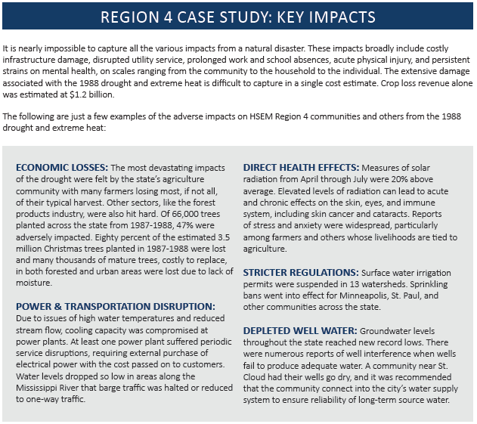
Example drought impacts:
Economic losses, crop and forests
Adverse mental health symptoms
Significant drop in water levels, permits suspended, wells run dry
Increased wildfires
Power, transportation disruptions
Key Takeaway: Need information systems or channels to communicate local impacts from disasters (e.g. NIDIS)

Slide 23
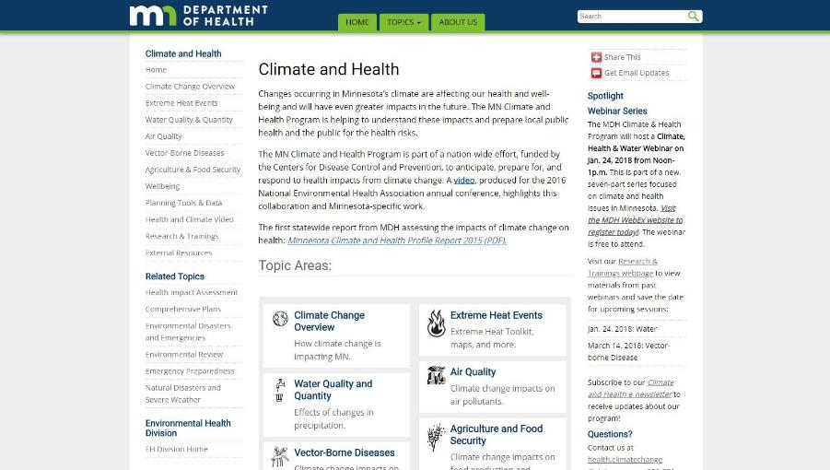
Sign up for our Climate & Health Newsletter!
Free, semimonthly
Stay up-to-date on:
  The latest research
  Trainings/resources
  Funding opportunities
  Job openings
www.health.mn.gov/climatechange

Slide 24
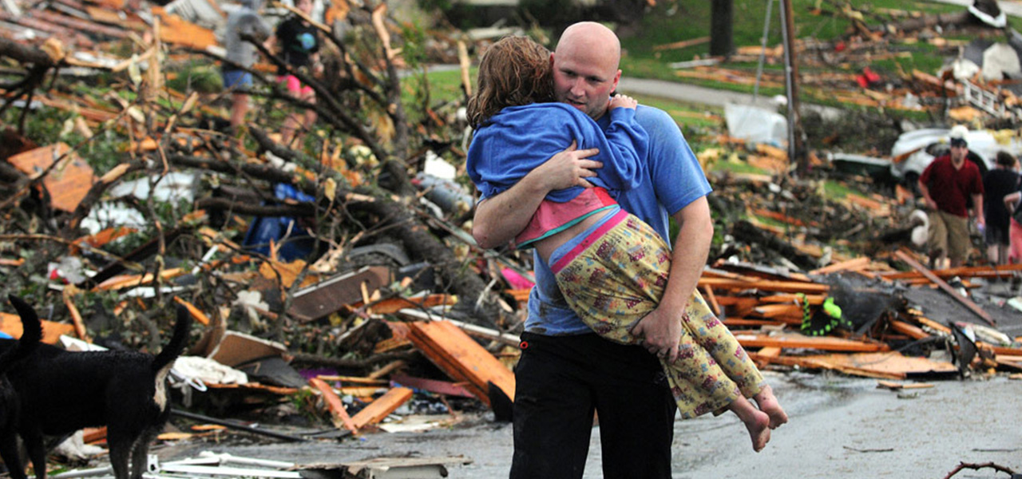
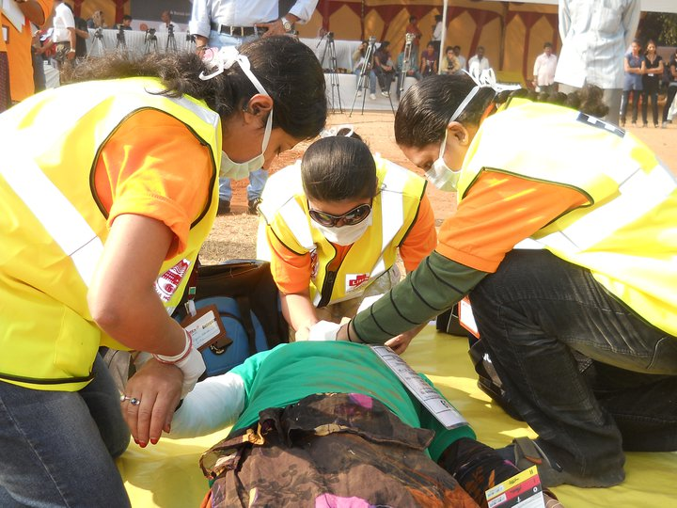
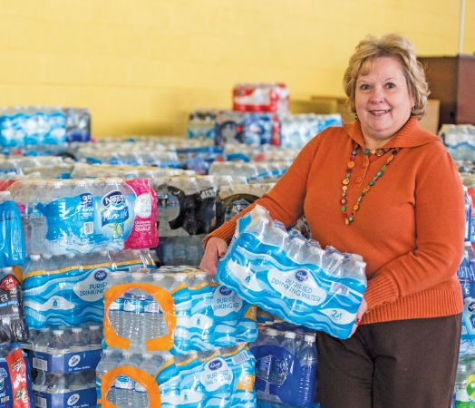
Thank you!
Brenda Hoppe
brenda.hoppe@state.mn.us
http://frontlinecrisisresponse.com/

