Slide 1
Community Assessment for Public Health Emergency Response (CASPER)
Tess Konen, MPH
September 16th, 2020

Slide 2
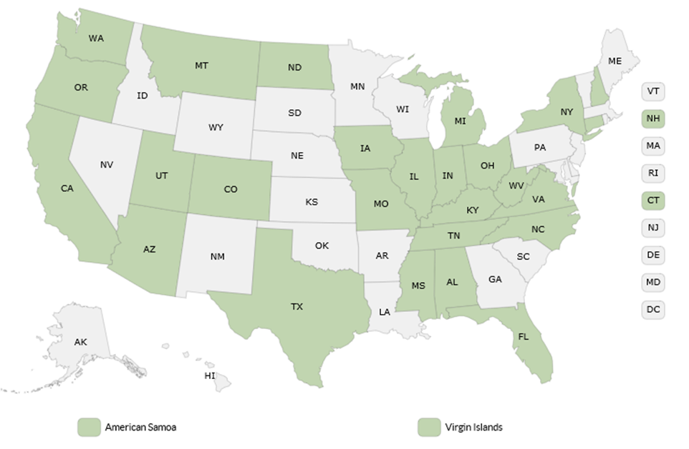
Scope of CASPERS in US
Over 125 CASPERs conducted in states across the US
Increase in number of preparedness and non-disaster CASPERs
Notes:
MN has never done one before, but many states have and they are frequently done before during and after disasters
Some states, like Texas have done more than 11

Slide 3
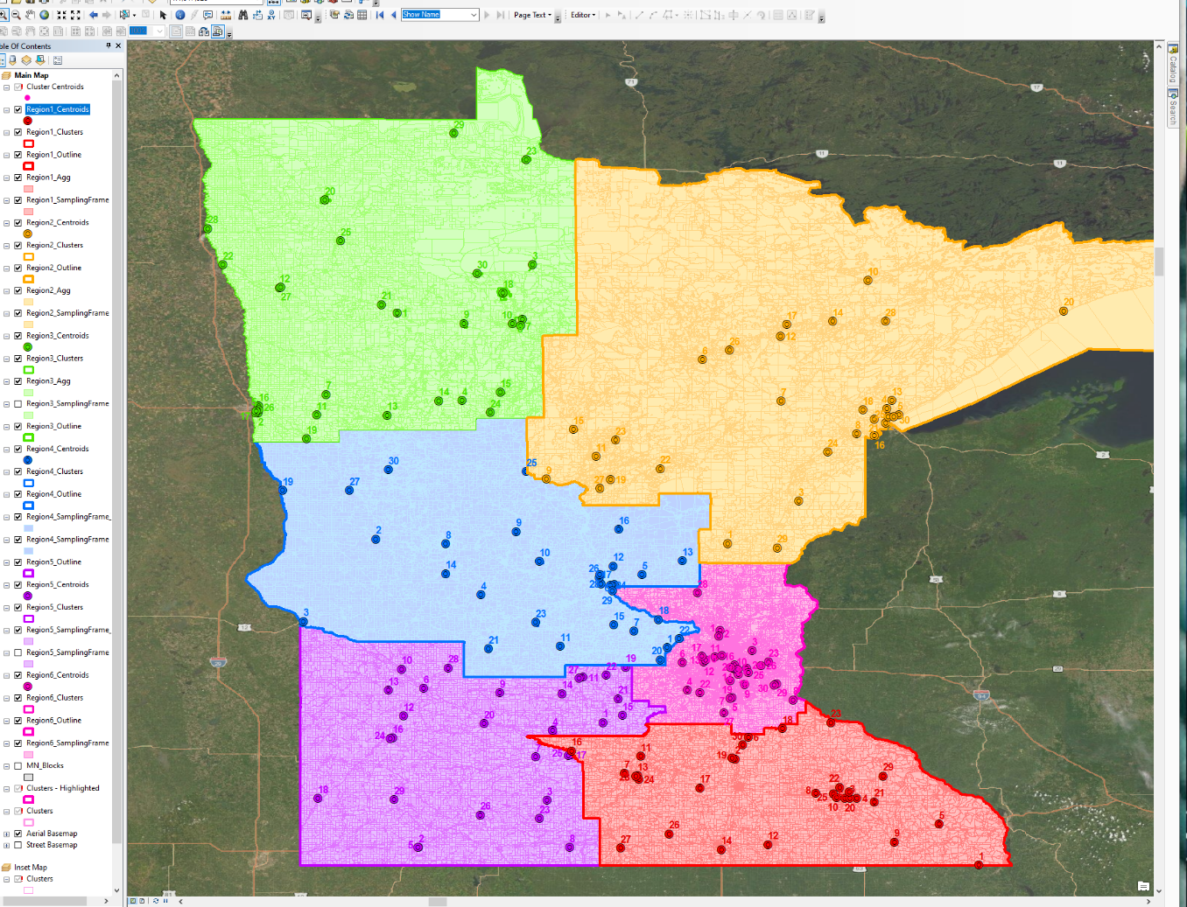
Selected Clusters
Region 1= southeast
Region2= northeast
Region3= northwest
Region4= west central
Region5= southwest
Region6= metro
Notes:
Within the 6 preparedness regions, 30 clusters were selected each.

Slide 4
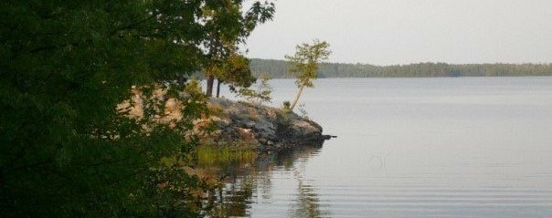
Purpose of the Minnesota CASPERs

Slide 5
Objectives
Determine the extent of infection in communities: overall SARS-CoV-2 seroprevalence
Determine factors associated with SARS-CoV-2 seropositivity
Explore differences in SARS-CoV-2 seroprevalence in different regions
Assess community prevalence of asymptomatic carriers of SARS-CoV-2
Identify areas for improved health messaging regarding modifiable health behaviors

Slide 6
MDH Modified CASPER
Conduct 1 CASPER in each of 6 Minnesota Preparedness Regions
  30 clusters, 7 households per cluster = 1,260 interviews!
  Data weighting to obtain population estimates
  One survey per household
Modified CASPER design
  Includes some individual level questions
  Specimen collection
Collect specimens for SARS-CoV-2 antibody and PCR testing at MDH PHL
  All interested individuals in household will be tested
  Separate consent boxes for each sample type
Notes:
Minimum >=1 specimen per household to participate. Would not complete the survey if no one consented to testing – defeats the purpose.

Slide 7
MDH Modified CASPER
Sampling
  Capillary blood specimen for antibody testing
  Swab for PCR testing
    Anterior nares preferred specimen type
    Positive results returned by phone; all others returned by text message

Slide 8
Use of Data
Share with:
Study Participants
MDH leadership
Governor's Office to provide context for decision-making
MDH-UMN modeling team to inform SARS-CoV-2 modeling efforts
Media to inform the public
Results will also be compared to similar studies being conducted by CDC in other geographic areas.

Slide 9
Staffing
ICS can not provide enough staff
CDC staff for interviewers and also LPH assisting
Contracted to get nurses for collecting samples

Slide 10
Survey development
Selected questions for to inform health education
Includes questions on mask and social distance adherence, accessing health care, different risk factors
Using RedCap for collecting survey data, but collecting in paper format
Tested several times

Slide 11
Language needs
Documents will be translated into these languages:
  Spanish
  Somali
  Hmong
  Oromo
  Amharic
Used Census data to look through clusters and identify areas with other language needs and assigned staff with that skill

Slide 12
Participants receiving results
Offer how and when test results will be available
  Within a few days
  If all negative: text message
  If either positive: phone call
Gift card will be mailed within the next few weeks
Participants will be notified when study results are available
Notes:
A health professional will deliver any positive results by phone and will provide further information as necessary

Slide 13
Field Teams
2 people per team: 1 interviewer + 1 sample collector
  If non-English language expected: one or more team members also needs to speak the language
  Language line available if household speaks a language the interviewer doesn’t
Each team covers 2-3 clusters over 3 days
15 teams in the field on each day
Notes:
Stay in pairs!!! Male/male can be intimidating for households

Slide 14
Field Team Schedule
Operations centers based out of MDH field offices or local hotel conference rooms
Covering clusters based on distance to ops center, not necessarily by region
Five sets of 3-day periods
  September 14–16: Rochester and St. Paul
  September 17–19: Marshall, Mankato, and St. Paul
  September 21–23: Duluth and St. Paul
  September 24–26: St Cloud, Fergus Falls, and St. Paul
  September 28–30: Bemidji and St. Paul

Slide 15
Driving there
Ideally, drive separately to the cluster location
  Take 1 vehicle between clusters
Keep windows down as long as possible
1 person in front, 1 in back
Both wear a mask (cloth or surgical)

Slide 16
Approaching a house
Lock the car when exiting
Assess area for risks (e.g., dangerous dogs)
Wear a surgical mask and vest, approach the house
Knock on door and back up 6 feet
  Read intro script
Can read and sign consent, conduct interview and collect samples inside the home, or outside (e.g., in yard) if preferable and reasonable

Slide 17
Personal Protective Equipment (PPE)
If household consents, change into PPE before entering the home
  Interviewer: mask + face shield
    Gloves if handling samples (use hand sanitizer before)
    Can wear normal clothes (no gown)
  Sample collector: mask + face shield + gown + gloves
Use hand sanitizer after each household
Notes:
Interviewer – can be surgical mask
Sample collector – should be N95 or surgical mask, NOT a cloth face covering

Slide 18
Thank you.

