Slide 1
Epidemiological response team
Resource Typing
Joanne Amlag (Washington State)

Slide 2

Washington State Department of Health
Office of Communicable Disease Epidemiology
June 2019 – CSTE DE SC EM Collab. Workgroup
Joanne Amlag
Disaster Epidemiologist &
Epidemiological Response Team Lead
Notes:
Welcome and introductions

Slide 3

Objectives – let’s keep it informal
FEMA Resource Typing – current state
FEMA Epi Response Team (ERT) Review
WA ERT Overview
WA ERT Resource Typing
Q&A

Slide 4
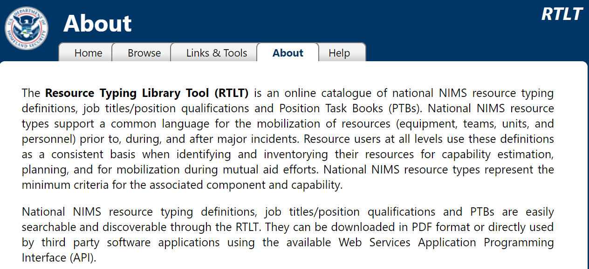
FEMA Resource Typing Library
https://rtlt.preptoolkit.fema.gov/Public/Home/About

Slide 5
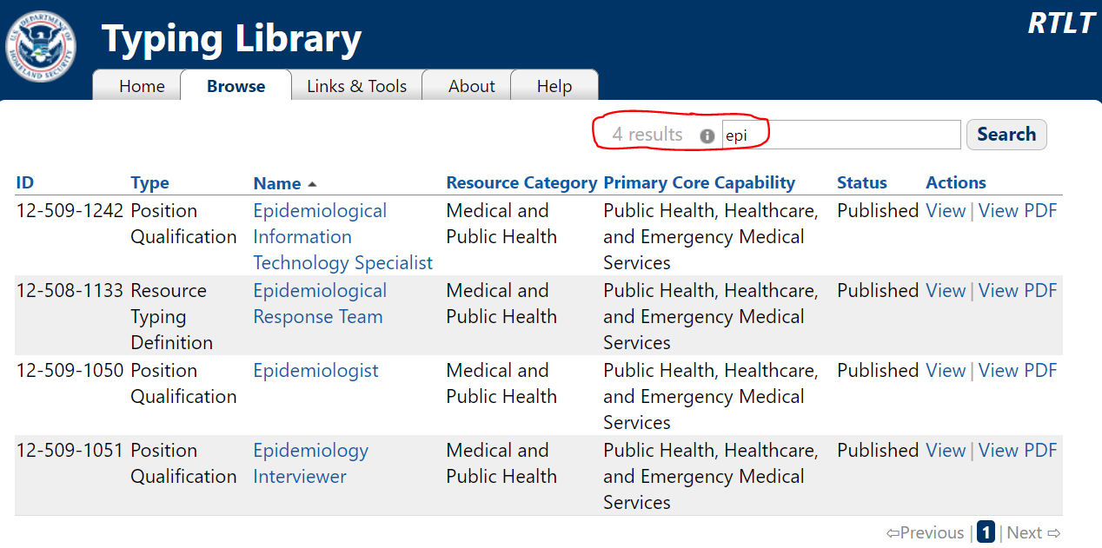
FEMA Resource Typing – “epi”

Slide 6
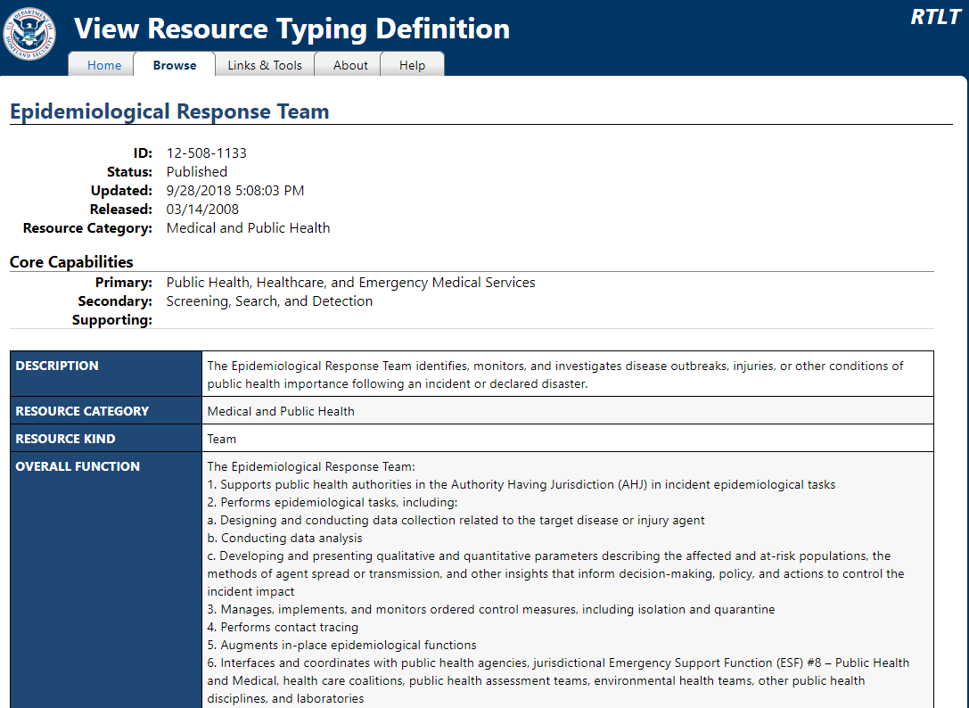

Slide 7
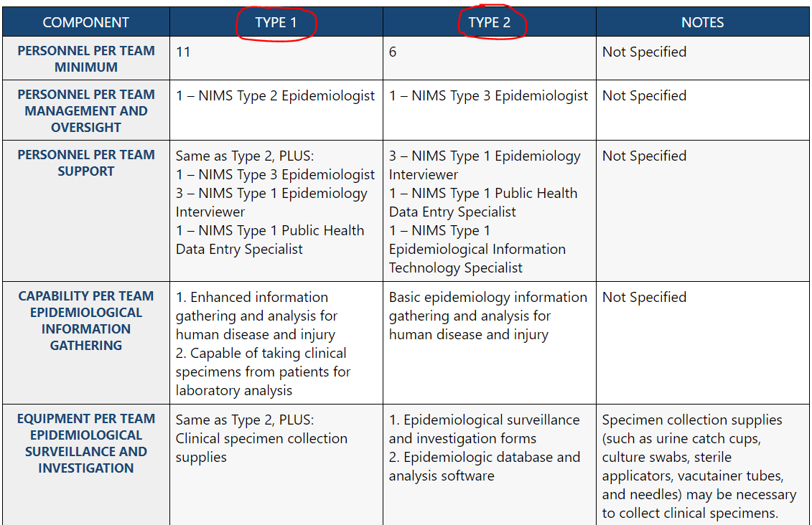

Slide 8
FEMA ERT Positions
Epidemiologist (FEMA ID: 12-509-1050)
  The Epidemiologist performs epidemiological assessment and analysis
Epidemiological Information Technology Specialist (FEMA ID: 12-509-1050)
  The Epidemiological Information Technology Specialist provides information technology support for epidemiological responses
Epidemiology Interviewer (FEMA ID:12-509-1051)
  The Epidemiology Interviewer collects data through interviews in order to determine the causes and the trajectories of diseases that have become epidemics
Public Health Data Entry Specialist (FEMA ID: 12-509-1240)
  The Public Health Data Entry Specialist enters and organizes public health data in a uniform format

Slide 9

WA Epidemiological Response Team (ERT)
Brief Overview
2019 Summer Training Season
121 DOH staff across all divisions have expressed interest in joining the ERT: info sessions, email, old member, etc.
46 members submitted applications and counting
Membership represented by all divisions
ERT members are: epidemiologists, supervisors, health service consultants, IT specialists, directors, etc.
Notes:
Welcome and introductions

Slide 10

Summer Training Season
June examples
  DOH IMT 101
  PHEP 101
  Complete ICS Basics
July examples
  Outbreak Epi Investigation Panel
  WDRS Outbreak Module training
August examples
  CDC Disaster Epidemiology Training

Slide 11
WA ERT Guideline Scope
WA DOH Annex 7, Appendix 1, ERT Guideline:
Provides the WA ERT concept of operations
Defines the Epi Response Team’s capability and capacity to support partners during an all-hazards event
Describes the Epi Response Team organization and strategic activities during steady state and response operations
Does not provide step-by-step instructions for tactical procedures carried out during response operations
  (ERT Operations Manual in development)
Notes:
The scope of the new ERT guideline is to:
Define ERT capability and capacity to support partner jurisdictions during an all-hazards event
It describes how the team is organized and the strategic activities during steady state and response operations
Does not provide step-by-step instructions for ERT members:
Although currently developing the ERT Operations Manual for tactical procedures during a response

Slide 12
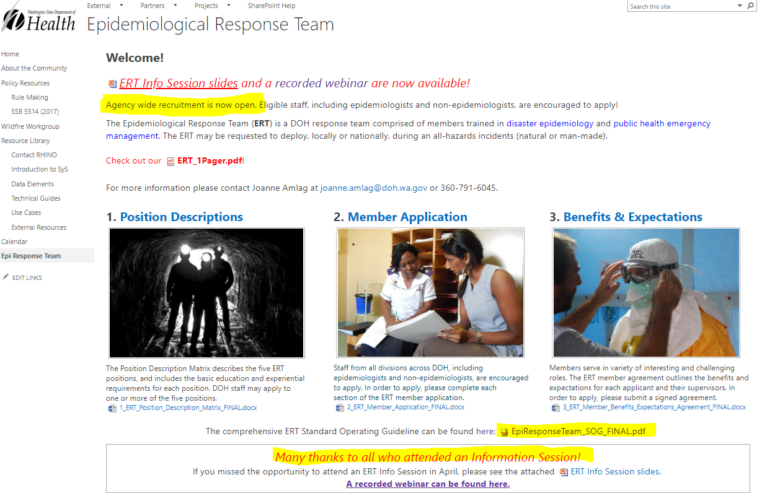

Slide 13
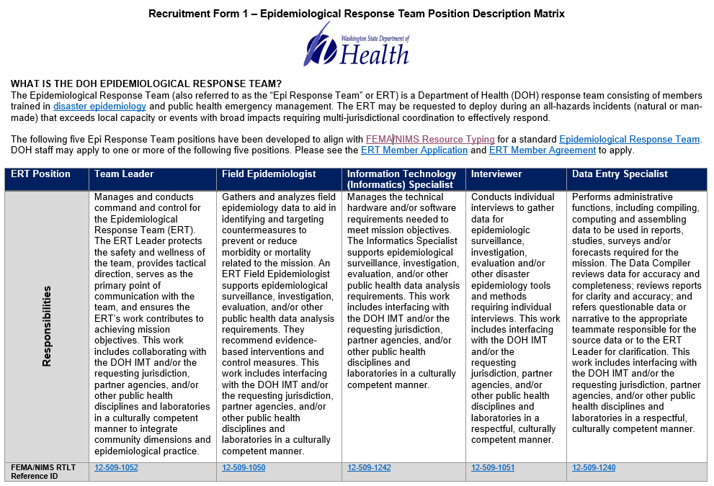

Slide 14
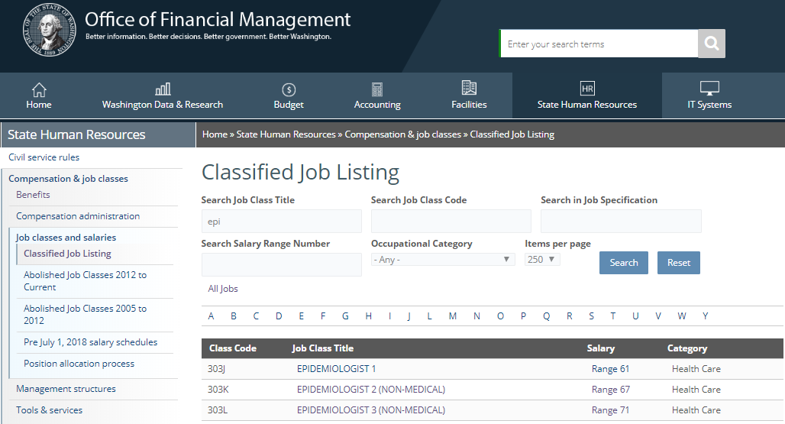
Mapping DOH Job Classifications

Slide 15

Mapping CSTE Competencies

Slide 16
ERT Positions
Staff can apply to more than one ERT position!
Team Leader
  Provides leadership for the team and interfaces with requesting jurisdiction/IMT
Field Epidemiologist
  Conducts surveillance, investigation, evaluation, and makes recommendations to mitigate health threats
Information Technology (Informatics) Specialist
  Provides basic hardware and software support for the ERT as well database guidance and development
Interviewer
  Gathers data to support effective epidemiology practice
Data Entry Specialist
  Performs administrative functions, enters and reviews data

Slide 17
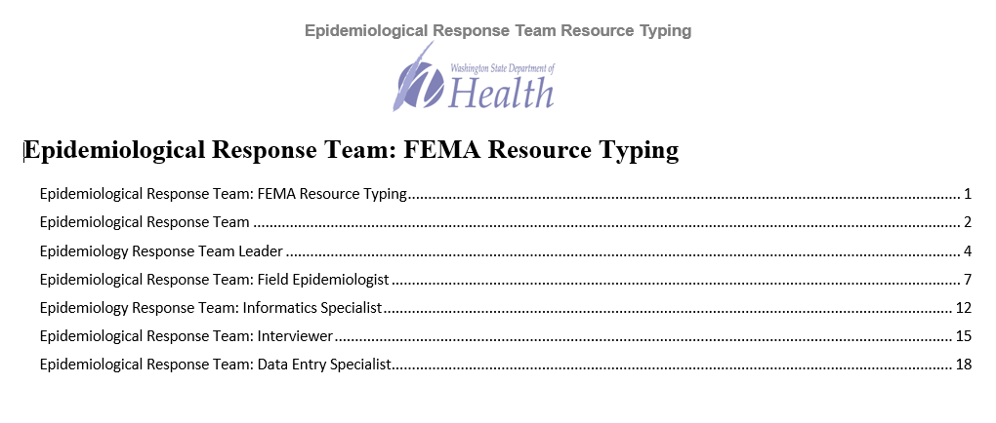
ERT Resource Typing Project – review

Slide 18
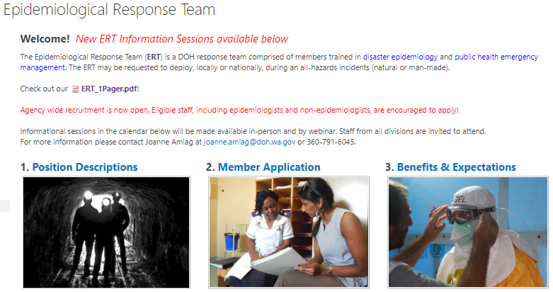


ERT SharePoint & Resources
Standard Operating Guidelines (aka the mothership ERT plan)
ERT SharePoint
ERT 1-pager
Position Descriptions
Member Application
Benefits & Expectations
ERT Newsletter
And many more!
Notes:
Current members: OCDE and OID
Future recruitment: DOH agency wide outreach, LHJs, Tribes, and key stakeholders/partners

Slide 19

We are only as good as our members
Joanne Amlag
Kevin Wickersham
Disaster Epidemiologist
Preparedness and Response Unit Supervisor
Office of Communicable Disease Epidemiology
Office of Communicable Disease Epidemiology

