Slide 1
eCR in Michigan
Developing Complementary Approaches

Slide 2
Overview of Approaches
Digital Bridge and Michigan’s Unified eCR Models

Slide 3
Digital Bridge
A national partnership between CDC, APHL, EHR Vendors, PHAs, and Healthcare Providers
eICRs to be triggered at EHR level, routed through a national decision-support intermediary (RCKMS) at APHL, and referred to the appropriate PHA, as applicable.
Current project covers five conditions: Salmonellosis, Chlamydia, Gonorrhea, Pertussis, and Zika

Slide 4
Digital Bridge
Michigan’s DB Participation
  Focuses on supporting local health department (LHD) clinics.
  Aim is to reduce the need to enter reports of communicable disease in both LHD clinic EHRs and in PHA reporting systems.
  EHR Vendor partner – Netsmart
    Will trigger eICR reports from LHD EHR (myInsight)
    Send eICRs to HIE (MiHIN) through normal message transmission process
  eICRS routed to APHL for RCKMS adjudication
  eICRs and/or RRs returned to HIE
  eICRs routed to PHA when reportable condition identified

Slide 5
Unified model
Initially conceived under the DB architecture
MiHIN will monitor existing CCDs exchanged across its interfaces
  These CCDs are exchanged as part of an existing use case with insurance coverage providers – hence ‘unified’ nature of models
When reportable condition contents are identified, MiHIN will generate eICRs
  eICRs are initiated based on sets of trigger codes using LOINC, SNOMED-CT, and ICD-10
eICRs will be directly routed to PHA as case referrals.

Slide 6




Traditional concept of eCR
Where eCR represents a “new” data stream, in addition to existing information exchange, that requires full end-to-end participation from healthcare providers through to PHAs.

Slide 7
Unified concept of eCR
This existing information exchange can be leveraged so as not to duplicate development efforts and to reduce burden on system actors.

Slide 8
Unified model
A change in both assumptions and constraints
    No longer accessing RCKMS
      Model is predicated on eICR triggering without more granular DSI adjudication
        However, this DSI adjudication could be implemented as an extension of this model.
      Opportunity to open model up to all conditions, not just five test conditions in DB
    eICRs no longer triggered at EHR-level. Triggering occurs at HIE level with existing data exchange.
    Development does not require active participation of healthcare provider community
    Development does not require active participation of EHR vendor community or additional development to existing EHR software.
    Model does require existing data exchange that can be leveraged for eICR generation (e.g., CCDs or other CDAs constrained to a C-CDA standard).
    Model does require intermediary agency (e.g., HIE) to act as central hub of both actors and data

Slide 9
MiHIN routing and eicr generation
Routing in Digital Bridge Model and eICR Generation and Routing in Unified Model

Slide 10




Digital Bridge eCR Pilot: Michigan Site
AIMS Platform
(APHL)
Referral
MDHHS
(Public Health Agency)
NetSmart
MiHIN
Electronic
Case Report
Catcher
This work made possible by funding from the Michigan Department of Health and Human Services
Copyright 2015-2018 Michigan Health Information Network Shared Services

Slide 11
Digital Bridge eCR Pilot: Non-Reportable
AIMS Platform
(APHL)
Referral
MDHHS
(Public Health Agency)
NetSmart
MiHIN
Electronic
Case Report
Catcher
This work made possible by funding from the Michigan Department of Health and Human Services
Copyright 2015-2018 Michigan Health Information Network Shared Services

Slide 12
Expanding on Digital Bridge Pilot
Michigan determined:
  EHR adoption of eCR standard may limit provider ability to participate quickly
  Mechanism needed to support providers whose EHRs do not yet produce eICRs
  Electronic Initial Case Report (eICR) template is partial subset of Continuity of Care Document (CCD)
  Majority of CCDs already flowing via HIN contain majority of eICR content
  Using CCDs to create eICRs at HIN is viable addition to eICR creation at EHR level
  Decided to use CCDs (from EHR) for eCR generation at HIN
    In addition to eICRs created by EHR at later date
This work made possible by funding from the Michigan Department of Health and Human Services
Copyright 2015-2018 Michigan Health Information Network Shared Services

Slide 13
Unified eCR Approach
Unified approach allows EHRs in process of adopting eCR standard to participate now because they can already create/send CCDs
EHRs unprepared to create eCRs can immediately rely on CCDs as mechanism for participation – accelerating adoption
Mechanism for using CCDs:
  CCDs sent after every patient interaction are matched against Trigger Codes built into HIN environment to determine if eICR is needed
  If trigger codes indicate eICR needed, eICR is created by extracting data from CCD
This work made possible by funding from the Michigan Department of Health and Human Services
Copyright 2015-2018 Michigan Health Information Network Shared Services

Slide 14
PHASE one: simple matching
Check CCD against list of trigger codes
  Initial match tells us message has potential to be reportable condition
  Parse out irrelevant information in CCD
    e.g. vital signs, allergies, other information not needed for eICR
  Convert relevant CCD information to eICR
  Generate reportability response (RR) - potentially with third-party vendor
  Route eICR and RR to public health agency as appropriate
This work made possible by funding from the Michigan Department of Health and Human Services
Copyright 2015-2018 Michigan Health Information Network Shared Services

Slide 15
PHASE two: complex matching
Perform simple matching exercise from phase one
Any CCD generating a match will be sent to the Micro Verification Service™ (MVS) for decision support and better accuracy in determining reportable conditions
For positive matches, generate RR and route to public health agency as appropriate
This work made possible by funding from the Michigan Department of Health and Human Services
Copyright 2015-2018 Michigan Health Information Network Shared Services

Slide 16

eICR Submission w/ Simple Match
Health Informatiion Network
Public Health Agency
EHR
Simple
Referral
UNIFIED
Case Report
Catcher
Apply simple rules and add Reportability Response
This work made possible by funding from the Michigan Department of Health and Human Services
Copyright 2015-2018 Michigan Health Information Network Shared Services

Slide 17

CCD Submission w/ Simple Match
Health Informatiion Network
Public Health Agency
EHR
Simple
Referral
UNIFIED
Case Report
Catcher
Apply simple rules and add Reportability Response
This work made possible by funding from the Michigan Department of Health and Human Services
Copyright 2015-2018 Michigan Health Information Network Shared Services

Slide 18

CCD or eICR w/ Complex Match
Micro-Verification service
Complex
Referral
Health Informatiion Network
Public Health Agency
EHR
UNIFIED
Case Report
Catcher
This work made possible by funding from the Michigan Department of Health and Human Services
Copyright 2015-2018 Michigan Health Information Network Shared Services

Slide 19
Setting ecr on FHIR®
Fast Healthcare Interoperability Resources (FHIR):
  Simpler to generate and to consume than CDA’s template representations
  Emerging standard of choice for clinical quality measures (FHIR ValueSet, Library, Measure, MeasureReport)
  Emerging standard of choice for clinical decision support (CDS Hooks)
  Standard of choice for new health information exchange applications
  Blues have committed to using FHIR resources going forward
Existing FHIR resources used for quality and decision support can also be used to specify eICR criteria & to package results

Slide 20
FHIR® valuesets and ecr
Current eICR criteria are defined by ValueSets of diagnosis codes (FHIR Conditions), lab order codes (FHIR Procedures), lab result codes (FHIR Observations) and observed organisms (FHIR DiagnosticReports)
The ValueSets tend to be large (over 2500 Salmonella organisms). A FHIR Pilot Interoperability Testbed populated with these ValueSets could be a Terminology Server for this information
  Easily populated
  Easily queried to see if a given code is in a given ValueSet
  Updatable via automated means

Slide 21
Clinical quality language and ecr
Current eICR criteria can be expected to incorporate more complicated logic as they evolve, e.g. to take temporal and familial relations into account
This will require an expression language to describe these more robust criteria
CQL is an ideal language in which to represent and communicate these criteria
Our FHIR Pilot Interoperability Testbed for Quality can store Libraries of these criteria and apply them to given patient data provided in a single client query
For example: already a nascent Zika CDS Hooks effort that we could leverage

Slide 22
PHA Processing and Provisioning to MDSS
Transport, Routing & Validation, Vocabulary Mapping and Translation, Ingestion into MDSS

Slide 23
Data flow - current
MLLP
+ HL7v2
Encapsulation
State Network
EHR
MiHIN
Datahub
Integration Engine + services
MDSS
APHL

Slide 24
Encapsulation
CDA
HL7v2 (Routable)
<ClinicalDocument xmlns:xsi="http://www.w3.org/2001/XMLSchema-instance" xmlns="urn:hl7-org:v3" xmlns:sdtc="urn:hl7-org:s
dtc" xsi:schemaLocation="urn:hl7-org:v3 CDA.xsd">
<realmCode code="US"/>
<typeId root="2.16.840.1.113883.1.3" extension="POCD_HD000040"/>
<templateId root="2.16.840.1.113883.10.20.22.1.1" extension="2015-08-01"/>
<id root="1.2.3.4.5.6.7.8.9.0.155" extension="15"/>
<code code="34133-9" codeSystem="2.16.840.1.113883.6.1" codeSystemName="LOINC" displayName="Summary of Episode N
ote"/>
<effectiveTime value="20171010132347"/>
<confidentialityCode code="N" codeSystem="2.16.840.1.113883.5.25"/>
<languageCode code="en-US"/>
<recordTarget>
<patientRole>
<id root="1.2.3.4.5.6.7.8.9.0" extension="15"/>
<addr use="H">
<state>OR</state>
<postalCode>97006</postalCode>
<city>Beaverton</city>
<streetAddressLine>1357 Amber Drive</streetAddressLine>
</addr>
<telecom value="555-723-1544" use="H"/>
<telecom value="555-777-1234" use="MC"/>
<patient>
<name>
<given>ALICE</given>
<given>JONES</given>
<family>NEWMAN</family>
</name>
<name>
MSH|^~\&|NextGenRosetta|Alpena|MCSR|MDCH|2016012708412||ORU^R01^ORU_R01|20160127||2.5.1|
PID|1|||||||F
OBR|1|12345^Encapsulation Placer ID|121212^Encapsulation Filler ID|ENDOC^EncapsulatedDocument^L|||20160127084129|||||||||||||||0000|||F|
OBX|1|ST|MD5^MD5 Message Digest^L||9a6fa2bccd687690b8c201a9f64b1f53||||||F |||20160127084129||||||||||
OBX|2|NM|LEN^Message Length^L||2236||||||F |||20160127084129||||||||||
OBX|3|ED|Content^Message Content^L||CDA Content^application^text/xml^Base64^PD94bWwg ..<more data>.. Rob3I+DQo=||||||F |||||||||||||
Base64 Encoded
data

Slide 25
Data flow - updated
XDR / Direct
Messaging
State Network
EHR
MiHIN
Datahub
Integration Engine + services
MDSS
APHL

Slide 26
Integration processing
State Network
Integration Services – Rhapsody, Java
Data
Hub
MDSS
Un-encapsulation
Validation
Mapping
And
Translation
VADS
Message +
Validation

Slide 27
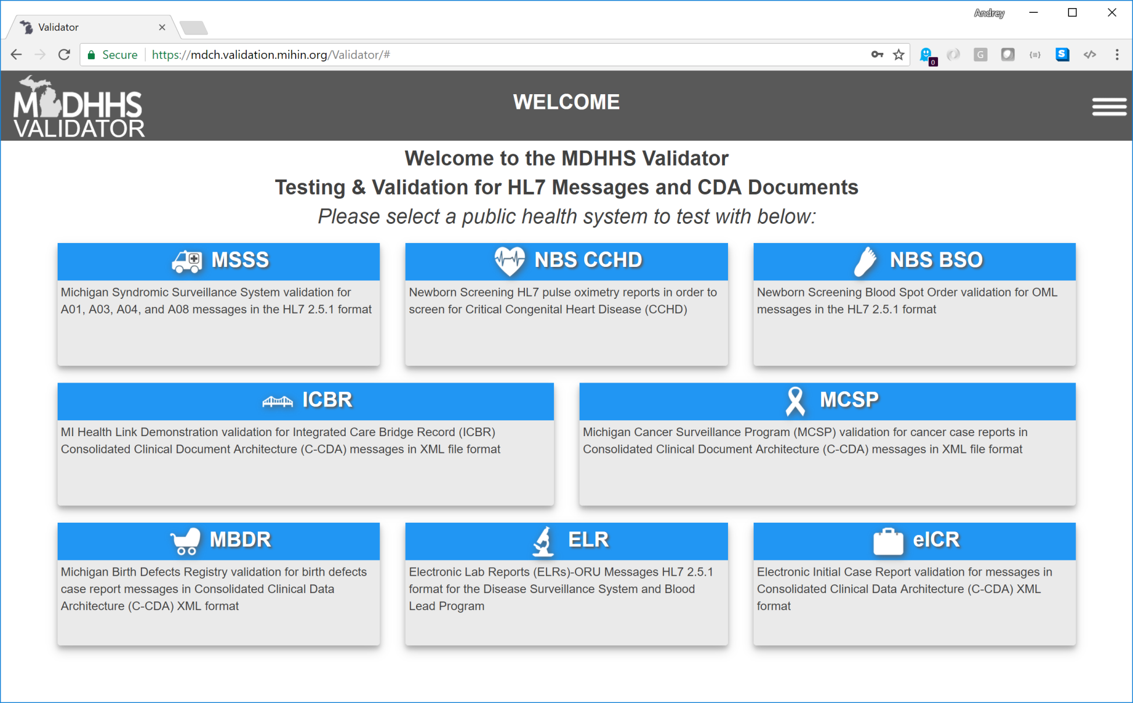
Validation

Slide 28
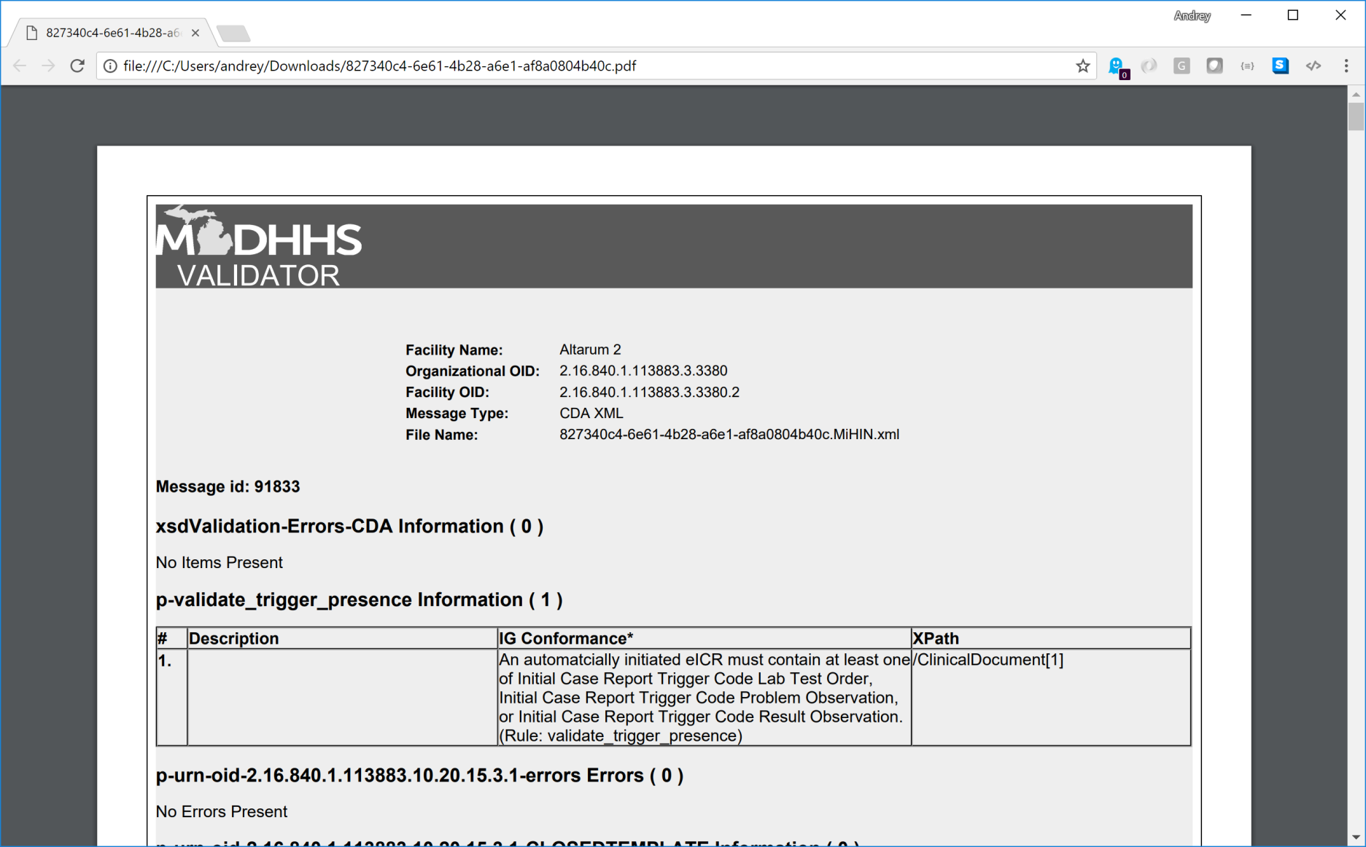
Validation

Slide 29
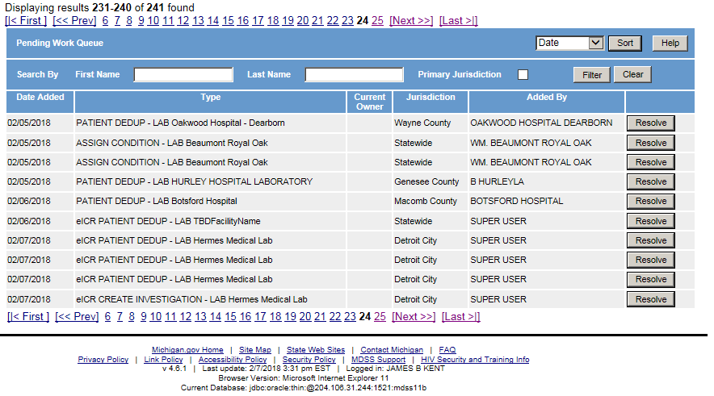
Ingestion into Mdss

Slide 30
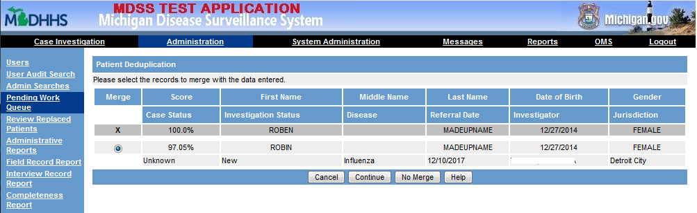
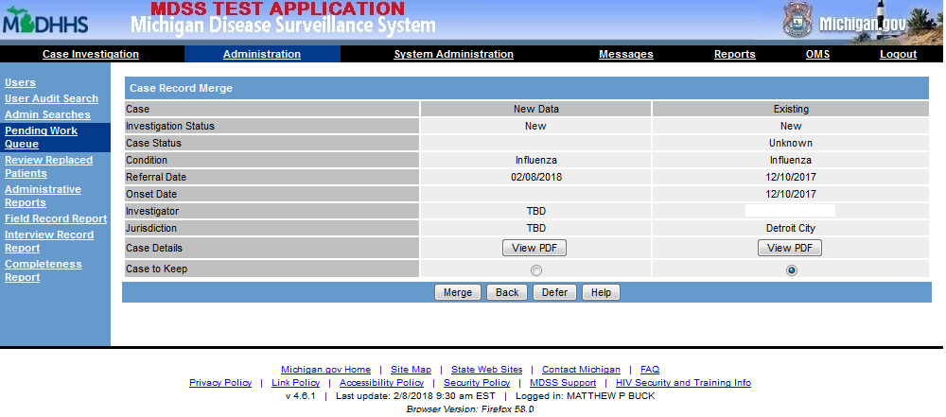
Case handling
Patient
Deduplication
Case
Deduplication

Slide 31
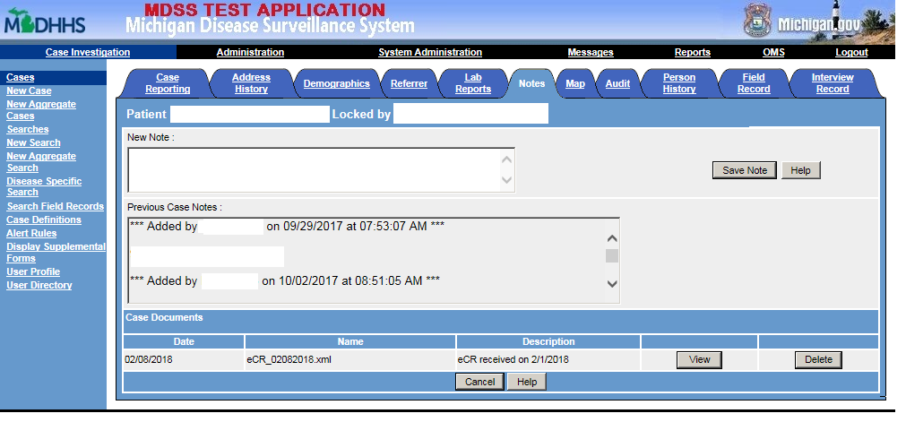
eCR Listings

Slide 32
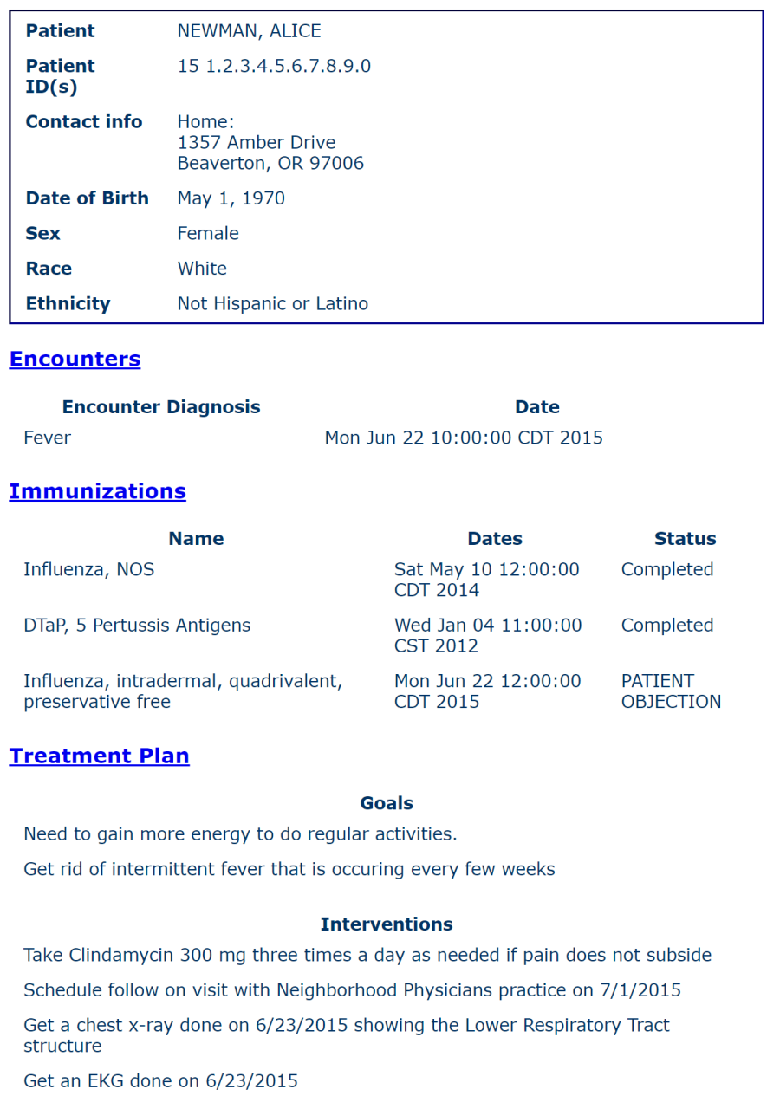
Ecr Rendering for users
Store original eCR report
Linked to case
Available for user viewing
Available for later remapping to capture new data

Slide 33
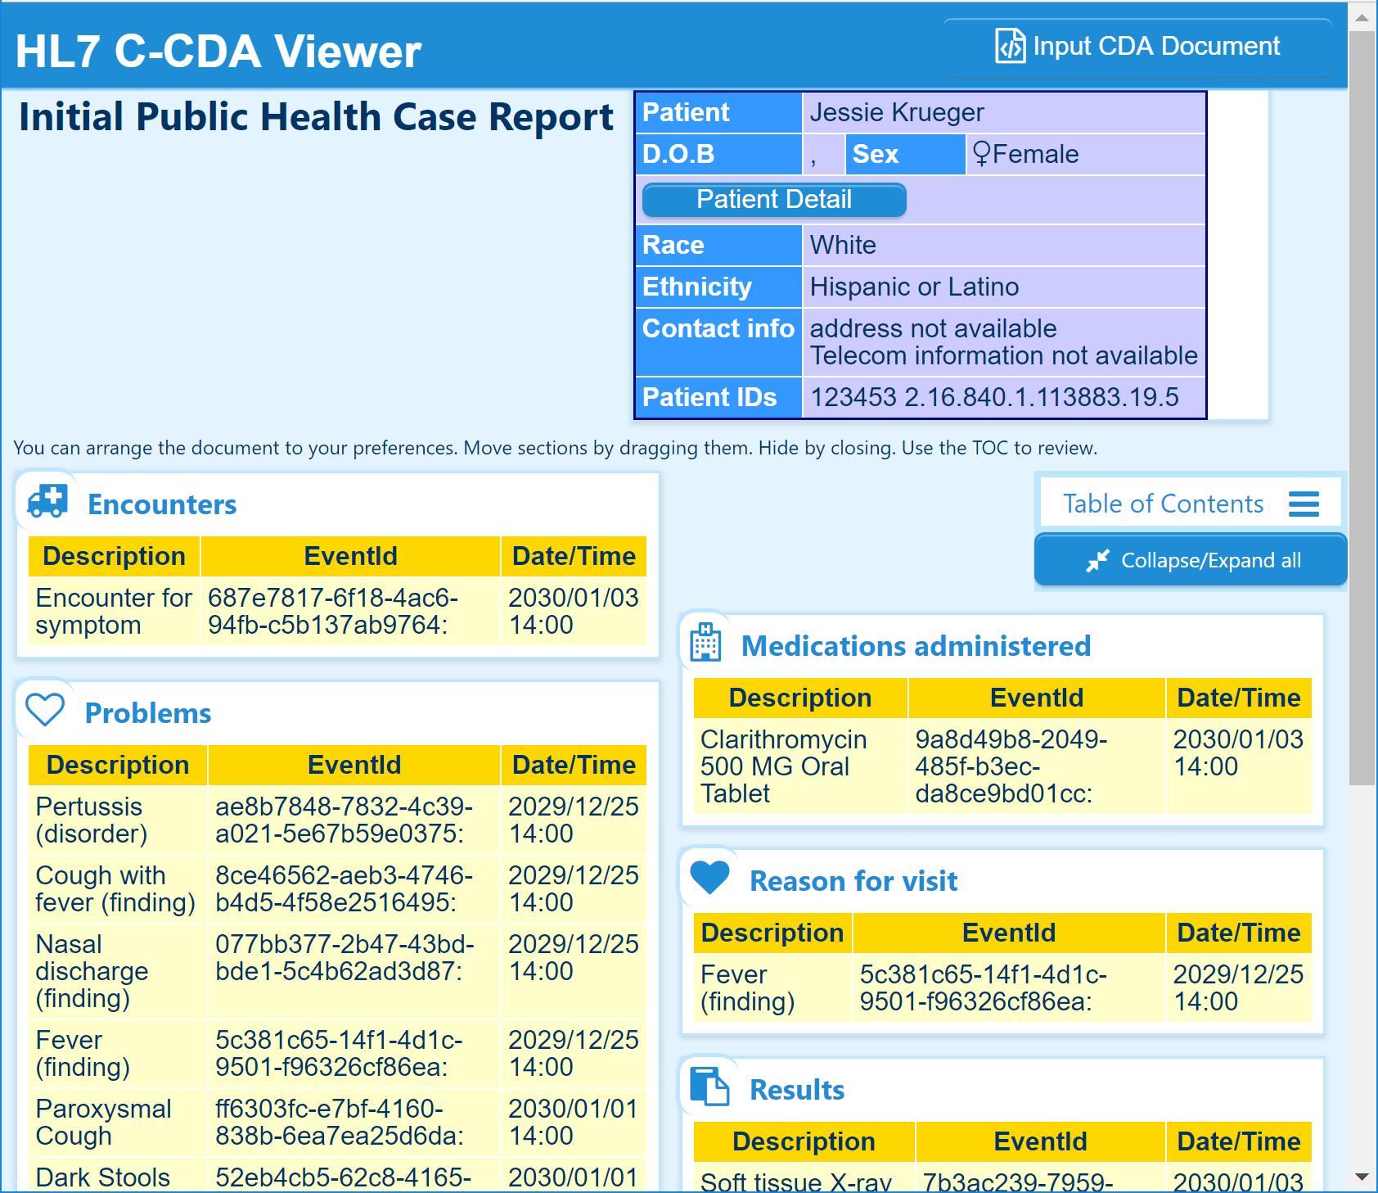

Slide 34
Questions?
Additional questions and comments can be sent to:
  E-mail: mdhhs_mdss@michigan.gov
  Phone: 517-335-8165
Thank you!

