Slide 1
Communities of Practice 101
Presented by Michael A. Coletta, MPH
Prepared by Deborah W. Gould, PhD
Division of Health Informatics and Surveillance
Centers for Disease Control and Prevention
December 9, 2014
Center for Surveillance, Epidemiology, and Laboratory Services
Division of Health Informatics and Surveillance

Slide 2
What is a Community of Practice?
A Community of Practice (CoP) is defined as “a group of people who share a concern, a set of problems, or a passion about a topic, and who deepen their knowledge and expertise by interacting on an ongoing basis.”
Wenger E, McDermott R, Snyder WM. Cultivating Communities of Practice.
Harvard Business School Press. Boston, MA. 2002
Communities of practice are groups of people who come together to share and to learn from one another face-to-face and virtually. They are held together by a common interest in a body of knowledge and are driven by a desire and need to share problems, experiences, insights, templates, tools, and best practices.
APQC’s Best-Practice Report. Successfully Implementing Knowledge Management
American Productivity & Quality Center, 2000

Slide 3
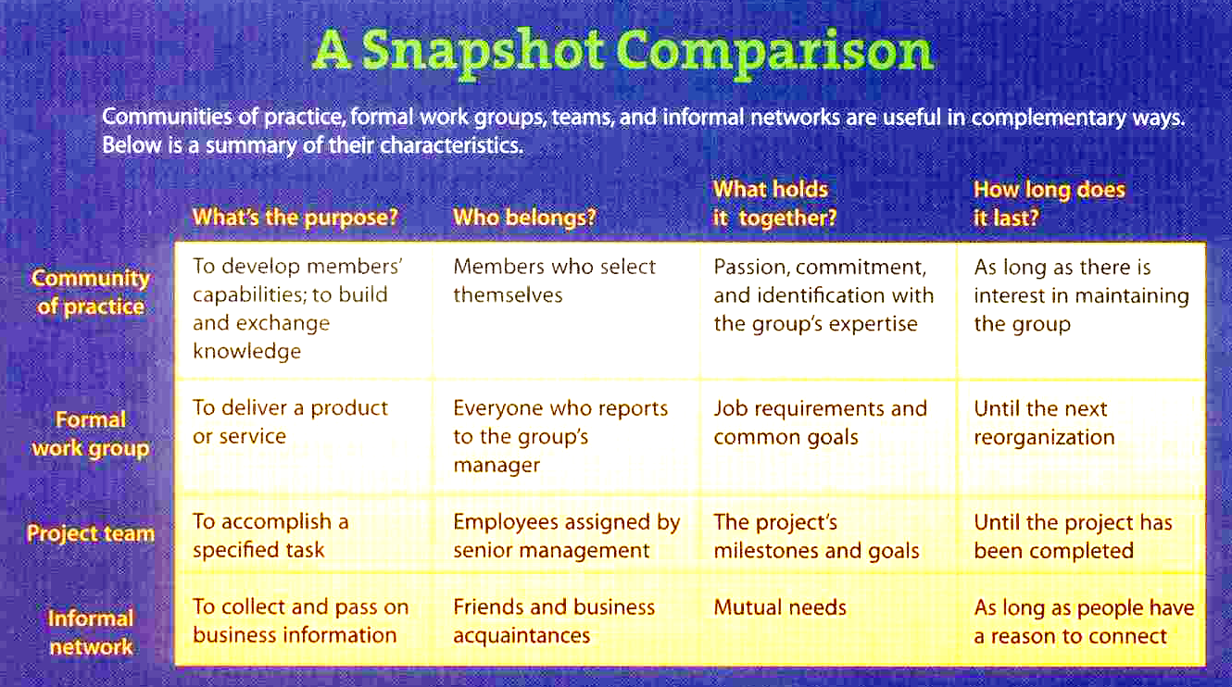
CoPs Aren’t Teams or Workgroups
Wenger E, Snyder WM. Communities of practice: The organizational frontier. Harvard Business Review. Jan –Feb 2000

Slide 4
Three Distinct Elements of a CoP
Domain
Practice
Community
Topic of shared
interest/passion
Relationships among
members & sense
of belonging
Body of
knowledge,
tools,
methods,
stories, etc
Notes:
Three distinct elements that comprise a CoP:
A community that enables interaction (such as discussions, collaborative activities, and relationship building)
A shared domain of interest (such as syndromic surveillance)
A shared practice of experiences, stories, tools, and ways of addressing recurring problems

Slide 5
Key Characteristics of a CoP
A focus on building and sharing knowledge among practitioners vs. delivering a produce or service to customers
A reliance on interest, relationships, and shared experiences, as opposed to dependence on formal rules and job descriptions.

Slide 6
Value of a CoP
 | Short-term Value | Long-term Value
Members | Means to share experiences Access to SMEs Access to tools, resources Peer-to-peer mentoring Technical assistance Sense of belonging | Enhanced network of colleagues Published documents/tools from collaborative efforts Sense of professional identity
Organization | Arena for problem solving Knowledge sharing Improved communications with partners Enhanced coordination & standardization Shared tools, resources Enhanced technical assistance | Strategic capabilities Well trained workforce Efficient use of resources Increased capacity to conduct syndromic surveillance Established system for providing technical assistance

Slide 7
Levels of Participation in a CoP
Rarely participate
Peripheral
Interactions
Formal
Informal
Virtual
Participate when interested
Occasional
Active
Practitioners
Core
Group
Lead & coordinate
Notes:
Core group: key leaders/decide the learning agenda/meets regularly. Success of CoP depends on them.
Active participants: members who are recognized as practitioners and define the community. They may attend meetings regularly and participate in community forums, but without the regular intensity of the core group.
Occasional participants: members who only participate when the topic is of special interest or when they have something specific to contribute.
Peripheral participants: people who have a sustained connection to the community but are on the peripheral and rarely participate. They generally make up the largest portion of community members.

Slide 8
Ten Commandments of CoP Governance
Stick to strategic objectives
Divide objectives into sub-topics
Form governance committees with sponsors and CoP leaders
Have a sponsor and CoP leaders who are ‘best practice” control agents.
Regularly feed the CoP with external expertise
Promote access to other intra and interorganizational networks
CoP leaders must have a driver and promoter role
Overcome hierarchy-related pressures
Provide Champion/sponsor with measurable performance
Illustrate results for CoP members
Probst G. Borzillo S. Why communities of practice succeed and why they fail. European Mgmt Journal (2008) 26, 335-347

Slide 9
5 Main Reasons CoPs Fail
Lack of a core group
Low level of one-to-one interaction between members
Rigidity of competencies (e.g. reluctance to learn from others)
Lack of identification with the CoP
Practice intangibility (e.g. failure to illustrate the practice)
Probst G. Borzillo S. Why communities of practice succeed and why they fail. European Mgmt Journal (2008) 26, 335-347

Slide 10
Suggested Next Steps to Formally Launch NSSCoP
Establish a Core Group to drive establishment of the CoP
  Explore evolving the role of the BGG to become the Core Group; re-assess membership and community representation
  Develop charter with mission, goals, objectives, scope, etc
  Establish rules of engagement
  Create website, communication plan, and knowldege repository
Gather community requirements and opportunities for quick wins
Developed timeline aligned with availability of resources
Align public health partners activities to support the CoP
Evaluate/monitor progress

