Slide 1
CSTE Mentorship Program Orientation
Jessica Arrazola, DrPH, MPH, CHES
CSTE Senior Program Analyst

Slide 2


CSTE Team
Jessica Arrazola
Mia Israel

Slide 3
Objectives
Outline the CSTE Mentorship Program Structure
Describe at least two strategies to facilitate e-mentoring
Describe at least two mentoring best practices

Slide 4
Program Structure

Slide 5
Mentorship Program
Background
Purpose
  Provide an opportunity to build relationships and foster shared learning among applied epidemiologists
Goal
  Promote the exploration of STLT career opportunities

Slide 6
Mentorship Program Structure
9 month program October 2017 through June 2018
  Developed based on lessons learned from our fellowships, the published literature on mentorship, and the 2017 pilot program
54 mentors and 72 mentees matched across the country

Slide 7
Stages of Mentoring Relationships
Timing | Stages | Challenge | Activities
Beginning | Initiation and goal setting | Develop rapport | Share background experiences, values, and learning preferences. Identify relationship purpose or goals.
Middle | Cultivation | Learn to collaborate | Select a topic or activity on which to collaborate
End | Separation and redefinition | Reflect and grow | Reflect on lessons learned, identify future professional development needs Transition to relationship that is collegial, friendship, or ad hoc. Check in occasionally to maintain the connection
Adopted from Lunsford, L. (2016). A handbook for managing mentoring programs. (p. 100).
Notes:
Kram (1985) first identified stages of mentoring relationships in her qualitative study of 18 mentoring dyads in a large utility company. She found that mentoring partners moved through four stages in their mentoring relationship: initiation, cultivation, separation, and redefinition
The stages proceed in order but may overlap. Mentoring relationships progress through stages. They are marked by a beginning, middle, and end. Mentors and mentees will benefit from understanding that different tasks are required in each stage.

Slide 8
Mentorship Program Structure
“Live Events”
  October Orientation
  November “Applying for Epidemiology Jobs” Webinar
  Other Early Career Professionals-sponsored webinars TBD
Tasks (Complete November-June)
  Self-assessment
  Goal setting exercise
  Leadership Teachable Point of View exercises
  Implementation intention exercise
Activities
  “Meet” between mentor and mentee at least three times during the program
    Strongly suggest first meeting is by phone or skype
    Can also communicate by email, instant messenger, or skype
  Newsletters will be sent monthly with activities and suggested discussion topics
  Half way point check in by email
  Evaluation
    Provide feedback for program improvement
Potential opportunity for sponsored travel to 2018 CSTE Annual Conference

Slide 9
Self-Assessment
Purpose
  Intended to help mentors and mentees reflect on how they work with others and what they bring to the relationship
Format
  Two brief questionnaires
    Working style
    Communication style
  Independent and self-scored
  Question prompts will be provided to guide discussion once both parties complete

Slide 10
Goal Setting
Purpose
  Intended to guide mentors and mentees through the process of establishing the mentoring relationship
  Think about what you want out of the relationship but also what strengths you can bring to it
Format
  Independent worksheet
  Some additional questions only for mentees to consider
Mentors and mentees should compare and discuss once complete in order to develop common rules and goals for the relationship

Slide 11
Leadership Teachable
Point of View (LTPOV)
Purpose
  Reflect on your personal leadership journey and values as an individual
  Helps mentors/mentees get to know one another and connect on an interpersonal level
Format
  Two exercises, spread out over 2 months
    Leadership Journey Line- reflect on where you’ve been and where you want to go in your leadership journey
    Values Exercise- identify your core values
Mentors and mentees should set a time to discuss each exercise once complete

Slide 12
Implementation Intention
Purpose
  Develop a list of intentions outlining how you will implement the lessons learned in the program in the workplace/your future career
Format
  Independent action planning form
  Can be adapted to fit individual needs
Mentors and mentees should compare and discuss once complete

Slide 13
E-Mentoring

Slide 14
Face-to-Face Mentoring
Advantages
Disadvantages
Stronger bond
Non-verbal communication
Immediacy of response
One mentor
Limited by location and not skill set or need
Notes:
http://work.chron.com/facetoface-vs-virtual-mentoring-3464.html
Advantages
1.) mentor and mentee are able to form a stronger bond because of the personal nature of the in-person meeting.
2.) They can use non-verbal communication to emphasize and explain main points, instead of having to interpret them through text alone.
3.) The co-worker is also able to get immediate responses to questions, instead of having to wait for the mentor to type a reply.
Disadvantages
1.) In face-to-face mentoring, a co-worker is only able to benefit from the guidance of one mentor, which can limit his growth potential.
2.) Mentors are limited to those in that location, regardless of whether or not their skill sets match her needs.
3.) It can also be challenging to coordinate the schedules of two different people, so it can be difficult to find times to meet regularly.

Slide 15
Virtual Mentoring
Advantages
Disadvantages
Location doesn’t matter
Connect with SMEs
Time efficient
Messaging & written communication
Difficult to build relationship
Lack of accountability
Coordinate communication
Notes:
http://work.chron.com/facetoface-vs-virtual-mentoring-3464.html
Advantages
1.) In virtual mentoring, location is not involved.
2.) Mentors who can offer specific guidance that a particular employee is looking to find can connect with that person virtually.
3.)Virtual mentoring is very time efficient because there is no travel time involved in getting to meetings, and both people can respond to messages at their own convenience.
Disadvantages
1.) In virtual mentoring, the people involved do not have the opportunity to create a bond built by physically meeting to spend time together. It can be very difficult to build a meaningful relationship through email.
2.) It’s much easier for either party not to take the mentoring relationship seriously because there is little accountability in a virtual setting.
3.) Constraints caused by living different time zones can also make it difficult to get timely responses to questions.

Slide 16
How to Mentor at a Distance
Allow time to build the relationships
Plan ahead
Listen actively and avoid interruptions
Use technology for better communication
Take extra time to understand how business and culture are different where the other person lives
Anticipate needing to manage communication across time zones
Rely more on writing to clarify details not understood in conversation
Notes:
https://www.micromentor.org/learn-more/mentoring-distance

Slide 17
Mentoring & Coaching Skills
Create an open and supportive climate for discussion
Demonstrate good listening/follow-up skills
Provide constructive feedback and advice
Notes:
http://www.asha.org/students/mentoring/coach/
1. Create an open and supportive climate for discussion
Seek to develop trust by encouraging open, two-way communications; this often means sharing personal experiences or difficult times you went through so that the mentee knows she or he can discuss tough issues.
Respect the mentee's individuality. Your mentee may or may not have a similar style.
Be patient if your mentee seems unfocused-help her or him focus by presenting and discussing options.
Make it clear that you hope to learn from this experience.
2. Demonstrate good listening/follow-up skills
Most of us need to improve our listening skills; we tend to talk more than we listen and to interrupt people more than we should.
Ask open-ended questions to get your mentee to open up as much as possible (Examples: How did you decide to major in communication sciencesand disorders? What are your longer term goals?)
After you have listened fully to a response, ask good follow-up questions to demonstrate genuine interest. (Example: After you've completed yourinternship, what do you hope to do next to move to the next step?)
If you do not understand something, try to paraphrase it to be sure you understand what the person is trying to say. (Example: So what I thinkyou're saying is that you want to broaden your knowledge of opportunities)
After you've discussed an issue in one conversation, be sure to ask how the situation has progressed next time you write an e-mail or talk.
Don't assume that what worked for you will work for your mentee; rather, try saying something like, "My experience was (xxx). What do you think will work for you?"
3. Provide constructive feedback and advice.
It is important for you to match the degree of openness of your mentee. Do not give negative feedback until you have built a strong relationship and the mentee is ready to receive it.
Give a balance of both praise and constructive feedback on how to improve.
Always focus on behaviors that can be changed (not personality traits!) and behaviors that are appropriate within the organization/field/environment.
Let your mentee set the initial goals and then give feedback and suggestions.
Help your mentee make goals specific and realistic with target dates; monitor progress, help her him or her adapt plans when necessary, and provide ongoing encouragement.
Do problem solving with your mentee when issues/barriers arise. Do not feel that you have to have all the answers but rather help your mentee think through strategies and options.
Consider and discuss additional ways for your mentee to get advice and information he or she needs. Call on other mentors/colleagues when appropriate and try to help your mentee widen his or her network.

Slide 18
Mentoring Best Practices

Slide 19
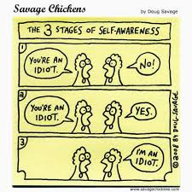
Increase your awareness of yourself and others
Notes:
*Mentoring and communication
http://www.ohsu.edu/xd/education/schools/school-of-medicine/faculty/mentoring/mentoring-best-practices/communication/index.cfm
You are the instrument through which mentoring happens, both as mentor and mentee. The more you are clear about your own agenda and able to separate out your own thoughts, feelings, and wants from those of your mentor/mentee, the greater the potential for intentional partnership and mutual benefit.
"In each moment you spend in another person's presence, you are communicating that person's importance to you. Are you doing this consciously or unconsciously?" Denise Holmes

Slide 20

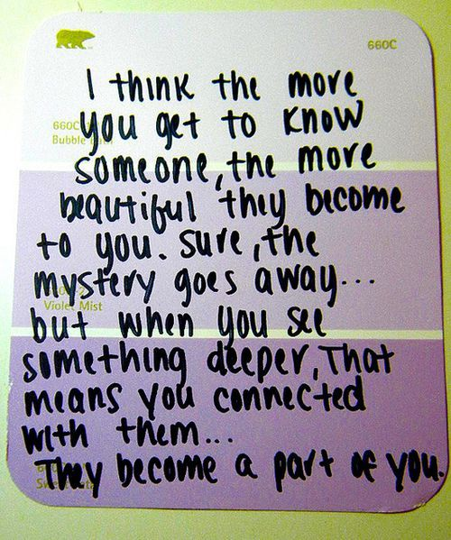
Get curious about the other person’s story
Notes:
http://www.ohsu.edu/xd/education/schools/school-of-medicine/faculty/mentoring/mentoring-best-practices/communication/index.cfm
Listening in order to learn something new (rather than to confirm what you already know) is essential to good mentoring. When you get curious about the other person’s story, you open up the possibility of greater connection and value for both parties.
"In order to understand what another person is saying, you must assume that it is true, and try to imagine what it could be true of." George Miller
http://www.dtelepathy.com/blog/wp-content/uploads/2012/10/featureimage.jpg

Slide 21
Barriers to Effective Communication
Defensiveness or premature assumptions
Judgments based on cultural differences or interpersonal relationships
Mixed messages
Notes:
http://www.ohsu.edu/xd/education/schools/school-of-medicine/faculty/mentoring/mentoring-best-practices/communication/communication-barriers.cfm
Defensiveness or premature assumptions
Problem: A defensive listener will be less able to "hear" what the speaker is saying. In some cases, instead of listening, a person is thinking about why an interaction is occurring or perhaps preparing a response to a message that he or she hasn't heard. By making assumptions about the speaker and the reasons that a conversation is taking place, the listener keeps him/herself from paying attention to the real message.
Solution: The listener should not presuppose that he or she knows the reason for or the basis of the communication, nor should the listener feel defensive without knowing what is being said. Being open and nonjudgmental will allow the listener to truly hear what is being said.
Judgments based on cultural differences or interpersonal relationships
Problem: This problem goes hand in hand with that of making assumptions. In this case, the problem involves presupposing things about another person based on cultural differences and personal associations. This can result in not hearing a message or misinterpreting the message.
Solution: It's important for the speaker and listener to be open with each other to dispel assumptions and biases. For this to happen, it may be useful to address biases straight on in an open dialogue. By revealing and discussing biases and assumptions, it is possible to minimize their negative impact and thereby communicate more fully and effectively.
Mixed messages
Problem: A conversation that conveys contradictory messages or conflates the intended message with extraneous issues can cause confusion, concern, or resentment.
Solution: Before speaking, people should think carefully about the points to be made. Written talking points can be useful in this regard. If there are multiple messages to convey (perhaps some positive and some negative messages), it may be better to present them on separate occasions or in different environments. Conveying only one message at a time can help avoid confusion and misunderstanding. [ds1]If at all possible, this kind of formatting works best in definition list style. We may want to talk about it. [KWM2]Sure. I'd like to see what it is. I think this is hard to read as it is…

Slide 22
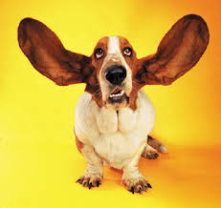
Listen for passion and potential
Notes:
http://www.ohsu.edu/xd/education/schools/school-of-medicine/faculty/mentoring/mentoring-best-practices/communication/index.cfm
Great mentoring means understanding what makes the other person tick, what has brought them to this moment in their career, and where they would like to go next.
"Listening for potential means listening to people as if they have all the tools they need to be successful, and could simply benefit from exploring their thoughts and ideas out loud." David Rock
https://media.licdn.com/mpr/mpr/shrinknp_400_400/p/8/000/234/004/386bf30.jpg

Slide 23
Active Listening Strategies
Maintain eye contact with the speaker while he or she is talking
Avoid distractions
Stop all other activities
Pay attention to what the speaker is saying
Ask for clarification
Summarize what the speaker has said
Pay attention not only to the words but also to the feelings behind the words.
  By referring to the speaker’s feelings “It seems that you are angry about…”, you can make it clear that you understand what the speaker is saying and also understand the speaker’s feelings about the topic.
Notes:
http://www.ohsu.edu/xd/education/schools/school-of-medicine/faculty/mentoring/mentoring-best-practices/communication/active-listening.cfm
Active listening is an art that can be learned. Often, when you listen to another person speak, you are listening to some extent but you can also be distracted and engaged in other pursuits –thinking about something else, looking around, typing, listening to others, reading, etc. Sometimes, you assume that you know what the speaker is going to say and you start to formulate a response, rather than paying complete attention to what they are saying in the moment. Active listening involves forgoing all other activities for the time being and giving your full attention to the act of listening to ensure that you understand the speaker's intent as well as the feelings behind the speaker's words.

Slide 24

Share your own crystallized experience
Notes:
http://www.ohsu.edu/xd/education/schools/school-of-medicine/faculty/mentoring/mentoring-best-practices/communication/index.cfm
One of the pleasures of mentoring is the chance to share one’s own hard-earned experience so that it might be helpful to others coming along a similar path.
"Ecologists tell us that a tree planted in a clearing of an old forest will grow more successfully than one planted in an open field. The reason, it seems, is that the roots of the forest tree are able to follow the intricate pathways created by former trees and thus imbed themselves more deeply. This literally enables stronger trees to share resources with the weaker so that the whole forest becomes healthier. Similarly, human beings thrive best when we grow in the presence of those who have gone before." Parks Daloz
http://www.jokesmania.com/wp-content/uploads/2015/12/share4.png

Slide 25
Discussion Topics
Manage conflict within the office or unit
Career progression
Networking
Influencing others
Managing politics in the office and organization
Newest trends in technology
Time management
Work/life balance
Leadership development

Slide 26
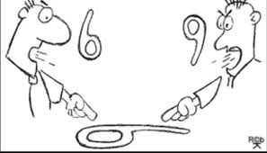
Be aware of your own assumptions
Notes:
*Mentoring across differences
http://www.ohsu.edu/xd/education/schools/school-of-medicine/faculty/mentoring/mentoring-best-practices/mentoring-across-differences/index.cfm
In the same way that others may have different points of view because of differences in their life experiences, you likely have been shaped by your gender, race, social class, education, generation, geography, and a multitude of other cultural influences. Increasing your awareness of the ways you are a product of your past can help you avoid assuming that others see the world in the same way.
https://media.licdn.com/mpr/mpr/AAEAAQAAAAAAAARRAAAAJDcyZDI3MDk0LWFkYTktNDg1ZS04NTY4LWQ0M2ZmMmYxMTc0Yw.png

Slide 27
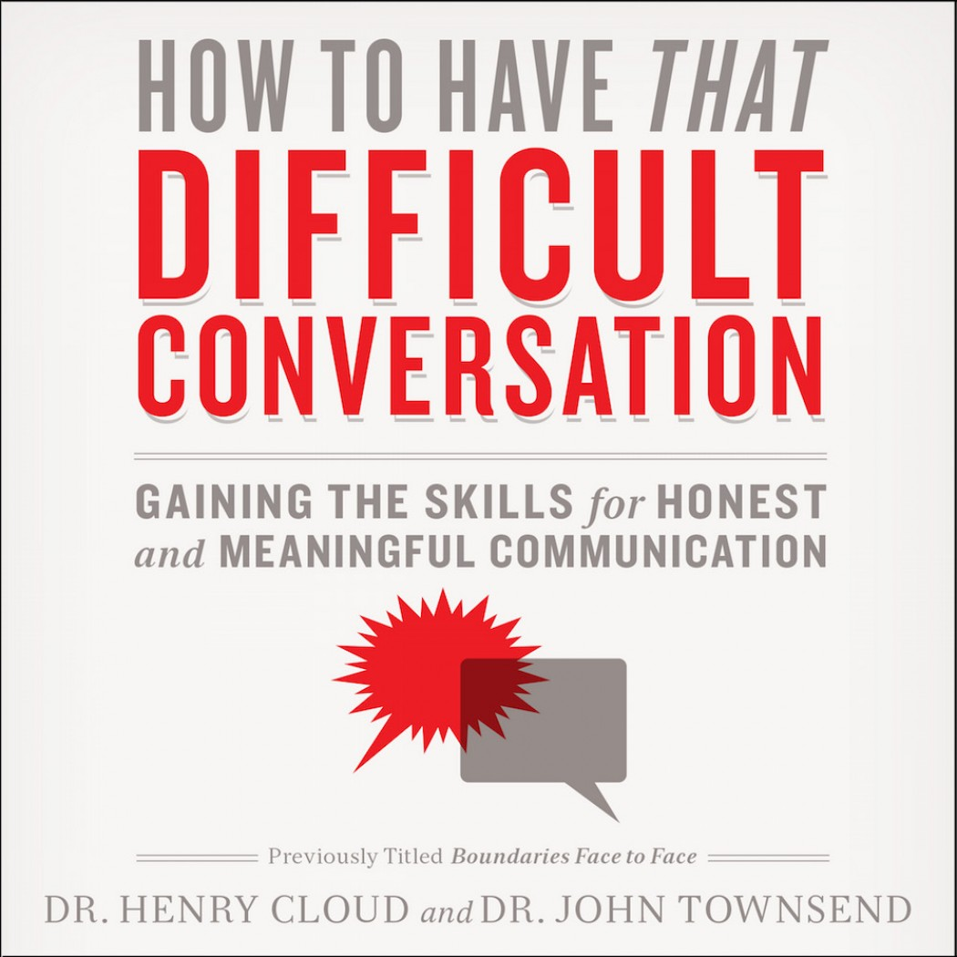

Address differences openly
Notes:
http://www.ohsu.edu/xd/education/schools/school-of-medicine/faculty/mentoring/mentoring-best-practices/mentoring-across-differences/index.cfm
Relationships in which it becomes comfortable to talk about and acknowledge differences have much greater potential value for both mentor and mentee. While it may initially feel uncomfortable to talk about topics such as race, gender, and/or socioeconomic background, the potential for increased understanding and connection makes it worth the risk.
https://adobe99u.files.wordpress.com/2014/07/cringe.jpg?quality=100&w=550&h=273
http://christianaudio.com/media/catalog/product/cache/1/image/1050x1050/170ec19af00183b5e0368529fc2daa2f/9/7/9780310342564.jpeg

Slide 28
If things aren’t going as you expected, what do you do?
What is the challenge?
  Interpersonal or task-oriented
What can you do to improve the situation on your own?
  Did it work? If not, what other options are available?
Let CSTE know about your challenge
  CSTE can only address challenges if we are aware of them

Slide 29
FAQs
Is there an online platform for the CSTE Mentorship Program?
Will CSTE be available to provide additional support and resources to mentors and mentees if requested?
How can mentors connect to share ideas and resources amongst themselves?
Notes:
Is there a Facebook/Linked in group?
Mentors might need technical support or specific expertise- can CSTE help with this?
Mentor calls/check-ins/a forum would be helpful

Slide 30
Q & A
What questions do you have?
What would you like to discuss with the other mentors and mentees on the phone today?
What else can CSTE provide to support your participation in the mentorship program?
Reminders:
  Complete webinar eval as you exit
  Send any questions, comments or concerns to Jessica Arrazola (Jarrazola@cste.org)

Slide 31



CSTE National Office
2872 Woodcock Boulevard, Suite 250
Atlanta, Georgia 30341
770.458.3811
770.458.8516
Jarrazola@cste.org

