Slide 1
COVID-19
IRB Resources
CSTE IRB Workgroup Call
18 May 2020

Slide 2
OHRP COVID-19 guidance
08 April 2020
Public Health and Clinical Activities: Actions taken for public health or clinical purposes, and not for research purposes, are not research procedures and therefore do not require institutional review board (IRB) approval before being implemented.
  Surveillance
  Legally required reporting
Research Changes to Eliminate Apparent Immediate Hazards:
  It is expected that investigators are cancelling or postponing non-essential study visits or conducting phone visits instead of in-person visits to reduce COVID-19 transmission risks.
  In these situations, investigators may make such changes to the research to reduce risks without prior IRB approval, but they should report those changes to the IRB.
Suspensions or terminations of approved research
  Only IRB suspensions or terminations of approved research are required to be reported to OHRP. If an investigator or an institutional official suspends or terminates approved research, such actions are not required to be reported to OHRP under 45 CFR 46.113.
Proposing and Reviewing Study Changes:
  Investigators may submit any proposed changes to previously approved research to the IRB at any time.

Slide 3
Possible protocol changes in response to COVID-19 could include:
Addition of pre-screening questionnaires to exclude persons who display symptoms of COVID-19 or are at high risk of having been exposed to COVID-19
Decreasing or delaying study visits or study surveys
Allowing wider visit windows
Replacing protocol mandated in-person study visits with one or more of the following:
  phone calls
  home visits
  telemedicine virtual visits
  implement digital technology to record clinical information
Allowing blood draws at remote or commercial laboratories
Shipping investigational products directly to research participants

Slide 4
Tips for IRB Function During Emergencies*
Four basic areas of consideration for a disaster plan for IRBs include:
IRB administration activities including IRB office functions, communications, and records.
IRB Committee function including review and approvals of research and convened IRB meetings.
Impact on the conduct of previously approved human subject research during emergencies.
Timely approval of research aimed at studying emergent disasters. The basic IRB disaster philosophy is that the protection of human subjects, and the enforcement of federal regulations and institutional policy will be maintained to the maximum extent possible for the duration of the emergency.
*Slides 4-8: Apex Ethical Services LLC: https://www.apexethical.com/special-issue-of-irb-easyed
https://611d13b4-f5c9-4bb5-88f4-f8b67a45c3f3.filesusr.com/ugd/7d2dfb_5af1acf01daf46ecaadcc0333df36da2.pdf?index=tru

Slide 5
IRB Administration
During a disaster, key issues are whether physical access to IRB facilities is possible, if staff can get to work, and if records can be accessed. Most IRBs maintain electronic records with backup although some still have paper files. Disaster plans should include:
  The ability of staff to work at another location or from home when necessary.
  The ability of staff to communicate remotely by phone or internet (email, web meeting) with the IRB Chair and Members, investigators, and administrators, including the Institutional Official.
  The ability of staff to access records remotely. This includes assuring the staff has the appropriate equipment (e.g. laptop, headset), software (e.g. IRB software, web meeting platform), and electronic access to databases and files.
  An information security plan must include how remote access to materials and communications are protected.
  If staff must work from home consider instituting flexible work hours and rotating schedules
  The IRB administration should maintain emergency contact information for regulatory and other official agencies including OHRP, FDA, institutional officials, police, state disaster agencies, and federal disaster agencies

Slide 6
IRB Committee Function
During disasters and emergent situations the IRB must still have the ability to conduct exempt determinations, expedited reviews, full board reviews and continuing reviews as well as reviewing noncompliance, adverse events, protocol deviations, unanticipated problems involving risk to subjects or others, and suspensions and terminations of research. Disaster plans should include:
  The ability to assign reviewers and provide complete protocols to the reviewers in adequate time for review.
  The ability of the IRB to convene at another location or conduct virtual meetings when necessary. This includes assuring the IRB Chair and Members have the appropriate portable equipment (e.g. laptop computer, headset), software (e.g. IRB software, web meeting platform), and electronic access to databases and files.
  Have a policy for conducting virtual meetings including attendance, conflicts, voting, and materials for review.
  Consider, if appropriate, a smaller and nimble Disaster IRB, which may be a subset of the full IRB.
    This IRB must meet the regulatory criteria for an IRB in terms of number and composition and be registered. If your IRB cannot function for an extended period of time consider delegating work to another institution’s IRB. If the disaster is of an extreme nature and duration with no electricity, phones, or internet there may reach a point where the IRB cannot function. In this case it is likely that research functions may also be unable to continue.

Slide 7
OHRP Memo(2000)
Effective immediately, OPRR will recognize as "convened" those IRB meetings conducted via telephone conference call, provided that each participating IRB member
(i) has received all pertinent material prior to the meeting, and
(ii) can actively and equally participate in the discussion of all protocols.
Minutes of such meetings must clearly document that these two conditions have been satisfied in addition to the usual regulatory requirements (e.g., attendance, initial and continued presence of a majority of members, including at least one nonscientist member; actions taken by the IRB; the vote on such actions; discussion and resolution of controverted issues).
www.hhs.gov/ohrp/regulations-and-policy/guidance/irb-meetings-convened-by-telephone-call/index.html

Slide 8
Considerations for ongoing previously approved research during a disaster
In some emergency situations, such as the COVID-19 pandemic , the institution, in concert with the IRB, may require investigators to stop face-to-face visits.
The IRB should make investigators aware of the IRB disaster plan and encourage PIs to develop their own disaster plans for their research programs. This should include plans for contact information for the IRB Chair and IRB Staff, clinics, pharmacies, etc., and how to access the subject and sponsor contact information if needed.

Slide 9
IRB Approval of Emergent Research
Some investigators may want to study the effects of emergencies or disasters and spontaneously develop research protocols.
The IRB should have a plan for the timely review and approval of IRB applications for the study of such emergencies.
This may include a quick exempt determination or expedited review by the IRB Chair or another Member, or an ad-hoc meeting of the IRB (or the Disaster IRB) to review the protocol.
Reference: Conducting Science in Disasters: Recommendations from the NIEHS Working Group for Special IRB Considerations in the Review of Disaster Related Research Joan P. Packenham et al., Environmental Health Perspectives, 2017 Sep; 125(9): 094503.
https://www.ncbi.nlm.nih.gov/pmc/articles/PMC5915198/pdf/EHP2378.pdf

Slide 10

COVID-19 Webinar for IRBs
www.primr.org/

Slide 11

IRB Forum (www.irbforum.org)
 | by Tamiko | 2 | 05/18/2020 06:49AM Last Post by Aimee H
 | EUA for remdesivir (no more expanded access protocol) | 7 | 05/16/2020 05:09AM Last Post by Lynn Shields
 | Allowing PIs to continue with in-person research | 1 | 05/15/2020 10:27AM Last Post by Karen Russo
 | COVID-19 Testing More Than Minimal Risk | 6 | 05/13/2020 04:35AM Last Post by Brian Stello
 | COVID testing and FDA requirements | 1 | 05/11/2020 05:25AM Last Post by clpepp01
 | Covid related health screenings to return to work and ultimately "open" institution | 7 | 05/11/2020 05:20AM Last Post by tghani
 | COVID-19 and Experimental Research | 1 | 05/04/2020 08:20AM Last Post by Teri Gabriel
 | Investigational use of convalescent plasma.. | 19 | 04/30/2020 10:05AM Last Post by amyl_h
 | FDA Guidance on Documentation of Consent | 3 | 04/30/2020 04:13AM Last Post by Raffaella Hart, CIP
 | Nasopharyngeal swabs - greater than minimal risk? | 11 | 04/28/2020 05:33AM Last Post by G Pomiecko
 | Database/registry for COVID-19: non-HSR vs. exemption vs. IRB review | 6 | 04/28/2020 03:31AM Last Post by Harry McGee
 | Survey of IRB Directors, Chairs or Delegates on COVID-19 Research | 1 | 04/27/2020 06:03PM Last Post by James DuBois
 | COVID 19 research and informed consent | 15 | 04/27/2020 02:38PM Last Post by Alan Stockdale

Slide 12
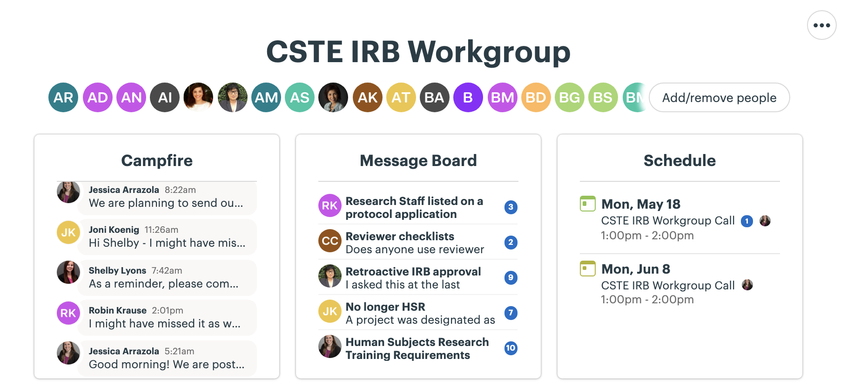
CSTE Basecamp

