Slide 1
CSTE LEAD: Leading Epidemiologists, Advancing Data
Orientation
February 5, 2021

Slide 2
Objectives
Describe the CSTE LEAD program elements
Review the CSTE LEAD curricula schedule
Demonstrate CSTE Learn
Demonstrate Basecamp
Notes:
PROJECT PURPOSE: Establish and implement a 18-month leadership development program for mid-level career applied epidemiologists.
PROJECT SUMMARY: There is a lack of training and professional grooming among mid-level applied epidemiologists to prepare them for leadership positions. With an increasing need for leadership among CSTE members and the expected turnover among the workforce, leadership training is necessary to maintain institutional knowledge and prepare the next generation of applied epidemiology leaders. CSTE has developed a leadership program to provide leadership training for applied epidemiologists at state, territorial, local, and tribal health departments. CDC has already created the FLIGHT program to provide additional leadership training for EIS graduates to groom leaders for CDC headquarters. CSTE’s request is for financial support to enhance the program rigor and benefits and use evaluation to explore the sustainability and scalability of the program.
ADDRESSING THE NEED: The applied epidemiology workforce is highly educated but a majority lack substantial experience. The 2017 Public Health Workforce and Needs Survey describes the applied epidemiology workforce: 73% have attained a master’s degree or possess a doctoral degree (20%), 62% are 40 years old or younger, 74% have been in their current position for 5 years or less, most have been in public health practice for less than 10 years (55%), 29% indicated they were considering leaving their job in the next year (most commonly to take another governmental job in public health) – among those intending to leave 16% identified a lack of training as their top reason for leaving. The top training needs identified included areas of systems and strategic thinking, budget and financial management, developing a vision for a healthy community, cross-sectoral partnerships, cultural competency, and change management. In the 2017 Epidemiology Capacity Assessment, State Epidemiologists described insufficient resources at their agencies to meet the demand for training and mentoring of staff needed to maintain epidemiology capacity at their agency. Leadership development has been a CSTE Presidential Priority since 2017 and is included in the CSTE 2018-2020 Strategic Plan. Recent unpublished research illustrates the need for a mentorship program for mid-level applied epidemiologists that addresses strategic skills including leadership.
PH WINS (the Public Health Workforce Interests and Needs Survey) is the only nationally representative source of data about the governmental public health workforce. It was fielded in 2014, 2017 and is planned for 2020 in partnership between the de Beaumont Foundation and ASTHO. https://www.debeaumont.org/ph-wins/
Daly, E. (2020). Select results from dissertation analysis, unpublished.
CSTE. (2017). 2017 Epidemiology Capacity Assessment Report. Available at https://www.cste.org/group/ECA
Daly, E. (2020). Select results from dissertation analysis, unpublished.

Slide 3
Introductions

Slide 4
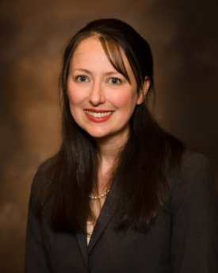
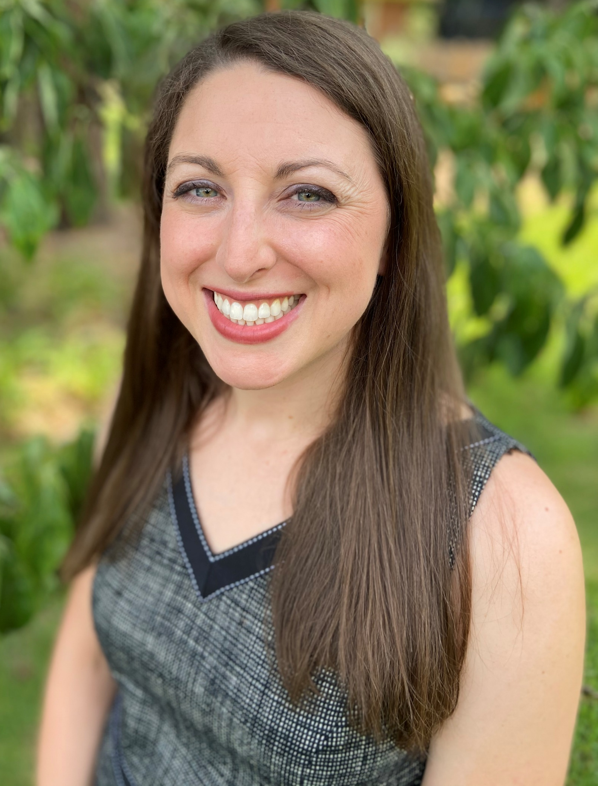
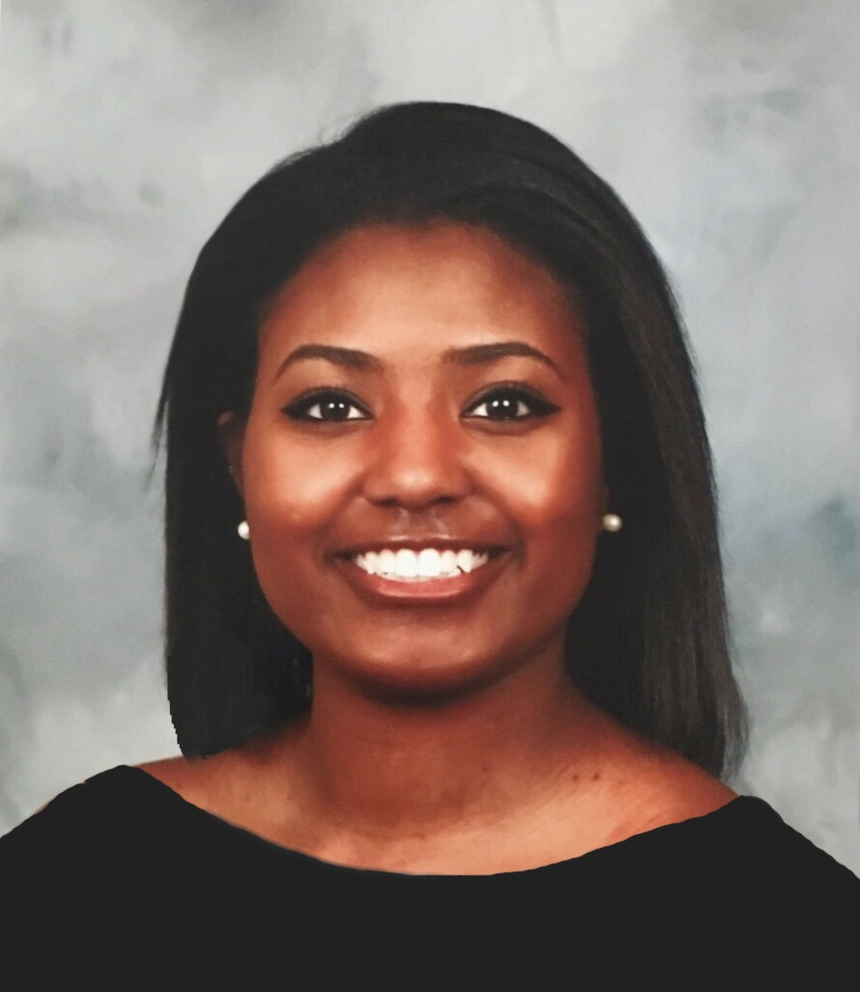
CSTE Team
Amanda Masters, MPH
Deputy Director of Governance, Strategy and Support
Jessica Arrazola, DrPH, MPH, MCHES
Senior Program Analyst
Symone Richardson
Intern
Notes:
Here are our pictures so that you can put a face to the name.
Jessica is a Senior Program Director and Symone is a program staff intern at CSTE. I am the main contact but you may reach out to either one of us if you need support.

Slide 5
CSTE LEAD Participants
Amy Bettano, MPH Massachusetts Department of Public Health
Jamie Black, MPH, Indiana Department of Health
Brooke Doman, MPH, New Mexico Department of Health
Daniel Drociuk, MT, South Carolina Department of Health and Environmental Control
Prabhu Gounder, MD, MPH, Los Angeles County Public Health
Rebecca Greeley, MPH, New Jersey Department of Health
Alfreda Holloway-Beth, PhD, MS, Cook County Department of Public Health
David Johnston, MPH, Hawaii Department of Health
Karen Martin, MPH, Minnesota Department of Health
Carrell Rush, MPH, Kentucky Department for Public Health
Em Stephens, MPH, Virginia Department of Health
Joli Weiss, PhD, Arizona Department of Health Services
Ying Zhang, PhD, MPH, Southern Nevada Health District

Slide 6
Support Team and Coaching
Mentor: Share from their public health leadership experience. Provide guidance related to working as an epidemiologist, serving as a leader, and project management. Commit 1-2 hours a month to engaging with the participant. Mentors may need to participate in some of the training activities to facilitate discussion with the participant.
Project Sponsor: Provides subject matter and technical expertise for the project. Commit at least 2-3 hours per month to provide project assistance.
Coach: Encourage and support participants to reach their highest personal and professional capabilities.

Slide 7
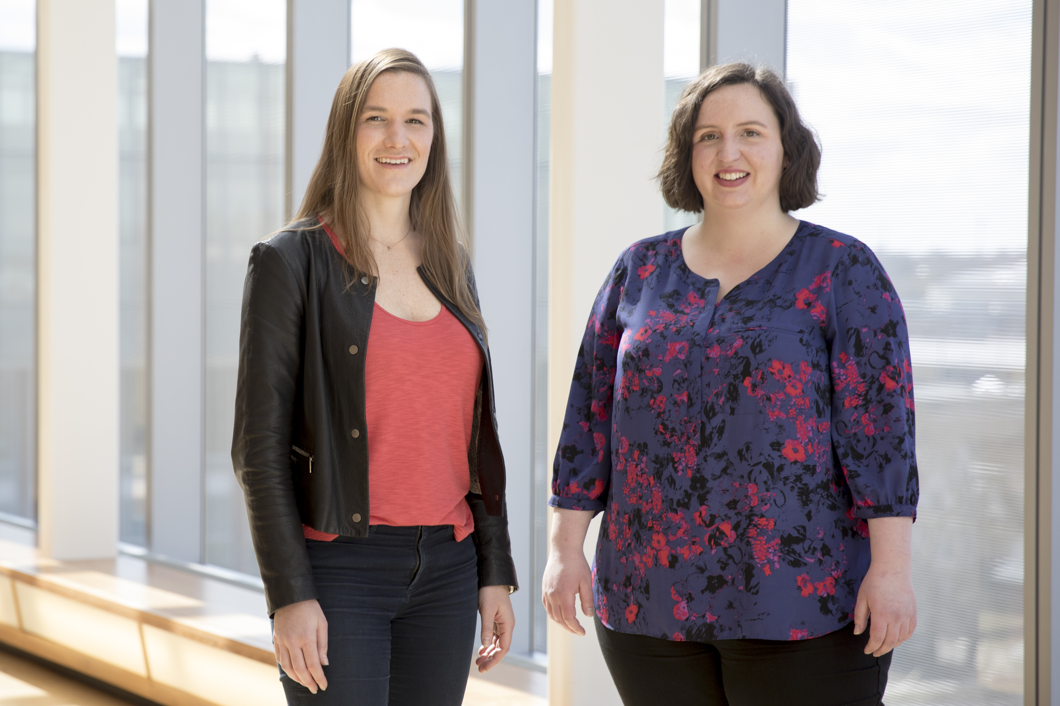
Wolf and Heron Team
Stephanie Judd and Kara Davidson
Notes:
Kara Davidson and Stephanie Judd, founders of Wolf & Heron, help driven professionals increase their impact through the skills of inspirational influence and facilitation. With a deep knowledge of the psychology of leadership and organizational behavior, they deliver skill-building workshops, offer one-on-one coaching, and speak about how to inspire others to think and act differently.
Kara
Kara draws her expertise in behavior change and leadership from a background in environmental activism and positive organizational scholarship. Her approach to one-on-one coaching is that of powerful listening and support where she aims to create a space to reflect on what is and imagine what could be.
In her free time, Kara enjoys being a puppy Mom, hanging out with family and friends in upstate New York, and listening to podcasts.
Stephanie
Stephanie Judd pulls her expertise in inspiration and behavior change from a background in technology and public health. Her approach to one-on-one coaching is anchored in visioning, self-motivation, and strong accountability
In her free time, Stephanie likes to rock climb, snowboard, and listen to TED talks in her home in the Colorado Rocky Mountains.

Slide 8
Program Activities

Slide 9
Program Purpose and Goals
Purpose: To provide a leadership program for mid-level epidemiologists to improve epidemiology capacity
Goals:
1.) Enhance the applied epidemiology workforce
2.) Develop leaders for CSTE activities
Notes:
*We want to support your professional growth and project progress.
*We want the program to be helpful and the curriculum to meet your needs. We have flexibility built in so let us know what is working and what we can adjust as we go.

Slide 10
Program Elements
CSTE Learn asynchronous curricula
Basecamp
Monthly calls (journal club, case study or group coaching)
  2nd Monday of the Month at 2pm ET
Support team (onsite supervisor, project sponsor, mentor)
Individual coaching
CSTE LEAD projects
HBR Access
Self Assessments; 360 Assessment
2021 CSTE Annual Conference
Journal and Reflection

Slide 11
Communications
Email for urgent items or action needed
Basecamp for nonrequired announcements, activities, and general discussion
  Include project sponsors, mentors, and/or onsite supervisors?
CSTE Learn for private participant only discussion
Calendar items – dates available in basecamp and CSTE Learn; access through CSTE Learn

Slide 12
Curriculum Content

Slide 13
Training Topics
Becoming a leader
Leadership in public health
Executive presence and approachability
Motivating a team
Group facilitation and consensus building
Engaging stakeholders
Leading an organization
Strategic communications
Change management
Navigating politics and systems change
Project management
Financial management
Integrated partnerships to improve public health
Using epidemiology data to drive policy
Public health politics 101
CSTE governance and position statement process

Slide 14
Curriculum Schedule
Month | Topic | Month | Topic
1 – February | Leadership in Public Health | 10 - November | Change Management ³
2 - March | Project Management ¹ | 11 - December | Preparedness and Response ¹
3 - April | Facilitating Virtual Meetings ² | 12 – January | Using Epi Data to Drive Policy ²
4 - May | Personal Leadership ³ | 13 – February | Public Health Politics 101 ¹
5 - June | Stakeholder Engagement ^{1, 4} | 14 - March | Leadership During an Emergency ³
6 - July | Strategic Communications ^{2, 3} | 15 - April | Telling Your Story ¹
7 - August | Financial Planning ³ | 16 - May | Mentorship⁵
8 - September | Boundary Spanning Leadership ¹ | 17 - June | Reflection & Evaluation Activities ^{4, 5}
9 - October | CSTE Governance and Position Statements ² | ¹ – Group Coaching ³ – Case Study ⁵ - Project Sharing ² – Journal Club ⁴ – CSTE Conference

Slide 15
Program Evaluation

Slide 16
Evaluation Activities
Capture the pilot experience
Document lessons learned
Data Sources
  Timing: 6-, 12-, and 18-month marks
  After live sessions (e.g. orientation and monthly calls)
  CSTE Learn administrative data
  Surveys with participants, onsite supervisors, mentors, project sponsors
  Interviews with coaches

Slide 17
Q&A
What questions do you have?

Slide 18
Basecamp Tour

Slide 19
CSTE Learn Tour

Slide 20


CSTE National Office
2635 Century Parkway NE, Suite 700
Atlanta, Georgia 30345
770.458.3811
770.458.8516
jarrazola@cste.org

