Slide 1
CSTE LEAD Journal Club
Month 3 – Facilitating Virtual Meetings

Slide 2
Permission Slips
Write in the chat box and share something you intend to give yourself permission to do or feel in the meeting.
Reminder of your intention for the meeting.
These aren’t promissory notes. These are intentions only, so there are no repercussions if you fail to deliver.
Benefits
  Check in with teammates
  Practice vulnerability
  Build trust
  Establish safety
  Practice mindfulness
Examples
  Listen with generosity
  Focus on paying attention rather than be distracted
  Listen more than you speak
  Ask questions
Notes:
As we get started we want to connect with where you are today using an activity called permission slips. This is an activity from Brene’ Brown’s work to understand where you are coming from today and so we can be open with each other as a group. We hope to start all future calls with permission slips.

Slide 3
Agenda
Meeting Roles, Meeting Norms, & Rules of Engagement
Article Introduction and Summary
Article Discussion
Reflection
CSTE Announcements & Reminders

Slide 4
Meeting Roles
Leader – Selects articles and topics for discussion; works with the facilitator to develop the discussion prompts; identifies action items
Co-Facilitator – Guides the group through the discussions; ensures equal speaking opportunity; communicates decisions and next steps; identifies action items
Timekeeper – Manages time limits on discussion items
Note Taker – Records key decisions and action items from discussion; reports on discussion notes

Slide 5
Meeting Norms and Rules of Engagement
Meeting Norms
Listen and respond respectfully
Actively participate in discussion
Come prepared to engage
Rules of Engagement
Show up on time
Include your agency/organization affiliation next to your name (and pronouns, if you would like)
Use the chatbox to comment in addition to the phone discussion
Turn your camera on (as internet bandwidth allows)
Stay on mute unless you are speaking.

Slide 6
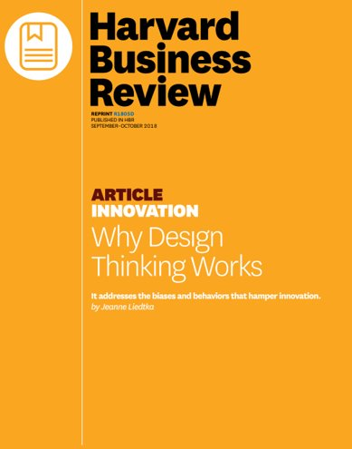
Article Introduction
What was the purpose of the article?
Who is the intended audience?
Notes:
The purpose of this article was to break out of cycles of status quo and give a structured process for troubleshooting and brainstorming ideas. This process allows groups to continue moving forward with new ideas.
The intended audience is towards businesses or anyone who offers a product or service. There was a lot of correlation to public health departments. Public health departments also have problems that require innovative solutions. Overall, a general audience was targeted.

Slide 7








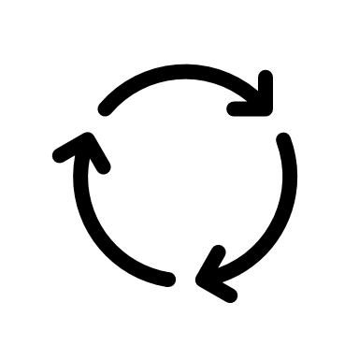
Article Summary
Three things you need for innovation:
Superior solutions
Lower risks and costs
Buy-in
Structure (aka Design Thinking) to the rescue!
Keeps you on track
Instills confidence
Creates safety net
Why Design Thinking works:
The human component
Commitment to change
Essentials at every phase
Notes:
The author starts off by stating there are three major factors that a business—or other types of agencies, such as in our case in the field of public health—that we need to consider in order for innovation to be successful: We need 1) superior solutions, 2) lower risks and costs associated with change, and 3) buy-in from our employees or team members.
Superior solutions are those that are user- or consumer-driven. These types of solutions not only take into consideration the feedback from your stakeholders, but they also include feedback from people with diverse lived experiences or backgrounds. The human-made barriers we create to truly having superior solutions include an overabundance of ideas that have no real direction to them. Lots of ideas on how to solve a problem are not always a good thing, and can lead to tangent discussions that lead down many “rabbit holes” and get further away from solving the problem. Also, if there are some creating ideas thrown into the pot, managers who are too quick to action will skip over those ideas as too risky and end up choosing solutions based on how easy they are to implement. Me personally, I’ve witnessed this first hand in my organization.
Lower risks and costs associated with change goes hand in hand with the first factor, in that to find a good balance between creative ideas and working towards a good solution, there needs to be less of a perceived risk in choosing the more creative ideas that are put forth. This can be hard if a manager or supervisor has a hard time labeling their idea as a “bad idea” and throwing it aside for other more “riskier” or forward-thinking ones. This occurs more often if your solution challenges processes that have been “the ways things have always been done”.
Lastly, Buy-in from employees or team members is crucial to moving innovation forward. Sometimes as a leader it is hard to know the balance of having enough team buy-in versus not asking for feedback on every decision that is made. Also, if too many different ideas are proposed by the team, including some ideas that are off-topic or less coherent, than meeting discourse can quickly become chaotic and off-track.
So in order to strive for these three factors, the author proposes having a base organization or structure to the discourse—aka Design Thinking. In providing some sort of standard for strategizing and problem solving, team members will not only be kept on track, but it also fosters a sense of confidence in brainstorming creative ideas and provides a safety net, or psychological safety, for the team to bounce ideas off each other without having to fear their suggestion will be considered “dumb” or not taken seriously.

Slide 8
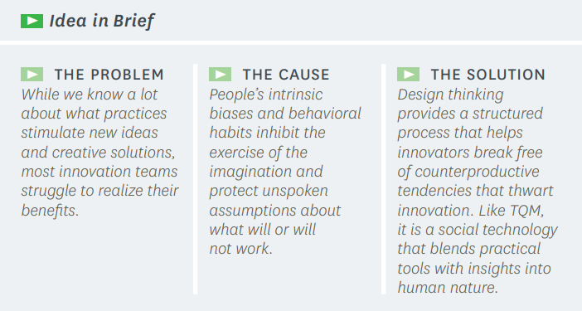
Article Discussion
Notes:
Defining a clear process to innovate for change. We value diverse perspectives but sometimes they bias our engagement. To mitigate risk aversion, design thinking offers a structure to build consensus and develop solutions that speak to the values of the participants and end user. As facilitators, we must be aware of the need of the participants but recognize their priorities and strategies for implementation vary. The design thinking process provides a structure and open space to articulate the values, priorities and develop recommendations as a group.

Slide 9
Article Discussion
Customer Delivery
Provides immersion
Makes sense of data
Idea Generation
Testing Experience
Offers pre-experience
Delivers learning in action
Builds alignment
Encourages emergence
Fosters articulation
Notes:
Design thinking allows the team lead to facilitate discussion and engage stakeholders to achieve solution-focused designs. The engagement process itself gains a broad commitment to change among participants. These seven steps offer incremental deliverables and can be achieved with various facilitation techniques. The selected techniques will depend on your goals, the participating stakeholders (e.g. do they know each other already and have established relationships or is this the first time they are meeting?), and the discussion format (e.g. virtual or in person). Ultimately, you want your stakeholders to feel that their perspective matters, they have been heard, that they have a role to play in the solution, and are committed to supporting the solution.

Slide 10
Shaping the Innovator’s Journey
PROBLEM | DESIGN THINKING | IMPROVED OUTCOME
Innovators are:
Trapped in their own expertise and experience | Provides immersion in the user’s experience, shifting an innovator’s mindset toward… | A better understanding of those being designed for
Overwhelmed by the volume and messiness of qualitative data | Makes sense of data by organizing it into themes and patterns, pointing the innovator toward… | New insights and possibilities
Divided by differences in team members’ perspectives | Builds alignment as insights are translated into design criteria, moving an innovation team toward… | Convergence around what really matters to users
Confronted by too many disparate but familiar ideas | Encourages the emergence of fresh ideas through a focused inquiry, shifting team members toward… | A limited but diverse set of potential new solutions
Constrained by existing biases about what does or doesn’t work | Fosters articulation of the conditions necessary to each idea’s success and transitions a team toward… | Clarity on make-or-break assumptions that enables the design of meaningful experiments
Lacking a shared understanding of new ideas and often unable to get good feedback from users | Offers pre-experiences to users through very rough prototypes that help innovators get… | Accurate feedback at low cost and an understanding of potential solutions’ true value
Afraid of change and ambiguity surrounding the new future | Delivers learning in action as experiments engage staff and users, helping them build… | A shared commitment and confidence in the new product or strategy
Notes:
As you facilitate discussions with stakeholders, you can plan your discussions based on these 7 design thinking phases to maintain focus, offer clear progress with distinct deliverables, and set expectations on where you are now and what you hope to achieve. Different techniques you may be able to use for each phase include:
Provides immersion – values or story telling exercises
Makes sense of data – post it note or dot activity to identify common themes and prioritize the data, virtual white boards such as miro
Builds alignment – use the raise hand or thumbs up/thumbs down in a virtual setting. If using cameras, you can do thumbs up, neutral horizontal thumb and thumbs down. For an in person meeting you can define room space for options to strongly agree to strongly disagree which helps facilitate movement and gives a visual about where people stand on issues.
Encourages the emergence – brainstorming individually or in small groups. Reporting out in a round robin one idea at a time or sharing ideas in the chatbox.
Fosters articulation – utilize a grid to map out the feasibility and importance/value or return on investment of the ideas. Alternatively, ask all participants to come up with pros and cons for all or some of the ideas then return to the next meeting ready to discuss and make recommendations. Conduct a thinking hat exercise, where participants are assigned a perspective to represent as solutions are discussed such as white hat to focus on the facts, green hat with creativity, red had with emotion, black hat is the pessimistic perspective finding the flaws, yellow hat for the positive perspective, and a blue hat to be worn as a facilitator with a neutral perspective.
Offers pre-experiences – use storytelling activities that describe the main workflows but leave enough gaps in detail to encourage questions and creative discussion.
Delivers learning in action – share written summaries with participants that outline clear actions from their engagement. Follow up with additional opportunities for comment and quality improvement. When possible frame discussion and actions in the context of the shared values, goals, and decisions. Consider relevant evaluation activities for the stakeholder engagement process and for the end users.

Slide 11
Article Discussion
How is design thinking used in your health department?
  - To what extent are diverse perspectives included in design thinking discussions?
What are some design thinking examples you have used in your work or from your supervisory experience?
How can you move forward with your project and in your work, using what you learned from this article, to foster innovation?
How can you utilize this information for your own challenges with innovation in your agency or organization?

Slide 12
Reflection
What went well in this meeting?
How can we integrate virtual meeting best practices into future meetings?
What could be done differently for future meetings?
What topics would you like to discuss in the future?

Slide 13
CSTE Announcements and Reminders
Thursday, 4/15 Orientation for Project Sponsors, Mentors and On-site Supervisors
Register for the CSTE Annual Conference by April 30th
Join or renew your CSTE membership with promo code CSTE10
Complete pre- and post-evaluation for CSTE Learn lessons
Complete the Facilitating Virtual Meetings lesson on CSTE Learn
Create and respond to the Facilitating Virtual Meetings discussion post on Basecamp
Sign up for rotating meeting roles for future virtual meetings
Schedule your coaching call with Wolf and Heron
Basecamp – avoid checking off the to do list, it marks it complete for everyone.

