Slide 1
CSTE LEAD: Leading Epidemiologists, Advancing Data
Project Support Team Orientation
April 15, 2021
*Introduce yourself in the chatbox; include: your name, agency, position and what excites you about your participant’s involvement in CSTE LEAD.

Slide 2
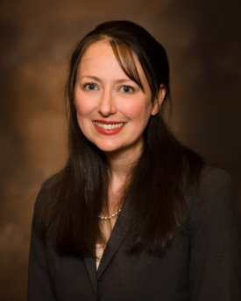
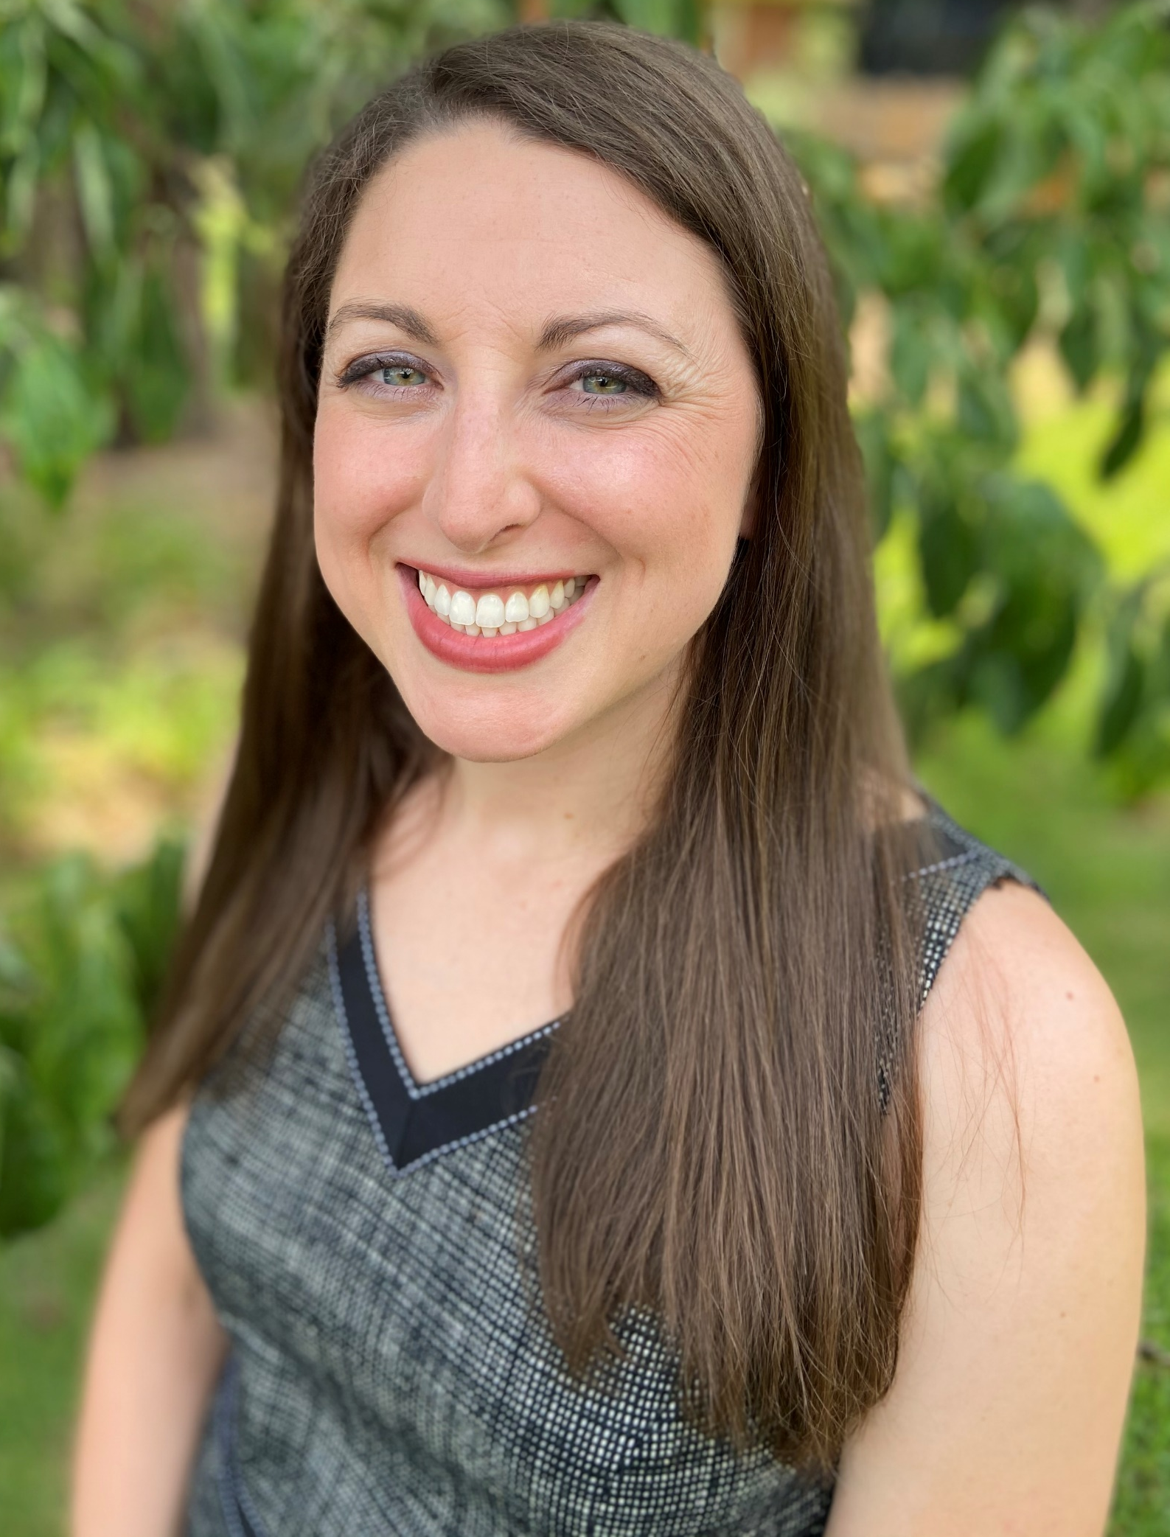
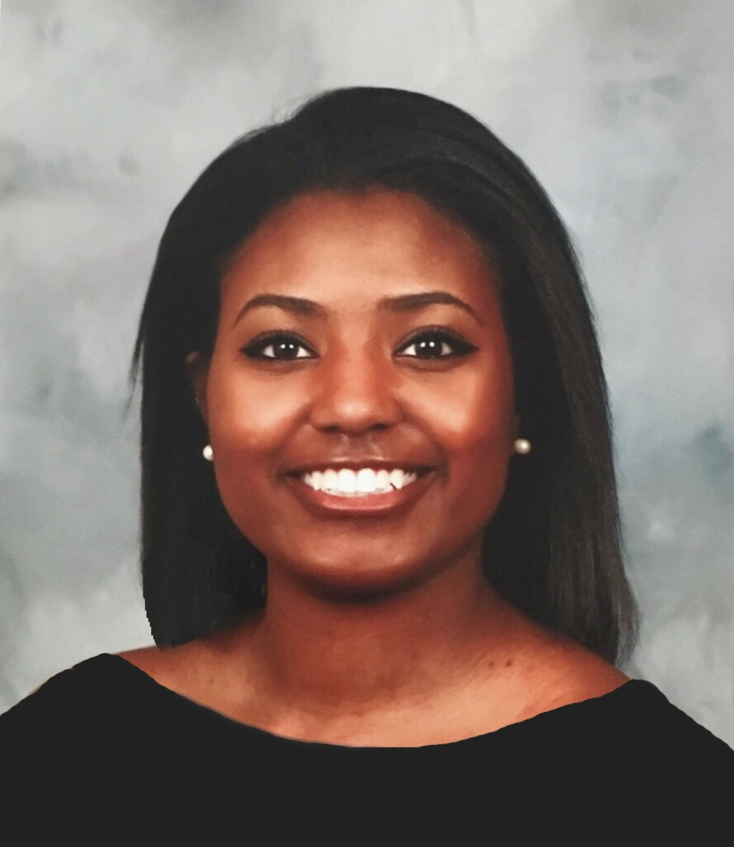
CSTE Team
Amanda Masters, MPH
Deputy Director of Governance, Strategy and Support
Jessica Arrazola, DrPH, MPH, MCHES
Senior Program Analyst
Symone Richardson
Intern
Notes:
Here are our pictures so that you can put a face to the name.
Jessica is a Senior Program Director and Symone is a program staff intern at CSTE. I am the main contact but you may reach out to either one of us if you need support.

Slide 3
Support Team and Coaching
Mentor: Share from their public health leadership experience. Provide guidance related to working as an epidemiologist, serving as a leader, and project management. Commit 1-2 hours a month to engaging with the participant. Mentors may need to participate in some of the training activities to facilitate discussion with the participant.
Project Sponsor: Provides subject matter and technical expertise for the project. Commit at least 2-3 hours per month to provide project assistance.
Onsite Supervisor: Authorizes dedicated time and resources to participate. Provides agency visibility and support.
Coach*: Encourage and support participants to reach their highest personal and professional capabilities.

Slide 4
CSTE LEAD Participants
Amy Bettano, MPH, Massachusetts Department of Public Health
Jamie Black, MPH, Indiana Department of Health
Brooke Doman, MPH, New Mexico Department of Health
Daniel Drociuk, MT, South Carolina Department of Health and Environmental Control
Prabhu Gounder, MD, MPH, Los Angeles County Public Health
Rebecca Greeley, MPH, New Jersey Department of Health
Alfreda Holloway-Beth, PhD, MS, Cook County Department of Public Health
David Johnston, MPH, Hawaii Department of Health
Karen Martin, MPH, Minnesota Department of Health
Carrell Rush, MPH, Kentucky Department for Public Health
Em Stephens, MPH, Virginia Department of Health
Joli Weiss, PhD, Arizona Department of Health Services
Ying Zhang, PhD, MPH, Southern Nevada Health District
Notes:
1.) Share about your role
2..) What excites you about your participant engaging in LEAD?

Slide 5
About the Program
Goals:
Enhance the applied epidemiology workforce with competency-based on-the-job leadership development training for mid-career applied epidemiologists
Develop leaders for CSTE member-led activities
Framework:
Competency-based and objective-focused learning
Evidenced-based approaches and theory-based leadership frameworks
CDC Quality Training Standards
Evaluation:
Robust evaluation to inform program development and address participant’ needs

Slide 6
CSTE LEAD Elements
18 months (January 2021-June 2022); up to 6 hours per month plus time commitment to project
Monthly calls (group coaching, journal club, or case study)
Online community of practice (Basecamp)
Asynchronous learning opportunities (CSTE Learn)
Experiential learning project (at health dept or CSTE)
Mentorship and coaching
  Mentor for career guidance
  Project sponsor to provide technical subject matter expertise related to the project
  Professional leadership coach for guidance and consultation
Notes:
Leverage existing content then customize for applied epidemiology audience; utilize flexible learner approach

Slide 7
Training Topics
Becoming a leader
Leadership in public health
Executive presence and approachability
Motivating a team
Group facilitation and consensus building
Engaging stakeholders
Leading an organization
Strategic communications
Change management
Navigating politics and systems change
Project management
Financial management
Integrated partnerships to improve public health
Using epidemiology data to drive policy
Public health politics 101
CSTE governance and position statement process

Slide 8
Curriculum Schedule
Month | Topic | Month | Topic
1 – February | Leadership in Public Health | 10 - November | Change Management ³
2 - March | Project Management ¹ | 11 - December | Preparedness and Response ¹
3 - April | Facilitating Virtual Meetings ² | 12 – January | Using Epi Data to Drive Policy ²
4 - May | Personal Leadership ³ | 13 – February | Public Health Politics 101 ¹
5 - June | Stakeholder Engagement ^{1, 4} | 14 - March | Leadership During an Emergency ³
6 - July | Strategic Communications ^{2, 3} | 15 - April | Telling Your Story ¹
7 - August | Financial Planning ³ | 16 - May | Mentorship⁵
8 - September | Boundary Spanning Leadership ¹ | 17 - June | Reflection & Evaluation Activities ^{4, 5}
9 - October | CSTE Governance and Position Statements ² | ¹ – Group Coaching ³ – Case Study ⁵ - Project Sharing ² – Journal Club ⁴ – CSTE Conference

Slide 9
Engaging with the Participants
Connection
Perspective
Direction
Notes:
Connection – individuals experience a greater sense of engagement with their career when they have a meaningful relationship at work. Mentoring relationships create that sense of connection that is so important for sustained engagement.
Perspective – When you are physically distanced from those with whom you work, you do not have the chance to benefit from the water-cooler conversations. Such informal conversations offer a chance to get perspective on present issues and workplace conundrums. Mentoring relationships offer a sounding board for new ideas and offer the participants a chance to get outside of their own head. According to HR Analytics: Role Clarity Impacts performance,” when employees are clearer about their roles, their performance increases by 25% and they report being more passionate and more satisfied with their jobs. Mentees often report that their mentoring relationships provide clarity by helping them to think through their long-term goals and map out the actions and behaviors that will best help them reach those goals. A mentor can help the participants process their thoughts so new insights can emerge.
Direction – When you are working in isolation, it can be easy to react to others’ needs rather than moving towards your own goals. Mentors help participants see possibilities that they may not have otherwise seen and in doing so help establish a compass for members to focus strategically on their own development.

Slide 10
Functions of a Mentoring Relationship
Sounding Board
Safety Net
Laboratory
Functions of a Mentoring Relationship

Slide 11
Responsibility to the Participant
Commit to the process
  Meet at least once a month
Encourage the participant to lead
Recognize and share learning opportunities
Make connections
Provide visibility for participant success and project progress
Notes:
1. Create an open, trusting environment that makes your participant feel like they can open up to you and be supported.
2. Let your participant take control of their project, program experience, etc. to ensure they stay committed to their own interests.
3. Keep an eye out for situations and opportunities that you can learn from your participant as well as your participant can learn from you.
*What other responsibilities do you feel you have to the participant?
4. Utlilize opportunities for networking with your participant for career growth
5. Provide support, advice and guidance in your participants journey towards success throughout the LEAD curriculum and project completion

Slide 12
Building a Meaningful Relationship
Discuss and set goals and expectations
Determine factors for success
Avoid rushing to problem-solve
Provide meaningful feedback
  Example: discussing results of leadership assessments
Notes:
1. It is important to establish specific and measurable goals and expectations for the relationship upfront.
2. After establishing goals, be sure to also establish clear outcomes to measure success.
*How do you define success?
3. Understand that your mentorship, support, and guidance is a process and try not to dive into solving your participant's problems too quickly.
4. Feedback allows you to acknowledge your participant’s strengths and to motivate them to work on areas of weakness. Make sure the feedback fosters the relationship and is timely.
*What does meaningful feedback look like? – Empowering the participant to think differently, not just give them a “correct” answer.

Slide 13
Discussion
How would you like to engage with other mentors, project sponsors, and/or onsite supervisors throughout the program?
How can CSTE support you and your participant?
What else would you like CSTE to know?

Slide 14
Questions?
What questions do you have?
  Share in the chatbox
  Unmute your line to ask over the phone
If you have questions later, email Jessica Arrazola at Jarrazola@cste.org or call 770-458-3811.

Slide 15


CSTE National Office
2635 Century Parkway NE, Suite 700
Atlanta, Georgia 30345
770.458.3811
770.458.8516
jarrazola@cste.org

