Slide 1
Case Study
Something’s Rotten at the Pink Panther

Slide 2
Case Study
Something’s Rotten at the Pink Panther
  Who is Tom Lockman?
  Who is Garth Higgs?
  What is the public health relationship between Adams State and Wayne County?
  What are some of the key leadership and management challenges in this scenario?

Slide 3
Case Study Discussion
Define leadership versus management
What are the factors that influence leadership versus management?

Slide 4
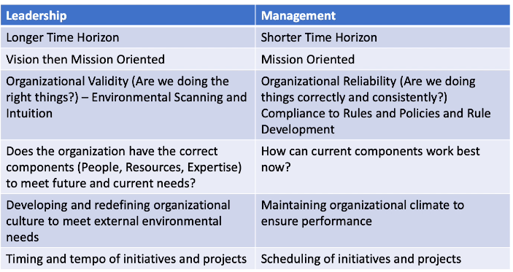
Case Study Discussion
Do Tom and Garth demonstrate effective leadership and management skills? Why or why not?

Slide 5
Case Study Discussion
Which of the following best define Tom’s leadership style?
  Authoritarian
  Participative
  Laissez-faire

Slide 6
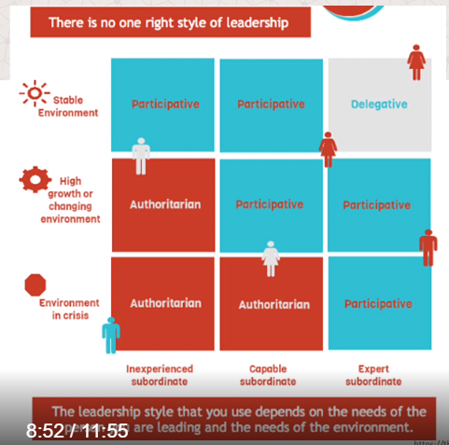
Case Study Discussion
Which leadership approach between Tom and Garth would be best in this situation?

Slide 7
Case Study Discussion
What ethical issues are relevant to the situation?
How can Tom exert leadership and foster a culture of high moral and ethical standards?

Slide 8
Case Study Discussion
Describe the role of power and privilege as it relates to the State Epidemiologist.
  Positional Power
    Legitimate power
    Reward power
    Coercive power
    Information power
  Personal Power
    Expert power
    Referent power
Notes:
Positional Power Sources
Legitimate Power can also be referred to a 'title power', because it is the power that comes along with being appointed to a specific position.
Reward Power is typically financial when talking about a leader within a company, for example the ability to reward your team members with things like bonuses or pay raises.
Coercive Power is the opposite of reward power and is based on the ability to take things away. In the workplace this would normally mean being able to demote or fire someone.
Information Power is control of information by agent as a source of power (Added by Yukl, 1994).
Personal Power Sources
Expert Power is achieved when someone finds themselves in a position of power based on their knowledge or experience.
Referent Power is power that is not achieved by any of the above, and may be based on something intangible like popularity, attitude, or charm.

Slide 9
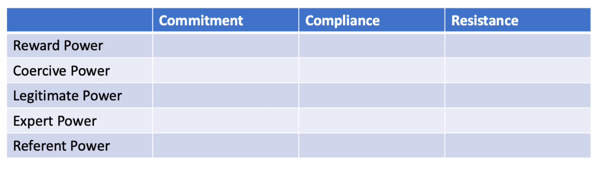
Case Study Discussion
What some of the possible outcomes if the State Epidemiologist exercised positional power?
Notes:
Positional Power Sources
Legitimate Power can also be referred to a 'title power', because it is the power that comes along with being appointed to a specific position.
Reward Power is typically financial when talking about a leader within a company, for example the ability to reward your team members with things like bonuses or pay raises.
Coercive Power is the opposite of reward power and is based on the ability to take things away. In the workplace this would normally mean being able to demote or fire someone.
Information Power is control of information by agent as a source of power (Added by Yukl, 1994).
Personal Power Sources
Expert Power is achieved when someone finds themselves in a position of power based on their knowledge or experience.
Referent Power is power that is not achieved by any of the above, and may be based on something intangible like popularity, attitude, or charm.

Slide 10
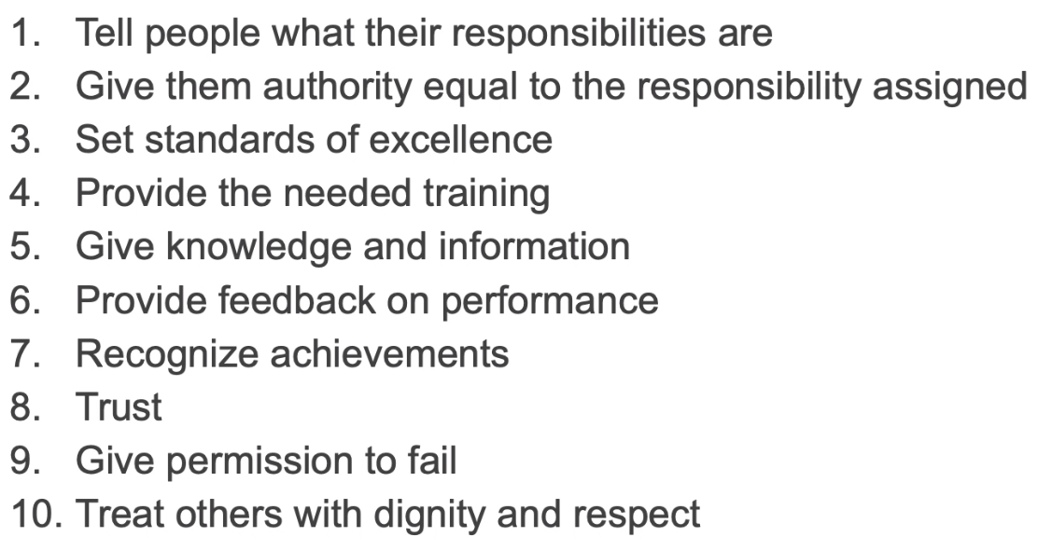
Case Study Discussion
Could the following empowerment strategies by Nichole have built commitment from Garth in the response?
Notes:
Positional Power Sources
Legitimate Power can also be referred to a 'title power', because it is the power that comes along with being appointed to a specific position.
Reward Power is typically financial when talking about a leader within a company, for example the ability to reward your team members with things like bonuses or pay raises.
Coercive Power is the opposite of reward power and is based on the ability to take things away. In the workplace this would normally mean being able to demote or fire someone.
Information Power is control of information by agent as a source of power (Added by Yukl, 1994).
Personal Power Sources
Expert Power is achieved when someone finds themselves in a position of power based on their knowledge or experience.
Referent Power is power that is not achieved by any of the above, and may be based on something intangible like popularity, attitude, or charm.

Slide 11
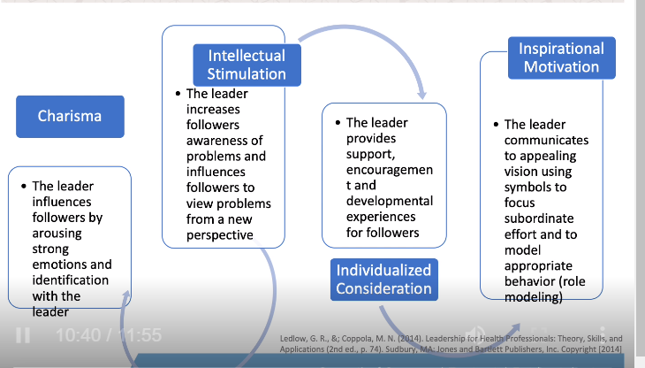
Case Study Discussion
Describe the role of transformational leadership as it relates to this case study.

Slide 12
Case Study Discussion
What recommendations do you have to lead change in the organizations to improve organizational performance?
What challenges may leadership encounter when instituting change?

Slide 13
Announcements
Join CSTE - Membership discount good through 5/31
Schedule calls with coaches
360 Assessment – coming soon
Complete evaluations in Learn
Virtual Meeting sign up – case study in July
Next meeting – Monday, June 7th at 2pm ET
CSTE Conference – June 13-17th

