Slide 1

Crisis Communication Primer
CERC+
Notes:
Welcome to Crisis Communication Primer- CERC plus. You should have already watched a short video on CDC’s Crisis and Emergency Response Communication or CERC.

Slide 2
Crisis Communication Primer
Review the 7 Cs of communications and their role in crisis communication
Discuss the communication principles of being first and showing respect
Apply communication strategies
Notes:
In this session, we will
review importance of the 7 Cs of communications in crisis communications,
review all the six principles of communication, with a focus on the first and last principles, being first and showing respect,
And finally, we discuss how to apply these principles to crisis communication.

Slide 3

Remember the 7 C’s of Communication?
Clear
Concise
Concrete
Correct
Coherent
Complete
Courteous
They also apply to Crisis Communication!
Notes:
Do you remember the seven “c”’s of communication from Month Six on Strategic Communications? (click)
As mentioned there, the seven c’s don’t just apply to project communications, but to other aspects of your daily work- including crisis communication. So, make sure you keep these in mind as you are crafting written or oral communications during a crisis or emergency.

Slide 4







Specific Principles
1
Be First
2
Ensure limited resources:
Are managed well
Do the most good
Be Right
3
Be Credible
4
Express Empathy
5
Promote Action
6
Show Respect
Notes:
But, as you learned in the CERC video, there are additional- yet related and consistent- principles that relate to crisis communications.
Utilizing these principles helps ensure that limited resources are managed well and can do the most good at every phase of an emergency.
As a reminder, the six principles of crisis and emergency response communication are: be first, be right, be credible, express empathy, promote action, and show respect. If you need to review any of these further, you can consult CDC’s CERC Manual posted online on the CDC website.

Slide 5
These are often the easiest for public health
1
Be First
2
Be Right
3
Be Credible
4
Express Empathy
5
Promote Action
6
Show Respect
Notes:
All of the six principles of CERC are important and certainly merit attention. We are going to focus on the first and last in this module.
However, being right, being credible, expressing empathy, and promoting action are very important during a crisis or emergency!

Slide 6

1
Be First
Tell what you know, but also what you don’t yet know.
Explain how you will find more answers and then provide updates.
If you aren’t first, someone else will be—and will likely not provide helpful, and perhaps dangerous, information.
Reference: CDC (2017). CERC Corner: First Message in a Crisis.
Notes:
The first principle, Be First, is often cited as the most challenging for public health. However, it is extremely important during a crisis or emergency because crises are time-sensitive and communicating information quickly is crucial. For the public, the first source of information often becomes the preferred source. Understandably though, it is daunting, especially for epidemiologists who stake our reputations on providing accurate and full data, to respond quickly and without a full, or sometimes even basic, understanding of the data and situation. However, if you aren’t first, someone else will be- perhaps with inaccurate information that causes more disease, injury, or even death.
Therefore, when being first, focus on telling what you know, but also what you don’t know yet. It is ok to admit that you don’t have all the information yet and the public will often appreciate your honesty, candor, and transparency.
Tell them not only what you don’t know, but how you plan to find more answers and when you will provide more updates. Doing this will help establish trust with the public- providing data or information that could turn out to be ultimately incorrect or biased when not fully vetted has strong negative consequences at any time, but especially in an emergency when you need the public to take action.

Slide 7

6
Show Respect
Cultural factors that affect communication during a crisis:
  Languages spoken
  Risk perception
  Trusted sources of information
  Traditional family roles and relationships
  Rituals for grieving and death
  Acceptable forms of communication
Reference: CDC (2017). CERC Corner: First Message in a Crisis.
Notes:
The sixth principle, Show Respect, is not difficult for public health- providing respectful communication is a basic tenet of what we do in public health and helps to promote cooperation and rapport in many of our programs and services. In an emergency, respectful communication is particularly important because people are feeling especially vulnerable. However, a brief study of CERC does not go far enough regarding how important cultural competency and humility is in crisis communications.
A multitude of cultural factors must be taken into consideration such as
languages spoken by the audience,
risk perception among different groups,
who trusted sources of information are for certain groups,
traditional family roles and relationships among different cultures,
rituals for grieving and death among different cultures or religions,
and acceptable forms of communication for different groups.

Slide 8

6
Show Respect
Incorporate as much cultural competency as appropriate
Leverage the knowledge and experience of cultural agents
Establishing ties and trust to diverse ethic and cultural communities really needs to occur BEFORE a crisis.
Reference: CDC (2017). CERC Corner: First Message in a Crisis.
Notes:
Obviously, when trying to be first and provide communication as soon as possible during a crisis or emergency, taking into account a full range of cultural competency considerations is difficult and almost impossible to do.
However, try to incorporate as much cultural competency and humility into your communications as is appropriate with your knowledge and understanding.
If you have time, also leverage the knowledge and experiences of cultural agents to assist you or speak with you- they are usually more than happy to assist and serve as liaisons with their communities.
However, the best way to prepare for showing respect in crisis and emergency communications is to gain as much knowledge and understanding about cultures in your community BEFORE crises and emergencies occur. Additionally, establishing ties and trust to diverse ethnic and cultural communities BEFORE the crisis will help your audiences trust your message and take the actions necessary to protect their health.

Slide 9
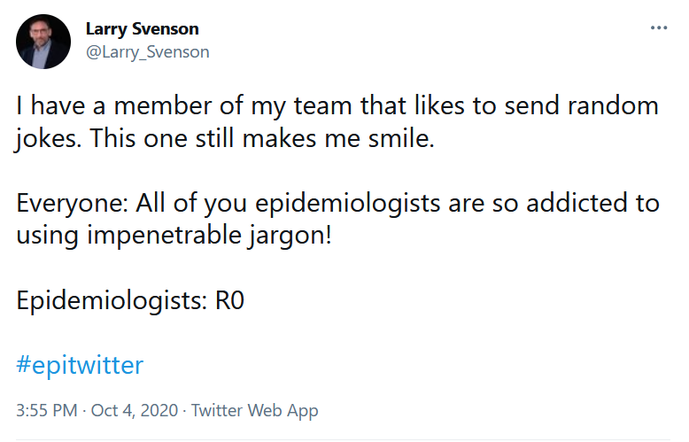
Use Plain Language
Notes:
Something not specifically referenced in a CERT principle but noted as important is the need for use of plain language. For epidemiologists, this is especially important as we LOVE our scientific writing and talking. Unfortunately, not everyone understands this type of communication on a normal day, but especially not in a crisis when they may be thinking differently and not as logically.

Slide 10

What emotions do people experience during a crisis?
Emotions are not positive or negative, but the behaviors they trigger can be.
horror, apprehension, grief, desire for revenge, loneliness, sadness, repulsion, vigilance, anguish, guilt, fear, anger, anxiety, sorrow, surprise, shock, disgust, and love
Notes:
Crisis at any level can have a human impact and can bring many emotions.
Emotions generally include: horror, apprehension, grief, desire for revenge, loneliness, sadness, repulsion, vigilance, anguish, guilt. fear, anger, anxiety, sorrow, surprise, shock, disgust, and love. (Klann, 2003) p. 7-8). These emotions mean people take in communications and messaging in different ways during a crisis.

Slide 11



Emotion
Behavior
Notes:
And people’s emotions are directly tied to their behavior.
So, messaging needs to be sensitive to people’s emotions during a crisis so that we can effectively persuade them to take the actions necessary to protect their health.

Slide 12



Emotion Behavior
Crisis
Threatened need
Move to
action
Emotion
Behavior
Notes:
That connection describes a sequence that starts with a crisis, results in an emotion in answer to a threatened need and is followed by a move to action and subsequent behavior (Klann, 2003) p. 42.
Leaders and communicators need to take emotions into consideration because the people in their community behave in ways consistent with their emotions. (Klann, 2003) p. 42
In a crisis emotions can become unbalanced and lead to behaviors that may be uncharacteristic. A key to crisis communication is anticipating this chain of events and communicating in a way that is extremely clear and understandable. Hence, using plain language is essential.

Slide 13

Use Plain Language
People under stress may:
Not fully hear information
Not remember as much as normal
Interpret confusing action messages
Reference: CDC (2017). CERC Corner: Using Plain Language.
Notes:
When under stress or juggling too much information, people often miss important details, even when it relates to their safety and health.
They may not fully hear information due to too many facts at once,
may not remember as much as normal,
and may interpret confusing action messages.

Slide 14

Use Plain Language
Practice what you are going to say
Have someone else listen to point out instances of complex/scientific language
Notes:
So, what is the key to using plain language? When being first, you may not have a lot of time to craft your message and, unfortunately, we revert to our comfortable behaviors- like using overly scientific terminology- when we are ourselves stressed.
However, practice makes perfect here. As much as possible, practice what you are going to say and even have someone else listen to point out instances of complex or scientific language you use. Take some deep breaths before speaking and feel free to stop yourself if you catch yourself using a term by stopping and saying something such as “which is..” or “also called.”
Also, practice this when NOT in a crisis as you will always have times when you need to communicate to lay audiences.

Slide 15
In Summary
Emotion
Behavior
Being first is hard… but necessary
Build trust with diverse ethnic and cultural communities BEFORE a crisis
Acknowledge the connection between emotions and behaviors
Practice, practice, practice

Slide 16


CSTE National Office
2635 Century Parkway NE, Suite 700
Atlanta, Georgia 30345
770.458.3811
770.458.8516
learn@cste.org
Notes:
Reference:
Klann, Gene. Crisis Leadership: Using Military Lessons, Organizational Experiences, and the Power of Influence to Lessen the Impact of Chaos on the People You Lead : How Military Lessons and Corporate Experiences Can Help Leaders Find Opportunity in Times of C..., Center for Creative Leadership, 2003. ProQuest Ebook Central, https://ebookcentral-proquest-com.libproxy.lib.unc.edu/lib/unc/detail.action?docID=3007579.

