Slide 1
Permission Slips
Write in the chat box and share something you intend to give yourself permission to do or feel in the meeting.
Reminder of your intention for the meeting.
These aren’t promissory notes. These are intentions only, so there are no repercussions if you fail to deliver.
Benefits
  Check in with teammates
  Practice vulnerability
  Build trust
  Establish safety
  Practice mindfulness
Examples
  Listen with generosity
  Focus on paying attention rather than be distracted
  Listen more than you speak
  Ask questions
Notes:
As we get started we want to connect with where you are today using an activity called permission slips. This is an activity from Brene’ Brown’s work to understand where you are coming from today and so we can be open with each other as a group. We hope to start all future calls with permission slips.

Slide 2
Virtual Meeting Expectations
Meeting Norms
Listen and respond respectfully
Actively participate in discussion
Come prepared
Be open to differing opinion and expertise.
Focus on the meeting topic
Rules of Engagement
Show up on time
Include your agency/organization affiliation next to your name (and pronouns, if you would like)
Use the chatbox to comment in addition to the phone discussion
Turn your camera on (as internet bandwidth allows)
Stay on mute unless you are speaking.
Use emoticons such as raising your hand to speak

Slide 3
Roles
Leader – Natalie Marzec
Co-Facilitator – Rachel Amiya

Slide 4
Case Study
Something’s Rotten at the Pink Panther

Slide 5
Case Study
Something’s Rotten at the Pink Panther
  Who is Tom Lockman?
  Who is Garth Higgs?
  What is the public health relationship between Adams State and Wayne County?
  What are some of the key leadership and management challenges in this scenario?

Slide 6
Case Study Discussion
Define leadership versus management
What are the factors that influence leadership versus management?

Slide 7
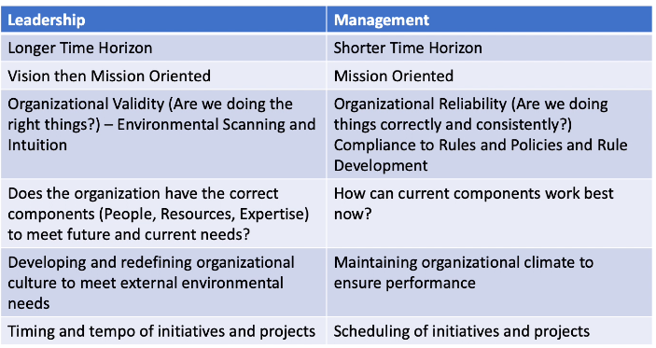
Case Study Discussion
Factors influencing leadership versus management

Slide 8
Case Study Discussion
Do Tom and Garth demonstrate effective leadership and management skills? Why or why not?
Notes:
*addresses Managerial Skills & Leadership in Teams

Slide 9
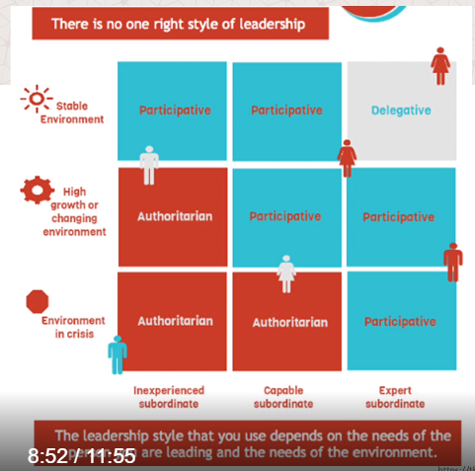
Case Study Discussion
Which leadership approach between Tom and Garth would be best in this situation?

Slide 10
Case Study Discussion
Describe the role of power and privilege as it relates to the State Epidemiologist.
  Positional Power
    Legitimate power
    Reward power
    Coercive power
    Information power
  Personal Power
    Expert power
    Referent power
Notes:
Positional Power Sources
Legitimate Power can also be referred to a 'title power', because it is the power that comes along with being appointed to a specific position.
Reward Power is typically financial when talking about a leader within a company, for example the ability to reward your team members with things like bonuses or pay raises.
Coercive Power is the opposite of reward power and is based on the ability to take things away. In the workplace this would normally mean being able to demote or fire someone.
Information Power is control of information by agent as a source of power (Added by Yukl, 1994).
Personal Power Sources
Expert Power is achieved when someone finds themselves in a position of power based on their knowledge or experience.
Referent Power is power that is not achieved by any of the above, and may be based on something intangible like popularity, attitude, or charm.

Slide 11
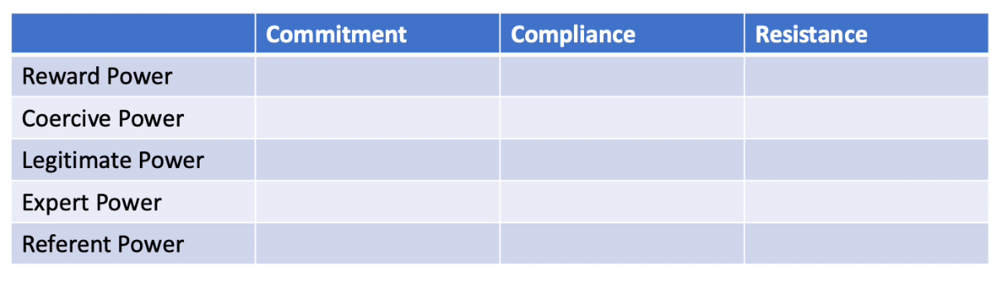
Case Study Discussion
What are some of the possible outcomes if the State Epidemiologist exercised positional power?
Notes:
Positional Power Sources
Legitimate Power can also be referred to a 'title power', because it is the power that comes along with being appointed to a specific position.
Reward Power is typically financial when talking about a leader within a company, for example the ability to reward your team members with things like bonuses or pay raises.
Coercive Power is the opposite of reward power and is based on the ability to take things away. In the workplace this would normally mean being able to demote or fire someone.
Information Power is control of information by agent as a source of power (Added by Yukl, 1994).
Personal Power Sources
Expert Power is achieved when someone finds themselves in a position of power based on their knowledge or experience.
Referent Power is power that is not achieved by any of the above, and may be based on something intangible like popularity, attitude, or charm.

Slide 12
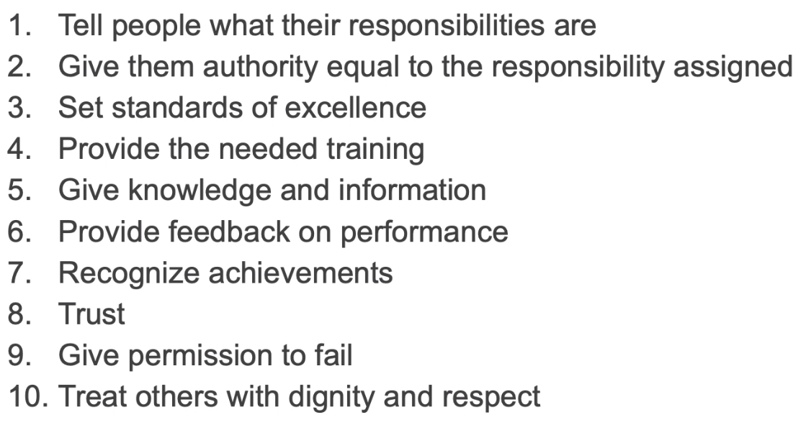
Case Study Discussion
Could the following empowerment strategies by Nichole have built commitment from Garth in the response?
Notes:
Positional Power Sources
Legitimate Power can also be referred to a 'title power', because it is the power that comes along with being appointed to a specific position.
Reward Power is typically financial when talking about a leader within a company, for example the ability to reward your team members with things like bonuses or pay raises.
Coercive Power is the opposite of reward power and is based on the ability to take things away. In the workplace this would normally mean being able to demote or fire someone.
Information Power is control of information by agent as a source of power (Added by Yukl, 1994).
Personal Power Sources
Expert Power is achieved when someone finds themselves in a position of power based on their knowledge or experience.
Referent Power is power that is not achieved by any of the above, and may be based on something intangible like popularity, attitude, or charm.

Slide 13
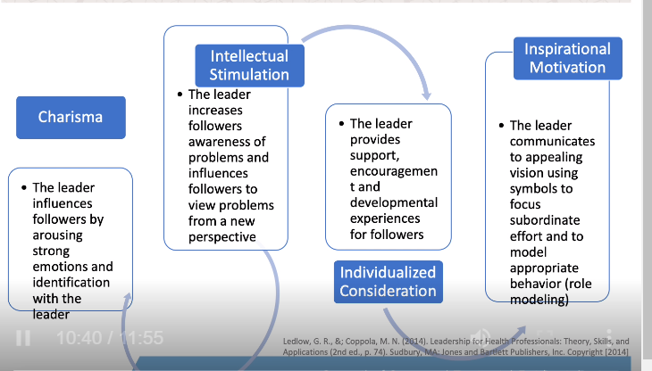
Case Study Discussion
Describe the role of transformational leadership as it relates to this case study.

Slide 14
Reflection
How did you feel about today’s case study?
What went well in this meeting?
What could be done differently for future meetings?
What topics would you like to discuss in the future?

Slide 15
Announcements
Support team engagement
  Orientation
  Support team networking
Schedule calls with coaches
Complete evaluations in Learn
Virtual Meeting sign up – Project Sharing in April and May
Next meeting – Monday, March 24th at 1pm ET

Slide 16
Case Study Discussion
Which of the following best define Tom’s leadership style?
  Authoritarian
  Participative
  Laissez-faire
Notes:
Delete

Slide 17
Case Study Discussion
What ethical issues are relevant to the situation?
How can Tom exert leadership and foster a culture of high moral and ethical standards?
Notes:
Delete

Slide 18
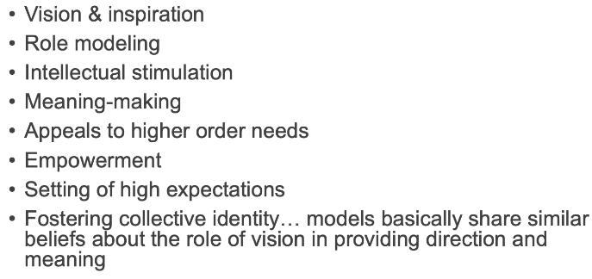
Case Study Discussion
What ethical issues are relevant to the situation?
How can Tom exert leadership and foster a culture of high moral and ethical standards?
Notes:
Delete

Slide 19
Case Study Discussion
What recommendations do you have to lead change in the organizations to improve organizational performance?
What challenges may leadership encounter when instituting change?
Notes:
Delete

