Slide 1
G360 Feedback Debrief Session
Brian Griffith, Ph.D.
G360 Surveys
brian.griffith@g360surveys.com
Notes:
*Contact support@g360surveys.com or brian.griffith@g360surveys.com with any questions.

Slide 2

We get better at
most things by trying something and then evaluating the results.
Notes:
This is also known as trial and error or experiential learning.
In some things, we get immediate feedback, i.e., playing the guitar.
How do we know if we’ve hit a good golf shot? We can see if the ball goes where we wanted it to go.

Slide 3
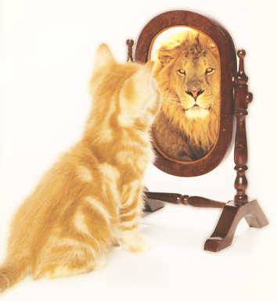
But we’re not always very good judges of our own performance.
We don’t always know ourselves very well.
Notes:
Research on self-assessment
The worse we are at something the more inaccurate our assessment
Example: a person who is singing along to a song their listening to with their headphones on (see next slide).

Slide 4

Notes:
When we don’t get feedback (because the ear buds prevent us from hearing ourselves), it might be pretty bad. We tend to sing loud and off key.

Slide 5

How am I doing?
Sometimes we need an outside perspective

Slide 6
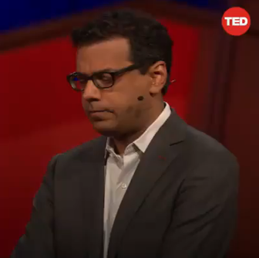
Atul Gawande
Feedback Improves Performance
https://www.ted.com/talks/atul_gawande_want_to_get_great_at_something_get_a_coach
Notes:
Atul Gawande is the author of “The Checklist Manifesto” which has dramatically improved patient safety and healthcare quality.

Slide 7
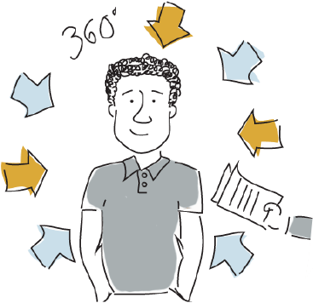
360 degree feedback comes from multiple sources such as supervisors, peers, direct reports and/or customers. Because of this, it tends to be more comprehensive and richer.

Slide 8
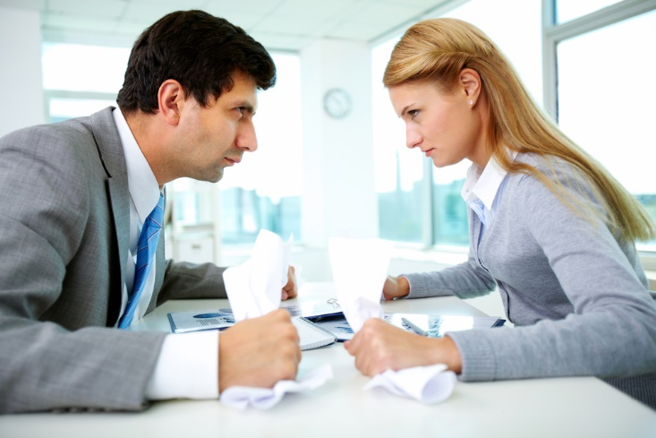
But giving and receiving feedback is not so easy.
Notes:
Passing back Team Analysis Papers in HOD 1100

Slide 9
For example, research has shown that …
Peer feedback leads to higher team performance, more positive attitudes about team experiences, and greater levels of personal development (Hansen, 2006)
Peer feedback also leads to increased self-awareness and an internalized set of leadership standards and ideals (Topping, 1998)

Slide 10

Possible Reactions to Feedback
Read “The Ways People Respond to Feedback”
Check the items that might pertain to you
Notes:
Hand out the checklist and have people identify the things they typically do when getting critical feedback. Ask a few people to volunteer to say which items they checked.

Slide 11
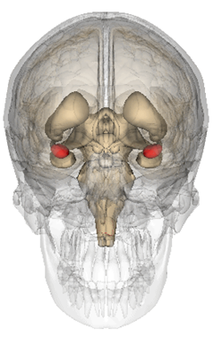

Common Reactions to Feedback
Fight
Perceived Threat
Physical
Psychological
Social
Flight
Amygdala is Activated
Notes:
Why are we so defensive!?
When we feel threatened, the Sympathetic Nervous System is activated.
- Adrenalin is released.
Pupils dilate (visual perception is focused), heart rate increases, blood flow increases to the large muscle groups to either fight (arms) or run (legs). Ironically, blood flows away from the brain.

Slide 12

Having a Growth Mindset
Performance is not a measure of personal worth
Pursue challenges and learn from critical feedback
Skills are developed through hard work and practice
SOURCE Mindset: The New Psychology of Success by Carol Dweck
Notes:
Instead of the typically fight, flight or freeze response, we need to have a growth mindset to learn from the feedback.

Slide 13




G360 Surveys are part of an automated system that allows users to give and receive feedback in the following areas.
Personal
Qualities
Interpersonal
Skills
Problem Solving
Skills
Leadership
Skills
Notes:
These are the standard areas that G360 surveys measure. Specific surveys follow. Just show the survey that your debriefing.

Slide 14
G360 Emerging Leader Competencies
Personal Qualities
Interpersonal
Skills
Problem Solving
Skills
Leadership
Skills
Integrity
Dependability
Work Ethic
Self-Awareness
Respect for Others
Social Awareness
Communication
Collaboration
Problem Analysis
Creativity
Decision Making
Learning Orientation
Optimism
Initiative
Coordination
Encouragement
* These are the same competencies used in the team member report

Slide 15
G360 Feedback Reports
Easy to understand
Embedded with development and training resources
Includes a personal development planning worksheet

Slide 16
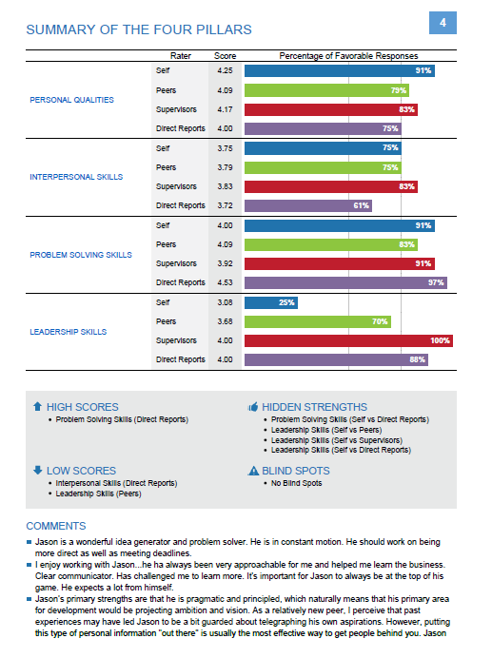
Percentage of Favorable Responses
Interpretation of Scores
Open-ended Feedback

Slide 17
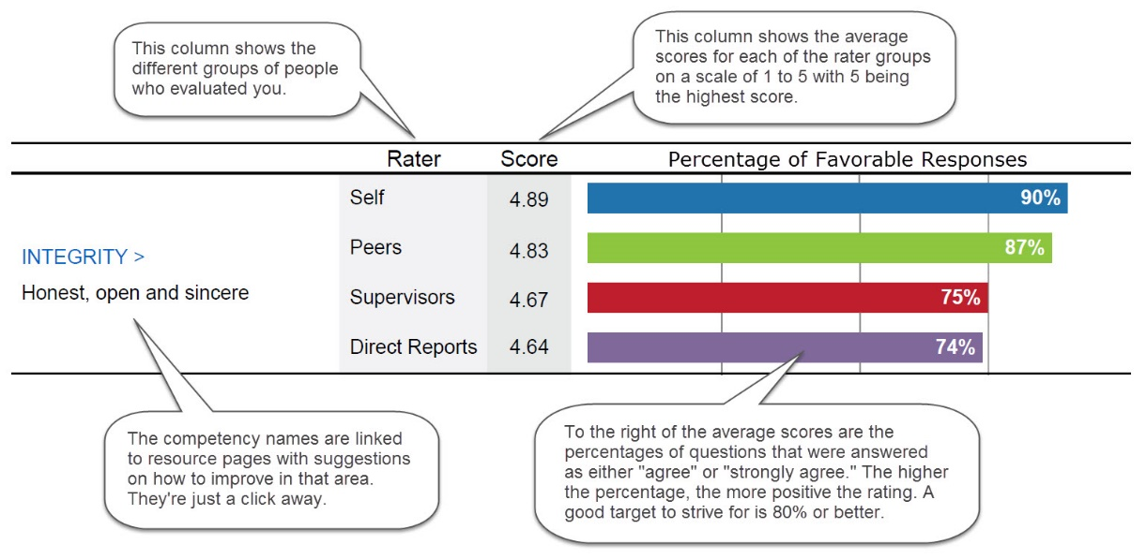
Understanding the Bar Graphs

Slide 18
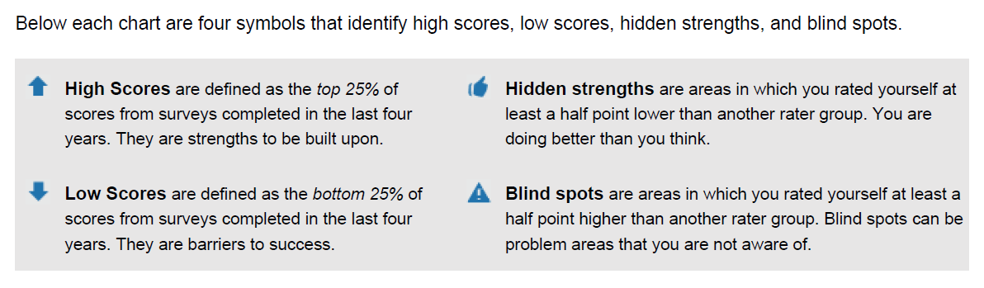
Interpretation Box

Slide 19
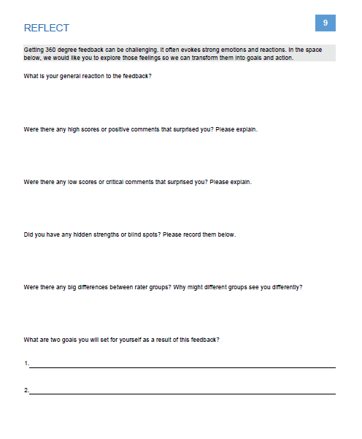
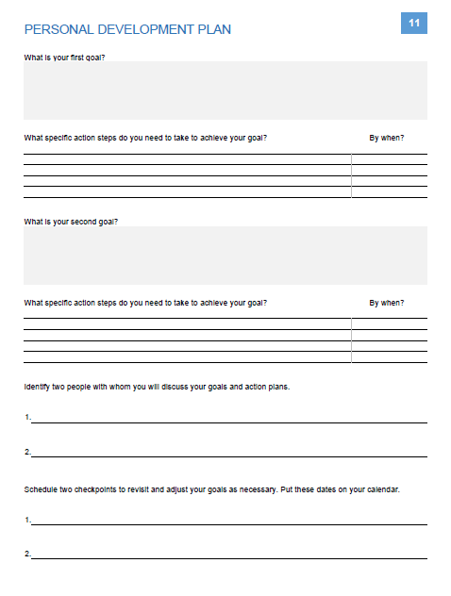
Notes:
Emphasize the importance of having people complete a personal development plan. That’s where the feedback and new insights get turned into action.

Slide 20

Embedded Training Resources
Users can click on the names of any of the 16 competencies in the reports for detailed definitions, action plans and recommended books, articles, and videos to watch. >>>

Slide 21

Team Survey
Shared Vision
Task Management
Communication
Psychological Safety

Slide 22
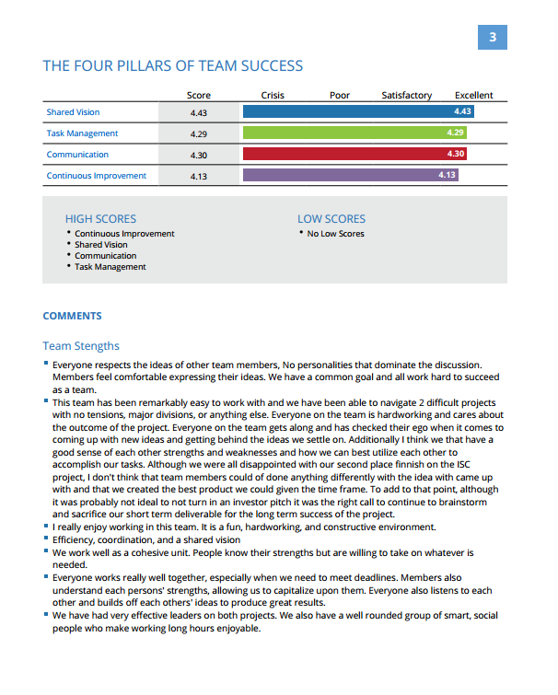
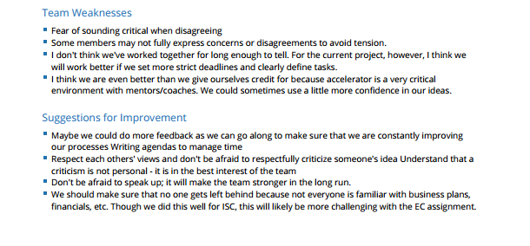
Excellent (4.0-5.0)
Satisfactory (3.0-3.99)
Poor (2.0-2.99)
Crisis (1.0-1.99)
High scores are above 4.0
Low scores are below 3.0

Slide 23
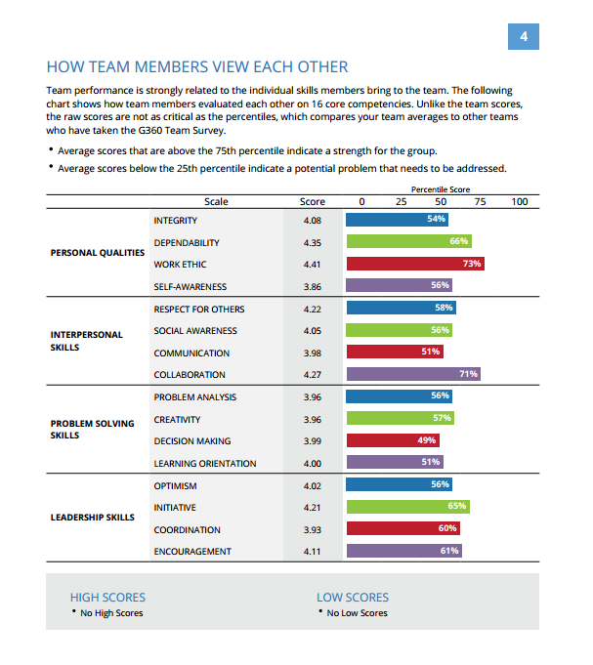
Team averages show the collective strengths and weaknesses of the team

Slide 24
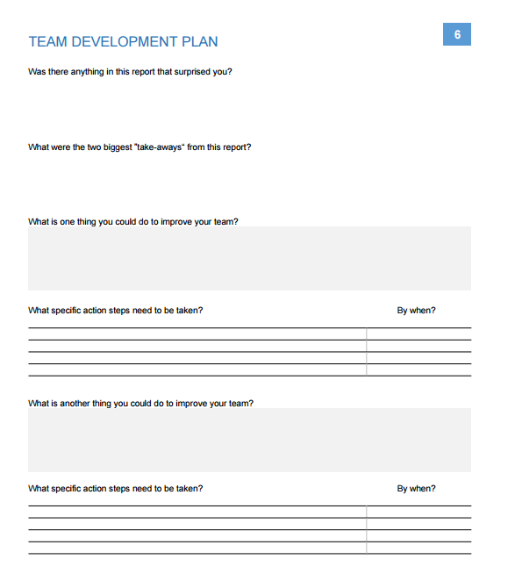

Slide 25
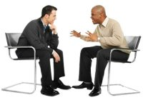
Coaching Sessions (Optional)
Unpack the feedback
Process any feelings
Identify two areas to improve
Create a specific action plan

Slide 26

The Development Process
Set reasonable goals
Create a detailed plan
Work the plan diligently
Follow-up / Get more feedback*
* Leadership is a Contact Sport by Marshall Goldsmith and Howard Morgan

