Slide 1
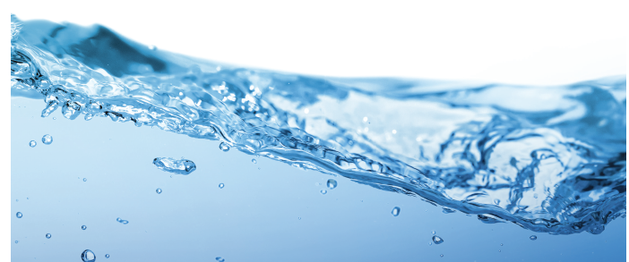
Preventing and Investigating Legionnaires’ Disease Outbreaks
Water Safety Plans, the CMS Mandate, and the role of Legionella Sampling
David Krause, PhD, MSPH, CIH
Certified Industrial Hygienist / Toxicologist
Co-Author of 2015 AIHA Legionella Guideline

Slide 2

CDC: June 2016-2017
450% Increase reported cases since 2000
Fatalities in 10% to 25% of persons infected
Examined 23 outbreaks
11 of 23 (49%) in healthcare facilities
2018 on track with 2017

Slide 3
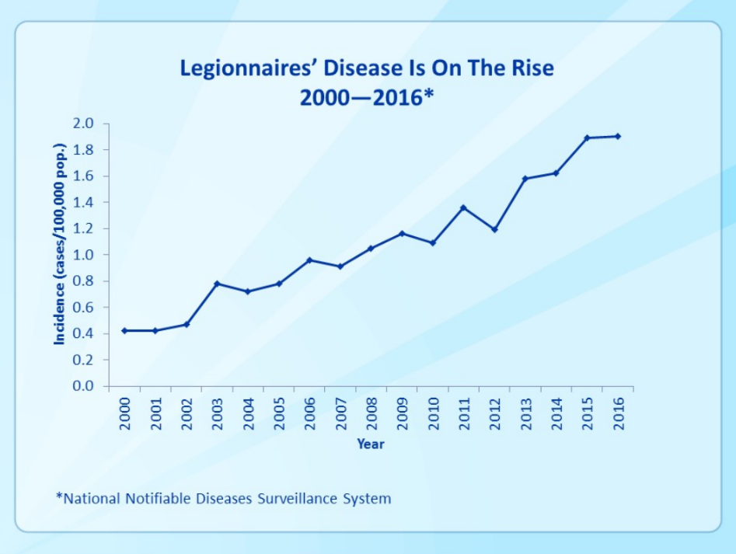
The Cause(s) of this Trend?
Source: Centers for Disease Control

Slide 4
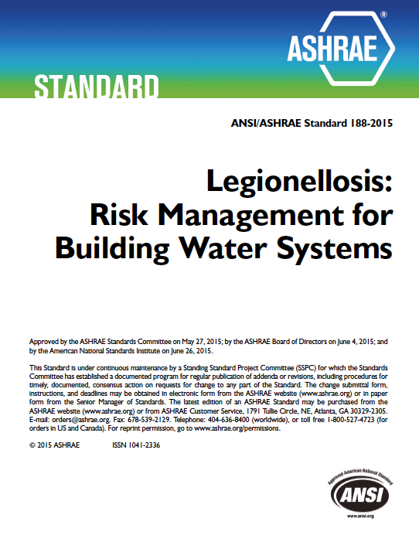
ASHRAE Standard 188-2015
water management program (program): (WMP) the risk management plan for the prevention and control of legionellosis associated with building water systems, including documentation of the plan’s implementation and operation.
ASHRAE Standard 188-2015 Legionellosis: Risk Management for Building Water Systems.
  Management system based on HACCP.
  Establishes minimum risk mgmt. requirements for building water systems.
  Develop water-system schematics of potable and non-potable water systems.
  Determine where control measures are applied and monitored.

Slide 5
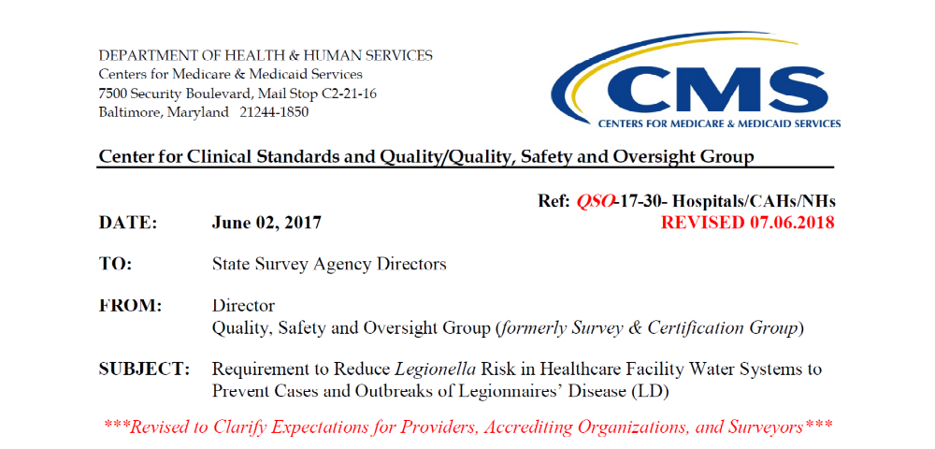
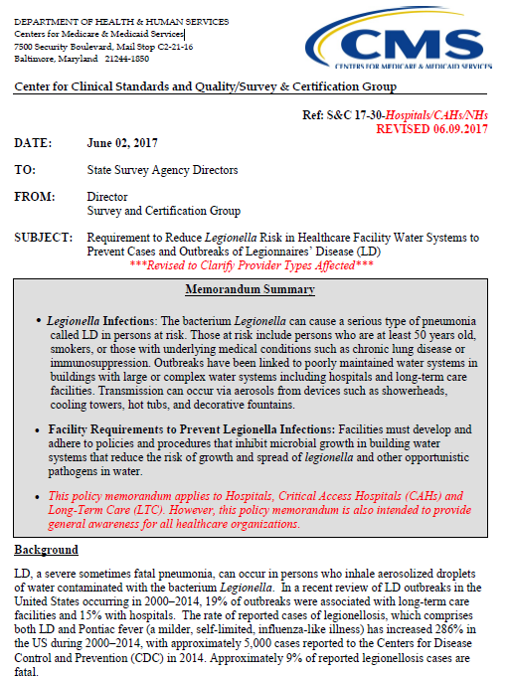
Effective Date: Immediately. This guidance should be communicated with all survey and certification staff, their managers and the State/Regional Office training coordinators within 30 days of this memorandum.

Slide 6
Why are WMPs Important?
Records may become valuable information during an outbreak investigation.
Environmental Isolates may already be available from the period when exposure occurred.
Allows for operators of suspected sources to implement their “contingency response plan”.
However, many written plans are not complete, compliant, or implemented.
CSTE should consider WMPs and how they can be integrated as part of outbreak, healthcare, and occupational exposure investigations.

Slide 7
Who is Impacted by CMS?
“This policy applies to…”
Hospitals
Critical Access Hospitals
Long Term Care
…intended as general awareness for ALL healthcare organizations
Who is Impacted by ASHRAE 188?
Just about everyone else…
Not Single Family Residential
Not a Regulatory Standard, but may be seen as a “Standard of Care”.

Slide 8
Water Management Program
Establish a Water Management Team
Perform a Water System Survey and Prepare Diagrams of building water systems
Conduct a Facility Risk Assessment to identify areas where Legionella and other waterborne pathogens could grow and spread in the facility water systems
Establish acceptable ranges for control measures and operations*

Slide 9
Water Management
Implement a water management program that considers ASHRAE industry standard and the CDC tool kit, and includes control measures
Perform Verification and Validation
  Verification = Documenting that you are doing what your plan says
  Validation = Documenting that what you are doing is achieving your objectives (i.e. controlling the growth of waterborne pathogens), which is typically achieved through sampling of water and systems for the pathogens you are trying to control.

Slide 10
Water Management
Keep records of measurements and corrective actions*
Periodically review and update the plan
This is a continuous improvement model for the life of the building
You are establishing a written “standard of care” for your facility.
If your Plan/Program fails to meet acceptable or normal practices, and cases of disease occur, expect criticism from investigating authorities.

Slide 11
Corrective Actions*
What is your “Contingency Response Plan”?
  When you have a suspected or confirmed Case of LD
  When you have an outbreak
  When you have a boil water notice
  When your validation samples come back positive
  When your control measures go “off the rails”
  When you undergo construction or other high-risk activities
  Your water supply source is interrupted
Interim Measures (i.e. POU Filters, Bottled Water, Water Restrictions)
Long-Term Measures (i.e. POE Treatment, Engineering Modifications, Disinfection & Cleaning)

Slide 12
CMS Requirements
Develop and implement a water management program that “considers ASHRAE 188 Standard and the CDC Toolkit”.
CMS goes BEYOND ASHRAE and CDC guidance.
Specify testing protocols and ranges for control measures.
Choose your threshold and limits wisely.
Select measurement methods and techniques that are valid, reliable, and relevant.
Use trained, experienced, and qualified personnel to collect samples.
Use a certified laboratory to analyze samples.

Slide 13
CMS Requirements
Establish a documentation program for all test results AND corrective actions for when control limits are not maintained.
Creates a MOUNTAIN OF DATA.
How does data on paper in log books get analyzed?
Outside contractors may not participate and record all of their corrective actions.
Contracts for Cooling Tower Service providers probably do not comply with the WMP.
Validation of Program Effectiveness and Corrective Actions or Treatment performed by person or vendors who are responsible for doing the work “Self-Grading” homework poses a risk.

Slide 14
CMS Requirements
Comply with all other applicable Federal, State, and Local requirements.
A litany of water-related requirements exist that either limit your actions or increase the risk of Legionella amplification within water systems.
Safe Drinking Water Act (SDWA)
Cooling Tower Regulations (NYC and New Orleans)
Scalding Limits in Plumbing Codes and Healthcare Regulations
Water Conservation Requirements
Disposal of chlorinated water limits…
Chemical Rx must comply with FIFRA, and sometimes State regulations as a Biocide

Slide 15
How to Quickly Assess a WMP
Was it written by “Corporate” and does it “Apply to ALL Facilities”?
Are the individual NAMES of the WMT listed?
Review the Meeting Minutes of last few WMT Meetings.
Review the Corrective Actions Log.
Review the Contingency Response Plan for each System.
Is there a Water System Schematic, such as…

Slide 16
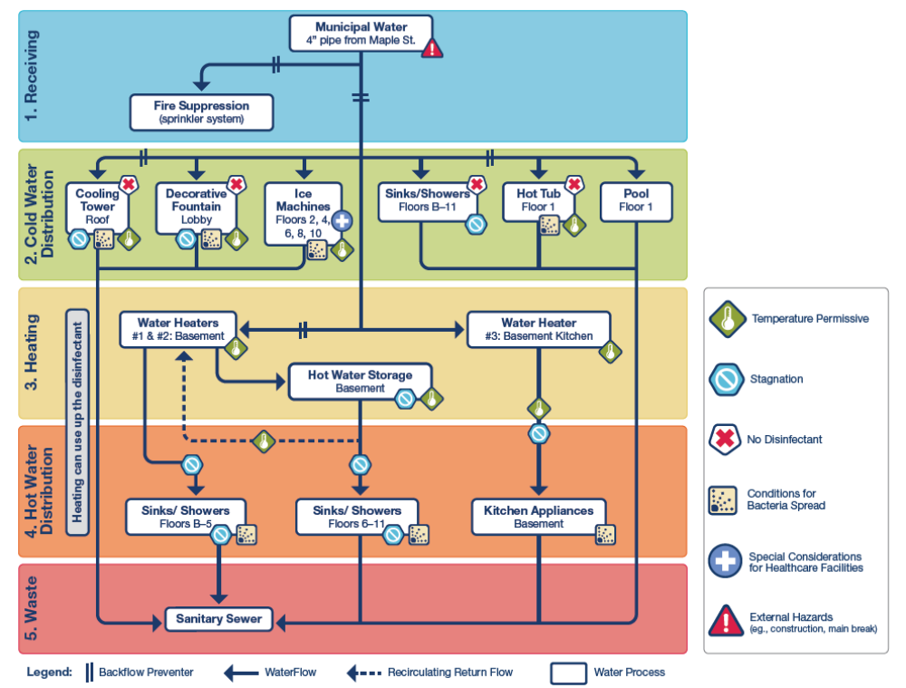

Slide 17
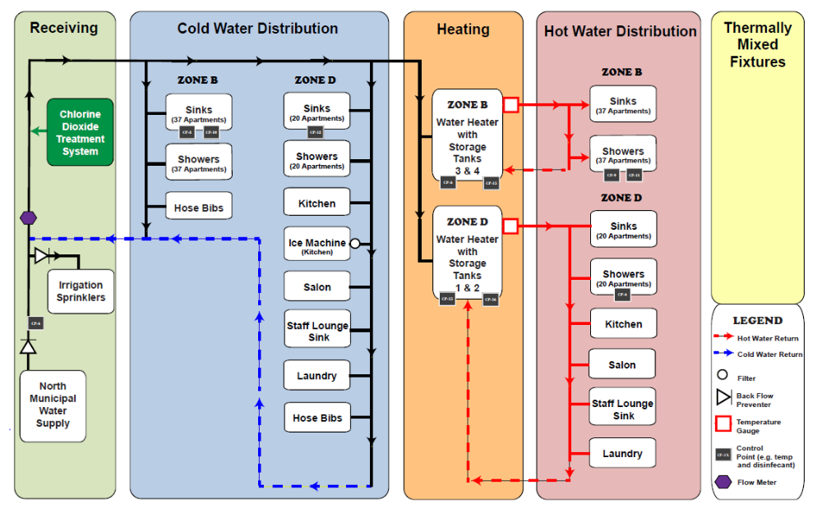

Slide 18
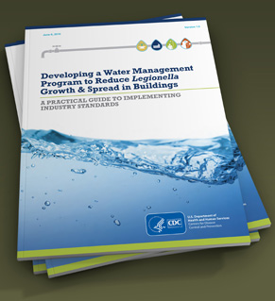
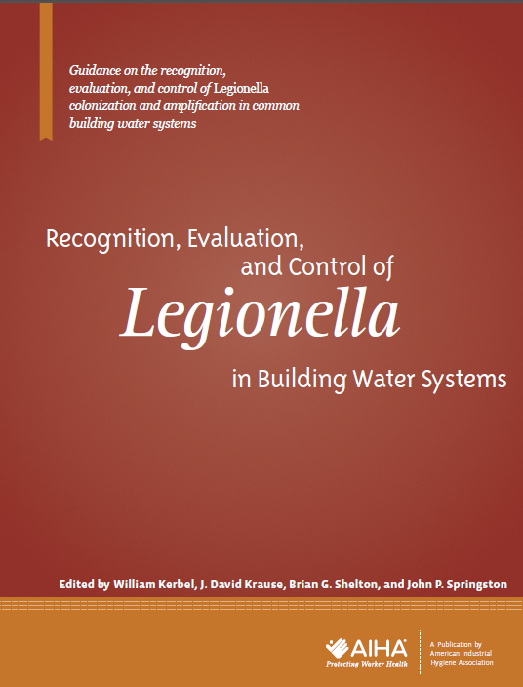
What is a Legionella Source Risk Assessment?
Not defined in ASHRAE 188
Not defined in CDC Toolkit
Is defined in AIHA Guidance on the Recognition, Evaluation, and Control of Legionella in Building Water Systems
Routine vs. Investigative
“The primary goal of a Legionella risk assessment is to identify potential amplification sites and transmission sources…in order to minimize exposure risks”

Slide 19
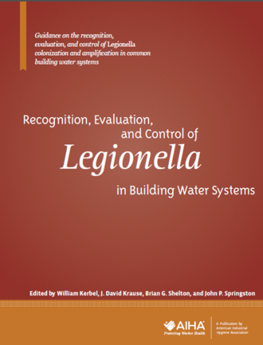
AIHA Guideline
Recognition, Evaluation, and Control of Legionella in Building Water Systems
Incorporates industrial hygiene approaches.
Focuses on proactive prevention.
Prevent disease through source identification, risk assessment, and control.
Avoiding exposure to Legionella amplification sources through effective source identification and control holds the most promise to prevent outbreaks and sporadic cases of Legionnaires’ disease.

Slide 20
Industrial Hygiene Approach to Legionella Prevention
Industrial Hygiene is defined as “that science/art devoted to the anticipation, recognition, evaluation, and control of those environmental factors or stresses arising in or from the workplace, which may cause sickness, impaired health and well-being, or significant discomfort among workers or among citizens of the community.”

Slide 21
According to the CDC (2017 Toolkit)
“Legionella is found naturally in freshwater environments, like lakes and streams, but generally the low amounts in freshwater do not lead to disease. Legionella can become a health problem in building water systems. To pose a health risk, Legionella first has to grow (increase in numbers). Then it has to be aerosolized so people can breathe in small, contaminated water droplets.”

Slide 22
Industrial Hygiene Approach to Legionella Prevention
The American Industrial Hygiene Association recommends that Legionella amplification sites, reservoirs, and sources of exposure be proactively identified using validated reliable laboratory methods to measure viable Legionella bacteria concentrations.
Secondary water measurements used as indicators of conditions that can allow Legionella amplification should not be relied upon to validate control measure effectiveness.

Slide 23
Industrial Hygiene Approach to Monitoring Control Measures for Legionella
Validation of control measures for Legionella and other waterborne pathogens typically relies upon collecting and analyzing samples for Legionella.
With Legionella often found to be present in municipal water supplies and building water systems, the only way to know if amplification is occurring is by sampling.
The concentration of Legionella in building water systems is one of several factors that indicate if it is growing or amplifying.

Slide 24
Interpreting Legionella in Water Samples
Sample Source | Non Detectable | Acceptably Low* | Action | Possible Amplification | Action | Indicates Amplification | Action
Humidifiers & Misters | <1 CFU/mL | <1 CFU/mL | 1 | 1–10 CFU/mL | 2 | >10 CFU/mL | 3
Decorative Fountains and Water Features | <1 CFU/mL | <1 CFU/mL | 1 | 1–10 CFU/mL | 2 | >10 CFU/mL | 3
Hot Tubs, Whirlpools and Spas | <1 CFU/mL | <1 CFU/mL | 1 | 1–10 CFU/mL | 2 | >10 CFU/mL | 3
Potable Water | <1 CFU/mL | <10 CFU/mL | 1 | 10–100 CFU/mL | 2 | >100 CFU/mL | 3
Industrial Working Fluids | <1 CFU/mL | <10 CFU/mL | 1 | 10–100 CFU/mL | 2 | >100 CFU/mL | 3
Cooling Towers & Evaporative Condensers | <10 CFU/mL | <100 CFU/mL | 1A | 100–1,000 CFU/mL | 2A | >1,000 CFU/mL | 3A
AIHA 2015 Guideline Table 3.1

Slide 25
Sources of Legionella Amplification or Exposure
Cooling Towers

Slide 26
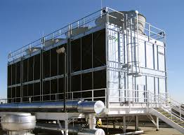
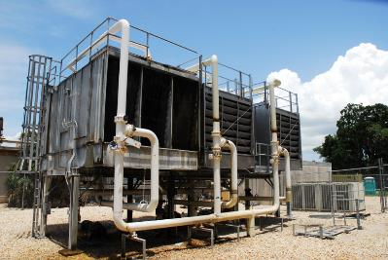
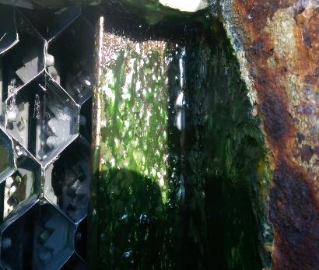
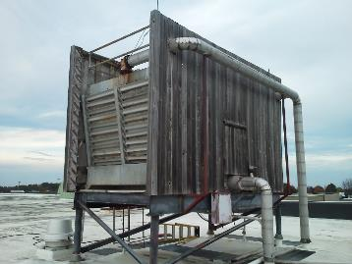

Slide 27
Sources of Legionella Amplification or Exposure
Cooling Towers
Potable (Municipal ) Water Systems
Water Heaters

Slide 28
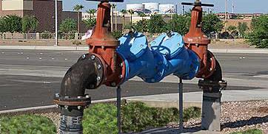
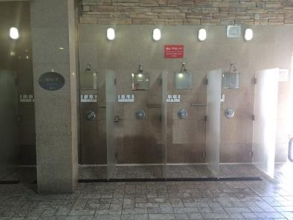
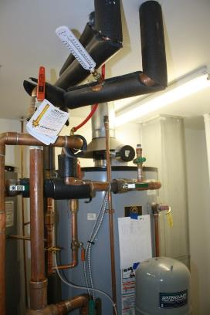
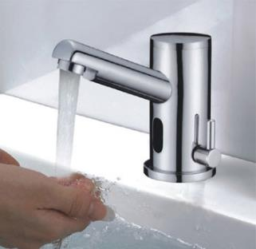
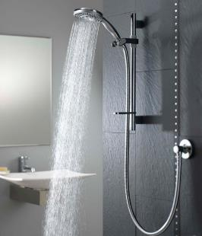

Slide 29
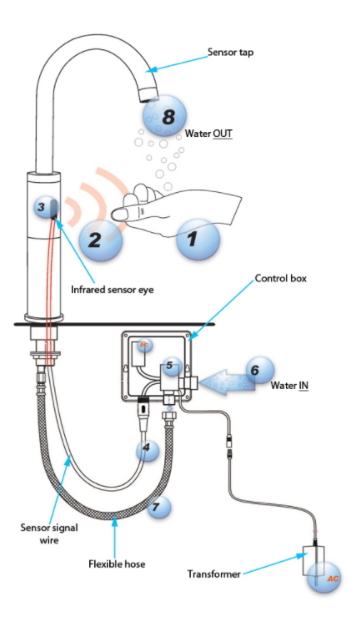
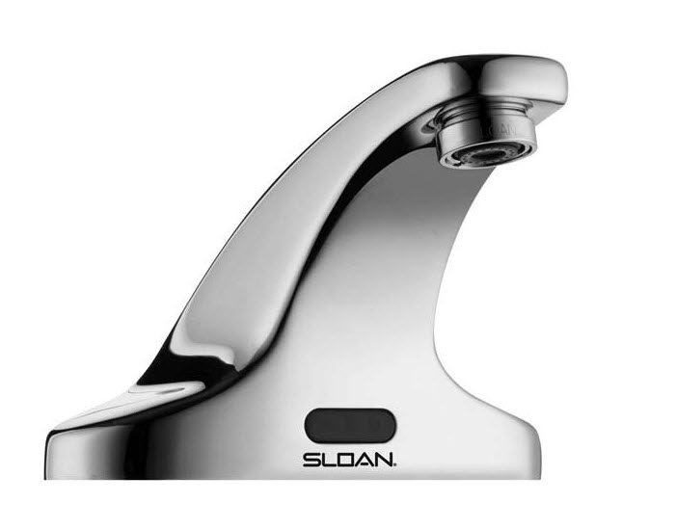

Slide 30
Sources of Legionella Amplification or Exposure
Cooling Towers
Potable (Municipal ) Water Systems
Water Heaters
Hot Tubs or Spas

Slide 31
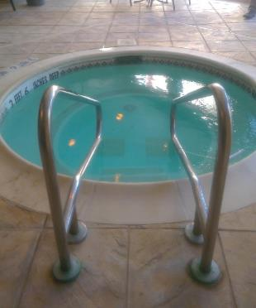
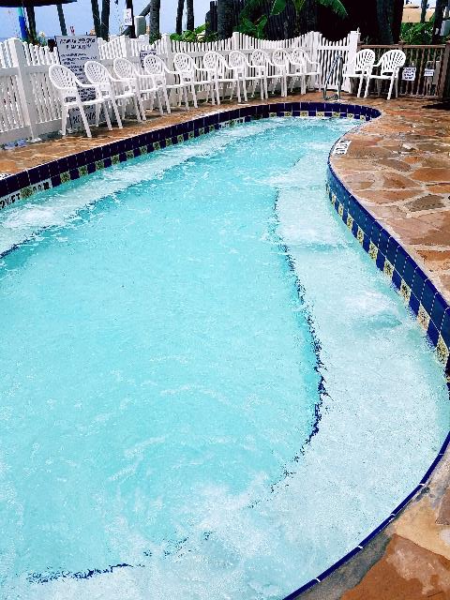
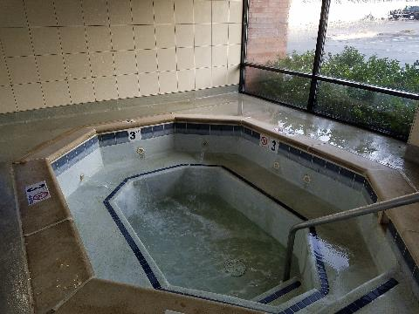

Slide 32
Sources of Legionella Amplification or Exposure
Cooling Towers
Potable (Municipal ) Water Systems
Water Heaters
Hot Tubs or Spas
Decorative Water Features

Slide 33
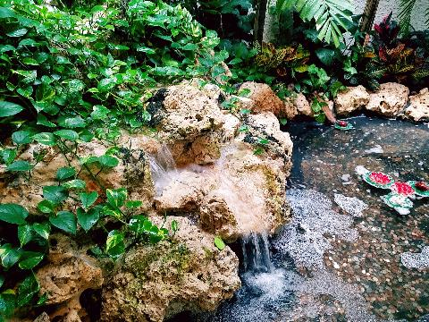
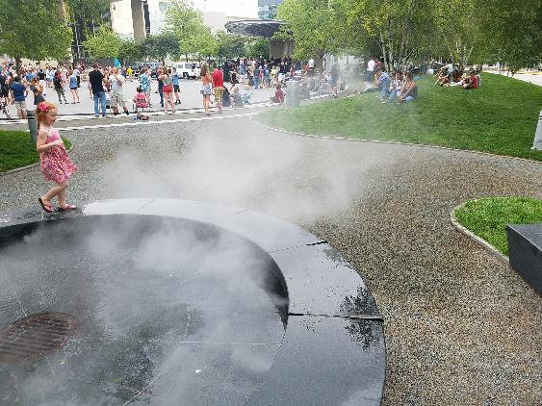
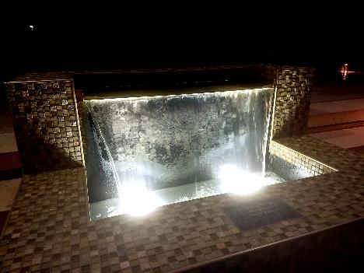
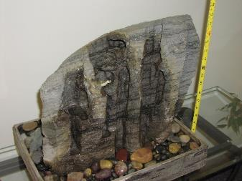

Slide 34
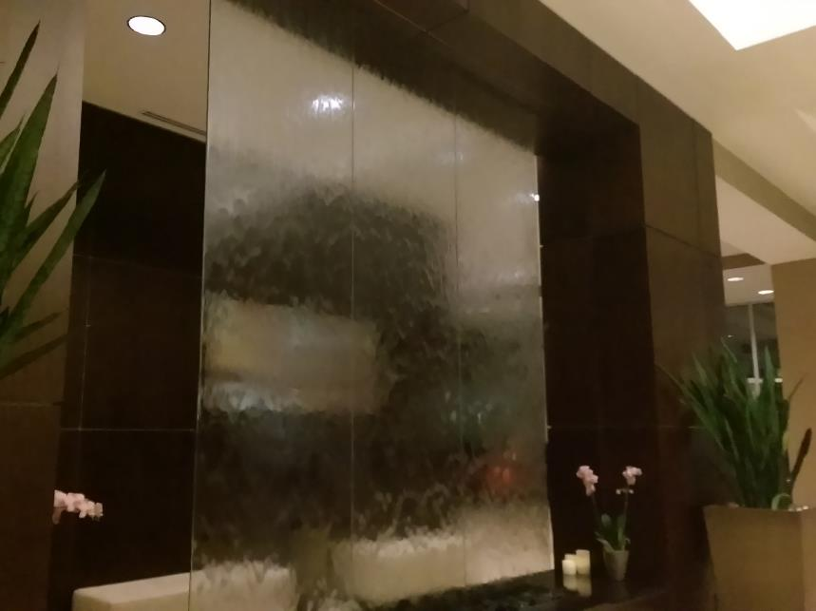
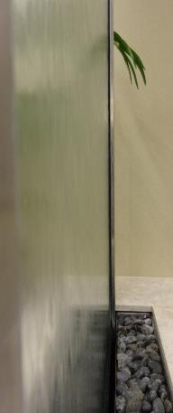
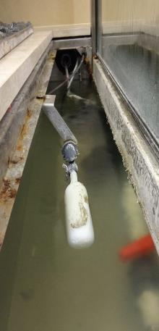
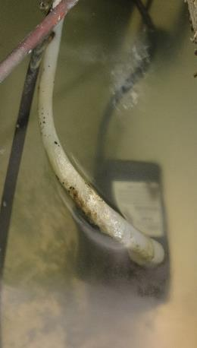

Slide 35
Sources of Legionella Amplification or Exposure
Cooling Towers
Potable (Municipal ) Water Systems
Water Heaters
Hot Tubs or Spas
Decorative Water Features
Mist Generating Sources
  Produce Misters and Humidifiers (not steam)

Slide 36
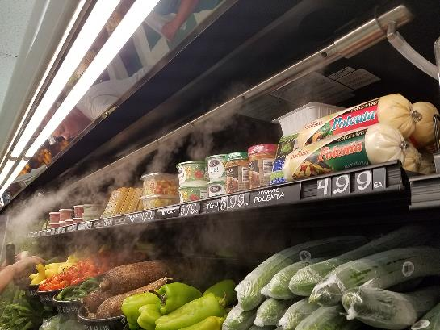
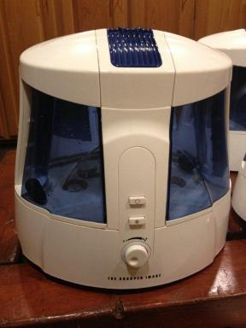
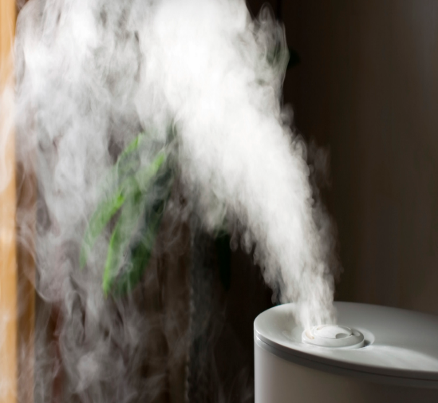
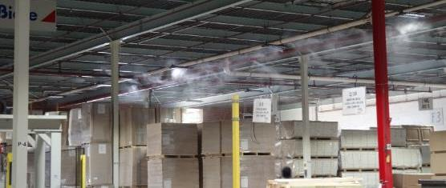

Slide 37
Sources of Legionella Amplification or Exposure
Cooling Towers
Potable (Municipal ) Water Systems
Water Heaters
Hot Tubs or Spas
Decorative Water Features
Mist Generating Sources
  Produce Misters and Humidifiers (not steam)
Other…
  Hose Bibs
  Construction Equipment
  Pressure Washers
  Etc.

Slide 38
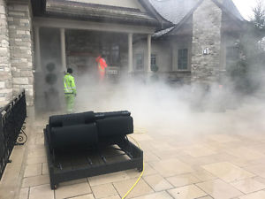
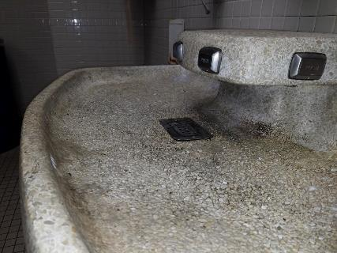
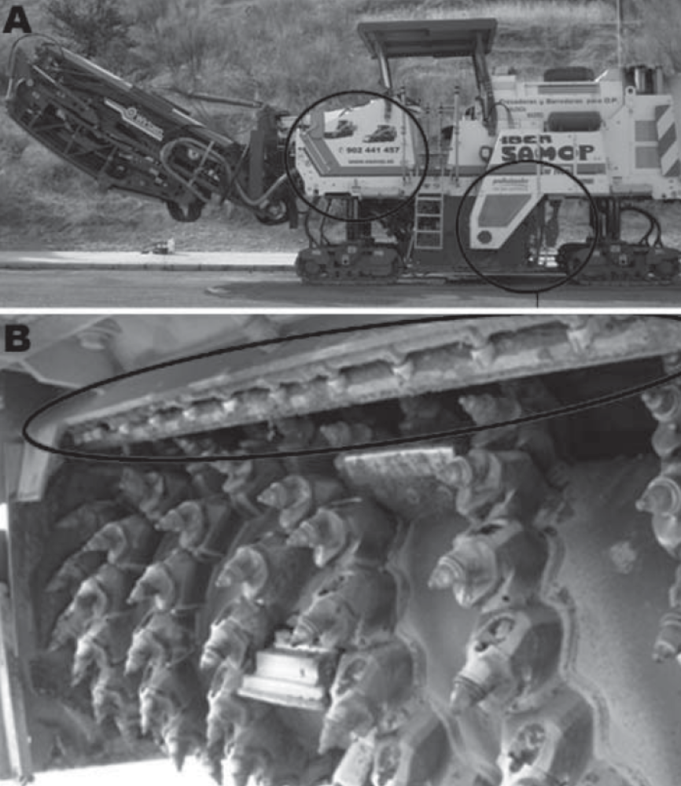
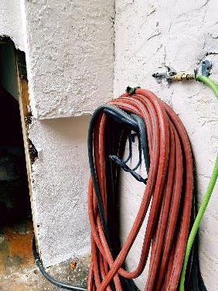

Slide 39
Question & Answer Session

Slide 40
Thank You!
Forensic Analytical Consulting Services, Inc.
Right
People.
Right
Perspective.
Right
Now.

