Slide 1
Purple Heart Presentation on Opioid v2

Slide 2
Our Purpose for syndrome surveillance
The Purpose is for situational awareness affected by public health concern regarding how drug-use affects deaths, communicable disease, comorbidities (such as heroin users at risk for hep c) associated with public health crisis.

Slide 3
Evaluating the Opioid V2 query
We did not change the query definition classifiers but different regions use different classifications. We did discuss how certain classifiers affect the output by determining if outcomes are intentional or not intentional overdose.

Slide 4
Caveats for data validity
One concern is data may be very different based on how chief complaints are entered into different health care systems. Many health care systems are not sending diagnosis and data quality is higher for systems that do. Using tools such as the phin guide to govern how data is collected can creation for consistency in data. Filtering data based on diagnostic codes and caparative text can vary data results.
We discussed how actions such as prevention messaging can respond to public health crisis based on data findings. Social messages that educate the public awareness to different alerts.

Slide 5
Taking Action
We discussed how actions such as prevention messaging can respond to public health crisis based on data findings. Social messages that educate the public awareness to different alerts.

Slide 6
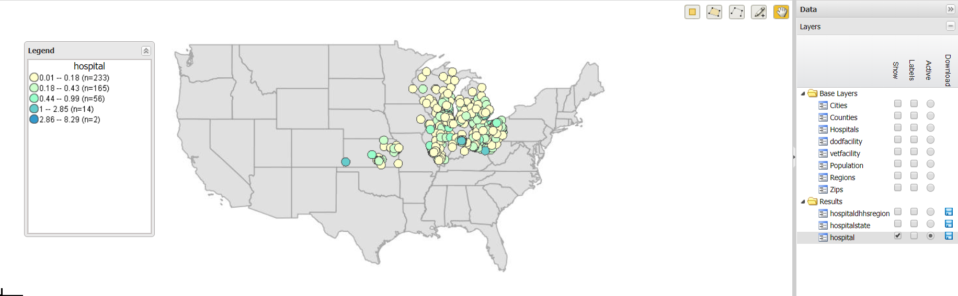

Slide 7
