Slide 1

New Mexico DOH
ELR Onboarding Development Project
CSTE Presentation
11 AM, November 5, 2019
1190 S. St. Francis Drive • Santa Fe, NM 87505 • Phone: 505-827-2613 • Fax: 505-827-2530 • nmhealth.org

Slide 2
Business Need for Project
There is no current standard process for ELR onboarding.
The process depends on the efforts and knowledge of current employees.
Past ELR onboarding efforts have experienced numerous issues.
Process stakeholders disagree on components of the process.
Onboarding labs and hospitals receive insufficient documentation when onboarding ELRs.
All process stakeholders need a consistent, documented process that implementors can use repeatedly and does not depend on the knowledge of one employee.
2

Slide 3
Project Objectives
Develop desired ELR Onboarding Process by engaging stakeholders in process analysis. Stakeholders include:
  Infectious Disease Epidemiology Bureau Informatics Data Team
  NM Health Information Collaborative
  SMEs
  Trading Partners
Identify and develop standard operating procedures for each step
Identify parties and responsibilities in ELR Onboarding process
Review and revise supporting NM Health Information Technology website
Develop and vet documentation required for ELR Process. Documents include:
  Trading Partner Questionnaire (TPs complete at beginning of process)
  ELR Onboarding Handbook
  ELR Onboarding Trading Partner Agreement
  Electronic Laboratory Reporting Guidance (Condition/Test/Result List developed from SME input)
  Structural and Content Testing Checklists
3

Slide 4
A Big
THANK YOU!!!!
To Tennessee for Document Templates
4

Slide 5
Project Timeline
August September October November
Planning (Charter, Schedule, Communication Plan) 8/05-8/28
Process Development 8/05-10/4
Document Development 08/05-11/18
Project Closure 11/18-11/27
5

Slide 6
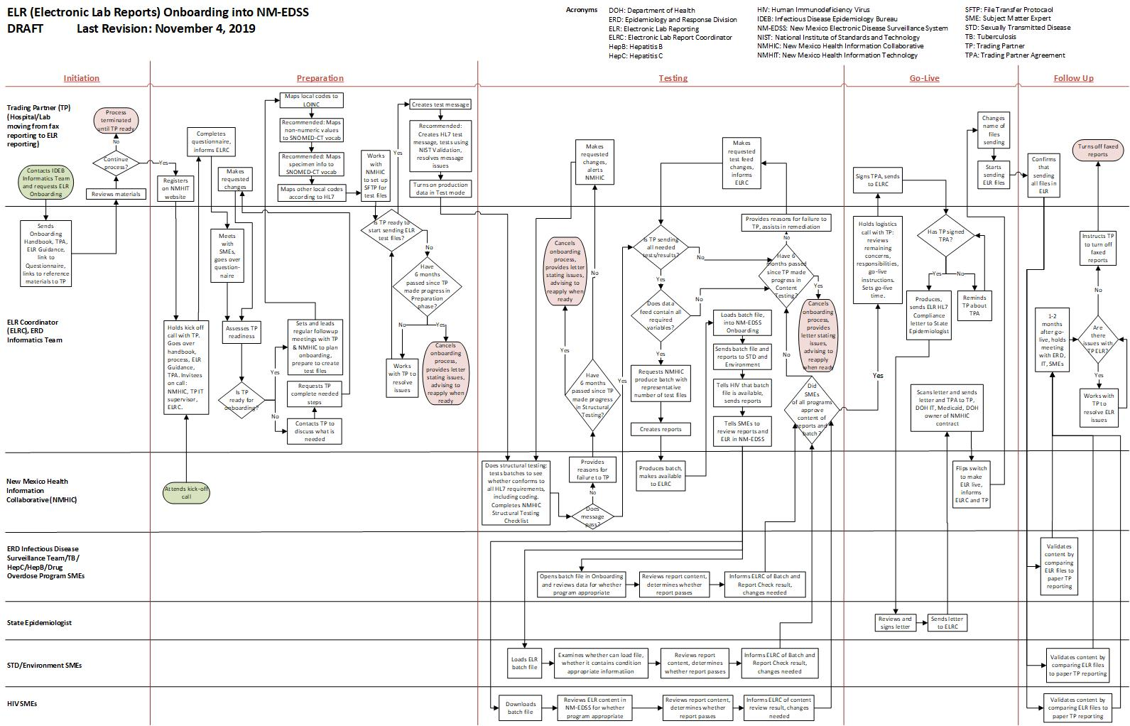
ELR Onboarding Process Flow
6

Slide 7
Accomplishments to Date
Planning Completed: Project Charter, Schedule, Communication Plan, Risk/Issue/Decision Log developed
Process Developed: Flow developed, revision continues as documents revised
Stakeholders engaged: SMEs, Bureau Leaders, Trading Partner included in orientations, information gathering, document review, updates
Review of TN documents for templates. THANK YOU TO Tennessee!!
Documents Developed: First draft completed. Documents currently being revised
  Trading Partner Questionnaire (form developed)
  ELR Onboarding Handbook
  ELR Onboarding Trading Partner Agreement
  ELR Guidance (Condition/Test/Result List developed from SME input)
  Structural Testing Checklist
NMHIT Website Revision: Website reviewed; workgroups engaged in website revamp over the next month
7

Slide 8
Next Steps and Timing
Complete document revision, review, signoff—11/22
Complete and test NMHIT website revision—11/31
Complete Pilot Onboarding—Q2 2020
8

Slide 9
Questions for CSTE team
Do other states require SNOMED for non-numeric results? Specimen information?
How do other states ensure that laboratory/hospital is sending all results?
Do other states require signing an agreement that sets out expectations once in production?
How do other states prioritize the order of laboratories/hospitals to onboard?
9

Slide 10
Thank you!
For further feedback, questions, please email Amy Drake at Amy.Drake@state.nm.us
10

