Slide 1
MN – ELR Auditing Project

Slide 2
ELR Audit Road map
Started January, 2019 with CSTE AITT
Informal evaluation on all program area lab audits – varied by program and facility
  Identify other options for audits – challenge set
Program agreement on what information was needed for audits
MEDSS Ops determined which fields to monitor for ELR data quality
Worked on creating R code to break down ELR messages and identify errors
2018
Beginning
2019
Initial idea from EIP request for lab audit using ELRs
Apply for CSTE AITT
Data dashboard to monitoring incoming data quality, data trends
Expand to eCR(?)
2019
2020
PDF report
  Familiarize ourselves with data and errors to build dashboard(s)
Test R code for corrections
Gather Feedback from external partners

Slide 3
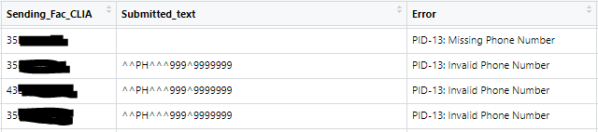
ELR Steps
Receive ELRs at MDH
Grab submitted messages from database and run through R code
R code breaks messages into individual segments
  Focus on: PID, PV1, ORC, OBR, OBX, SPM (2.5.1 version)
Identifies different types of errors and outputs list by submitter

Slide 4
Project Challenges
Finding consensus across all programs on auditing in general
Technical solution for data storage and data visualization
Drilling down by program/disease for the audit
  i.e. culture tests
Evolving lab landscape (test catalogs always changing; which reference labs are used)
Meeting with external partners

Slide 5
Impact on ELR Auditing
Less reactive
  More actively monitoring
More timely and complete data – quicker aberration detection
  Help with test catalog updates and reference lab changes
Assist with quickly reviewing onboarding
EIP staff – less time auditing and more time for program activities

Slide 6
MN Recommendations
Look at other states
  Code, visualization, which fields to review
Find a project champion in EIP program to work with
Ask open ended questions
Allow dedicated staff time to the project
Watch tone when communicating with external partners on changes
Think bigger picture – how can some of this be used/implemented for eCR?

Slide 7
Thank you.
Ann Kayser (ann.kayser@state.mn.us)
Sarah Solarz (sarah.solarz@state.mn.us)

