Slide 1
SOGI Data in Lab Messages
Finding a standard solution

Slide 2
SOGI
Sexual Orientation and Gender Identity
HL7 Gender Harmony Project
Goal is to represent the concepts the same way in ALL HL7 product family standards
Provide the proper answers and related codes as per the transgender community representatives
has been published here: http://www.hl7.org/implement/standards/product_brief.cfm?product_id=564
Next Steps:
Ballot in September 2022 cycle for the cross-paradigm guide
Reconcile comments and publish as soon as possible – assume Q4 2022 or Q1 2023
Publish update to underlying HL7 base standards (v2 and CDA)
  If that needs a ballot then Ballot in Jan 2023 cycle and publish in Q2-Q3 of 2023

Slide 3
Legislation for SOGI data in Lab Messages
Background confluence page from OO: SOGI
CA in ELR messages for COVID-19 reporting
  since late 2020
  HL7 provided a solution in Feb 2021 (AOE question OBX under the OBR for the COVID test)
NJ in ALL lab messages for ALL lab tests [MY READ – so NJ please correct me!]
  Effective 180 days after effective date – so some time in May 2022
  Calls out use of HL7 standard fields for use
  Includes race and ethnicity values (that may need to be looked at, too)
  Includes list of concepts to use for SOGI
  Labs need to collect, if they have patient contact at specimen collection, else data expected from the EHR-s
  Includes fines for vendors if non-compliant

Slide 4
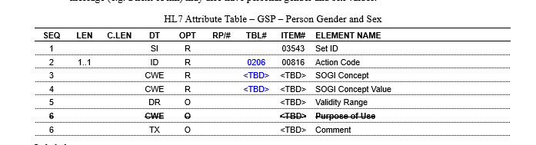
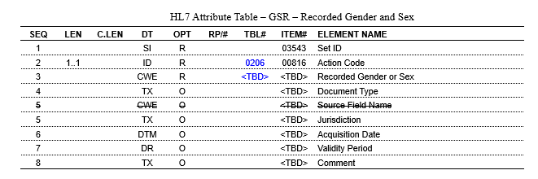
Current long term v2 proposal
3 proposed segments:
GSP = self-declared
GSR = in records
GSC = Sex for clinical Use

Slide 5
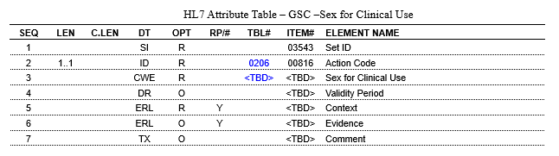
Current long term v2 proposal (cont.)
GSC = Sex for clinical Use
Slightly different form the others – will need the clinical context – right now proposed to be in the same place (after PID and use a pointer GSC.5 for context and GSC.6 for evidence)

Slide 6
PID/ zGSP
z segment like NEW GSP segment after PID
PID/ zOBX
z segment like OBX after PID
Potential Options
OBR/ AOE OBX
OBX like AOE (after every OBR)
OBR/ AOE OBX
Panel for SOGI data, reported in OBX
PID/ NTE
NTE after PID

Slide 7
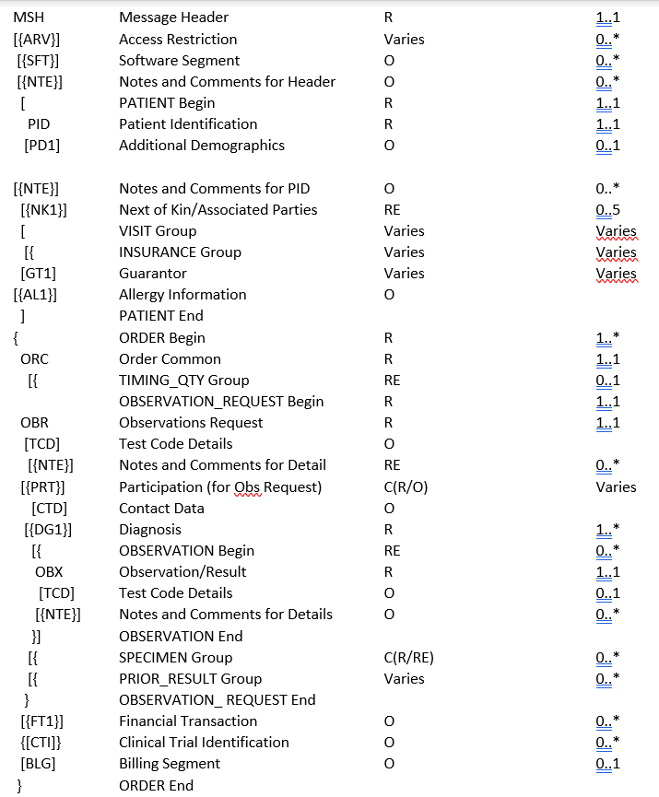
Z Segment after PID – like NEW GSP segment
PID/ zGSP
PROS | CONS
structured data (same as in the new GSP segment), so only update is to change name of the segment when overall SOGI solution for v2 is ready as long as there are | Using z segment (not best practice)
 | some partners cannot take z segments
zGSP SOGI RE 0..*

Slide 8
Z Segment after PID – like OBX segment
PID/ zOBX
PROS | CONS
structured data (same as in the new GSP segment) | this won’t include the timeframe (no end date) unless we update the standard and pre-adopt it before it is published
provides more flexibility for other topics (like Social Determinants for health) | will need to be redone when overall SOGI solution for v2 is ready, unless we chose to use OBX, which requires adding OBX into the OML in the base and re-publication)
zOBX ZOBX for SOGI/other patient level observations RE 0..*

Slide 9
OBX segments like AOEs under OBR
OBR/ AOE OBX
PROS | CONS
structured data (same as in the new GSP segment) | this won’t include the timeframe (no end date) unless we update the standard and pre-adopt it before it is published
can be done now without IG changes | Will need to be redone when overall SOGI solution for v2 is ready, unless we use AOEs for the final solution
this is how suggested implementation in ELR for CA | Need to send with EVERY order where SOGI data is mandated, so lab will have to update their compendia
Sex for Clinical use would have to be sent here anyways, since the clinical context is needed | If the data cannot be imported from another place in the EHR-s, then the provider will have to fill this out for EVERY order!
Add OBX for SOGI for EVERY OBR

Slide 10
Create separate OBR group for SOGI data, report each as OBX
OBR/ AOE OBX
PROS | CONS
structured data (same as in the new GSP segment) | this won’t include the timeframe (no end date) unless we update the standard and pre-adopt it before it is published
this can be done now, no changes to the IG | Probably should be used the same in ORU messages, so a change from current recommendation
 | Some partners only take one OBR
 | will need to be redone when overall SOGI solution for v2 is ready
Repeat this group with ORC+OBR for SOGI+OBX

Slide 11
HL7 Call information
Gender Harmony call Mondays 4 – 5:30 EDT
  Call info: https://zoom.us/j/7183806281?pwd=WHVnUUlkWWhhcnRaYk9sWWQyOEkvUT09 | Meeting ID: 718 380 6281 Password: 370553 | Search local number: https://zoom.us/u/aciVC9RrJ6
  Confluence link: http://hl7.me/GHP
Orders and Observation WG:
  Call info: https://zoom.us/j/5100467805 |Meeting ID: 510 046 7805 | Search local number: https://zoom.us/u/acrJHLNHol
  Confluence link: https://confluence.hl7.org/display/OO/Orders+and+Observations
  Lab Topics call Fridays 1 – 2 PM EDT
  Specimen call Mondays 2 – 3 PM EDT
  Main OO Call (final decisions / any topic) Thursdays 1 -2 PM EDT

