Slide 1
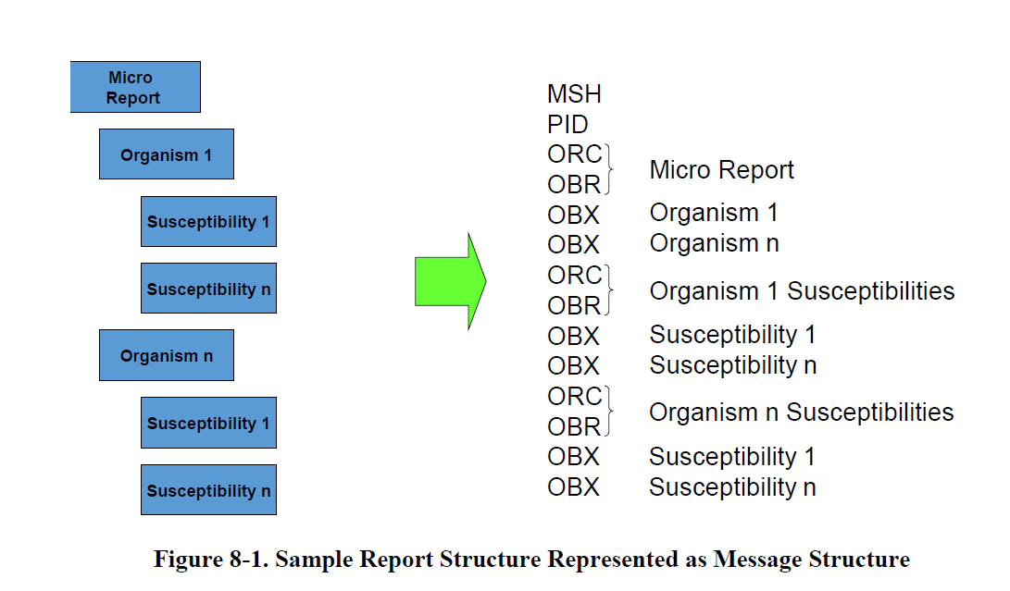
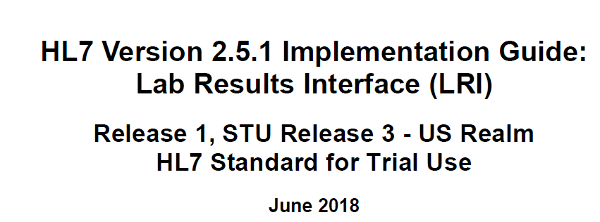
The problem
Parent-child linking should be done even when only 1 organism is isolated/resulted to ensure consistency and clarity.
Page 172

Slide 2
Parent Child Linking
Results of one test lead to one or more order(s) of new tests = Reflex
Result of the Reflex test are related to the result that spawned it
Relationship must be maintained
  The first test is called “parent”
  The reflex test is called “child”
  The child references the “parent”
Examples of reflex testing:
  Culture and susceptibility testing
  Culture and other follow on studies
  Pathology workflows
  Complex workflows for Chemistry / Hematology

Slide 3
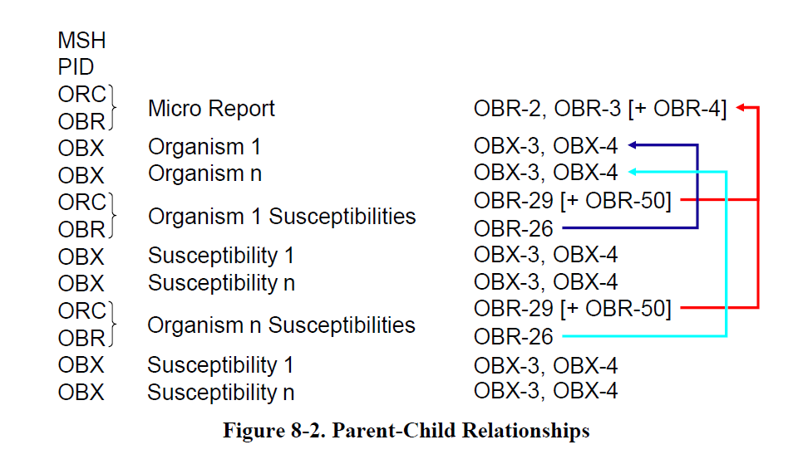
HL7 fields used
In Parent order group:
  OBR-2 (Placer Order number)
  OBR-3 (Filler Order Number)
  OBR-4 (Universal Service Identifier)
  OBX-3 (Observation Identifier) and OBX-4 (Observation Sub-ID) and OBX-5 (Observation Value)
In Child order group:
  OBR-11 (Specimen Action Code) can be ‘G’ – optional in ELR
  OBR-26 (Parent Result) = references combined OBX-3 and OBX-4 and OBX-5 from the parent
  OBR-29 (Parent) = references combined OBR-2 and OBR-3 from the parent
  OBR-50 (Parent Universal Service Identifier) - optional in ELR
Page 173 From

Slide 4
Linkages:
OBR-2/OBR-3 (parent) = OBR-29.1/OBR-29.2 (child)
OBX-3/OBX-4/OBX-5 (parent) = OBR-26.1/OBR-26.2/OBR-26.3 (child)
General Message Example:
MSH
SFT
PID
ORC
OBR|1|Placer Order Number|Filler Order Number|…..
OBX|1|CWE|Observation Identifier|Observation Sub-ID|Observation Value|…
OBR|2|||||||||||||||||||||||||Observation Identifier&Observation Sub-ID&Observation Value|||Placer Order Number&Filler Order Number|…
SPM

Slide 5
MSH|^~\&#|STARLIMS.IN.Stag^2.16.840.1.114222.4.3.3.2.4.2^ISO|IN.Indianapolis.SPHL^2.16.840.1.114222.4.1.77756^ISO|AIMS.INTEGRATION.STG^2.16.840.1.114222.4.3.15.2^ISO|ViralExDHQPDiagMicro^2.16.840.1.114222.4.1.213285^ISO|20191007092734-0400||ORU^R01^ORU_R01|20191007092734|T|2.5.1|||||||||PHLabReport-NoAck^phLabResultsELRv251^2.16.840.1.113883.9.11^ISO
SFT|…
PID|…
ORC|…
OBR|1||C19000082-01-1^STARLIMS.IN.Stag^2.16.840.1.114222.4.3.2.4.2^ISO|68991-9^Epidemiologically Important Information for public health reporting^LN|||20190318|||||||||26559^^^^^^^^STARLIMS.IN.Stag&2.16.840.1.114222.4.3.2.4.2&ISO^^^^XX||||||201903181236-0400|||F
OBX|1|SN|35659-2^Age at specimen collection^LN||^37|a^Year^UCUM|||||F||||||||201903181236||||ISDH^L^^^^CLIA&2.16.840.1.113883.19.4.6&ISO^XX^^^15D0662599|550 W 16th Street^^Indianapolis^IN^46202
…
OBX|6|CWE|PLT644^Species tested for carbapenem resistance^PLT|1|91288006^Acinetobacter baumannii^SCT||||||F||||||||201903181236||||ISDH^L^^^^CLIA&2.16.840.1.113883.19.4.6&ISO^XX^^^15D0662599|550 W 16th Street^^Indianapolis^IN^46202
OBX|7|ST|81658-7^Suspected organism [Identifier] in Unspecified specimen^LN||Acinetobacter baumanii complex||||||F||||||||201903181236||||ISDH^L^^^^CLIA&2.16.840.1.113883.19.4.6&ISO^XX^^^15D0662599|550 W 16th Street^^Indianapolis^IN^46202
OBR|2||C19000082-01^STARLIMS.IN.Stag^2.16.840.1.114222.4.3.2.4.2^ISO|50545-3^Bacterial Susc Pnl Islt MIC^LN|||20190318|||||||||26559^^^^^^^^STARLIMS.IN.Stag&2.16.840.1.114222.4.3.2.4.2&ISO^^^^XX||||||20190318123211-0400|||F|PLT644&Species tested for carbapenem resistance&PLT^1^Acinetobacter baumannii|||^C19000082-02-1&STARLIMS.IN.Stag&2.16.840.1.114222.4.3.2.4.2&ISO
OBX|1|SN|12-5^Amikacin Islt MIC^LN||>^32|ug/mL^microgram per milliliter^UCUM|||||F|||20190318|||39334004^broth microdilution susceptibility test^SCT||20190318123211-0400||||ISDH^L^^^^CLIA&2.16.840.1.113883.19.4.6&ISO^XX^^^15D0662599|550 W 16th Street^^Indianapolis^IN^46202
OBX|2|SN|6644-9^Cefepime Islt MIC^LN||>^16|ug/mL^microgram per milliliter^UCUM|||||F|||20190318|||39334004^broth microdilution susceptibility test^SCT||20190318123211-0400||||ISDH^L^^^^CLIA&2.16.840.1.113883.19.4.6&ISO^XX^^^15D0662599|550 W 16th Street^^Indianapolis^IN^46202
OBX|3|SN|108-1^Cefotaxime Islt MIC^LN||>^32|ug/mL^microgram per milliliter^UCUM|||||F|||20190318|||39334004^broth microdilution susceptibility test^SCT||20190318123211-0400||||ISDH^L^^^^CLIA&2.16.840.1.113883.19.4.6&ISO^XX^^^15D0662599|550 W 16th Street^^Indianapolis^IN^46202
…
SPM|1|54546&ISDH-Lab&2.16.840.1.113883.19.3.2.3&ISO^C19000082&STARLIMS.IN.Stag&2.16.840.1.114222.4.3.3.2.4.2&ISO||446577002^Swab obtained during autopsy^SCT|||||||||||||20190318|201903181141-0400

