Slide 1
HL7 Electronic Laboratory Reporting (ELR) from
CDC Infectious Disease Labs and CSTOR Web Portal
Prepared For:
CSTE National ELR Workgroup
September 2022
Julie Crowder – HL7 Implementation Lead
Val Albrecht, Steve Soroka, James Tolson: CDC Project Managers
Notes:
1

Slide 2
Contents
CDC Labs Live with HL7 Messaging
Which Tests are being Reported?
States Live with HL7 Messaging
Onboarding States to HL7 Messaging
CSTOR Web Portal
CSTOR Benefits
CSTOR Dashboard
CSTOR Dashboard cont.
CSTOR Check Status
CSTOR View Reports
Obtain CSTOR Access

Slide 3
CDC Labs Live with HL7 Messaging
HL7 Status | Unit | Unit Name
Live | Unit 13 | Antimicrobial Resistance and Characterization Laboratory
Live | Unit 72 | ADB (Diagnostic - Arboviral Diseases) (Fort Collins)
Live | MPIR | Microbial Pathogenesis and Immune Response
Live | Unit 12 | Pertussis and Diphtheria Laboratory
Live | Unit 23 | Respiratory Diseases - Chlamydia/Mycoplasma
Live | Unit 31 | LRRB STI Direct Detection
Live | Unit 37 | Fungal Serology Laboratory
Live | Unit 40 | Fungus Reference Laboratory
Live | Unit 91 | Zoonotic and Select Agent Laboratory (ZSAL)
Live | Unit 10 | Meningitis Laboratory - N. meningitidis
Live | Unit 44 | Meningitidis Laboratory - H. influenzae
Live | Unit 84 | Respiratory Virus Diagnostics Unit
Live | *Unit 90 | Division of Viral Hepatitis, Laboratory Branch
Live | *Unit 66 | CDC Surge Lab: COVID-19 Response
Live | *Unit 71 | Division of Vector Borne Diseases- Dengue Branch
Live | *Unit 81-Z | MMR Surge Capacity
Live | *Unit 187 | Rotavirus Unit
Live | Unit 52 | Parasitology
Live | Unit 57 | Parasitic Serology
Live | Unit 81 | Viral Vaccine Preventable Diseases Branch
Live | Unit 29 | National Tuberculosis Reference Laboratory
Live | Unit 80 | Viral Vaccine Preventable Diseases Branch
Live | Unit 225 | Polio Population Immunity and Clinical Trials
Live | Unit 26 | National Botulism Laboratory
Live | Unit 53 | Water, Sanitation and Hygiene Laboratory
Upcoming | Unit 47 | Poxvirus Laboratory/Poxvirus and Rabies Branch
Upcoming | Unit 33 | Pneumonia Response and Surveillance Laboratory
Upcoming | Unit 77 | HIV Reference Laboratory
Upcoming | Unit 89 | Rabies Clinical Laboratory
Upcoming | Unit 76 | Polio Diagnostics Unit
* This Unit is Live for COVID Tests Only
Notes:
There are currently 25 CDC Infectious Disease labs (“units”) live with HL7 messaging (“live” means that HL7 messages are being sent to state partners for at least one test in the lab). The goal is to onboard all ~50 CDC Infectious Disease labs to HL7 messaging.
The order in which labs are configured for HL7 messaging is determined based upon need (monkeypox), volume of samples undergoing reportable testing, and configuration of tests within ELIMS
3

Slide 4
Which Tests are Being Reported?
Only those tests that are CLIA reportable, with results sent back to the submitter, are configured for HL7 messaging.
    The HL7 Team maintains a master list of all tests that are currently reported via HL7 messaging
For each CDC lab that goes live with HL7 messaging, a Test Catalog (Excel) is generated and shared with the states.
    This contains names and LOINC or SNOMED codes for the following:
      Tests
      Analytes
      Possible Results
      Interpretations
      Specimen Source
Notes:
4

Slide 5
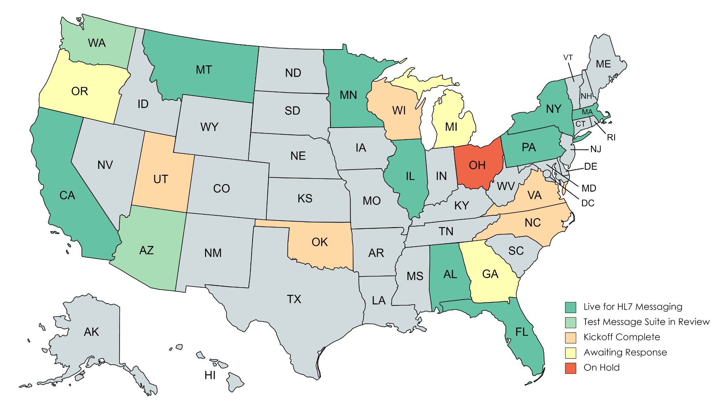
States Live with HL7 Messaging
Notes:
There are currently 9 states receiving HL7 messages from CDC (AL, CA, FL, IL, MA, MN, MT, NY, PA). 2 additional states (WA and AZ) are in the onboarding process and should be live soon.

Slide 6
Onboarding States to HL7 Messaging
Our goal is to send CDC lab results electronically (HL7 v2.5.1.) to State Public Health Lab (SPHL) LIMS
  Currently CDC reports lab results via pdf to the SPHL
  PDF reports will continue along with HL7 ELR messages
If SPHL LIMS is unable to receive and process HL7 ELR messages, we work with State Health Departments to process ELRs into their Disease Surveillance System
The order in which states are approached to onboard HL7 Messaging is dependent on:
  Volume of samples received by CDC from state
  State prioritization of onboarding ELR
  State readiness for implementation
    Technical capabilities - Onboard ELR now to their Disease Surveillance System or wait until they can ingest in their SPHL LIMS?
    Available Personnel -To manage the effort, set up Rhapsody decryption routes, review HL7 messages for structure and content
Notes:
States can reach to Val and Julie when they are ready to onboard.
6

Slide 7
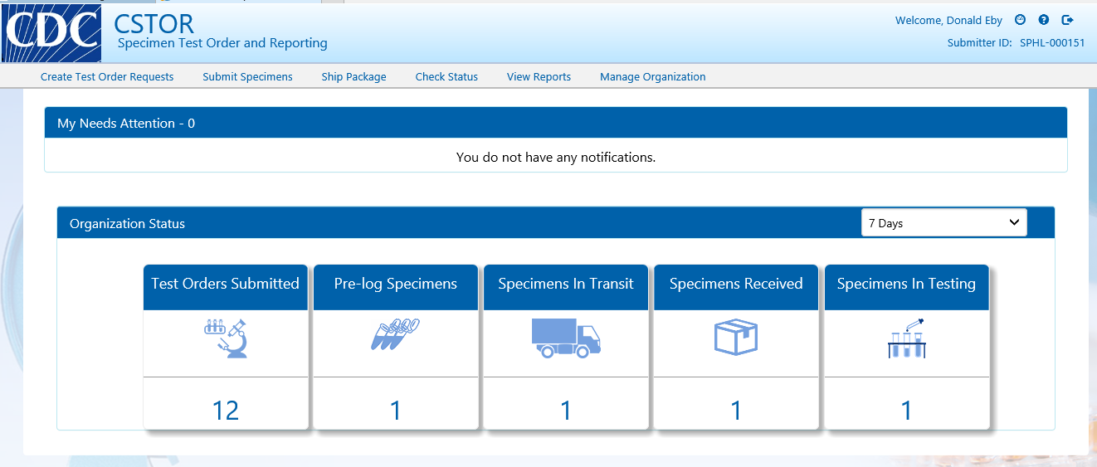
CSTOR Web Portal
Notes:
7

Slide 8

CSTOR Web Portal
CSTOR benefits for CDC ID Specimen Submitters:
  Streamlines and centralizes CDC Infectious Diseases Test Order request
  Provides an online 50.34 Specimen Submission Form and automates standardized package paperwork
  Provides batch capabilities to submit more than 1 sample
  Provides all CSTOR users ability to view/download test results and reports easily and securely online
  Validates specimen data and ensures accurate data entry
  Secure authentication and transfer of PHI/PII
Notes:
8

Slide 9
CSTOR Web Portal – Dashboard
Notes:
9

Slide 10
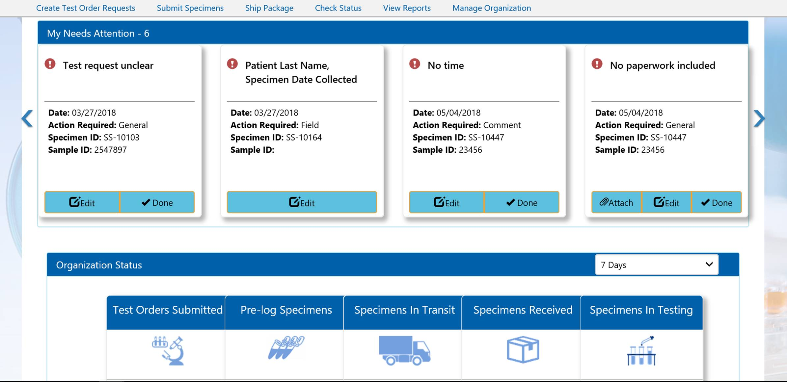
CSTOR Web Portal – Dashboard
Notes:
10

Slide 11
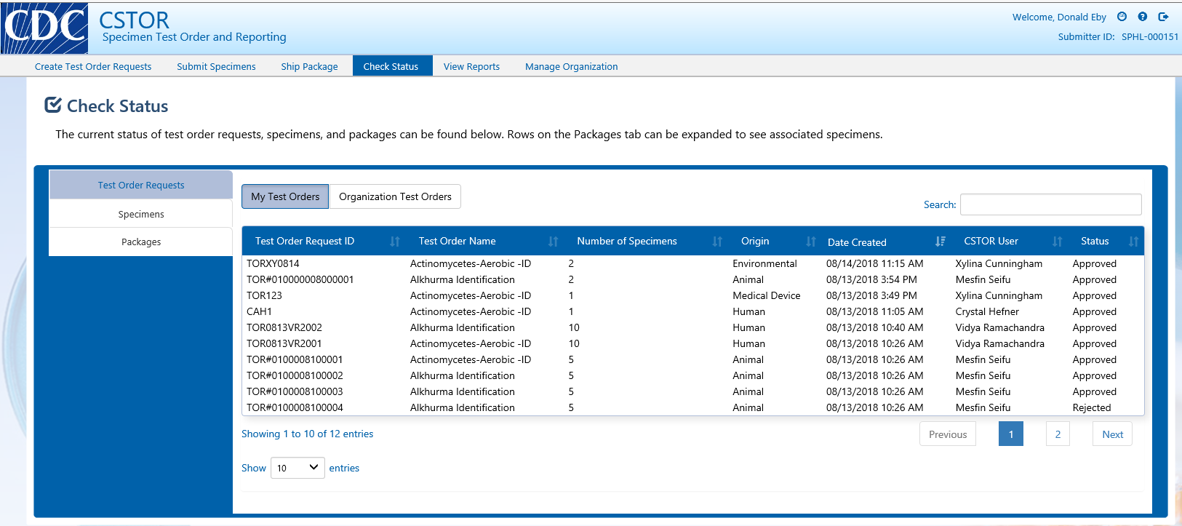
CSTOR Web Portal – Check Status
Notes:
11

Slide 12
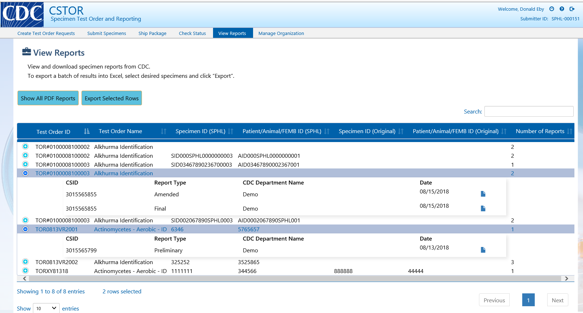
CSTOR Web Portal – View Reports
Notes:
12

Slide 13
How to obtain access for your organization
Email cstor@cdc.gov and request access which requires SAMS and an authentication and identity verification process
Designate 2 organization administrators
Administrator onboarding, training, and access
New administrators will onboard and train their users
  Administrations request new users which will trigger SAMS invitation and process the user will complete
  Please instruct new users to use the same email address the admin used for CSTOR access during their SAMS proofing
Notes:
13

Slide 14
Questions and Thank You!
Julie Crowder : quu9@cdc.gov
Valerie Albrecht: gpy8@cdc.gov
Notes:
14

