Slide 1
ELR Data Quality Assurance Strategies
Surveillance Systems and Informatics Program
Mary Ellen Travers, MPH, MS (she/her)

Slide 2
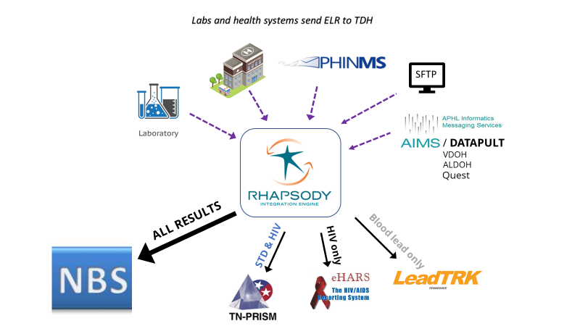
TN ELR OVERVIEW
ELR
HL7
Spreadsheets/Emergency Use Templates (EUTs)
POC REDCap Projects (COVID-19)
All ELR is processed by Rhapsody
All labs are imported into NBS
Notes:
POC REDCap Project for facilities reporting smaller volumes.

Slide 3
Rhapsody Production Errors
NBS helps dictate true message failures vs. production errors
  Some examples of missing information that would fail a message:
    First Name
    Last Name
    LOINC
    Result
    Specimen collection date
  Messages can still be imported into NBS but require review if missing additional information. Some examples include:
    Missing OBX 3.1 values
    Date of Birth
    Zip Code
  Duplicates
All errors generate an email with the error details
Notes:
Onboarding a partner – detailed message structure checks, test scenarios, etc.

Slide 4
EUT (Spreadsheet) Data Quality Checks
R codes and manual review
  Individual R code for each EUT partner
  Transforms .csv, .xlsx, etc. into a .txt file to be processed
  Some partners’ .txt files are sent to a folder to be manually reviewed
  NEW: Generic code to run through all partner folders
    Created a production errors table in SQL to catalog EUT errors for each partner
    Replacing individual codes for better upkeep
      A couple of mapping files vs. entire R codes for all partners
    If there is an error, file is manually reviewed, and an email alert is sent out to EUT processing team.

Slide 5
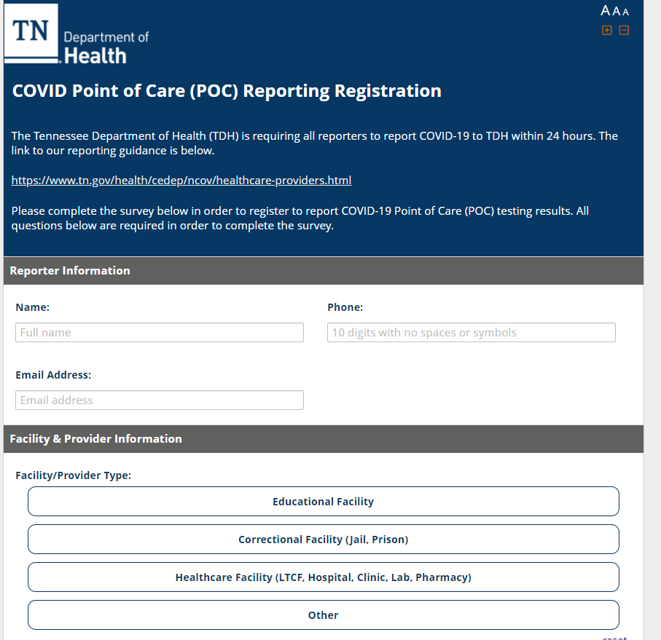
REDCap Projects
Built in logic to ensure data quality
  Facility registration
  Dates
  Required fields

Slide 6
Additional Data Quality Checks
30 Hour Alert
  Uses a SQL table to monitor ELR partner reporting frequency (HL7 & EUT)
  Partners are assigned frequency when onboarded (daily, sporadic or as needed)
  An email alert is triggered when they have not reported within their assigned frequency
Facility | Last File Timestamp | # Hours | ELR/POC Team
Organization A | 2023-01-31 | 142 | Spreadsheet Staff
Hospital B | 2023-02-02 | 96 | HL7 Staff
Laboratory C | 2023-02-03 | 78 | HL7 Staff
Notes:
Allows us to check in with partner and then transport method.
COVID-19 case definition update (reporting positive result within 7 days) will impact this alert if partners change their reporting frequency.
In addition to this, we receive a daily alert from AIMS/Datapult for partners that do not have any messages to send to TN.
This allows us to first check the 30 hour alert, and if it’s an interpartner file, check the list sent by AIMS/Datapult before reaching out to a partner.

Slide 7
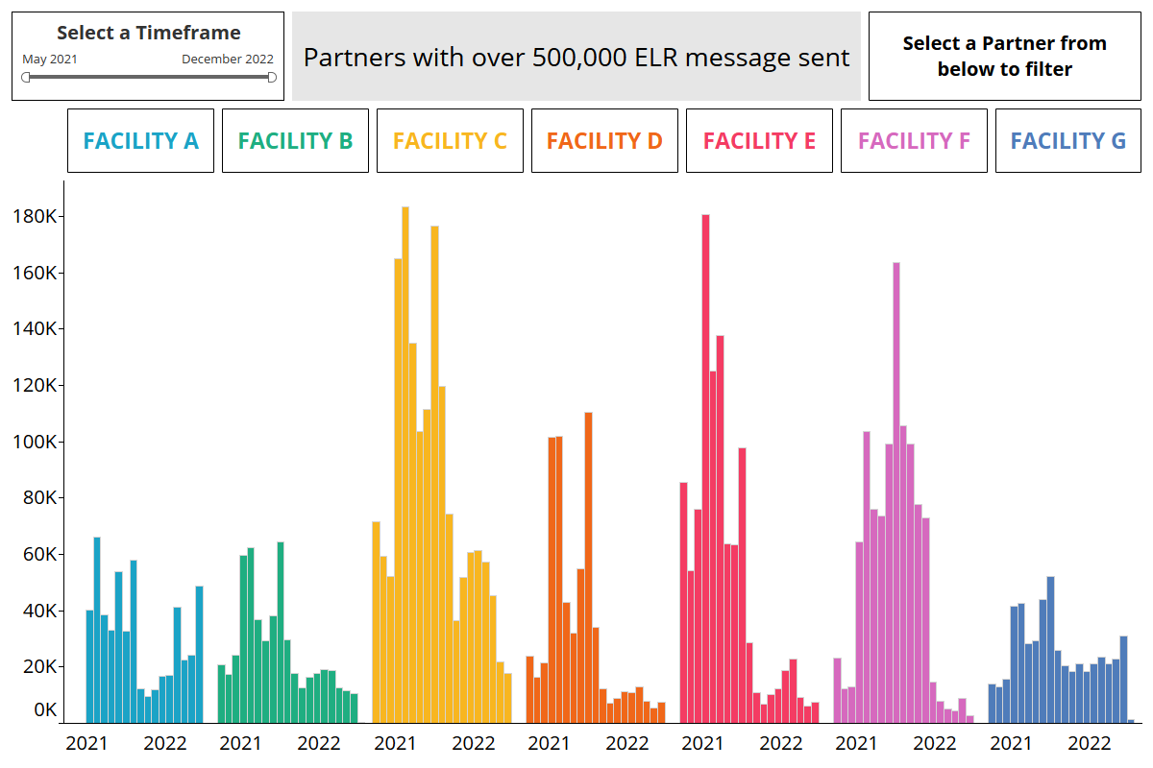
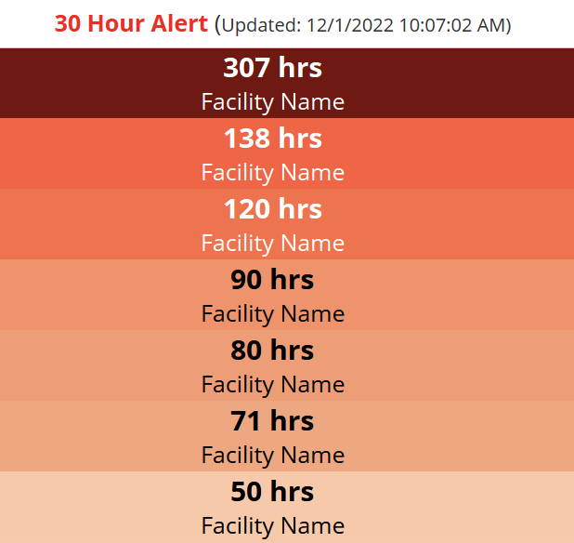
Future Plans
Report cards for Trading Partners
  Top errors (categorized by production errors)
Tableau Dashboard for ELR partners
  Volume
  Frequency
  Errors

