Slide 1
ELR Data Quality Assurance Practices and Future Strategies
Cody McNeese, MPH (she/her/hers)
Larissa Williams, MEd (she/her/hers)

Slide 2
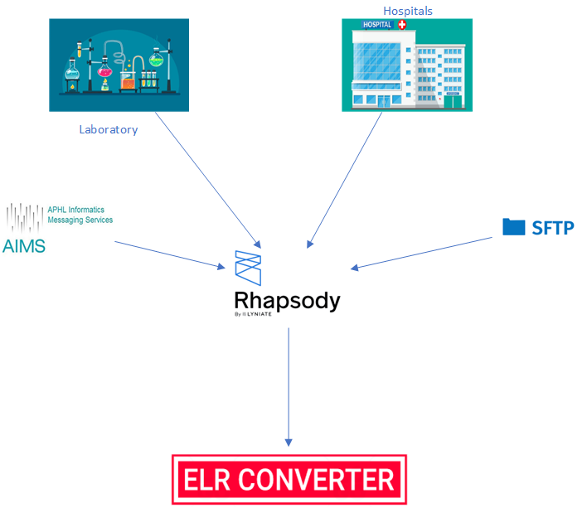
Oregon ELR Overview
HL7
CSV Template – Oregon Specific
All ELR’s are initially processed by Rhapsody before being inserted into our ELR Converter which is a FileMaker database where all ELRs are reviewed.

Slide 3
Validation in Rhapsody
ELR Validation
Message Mappers to convert HL7 2.3.z to 2.3.1, 2.3.1 to 2.5.1, and CSV to HL7
Adjustments to "Clean HL7 message"
Evaluate for missing OBR and OBX
Remove empty OBX segments from messages
Review PID fields for missing/invalid data such as date of birth
Duplicate message detection and review
Monitoring File Sizes
Error reports sent to team email
ELR Converter evaluates a message for true message failures and production errors. Looking at Patient Demographic Data, LOINC and SNOMED codes, specimen collection dates.
Messages that "fail" go to a queue where we manually review messages.
Missing OBX 3 and OBX 5 values
Non-numerical value the database does not recognize, typically summary of result.
Duplicates
Other Data Quality Tools used
Tableau
SQL views
User notifications

Slide 4
ELR Data Quality Dashboard
Data Quality
Administrative
HL7 Field Completeness
Volume Alerts
Volume Maps
Timeliness Alert
Test Prevalence
Which sites send data for which tests

Slide 5
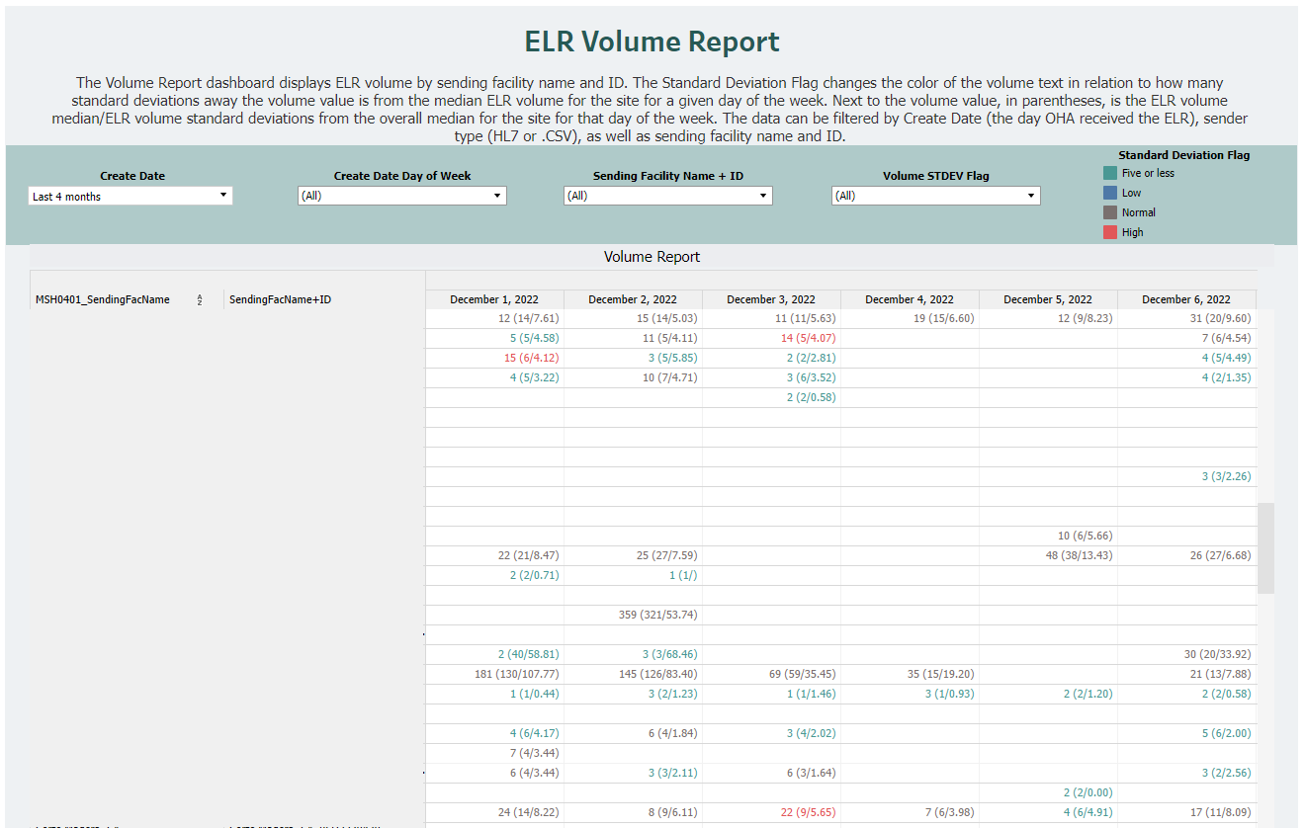

Slide 6
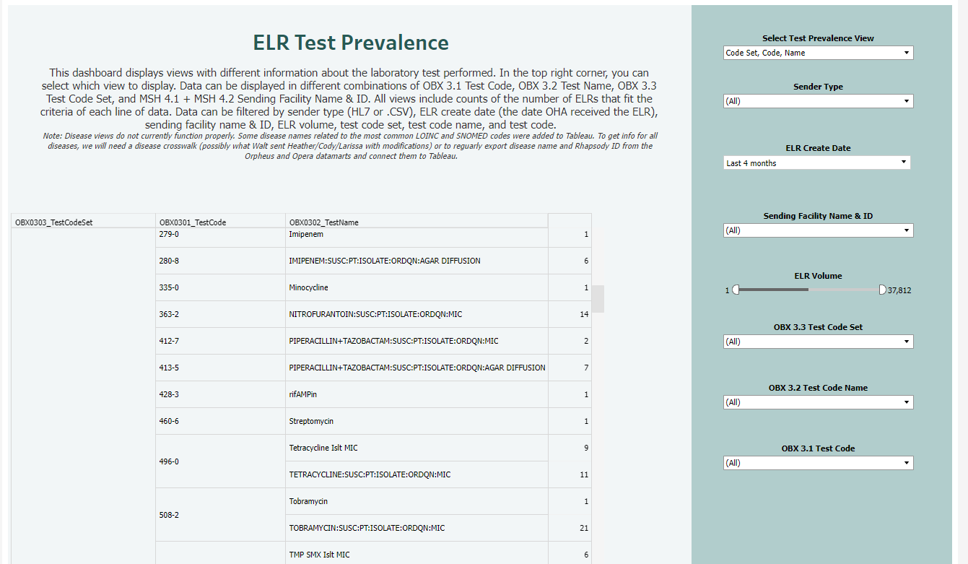

Slide 7
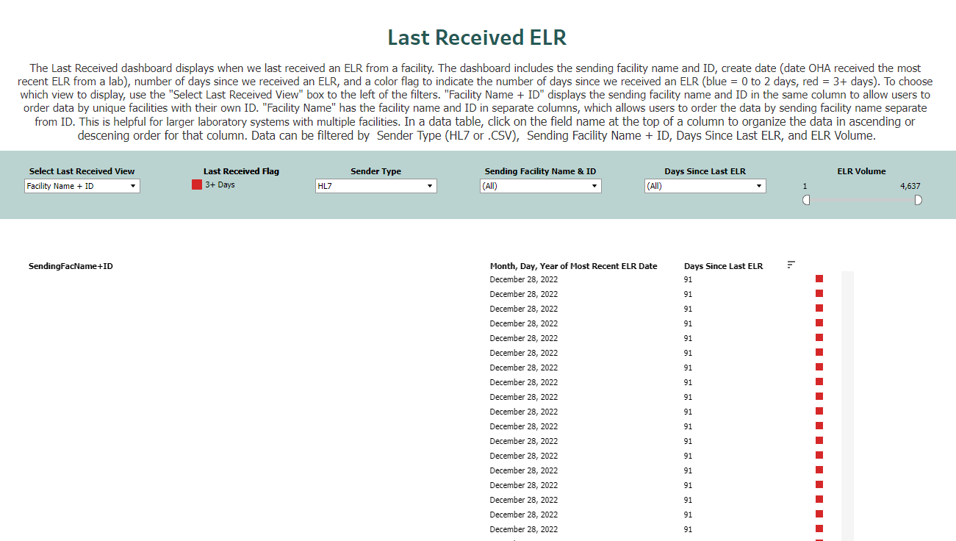

Slide 8
ELR Data Quality Reports
Focus
Completeness
Validity (accuracy)
Timeliness of reporting
Thank you, Kerry Regan, at Utah Department of Health for inspiration and sharing of R code.
Thank you to Bret Moulton and Rebecca Lee of LA County for meeting with us to share ideas.

Slide 9
ELR Data Quality Reports
Materials
Introduction Letter (PDF)
ELR Data Quality Program Guide (PDF)
Validity Guide (PDF)
Data Quality Report (PDF from RMarkdown)
Data Quality Metrics (Excel from R)
Invalid Data (Excel from R)

Slide 10
ELR Data Quality Reports
Process
Identify site
Generate materials
Review materials as a team
Review raw data for glaring issues
Send materials + request meeting
Provide technical assistance

Slide 11
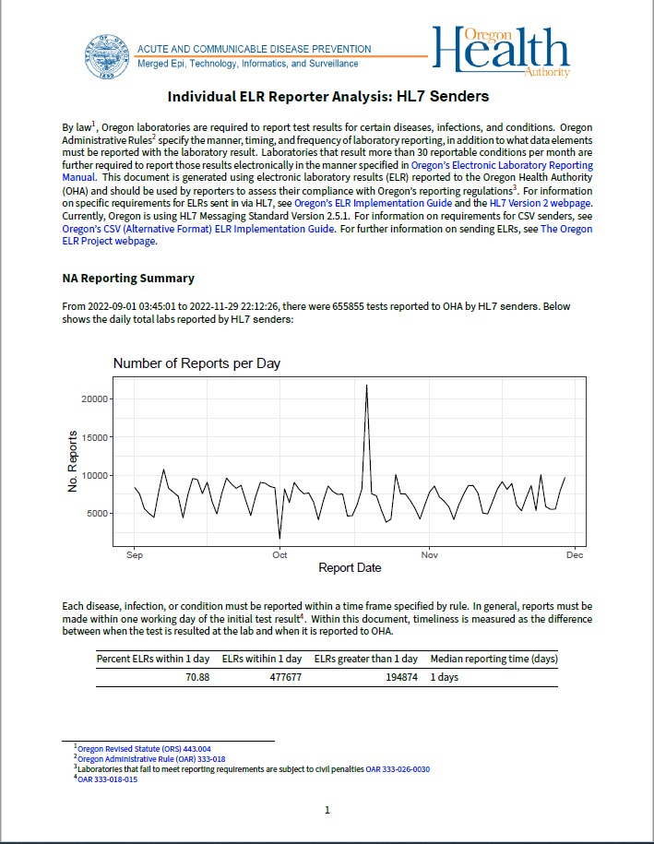
Data Quality
Report

Slide 12
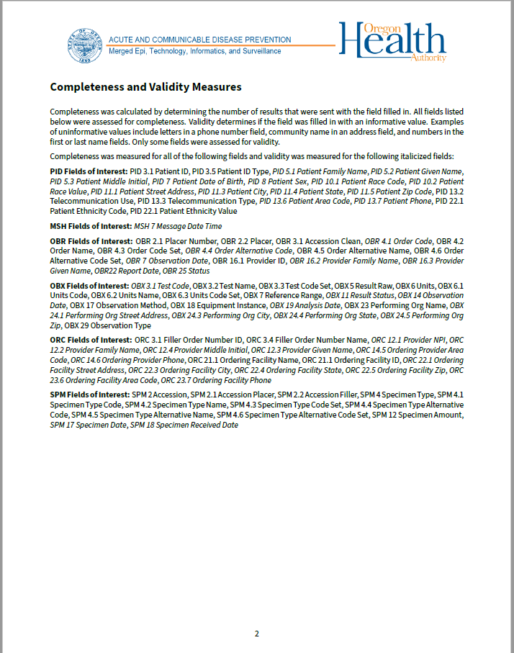
Data Quality
Report

Slide 13
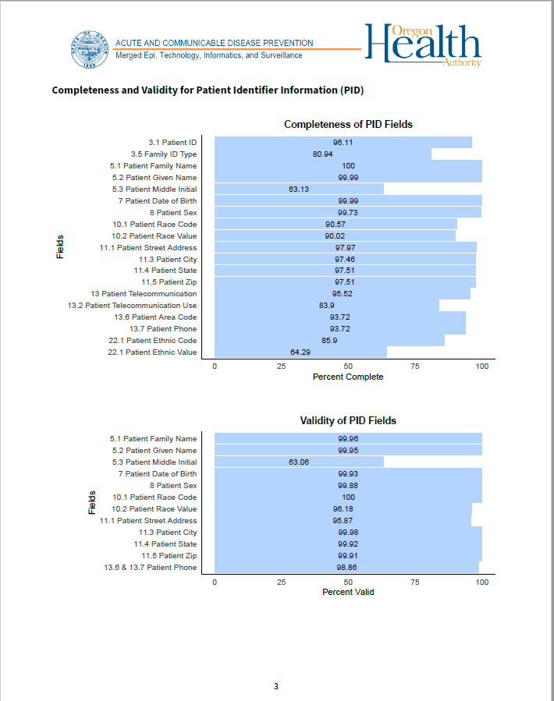
Data Quality
Report

Slide 14
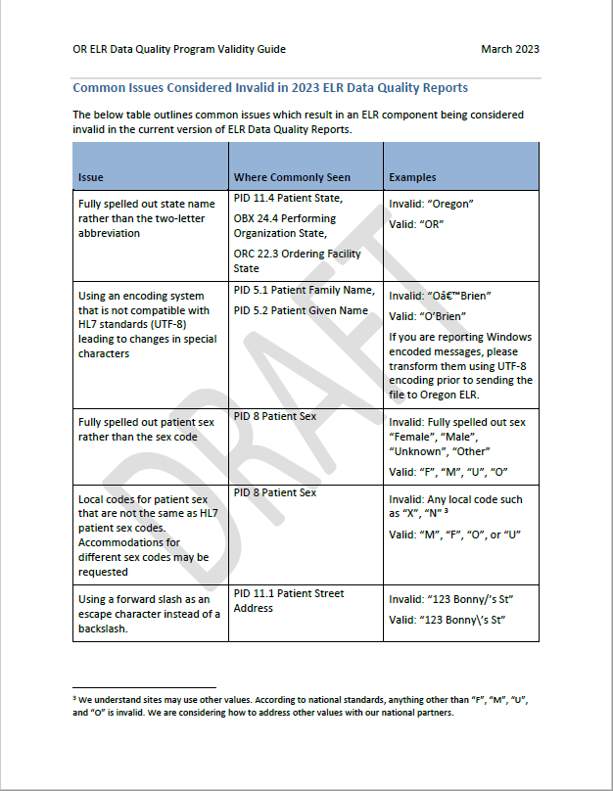
Validity
Guide

Slide 15
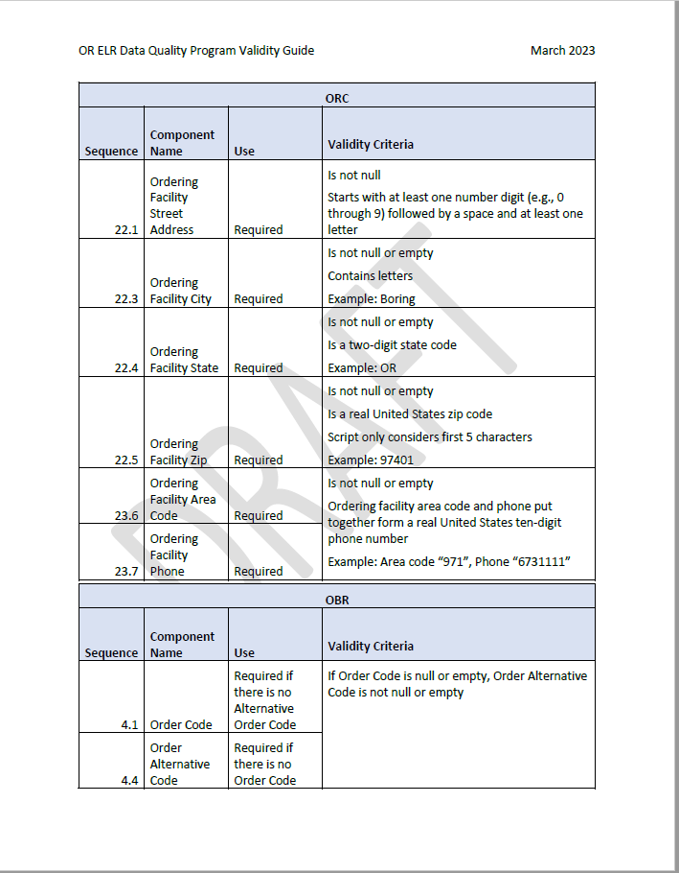
Validity
Guide

Slide 16
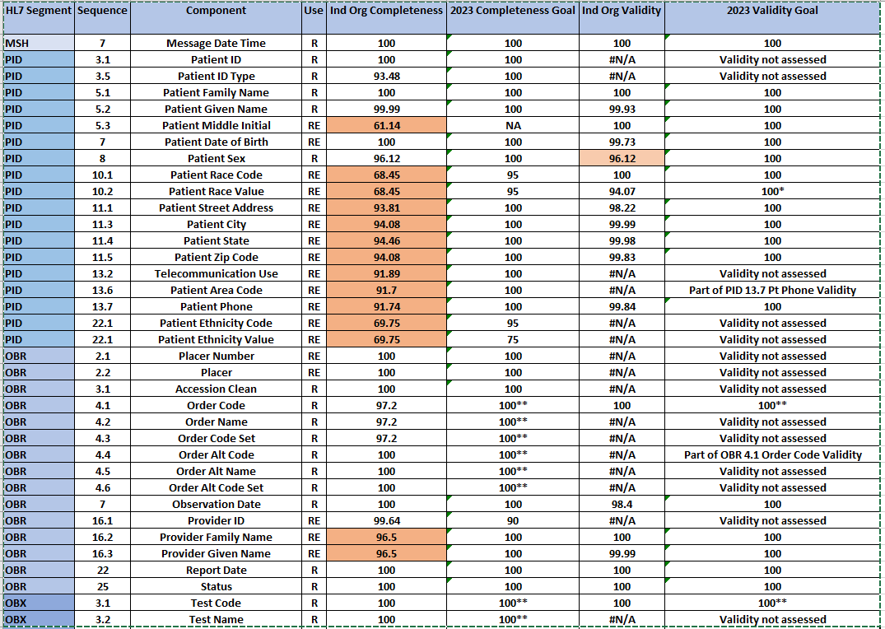
Data
Quality
Metrics

Slide 17
Future Goals
Incorporate feedback from Pilot stakeholders to adapt Data Quality Report Cards
Developed advanced analytics processes that will allow for day to day monitoring using Tableau and R
Implement Dashboards for trading partners to review their Data Quality
Incorporate Validation filters into Rhapsody- Currently incorporating into Test environment
Requirement to use standardized code sets only

