Slide 1

CDC’s Public Health Laboratory ETOR Initiative
Jasmine Chaitram
Chief
Informatics and Data Science Branch
Division of Laboratory Systems

Slide 2
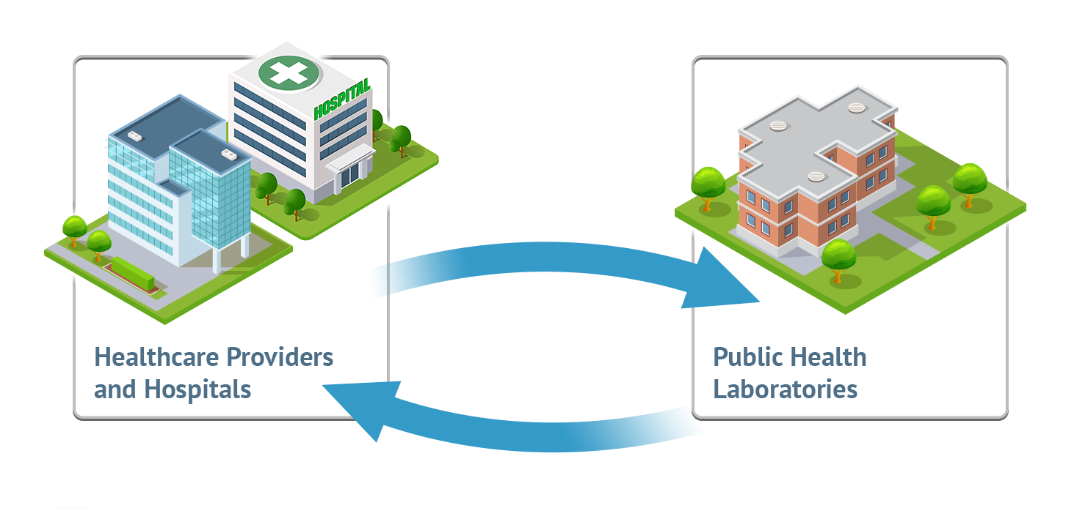
What is ETOR?
Notes:
Electronic Test Orders and Results (ETOR) is a multidirectional exchange of information that will streamline data transmission and improve interoperability between healthcare facilities and public health laboratories (PHLs).
This exchange will decrease the use of paper-based test orders and reports, reducing the risk of errors in manual data entry and result reporting, and ensuring that accurate testing information is captured and transmitted to a patient’s medical record in a timely manner.
Implementing ETOR will also strengthen public health surveillance and emergency response by linking laboratory data with patient information through standardized data elements included in the test order.
We are specifically working to improved ETOR capabilities within PHLs for exchanging data with healthcare.

Slide 3



Benefits of ETOR
Laboratories
Data accuracy
Improve Lab Workflow
Cost efficiencies
Healthcare
Automated ordering
Timely results
Improved patient care
Public Health
Reporting
Response
Surveillance
Notes:
Touch on each box –
Less manual entry -> less errors and more/standardized data and more complete records/information
Timeliness – prepare/plan work, awareness of (missing) specimens, faster resulting
Availability of results for patient care and for public health use

Slide 4


ETOR Current and Future State
Web
Portal
Web Portal
Healthcare Providers & Hospitals
Public Health Labs
Direct Integration
Healthcare Providers & Hospitals
Public Health Labs
Indirect Integration
Intermediary
Notes:
Some PHLs have all, some or no ETOR solutions in place.
Simplest is webportal – still requires some level of human interaction. Often a useful solution for low volume tests and submitters who don’t want to invest in integrated solutions
Direct integration – requires systems to ‘speak the same language’ ; must establish between every partner
Indirect integration – allows each system to maintain it’s native format and leverages an intermediary for tools and services such as message translation.
Benefit is reduction of point-to-point connections; connect once to the intermediary.
CDC is working to enhance the use of intermediaries for ETOR

Slide 5



ETOR Future State
Health Data Exchanges
Provider
Group
PHL
AIMS
ReportStream
EHR Vendors
Provider
Group
PHL
PHL
Provider
Group

Slide 6
What is CDC Doing to Support ETOR?
Enhancing Intermediaries
Working to enhance two intermediaries
  APHL Informatics Messaging Services (AIMS)
  CDC’s ReportStream
Centralize, standardize, translate messages between PHLs and healthcare through tools and services
Reduce point-to-point connections
Expanding PHL Use of Web Portals
Assisting PHLs in setting up web portals
Solution to connect low-volume submitters
Allows quick response to data needs
for public health emergencies

Slide 7
What is CDC Doing to Support ETOR?
Providing Funding
Funding contractors to provide technical assistance (TA) to clinical partners
Funding APHL to provide TA to PHLs
Funding contractors to build infrastructure at CDC to build services to support ETOR
Funding APHL to enhance and build services within AIMS to support ETOR
Funding the Epidemiology and Laboratory Capacity cooperative agreement to support ETOR in PHLs
Partnering to Align on Strategies
Reaching out to Electronic Health Record systems and LIMS vendors, healthcare systems, and standards organizations
Engaging with healthcare providers to understand challenges implementing ETOR with PHLs
Working with the Office of the National Coordinator and Centers for Medicare & Medicare Services to explore incentives for use of standards and implementation of ETOR

Slide 8
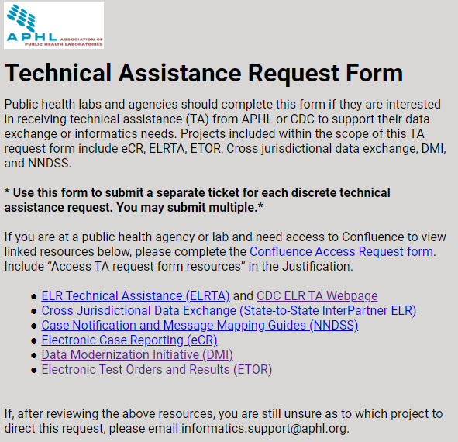
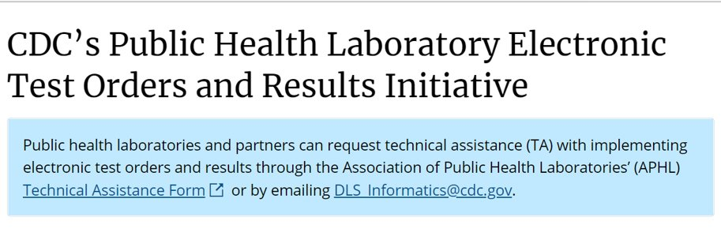
Technical Assistance and Resources
www.cdc.gov/csels/dls/public-health-laboratory-etor.html
https://app.smartsheet.com/b/form/4fe7d6f0c607491abe1ea88209d5aaff

Slide 9
Piloting ETOR via Intermediaries
Initial use case is newborn screening (NBS)
Key aim of “meeting partners where they are”
Objectives
  Develop protocols and procedures for delivering TA for ETOR implementation
  Solicit feedback from pilot participants to improve TA for ETOR implementation
  Demonstrate the use of an intermediary to route electronic orders and results for NBS testing
  Capture metrics to compare the efficiency and effectiveness of ETOR compared to existing processes
Project will run May – Dec 2023
4-6 pilots sites to include
  PHLs
  NBS LIMS & EHR system vendors
  Healthcare organizations (birthing hospitals)

Slide 10
Questions?

Slide 11
Contact Information
Rebecca McNall DQO2@cdc.gov
Jasmine Chaitram ZOA6@cdc.gov
DLS Informatics DLS_informatics@cdc.gov

Slide 12

Thank you!

