Slide 1
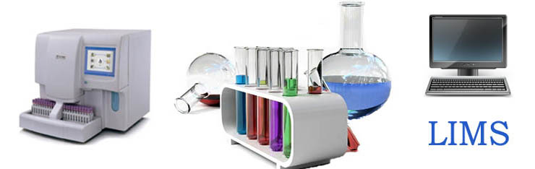
elr QA efforts
California DPH
Garrett Jenkins

Slide 2
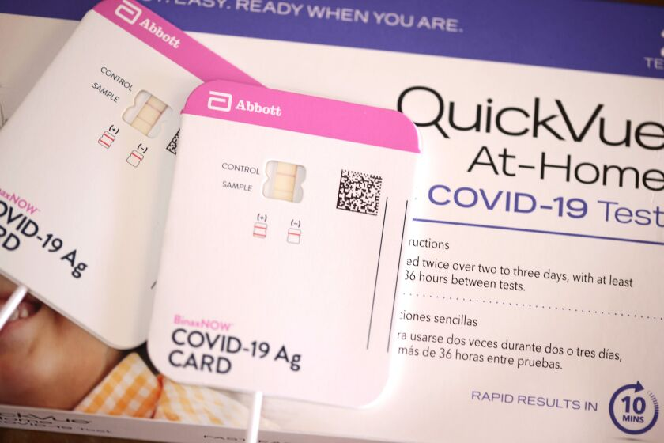
TOPICS
Overall Data Flow
Onboarding UAT
Front end uplift
Cloud-based data storage/retrieval
Automated quality alerts
Automated routine reports

Slide 3
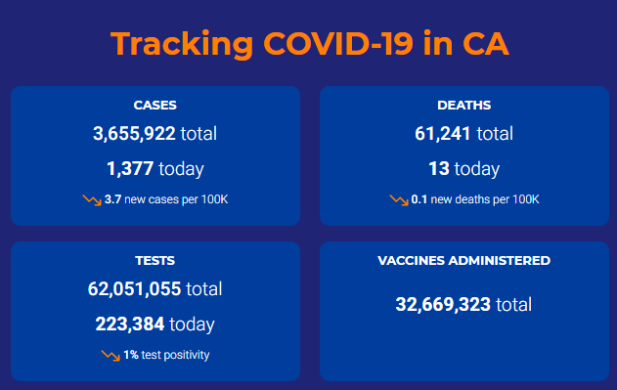






Data flow
Lab sends HL7/CSV file to “front door”
Some normalization/uplift
Copy of data to cloud warehouse
Copy of data to state surveillance system (not pictured)
Data used for reporting purposes

Slide 4
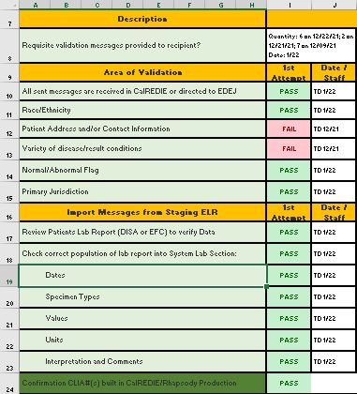
Onboarding UAT
Most important QA strategy
Most important QA strategy!
Most important QA strategy!!
Most important QA strategy!!!
Most important QA strategy!!!!

Slide 5
Front end uplift
OBX|1|CE|94309-2^SARS CORONAVIRUS 2 RNA:PRTHR:PT:XXX:ORD:PROBE.AMP.TAR^LN^219891638^C19 NAA Neg^L^2.5.1^v1||260415000^Not detected (qualifier value)^SCT^COVID NOT DETECTED^COVID NOT DETECTED^L||||||F|||20230517014200-0700|||||20230517014237-0700||||
OBX|1|CE|94309-2^SARS-CoV-2 (COVID-19) RNA NAA+probe Ql (Specimen)^LN^219891638^C19 NAA Neg^L||260415000^Not detected^SCT^COVID NOT DETECTED^COVID NOT DETECTED^L||||||F|||20230517014200-0700|||||20230517014237-0700||||
PID|1||CONFIDENTIAL PATIENT IDENTIFIER^^^^MR||PATIENTLASTNAME^PATIENTFIRSTNAME||PATIENTDOB|F||2106-3^White ^HL70005|PATIENT ADDRESS^^San Diego^CA^98531|||||||||||H^Not Hispanic or Latino^CDCREC||||||||
PID|1||CONFIDENTIAL PATIENT IDENTIFIER^^^^MR||PATIENTLASTNAME^PATIENTFIRSTNAME||PATIENTDOB|F||2106-3^White ^HL70005|PATIENT ADDRESS^^San Diego^CA^98531|||||||||||H^Hispanic or Latino^CDCREC||||||||
Standardization of demographic codes and text descriptions
Population of missing demographic values with U/UNK/etc.
Standardization of test and result description text based on LOINC code

Slide 6

Cloud storage
Game changer
Ability to query all records/ID trends quickly
  >200M COVID records
  Compute DQ stats, stratify by lab, etc., across all records in minutes
Used Snowflake platform (but others are available)

Slide 7
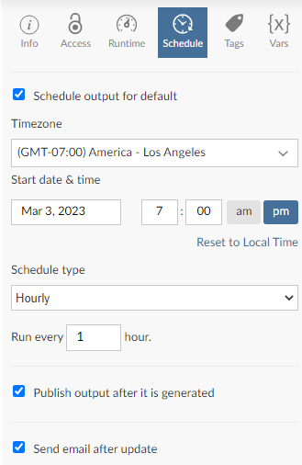
automation
Various tools available
Some cloud-based platforms have sufficient functionality
We use Posit (previously Rstudio) Connect
Allows for uploading and scheduling of R (and python) syntax
Can write R syntax to interface with cloud storage to analyze and email out reports or alerts

Slide 8
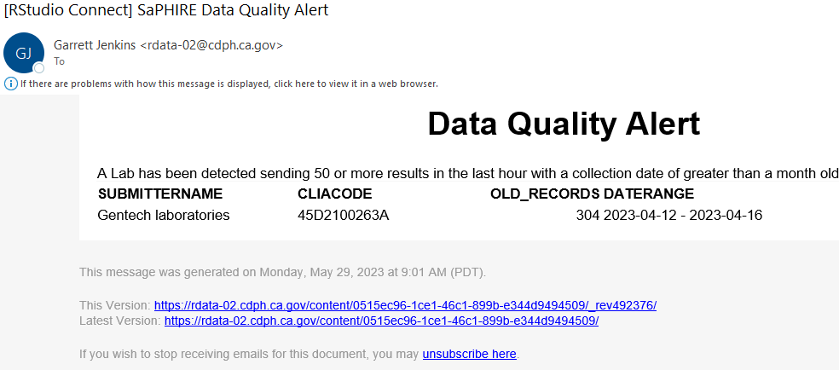
Automated alerts
- Most important QA strategy

Slide 9
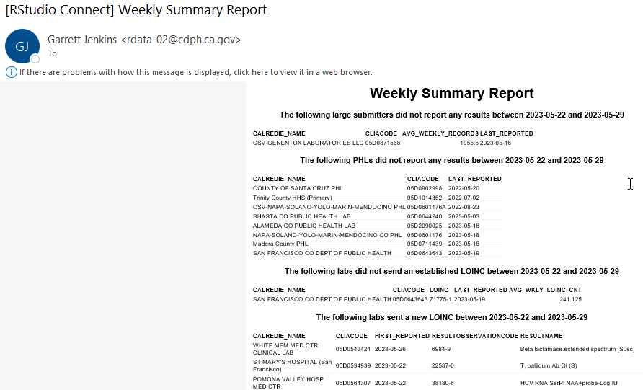
Routine automation

Slide 10
Questions?
Garrett Jenkins​​
Garrett.Jenkins@cdph.ca.gov

