Slide 1
DMI Stories from the Field

Slide 2


Slide 3

DMI Stories from the Field project
Through the DMI Stories from the Field project, we invite our members to submit content regarding the work you’ve done increasing your ability to leverage data for action, modernize systems and processes, or advance public health surveillance. Stories of any magnitude are welcome; big or small, works in progress or complete. CSTE will then work with submitters to further cultivate content and edit summaries, complete additional audio and video recording for some, and produce a variety of public outputs documenting this amazing and important work.
Purpose: Recognize innovation and resiliency in public health surveillance and informatics​; Inspire cross-jurisdictional collaboration​; Advocate for importance of DMI through documentation of successes​; Document and share these stories through CDC and CSTE outlets; Create multimedia outputs​
​Any story of a success in using data for action, no matter how big or small, is welcome​
Stories do not have to be explicitly tied to DMI funding or infectious disease surveillance
Jurisdictions and individuals can submit more than one story
To submit content, please use this form​
For additional information, please contact Megan Tompkins: mtompkins@cste.org​
​

Slide 4
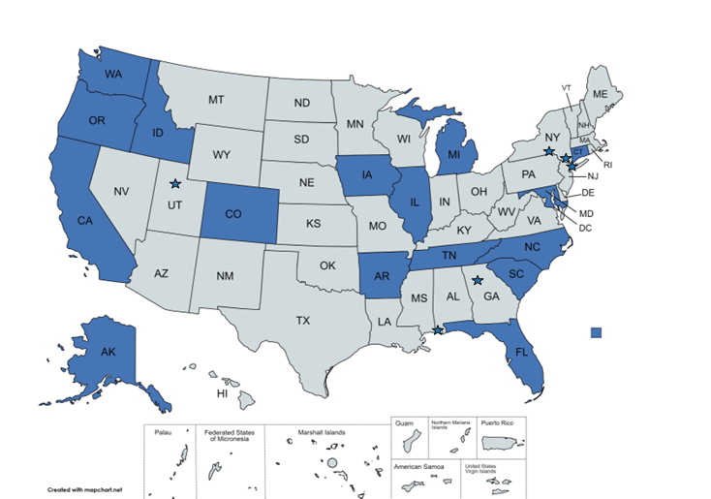

Slide 5
Thank you to our storytellers (so far)!
Angela Dunn – Salt Lake County Health Department
Carlos Saldana – Emory University
Chris Baumgartner – Washington State Department of Health
Christopher Ryan – Broome County Health Department
Cody McNeese – Oregon Health Authority
Connie Austin – Illinois Department of Public Health
Donald McCormick – Arkansas Department of Health
Libby Luoma – New York City Health Department
Eric Mooring – Alaska Department of Health
Erika Samoff – North Carolina Department of Health and Human Services
Erin Holt Coyne – Tennessee Department of Health

Slide 6
Thank you to our storytellers (so far)!
Janae Price – Illinois Department of Public Health
Jennifer Stewart – North Carolina Department of Health and Human Services
Jim Collins – Michigan Department of Health and Human Services
Karla Norsworthy – North Carolina Department of Health and Human Services
Katelynn Devinney – New York City Department of Health
Kathryn Turner – Idaho Department of Health and Welfare
Kayla Sankey – Iowa Department of Public Health
Laura Farrell – North Carolina Department of Health and Human Services
Laura Lane – South Carolina Department of Health and Environmental Control – Public Health Lab
Leah Eisenstein – Florida Department of Health
Louisa Castrodale – Alaska Department of Health

Slide 7
Thank you to our storytellers (so far)!
Marguerite Smith – Illinois Department of Public Health
Mary Foote – New York City Health Department
Max Habicht – South Carolina Department of Health and Environmental Control
Michelle Barber – Oregon Health Authority
Nancy Barrett – Connecticut Department of Public Health
Paul Gillenwater - Colorado Department of Public Health and Environment
Rendi Murphree – Mobile County Health Department
Rob Laing – Oregon Health Authority
Samuel Rubin – Orange County Department of Health (NY)
Shannon Allain – Oregon Health Authority
Sharon Greene – New York City Health Department
Shelby Fawaz – Florida Department of Health
Vi Peralta- California Department of Public Health

Slide 8

Oregon Health Authority
Submitted by Cody McNeese
For more than a decade, Oregon Health Authority (OHA) has planned to implement a robust data quality assurance protocol for electronic laboratory report (ELR) submitters. With additional staffing brought on during the COVID response, OHA resumed efforts to address data quality by creating a parallel repository for ELRs for the sole purpose of data quality evaluation. They have drafted a data quality protocol, validation and remediation guide, internal dashboards, and submitter report cards that were piloted in April 2023. They are in the process of working with submitting partners to review this first iteration, which includes validity and completeness checks for all required elements. The impact, which has not yet been realized, will be more complete, accurate and timely submission of data that conforms to nationally recognized standards.

Slide 9

North Carolina Department of Health and Human Services
Submitted by Jennifer Stewart and Karla Norsworthy
North Carolina Department of Health and Human Services (DHHS) worked with Virginia to set up automated routing of electronic lab reports (ELRs) that can take the place of faxing to exchange these records. DHHS is currently working on exchanging data for all communicable diseases, as well as on developing a process to route a case back out electronically if it is identified as being a resident of Virginia after DHHS has accepted it into their system.
Notes:
Approved by Jennifer Stewart for use 5/16/2023

Slide 10

Michigan Department of Health and Human Services
Submitted by Jim Collins, MPH, RS
Michigan has had ELR in place for seventeen years and, as in many other jurisdictions, the COVID-19 pandemic resulted in an exponential increase in ELR volume. With this increase in volume MDHHS also noted a paucity of race and ethnicity data, variables critical to addressing health equity issues in the state of Michigan. To improve demographic data completeness, MDHHS established a report card summarizing completion rates for fields essential to public health practice. Weekly report cards were shared with ELR submitters in a format that presented laboratories on a scale comparing them to their peers and to themselves over time.
Sharing completion rates with submitters and comparing laboratories with similar reporting profiles to one another generated a sense of friendly competition that drove up completion rates for the variables of interest. Receiving more demographic information, such as race and ethnicity, allowed MDHHS staff to detect disparities in the distribution of testing and identify locations to bring testing centers and clinics to the under-served populations. Further, this information contributed to the ability to better describe the pandemic experience in Michigan.
Notes:
Approved for use by Jim Collins on 5/16/2023

Slide 11


CSTE National Office
2635 Century Parkway NE, Suite 700
Atlanta, Georgia 30345
770.458.3811
770.458.8516
mtompkins@cste.org and bteevan@cste.org

