Slide 1
Welcome to the June National ELR Workgroup Call!
Agenda
Welcome/introductions – Nicole Kikuchi (FL)/ Cody McNeese (OR)
CSTE announcements – Devra Barter (CSTE)
Update on APHL Survey of Jurisdiction Plans for CELR after PHE Expiration – Brooke Beaulieu (APHL)
Update on Systemic Harmonization and Interoperability Enhancement for Laboratory Data (SHIELD) – Riki Merrick (APHL)​
Discussion series: Data Quality Assurance Strategies – Garrett Jenkins (CA)​
DMI Stories from the Field​ – Megan Tompkins/Bridget Teevan (CSTE)
Adjourn – July 4th call is cancelled
Next Call: August 1, 2023 @ 1 pm ET
Notes:
Welcome to the June ELR Call! Please introduce yourself in the chat by stating your name & organizational affiliation.
We are recording the call for internal note-taking purposes only!

Slide 2

CSTE Announcements
19 days away!
Conference Theme - Epidemiology Elevated: Supporting People and Places
Conference Registration Remains Open
Daily Agenda now available
  S/I Sunday Workshop
  17 Roundtable Sessions (in S/I Committee)
    National ELR Workgroup Meet & Greet – 6/26 @ 5:15 pm
    NSSP CoP Networking – 6/27 @ 7:30 am
    S/I Steering Committee – 6/27 @ 12:45 pm
    eCR/RCKMS CoP Roundtable – 6/28 @ 12:45 pm
  16 Breakout Sessions (in S/I Committee)
  Posters, Evening/Networking Receptions, Plenary Sessions, Exhibitor/Sponsors, Position Statements!
https://www.csteconference.org/
Notes:
The CSTE Annual Conference is just a few weeks away! We're looking forward to seeing many of you in Salt Lake City, Utah June 25-29th. Conference registration remains open. The daily agenda is now available on the cste conference website so you can start planning which sessions you'd like to attend each day. The cste conference app will be available soon – prior to the event.
We wanted to highlight a few sessions that we hope you can join us for during the conference. The S/I Sunday workshop is at capacity and those that have been moved from the waitlist have been notified. There are many exciting roundtable and breakout sessions in the S/I Committee this year on topics such as data modernization, electronic case reporting, electronic lab reporting, syndromic surveillance, data quality, automation, etc. We wanted to highlight 4 roundtable sessions that provide an opportunity for our various workgroups and communities to come together in person to discuss priorities for the year ahead. The ELR Workgroup meet and greet is on 6/26 at 515 pm, the NSSP CoP and SI Steering Committee have roundtable sessions on 6/27 and the eCR/RCKMS CoP meets on 6/28. In addition, there will be plenary sessions, evening and networking receptions, posters and exhibitor/sponsors to visit with.

Slide 3

Position Statement Track at Annual Conference
6 Roundtable Sessions | 6 Roundtable Sessions (5 ID + 1 CD/MCH)
ID | Monday, 6/26 | 7:30am to 8:15am
ID | Monday, 6/26 | 12:45pm to 1:30pm
CD/MCH | Monday, 6/26 | 5:15pm to 6:00pm
ID | Tuesday, 6/27 | 7:30am to 8:15am
ID | Tuesday, 6/27 | 12:45pm to 1:30pm
ID | Wednesday, 6/28 | 7:30am to 8:15am
11 Position Statements | 11 Position Statements (10 ID + 1 CD/MCH)
ID | Anaplasmosis​
ID | Congenital Cytomegalovirus (cCMV) ​
ID | Cronobacter​ infection in infants
ID | Ehrlichiosis​
ID | Hepatitis B – Acute and Chronic​
ID | Mumps​
CD/MCH | Neonatal Abstinence Syndrome
ID | Polio​
ID | Toxoplasmosis​ and Congenital Toxoplasmosis
ID | Varicella​
ID | Zika Virus Disease​
4 Voting Sessions | 4 Voting Sessions (3 ID + 1 CD/MCH)
ID | *NEW* Monday, 6/26 | 3:15pm to 5:00pm
ID | Tuesday, 6/27 | 3:15pm to 5:00pm
CD/MCH | Wednesday, 6/28 | 2:00pm to 3:15pm
ID | Wednesday, 6/28 | 4:00pm to 6:30pm
Notes:
“The 2023 position statement process is now live! At this year's annual conference and in the conference agenda, position statement-related sessions can be found in the new position statement track. There are 11 position statements under consideration (10 infectious disease and 1 maternal/child health) – all are now available on CSTE’s website for review. At the conference, there will be 6 roundtable discussions to provide authors the opportunity to present and receive feedback on proposed surveillance changes. There will then be 4 voting sessions to move position statements out of committee and up to a full Council vote. Please note the new Monday infectious disease voting session. More information on topic-specific position statement schedules will be provided in the conference app and agenda prior to your arrival in Salt Lake City. ”

Slide 4
Upcoming Position Statement Webinars
Tuesday, May 30 at 4:00-5:30pm EDT
  Mumps, Varicella, Polio
Wednesday, May 31 at 3:00-4:00pm EDT
  NAS, Cronobacter infection in infants
Friday, June 2 at 3:00-4:00pm EDT
  cCMV, Zika virus disease
Tuesday, June 6 at 4:00-5:00pm EDT
  Anaplasmosis, Ehrlichiosis
Thursday, June 8 at 4:00-5:00pm EDT
  Hep B – Acute and Chronic, Toxoplasmosis and Congenital Toxoplasmosis
Recordings and more information here: https://www.cste.org/page/PSWebinar
Notes:
“Prior to the conference, we will also hold at least 5 discussion webinars, that we encourage all members to participate in to share feedback and ask questions of the authors. These webinars will be structured as they have been in years past. More information (including Zoom information) can be found on the position statement website. The webinars that have taken place were recorded and have been posted to the same position statement website for member viewing.

Slide 5
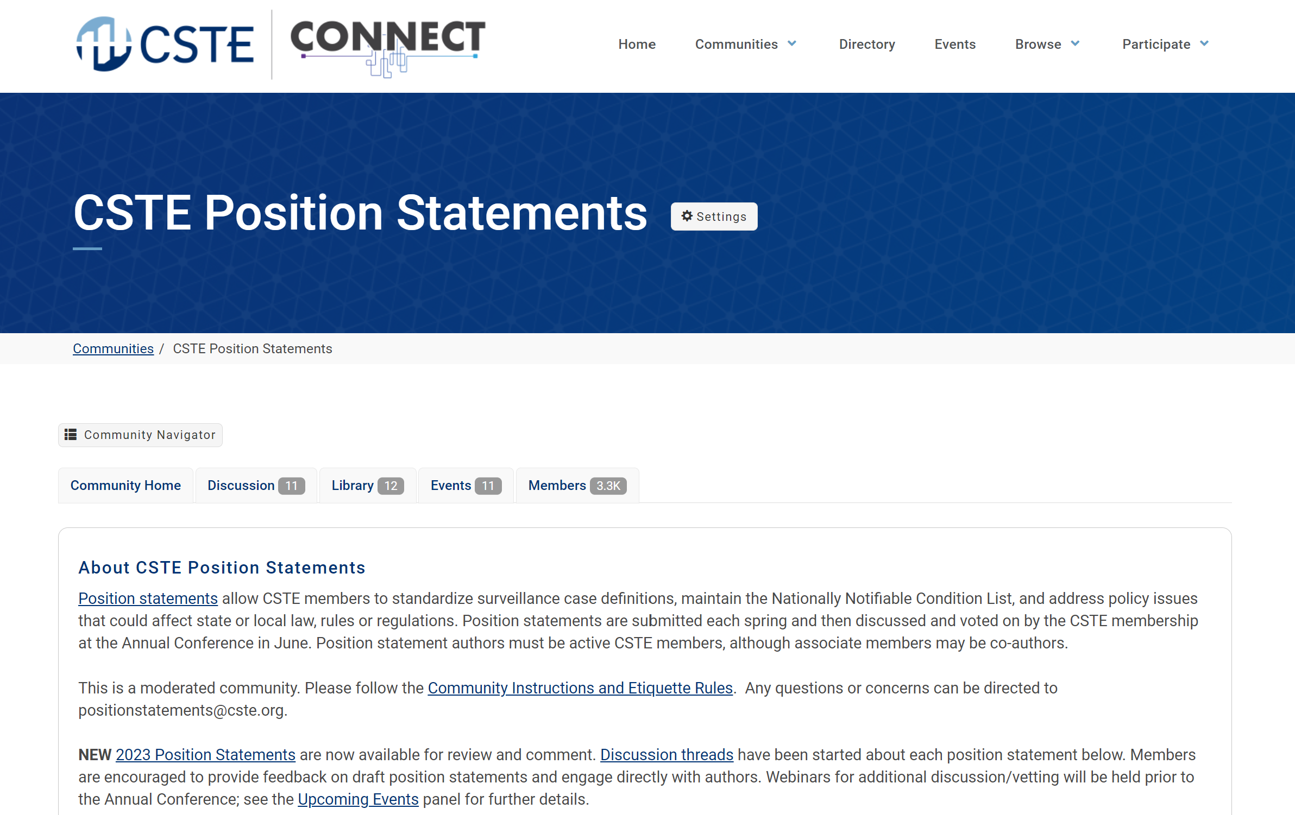
*NEW* CSTE Connect Discussion Threads
Link: https://connect.cste.org/
Notes:
“And new this year, we will be hosting discussion threads on CSTE Connect, CSTE’s new online engagement portal. If you are already a CSTE member with up-to-date dues, you already have access to CSTE Connect. Threads have been started for each position statement under consideration and we encourage all members to discuss position statement content directly with the authors on this site.”

Slide 6
Position Statement Disclaimer
Position statements are considered to be in DRAFT form until finalized and approved by the Council at the CSTE Annual Business Meeting. Draft position statements are under active review/vetting and discussion. They shall not be widely distributed and are intended only for official CSTE members, invited disease/condition subject matter experts, and position statement authors and writing groups prior to approval.
Direct all media inquiries related to any draft CSTE position statement to the CSTE National Office at positionstatements@cste.org.
Notes:
“And lastly, we ask that members do not widely distribute these position statements while they are still in draft form. If there are inquiries from members of the press about the position statement process or any draft position statement, please forward those along to the national office so that they can be appropriately triaged and responded to.”

Slide 7
Vote in 2023 CSTE Executive Board Run-off Elections
Voting in the CSTE Executive Board Run-off Elections: May 25 through June 8
Voting for the CSTE Executive Board is open to ALL Active* Members!
Open positions:
  At-Large Members (2)
For more information, visit the Election webpage: https://www.cste.org/general/custom.asp?page=2023-CSTE-Election
*Active CSTE Member – State, Territorial, Local, Tribal
Notes:
It is time to cast your vote in CSTE Executive Board Run-off elections! Thank you to our members who participated in this year’s CSTE Executive Board elections. Preliminary Results indicate the need for a Secondary (run-off) Election in two races:
Member-At-Large Slate II
Member-At-Large Slate III
Per CSTE bylaws, run-offs in these two races are needed as no single candidate received a majority of votes. In these run-off elections, only the top two scoring candidates from the initial ballot are moved forward. The Secondary Election is open from May 25 through Thursday, June 8, 2023. All Active Members can vote in the run-off, even if the member did not vote in the prior election.
Note: The entire slate of winners will be announced following the close of the Secondary Election. Results will be emailed to the full membership on Thursday, June 15, 2023

Slide 8
Upcoming S/I Call Schedule
Data Release, Presentation, Access, Suppression and Sharing Workgroup (DRPASS) Call
  6/6 @ 3:05 pm ET
  tpinsent@cste.org
Surveillance Policy Subcommittee Call
  6/9 @ 2:05 pm ET
  tpinsent@cste.org
eCR Workgroup Call
  6/20 @ 4 pm ET
  dbarter@cste.org
Electronic Laboratory and Disease Reporting Subcommittee Call (ELDRS)
  6/21 @ 3 pm ET
  dbarter@cste.org
Notes:
Quick look at the upcoming CSTE S/I calls in June

Slide 9
Welcome to the June National ELR Workgroup Call!
Agenda
Welcome/introductions – Nicole Kikuchi (FL)/ Cody McNeese (OR)
CSTE announcements – Devra Barter (CSTE)
Update on APHL Survey of Jurisdiction Plans for CELR after PHE Expiration – Brooke Beaulieu (APHL)
Update on Systemic Harmonization and Interoperability Enhancement for Laboratory Data (SHIELD) – Riki Merrick (APHL)​
Discussion series: Data Quality Assurance Strategies – Garrett Jenkins (CA)​
DMI Stories from the Field​ – Megan Tompkins/Bridget Teevan (CSTE)
Adjourn
Next Call: August 1, 2023 @ 1 pm ET
Notes:
Welcome to the March CSTE Surveillance Practice and Implementation Subcommittee Call! Please introduce yourself in the chat by stating your name & organizational affiliation.
We are recording the call for internal note-taking purposes only!
Please note your attendance on today’s call by clicking on this link: https://cste.co1.qualtrics.com/jfe/form/SV_4UXGlKNghPXNAq1

