Slide 1
Utah ELR Data Quality Assurance
Teri Bills
Utah Division of Population Health: Informatics Program
Electronic Data Exchange Senior Health Informaticist
Notes:
This is a template. Please make a copy/duplicate of the template before editing.

Slide 2
Continual Quality Assurance
Utah DHHS Division of Population Health Informatics Program (DPHIP) performs ongoing QA throughout the lifetime of a healthcare organization’s ELR reporting
This QA is accomplished during 3 main phases:
Onboarding QA
Validation QA
Maintenance QA

Slide 3
Onboarding Quality Assurance

Slide 4

Minimum Data Set
Utah DPHIP has identified a minimum data set required for laboratory reporting. This data set includes:
Demographic data required for case investigation
Reporting facility information
Clinician contact information
Performing laboratory information
Laboratory specimen, test, and result data
This minimum data set is regulated within Utah’s Communicable Disease Rule for electronic reporters.
Notes:
Every reporter is required to meet minimum data set prior to moving on to the next onboarding step

Slide 5
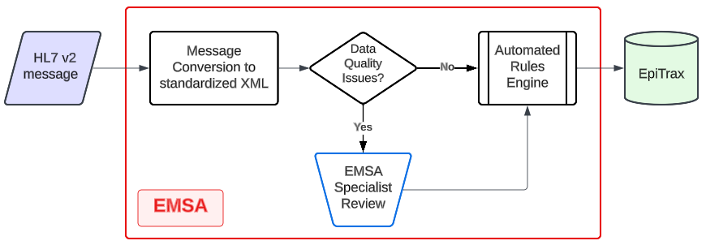
Electronic Message Staging Area (EMSA)
Utah DPHIP utilizes the EpiTrax surveillance system sister program EMSA for processing of messages into our local and state EpiTrax instances.
This system maps HL7 v2 messages into a standardized XML format, allowing data elements to be translated, adjusted, or removed prior to processing into EpiTrax.

Slide 6
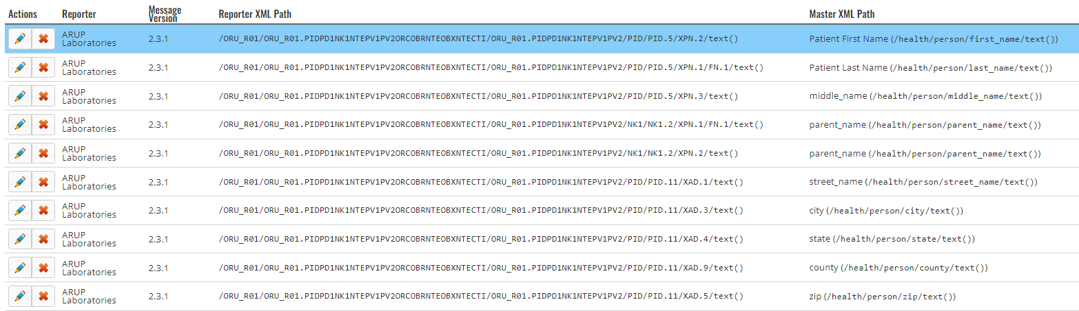
HL7 v2 EMSA Mapping
Notes:
We can specify this for each reporter so if they refuse to comply with the standard we can map accordingly

Slide 7
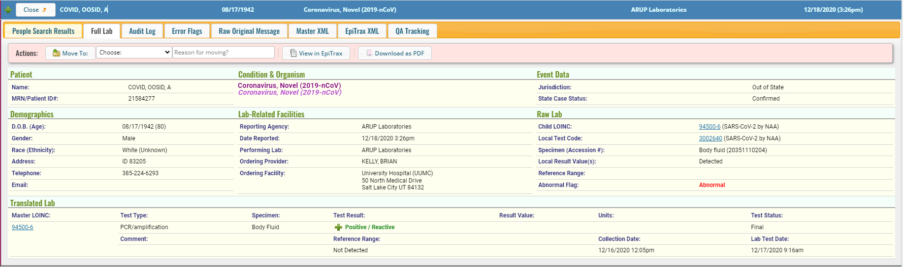
Message Quality User Interface in EMSA

Slide 8
Test Suite Data Set
A selection of messages is required from different groupings that encompass common scenarios DPHIP encounters during reporting
Examples:
  Do cases of Hepatitis trigger liver function reports?
  Do CT/GC panels contain Chlamydia and Gonorrhea results?
  Do antimicrobial susceptibility panels contain an organism identification and all appropriate breakpoints?
Once all scenarios are appropriately and consistently reported the reporter is moved into validation phase.
Notes:
We’ve found that reporters dont always send accurate test messages so we require all test suite messages to be production or production-like

Slide 9
Validation QA Process

Slide 10
Validation Process
Once a reporter’s ELR feed is moved into our production environment Utah DPHIP moves through the validation process.
Messages received are compared weekly against 4 validation metrics
  Volume
  Timeliness
  Completeness of Reporting
  Data Quality
Reporters must meet all 4 metrics for 4 consecutive weeks before legacy reporting can be stopped
  If any metric is missed the process begins again until 4 weeks in a row are accomplished

Slide 11
Validation Metrics
Volume
Reporters must be able to maintain feed stability at full reporting volume
Timeliness
Reporters must report 95% of ELR within 24 hours of test completion
Completeness of Reporting
Reporters must ensure that all results that should be reported are received by Utah DPHIP
  Accomplished by comparing ELR to manual reports received
Data Quality
Reporters must maintain minimum data set reporting with valid data quality
  Example: Date of Birth must be a valid date less than 100 yrs and greater than reported date
Notes:
Once these metrics are met for 4 consecutive weeks manual reporting or legacy reporting may be turned off

Slide 12
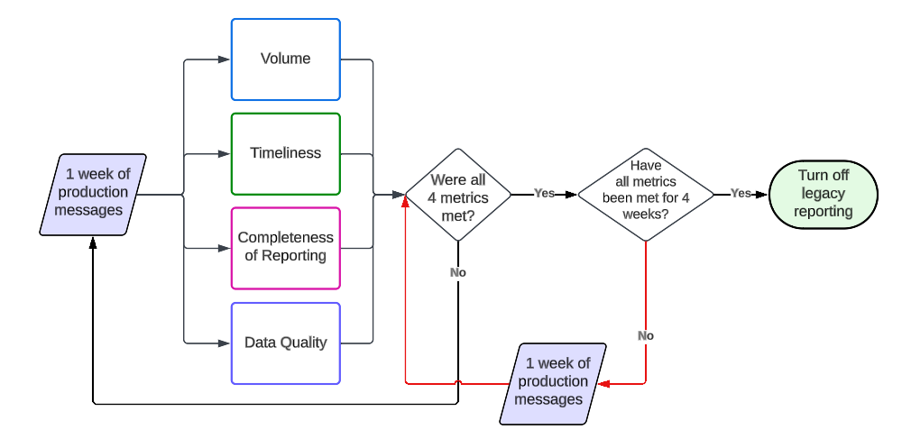
ELR Validation Process

Slide 13
Maintenance QA

Slide 14
Quality Assurance Dashboard
Utah DPHIP has developed a quality assurance dashboard to assist in post-production reporter quality assurance.
This dashboard queries and compiles data from each reporter, including:
Reporter volume
Reporter timeliness
Reporter percent positivity
Reported data completeness
Reported data validity
Reporting aberration detection
Notes:
This has shortened our

Slide 15
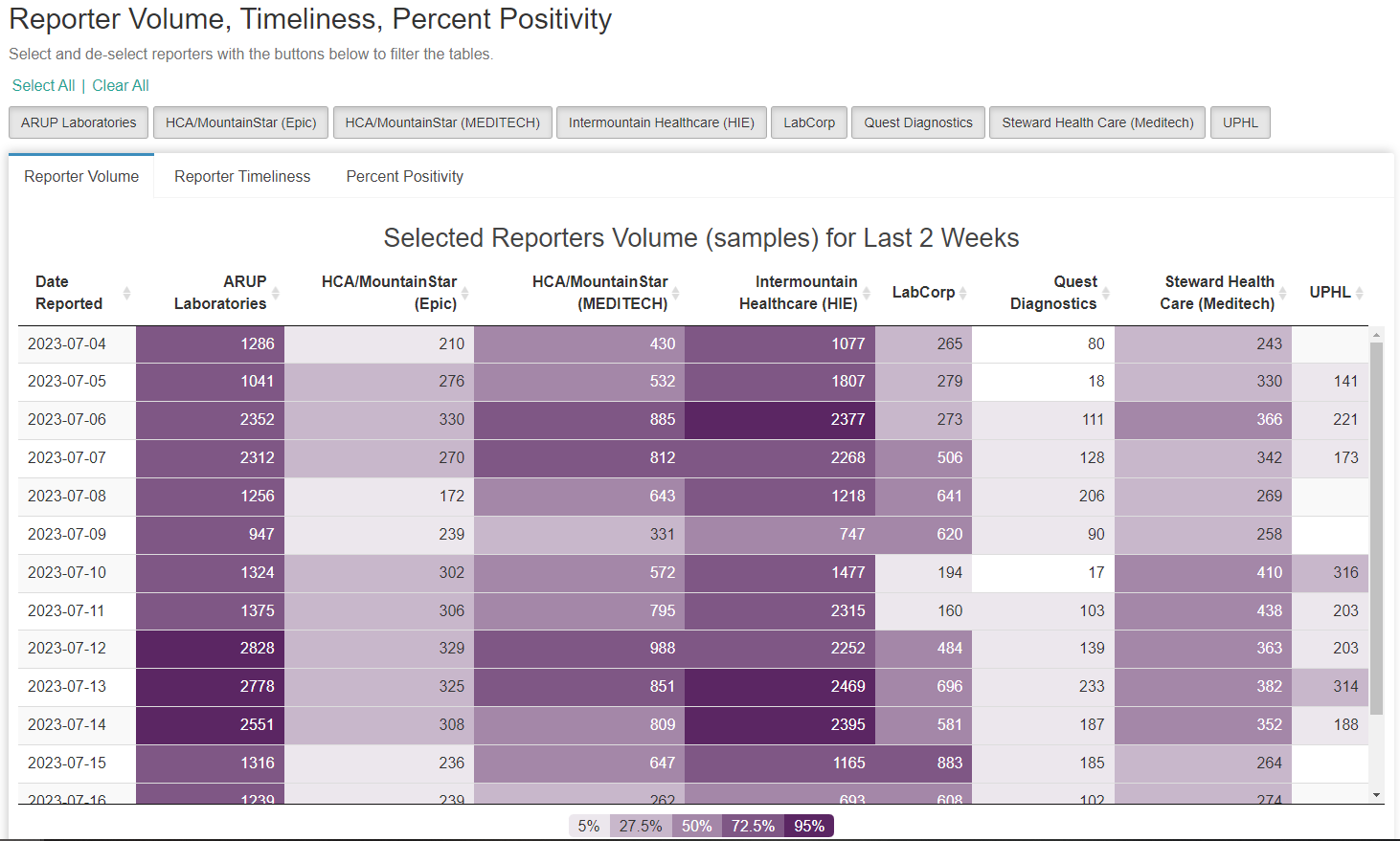
Volume, Timeliness, and Percent Positivity
Notes:
This is volume over time

Slide 16
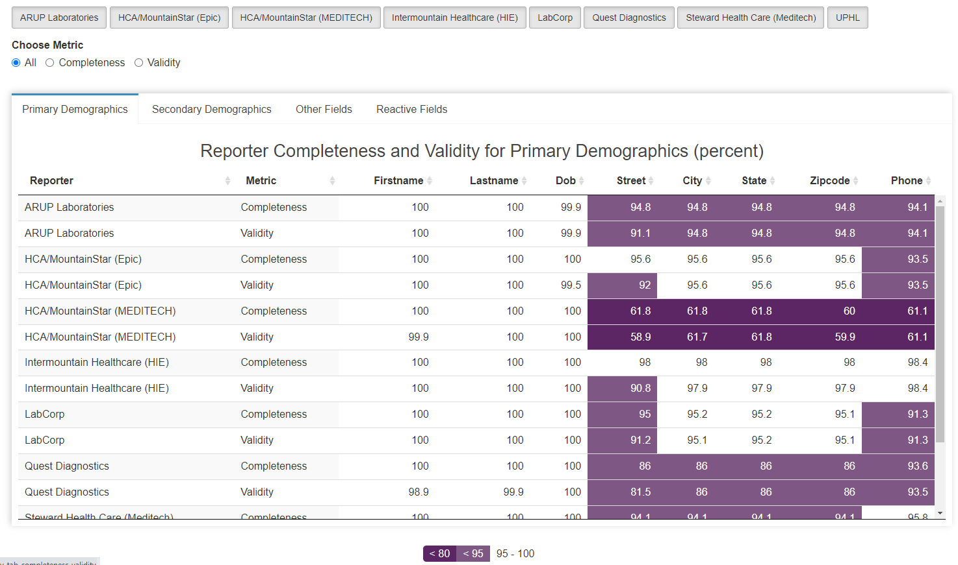
Data Completion and Validity

Slide 17
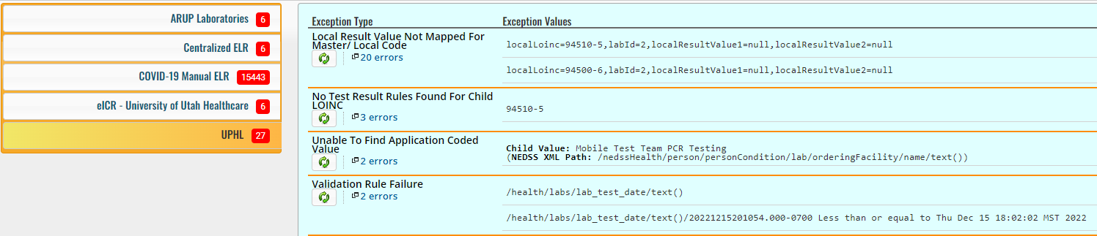
EMSA Processing
Production messages processed through EMSA are subjected to a rigorous rules engine that includes a vocabulary, validity, and new test or result reporting
98% of all messages received by EMSA are processed automatically and meet the QA requirements within the system
Messages that contain potential data quality issues are placed into “queues” for our EMSA Specialist team to review. Our electronic data exchange team can then review and correct these issues.
Notes:
For example, these messages have been marked because there is a new LOINC that our rules engine does not recognize. Our emsa team can then review the messages and determine how the system should process the messages for case management

Slide 18
Rachelle Boulton
Rocio Ramos
Emanuel Vasquez
Utah Electronic Data Exchange Team
Utah Dashboard Team
Acknowledgements

