Slide 1
Welcome to the August National ELR Workgroup Call!
Agenda
Welcome/introductions – Cody McNeese (OR)
CSTE announcements – Devra Barter (CSTE)
Discussion series: Data Quality Assurance Strategies – Teri Bills (UT)​
HL7 Standards Public Health Workgroup Updates – Craig Newman (Altarum)/ Erin Holt Coyne (TN)
Adjourn
Next Call: September 5, 2023 @ 1 pm ET
Notes:
Welcome to the June ELR Call! Please introduce yourself in the chat by stating your name & organizational affiliation.
We are recording the call for internal note-taking purposes only!

Slide 2
Upcoming S/I Call Schedule
Surveillance Practice and Implementation Subcommittee (SPIS) Call
  8/4 @ 1:30 pm ET
  blampkins@cste.org
Data Release, Presentation, Access, Suppression and Sharing Workgroup (DRPASS) Workgroup Call
  8/8 @ 3:05 pm ET
  Tpinsent@cste.org
Surveillance Policy Subcommittee Call
  8/11 @ 2:05 pm ET
  tpinsent@cste.org
eCR Workgroup Call
  8/15 @ 4 pm ET
  dbarter@cste.org
Electronic Laboratory and Disease Reporting Subcommittee (ELDRS) Call
  No August call
  dbarter@cste.org

Slide 3

CSTE Announcements
2023 Syndromic Surveillance Symposium (December 5-7) call for abstracts
  Open from now until August 25, 2023
  Contact syndromic@cste.org with any questions

Slide 4
CSTE Announcements
Applications for the 2023-2024 CSTE Early Career Professionals Mentorship Program is now open
  The purpose of the program is to build relationships and foster shared learning among applied epidemiologists
  Each mentor and mentee pair are expected to connect virtually once a month. The program runs from October 2023 – July 2024.
  A prospective mentee webinar will be held on August 8th at 1pm ET
  A prospective mentor webinar that will be held on August 9th at 10am ET
  Applications to be a mentor or mentee are open from now until August 25, 2023
  Contact Sarah Auer (sauer@cste.org) with any questions or visit https://www.cste.org/general/custom.asp?page=early-career

Slide 5
CSTE Announcements
USCDI v4 was released July 2023
ONC is accepting submissions for new data elements for USCDI v5
  New submissions and comments are due September 20, 2023.
  To submit new data elements or comments, visit https://www.healthit.gov/isa/united-states-core-data-interoperability-uscdi

Slide 6
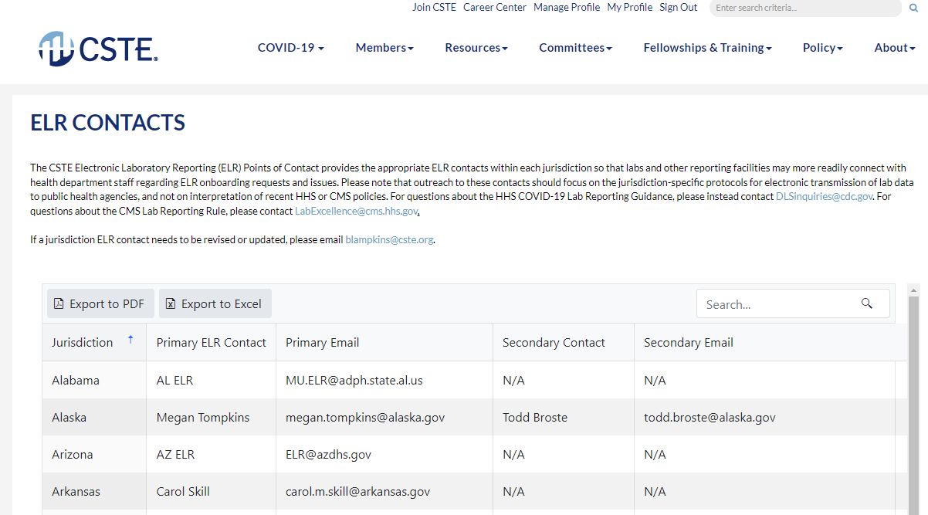
ELR Contacts on CSTE website
Review the ELR Contacts list on the CSTE website (https://www.cste.org/page/elr-contacts)
  Please send any updates to Devra Barter (dbarter@cste.org)

Slide 7
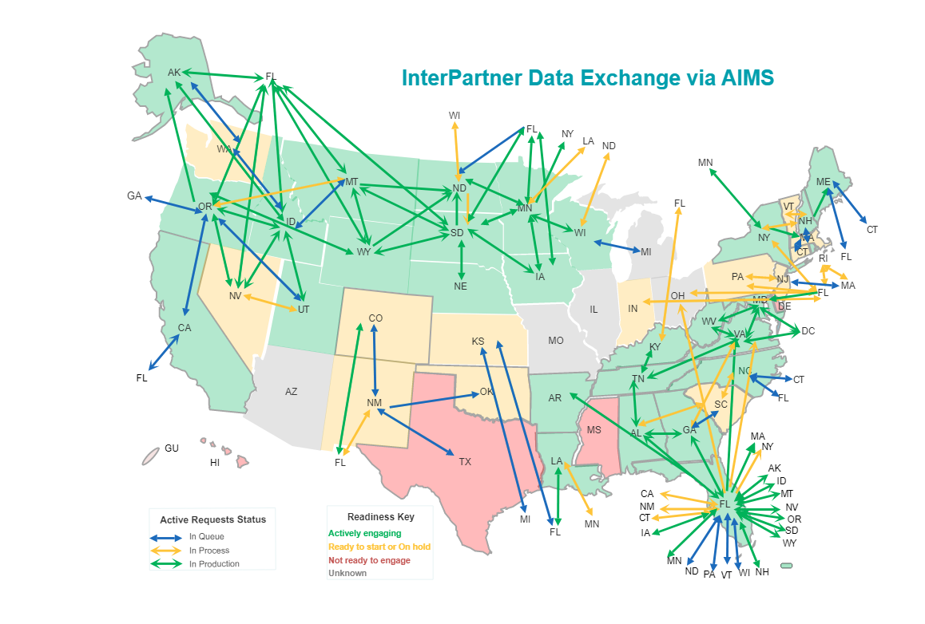
APHL’s InterPartner Dashboard
APHL has an InterPartner Dashboard (https://app.smartsheet.com/b/publish?EQBCT=0336885b8fc842c7869bf617fa6d4075) where jurisdictions can review and update their willingness to engage and specify jurisdiction-specific contacts
Contact Brooke Beaulieu (brooke.beaulieu@aphl.org) with any questions

Slide 8
Welcome to the August National ELR Workgroup Call!
Agenda
Welcome/introductions – Cody McNeese (OR)
CSTE announcements – Devra Barter (CSTE)
Discussion series: Data Quality Assurance Strategies – Teri Bills (UT)​
HL7 Standards Public Health Workgroup Updates – Craig Newman (Altarum)/ Erin Holt Coyne (TN)
Adjourn
Next Call: September 5, 2023 @ 1 pm ET
Notes:
Welcome to the June ELR Call! Please introduce yourself in the chat by stating your name & organizational affiliation.
We are recording the call for internal note-taking purposes only!

