Slide 1

Data Exchange Onboarding
WA's Data Quality Assurance Strategies

Slide 2
QA begins with Onboarding
Like other states, QA begins with the onboarding process and communications
ELR data is processed by our Washington Electronic Lab Reporting System (WELRS) prior to sending lab data to surveillance systems
Washington uses the Maven system for GCD, TB, Hep and Blood Lead we call the Washington Disease Reporting System – WDRS
Case data for all conditions are in the onboarding pathway of WDRS though no HIV and STI data in our WDRS Production pathway, they are in production for their systems
Notes:
WA has a long history of data QA at the beginning of the onboarding process. We only accept HL7 messages, and we do not accept .csv files for loading to our systems.
We begin by having a UAT or onboarding pathway and a Production pathway.
We use the WELRS system to process lab data prior to sending the data to subsequent surveillance systems. We use the WA disease reporting system we call WDRS for everything except HIV and STD in Production. We do send HIV and STD data to our onboarding environment for validation only.

Slide 3
What is validated?
ELR – Until recently, only onboarding for ELR data
eCR - Beginning content validation for eCR data with hopes to have our first submitter’s eCR in Production by the end of September 2023.
Notes:
The onboarding process is when we have the most levereage to obtain the best data possible. Until now, ELR has been my team’s only work, though we are broadening to be the onboarding team for the 4 public health measures in Promoting Interoperability. Because all hospitals who want to attest to the measure must be on ELR, we need to get the onboarding process refined to have all hospital labs in ELR by end of Q3 2025.

Slide 4

Types of Submitters We Onboard
New ELR submitters for HL7
Labs that have LIS System Upgrades or Changes
Labs changing from COVID only to all notifiable conditions (ANC)
2.3.1 to 2.5.1
Notes:
The onboarding team will work with new and production submitters, depending on what is being onboarded. For instance we have submitters adding community connect sites to their production feed which are not necessarily the same as the production submitter’s data. Upgrades from 2.3.1 to 2.5.1. Moving from COVID only onboarding to all conditions takes considerable amount of time for validation.

Slide 5
Onboarding Process Overview
Connection
Content Validation
SME Validation
Structural Validation
Parallel Production
Production Support
Notes:
Here is an overview of our onboarding process after registration and once they have come up on our queue.

Slide 6

Connection
DOH Preferred methods for receiving Lab Data
  Health Information Exchange (HIE)
  APHL AIMS
  MFT/SFTP requires permission
Test feed (UAT) to Onboarding
  Used for all validation work
Production feed
  When moved to Production
Connection
Content Validation
SME Validation
Structural Validation
Parallel Production
Production Support
Some submitters use the Production feed and we re-route data to populate an Onboarding pathway.
Notes:
WA has a policy of onboarding new submitters if they are using the HIE or AIMS platforms. We’ve moved from SFTP to MFT and we’ve stopped allowing new onboarders to use MFT.
We use the OB pathway for all validation prior to moving to PROD

Slide 7

Structural Validation
Connection
Content Validation
SME Validation
Structural Validation
Parallel Production
Production Support
Structural validation goals
  Use NIST validator and a custom validator program to assess errors/warnings of HL7 message structure and content
  Requires production-level data ONLY
ELR Interface Mapping Logic
Minimum amount of data files for validation required
Notes:
After making sure the connections are correct and we receive the data files correctly, then the ELR structural validators begin evaluating the data with the NIST tool and a custom validator program. We only accept production level data for validation, since that is what we will be working with. Anyone can create a perfect HL7 message for testing. We don’t move to the next stage until all errors and warnings have been resolved. We limit any data manipulation in rhapsody.

Slide 8
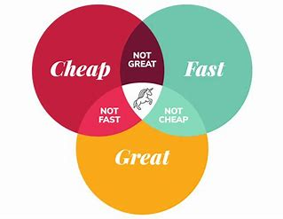
Perfectionism vs. Good Enough
The goals of onboarding validation
Bring the best, most complete, timely, accurate, and consistent data
  If we’re not sure, we’ll ask SME’s/Epi’s
Turn off our perfectionism
  All of us would like to see things 100% perfect, but sometimes technology gets in the way
It’s our goal to get labs in production so we are getting better quality, more reliable, and more complete data.
  Public benefit to receive data sooner than wait for perfection
  Document the variance and move forward
Notes:
The onboarding process is the only carrot we have to getting complete required data with lab results. Enforcement before onboarding will incentivize the organization to dedicate resources into getting the required data. While onboarding COVID only reporters was somewhat easier, getting all data needed for all other conditions has proven to be a challenge for multiple reasons. As the Venn diagram of good/fast/inexpensive shows, you can only have 2. While we strive to get all the data elements each program needs, we are validating for required data only. Sometimes its system limitations vs workflow adjustments needed on the submitter side.
We would all like 100% accuracy and hopefully the gaps in demographic data will be alleviated in the future with the roll out of eCR.

Slide 9

Content Validation
Connection
Content Validation
SME Validation
Structural Validation
Parallel Production
Production Support
Content Validation spreadsheet
  Review notifiable conditions sheet
  Production level data ONLY
  Run reports for data and evaluate data completeness percentages manually
  Will ask for test messages only for low volume reportable items
Notes:
Once all messages are error-free, we begin content validation where we ensure complete data for all elements required by our WAC. We review this list during our kickoff call with the submitter and require they indicated whether they perform the tests inhouse, as sendouts and list of associated LOINCs. We’ve found some submitters haven’t mapped LOINC’s to all their lab tests in their system yet, and so we place them on hold until that is completed.
Again, only production level data is used and we may ask for a test message for any low volume tests which they indicate they perform. We work with the programs to identify if needed.

Slide 10
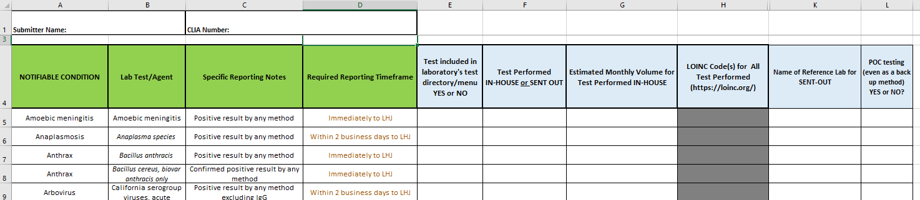
All Conditions Worksheet
Column E
Mark Yes or No if the corresponding test is orderable in your test menu (do not mark “Yes” for tests that are orderable as Miscellaneous Tests)
Column F
If test is orderable in test menu, please indicate if the test is performed in-house or if it is sent out. If the test requires confirmatory testing at reference lab, please note that the reflex test is sent out.
Column G
Please note the expected monthly volume performed for that test. If low volume, use approximate expected annual volume
Column H
For HIV and Hepatitis testing, please list the LOINC codes for all tests that are performed/resulted
Column K
Please note the Name of the reference lab(s) utilized
Column L
Please indicate if any POC testing is performed for a notifiable condition, even as a backup option
Notes:
Sample of our worksheet submitter must return prior to content validation.

Slide 11
Content of laboratory reports
(a) Patient's first and last name
(b) Patient's physical address including zip code
(c) Patient's date of birth
(d) Patient's sex
(e) Patient's ethnicity, as required in WAC 246-101-011(4)
(f) Patient's race, as required in WAC 246-101-011(5)
(g) Patient's preferred language, as required in WAC 246-101-011(6)
(h) For hepatitis B virus, pregnancy status (pregnant, not pregnant, or unknown) of patients twelve to fifty years of age
(i) Patient's best contact telephone number
(j) For blood lead level, Medicaid status of patients less than seventy-two months of age
(k) Requesting health care provider's name
(l) Requesting health care provider's phone number
(m) Address where patient received care
(n) Name of submitting laboratory
(o) Telephone number of submitting laboratory
(p) Specimen type
(q) Specimen collection date
(r) Date laboratory received specimen
(s) Test method used and
(t) Test result.
Notes:
List of required elements by our WAC, also reviewed with the submitter at kickoff.

Slide 12
SME Validation
Connection
Content Validation
SME Validation
Structural Validation
Parallel Production
Production Support
SME Objectives
SMEs will validate the ELR content and volume for all onboarding laboratories
SMEs will review production-level ELR data for any missing, incomplete, incorrect or nonsensical data in their respective test system
Notes:
The final step before approval for activation into PROD, is the surveillance system program SME’s. Each time we run into new questions/challenges in the data, we note that for future onboarding validation items.

Slide 13

Parallel Production
Connection
Content Validation
SME Validation
Structural Validation
Parallel Production
Production Support
Validation complete and ready for Production
  DOH parallel reporting for 2 weeks – both paper and electronic
  If no discrepancies, we notify the lab they will be moved to Production Support
Notes:
Once we have the OK to move to PROD, we let the submitter know the go live date. We require they continue to report manually until we have 2 weeks of error free data. Once 2 weeks are up, we give them the OK to turn off manual reporting.

Slide 14


Production Support
Connection
Content Validation
SME Validation
Structural Validation
Parallel Production
Production Support
Paper off!
  No longer manually reporting to LHJ’s
  Inquiries for missing data are investigated by ELR team
  R-Shiny program used to track if we’ve not received data from submitters within a certain timeframe
Notes:
At this point they are in production support, where they are monitored for errors and missing results. Production ELR team uses an Rshiny program which monitors submitters and notifies us if we’ve not seen results from them recently.
All changes should be reported to the ELR PROD team and all issues are handled by them using an issue tracker in smartsheet. At this point, the onboarding team is no longer involved unless the production submitter is making changes which require onboarding activities again. This is the circumstance where submitter is in production and onboarding at the same time.

Slide 15

Questions?

