Slide 1
HL7:
Where Sausage is Made and
Cookies are served at 3pm
Erin Holt Coyne, MPH
Office of Informatics and Analytics
Tennessee Department of Health
Craig Newman
Interoperability Subject Matter Expert
Altarum
Sept 5, 2023

Slide 2
Outline
Standards development process
Balloting tools

Slide 3

Health Level Seven International
Founded in 1987
Not-for-Profit
Volunteer based
International
Healthcare Interoperability Standards Developer
Mission: To provide standards that empower global health data interoperability
Vision: A world in which everyone can securely access and use the right health data when and where they need it.

Slide 4
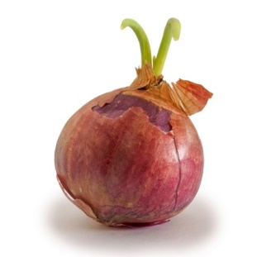
HL7 Participation- How can I participate?
Serve on a project team
Development of the materials
Subject matter expertise and contribute to content
Review materials and vote in ballots
Participate in ballot reconciliation
Assist in editing
Comment and improve existing STU standards
Serve in a leadership position
Listen and learn
Membership/Pay
Membership

Slide 5
HL7 Guiding Principles for Due Process
  Openness
  Lack of Dominance (no preponderance of influence)
  Balance (of interest)
  Coordination and Harmonization
  Notification of Standards Development (communication for participation)
  Consideration of Views and Objections
  Consensus Vote
  Appeals
  Written Procedures
  …..

Slide 6
Types of HL7 Standards
Normative
The industry gold standard
Standard for Trial Use
Up to two-year life, then replaced (or renewed)
Informative
Lower threshold for passing, lower authority
Comment Only
Five-year life, then reaffirmation or replacement
Possible minor changes, "dot" releases
Exploratory
Most common type of standard
Notes:
Normative- during those 5 years there is very little work needed to maintain (Industry has agreed that this is the only way to do something)
STU- constant work during two years, and at the end of two years, you can do it again… go to normative
Informative- never expire, some maintenance required (Industry has agreed that this is A way of doing something)

Slide 7
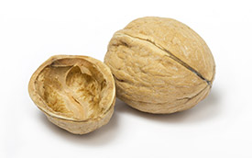
How to develop an Implementation Guide
  Gather as many interested parties as possible
  Write a project proposal/scope and form a team
    The WG doesn’t bring specific writing resources to the table
  Find an HL7 home
  Write one or more "use cases"
  Pick a base product family and version
  Constrain it and constrain it some more
  Ballot and discuss it until the believers outnumber the non-believers
https://confluence.hl7.org/display/PHWG/Project+Expectations

Slide 8
Standards Development and Publication
1.
Project Proposal
2.
Requirements
Content & Draft Document
3.
Submit draft for Ballot (3 times a year)
Find a Home - Responsible parties, other workgroup co-sponsors/interested parties
4.
Apply resolution comments to document
Submit for publishing or submit for re-ballot
Notice of Intent to Ballot (NIB)
Project Scope Statement
Socialization - Scope, background, need, stakeholders
Ballot Commenting (must be an HL7 member*)
Ballot Reconciliation (must participate in work group)
Approvals at every step
Notes:
Approvals by work group sponsoring, co-sponsoring and TSC

Slide 9
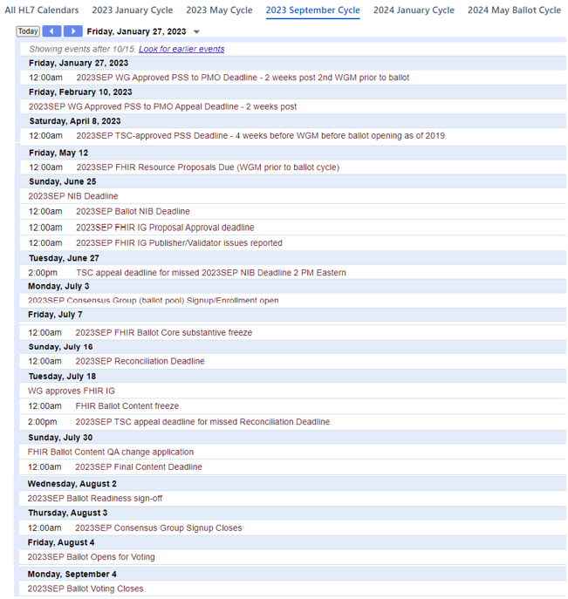
Timelines
PSS Approval
Ballot Close
(and then the fun begins)
https://confluence.hl7.org/display/HL7/All+HL7+Calendars

Slide 10
Balloting Process
HL7 process to seek comment from community on artifacts prior to publishing to help enhance the development of the standard
Part 1- Review and Comment
    Must be an HL7 member or pay per pool
    Individual vote on the overall ballot
Part 2- Reconciliation
    Must participate in the workgroup
    Don’t have to be an HL7 member
    Vote on comments and approval of changes

Slide 11
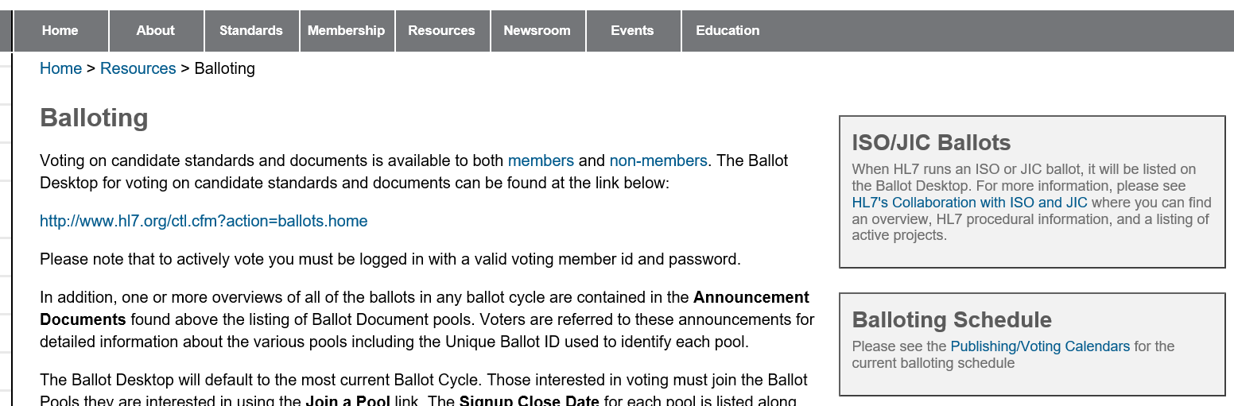
Balloting- Review and Comment
Non- Members:
  administrative fee for participating
  typically $400 per pool, but not to exceed fee
  for an individual membership.

Slide 12
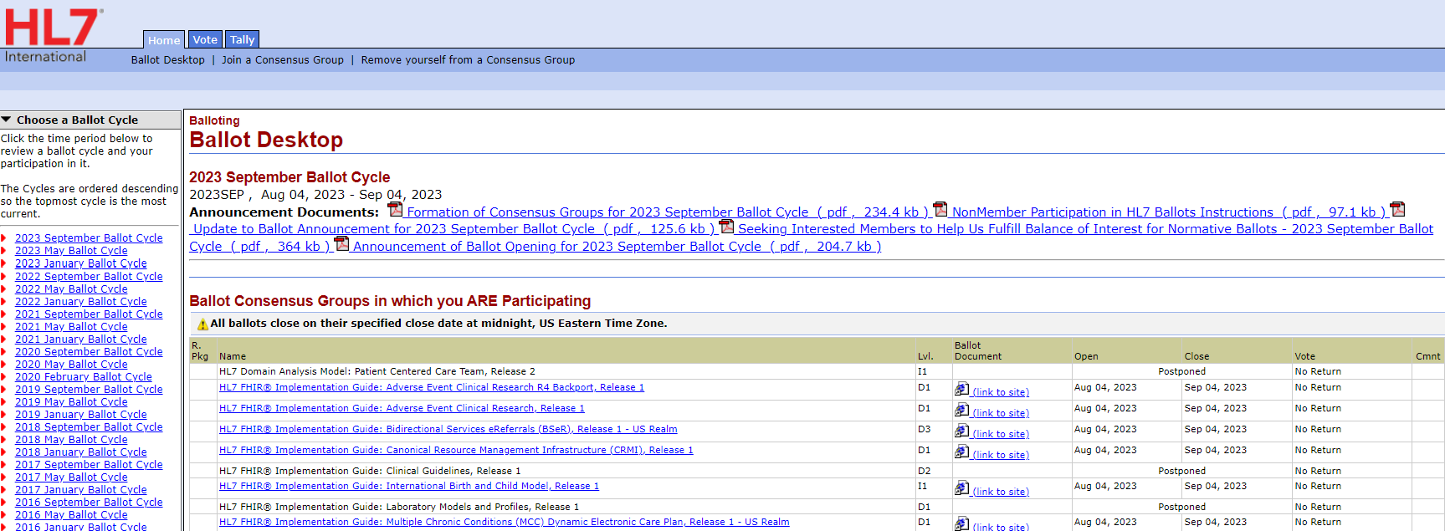
Ballot Desktop
Notes:
Balloting happens on standards in all 3 product families (v2, CDA and FHIR)

Slide 13
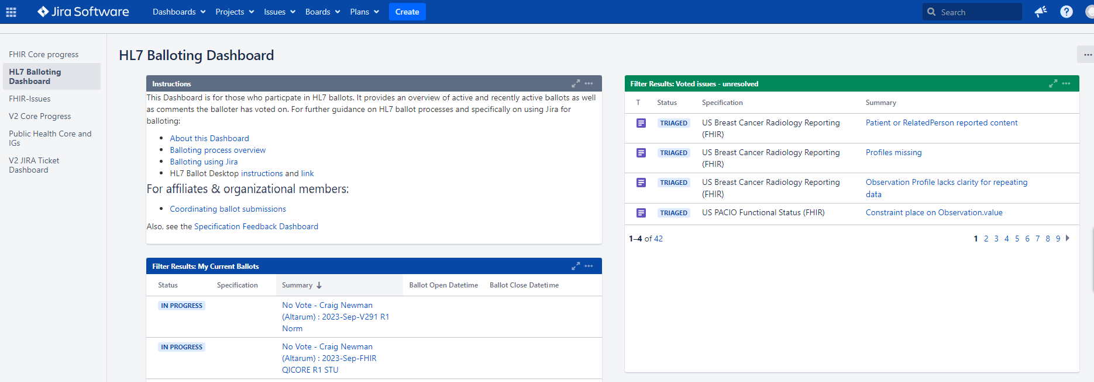
Balloting - Dashboard
Notes:
HL7 is constantly evolving, and in the spirit of coordination and harmonization, it is undergoing changes to harmonize its balloting processes into a single web-based process.

Slide 14
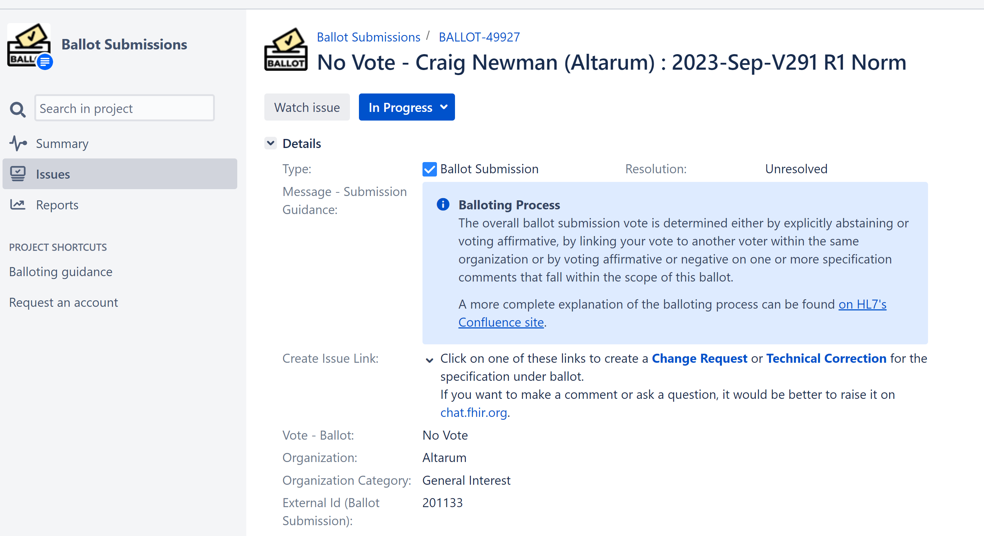
Balloting - Voting
Notes:
HL7 is constantly evolving, and in the spirit of coordination and harmonization, it is undergoing changes to harmonize its balloting processes into a single web-based process.

Slide 15
Balloting – Making Comments
Two major comment types
  Technical Corrections
  Change Requests
  Technically there are Questions and Comments – but don’t do it!
Two vote types
    Affirmative & Negative
Can ask for “in person” resolution
Multiple people in an organization can suggest comments but typically they are collated and entered by a single person
Writing a good comment is more art than science…
Notes:
HL7 is constantly evolving, and in the spirit of coordination and harmonization, it is undergoing changes to harmonize its balloting processes into a single web-based process.

Slide 16
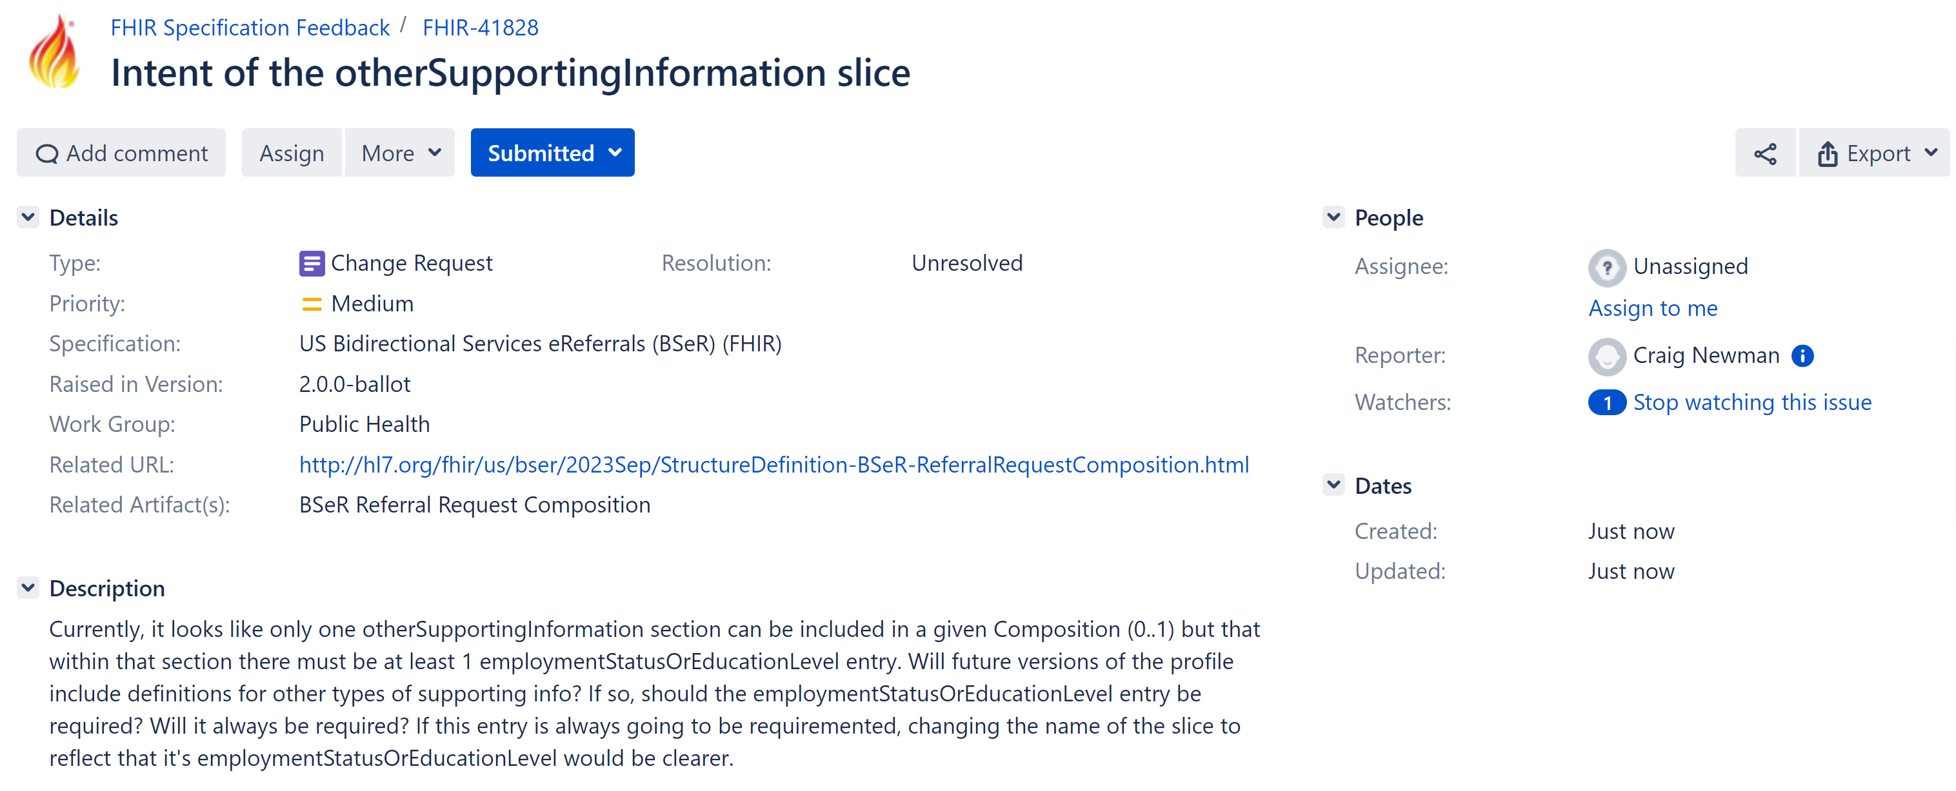
Balloting – Making Comments
Notes:
HL7 is constantly evolving, and in the spirit of coordination and harmonization, it is undergoing changes to harmonize its balloting processes into a single web-based process.

Slide 17
Balloting – Resolution
Often a smaller team will propose resolutions which are validated by the Work Group
Multiple comments can be resolved in a “block vote”
  Proposed resolutions are circulated at least a week in advance of the vote in the Work Group so that people have time to review the proposed solutions
Common outcomes are:
  Persuasive/Persuasive with Mod
  Not Persuasive/Not Persuasive with Mod
  Deferred (Future Consideration) – the Zombie option
  No Change Required
Notes:
HL7 is constantly evolving, and in the spirit of coordination and harmonization, it is undergoing changes to harmonize its balloting processes into a single web-based process.

Slide 18
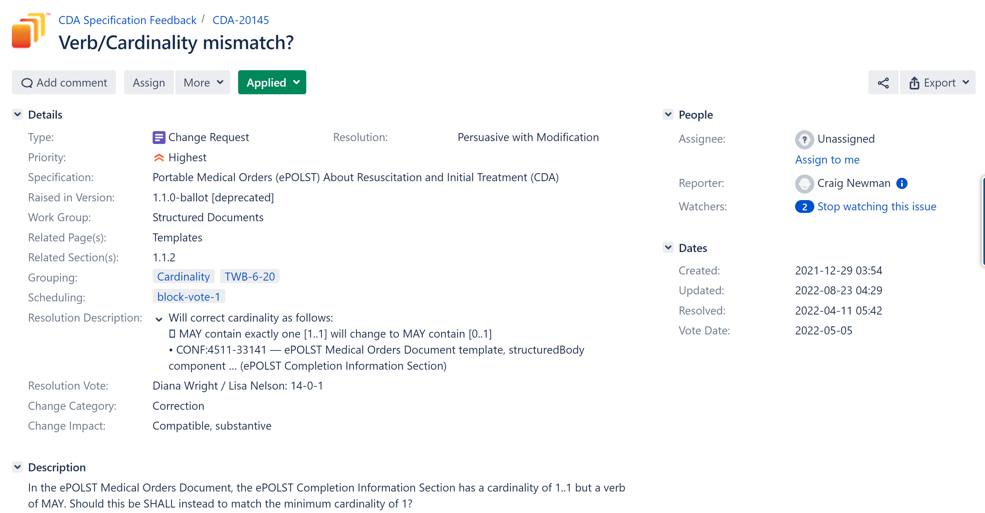
Balloting - Resolution
Notes:
HL7 is constantly evolving, and in the spirit of coordination and harmonization, it is undergoing changes to harmonize its balloting processes into a single web-based process.

Slide 19
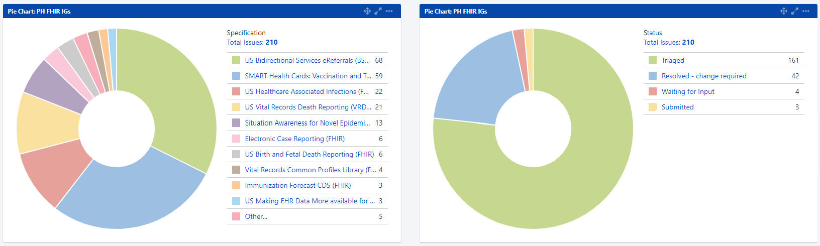
Balloting – Tracking Issues
Notes:
HL7 is constantly evolving, and in the spirit of coordination and harmonization, it is undergoing changes to harmonize its balloting processes into a single web-based process.

Slide 20
Work Group Health
The health of our projects impacts the health of the work group
  Stale tickets
  Delays at any step (ballot reconciliation, publication, etc)
Work group health impacts our ability to start new projects
Project teams must be diligent!!

Slide 21
FHIR Maturity (Base Standard)
Indicates stability of the artifact
Maturity Level | Description
FFM0 | Resource or profile has been published in current build
FFM1 | FFM0 and no warnings during build process and responsible WG has indicated resource is ready for implementation (ImmunizationRecommendation)
FFM2 | FFM1 and Artifact tested and used to successfully exchange between at least 3 independently developed systems at a connect-a-thon and results reported to FHIR Management Group
FFM3 | FFM3 and WG verified that artifact meets DSTU 32 Quality guidelines, with formal round of balloting with at least 10 implementer comments from at least 3 organizations resulting in at least 1 substantive change (Immunization)
FFM4 | FFM3 and Tested across scope, published, and implemented with multiple prototype projects. Responsible WG agrees resource sufficiently stable to require implementer consensus for subsequent non-backwards compatible changes (x1)
FFM5 | FFM4 and Published in two formal publication release cycles at DSTU level, implemented in at least 5 independent production systems in more than 1 country (x 11)
Normative is the goal!
Notes:
FHIR uses this concept of maturity that is based on review/feedback and breadth of implementation to determine stability
Ultimately, the goal is to get everything to Normative – some core FHIR resources are already normative
This same grading can also be applied to Igs (not just the base standard)

Slide 22
HL7 Participation- Where do I go?
Free
HL7 website user name and password
Access Standards
Manage membership
Resources
    Information about workgroups & projects
    Sign up for list serves
    Balloting
    Policies and procedures
Information on events and call calendar
Access education & certification
http://www.hl7.org

Slide 23
Don’t like the HL7
Implementation Guides? Think you
have better ways to do it?
Participate in HL7!
Erin.Holt@tn.gov
TDH.Informatics@tn.gov
craig.newman@altarum.org

Slide 24
Helpful HL7 Links
HL7 Home page: http://www.hl7.org/
    Standards, Membership, Resources, Events, Education
Ballot Desktop: Located under resources tab- http://www.hl7.org/participate/onlineballoting.cfm?ref=nav
Publishing Calendar*: http://www.hl7.org/documentcenter/public_temp_3BDC3C28-1C23-BA17-0CF74611A11D2146/schedules/ballot_calendar/pubs_schedule_2018.pdf
Listservs*: Located under resources tab- http://www.hl7.org/myhl7/managelistservs.cfm?ref=nav
Workgroups: Located under resources tab- http://www.hl7.org/Special/committees/index.cfm?ref=nav
Confluence & JIRA*: http://confluence.hl7.org/
    Agendas, Call/meeting details, minutes/notes
FHIR Standard: http://hl7.org/fhir/STU3/
* Will need a user/name and password (Free)

Slide 25
Key Terms
ANSI- American National Standards Institute
ASD-ANSI Accredited Standards Developer
CDA- Clinical Document Architecture
C-CDA- Consolidated Clinical Document Architecture
DAM- Domain Analysis Model
EHR - Electronic Health Record
FHIR- Fast Healthcare Interoperability Standards
IG- implementation Guide
IHE- Integrating the Healthcare Enterprise
ISO- International Organization for Standardization
LOI & LRI- Lab Orders Interface & Lab Results Interface

Slide 26
Key Terms
NIB- Notice of Intent to Ballot
ODH- Occupational Data for Health
PH (PHWG)- Public Health Work Group
PSS- Project Scope Statement
REST- Representational State Transfer
STU- Standard for Trial Use
WGM- Work Group Meeting

