Slide 1
Minding the GAP: Electronic Laboratory Reporting Data FLOW Analysis in WASHINGTON STATE
Caroline Thomas, Kyle Stohr, MD, Maggie Dorr, MPH, Julie Vanderkolk, MSPH
Washington State Department of Health, Tumwater, WA
Notes:
Hi everyone and thanks for tuning in, my name is Caroline Thomas and I currently work as a public health informatician at the WA State Department of Health on the Electronic Laboratory Reporting team. Today I’ll be sharing a project with you on ELR data flow analysis. Before we begin, I’d also like to recognize and thank my co-authors and members of the WA DOH ELR team, Kyle Stohr, Maggie Dorr, and Julie Vanderkolk.

Slide 2
Background and Motivation
ELR team monitors reporting cadences
Increase in ELR submitters due to COVID-19
Automated solution and better visualizations
Checks for unusual gaps in transmission
Created technical challenges for ELR monitoring
Improve efficiency and accuracy of monitoring
Notes:
To begin with the background and motivation for this project- the WA DOH ELR team provides production support for electronic lab reporting in several ways. One essential function of the WA DOH ELR Production Support team is to perform quality assurance checks and to make sure that expected files are received from each laboratory submitter. The team monitors reporting cadences for each lab and checks for unusual gaps or patterns in transmission that require further investigation. Monitoring each individual lab became more difficult with the large increase in ELR submitters due to COVID-19 which created technical challenges for the ELR team. Our previous monitoring consisted of manual copy/paste methods with a spreadsheet that was highly error prone and only provided a singular means for looking at the data. In response to this, we sought a more automated way to monitor ELR data and to create visualizations that could assist in more efficient and accurate characterization of reporting trends.

Slide 3



Project Goals
Integration
Integrate SQL server output in R script
Visualization
Create visualizations to characterize reporting cadences
Detection
Streamline processes to detect anomalies in ELR data flow
Notes:
The ELR team is always looking for ways we can improve and automate our processes.
The primary goals of this project were to:
1. Integrate SQL server output in an R script to move away from the current copy-and-paste, Excel-based process
2. Create visualizations of ELR data submissions to characterize reporting cadences and to allow us to improve retrospective investigation of ELR delays
3. Streamline processes to detect unusual gaps in data flow and anomalies in message volume
Some additional secondary goals included:
4. Make thresholds set for labs and lab information easier to change/update (we were previously utilizing conditional formatting in Excel which can be easy to mess up)
5. Ensure smooth addition of newly onboarded labs to our monitoring practices
6. Create a tool that can be used and maintained internally within the ELR Production team. This led us to developing the dashboard in R as the team was already familiar with R and required no additional licenses or training.

Slide 4
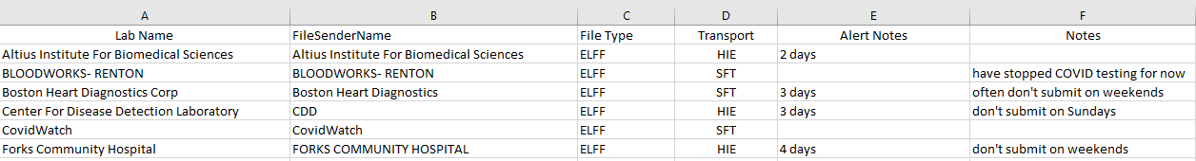
Methods
SQL Server Data
Data processing script
Application script
shiny
plotly
ggplot2
DT
DBI
tidyverse
Date received
Message counts
Results
Jurisdiction
Health condition
Reference Dataset
RShiny Dashboard
Notes:
The dashboard involves 2 R scripts, originally developed by the Booz Allen Hamilton Laboratory Reporting Technical Assistance (LRTA) team that we worked with during a two-month period of technical assistance. First, the data processing script uses the DBI package to extract raw SQL Server data from a WADOH database. This data contains the date processed, message counts, results, health conditions, and jurisdiction for ELR messages processed by WADOH. This data is then merged with a reference dataset containing details about each lab submitter (a snapshot of this reference dataset is shown here). The data are then cleaned and manipulated using tidyverse functions and additional date features are added such as day of the week and week of the month. Next, the application script accesses the processed data and implements the RShiny dashboard using the shiny package. The tables in the dashboard are created using the DT package and interactive graphics are created by wrapping ggplot2 visuals in plotly functions.
Now let’s take a look at the dashboard itself!

Slide 5
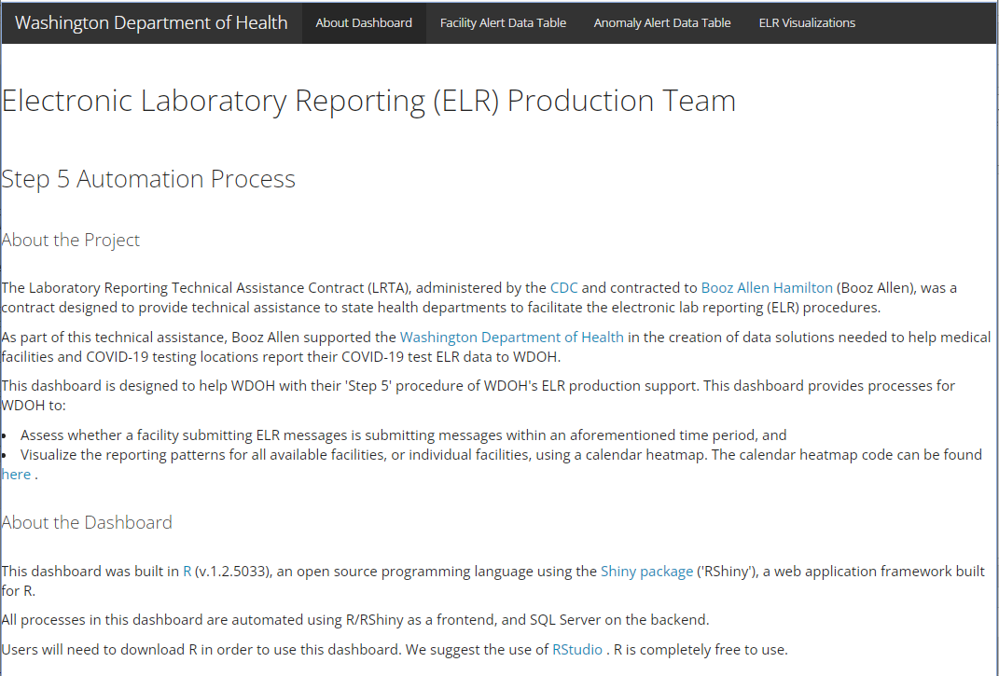
Landing Page
Notes:
When the app is launched, you are initially brought to the landing page shown here. There is some brief information about the project and about the dashboard. At the top, you can see there are four tabs- About the Dashboard (the landing page), Facility Alert Data Table, Anomaly Alert Data Table, and ELR Visualizations. We’ll now take a closer look at each tab.

Slide 6
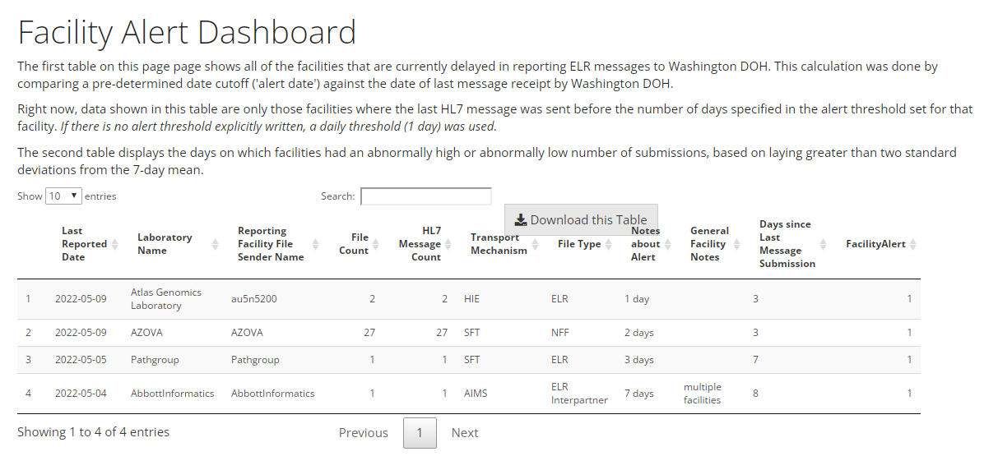
Facility Alert Data Table
Lab names redacted
Notes:
The Facility Alert table displays all the facilities that have exceeded their threshold of reporting which is based on a pre-determined cutoff that has been set in the reference dataset mentioned earlier. The date of the most recent results received* from each lab is used to determine the number of days since the last message transmission*. This is then compared to the threshold value* for each lab and a FacilityAlert value of 1 indicates that a facility has exceeded their threshold. The submitters displayed in this table may be encountering delays in reporting ELR messages to WA DOH due to transport or processing issues, which may be occurring on the lab side or the DOH side. This prompts additional investigation and contact with the lab. The table also includes information about the file type and transport mechanism for each lab to assist in troubleshooting potential issues. This allows us to see when there is a widespread issue impacting all facilities that submit using a particular mechanism or file type. The table includes sorting and searching functionality and can be downloaded as a csv file.

Slide 7
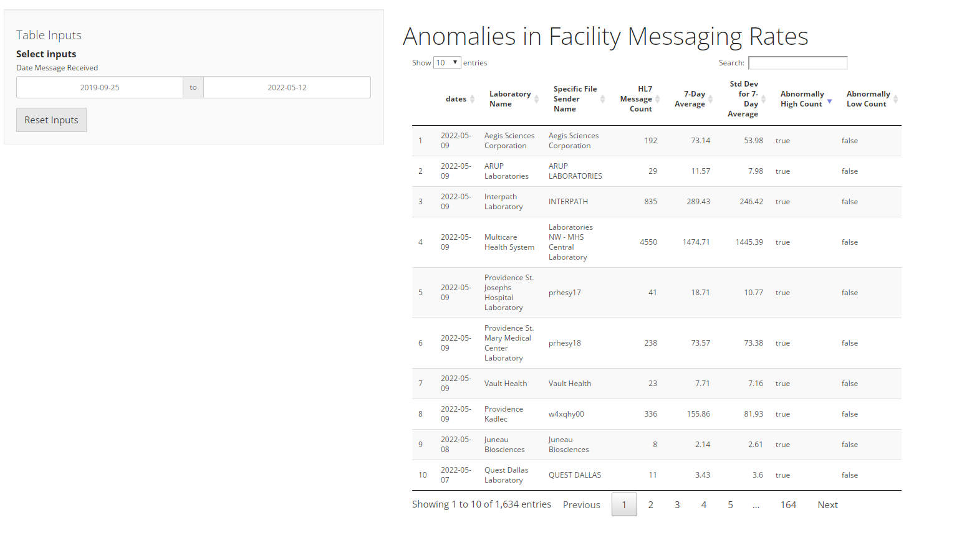
Anomaly Alert Data Table
Lab names redacted
Notes:
Next, the Anomaly Alert Data table displays the days on which facilities had an abnormally high or abnormally low result volume*, based on laying greater than two standard deviations* from the 7-day mean. The date range can be filtered for by using the inputs in the top left corner. These alerts prompt additional investigation to ensure labs are sending the expected data. For example, in the past, we’ve had labs accidently transmit their entire archive of data or send us large volumes of duplicate results, which cause problems for downstream workflows. These incidents show up on this table allowing the ELR team to notify downstream partners and minimize the impacts.

Slide 8
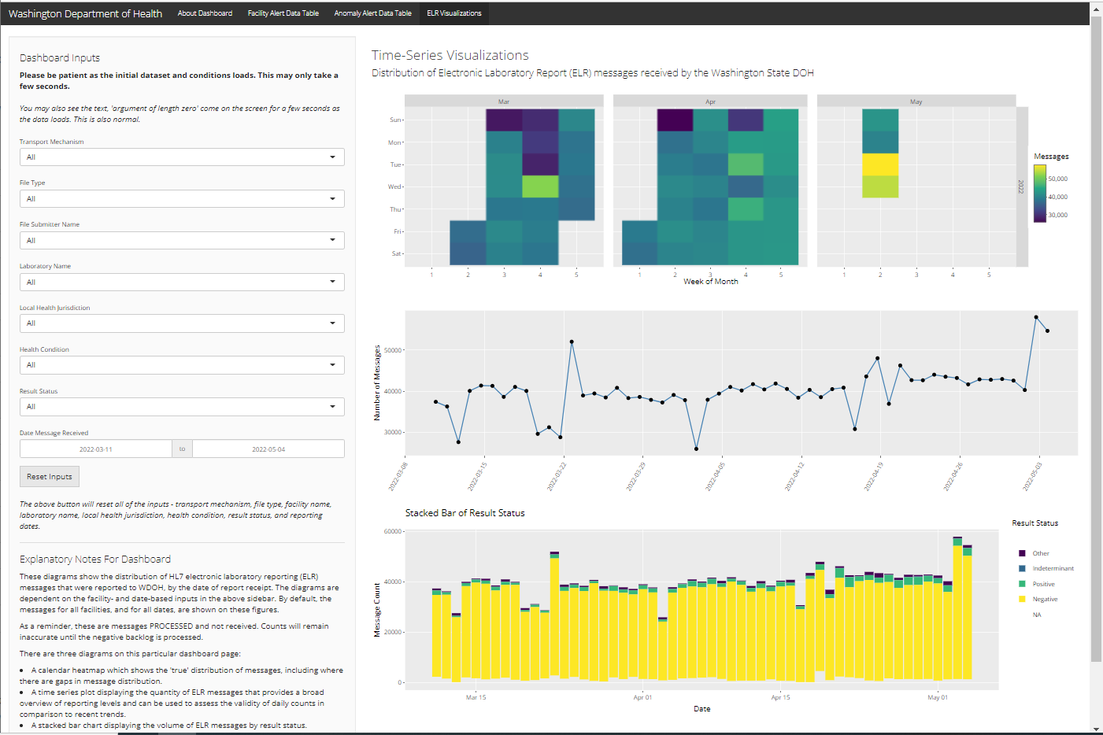
Visualizations
Notes:
Finally, we have the ELR visualizations page. On the left, there are options to filter the data and explanatory notes for each visual, and on the right, there are multiple graphics displaying the same data. Let’s take a closer look at each piece.

Slide 9
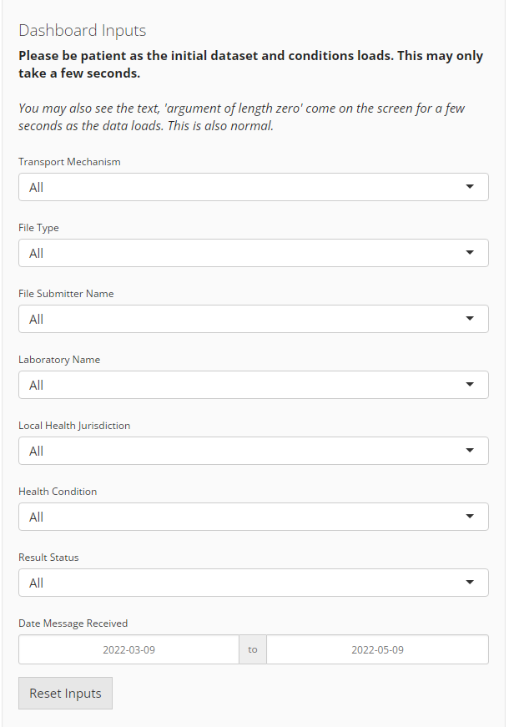
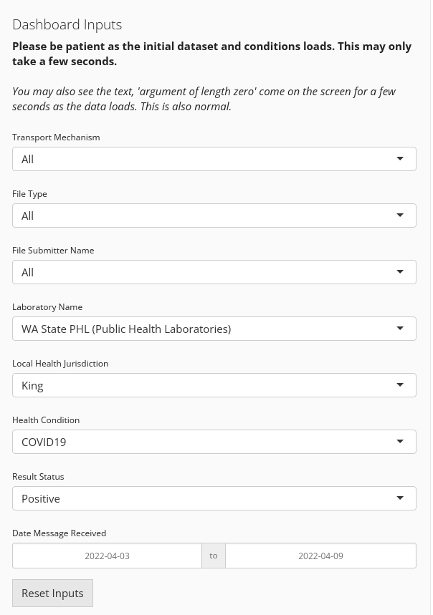
Filtering the Data
Notes:
The dashboard has many options to filter the data displayed in the visualizations. Multiple filters can be applied at the same time. This allows us to drill down to very specific subsets of the data that we are particularly interested in.
The filter options are:
Transport mechanism (such as Secure File Transfer, Health Information Exchange, PHINMS, APHL Informatics Messaging Services, etc.)
File type (such as HL7, National Flat File, ELFF, etc.)
File Submitter Name- this is the MSH 4.1 value in the electronic messages. This is not always an easily readable value, hence, we included an additional filter for
Laboratory Name- which is the more readable lab name and is specified in the reference dataset for each File Submitter Name
Local Health Jurisdiction- we often get requests to investigate reporting issues from local health jurisdictions, so this filter allows us to specifically look at the data for one jurisdiction.
Health Condition
Result Status (positive, negative, indeterminate, etc.)
Date Message Received
There is also a Reset Inputs button at the bottom.

Slide 10
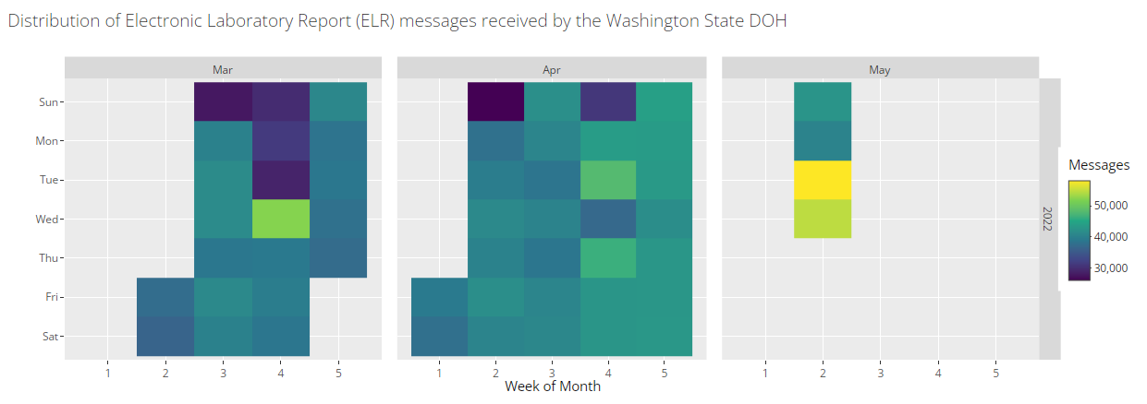
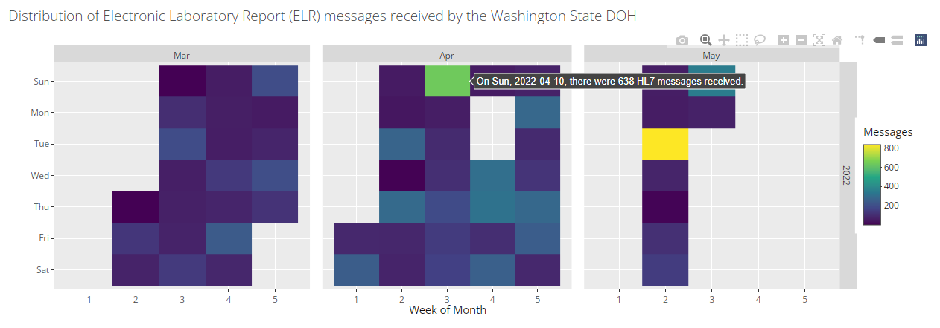
Calendar Heatmap
Notes:
The first visualization is a calendar heatmap that uses a color gradient to display ELR message volumes over time. The calendar displays year on the right vertical axis, month across the top, week of the month on the bottom, and day of the week on the left axis. Each cell represents one day and if you hover over a cell with your mouse, more exact information is provided about that day (this function is shown in the bottom plot). In this visual trends by day of the week and days with no messages received are particularly visible.
The top plot shown on the screen is a complete look at data from mid-March through early May without additional filters applied. The heatmap displays fairly consistent daily message volume with some variation. A few minor disruptions can be seen but these are typically caught up the following day. You can also see that DOH often receives and processes fewer messages on Sundays* as shown by the darker colors across the top row.
The second plot shows data that has been filtered for one individual facility. We can see that this facility sends results to DOH very consistently each day, however, there are a few anomalies. There is a *two day window mid-April in which no data from this facility was processed which is highly unusual. The facility was contacted and a transport issue was discovered. There are also two days*, one in April and one in May, in which the volume of messages was higher than normal.

Slide 11
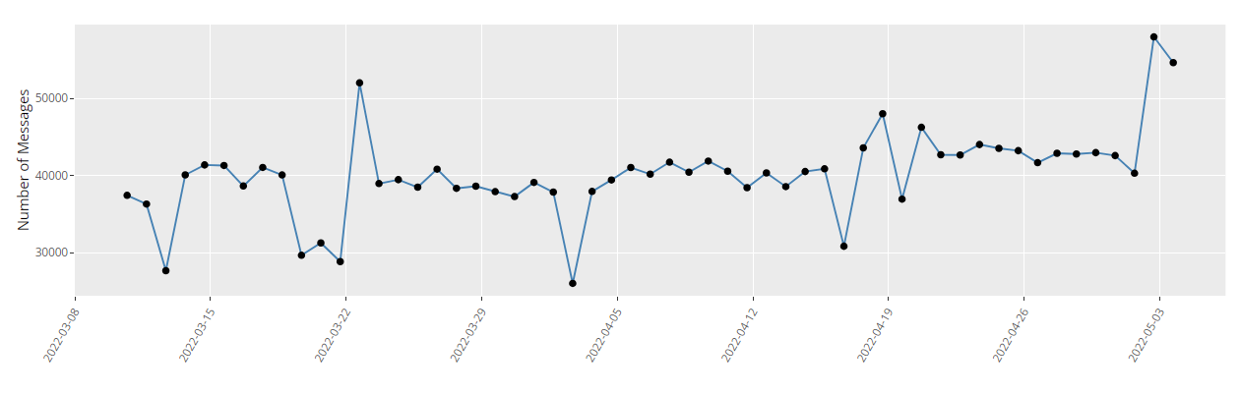
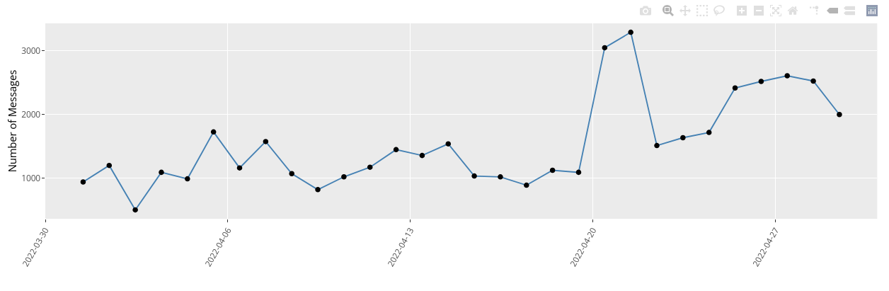
Line Plot
Notes:
The second visualization we have is a line plot. While it displays the same distributions of data as the calendar heatmap, it provides a very clear overview of trends over time without including the additional complexities of the calendar. The date is shown on the x-axis and number of messages is shown on the y-axis. While the heatmap clearly shows large deviations in data volume, daily counts with less separation and less dramatic trends are easier to see here.
Once again, the first plot shows data from early March to early May without additional filters.
The second plot shows the data filtered for COVID-19 positive results for the month of April. *Mid-April DOH experienced an issue resulting in the disruption of positive results from multiple submitters. The issue was resolved and the backlog of delayed positives was processed on April 20th-21st, hence the large spike in positives at that time. This spike isn’t as noticeable in the top plot because DOH processed a greater volume of negative results during the lull in positives. Additionally, there is a slight upward trend in positives throughout the month. This plot also has the mouse-over functionality to get more information about a given data point.

Slide 12
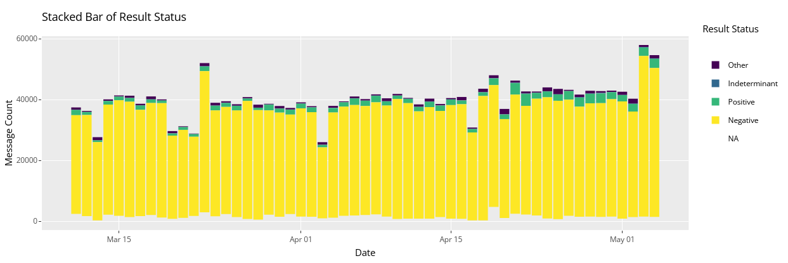
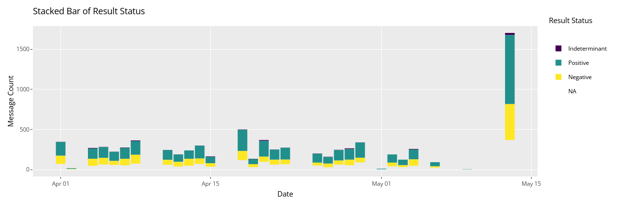
Stacked Bar Chart
Notes:
The third and final visualization is a stacked bar chart of result status. This breaks up the data to illustrate what proportion of data processed was positive, negative, indeterminate, other, etc. This is helpful in identifying issues that are only impacting positive or negative results as they are fed into our system in slightly different ways.
The top plot here contains the same March through May data that we’ve seen in the previous two slides. As you can see, message count is pretty steady over time.
The second plot is filtered for syphilis results from one particular lab in April and May. Here you can see that while there are occasional days on which no syphilis results are received, there is an *unusually large break in results for over a week in early May. In this situation, an issue was identified that was impacting HIV and syphilis results, however, the lab was still successfully sending COVID-19 results so they were not flagged elsewhere in our monitoring. *On May 13th, there is a large spike in results when the delayed results were received and processed.

Slide 13
Conclusions
Deeper insight into ELR data
Improved identification and resolution of reporting issues
Ongoing development to better fit evolving ELR needs
Notes:
The development of this dashboard has greatly increased the monitoring capacity of the WA DOH ELR team. With the capacity to specify health condition, result status, and jurisdiction, the ELR team can aid in reporting investigations to better support our public health partners including other teams at DOH, local health jurisdictions, and laboratories.
In the two weeks following implementation of the dashboard, the ELR team identified nearly twice as many potential delays in ELR submissions, compared to a similar period pre-implementation (19 vs. 9).
Ongoing development of the dashboard's ability to monitor ELR data at a more granular level will allow the team to continue to uncover and resolve issues at an expedited pace and limit the downstream public health impacts of such reporting delays. In the future, we hope to include monitoring of additional databases and additional data elements, and to create novel visualizations to better understand ELR data.

Slide 14
Acknowledgements
Michelle M. Schmitz, MSPH (CDC, Booz Allen Hamilton)
Sahitya Reddy, MS (CDC, Booz Allen Hamilton)
WA DOH Electronic Laboratory Reporting Production Support Team
Zach Smithingell (WA DOH)
Notes:
In addition to my co-authors, Kyle Stohr, Maggie Dorr, and Julie Vanderkolk, I’d like to acknowledge the following people for their help and support on this project. Michelle Schmitz and Sahitya Reddy of the Booz Allen Hamilton Laboratory Reporting Technical Assistance team who developed the original scripts for the dashboard during a two-month period of technical assistance with the WA DOH ELR team. My teammates on the WA DOH ELR Production Support team who encouraged this project and provided ideas and generous feedback. And finally, Zach Smithingell from WA DOH who provided technical R support throughout the project.

Slide 15
For more information, contact caroline.thomas@doh.wa.gov
Notes:
If you have questions, please submit them on the CSTE Conference platform or email me at caroline.thomas@doh.wa.gov.
Thank you!

