Slide 1
Welcome to the March National ELR Workgroup Call!
Agenda
Welcome – Nicole Kikuchi (FL)
CSTE Announcements – Devra Barter (CSTE)
Pregnancy status reporting criteria for ELR – Meghan Schaeffer (Aperio Statistical Consulting)
Discussion series: Data Quality Assurance Strategies – Karla Norsworthy (NC)
Open mic, time permitting
Adjourn
Next Call: April 4, 2023 @ 1 pm ET
Notes:
Welcome to the March CSTE Surveillance Practice and Implementation Subcommittee Call! Please introduce yourself in the chat by stating your name & organizational affiliation.
We are recording the call for internal note-taking purposes only!
Please note your attendance on today’s call by clicking on this link: https://cste.co1.qualtrics.com/jfe/form/SV_4UXGlKNghPXNAq1

Slide 2

CSTE Announcements
Conference Registration, Now Open!
  https://www.csteconference.org/
  Conference Theme - Epidemiology Elevated: Supporting People and Places
  Early bird discounted registration deadline – May 4, 2023
  Hotel reservations can be made after registration completed
  Invitations sent to presenting authors & late-breaker abstract submission period opens – March 24, 2023

Slide 3
CSTE Announcements
US Core Data for Interoperability
  ONC accepting feedback on Draft USCDI V4 through April 17, 2023
    Final USCDI v4 to be published in July 2023
  CSTE will collect comments from membership and can submit on your behalf
    More details coming soon on process/deadline
  If submitting feedback on your own, note 4/17 deadline and consider sharing with CSTE as FYI
HL7 Consensus Groups for May 2023 Ballot Cycle
  Consensus Group Sign-Up Close Date: Thursday, March 30, 2023
  Ballot Open Date: Friday, March 31, 2023
  Ballot Close Date: Monday, May 1, 2023
Notes:
USCDI: https://www.healthit.gov/isa/united-states-core-data-interoperability-uscdi#draft-uscdi-v4
HL7 Consensus Groups for May 2023 Ballot Cycle: http://www.hl7.org/documentcenter/public/ballots/2023MAY/Announcements/2023May_Announcement_of_Formation_of_Consensus_Groups.pdf

Slide 4
Upcoming Call Schedule
Data Release, Presentation, Access, Suppression and Sharing Workgroup Call
  3/7 @ 3:05 pm ET
  Surveillance Policy Subcommittee Call
    3/10 @ 2:05 pm ET
Electronic Lab and Disease Reporting Subcommittee Call
  3/15 @ 3 pm ET
eCR Workgroup Call
  3/21 @ 4 pm ET
S/I Steering Committee Call *new calendar invite coming soon*
  3/28 @ 12:30 pm ET
Data Standardization Workgroup Call
  3/31 @ 1 pm ET

Slide 5

CSTE Pregnancy Status Reporting Project
Dr. Meg Schaeffer, Owner/CEO Aperio

Slide 6
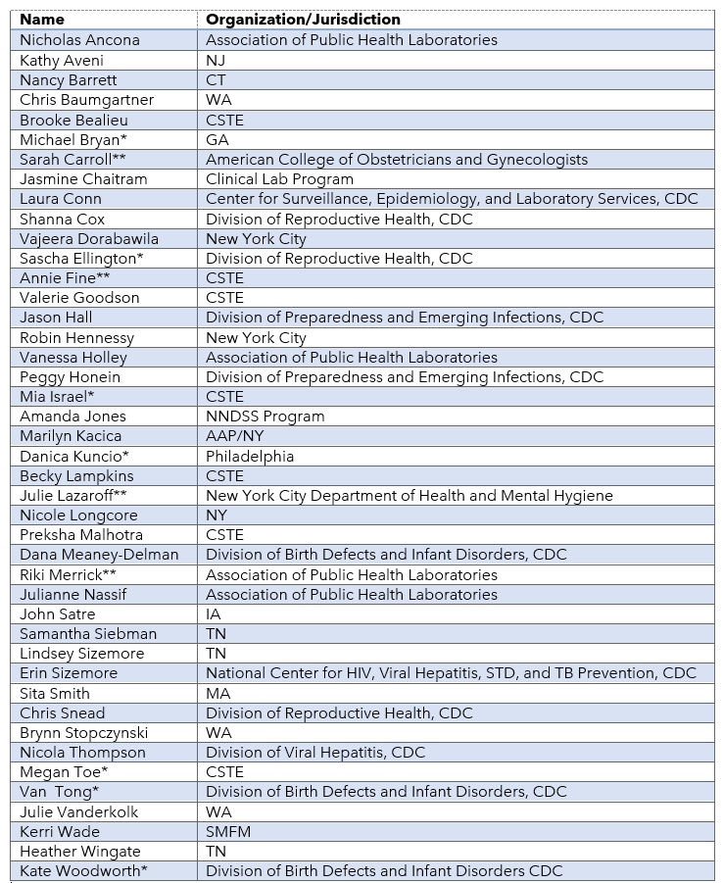
Workgroup Members, Coordinators*, and Editors**

Slide 7

Pregnancy Status Reporting Workgroup
Background
To prevent a recurrence of the patterns of past public health emergency responses and improve data capture of pregnancy status for diseases or conditions that most significantly impact maternal and child health, a set of cohesive, reasonable recommendations was needed. The PSRW drafted this document to serve as a template for future policy, a roadmap for STLT advancement of pregnancy status reporting, and a checklist for federal, clinical, and auxiliary agencies to ensure the right national constructs are in place. The precedence of decades of non-standard processes will be challenging to replace, but the result will fortify public health efforts to protect pregnant persons and their infants for the foreseeable future.

Slide 8
Pregnancy Status Reporting Workgroup
Purpose Statement
CSTE convened this multidisciplinary workgroup of subject matter experts and public health partners to identify recommendations to improve pregnancy status reporting accuracy and completeness. The emphasis of this effort is on COVID-19 surveillance with applicability to other infectious disease threats to maternal and child health. Recommendations are centered on the following:
Establishing a jurisdiction-specific framework for administrative code or law to require pregnancy status reporting
The allowance for a tiered approach for the extent of capture of pregnancy-related data elements for reporting by condition
Utilization of existing clinical, technical, and public health systems and processes
Refined and justified standards for capturing and reporting pregnancy status through ELR
Prioritization of the movement toward eCR
Acknowledgement that multiple approaches may be needed to ensure adequate identification of pregnancy status
Critical national-level actions to augment STLT progress towards adoption and use of eCR
The adoption of these recommendations will provide an excellent basis for improving public health’s ability to act and intervene for the benefit of maternal and child health.

Slide 9

Additional Background
Target audience
Public health laboratories
Commercial and private laboratories
Clinicians and clinical administrators
Federal health agencies (e.g., CDC, ONC, CMS)
Health information exchanges
Vendors of Clinical Information systems (Health Information Organization systems, Electronic health record systems (EHR), and Laboratory Information Systems (LIS))
Electronic data intermediary companies (e.g., ingestion, aggregation, processing services often referred to as middleware)
Professional organizations
Health IT professionals and consultants
Administrative code, legislative or similar advocates and authors
Intended Use
These recommendations are intended for assessing in strengthening and advancing STLT capabilities in capturing, ingesting, and reporting pregnancy status for COVID-19. STLT agencies may use the levels of recommendations to develop a roadmap for progressing to a faster, more comprehensive means of reporting. Or an STLT agency may use the document to review and identify opportunities for improvement in the current reporting process. Federal agencies may use these recommendations to prioritize funding, support efforts for STLT implementation of the recommendations, or to advocate for policies that would facilitate improved pregnancy reporting.

Slide 10
Project Deliverables
Interviews with stakeholders from various jurisdictions and agencies
Evaluation of pregnancy status reporting
  State, Federal, Clinical, and Laboratories
Review of relevant documentation, publications, websites, and other sources
Develop recommendations document

Slide 11

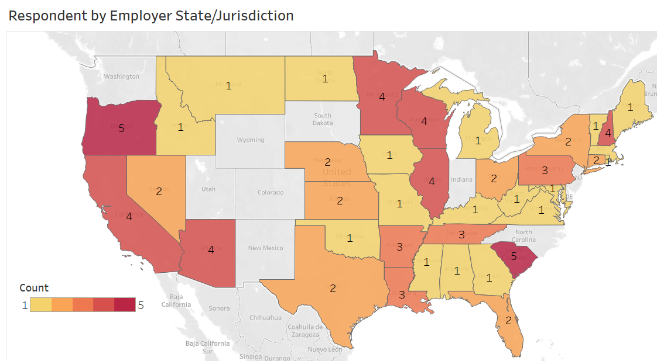
A total of 44 states and territories were represented in the assessment responses received. Within those states, 67 respondents represented STLT agencies, 15 represented laboratories, nine were clinicians, and nine represented federal agencies. Participation of STLT agencies was requested through CSTE listservs routinely used for participation in workgroups, federal agencies included those represented on the PSRW, clinicians were recruited through the American College of Obstetricians and Gynecologists, and laboratorians were solicited through the PSRW and their colleagues. Multiple responses were received for the same agency, clinic, or laboratory.
Figure 3. Respondent by employer state/jurisdiction
Chapter 1: Bullet Slide
Page: 11

Slide 12
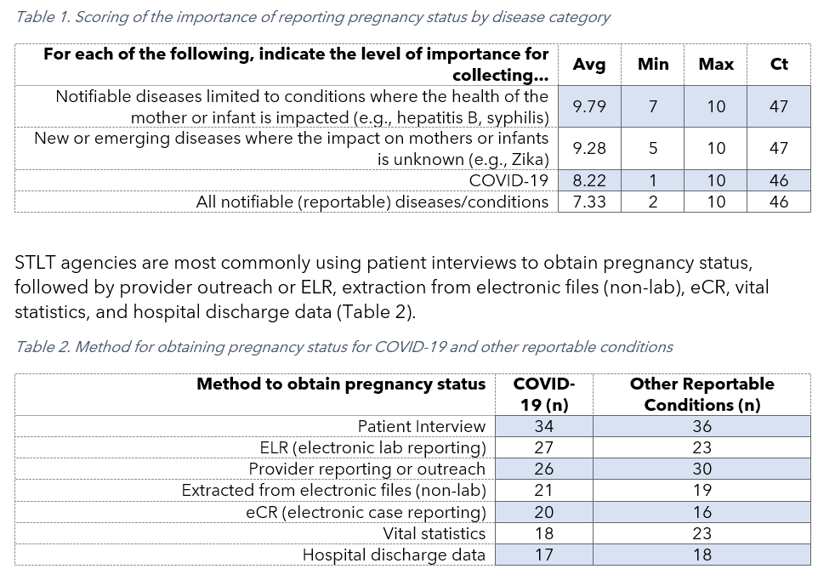
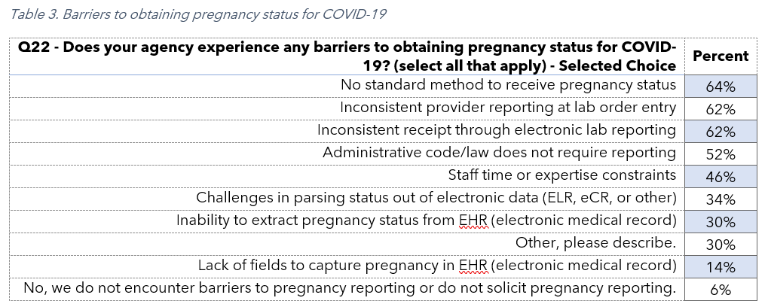
STLT practices and beliefs
STLT practitioners were asked to rate the importance of collecting pregnancy information across conditions. Respondents indicated pregnancy status was most important (9.79 out of 10) to report for “Notifiable (Reportable) diseases limited to conditions where the health of the mother or infant are impacted” with the next highest response rated 9.28 for “New or emerging diseases where the impact to mothers or infants is unknown”

Slide 13
STLT Response Summary- Additional Insights
For non-COVID diseases, similar primary sources are used. For non-notifiable conditions of public health importance, vital statistics and hospital discharge data are the most common sources of pregnancy status. State agencies most often want a simple y/n question for obtaining pregnancy status.
Inconsistency in reporting, coding and receipt are major barriers. There is also reluctance to share data across bureaus.
Seven respondents indicated administrative law exists to require reporting of pregnancy status. Agencies do link to vital records to obtain recent birth information.
With regards to eCR, COVID-19 is the most commonly reported condition. Expansion of eCR is focused on enteric diseases, respiratory conditions, sexually transmitted and vaccine preventable diseases. Significant expansion is slated to occur in the next year for most, with additional expansion within five years.
The biggest barriers to implementing eCR were retention and the presence of staff with expertise along with external technical assistance. There was mention of CDC impeding a process and a vendor not delivering an enhancement.
States indicate status reporting is very important for 'notifiable condition where the health of the mother or infant are impacted' or 'new or emerging diseases where the impact to mothers or infants is unknown', as well as COVID-19.
Page: 13

Slide 14
Laboratory Response Summary
Ask at order entry (AOE) is the most commonly used field for capturing pregnancy status for COVID-19 and other notifiable conditions. Relevant clinical information and diagnostic codes are sparsely used. Status is reported to public health using the 'Other' HL7 field or in 'Relevant clinical information' or 'OBX'.
Pregnancy status is most often collected for COVID-19 and Zika, followed by HIV and Syphilis. Manual data entry is required on paper lab requisition forms.
Laboratories confirm a simple picklist is the best approach to capture pregnancy status. If status were a required reporting element, codification in AOE is preferred. Laboratories indicate reporting capture burden is 4.2/10 effort. However, laboratorians do not feel pregnancy status should be captured by them unless clinically relevant. Most have a field to capture but challenges with ensuring reporting happens.
Page: 14

Slide 15
Clinician Response Summary
Clinicians report pregnancy status as diagnostic billing codes and dedicated fields when available. Most standard variables for following pregnant patients are routinely captured.
In terms of barriers to reporting to public health, clinicians cite EMR is not programmed to report to public health and lack of awareness of the need to report. However, clinicians feel reporting of all notifiable and emerging conditions is important.
Page: 15

Slide 16
Federal Agency Response Summary
Responses were smaller for this assessment. When obtained for COVID-19, pregnancy status is retrieved from vital statistics, eCR, and other files. Respondents indicated capturing status required significant effort. Expanded use of eCR is believed to improve reporting along with other state-level efforts. Respondents believe reporting of pregnancy status for all notifiable conditions is important.
Page: 16

Slide 17
Pregnancy Status Reporting Workgroup
Recommendations
The Council of State and Territorial Epidemiologists (CSTE) COVID-19 Pregnancy Status Reporting Workgroup (PSRW) formed the following recommendations for the improvement of pregnancy status capture and reporting. Specific scenarios to which these recommendations apply include:
Reporting of a notifiable condition (infectious or non-infectious) where there is known impact on the pregnant person, fetus, or infant; or,
Reporting of an emerging or reemerging disease where the potential health impact on a pregnant person, fetus, or infant is unknown.

Slide 18
Pregnancy Status Reporting Workgroup
Recommendations
Recommendation I: Inclusion of pregnancy status reporting for notifiable conditions in administrative code or law
The PSRW recommends jurisdictions draft or modify administrative code or laws to include pregnancy status as a required element for reporting notifiable conditions where the health of a pregnant person, fetus, or infant may be impacted. This includes specific language to require a pregnancy indicator for all emerging or reemerging conditions in addition to conditions with known perinatal impacts.

Slide 19
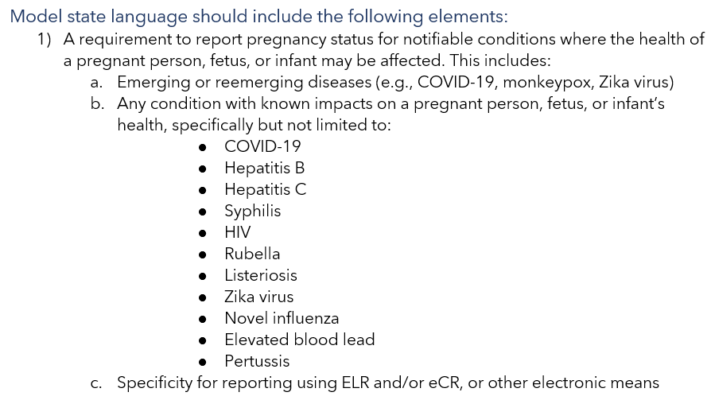

Slide 20
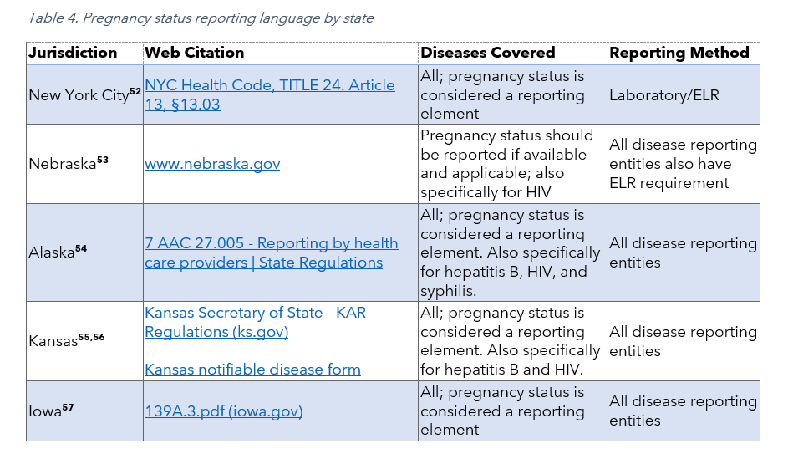

Slide 21
Pregnancy Status Reporting Workgroup
Recommendations
Recommendation II: Minimum reporting standards for electronic laboratory reporting
The PSRW recommends minimum reporting standards for obtaining pregnancy status capture and reporting for laboratories. The PSRW recommends the use of the following HL7 segments and ontologies for laboratory reporting of pregnancy status with the response extracted from AOE^{1,2}:
OBX-3 (LOINC 82810-3)
AND
OBX-5 (77386006^Patient currently pregnant (finding)^SCT, 60001007^Not pregnant (finding)^SCT

Slide 22
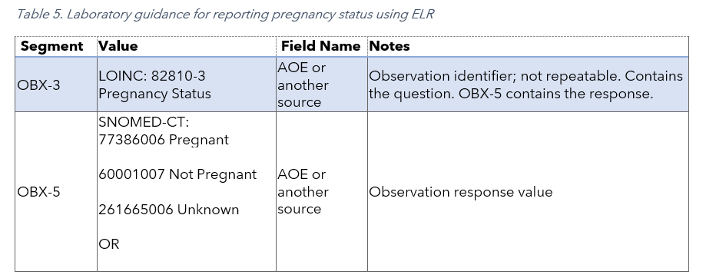
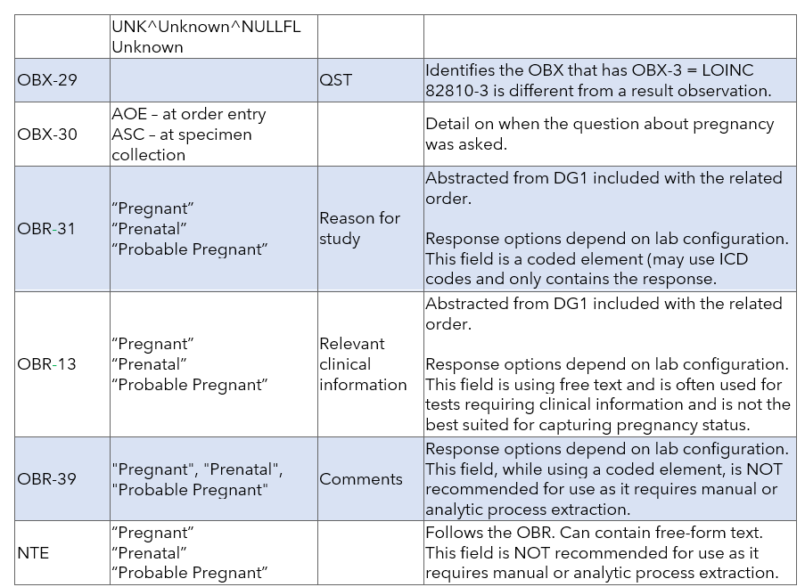

Slide 23
Pregnancy Status Reporting Workgroup
Recommendations
Recommendation III: Advancement and expansion of electronic case reporting (eCR)
The PSRW recommends all jurisdictions prioritize ingestion, extraction, and use of eCR for pregnancy status reporting. The pregnancy status reporting observation is already a required component of eCR reporting and provides adequate pregnancy data with an opportunity for expansion.

Slide 24
Pregnancy Status Reporting Workgroup
Recommendations
Recommendation IV: Essential Supporting Activities
The PSRW recommends additional activities involving multiple stakeholders influential in improving pregnancy status reporting. Top priorities include:
Promotion of the adoption of USCDI v4 Including pregnancy status data element capture in US CDI standards would create alignment with eCR reporting requirements and ensure clinicians have a standardized method to report pregnancy status within their EHR.
Provider reporting, education, and incentivization Support for provider education to improve pregnancy status reporting is essential. A multidisciplinary approach involving public health and professional organizations may be most efficacious in conducting education. Federal provider incentives should include routine capture and reporting of pregnancy status.

Slide 25
Pregnancy Status Reporting Workgroup
Recommendations
Use of supplemental methods of reporting Multiple supplemental methods for reporting pregnancy status are already in use in many jurisdictions. Even if states move toward reporting pregnancy status through standardized electronic laboratory reporting or eCR, other methods of capture may be useful especially in reporting notifiable conditions with less time sensitivity.
Policy brief development National policies are needed to support jurisdictional efforts to improve pregnancy status reporting. The creation and codification of policies provide explicit guidance and enforcement ability at the jurisdiction level.
Sustained funding support for STLT As noted in the comprehensive assessment completed for this project with STLT agencies, progress is being made towards the modernization of public health reporting systems. However, substantial investments are required to fortify and continue the work underway. Data modernization funding must not be a one-time opportunity, but a longitudinal investment in public health infrastructure.

Slide 26

Future Activities
Finalize and publish document
Expand on work completed into a policy statement
Conduct a deeper analysis of assessment data

Slide 27
Contact Information:
Dr. Meg Schaeffer meg@aperiostatisticalconsulting.com
Mia Israel misrael@cste.org

Slide 28
NC DPH ELR quality process
For CSTE presentation March 2023

Slide 29
What counts as “ELR”
HL7 ELR
CLDA (CSV files) – Converted to HL7
eCATR PTR (portal interface) – Produces a CLDA file
CLDA and eCATR PTR are only for COVID. Since they are converted to ELR prior to processing they look just like ELR in our system (but have their own quality control mechanisms)
This presentation focuses on the process for HL7 ELR – but we are also happy to share our quality process for the other systems if there is interest.

Slide 30
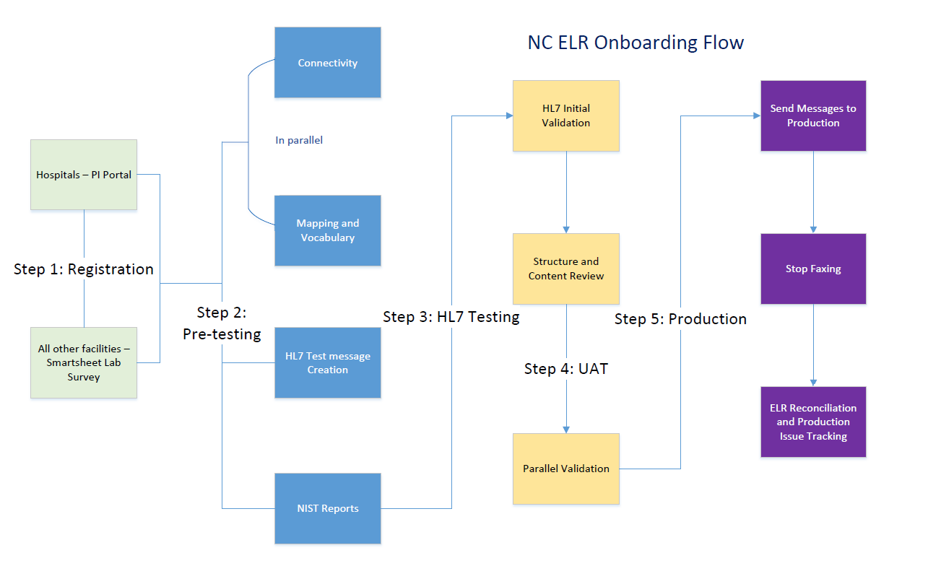
ELR Onboarding Process
Preparing laboratories to implement an electronic laboratory reporting interface to the North Carolina Division of Public Health (NC DPH). New facilities begin the process here and to set up connectivity and ensure that HL7 messages are being formatted properly and the proper codes are being used.

Slide 31

NC DPH Rhapsody Overview
NC PHIN DB
HIEA
Rhapsody logs processing activity to PHIN DB. Facility CLIAs and LOINC/Snomed code lookups are also stored here.
PHIN-MS
messaging service
Laboratories’ Systems
AIMS / Interpartner
Rhapsody separates files by type (CLDA, ELR, eCR), validates messages, and exports to Maven environments accordingly.
NCEDSS
NCCovid
NCLead
NC Maven instances

Slide 32
Some PHIN DB tables/functions
FAE (Facility Auth Environment) table for keeping track of sending facility IDs (CLIA ID, etc…)
LOINC/Snomed lookup table to validate approved tests and results. Updates to this table are also imported to Maven instances.
RhapsodyControlLog table for logging each file that we process in Rhapsody (both batch files and individual ELR results). Log types used here include:
BatchTrailer
BatchReject / BatchRejectDuplicate
Incoming (message)
OutputGood (message)
Reject (message)
PHIN DB
Rhapsody reject details table provides more details on why a reject occurred (missing LOINC/Snomed, HL7 validation, etc…)

Slide 33
ELR Daily Inspection/Reconciliation
NCLEAD Batch
NCCovid Batch
Laboratories’ Systems
PHIN-MS
messaging service
Rhapsody
NCEDSS Batch
AIMS S3
RhapsodyMap database:
Control Log Table,
RejectDetails table
NCCovid database
NCEDSS database
NCLEAD database
sFTP (download rejects, upload corrected messages)
Rhapsody
Monitoring
(web appln)
PHIN DB ACCESS (web appln)
NCEDSS Main
(web appln)
NCLEAD Main
(web appln)
NCCovid Main
(web appln)
Daily reconciliation:
Check that Routes and CommPoints are active. Check that Error queue and Hold queue counts are 0.
Run Rhapsody
control totals query.
Run ELR control totals report & reconcile it to Rhapsody control totals.
Check Failed Imports workflow.
Check ELR Reconciliation Report for warnings.
Reconcile
Exception handling:
If Error queue or Hold queue counts are non-zero, investigate and take corrective actions.
(These are unusual, where Rhapsody could not process normally. May be bad data file, database connection problem, bug in a filter, SQL error, etc.)
If expected file not received contact the sender.
If any Rejects in control totals: Run Reject Details query and take corrective actions.
Sometimes need to ask the sender to provide correction values and/or to fix a bug.
Usually resubmit the message after one or more of:
Add code(s) to translation table(s) in RhapsodyMap database.
Add code(s) to NCEDSS reference code tables and replicate to RhapsodyMap database.
Sender fixes and re-sends message
Add facility ID to FAE table

Slide 34

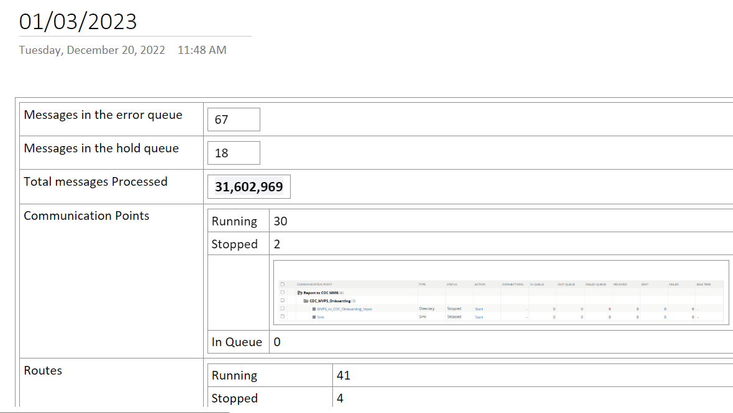
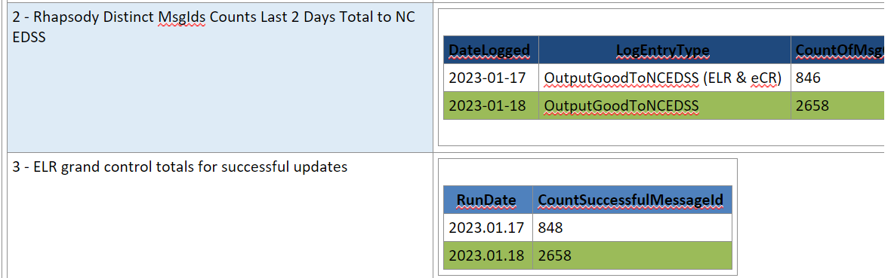
OneNote daily reconciliation journal
- Team creates a new entry for each day
- Allows ELR team to share information regarding:
Daily rejects
Batch counts by facility
Comparison of Rhapsody output counts and Maven input counts
Failed imports in Maven environments
Reconciliation report in Maven to catch any unknown diseases that are imported
State of Rhapsody (messages processed, active comm points, active routes, Hold Queue status, Error status)
- ELR team contacts facilities that haven’t sent expected files for the day

Slide 35

Smartsheets
Smartsheets are used for posting HL7 reject issues back to the facility and corresponding. Facilities are usually asked to fix issues with HL7 validation or incorrect/missing codes. When fixes are re-transmitted, this can also be tracked in the Smartsheet and the issue can be marked as resolved when an acceptable correction is received.
Most Common Reject Reasons
OBX-5 Missing SNOMED code (Missing Result/Result improperly coded)
OBX-2 Should instead be CWE (local code vs national code)
Non-ASCII character
PID-7/DateTimeOfBirth
PID-10 Race
Cannot Find Parent OBX
December 2022 Average Daily Rejects | January 2023 Average Daily Rejects
40.86 | 31

Slide 36
Rhapsody Reference Code Tables Maintenance
Rhapsody Ref codes Master EXCEL)
Code translation tables:
laboratory specific local codes to standard codes
SNOMED to SNOMED-CT
HL7 specimen sources to SNOMED-CT
Lookup tables:
SpecSourceKeepIfProductCodes (for certain invasive diseases controls which specimen sources are considered non-sterile and results are to be discarded)
Copy/paste formula-derived XML into Notepad xml template file,
save as filename
ELR Ref codes Vnn.xml file
ELR Ref codes Vnn.xml file (MavenIntegrationFormat)
nn is the version number
Edit master spreadsheets
All
NCEDSS / NCCovid / NCLead
environments
(Production, UAT, etc…)
ELR Ref code tables:
LOINCs, SNOMEDs, HL7_EVENT_LOOKUP, LOINCs_TO_EHARS_
TRANSLATION
Copy/paste formula-derived SQL for the particular table to Query page
New version of master spreadsheets
PHIN DB Access (browser UI):
Run SQL query
PHIN DB Access (browser UI):
Run SQL query
Rhapsody Test
environment
Rhapsody Production
environment
RhapsodyMap database: Rhapsody Reference code tables
RhapsodyMap database: Rhapsody Reference code tables
Sharepoint folder

Slide 37
Questions / Comments for NC?
Michelle Cummings, Data Modernization and Informatics Manager: michelle.cummings@dhhs.nc.gov
Anna Herring-VanRyswyk, ELR Team Lead: anna.herring-vanryswyk@dhhs.nc.gov
Scott Craddock, ELR Technical Lead: scott.craddock@dhhs.nc.gov

