Slide 1
Welcome to the December National ELR Workgroup Call!
Agenda
Welcome – Cody McNeese (OR)/ Nicole Kikuchi (TN)
CSTE announcements – Devra Barter (CSTE)
SHIELD updates – Riki Merrick (APHL)
  Laboratory Interoperability Data Repository (LIDR)
  All-disease LOINC In Vitro Diagnostic (LIVD) file
Regenstrief LOINC Mapping Assistant (RELMA) demonstration and discussion – John Hook/Steven Wagers (Regenstrief)
Open Discussion (time permitting)
Adjourn
January 2024 Workgroup Call is Canceled Next Call: February 6, 2024 @ 1 pm ET
Notes:
Welcome to the June ELR Call! Please introduce yourself in the chat by stating your name & organizational affiliation.
We are recording the call for internal note-taking purposes only!

Slide 2
Policy Briefs: Member Comments Due 12/15
Inclusion of Industry and Occupation as Core Demographic Variables in Public Health Surveillance
  Webinar recording available on CSTE Connect
Endorsement of the CDC-recommended ICD-10-CM Surveillance Case Definition for Injury Hospitalizations
  Webinar scheduled: Thursday, December 7 from 2-3 PM EDT
Endorsement of the CDC-recommended ICD-10-CM External Cause-of-injury Framework
  Webinar scheduled: Thursday, December 7 from 2-3 PM EDT
Notes:
Three Policy Briefs are now available for comment in CSTE Connect – make sure your voice is heard before Friday, December 15th! CSTE Policy Briefs are consensus documents developed by members, that describe issues and propose calls for action on topics of public health importance. These Briefs advocate for the inclusion of industry and occupation variables in all public health surveillance systems and endorse the ICD-10-CM codes used to define injury hospitalizations and external causes of injury. Please navigate to the CSTE Brief’s community in CSTE Connect to download the draft Briefs, vote on whether the Brief should be published, as written, in the discussion threads, and find all-member webinar recordings and event information. There will be an all-member webinar held on the 2 injury-related briefs, on Thursday, December 7th at 2PM EDT. We hope to see you all there and look forward to your comments on Connect!
Link to CSTE Briefs community: https://connect.cste.org/communities/cste-position-statements-thrive?CommunityKey=bbb4cafb-5795-4686-b36c-0189e5adb51c

Slide 3
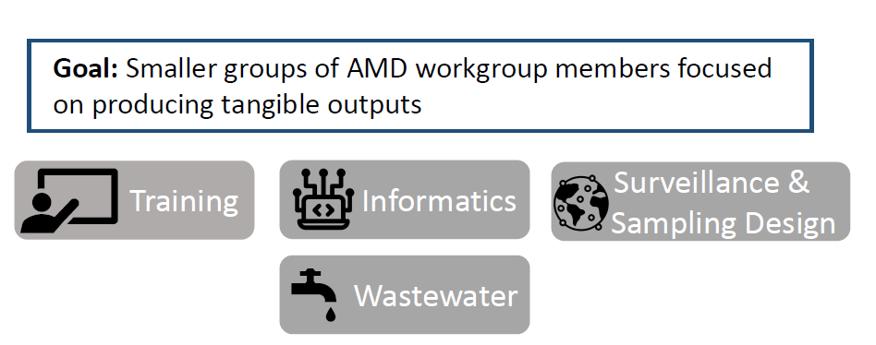
New: AMD Sub-Workgroups
Informatics
Potential areas of initial focus:
Develop set of guidelines for surveillance system capture of AMD outputs
Work with CSTE ELR Workgroup to set standards for HL7 ELR transmission of sequencing results
Create documentation of genomic data integrations being employed in different states (roster, HL7, SEDRIC API, etc.)
Interest sign-up form for AMD sub-workgroups: https://app.smartsheet.com/b/form/df0f44adc2cb4477b744c9bab61b557d
Please sign up by December 22, 2023
Email ahoffman@cste.org with any questions

Slide 4

2024 CSTE Annual Conference
The 2024 Call for Abstracts is OPEN!
The deadline for abstract submission is Thursday, January 4, 2024 at 11:59 pm EST.
Presenting authors will be notified of Planning Committee decisions by Thursday, March 7, 2024.
For more information and to submit an abstract, visit the Call for Abstracts webpage.
For tips on abstract writing, go to CSTE Learn

Slide 5
2024 CSTE Annual Conference
The 2024 Travel Sponsorship Request is now OPEN!
The deadline to apply for travel sponsorship is Thursday, January 4, 2024 at 11:59 pm EST.
Updates on funding status and official travel letters with sponsorship details for those selected will be sent to applicants on or after February 1, 2024.
For more information and to apply for travel sponsorship, fill out the request form

Slide 6
CSTE Applied Epidemiology Fellowship
Now recruiting host sites to host an AEF fellow beginning Summer 2024!
  Host Site applications are due January 31, 2024
  Candidate applications are due January 19, 2024
To apply and for more information, visit cstefellows.org
For questions, email aef@cste.org
Notes:
The Applied Epidemiology Fellowship application for both candidates and host sites are now open! Modeled after the Centers for Disease Control and Prevention (CDC) EIS program, the fellowship is designed to give recent public health graduates on-the-job training at health departments in preparation for a career as an epidemiologist at the state or local level. Through the guidance of experienced mentors, fellows are expected to develop and refine applied epidemiologic skills by participating in a series of prescribed fellowship activities and projects identified as priorities by the health department. This fellowship is open to recent graduates with master’s and doctoral degrees who have training in epidemiology.
AEF Class 22 Application Deadlines:
Candidate: 11:59pm on January 19, 2024
Host Site: 11:59pm on January 31, 2024
For Chat:
The Applied Epidemiology Fellowship application for both candidates and host sites are now open!
The fellowship’s mission is to meet the nation’s need for applied epi workforce capacity at the state/local level through a national two-year training program. This is a two-year program at a state, territorial, local, or tribal health department.
Learn more or access the application link at: https://cstefellows.org/
For questions, contact the CSTE AEF Team at aef@cste.org

Slide 7
New PHII Course
The Public Health Informatics Institute is hosting a new free course “Designing and Managing Public Health Information Systems”
  The course is 8 weeks, will launch March 27, 2024 for the spring course and September 11, 2024 for the fall course
  Designed for staff new to informatics/ information systems at state, tribal, local and territorial public health agencies who are planning or implementing an informatics or health IT project.
  Learn more about the course and pre-register online. The deadline to pre-register is January 31, 2024.

Slide 8
Upcoming Call Schedule
Surveillance Policy Subcommittee Call
  12/8 @ 2:05 pm ET
  tpinsent@cste.org
  DRPASS Workgroup Call
  12/12 @ 3:05 pm ET
  Tpinsent@cste.org
  eCR Workgroup Call
  12/19 @ 4 pm ET
  dbarter@cste.org
ELDR Subcommittee Call
  12/20 @ 3 pm ET
  dbarter@cste.org

Slide 9
Welcome to the December National ELR Workgroup Call!
Agenda
Welcome – Cody McNeese (OR)/ Nicole Kikuchi (TN)
CSTE announcements – Devra Barter (CSTE)
SHIELD updates – Riki Merrick (APHL)
  Laboratory Interoperability Data Repository (LIDR)
  All-disease LOINC In Vitro Diagnostic (LIVD) file
Regenstrief LOINC Mapping Assistant (RELMA) demonstration and discussion – John Hook/Steven Wagers (Regenstrief)
Open Discussion (time permitting)
Adjourn
January 2024 Workgroup Call is Canceled Next Call: February 6, 2024 @ 1 pm ET
Notes:
Welcome to the June ELR Call! Please introduce yourself in the chat by stating your name & organizational affiliation.
We are recording the call for internal note-taking purposes only!

